Slide 1
Mineral waters and the growth of towns
HI3T5
Week 10, 2022
Michael Bycroft

Slide 2
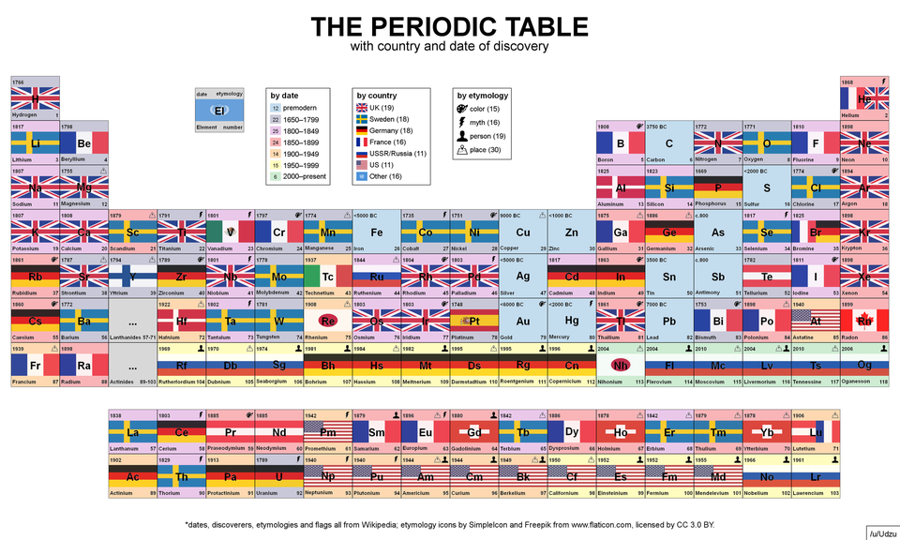

Slide 3
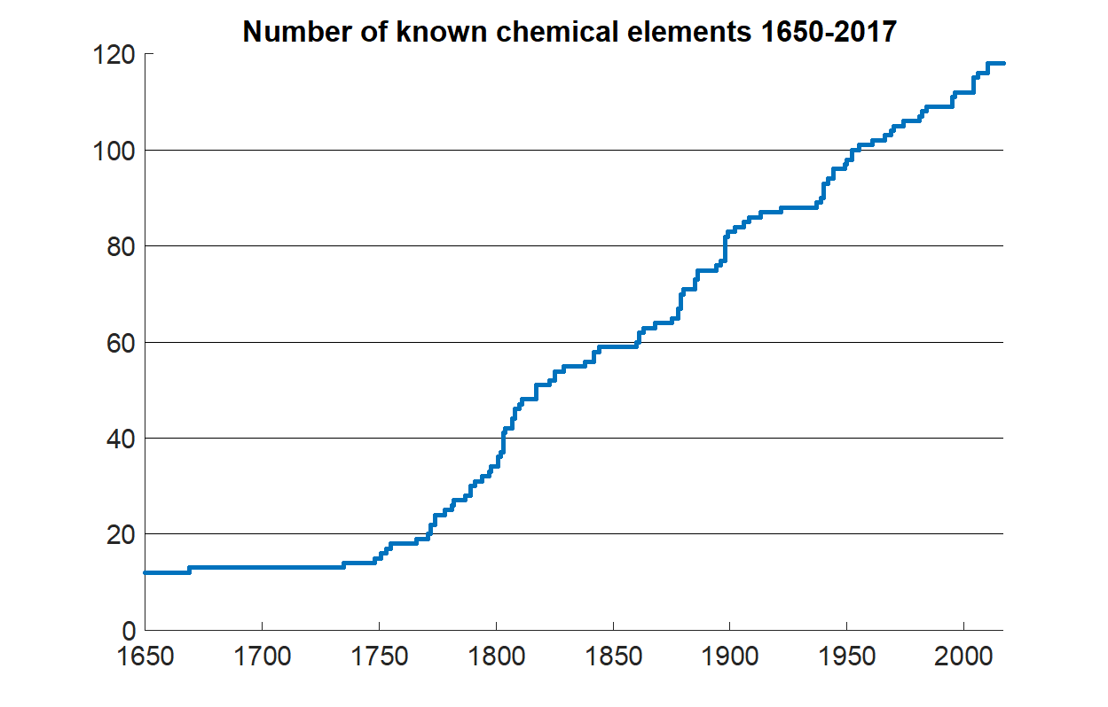

Slide 5
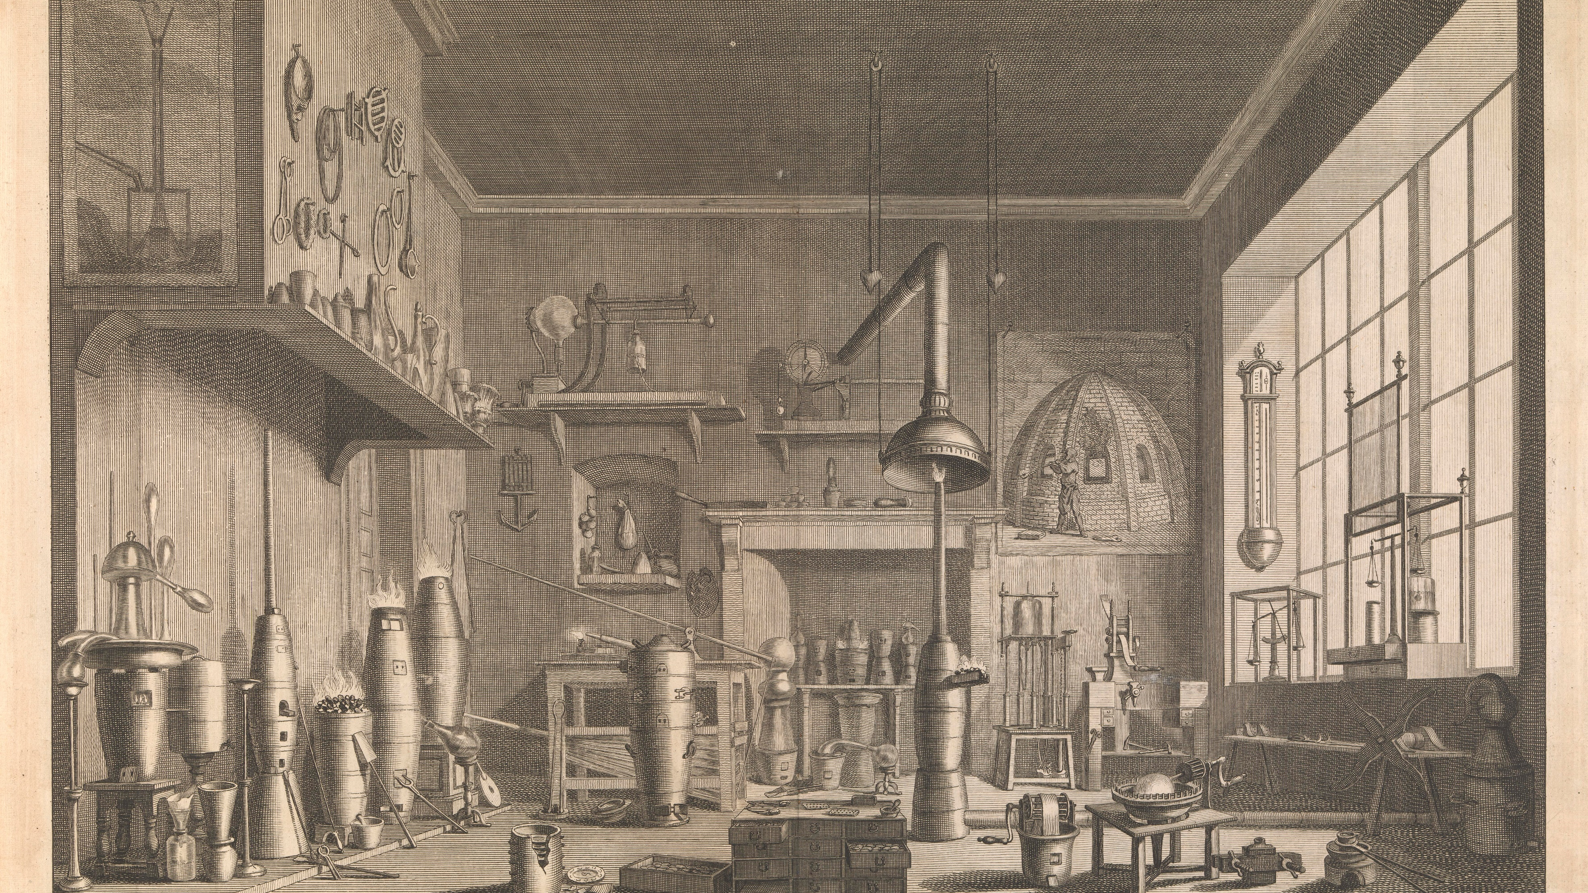
Assaying laboratory, from William Lewis, Commercium philosophico-technicum; or, the philosophical commerce of arts (1765)

Slide 6
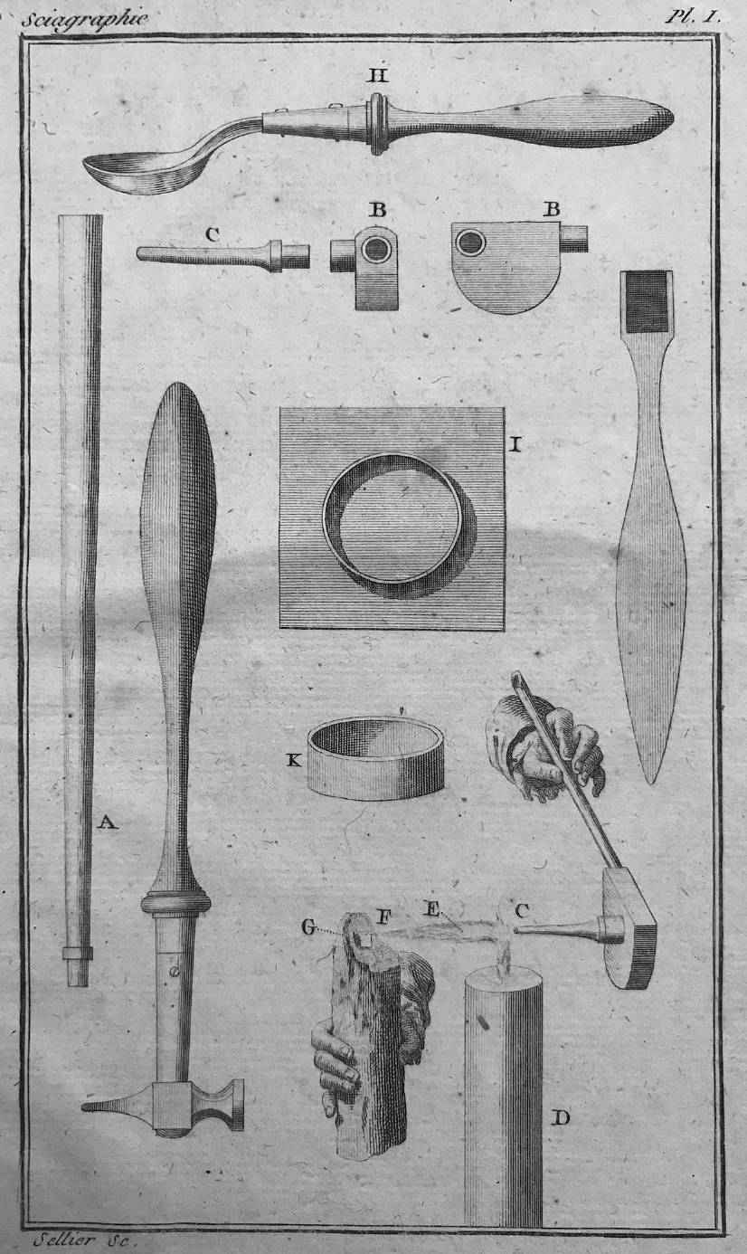
Blowpipe design, from Torbern Bergman, from Manual of the Mineralogist (Paris, 1792)

Slide 8
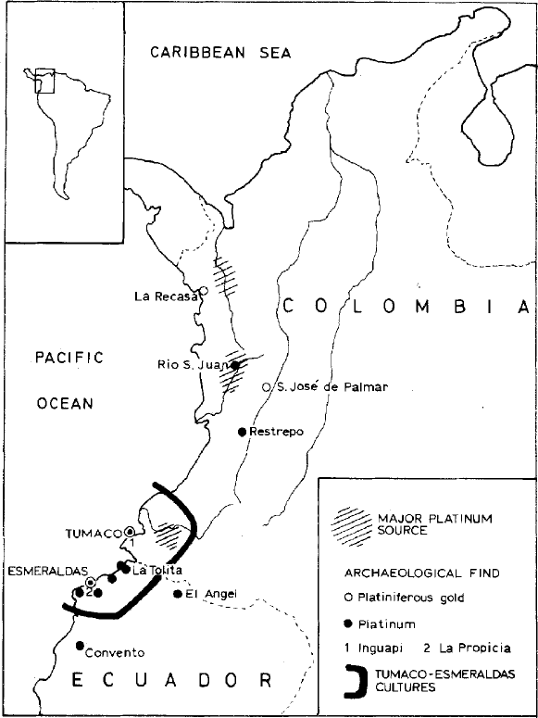
Matthey Johnston, “Ancient Platinum Technology in South America,” Platinum Metals Review (1980)

Slide 9
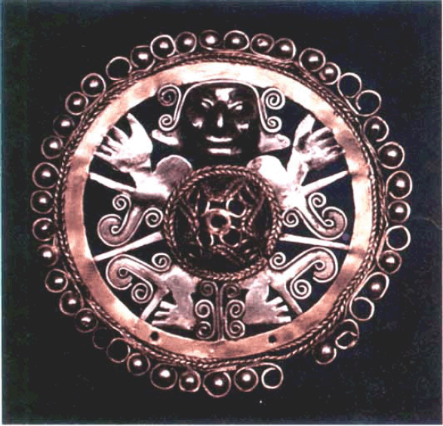
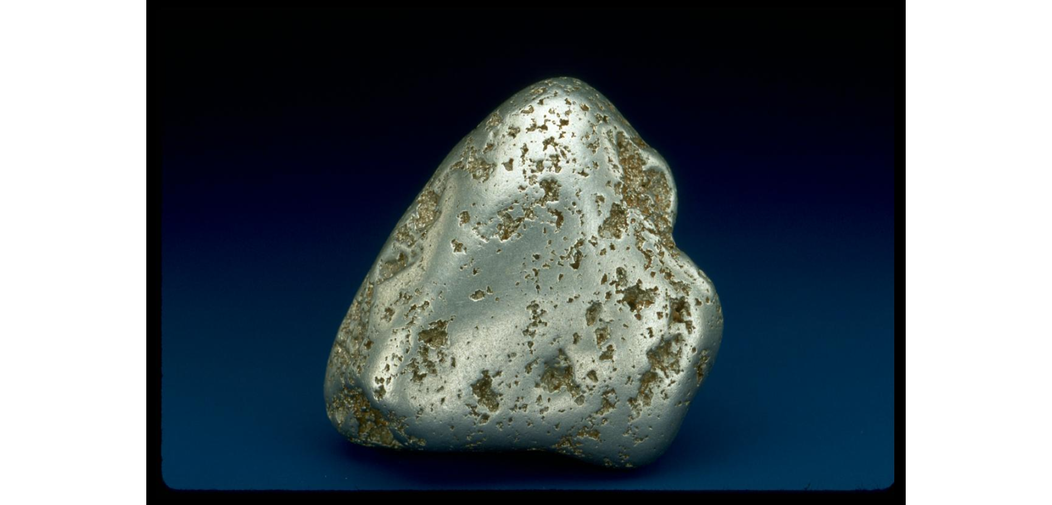
Platinum nugget, now in Smithsonian Museum, Washington - from a site in Russia, about the size of a golf-ball
A composite gold and platinum ornament, believed to be from the Tolita region of Esmeraldas, Ecuador - now in Museo del Banco Central, Quito

Slide 10
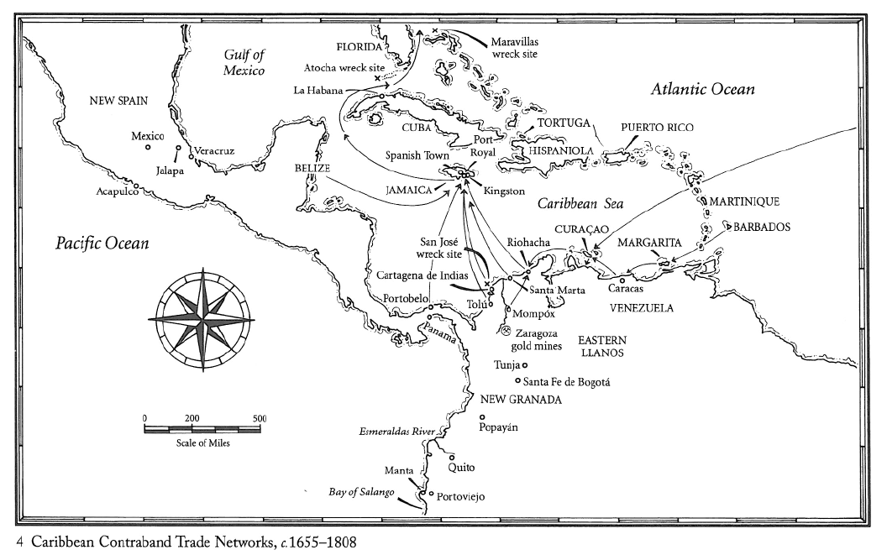
Kris Lane, The Colour of Paradise (2010)

Slide 11
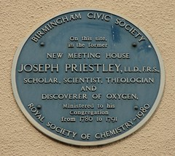

Slide 12
“I found, to my great surprise, that a quantity of this air required about five times as much nitrous air to saturate it, as common air requires…A candle burned in this air with an amazing strength of flame; and a bit of red hot wood crackled and burned with a prodigious rapidity…
But to complete the proof of the superior quality of this air, I introduced a mouse into it; and in a quantity in which, had it been in common air, it would have died in about a quarter of an hour, it lived, at two different times, a whole hour, and was taken out quite vigorous.”
-- Joseph Priestley to Sir Joseph Pringle, March 15, 1775

Slide 13
Why mineral waters?
From ‘air’ to ‘gases’
    One kind of air → many kinds
    The element air → the gaseous state
From ‘the dry way’ of analysis to ‘the wet way’
precipitation
colour indicators
The growth of spa towns across Europe, c. 1600-1800
    Renaissance classicism
    Iatrochemistry = chemical medicine
    Enlightenment sociability
    Physician-entrepreneurs

