Slide 1
Alcohol and the Fiscal-Military State
HI3T5 week 2.1, 2025
Dr. Michael Bycroft

Slide 2
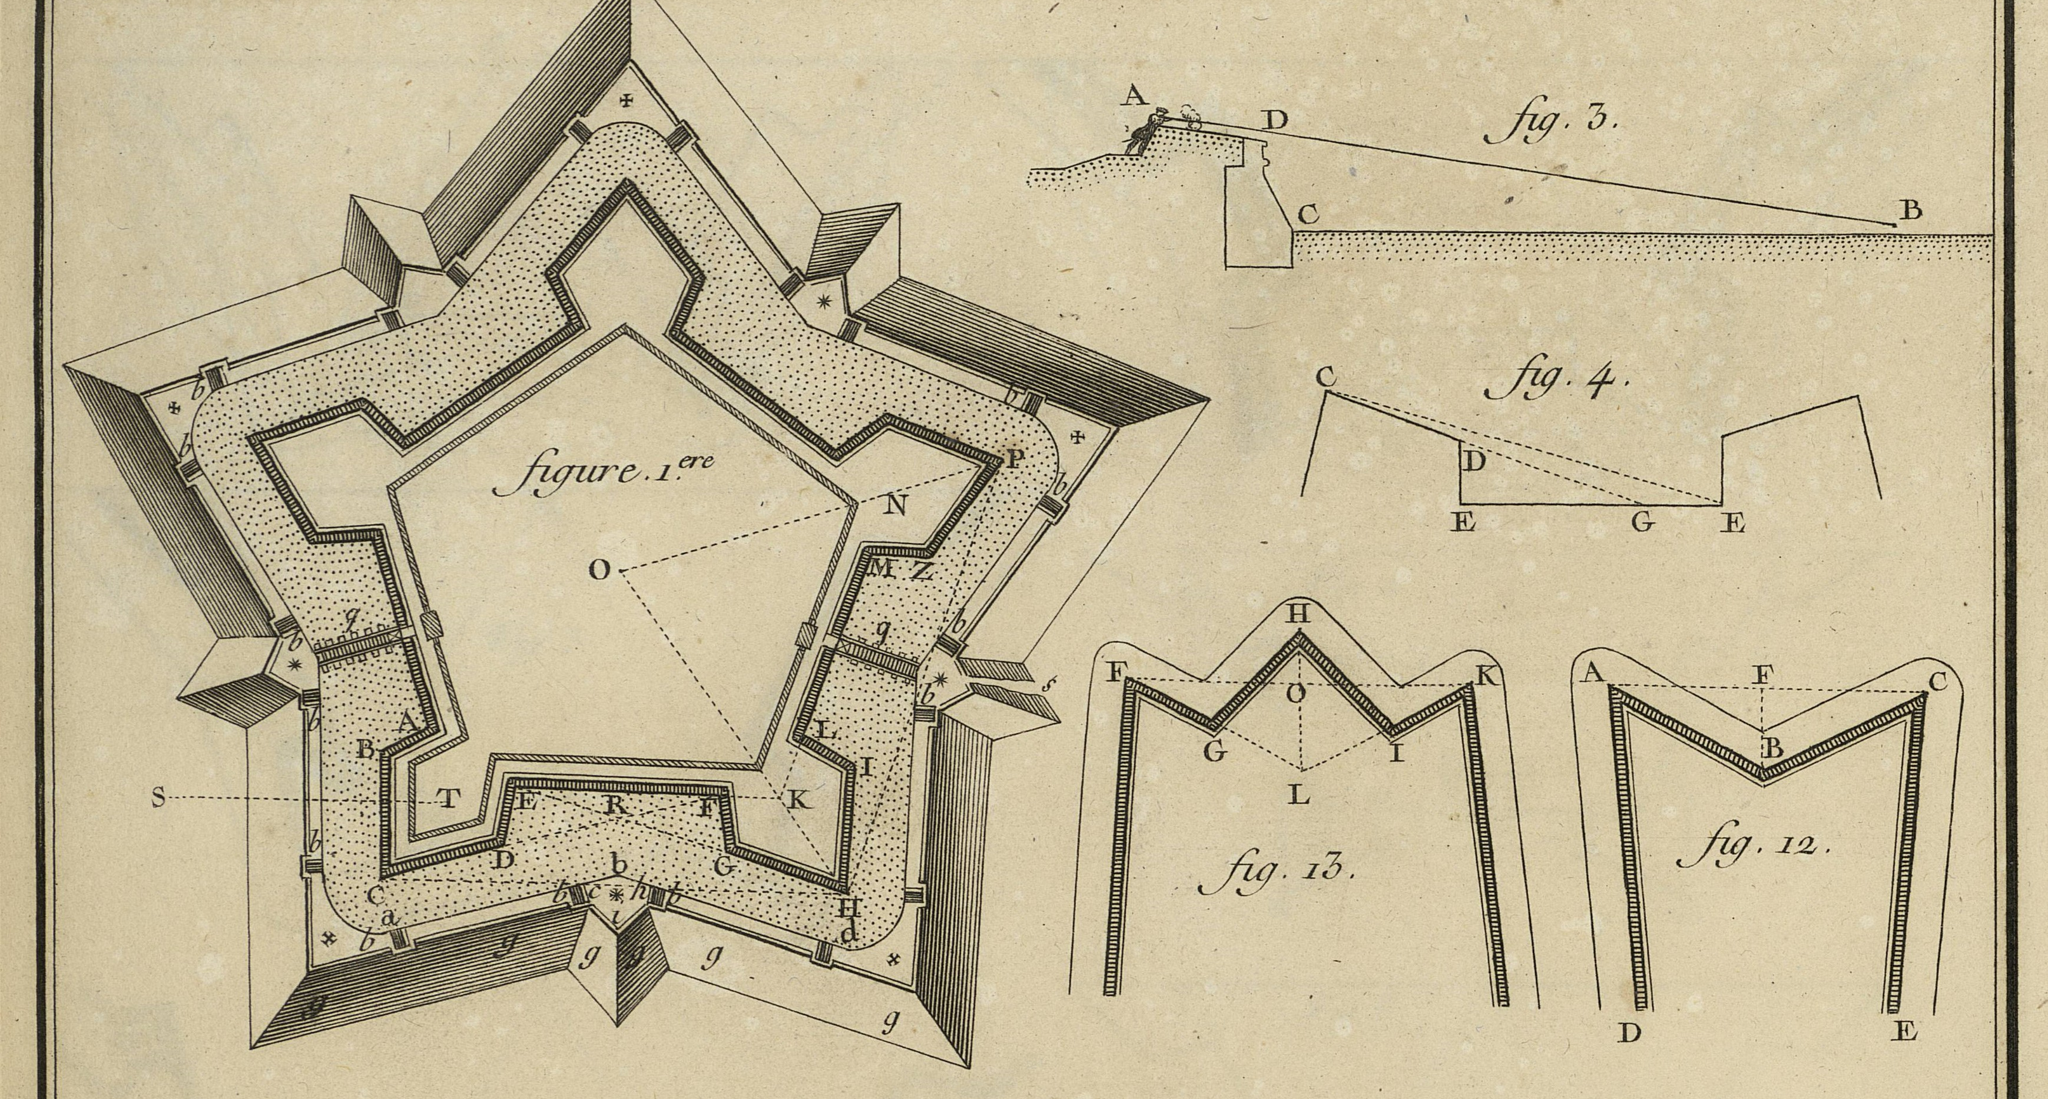
Diagram of fortification, in Diderot and d’Alembert Encyclopédie, vol. 1 of plates, 1762

Slide 3
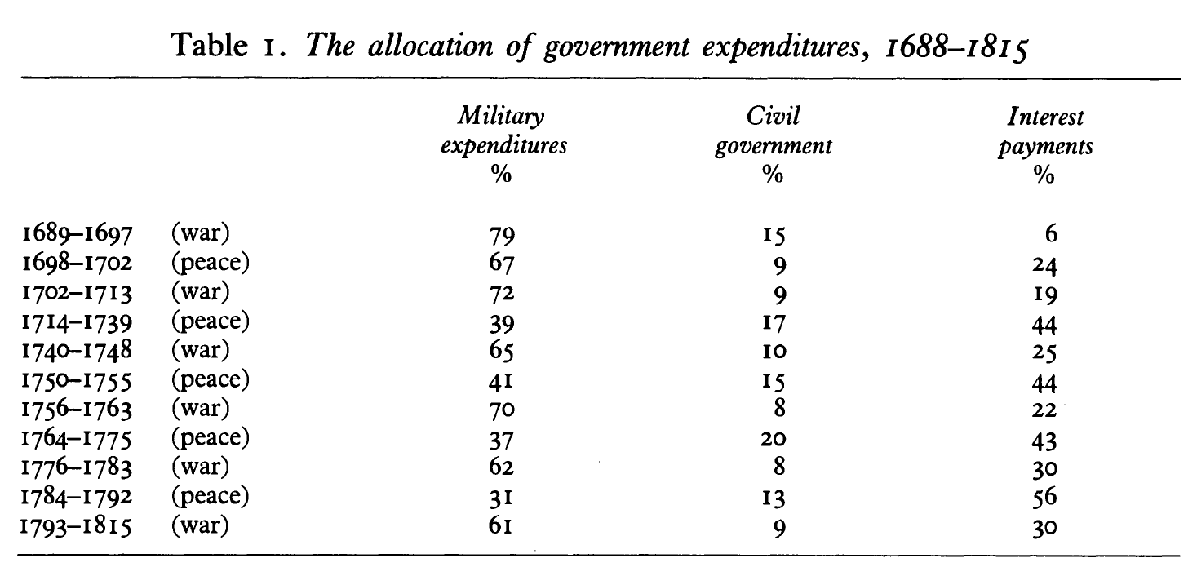
9 Years’ War
Spanish Succession
Austrian Succession
7 Years’ War
American Revolutionary
Great French Wars
From Patrick O’Brien, “The Political Economy of British Taxation, 1660-1815,” The Economic History Review (1988)
For comparison: military spending (‘defence’) was 4.8% of total UK government expenditure 2022-3

Slide 4
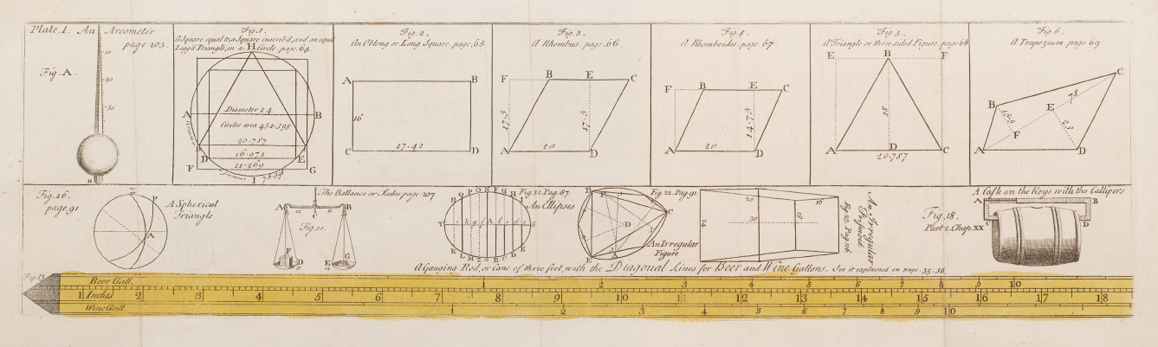
From Leadbetter, The Royal Gauger, 7th edition. Plate 1

Slide 5
From Leadbetter, The Royal Gauger, 7th edition. Plate 1

Slide 6
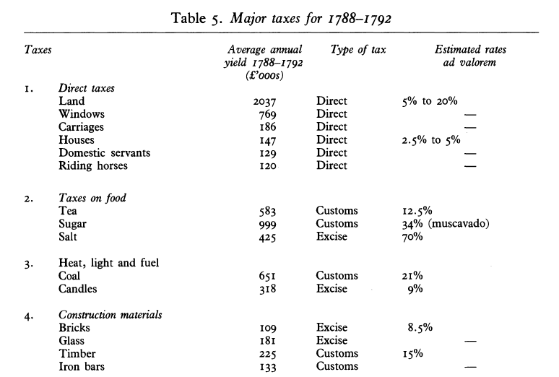
O’Brien, ‘Political Economy of British Taxation’

Slide 7
