Slide 1
Air and Social Reform
HI3T5 week 13
Dr. Michael Bycroft

Slide 2
https://www.youtube.com/watch?v=tyhWF1EYtok

Slide 3
gaseous state
gases
“hydrogen”
“oxygen”
test tubes

Slide 4
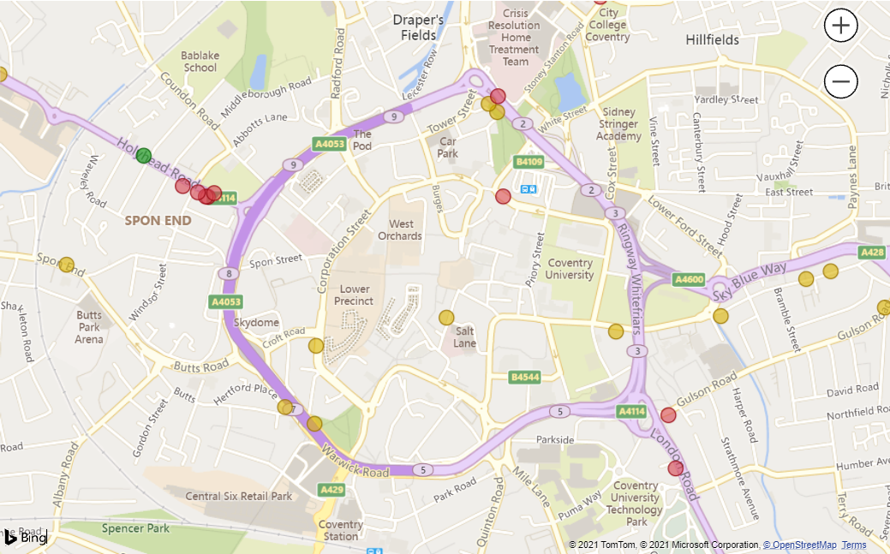
Coventry City Council Website, data from 2019
Red spots = nitrogen dioxide (NO2) concentrations above 40 micrograms per cubic metre
Coventry an ‘Air Quality Management Area’ since 2009; now has Air Quality Action Plan

Slide 5
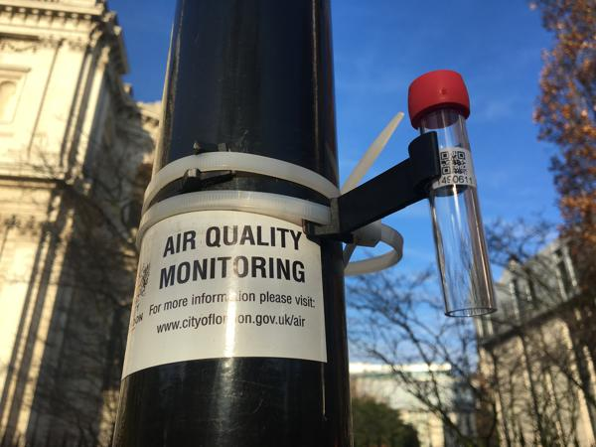
“Diffusion tube” of the kind used by the Coventry City Council to measure nitrogen dioxide (NO2) levels

Slide 6
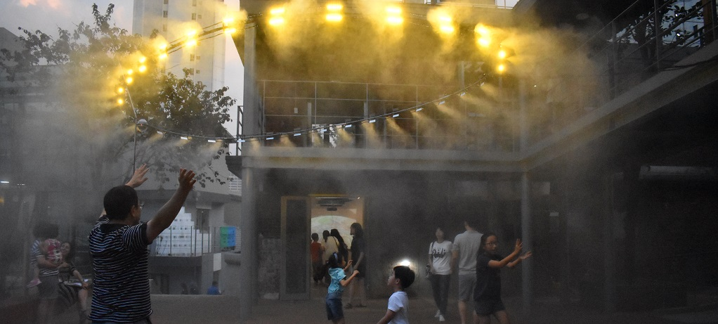
“Yellow Dust,” by Nerea Calvillo (CIM, Warwick), designed for the Seoul Biennale of Architecture and Urbanism 2017

Slide 7

“The toolkit focuses on strengthening connections to ongoing environmental projects, supporting communities to set up air quality projects, and mobilizing citizen data to build less polluting environments.” – Jennifer Gabrys, University of Cambridge, Sociology

Slide 8
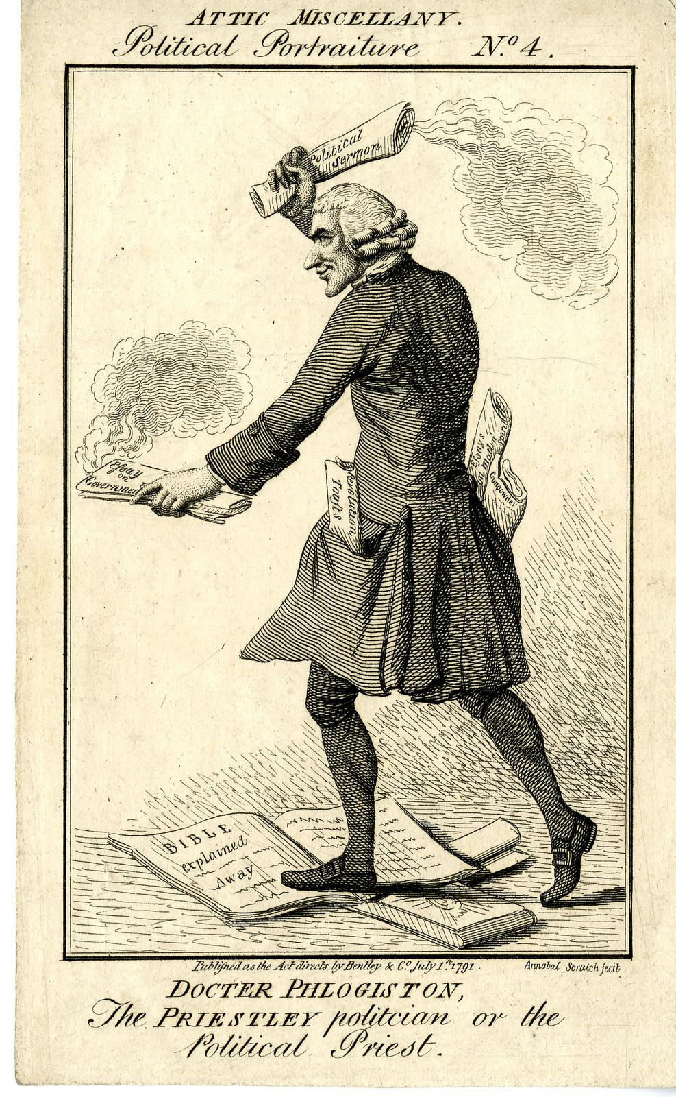
“Doctor Phlogiston, the Priestley Politician or the Political Priest,” July 1791

Slide 9
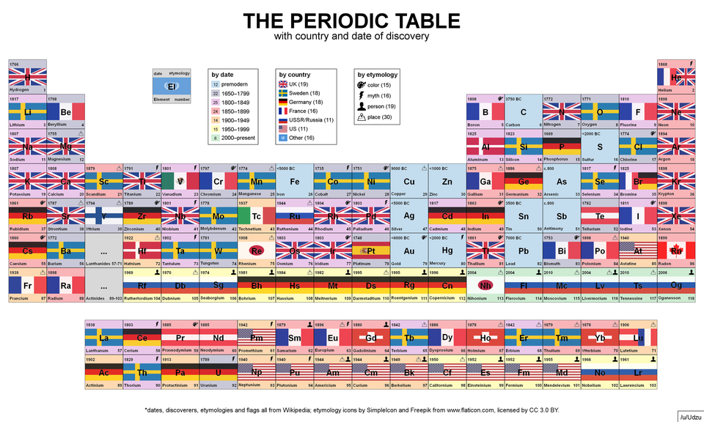

Slide 10
Some nitrogen compounds
“nitrous air” = nitric oxide = NO
“inflammable nitrous air” = “laughing gas” = nitrous oxide = N2O
“dephlogisticated nitrous air” = nitrogen dioxide = NO2
“nitre” = “saltpeter” = potassium nitrate = KNO3
the element nitrogen = N
nitrogen gas = N2

Slide 11
Interpret. Decipher the source so that it can be understood by a non-specialist audience. This may mean explaining technical terms, rephrasing complicated sentences, identifying rhetorical devices or figures of speech, or (for long texts) summarising the argument or narrative.
Contextualise. Relate the source to wider historical developments of the kind that we have covered in the module, such as the growth of the fiscal-military state, the growth of a consumer culture, and the outbreak of the French Revolution.

