Slide 1
Land and the British Empire
HI3T5 week 15
Dr. Michael Bycroft

Slide 2
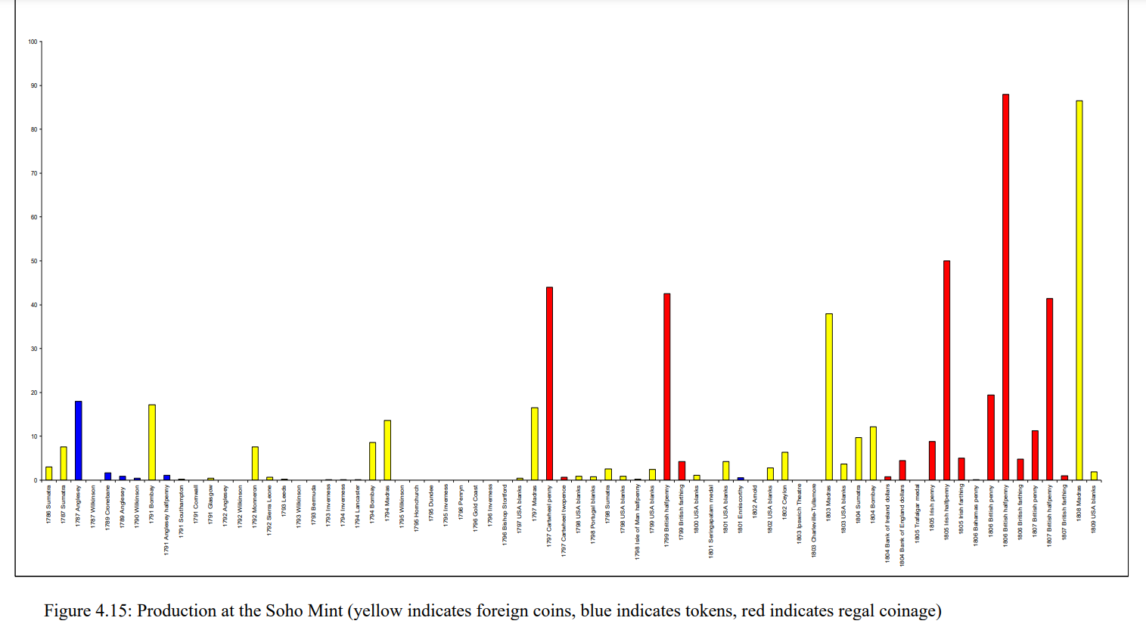
Sue Tungate, "Mathew Boulton and the Soho Mint: Copper to Customer" (University of Birmingham PhD thesis, 2010)
Data in millions

Slide 3
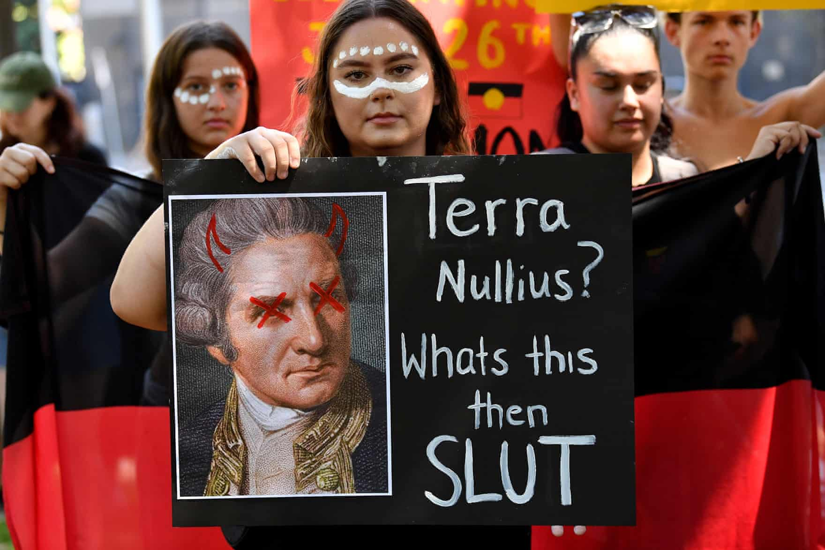
Protesters hold placards during an Invasion Day (aka Australia Day) rally in Sydney, Jan 26, 2023
Cf. raising of British flag at Sydney Cove, Australia, by British naval officers in 1788
Image: The Guardian Online

Slide 4
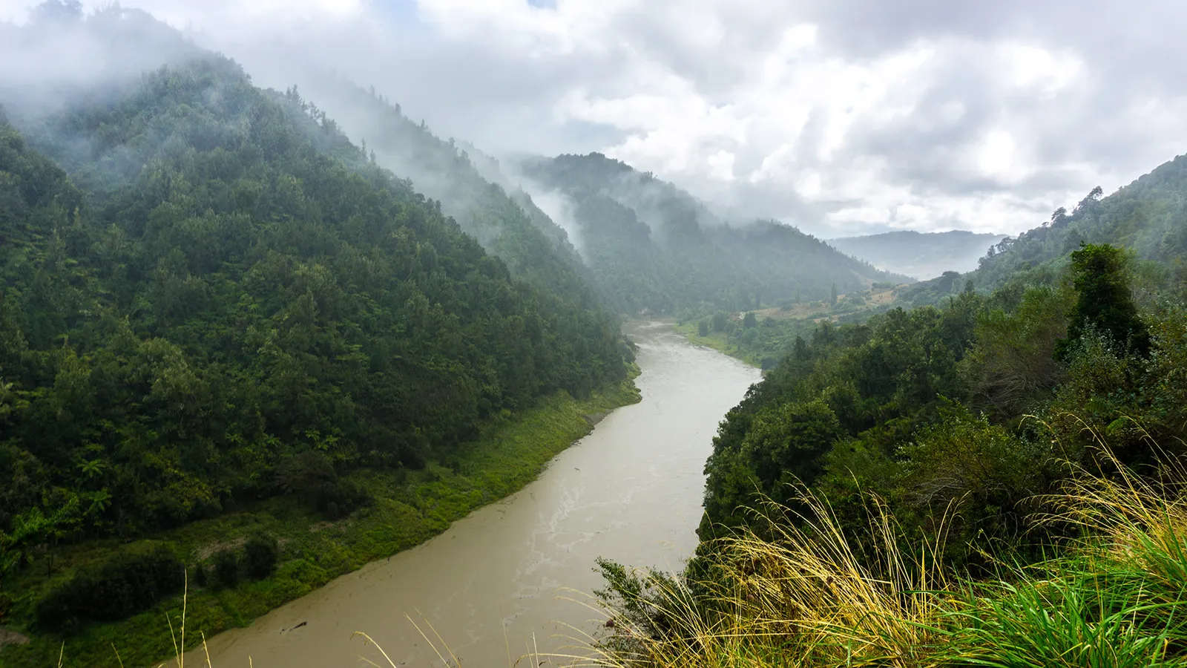
Whanganui river, New Zealand Aotearoa, granted legal personhood in 2017

Slide 5
https://books.google.com/ngrams/

Slide 6
“France, notwithstanding all its natural resources, languishes under an oppressive load of the same kind [ie. debt].
“Land and capital stock are the two original sources of all revenue both private and publick.”
Adam Smith, Wealth of Nations (1776), book 5, chap. 3.
Cf. Nathaniel Wolloch, Nature in the History of Economic Thought: How Natural Resources Became an Economic Concept (New York: Routledge, 2017).

Slide 7
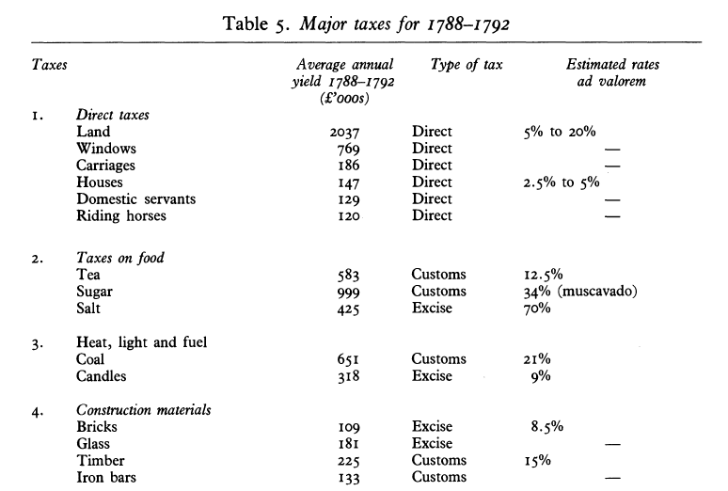
From Patrick O’Brien, “The Political Economy of British Taxation, 1660-1815,” The Economic History Review (1988)

Slide 8
Kapil Raj, “Circulation and the Emergence of Modern Mapping: Great Britain and Early Colonial India, 1764–1820,” in Relocating Modern Science: Circulation and the Construction of Knowledge in South Asia and Europe, 1650-1900
James Rennell, Map of Hindoostan (1782)
https://www.loc.gov/item/2009582749/

Slide 9
Interpret Rennell’s map. What sorts of things does it contain? What does it omit? Are there any obscure terms or techniques that you can elucidate?
Explain the map. How was it made, for whom, and for what purpose? What map-making genre does it belong to?
Consider: In what sense can this map be seen as a form of material evaluation? What does it share (or not share) with other kinds of evaluation considered in earlier weeks?

