Slide 1
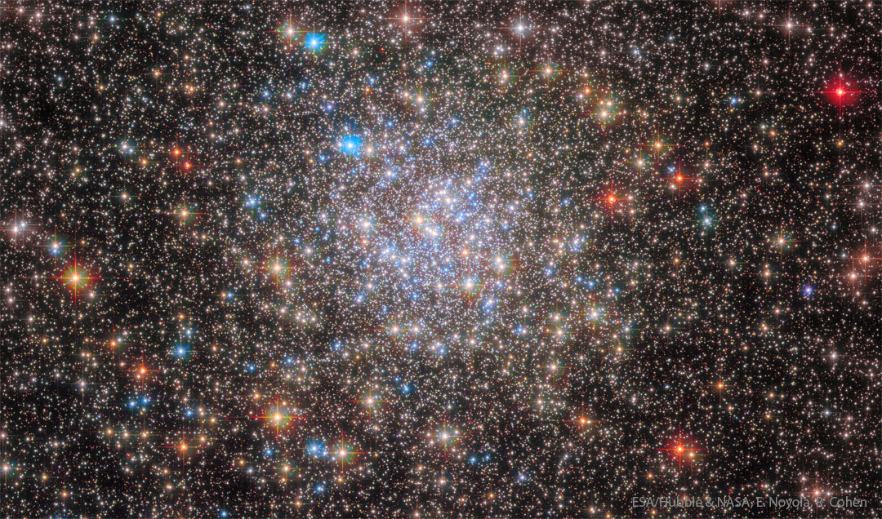
Globular Star Cluster NGC 6355 from Hubble Space Telescope, NASA Image of the Day Jan 30, 2023

Slide 2
“Globular clusters once ruled the Milky Way. Back in the old days, back when our Galaxy first formed, perhaps thousands of globular clusters roamed our Galaxy. Today, there are less than 200 left. Over the eons, many globular clusters were destroyed by repeated fateful encounters with each other or the Galactic center.
Surviving relics are older than any Earth fossil, older than any other structures in our Galaxy, and limit the universe itself in raw age. There are few, if any, young globular clusters left in our Milky Way Galaxy because conditions are not ripe for more to form. The featured image shows a Hubble Space Telescope view of 13-billion year old NGC 6355, a surviving globular cluster currently passing near the Milky Way's center.”
  NASA Image of the Day webpage

Slide 3
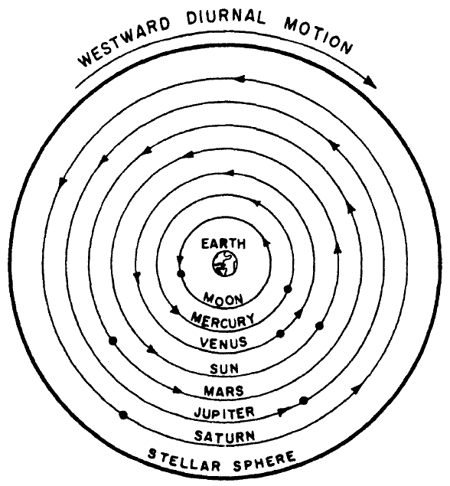
Modern diagram of earth-centred cosmos, from Thomas Kuhn, The Copernican Revolution (1985)

Slide 4
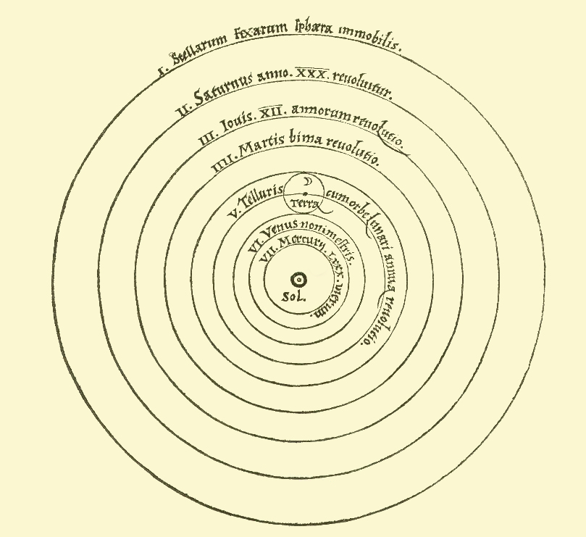
Stars stationary
Sun central and stationary
The earth is in motion
The universe according to Nicolas Copernicus, Revolutions of the Heavenly Spheres (1543)

Slide 5
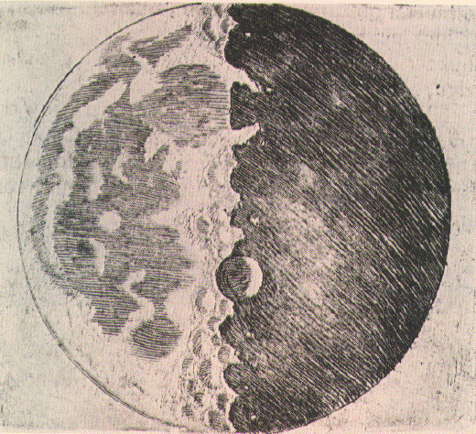
Surface of moon from Galileo’s Starry Messenger (1610)

Slide 6
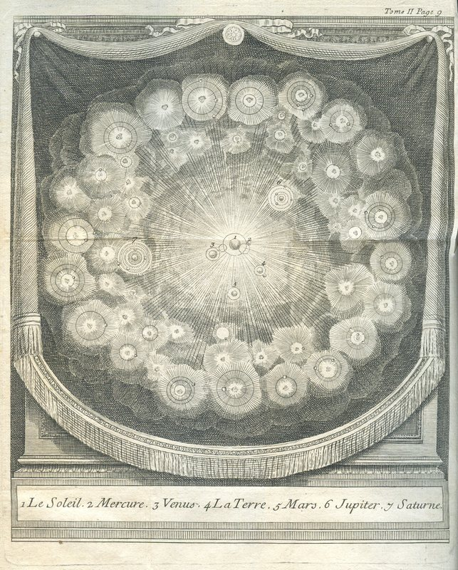
Bernard le Bovier de Fontenelle, Conversations on the Plurality of Worlds (first pub. 1686, this from 1766 edn.)

Slide 7
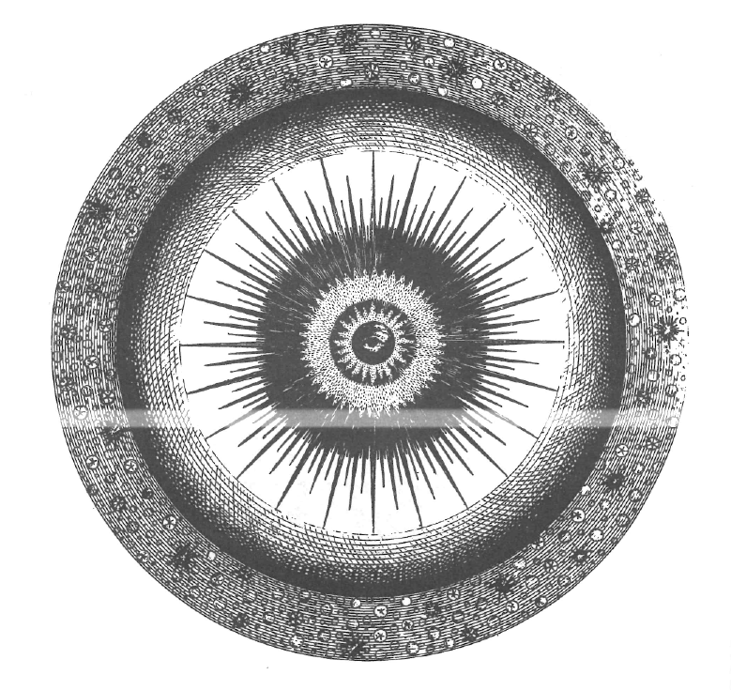
“a central section” of the universe, “with the eye of Providence seated in the centre”
Thomas Wright, Original Theory or New Hypothesis of the Universe (1750), plate XVc

Slide 8
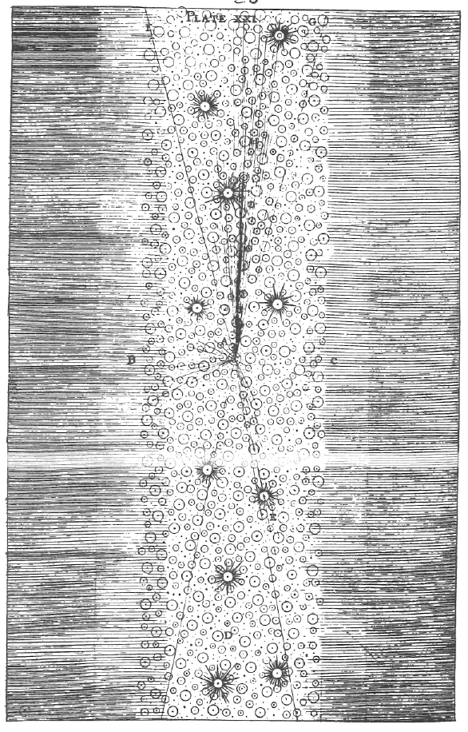
Explanation of the appearance of the Milky Way from planet Earth
Thomas Wright, Original Theory or New Hypothesis of the Universe (1750), plate XXIII

Slide 9
Heliocentrism well established in Europe by 1700
But this had little effect on the study of the stars – they remained the “fixed stars”
New theories about the stars emerged from natural theology
More precise instruments and star catalogues – linked to navigation and empire – also emerged
But the stars still marginal in 1760

Slide 10
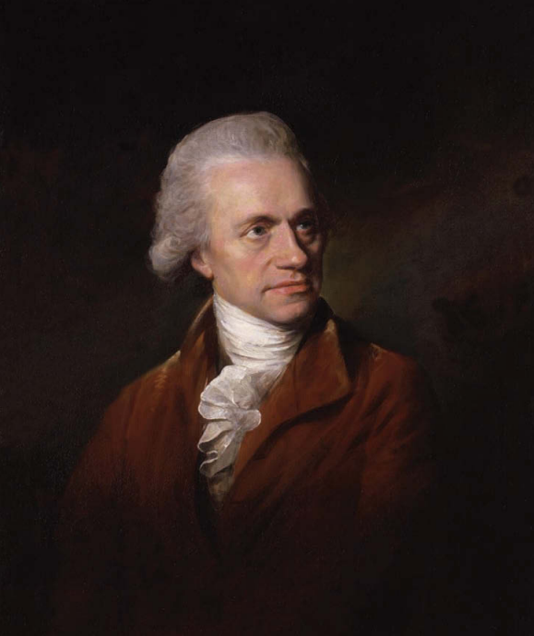
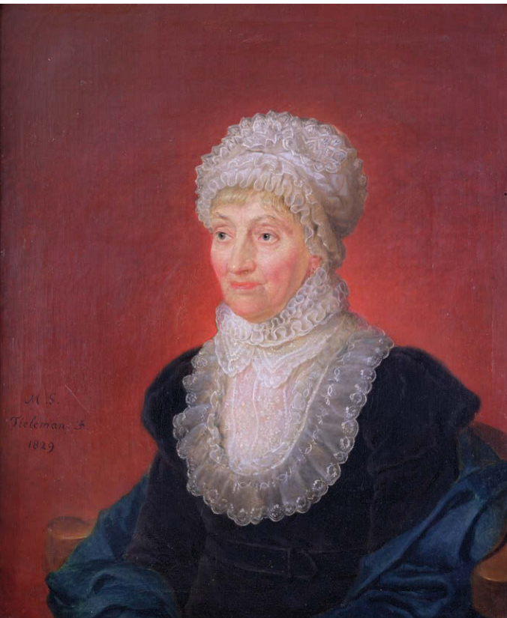
William Herschel (1738-1822) painted in 1785
Caroline Herschel (1750-1848) painted in 1829

Slide 11
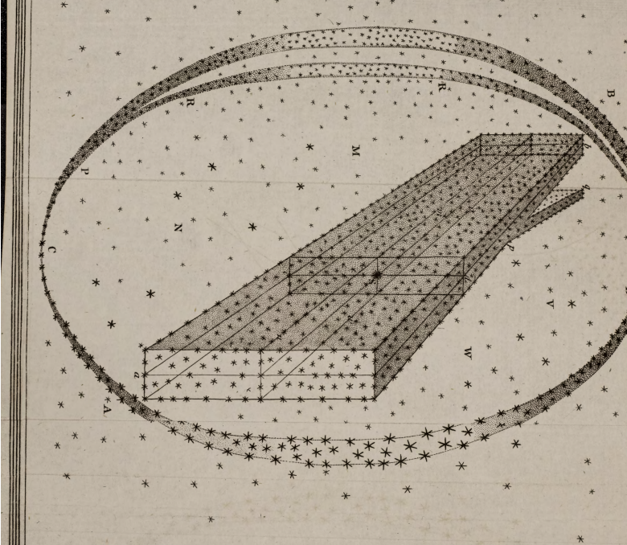
William/Caroline Herschel, “On the Construction of the Heavens,” Phil. Trans. 1784
Michael Hoskin, Discoverers of the Universe: William and Caroline Herschel, Chapter 6
Michael Hoskin, “Caroline Herschel” and “William Herschel,” in Dictionary of National Biography

Slide 12
What does the life and work of the Herschels tell us about Enlightenment science?
Were they evaluating anything, and if so what was it and how did they do it?

