Slide 1
Module recap
HI3T5
25/4/2023

Slide 2
“This seems to me the source of all liberty…For during this suspension of any desire, before the will be determined to action, and the action done, we have opportunity to examine, view, and judge, of the good and evil of what we are going to do.”
John Locke, Essay Concerning Humane Understanding (1790), book II chap. 21

Slide 3
Labour theory
Neoclassical (aka subjectivist/marginal/eye-of-beholder/price/market) theory
Bourdieu’s distinction theory
Graeber’s action theory
Mazzucato’s ? theory

Slide 4
Production
Consumption
Circulation
Evaluation

Slide 5
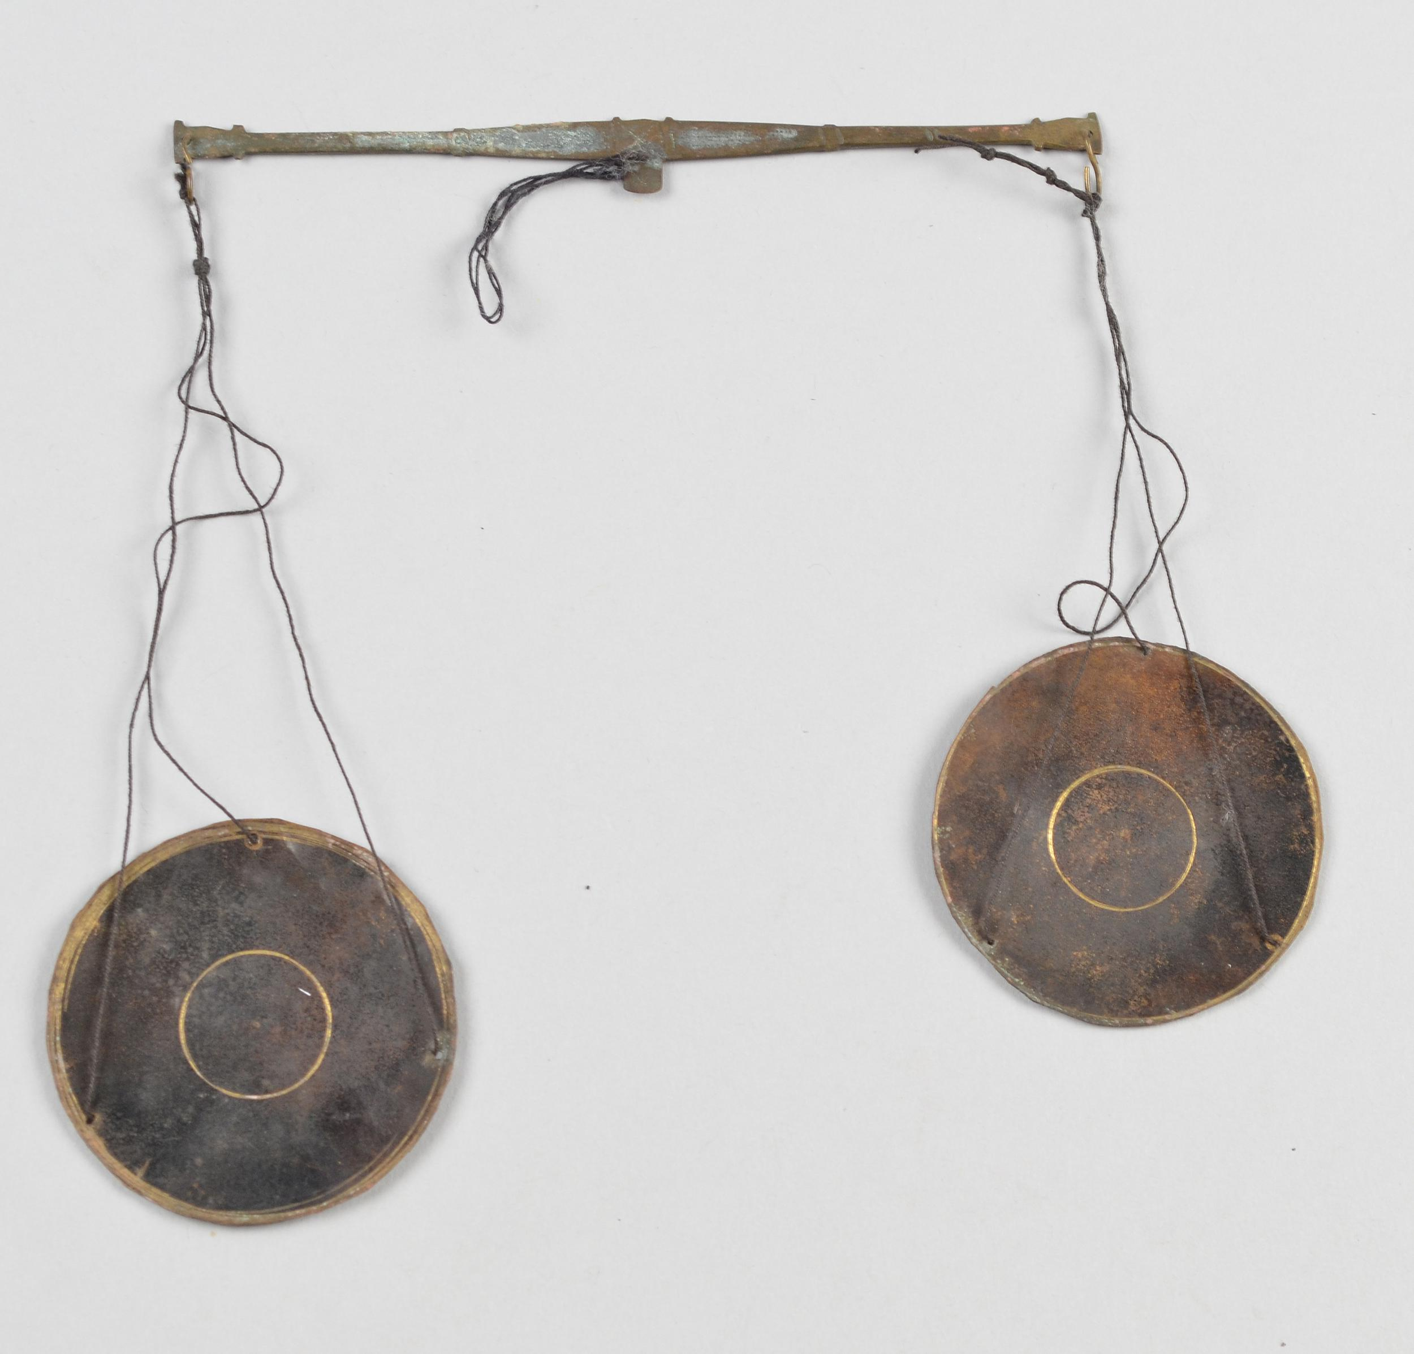
Gold-dust scales, balance made of brass
Used by Akan people (modern-day Ghana, early modern Ashante kingdom)
Image source: British Museum

Slide 6
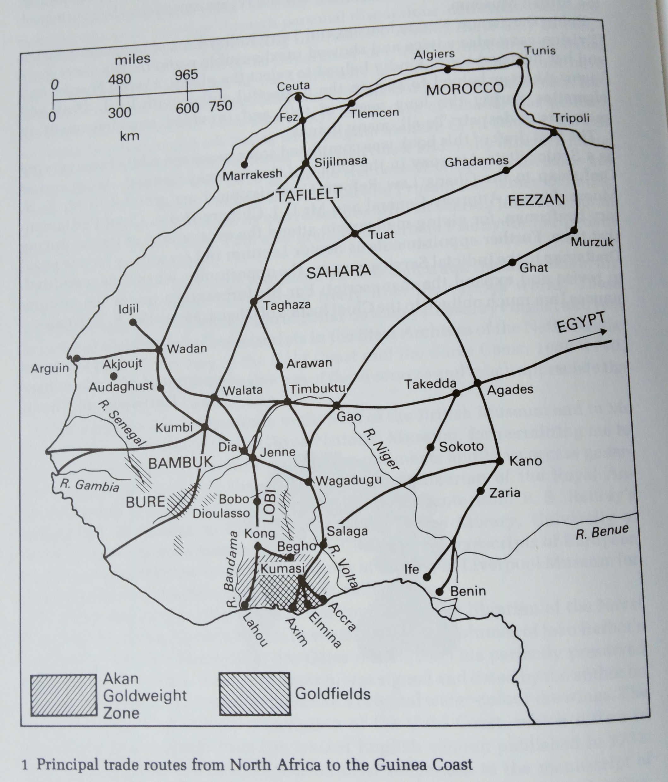

Slide 7
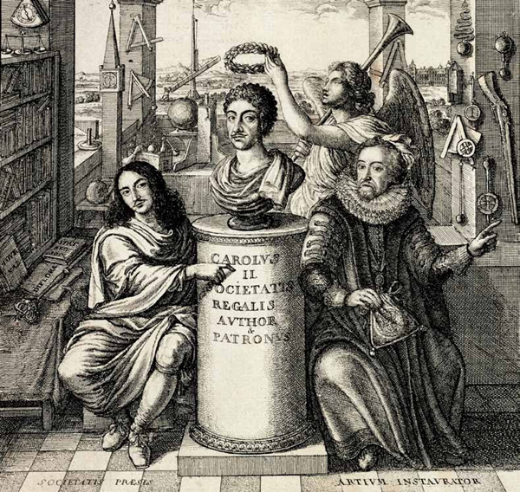
Frontispiece, from Thomas Sprat, History of the Royal Society of London for the Improvement of Natural Knowledge (1671)

Slide 8
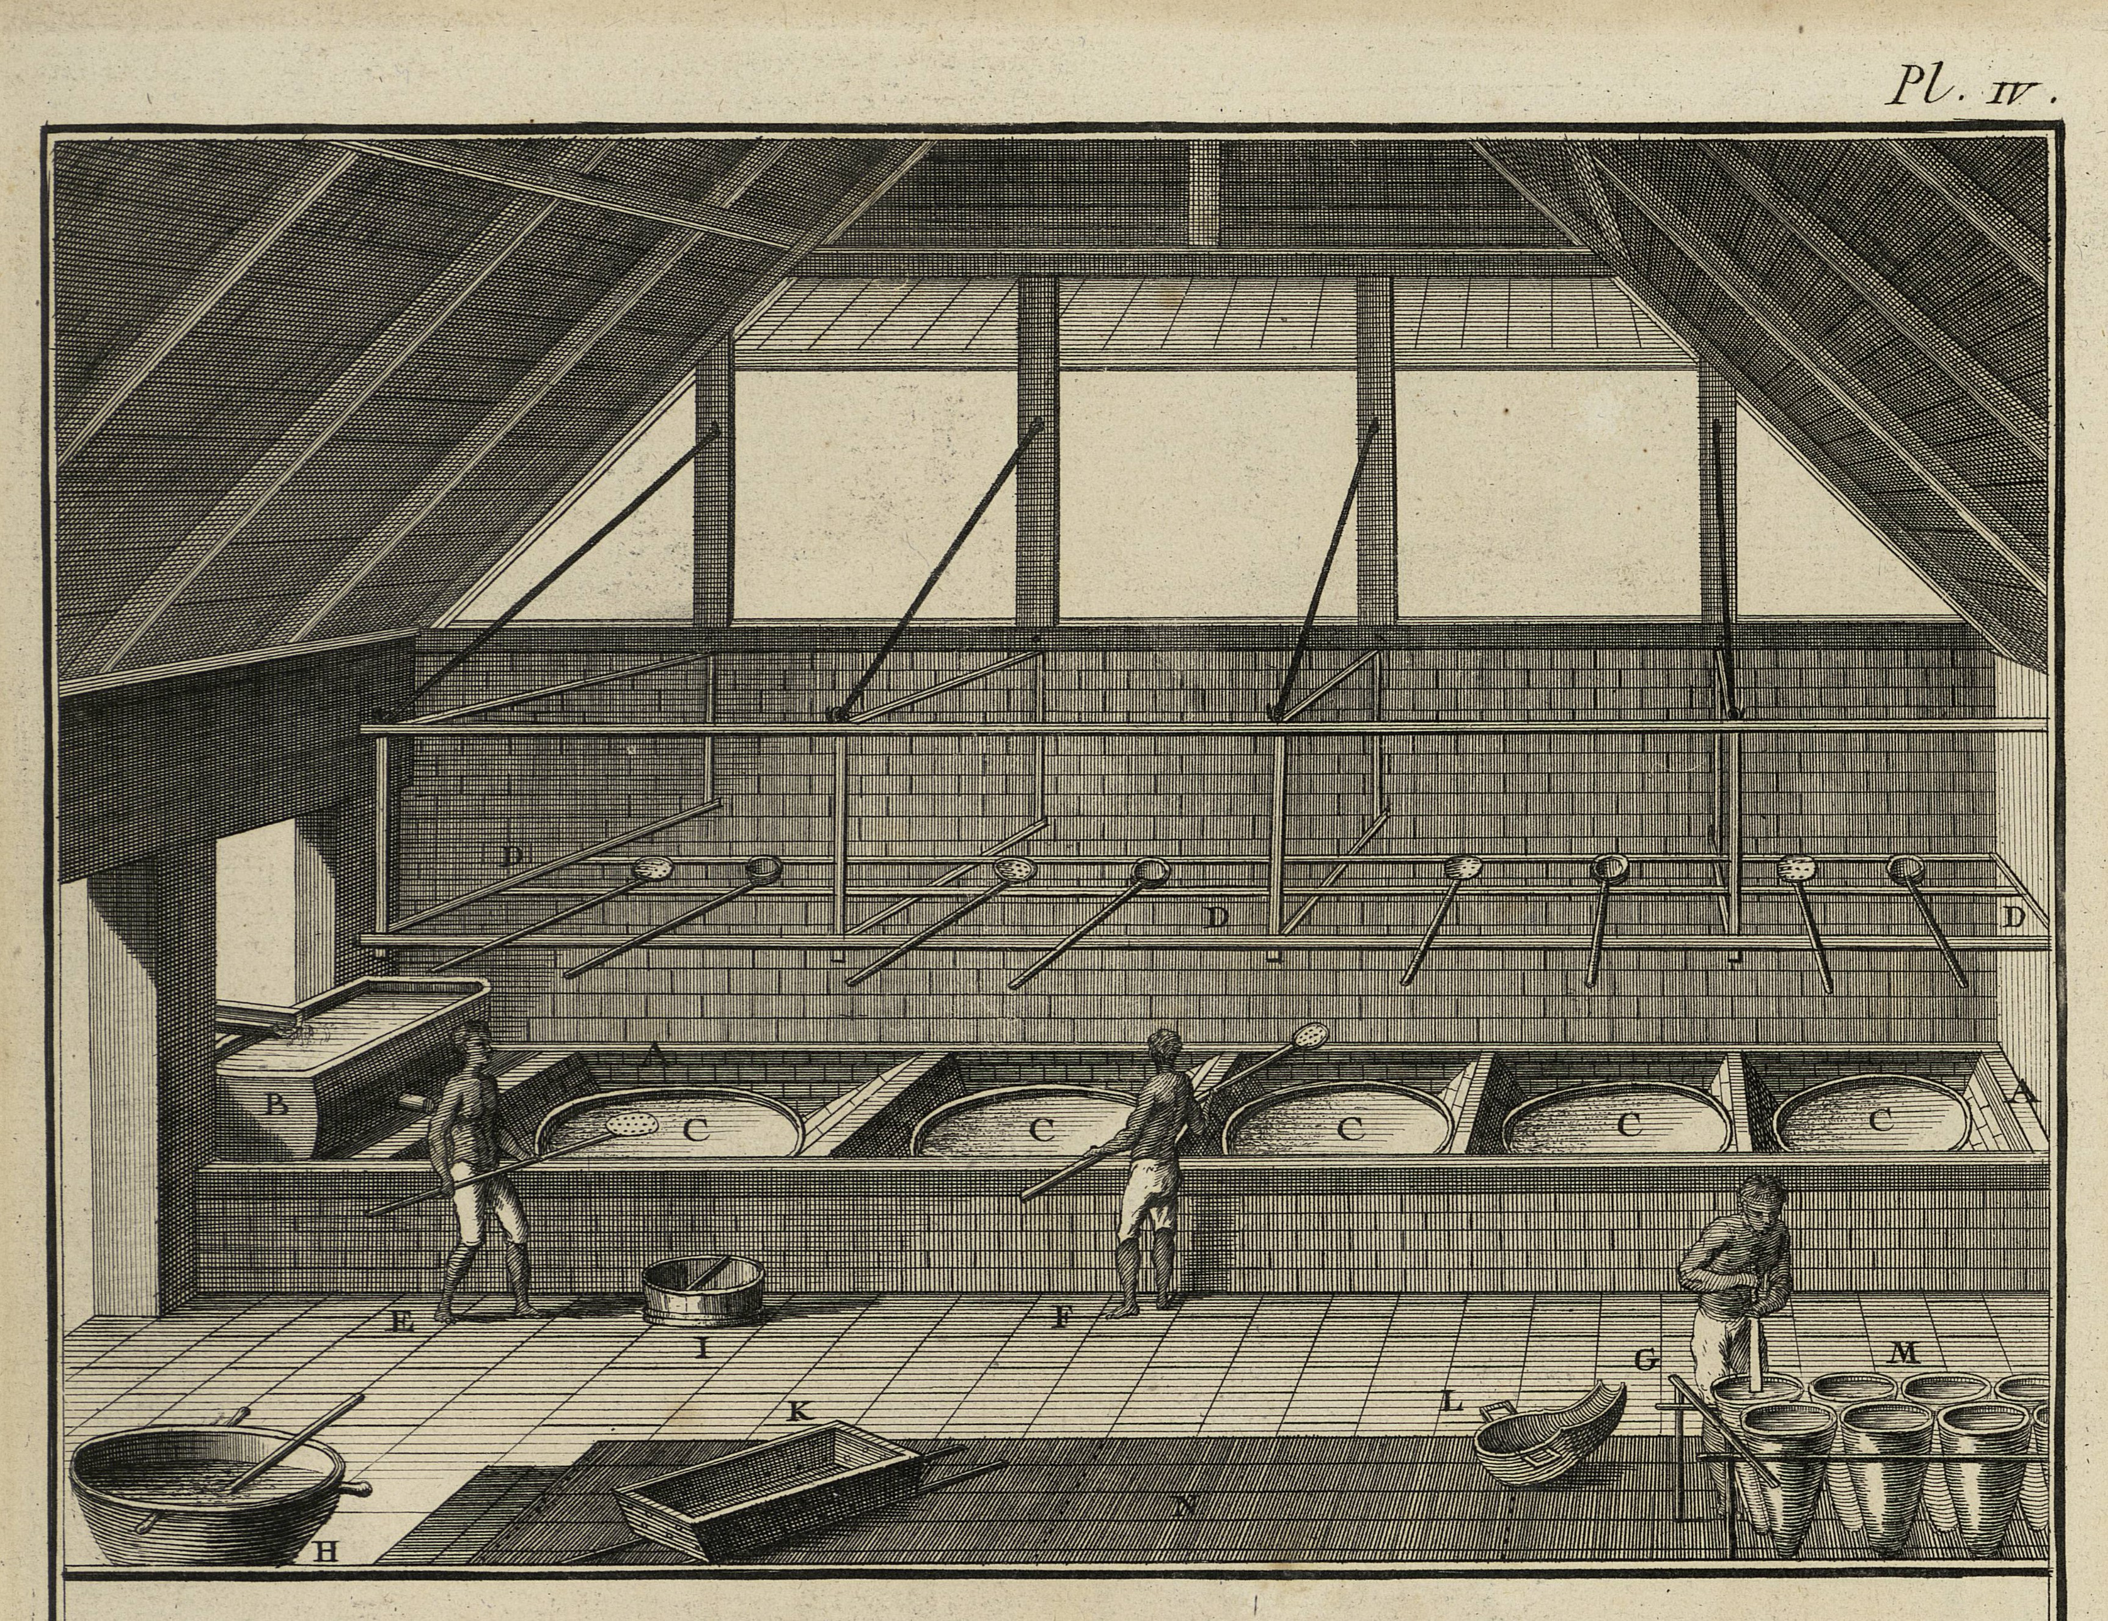

Slide 9
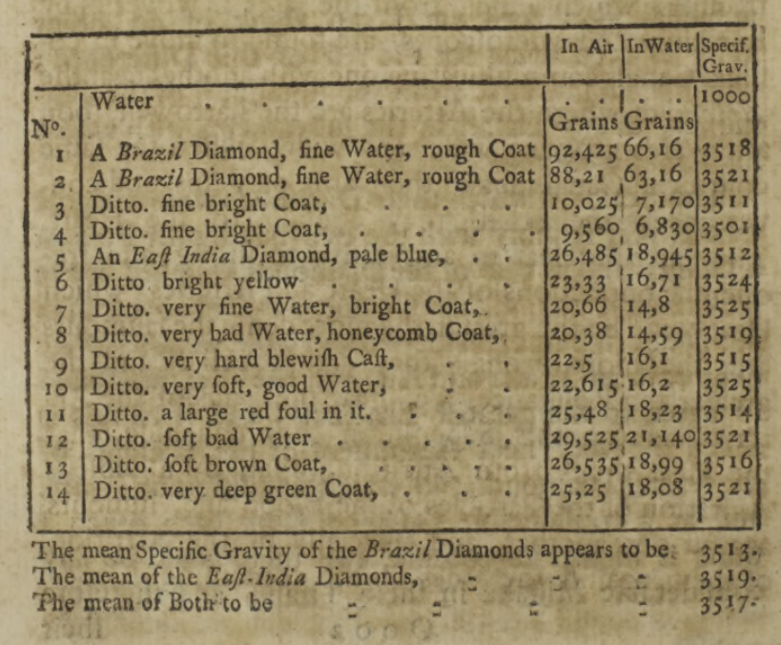
John Ellicott, article on density of diamonds in Phil. Trans. 1745

Slide 10
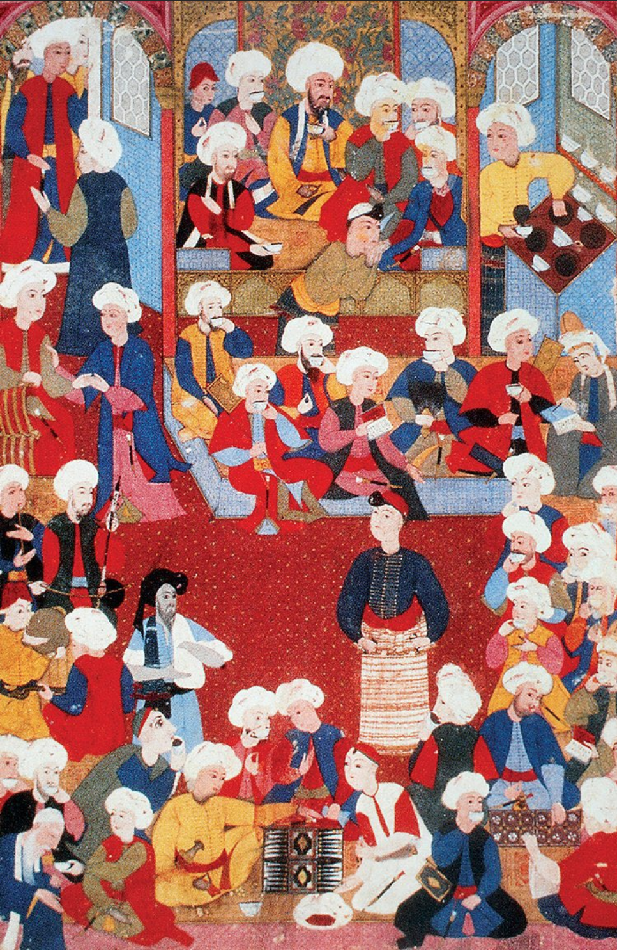
Turkish miniature showing a coffee-house, mid-sixteenth century

Slide 11
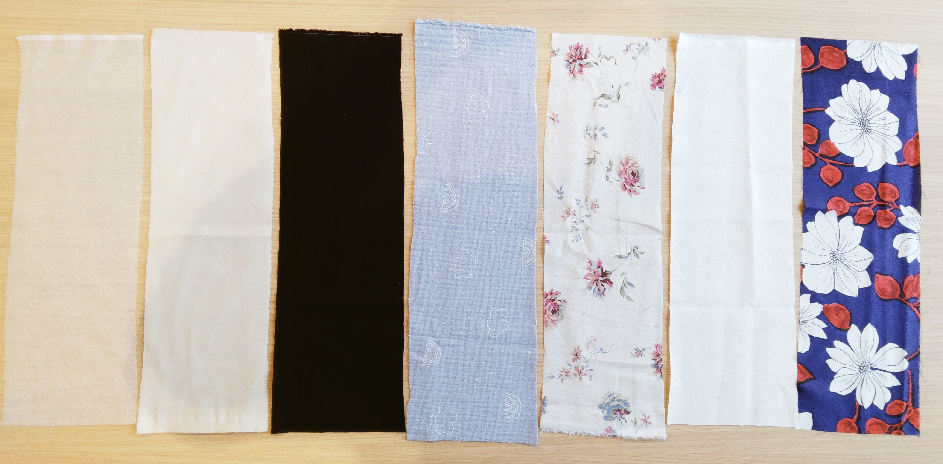
Cotton
Muslin
2 £/m2
Cotton
Calico
4
Cotton
Black
8.5
Cotton
Double gauze
10.2
Linen
Printed
10.7
Cotton/linen
Ivory-coloured
14
Pure silk
Printed
18.5

Slide 12
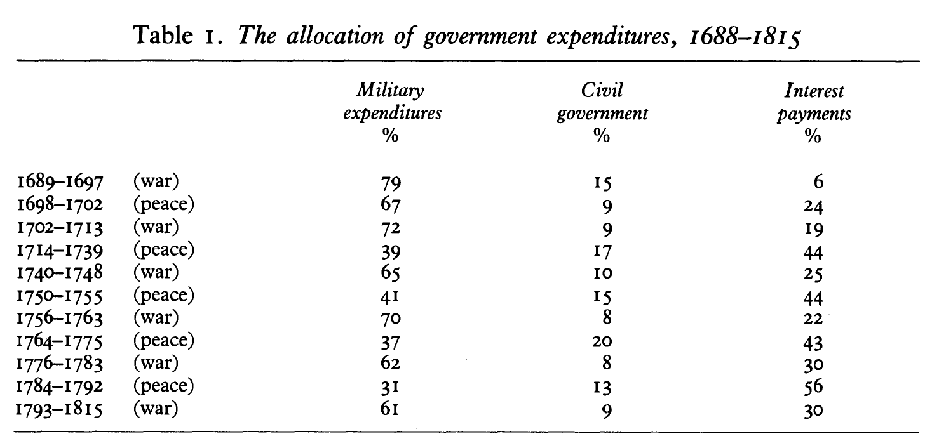
9 Years’ War
Spanish Succession
Austrian Succession
7 Years’ War
American Revolutionary
Great French Wars
From Patrick O’Brien, “The Political Economy of British Taxation, 1660-1815,” The Economic History Review (1988)

Slide 13
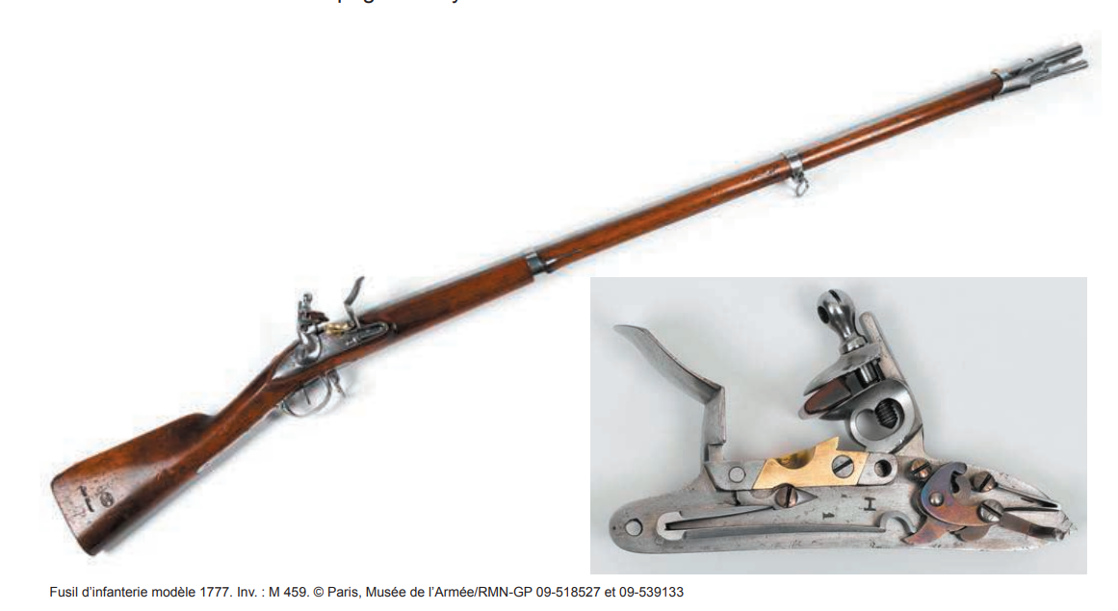

Slide 14
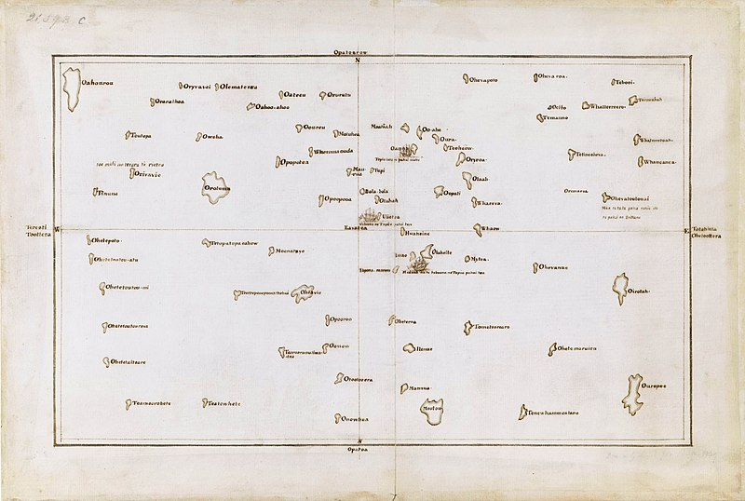
Map showing part of the Pacific Ocean, created by Captain James Cook and Tupaia (Tahitian priest)

Slide 15
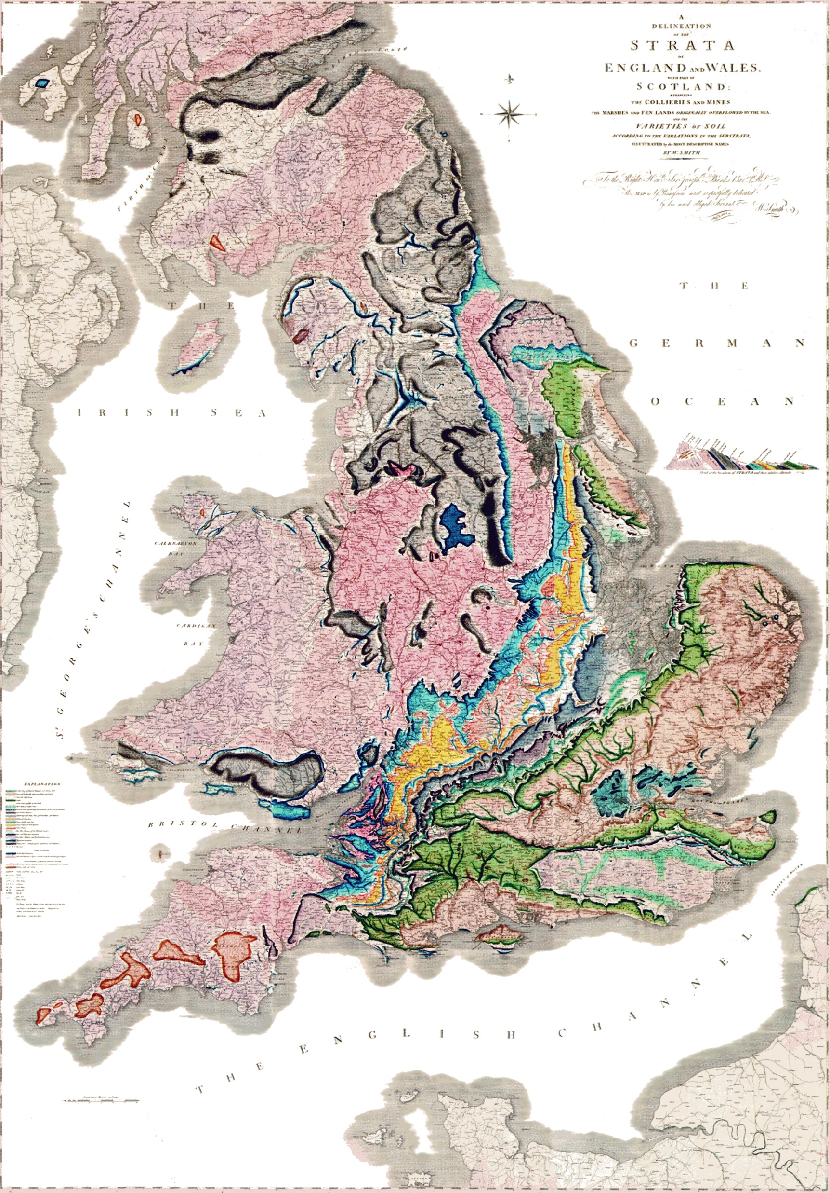

Slide 16
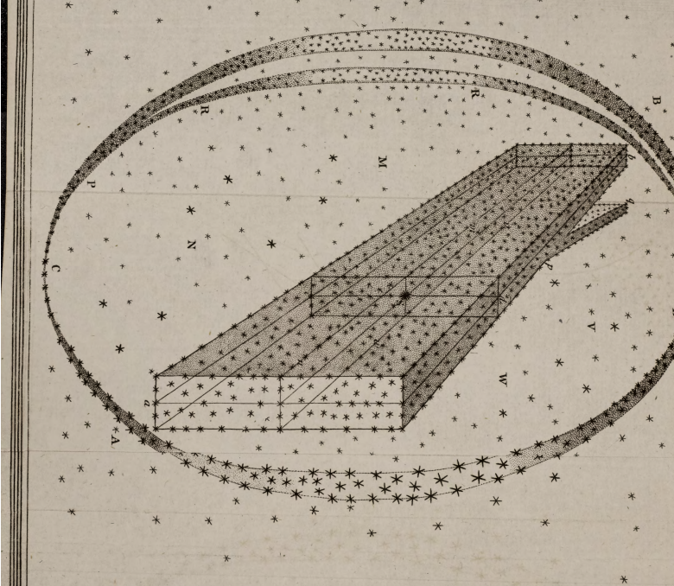
William/Caroline Herschel, “On the Construction of the Heavens,” Phil. Trans. 1784
Michael Hoskin, Discoverers of the Universe: William and Caroline Herschel, Chapter 6
Michael Hoskin, “Caroline Herschel” and “William Herschel,” in Dictionary of National Biography

Slide 17
What is being evaluated here?
How is it being evaluated?
What is at stake in the evaluation?
What does this have to do (if anything) with the kinds of Enlightenment evaluation we have discussed in the rest of the module?

