Slide 1
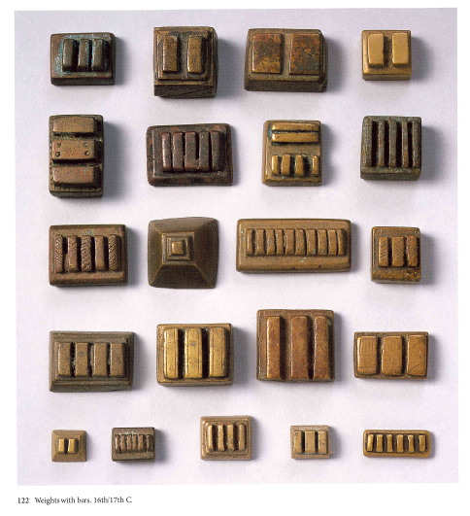
Weights with bars, c. 16th/17th centuries (presumed)
Phillips, African Goldweights

Slide 2
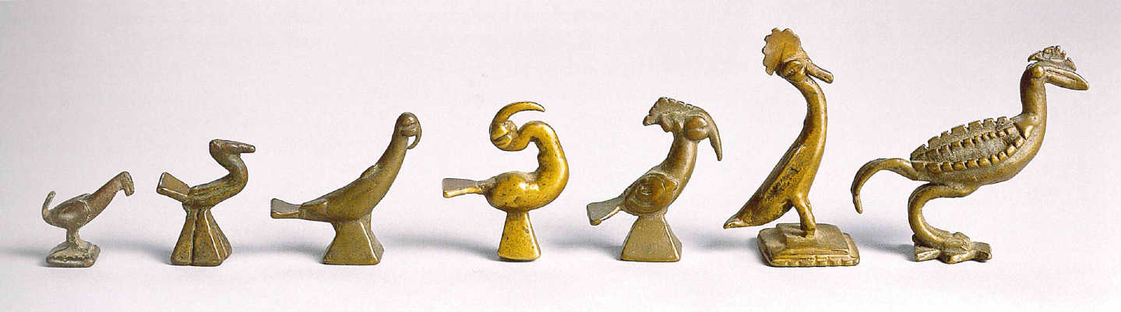
Bird motifs, 17th to 19th centuries (presumed), from 3.9 grams to 18.9 grams
Phillips, African Goldweights

Slide 3
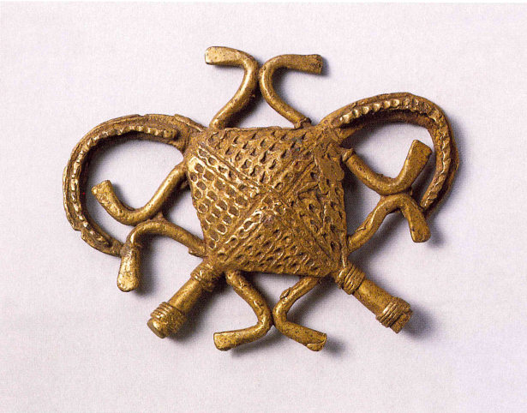
“It means, roughly: Stomachs mixed up, crocodiles’ stomachs mixed up, they both have one stomach but when they eat they fight because of the sweetness of the swallowing.”
Kwame Antony Appiah, quoted in Phillips, African goldweights
See also Peggy Appiah, Bu Me Be: Proverbs of the Akans (2008)
Crocodile with two stomachs, 19th century (presumed). Phillips, African Goldweights.

Slide 4
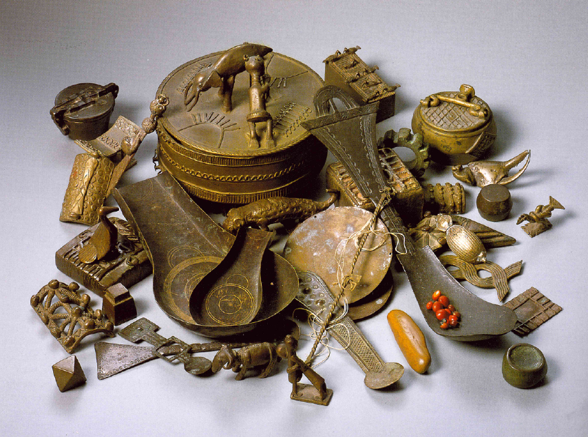
Akan weighing paraphernalia:
Goldweights
Scales
Blowpans
Scoops
Touchstone
Golddust boxes
Berries of abrus plant (Abrus pecatorius)
Kuduo (large box)
From Phillips, African Goldweights

Slide 5
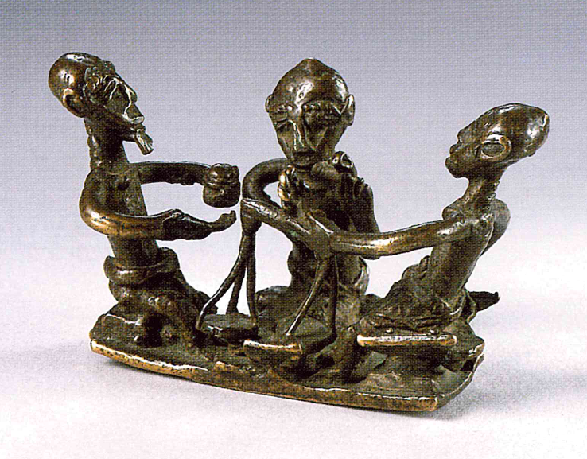
Goldweight showing three men in the act of weighing gold: “the only indigenous record of the activity” (p. 16). From Phillips, African Goldweights.

Slide 6
“though in his late nineties, frail and almost blind, he stood in the shade of a mango tree and demonstrated with some pride the proper grip for handling the scales (so that it might be clearly seen that no unfair pressure was being exerted to either side) and recited a list of weight values and their equivalents with, to my surprise, a well-remembered grasp of pounds, shillings and pence.”
-- Phillips’ account of an exchange in the mid-1980s with a villager near Kumasi who had learnt the art of weighing gold from his father in the late 19th century

Slide 7
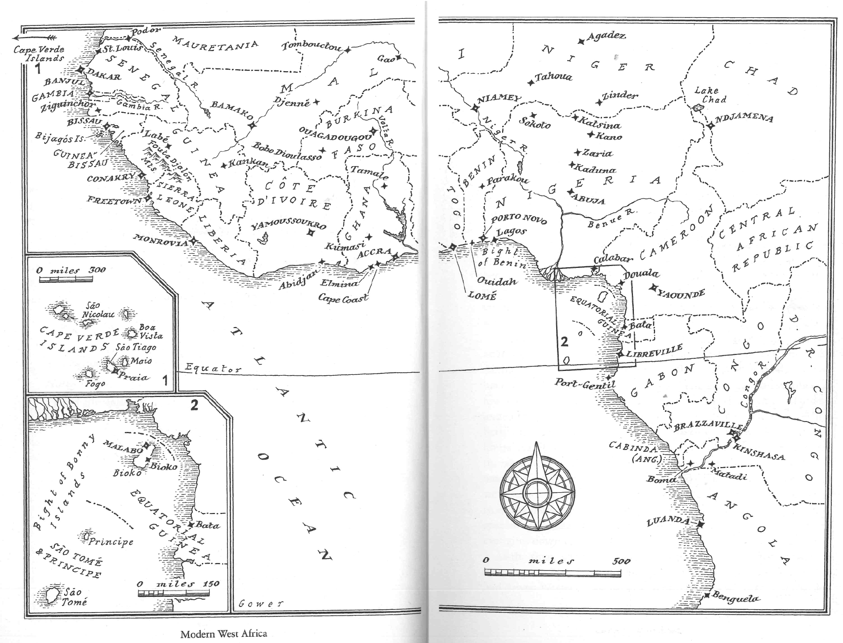
Modern West Africa
From Toby Green, A Fistful of Shells: West Africa From the Rise of the Slave Trade to the Age of Revolution (Penguin, 2020)

Slide 8
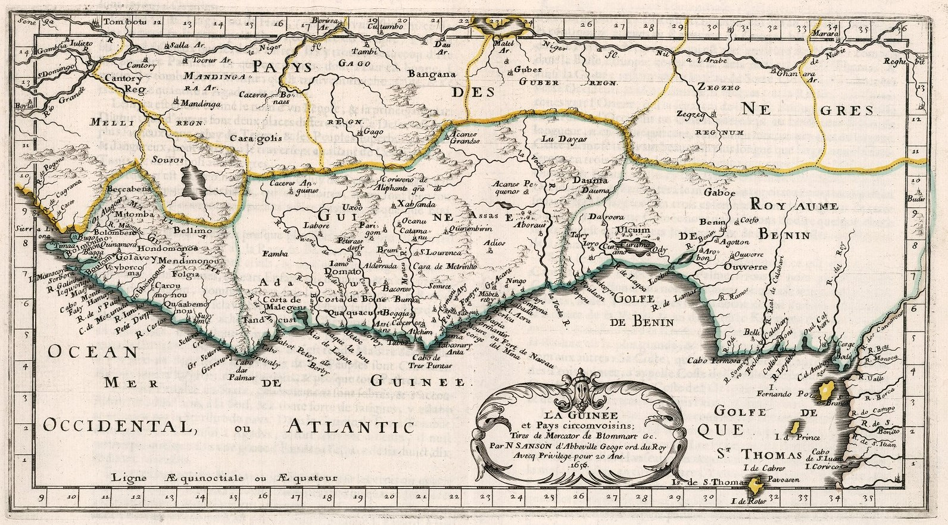
“Guinée” (Guinea in English) as an ocean and a region imagined by early modern Europeans. From atlas by Nicholas Sanson, Paris 1656. Courtesy of David Rumsey map collection, davidrumsey.com.

Slide 9
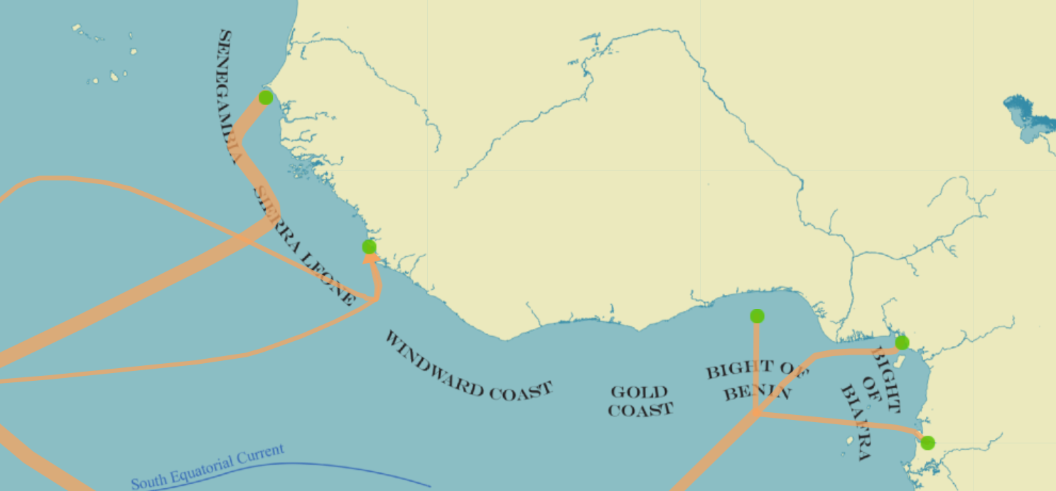
WEST
CENTRALAFRICA
Map of part of West Africa, showing a) names for coastal regions, b) locations of points of departure of slave ships for the period 1576 to 1850, and c) trajectories of these slave ships, with width of line indicating number of ships (more than half in period are from Senegambia up to 1600). From slavevoyages.org .

Slide 10
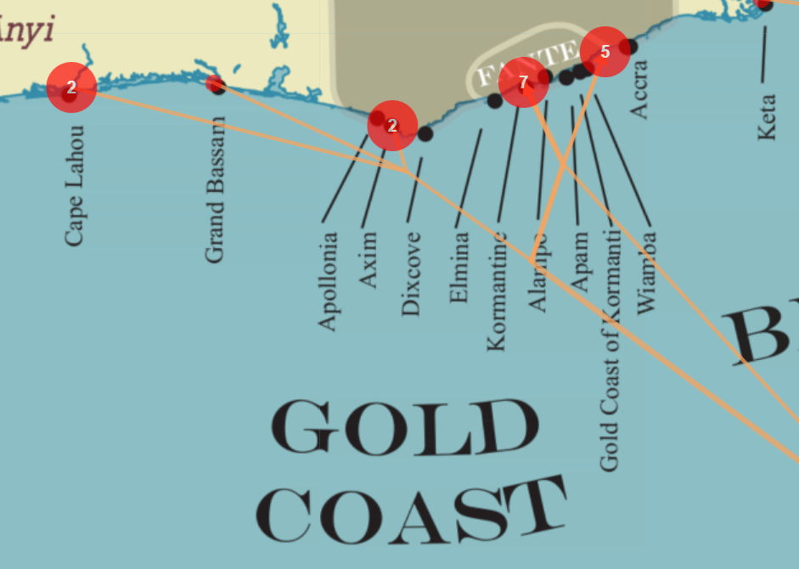
Locations of departures of slave ships from Gold Coast, 1576-1850. From slavevoyages.org.

Slide 11
“Africa was not a colonial setting until the nineteenth century, and from the thirteenth century on its peoples and rulers were active participants in shaping the modern world.”
Green, Fistful of Shells, xxiii

Slide 12
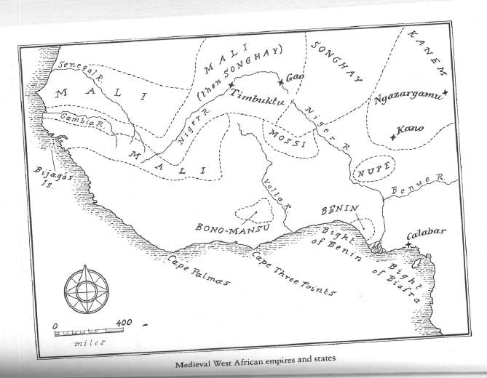
Medieval West African empires and states
From Green, Fistful of Shells

Slide 13
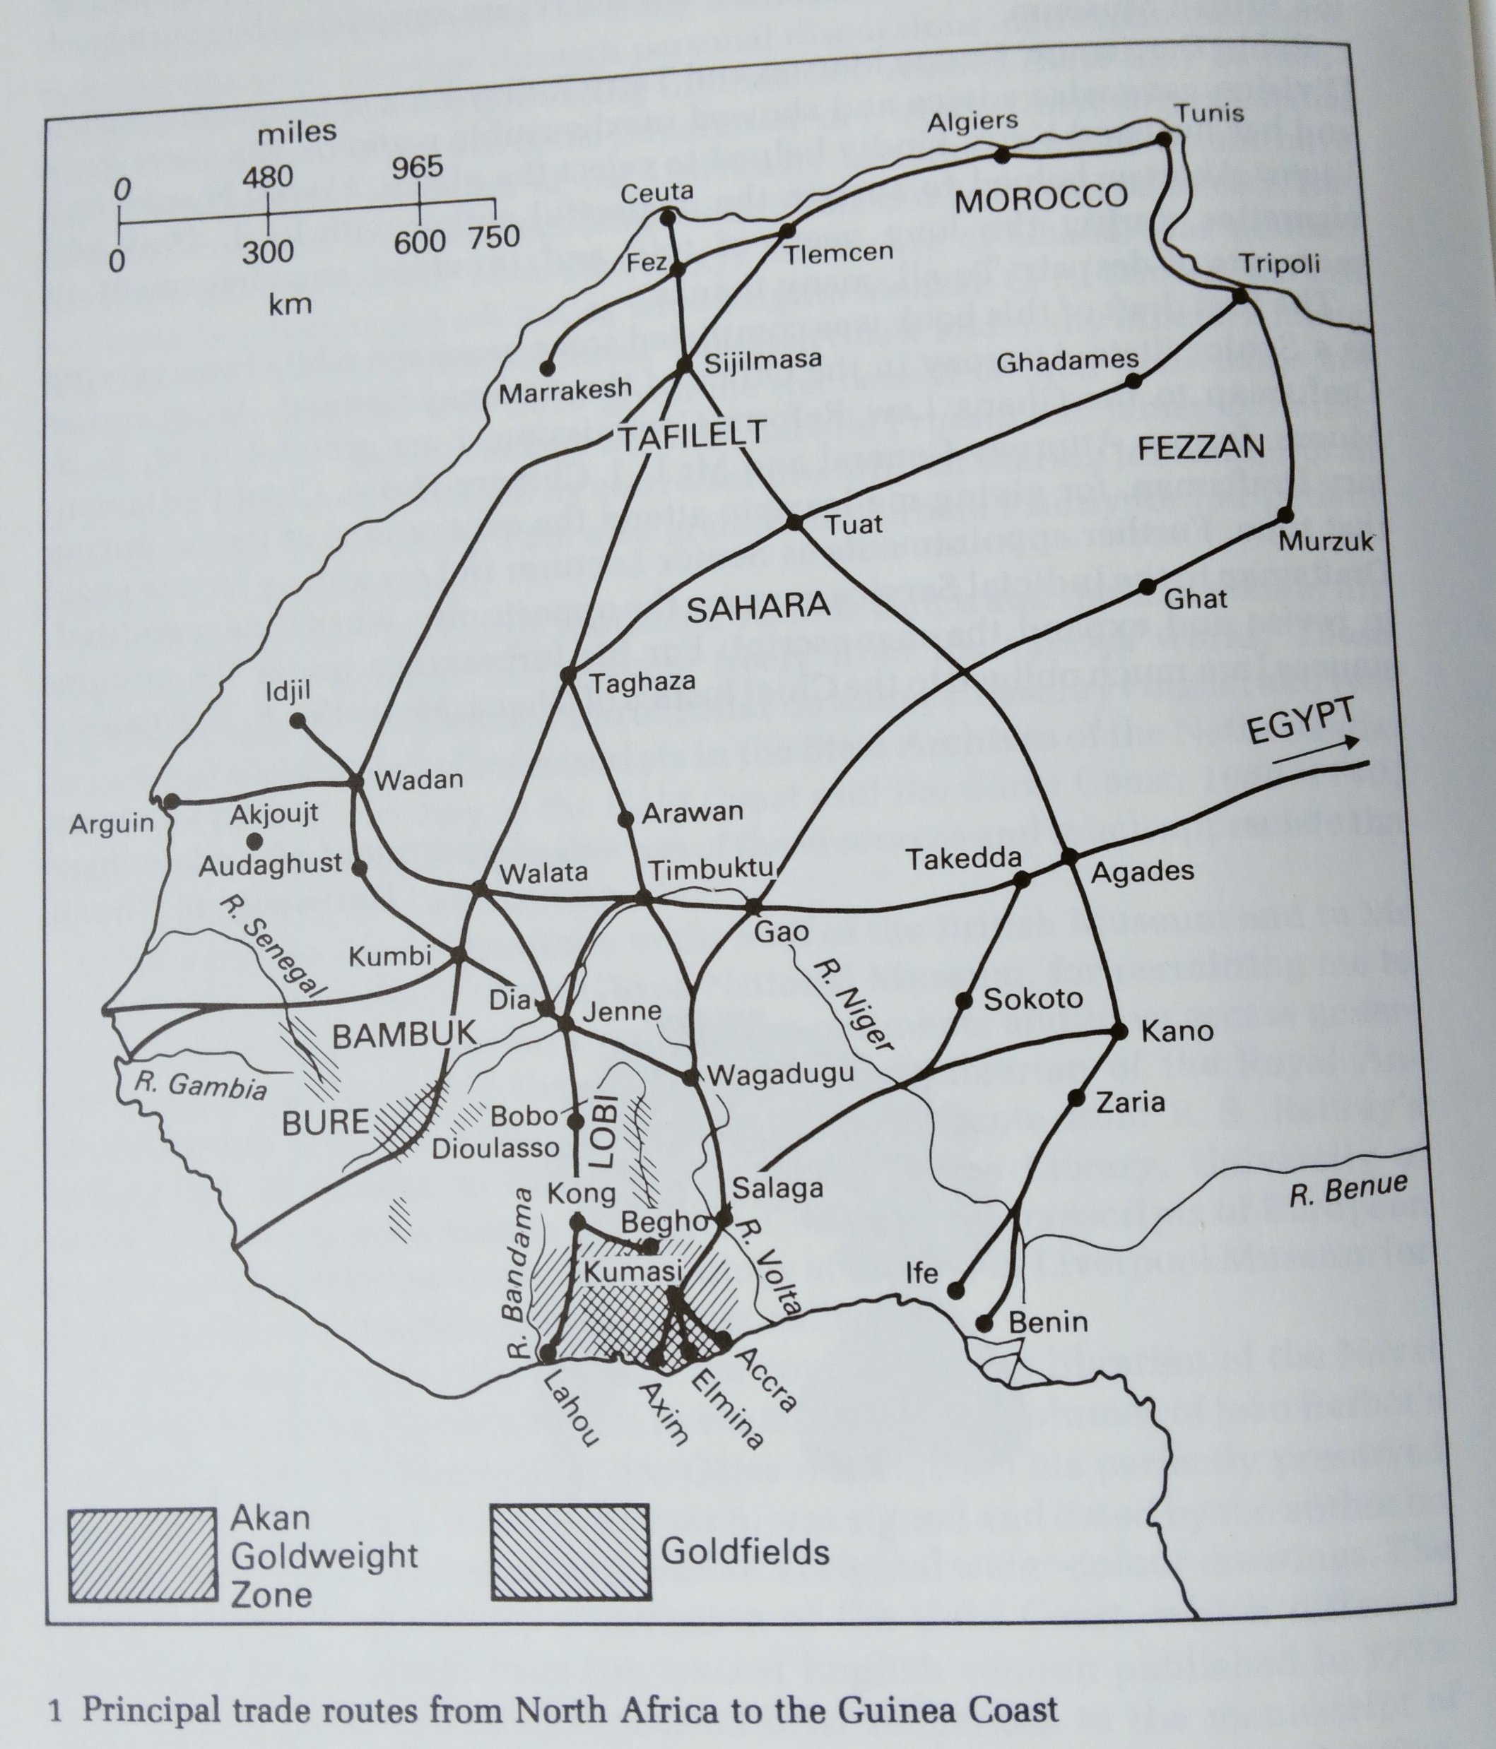
From Timothy F. Garrard, Akan Weights and the Gold Trade (New York, 1985)
Applies to late medieval period

Slide 14
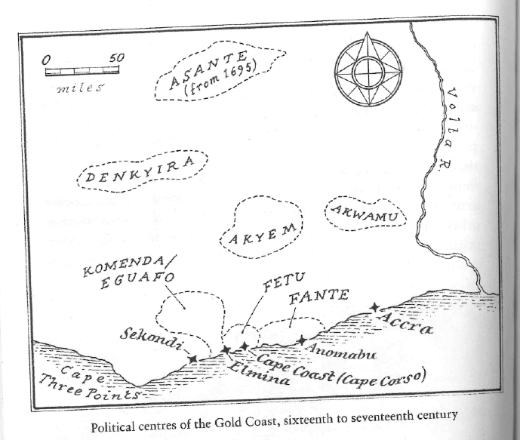
From Green, Fistful of Shells

Slide 15
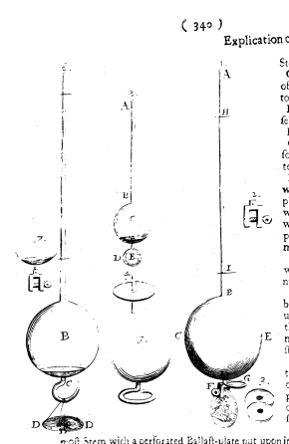
What is this, what is it made of, how does it work?
From Boyle, “New Essay-Instrument,” 1675

