Slide 1
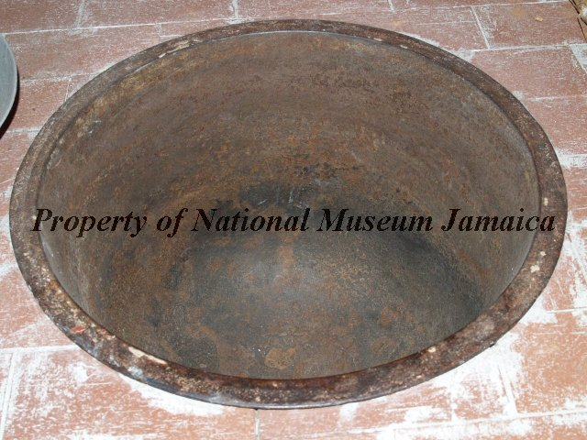

Slide 2
A “copper” now at the National Museum Jamaica, Object ID 2002.4.1. In the collection “Slavery, plantation life, and slavery.”
Large cast iron pot or copper was used to boil cane juice to make sugar. This copper is on display in the Montego Bay to the World Exhibition at National Museum West in Montego Bay, St. James.

Slide 3
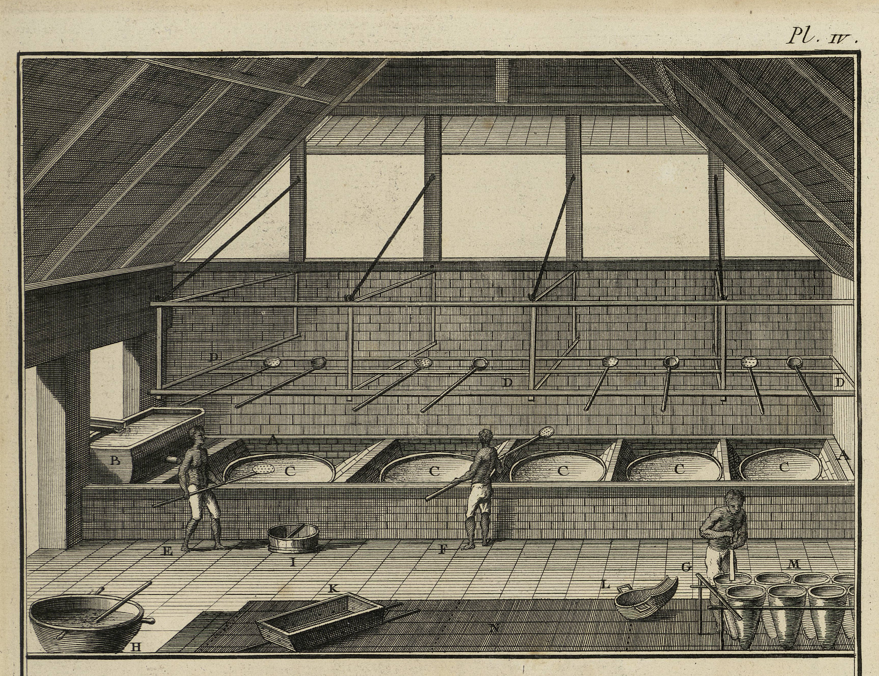
Boiling house of an 18c Caribbean sugar plantation
From Diderot and d’Alembert, Encyclopédie, vol. 1 of the plates (1762), under “Sucrérie”

Slide 4
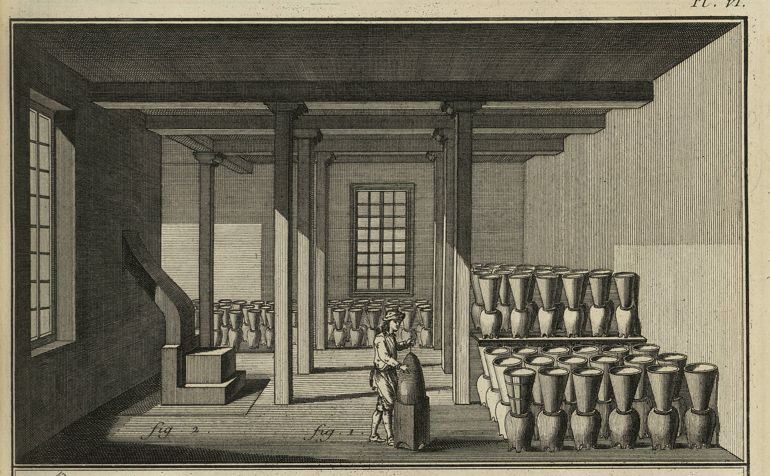
Sugar being ‘clayed,’ or left to stand in clay pots to produce white sugar. From Diderot and d’Alembert, Encyclopédie, vol. 1 of the plates (1762), under “Sucrérie”

Slide 5
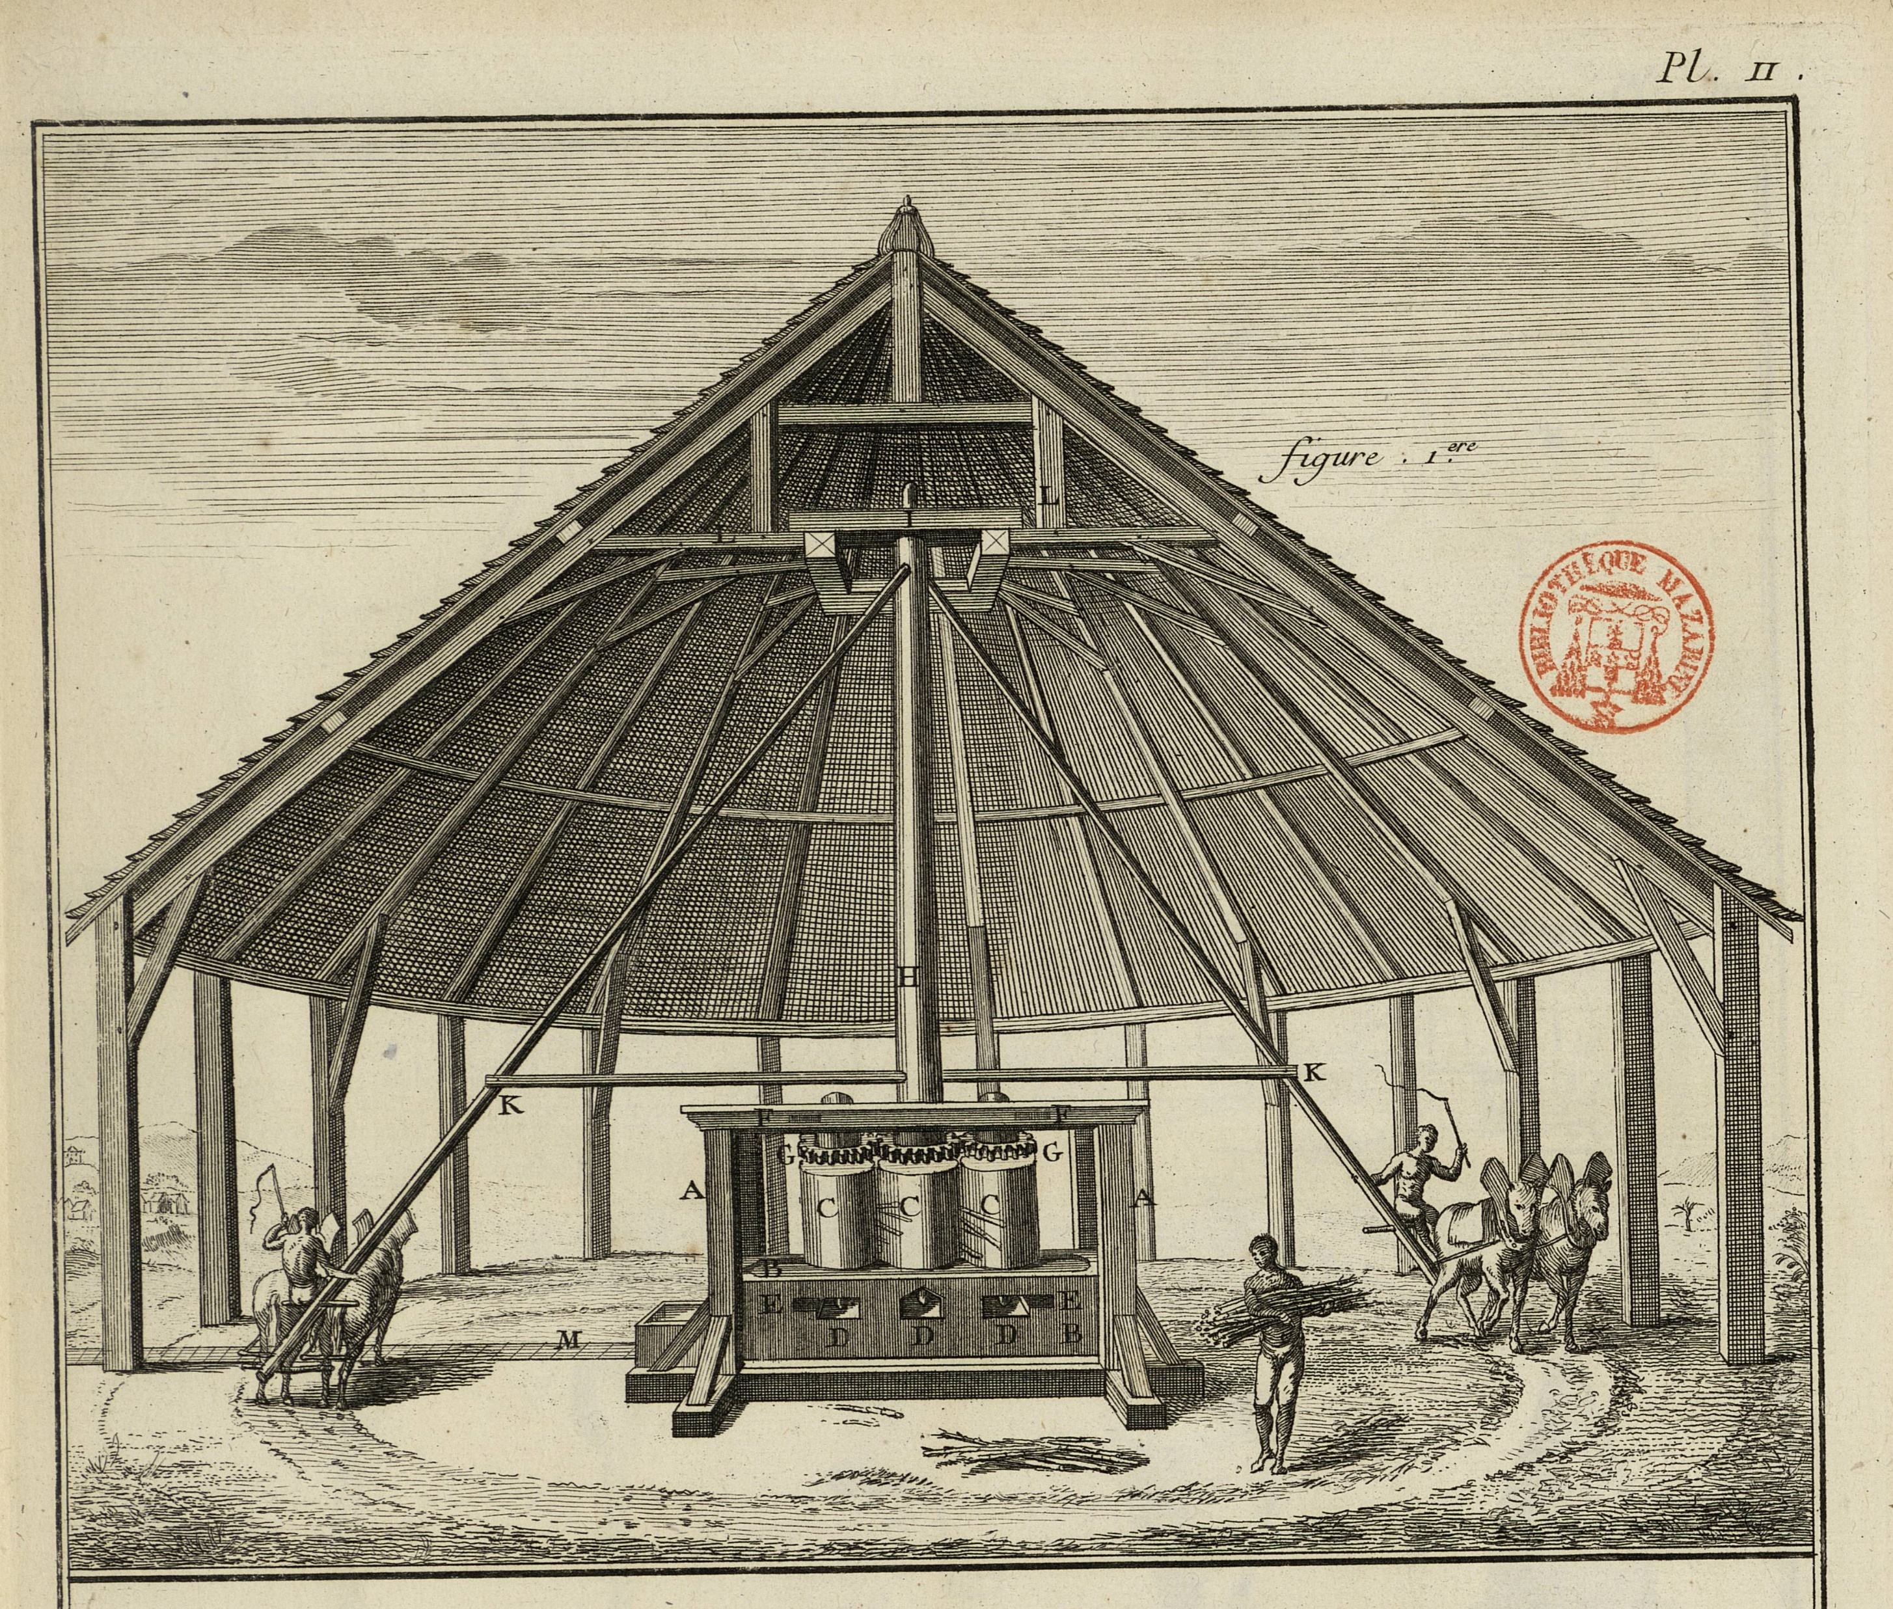
Mill for grinding sugar cane, showing three-roller vertical mill
From Diderot and d’Alembert, Encyclopédie, vol. 1 of the plates (1762), under “Sucrérie”

Slide 6
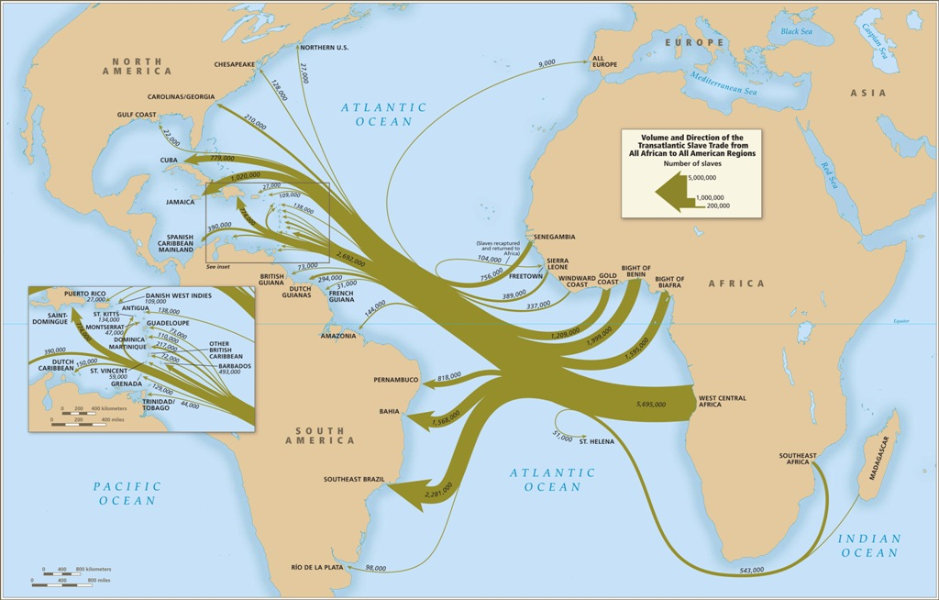
Volume and Direction of the Transatlantic Slave Trade from All African to All American Regions, 1500-1900 – from slavevoyages.org

Slide 7
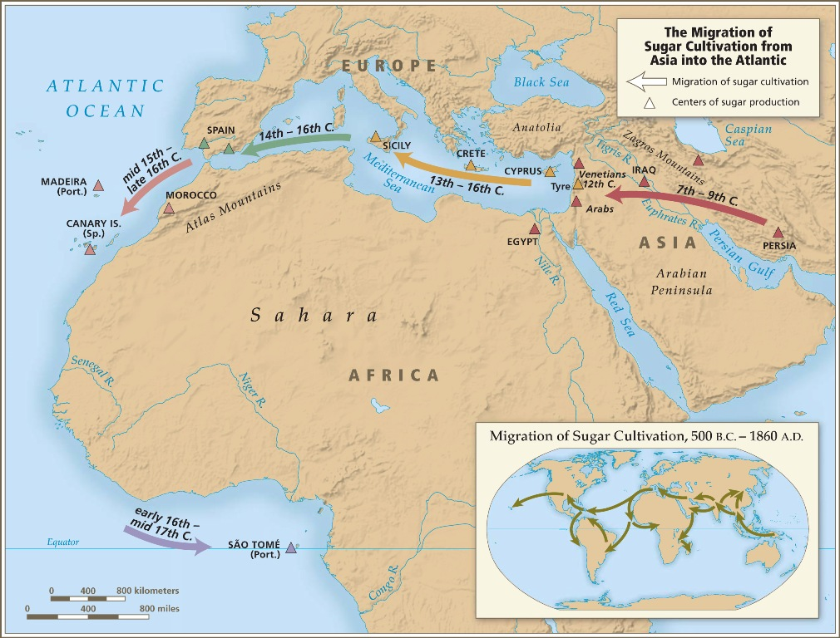
From slavevoyages.org

Slide 8
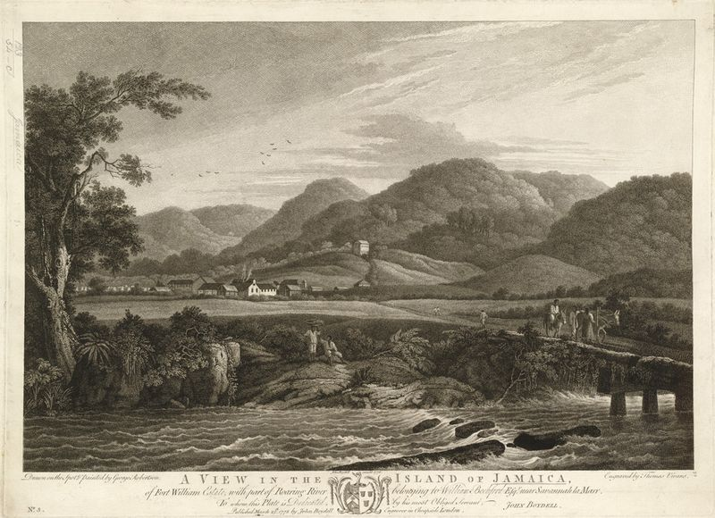
“A View of the Island of Jamaica, of Fort William Estate, with part of the Roaring River, belonging to William Beckford, 1778” drawn by George Robertson

Slide 9
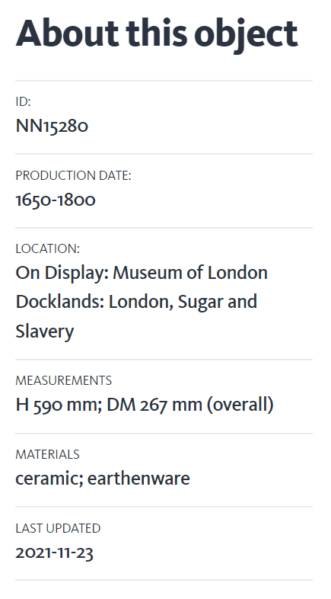
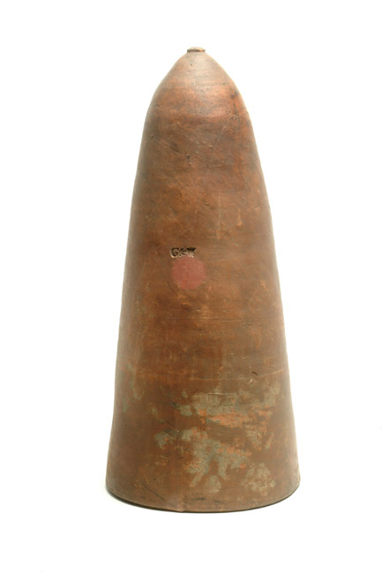
Data and image credit: Museum of London

