Slide 1
Coffee and Orientalism
HI3T5 week 1.5, 2024-5
Dr. Michael Bycroft

Slide 2
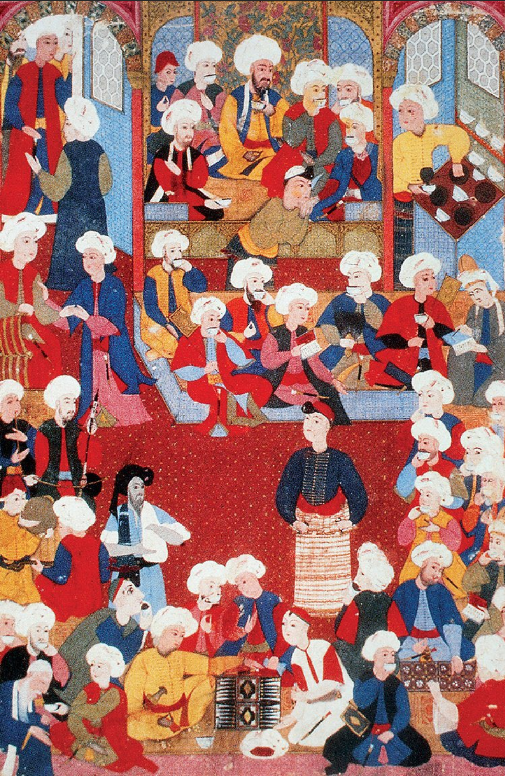
Turkish miniature showing a coffee-house, mid-sixteenth century

Slide 3
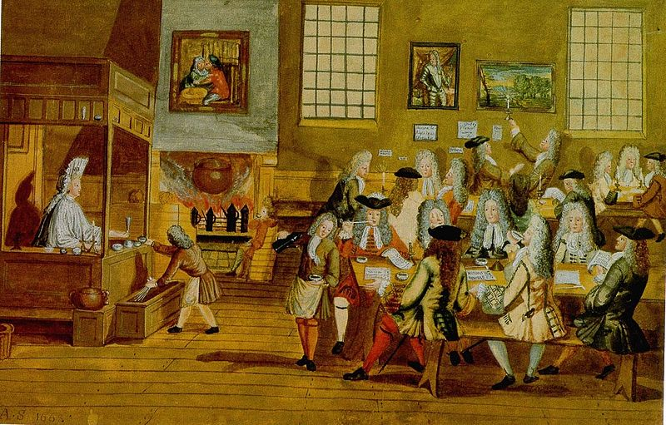
Interior of a London coffee house, c. 1690s

Slide 4
“My Lady made us drink our morning draught there [in parlour of his boss at Navy Board] - of several wines. But I drank nothing but some of her Coffee; which was purely made, with a little sugar in it.”
The Diary of Samuel Pepys [London, 1660s], cited in Phil Withington, "Where Was the Coffee in Early Modern England?", Journal of Modern History 92:1 (2020): 40-75.

Slide 5
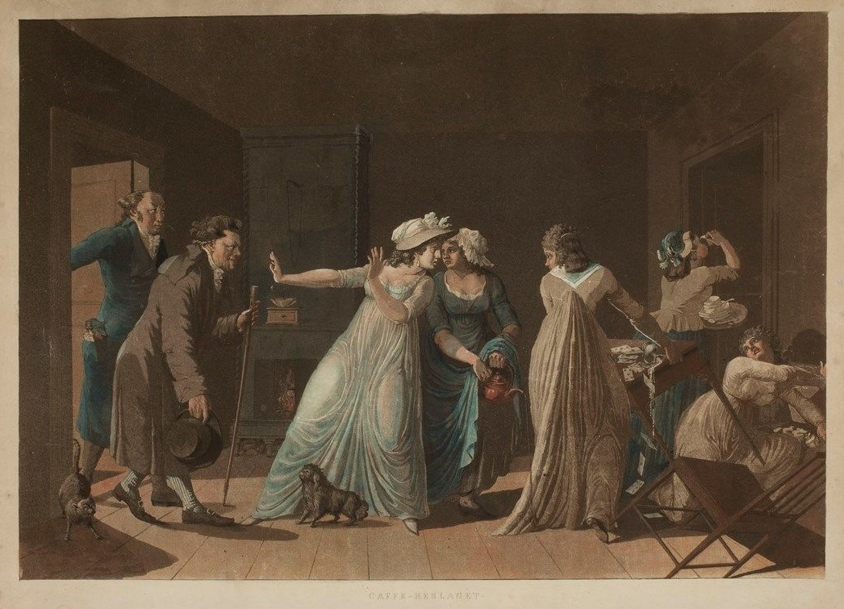
A coffee seizure in eighteenth-century Stockholm, painting by Mårten Rudolf Heland, 1799-1814

Slide 6
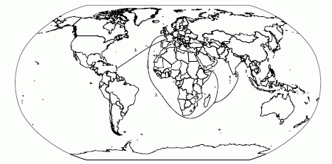
1
3
2
French coffee trade routes, 1670–1730:
The Levantine route, between Marseille and Cairo via the Mediterranean Sea
The East Indies route, from St. Malo via the Cape of Good Hope to the Mascarene Islands (inc. La Réunion/Ile Bourbon and Mauritius), the Indian trading outposts, and the Yemen
The American route, between western French ports and the Caribbean colonies, inc. Martinique and Guadeloupe
From Spary, Eating the Enlightenment

Slide 7
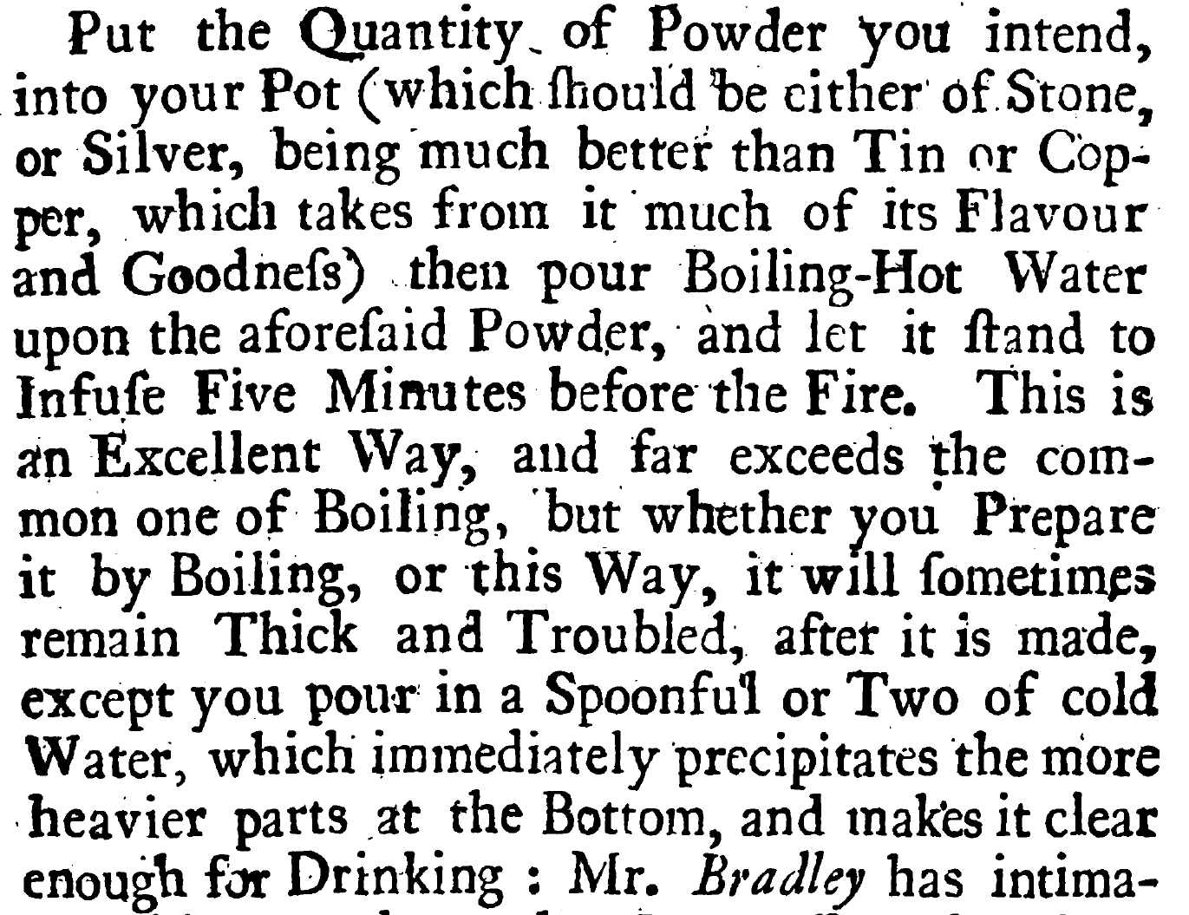
Humphrey Broadbent, The Domestick Coffee-Man, Shewing the True Way of Preparing and Making Chocolate, Coffee and Tea (London, 1722)

