Slide 1
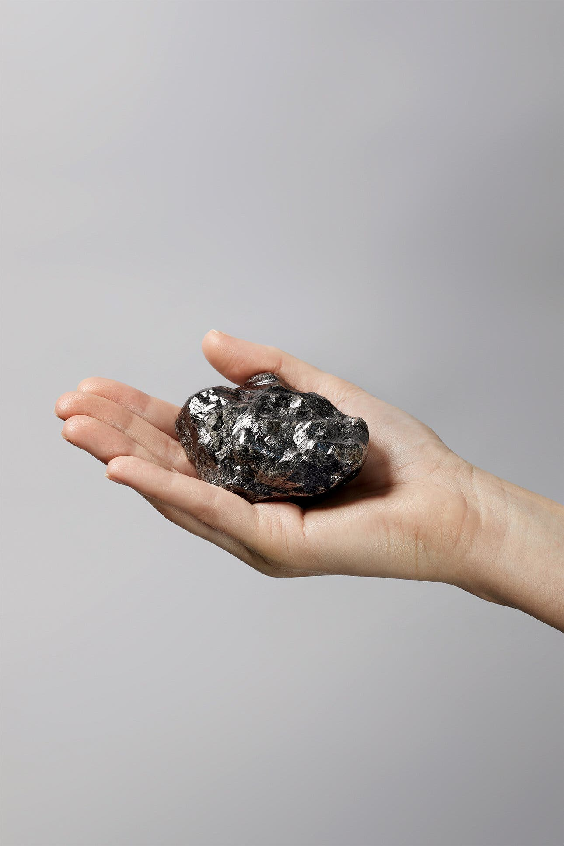

Slide 2
Asia the traditional European source of diamonds and diamond expertise
Venice-Antwerp the traditional diamond route
Lisbon became a hub in 16c – Goa taken by Portuguese in 1510
London-Amsterdam key from mid-17c – Fort St. George est. 1639
Diamonds discovered in Brazil in 1720s

Slide 3
Hydrostatic balance for gems in Islamic world from 10th century
Diamond polishing in Europe from c. 1400
‘Square rule’ for gems in European texts from early 16th century

Slide 4
How did eighteenth-century diamond merchants determine the value of their wares?
Why were these evaluations significant in the wake of the discovery of diamonds in Brazil?
Why did diamond merchants make their methods of evaluation public?

Slide 5
Material evaluation
Technique
Science
Material world
Age of Reason

Slide 6
TERM 1
1.2 How to Think About Value 1.3 Gold and the Atlantic Slave Trade 1.4 Sugar and the Plantation System 1.5 Diamonds and Imperial Rivalry
1.7 Coffee and Orientalism 1.8 Textiles and the Enlightened Consumer 1.9 Horses and Englishness 1.10 Mineral Water and the Growth of Towns

