Slide 1
Coffee and Orientalism
HI3T5 week 7, 2022

Slide 2
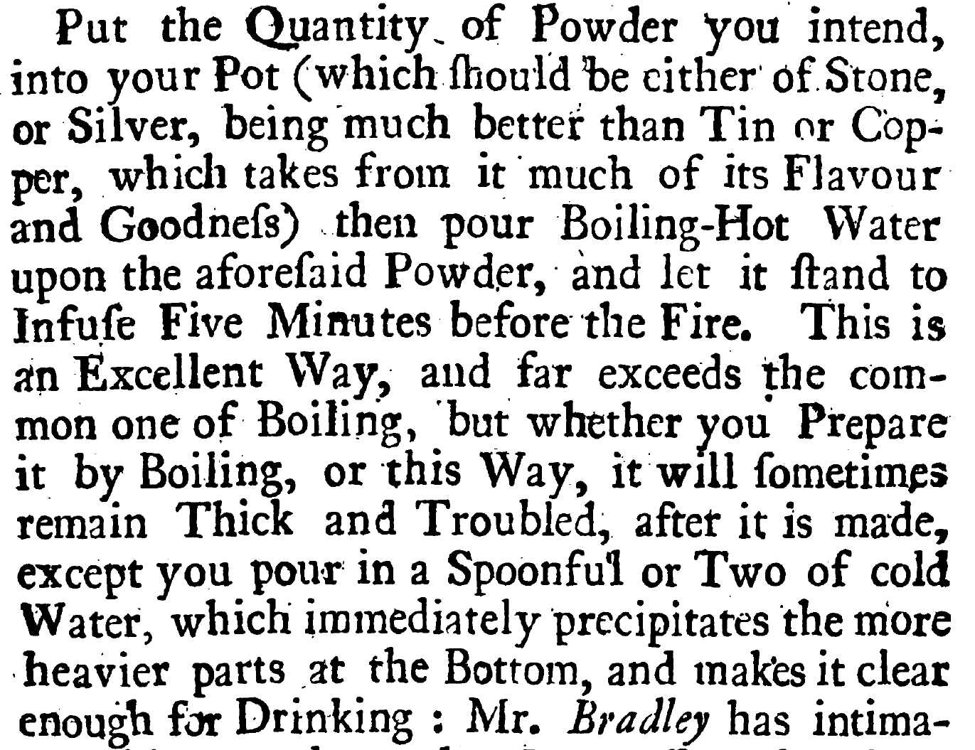
Humphrey Broadbent, The Domestick Coffee-Man, Shewing the True Way of Preparing and Making Chocolate, Coffee and Tea (London, 1722)

Slide 3
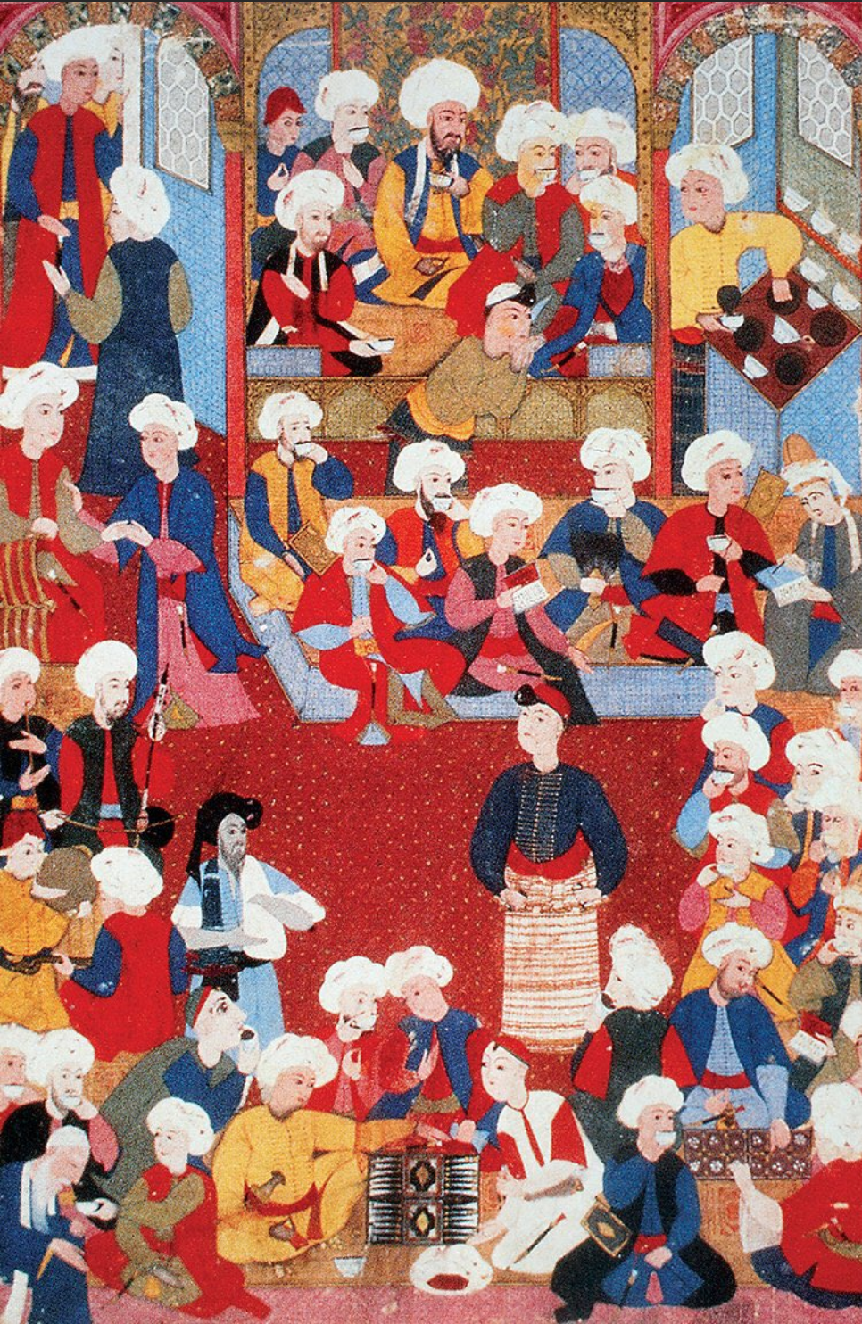
Turkish miniature showing a coffee-house, mid-sixteenth century

Slide 4
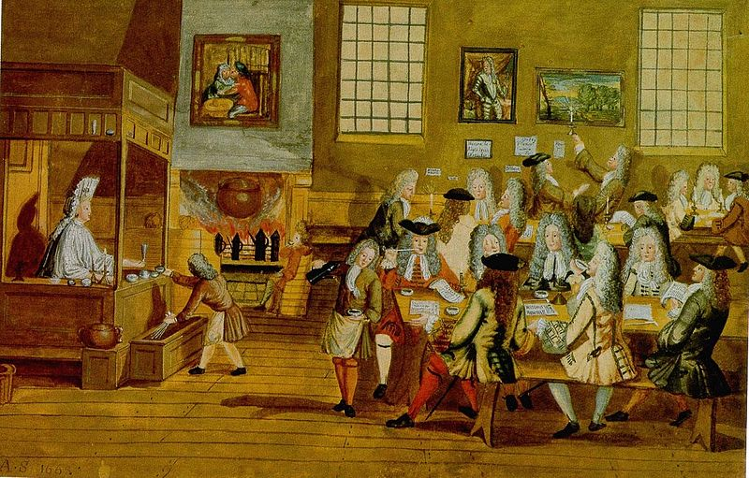
Interior of a London coffee house, c. 1690s

Slide 5
“My Lady made us drink our morning draught there [in parlour of his boss at Navy Board] - of several wines. But I drank nothing but some of her Coffee; which was purely made, with a little sugar in it.”
The Diary of Samuel Pepys [London, 1660s], cited in Phil Withington, "Where Was the Coffee in Early Modern England?", Journal of Modern History 92:1 (2020): 40-75.

Slide 6
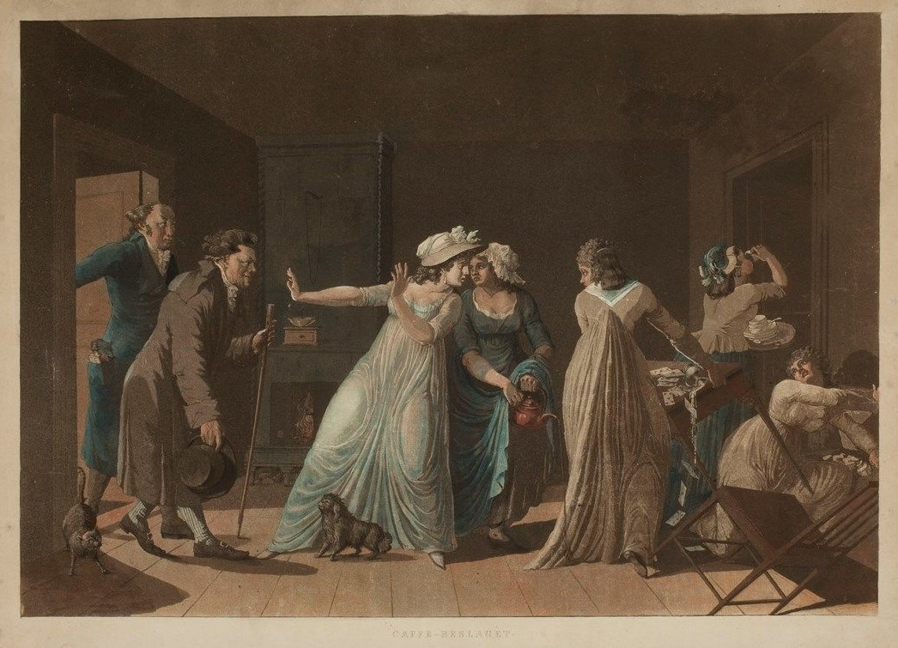
A coffee seizure in eighteenth-century Stockholm, painting by Mårten Rudolf Heland, 1799-1814

Slide 7
What does coffee tell us about the relationship between Europe and the Ottoman Empire around 1700?
What were the 'virtues' of coffee and how were they determined?
What were the different types of coffee in circulation, and why did these differences matter?

