Slide 1
Textiles and the Enlightened Consumer
Value in the Age of Reason, HI3T5
Week 8, Autumn 2022

Slide 2
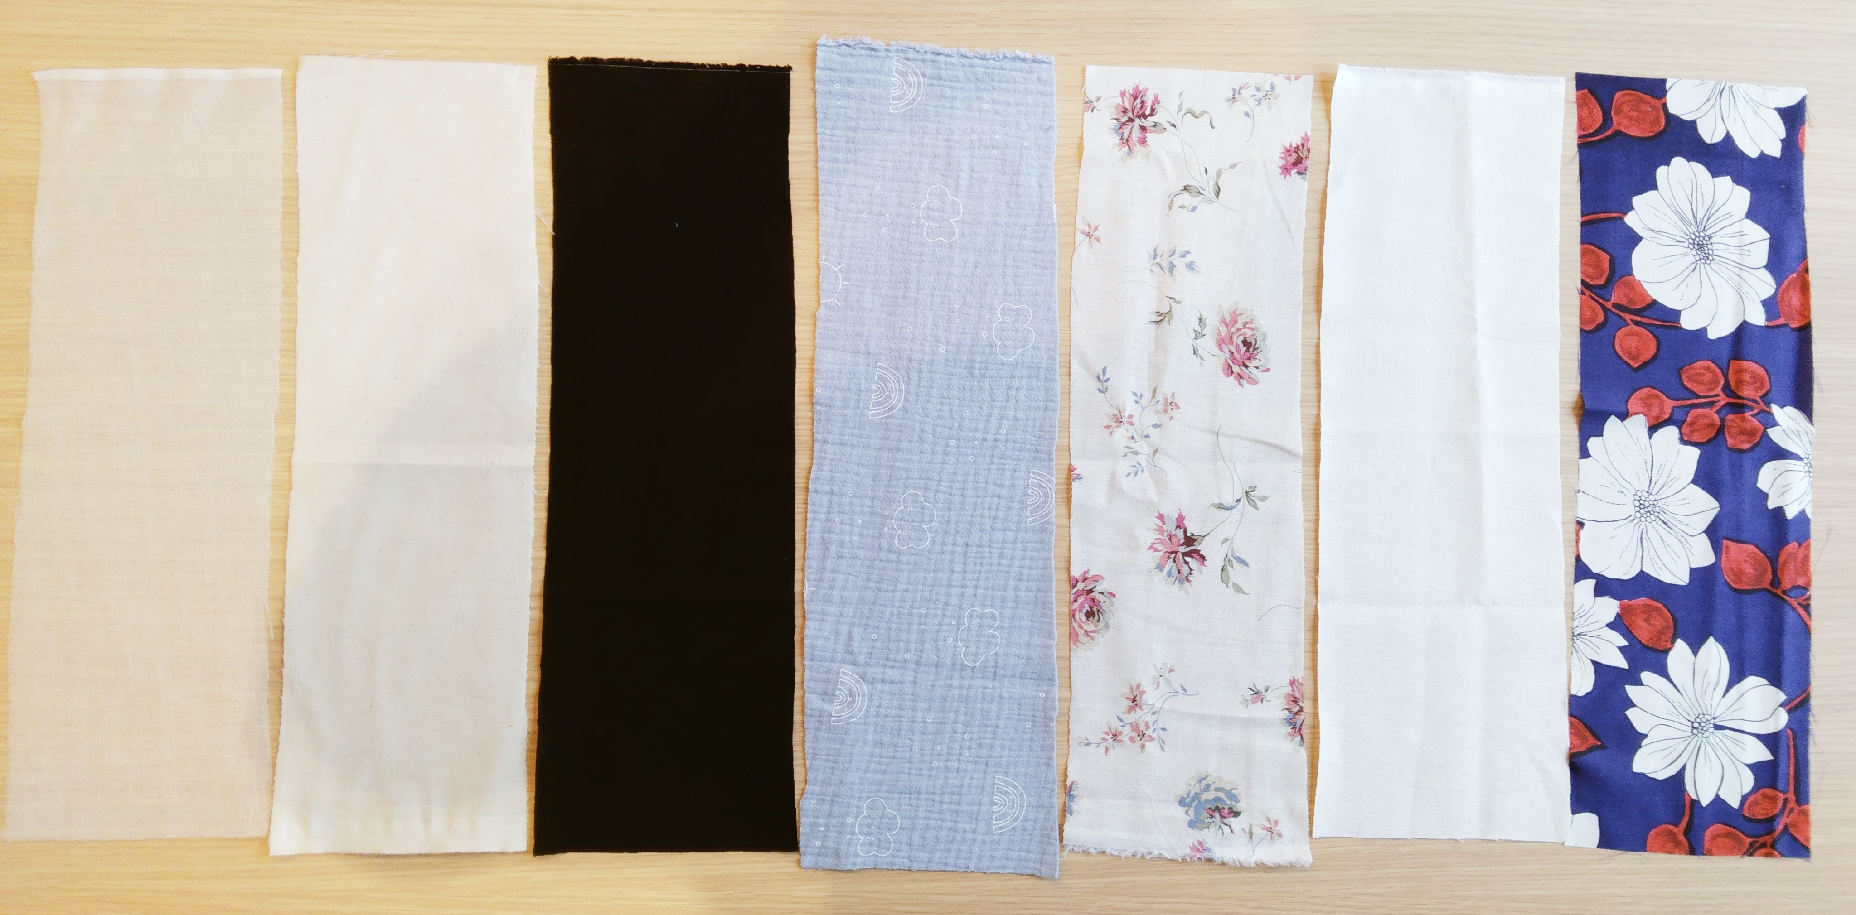
Cotton
Muslin
2 £/m2
Cotton
Calico
4
Cotton
Black
8.5
Cotton
Double gauze
10.2
Linen
Printed
10.7
Cotton/linen
Ivory-coloured
14
Pure silk
Printed
18.5

Slide 3
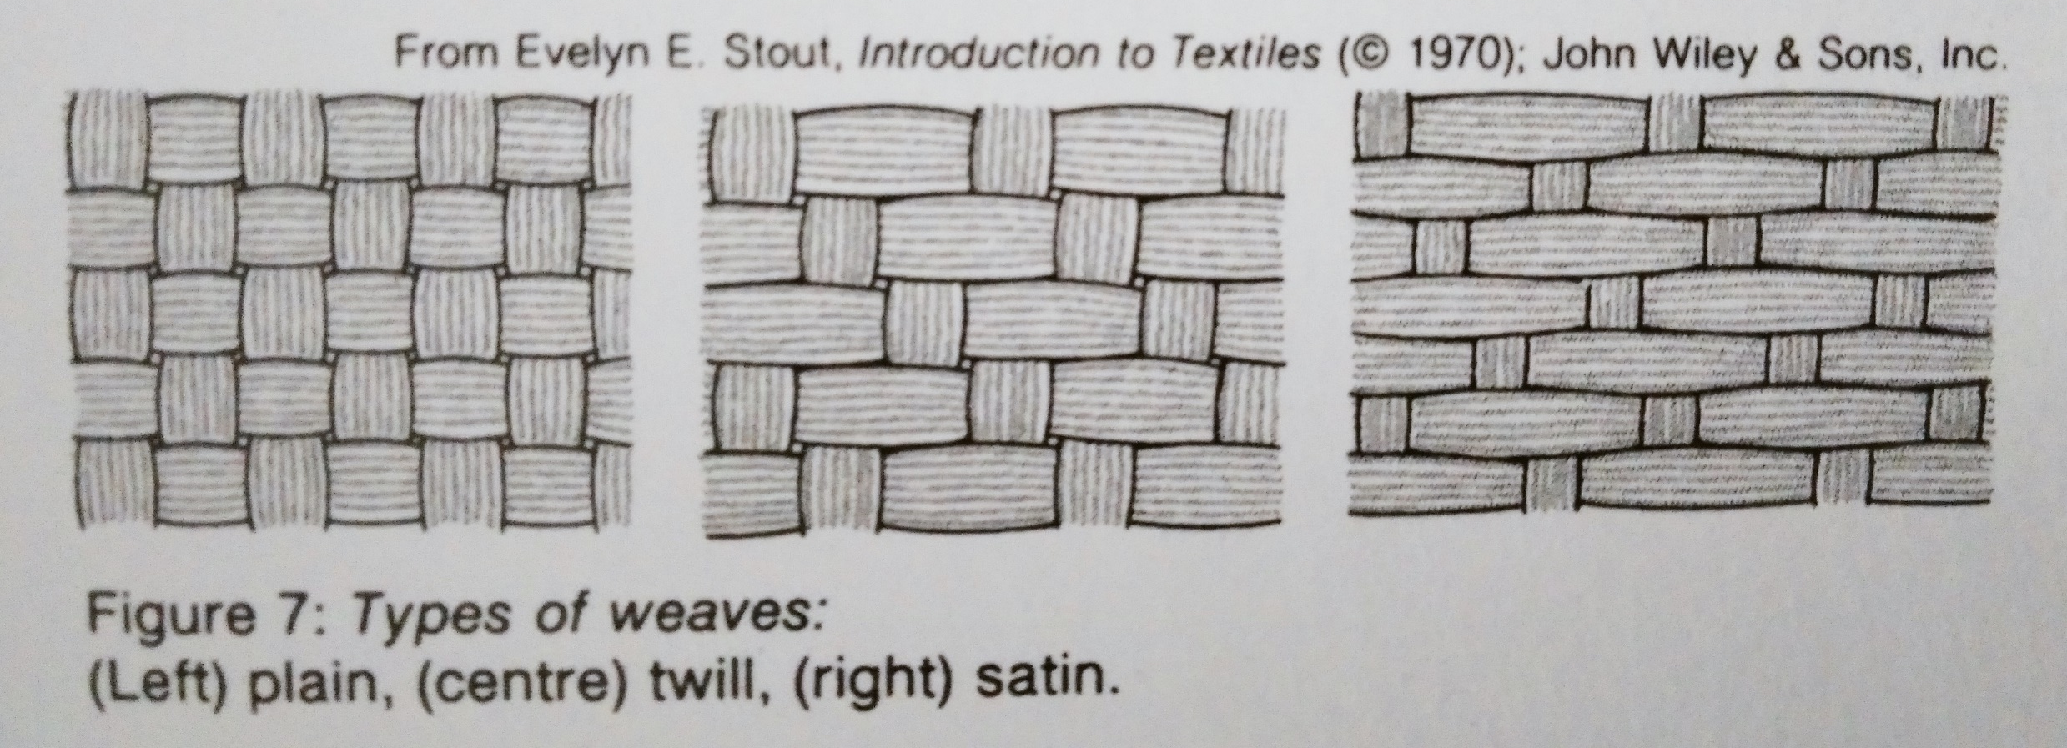
Natural fibres: wool, cotton, linen, silk, jute
Weaves: plain or tabby, twill, satin
Encyclopaedia Britannica, 15th edn, “Industries, Textiles”

Slide 4
Miscellaneous 18c textile terms
‘worsted’ = a high-quality wool used for weaving
‘fustian’ = a general term for the many types of fabric made of linen warp and cotton weft
‘Irish stuff’ = a fabric with silk warp and worsted weft
‘damask’ = silk patterned by alternating between a warp-faced and a weft-faced weave
From Anne Buck, Dress in Eighteenth-Century England (1979)

Slide 5
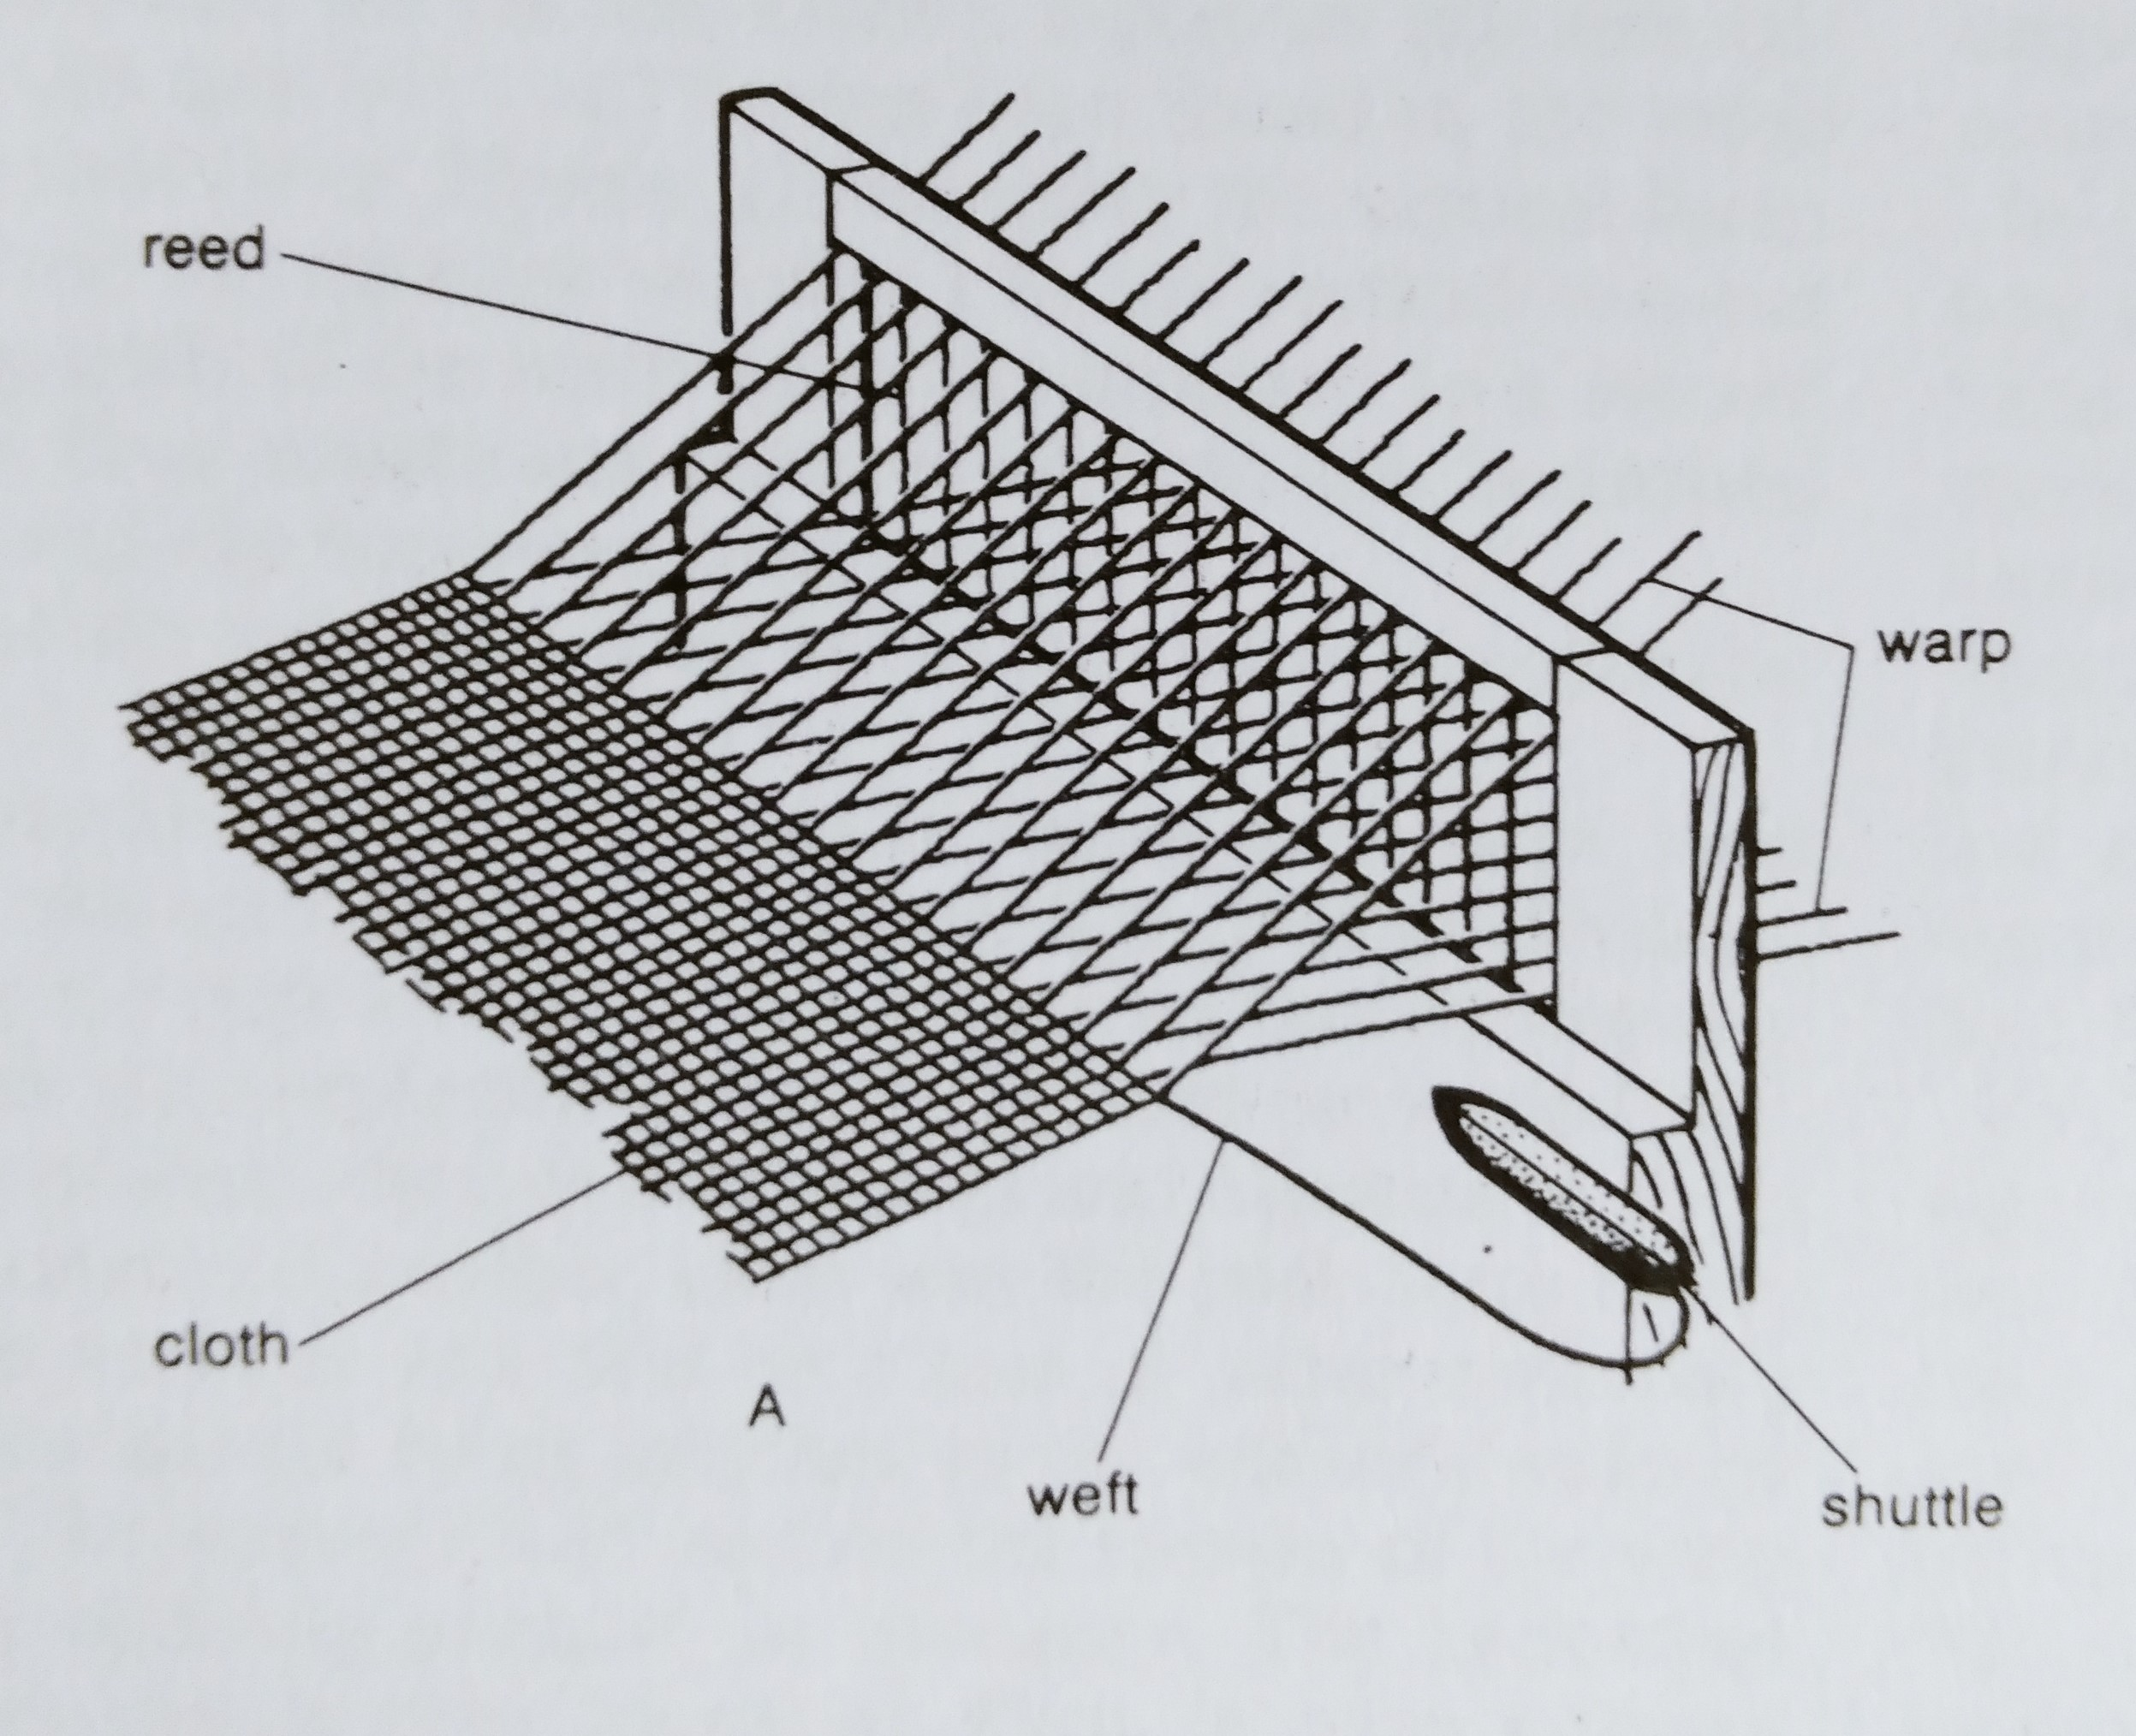
1733 – flying shuttle for speeding up movement of shuttle (John Kay)
1785 – power loom (Edmund Cartwright)
1801 – Jacquard attachment (Joseph-Marie Jacquard) for better automating of ‘shedding’ process
Generic diagram of loom for making textiles
Encyclopaedia Britannica, 15th edn, “Industries, Textiles”

Slide 6
Neil McKendrick, John Brewer, and J. J. Plumb, The Birth of a Consumer Society: the Commercialization of Eighteenth-Century England (1982)
John Brewer and Roy Porter, eds., Consumption and the World of Goods (1993)
Maxine Berg, Luxury and Pleasure in Eighteenth-Century Britain (2005)
Frank Trentmann, ed., The Oxford Handbook of the History of Consumption (2012)
Serena Dyer, Material Lives: Women Makers and Consumer Culture in the 18th Century (2021)

Slide 7
Aspects of 18th century consumption
market integration
marketing
consumer agency
shopping
fashion
consumer-driven globalization
consumer-driven industrialisation
→ material evaluation?

Slide 8
What did it mean to be an ‘Enlightened’ consumer?
How was consumption related to production and evaluation?
What might it mean to say that material evaluation was ‘gendered’?

