Slide 1
Mineral waters and the growth of towns
HI3T5
Week 2.7 2025
Michael Bycroft

Slide 2
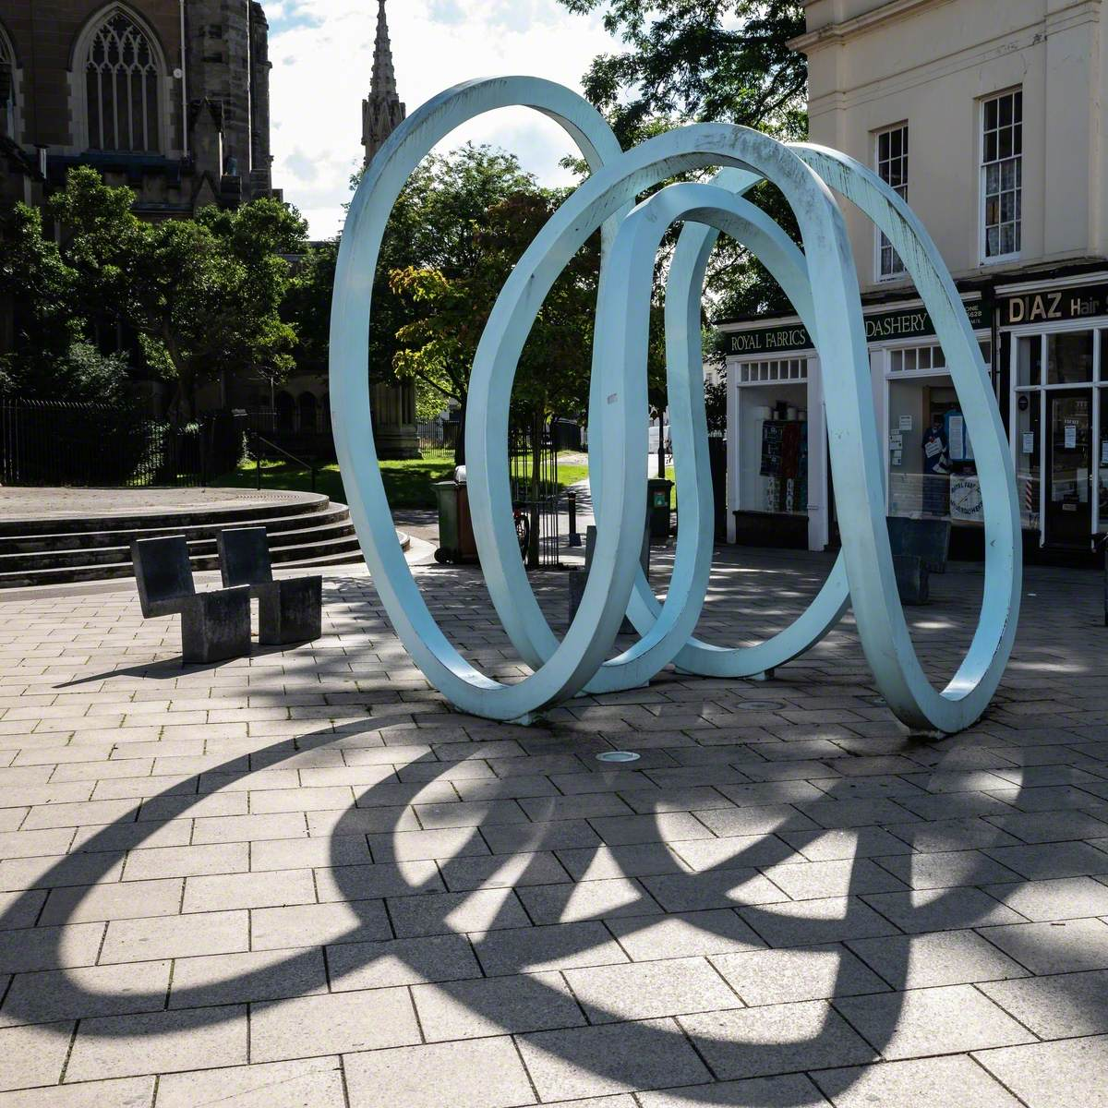
‘Spring,’ by Oliver Barratt, on the site of the Old Well, a source of mineral waters first recorded in 1480

Slide 3
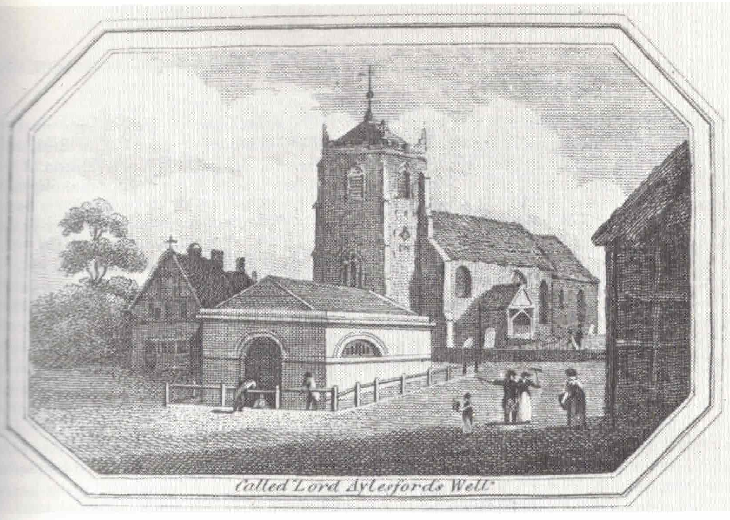
Lord Aylesford’s Well, a.k.a Old Well, with the stone building erected in 1803 and replaced in 1813. Parish church in background.
Reproduced from Cave, Royal Leamington Spa (1988).

Slide 4
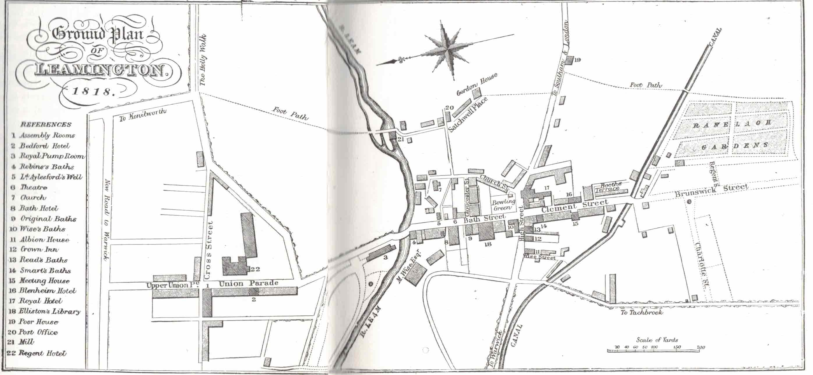
Ground plan of Leamington, from Spennell’s Directory, 1890. Reproduced from Cave, Royal Leamington Spa (1988).
In the references, ‘Ld Aylesford’s Well’ is the original spring known since 1480; ‘Original Baths’ is the first well used commercially, discovered by Abbotts in 1784.

Slide 5
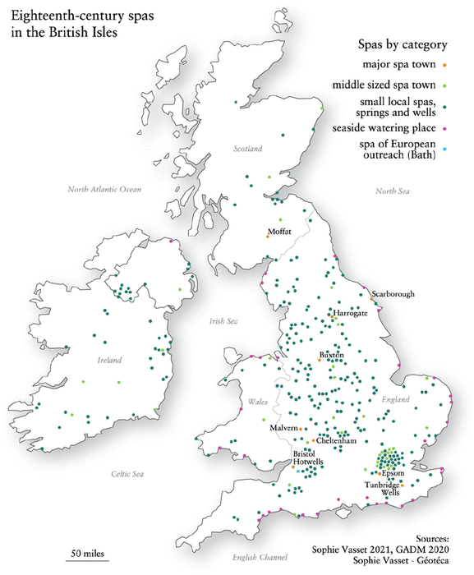
St. Peter, a.k.a Peterhead
Royal Leamington Spa,
formerly Leamington Priors
Bath
Spa towns in the British Isles in the long eighteenth century
From Vasset, Murky Waters (2022)

Slide 6
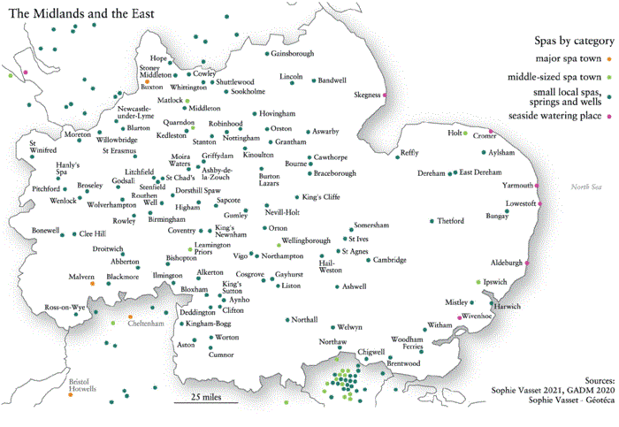
Spa towns in the Midlands and the East in the long eighteenth century
From Vasset, Murky Waters (2022)

