Slide 1
Air and Social Reform
HI3T5 week 2.8
Dr. Michael Bycroft

Slide 2
https://www.youtube.com/watch?v=tyhWF1EYtok

Slide 3
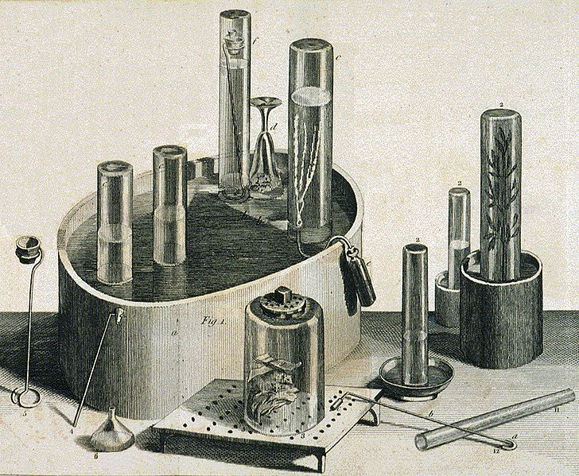
Pneumatic trough, from Joseph Priestley, Experiments and Observations on Different Kinds of Air (1775)

Slide 4
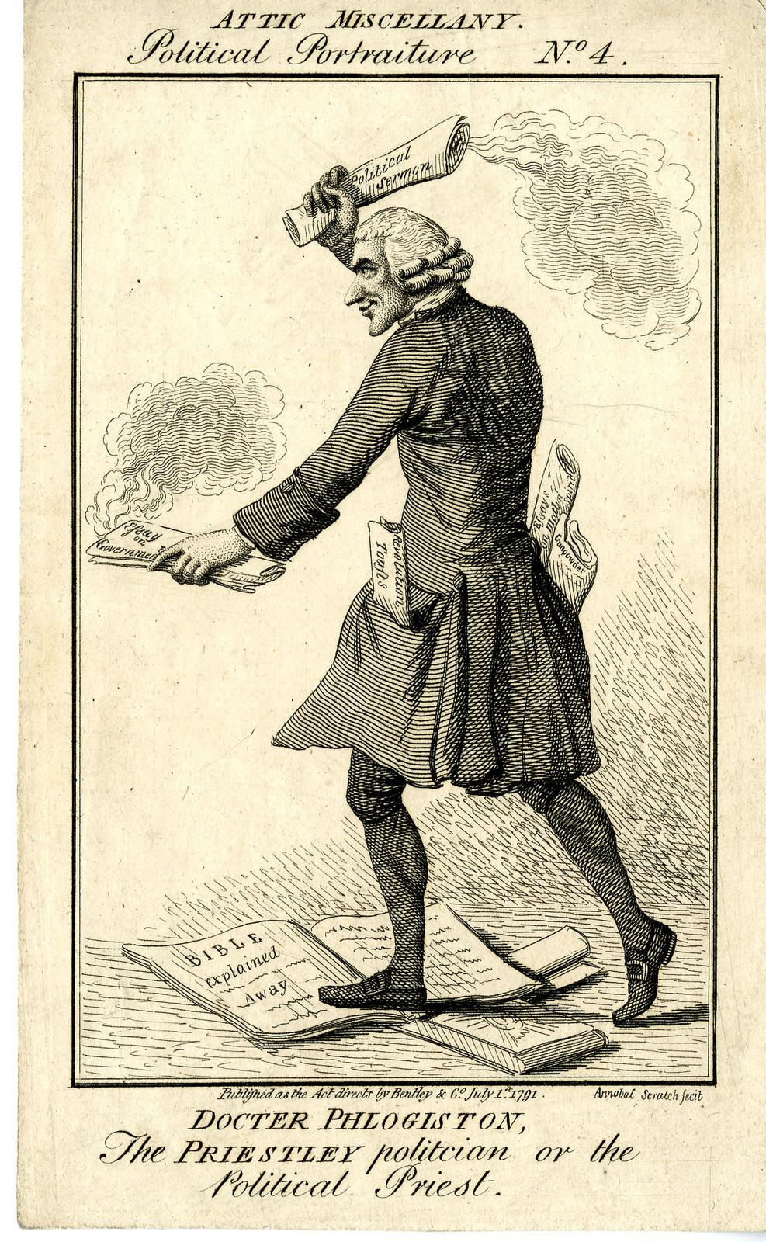
“Doctor Phlogiston, the Priestley Politician or the Political Priest,” July 1791

