Slide 1

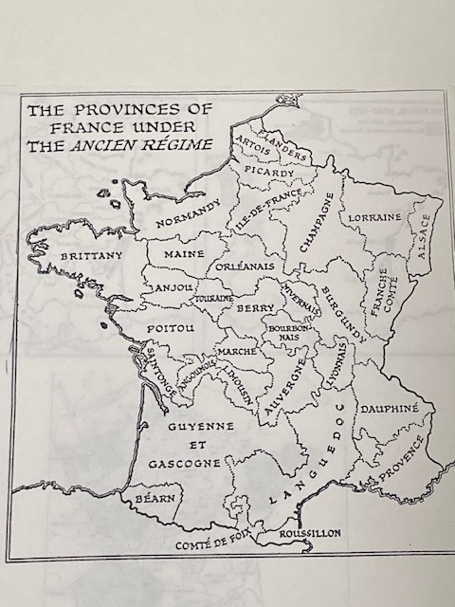
Sixteenth-century France

Slide 2
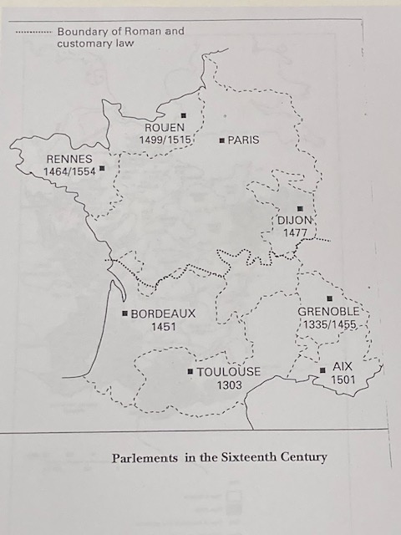
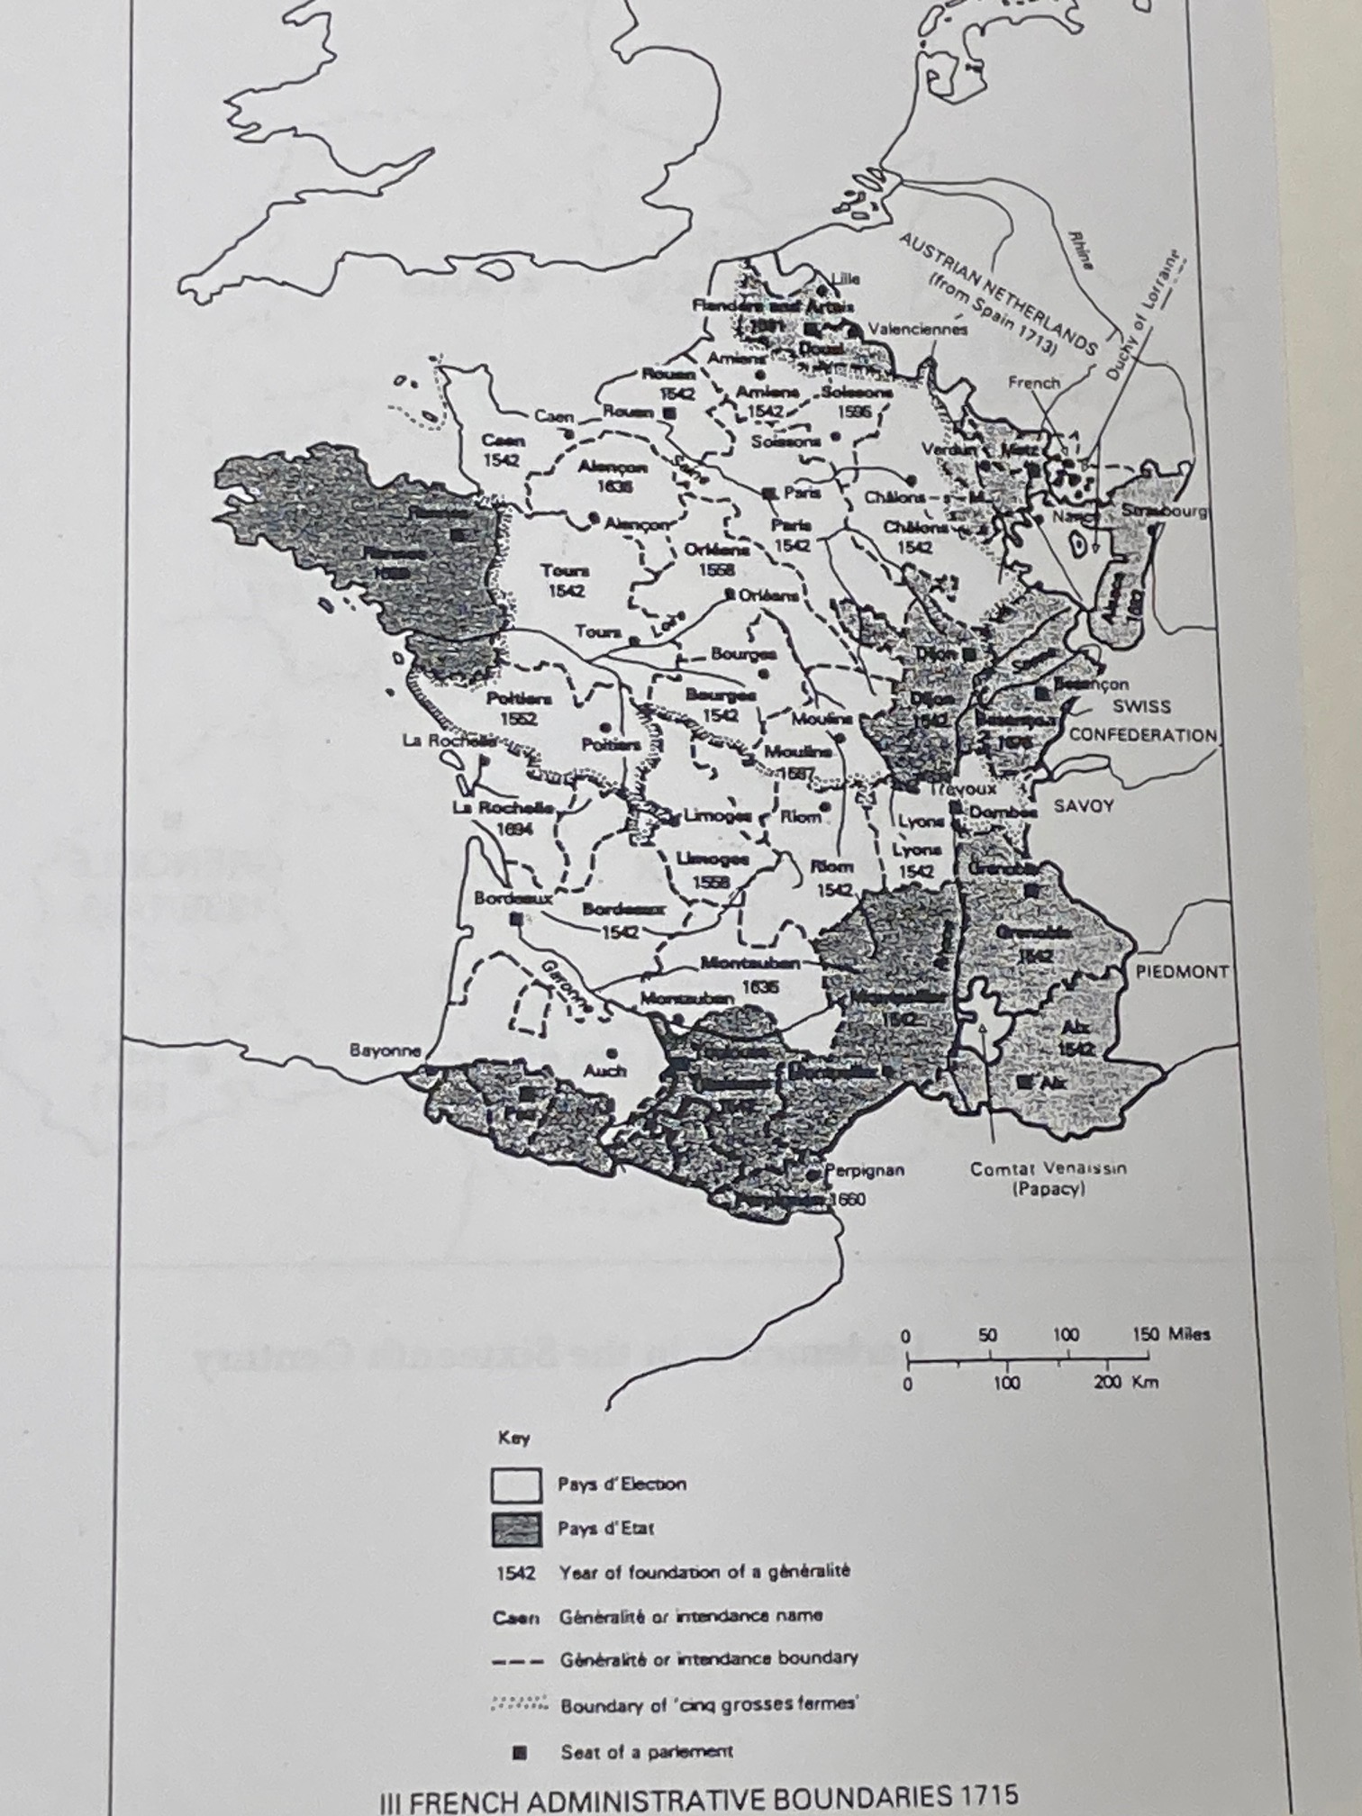

Slide 3
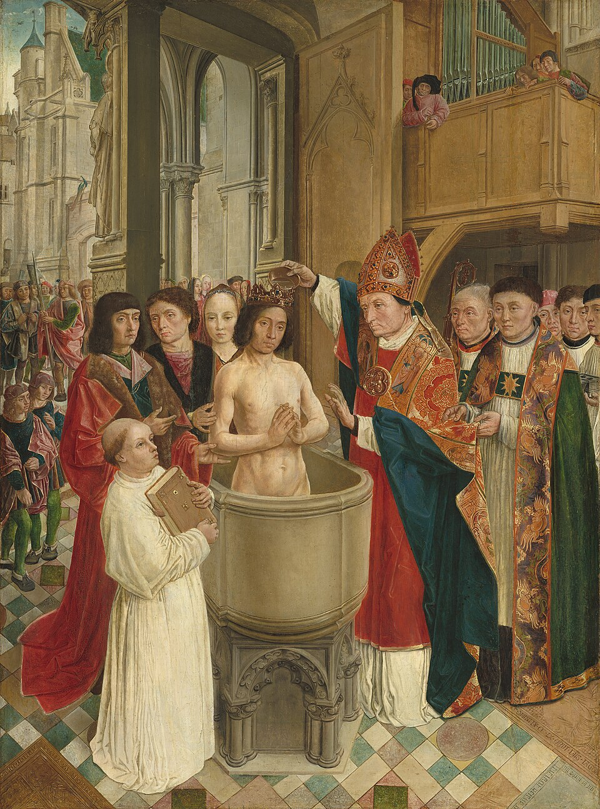
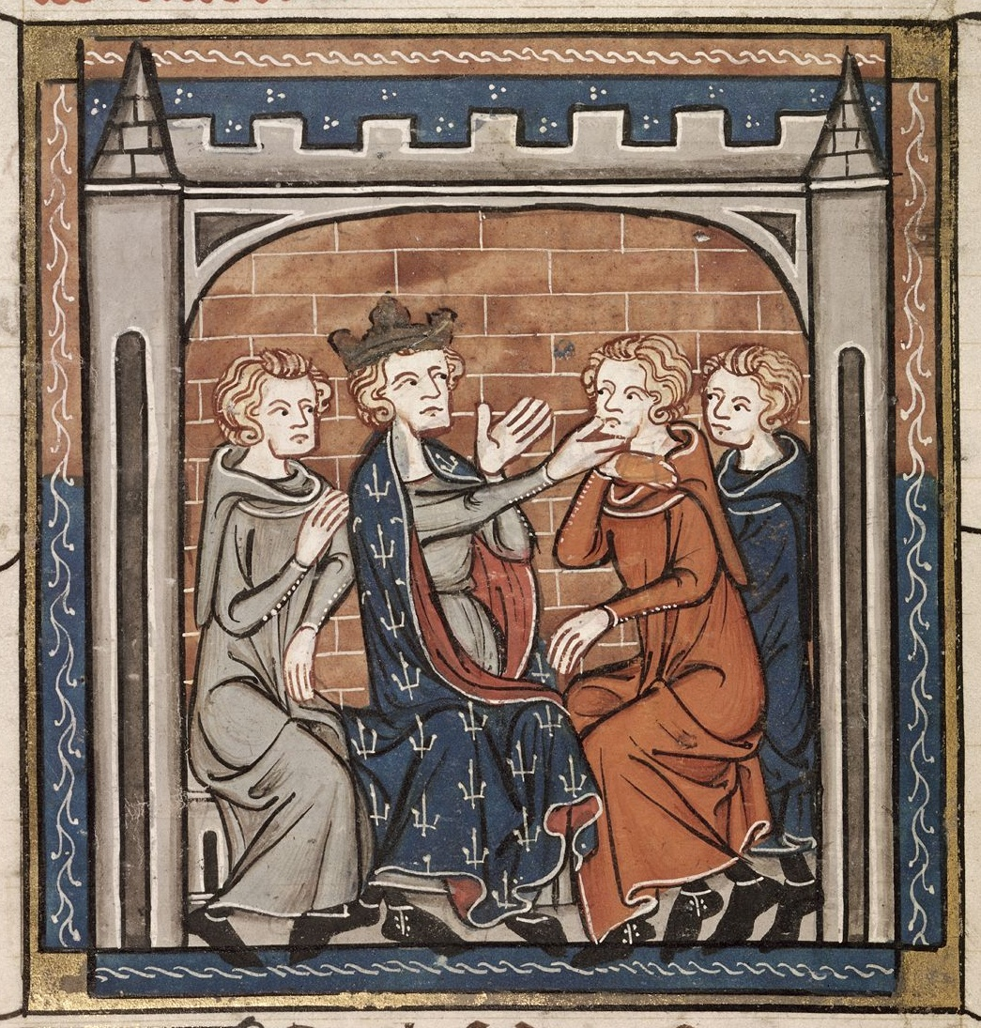

Slide 4
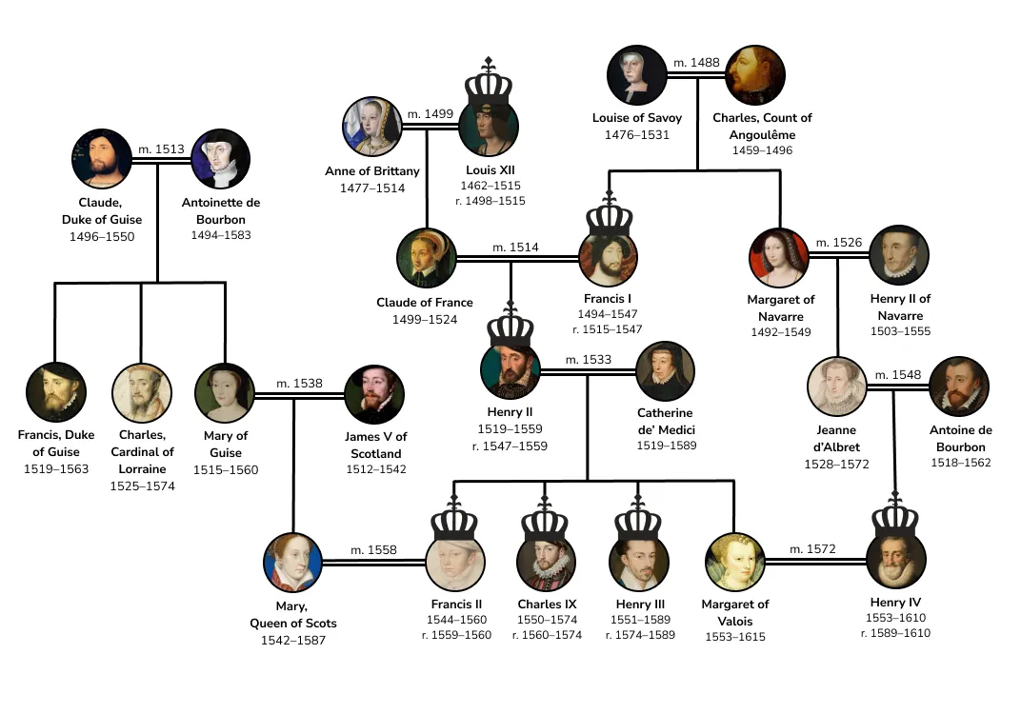

Slide 5
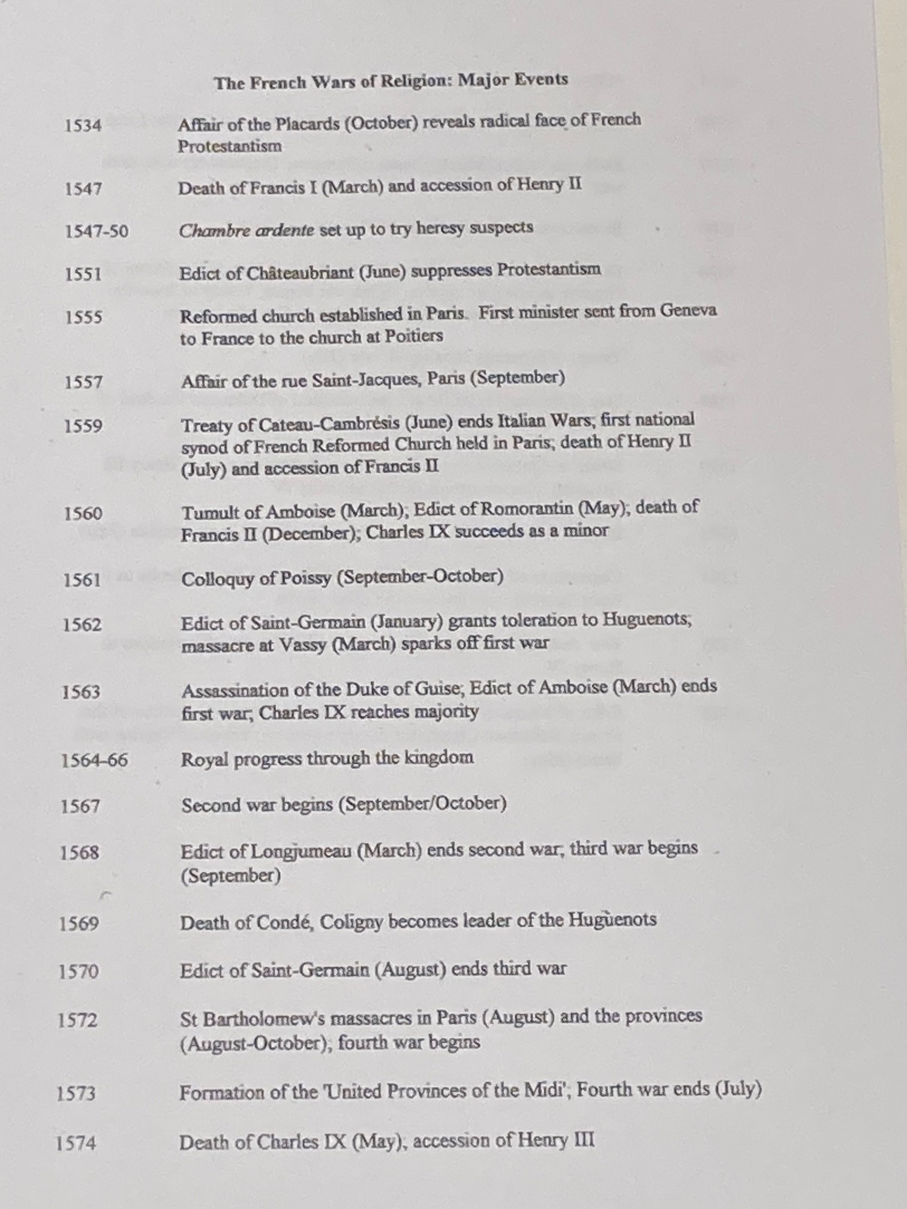
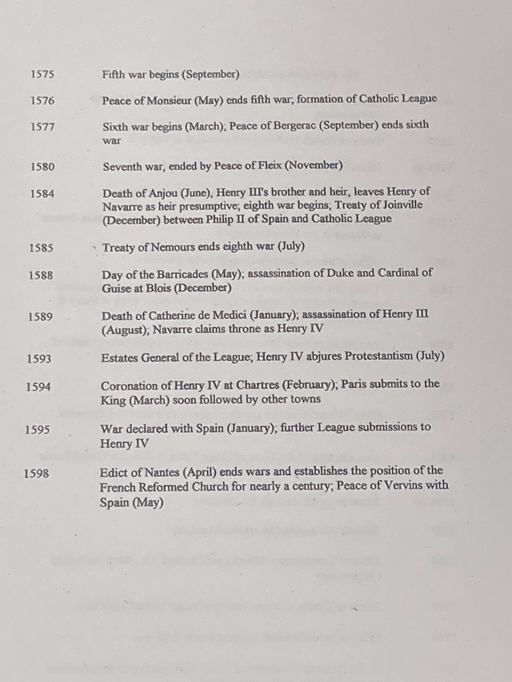

Slide 6
Royal edicts dealing with religious affairs before and during the wars
June 1540 Edict of Fontainebleau: removed jurisdiction over heresy cases from ecclesiastical to secular courts
June 1551 Edict of Châteaubriant: removed sole jurisdiction over heresy cases to parlements; tightened censorship; reporting of suspects mandatory; restricted office-holding to Catholics
July 1557 Edict of Compiègne: made death penalty for heresy mandatory
Mar. 1560 Edict of Amboise: pardon of all religious crimes on condition of abjuration
May 1560 Edict of Romorantin: returned jurisdiction over heresy to church courts
Apr. 1561 Edict of Fontainebleau: banned mutual abuse and provocation; provided amnesty for religious prisoners & exiles; permitted freedom of conscience
July 1561 Edict of Saint-Germain/July: confirmed earlier measures, sedition now to be judged by presidial courts; Reformed assemblies banned
Jan. 1562 Edict of Saint-Germain/January: permitted Reformed worship for 1st time, outside town walls in daylight hours
Mar. 1563 Edict of Amboise: first edict of pacification (ending a war); Reformed worship restricted to noble houses and suburbs of one town in each bailliage/sénéchaussée
Mar. 1568 Edict of Longjumeau: confirmed 1563 Edict
Sept. 1568 Edict of Saint-Maur: abolished edicts of pacification

Slide 7
Aug. 1570 Edict of Saint-Germain: Reformed worship allowed in suburbs of 2 designated towns in each gouvernement; 4 surety towns granted
July 1573 Edict of Boulogne: limited restoration of worship
May 1576 Edict of Beaulieu/Peace of Monsieur: freedom of worship except within 2 leagues of Paris & at court; allowed to build temples; chambres de l’édit established in parlements; 8 surety towns granted
Sept. 1577 Edict of Poitiers/Peace of Bergerac: Reformed worship restricted to suburbs of one town in each bailliage/sénéchaussée; chambres and surety towns retained
Feb. 1579 Treaty of Nérac: confirmed 1577 Edict with additions
Nov. 1580 Peace of Fleix: confirmed 1577 Edict and 1579 Treaty with additions
July 1585 Treaty of Nemours: between Henry III and the Catholic League, abolished edicts of pacification; Reformed faith banned
July 1588 Edict of Union: confirmed 1585 Treaty
July 1591 Letters of Mantes: restored 1577 Edict and 1579/80 additions
April 1598 Edict of Nantes: confirmed and expanded edicts

