Slide 1
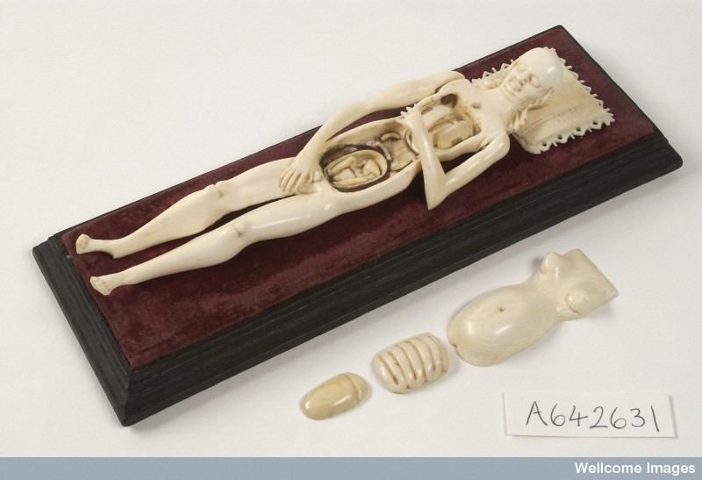
The Global Past of ‘Parts’ and ‘Wholes’
Roberta Bivins Centre for the History of Medicine University of Warwick

Slide 2
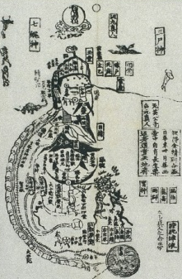
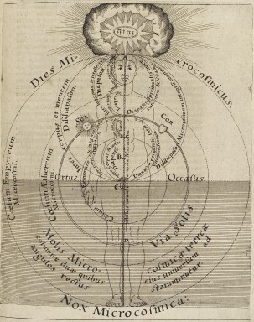
Mapping the Body, Mapping Society
Li Jiong, Canon of Eighty-One Problems… c.1436. Courtesy Wellcome Library London
Robert Fludd Microcosm Historia…, 1619
Courtesy Wellcome Library, London
Notes:
L0038056 Credit: Wellcome Library, London
Illustration from Robert Fludd's 'Microcosm historia ...' depicting a human figure within the microcosm. A string extends from God to Earth, and the three realms of the empyrean, ethereal and elemental correspond respectively to the head, the thorax and the abdomen.
Engraving and text c. 1619
From: Tomus secundus ... de supernaturali, naturali, praeternaturali et contranaturali microcosmi historia, in tractatus tres distributa. [Tomi secundi tractatus primi, sectio secunda, de technica microcosmi historia. Tomi secundi tractatus secundus, de praeternaturali utriusque mundi historia]
By: Robert Fludd
Published: For J.T. de Bry, by H. Galler ; Frankfort, E. Kempffer, for J.T. de Bry, 1619-1621Oppenhemii The metaphysical, physical, and technical history of the two worlds, namely the greater and the lesser
Fifteenth century Chinese woodblock illustration from the Daoist Canon (<I>Daozang</I>), showing the internal topography or inscape (<I>neijing</I>) of the human body according to Daoist teachings. Extracts from Daoist texts are incorporated into the design (see 'Lettering'). Around the human figure are depictions of the Blue/Green Dragon (qing long), White Tiger (bai hu) and Red Sparrow (zhu que) and of Xuan Wu, God of the Northern Sky.
Woodcut and text
From: Library of Zhongguo zhongyi yanjiu yuan (China Academy for Traditional Chinese Medicine), Huang Di ba shi yi nan jing zuan tu jujie (Canon of Eighty-One Problems [in the Inner Canon] of the Yellow Lord with Illustrations and Exegesis)
By: Li Jiong
Published: Hanfen LouShanghai 1436-1449

Slide 3
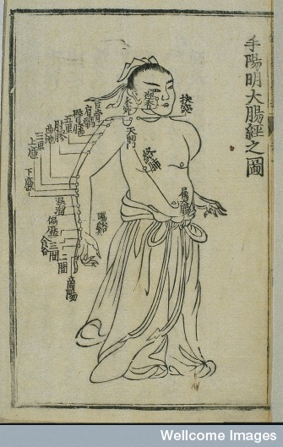
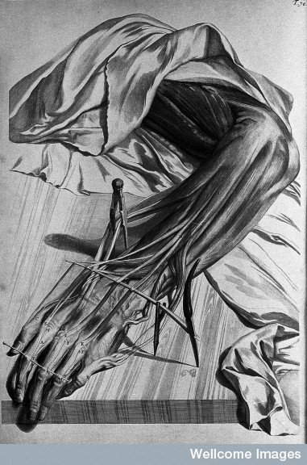
Exploring the interior

Slide 4
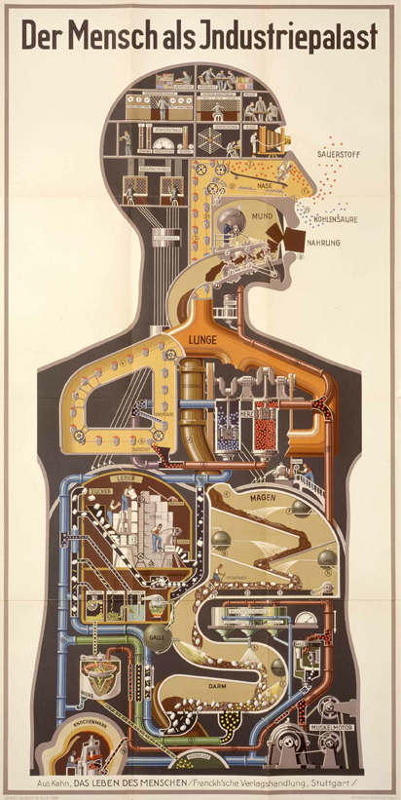
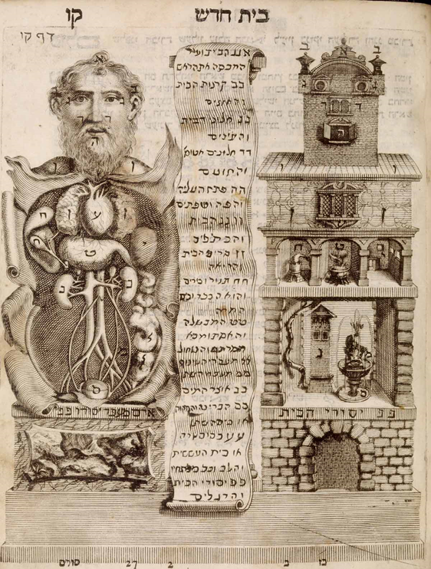
Building the Body-Machine
Toviyah Kats, Ma’a’seh Toviyah ( Work of Tobias, Venice, 1708). Courtesy National Library of Medicine, USA
Fritz Kahn, Der Mensch als Industriepalast (Man as Industrial Palace, Stuttgart, 1926) Courtesy National Library of Medicine, USA
Notes:
Ma’a’seh Toviyah
Venice, 1708. Woodcut. National Library of Medicine.
Toviyah Kats
(ca. 1652-1729)
[author]
This illustration from a Hebrew encyclopaedia pairs the interior of a human interior with the interior of a house, a visual metaphor: the organs, like rooms in a house, have different functions. Kats, one of the first Jews to study medicine at a German university, completed his degree at Padua and served as court physician to the Ottoman Sultan.
Figure 1. Der Mensch als Industriepalast (Man as Industrial Palace) (Stuttgart, 1926). From Fritz Kahn (1888–1968). Chromolithograph. National Library of Medicine USA, under fair use law. http://www.nlm.nih.gov/dreamanatomy/da_g_IV-A-01.html

Slide 5
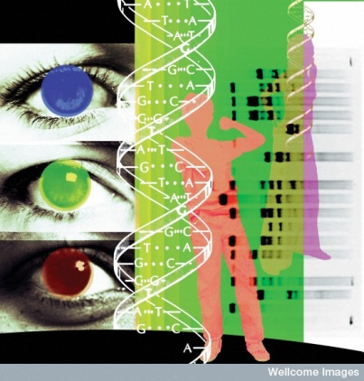
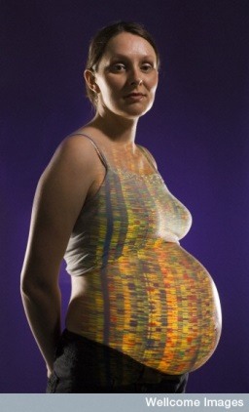
The Genomic Turn: Holism or Determinism?

