Slide 1
Life in the ‘Counting House’: Weighing up
Professor Roberta Bivins
Centre for the History of Medicine
University of Warwick
www.peopleshistorynhs.org

Slide 2
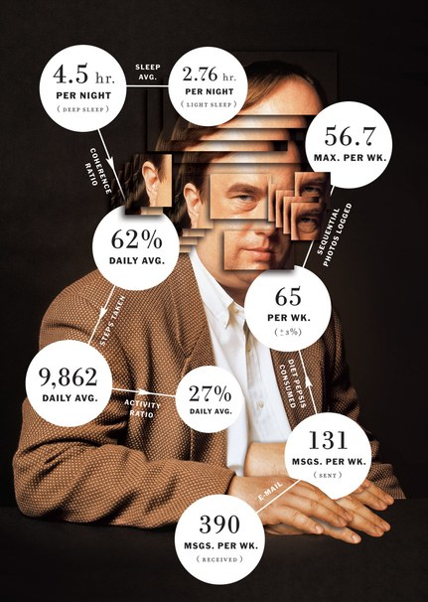
Situating the ‘Quantified Self’
In time
In space(s)
In society
In histories – of the body, of medicine, of science and of the household.
Vanity Fair, Feb 2013

Slide 3
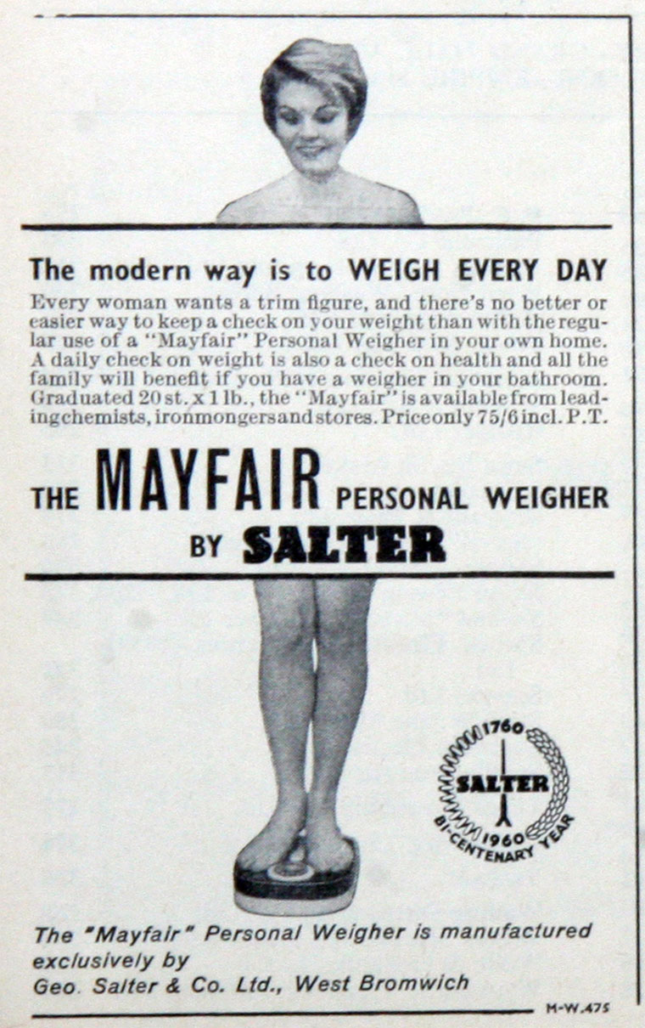
Case Study: Self-Weighing
‘The modern way is to weigh every day’? Birth of the bathroom scale
Time: c. 1840s to c. 1980s
Space(s): US and UK, public and private, domestic and scientific, medical and moral

Slide 4
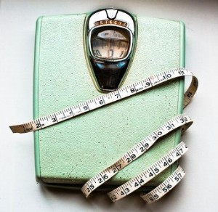
Questions
How did the bathroom scales get into the bathroom? In other words, how did the ‘surveillance medicine’ of public health become ‘self-surveillance’ medicine?
What happens to medical technologies when they become ‘domesticated’? Do their meanings, applications, or status change?

Slide 5
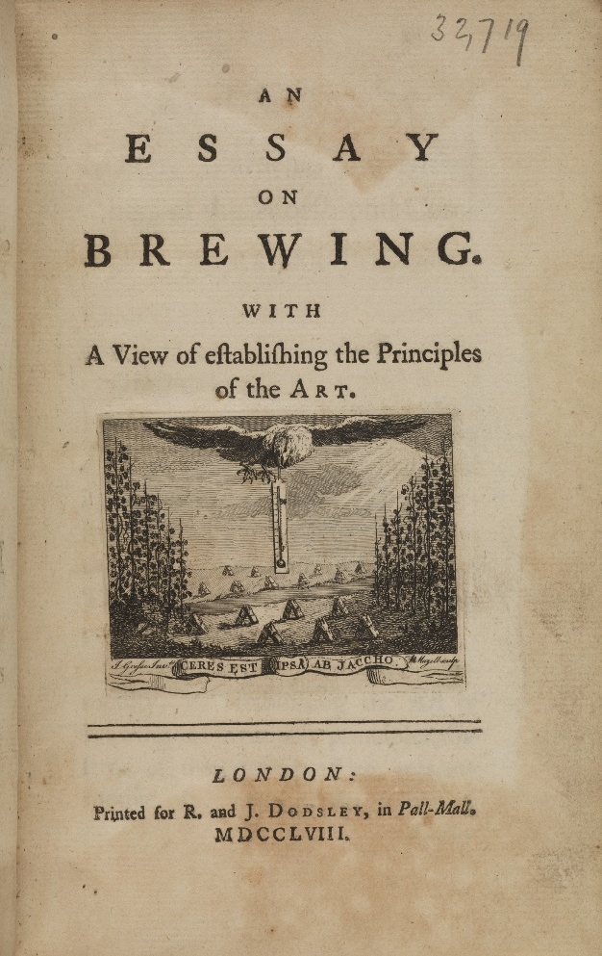
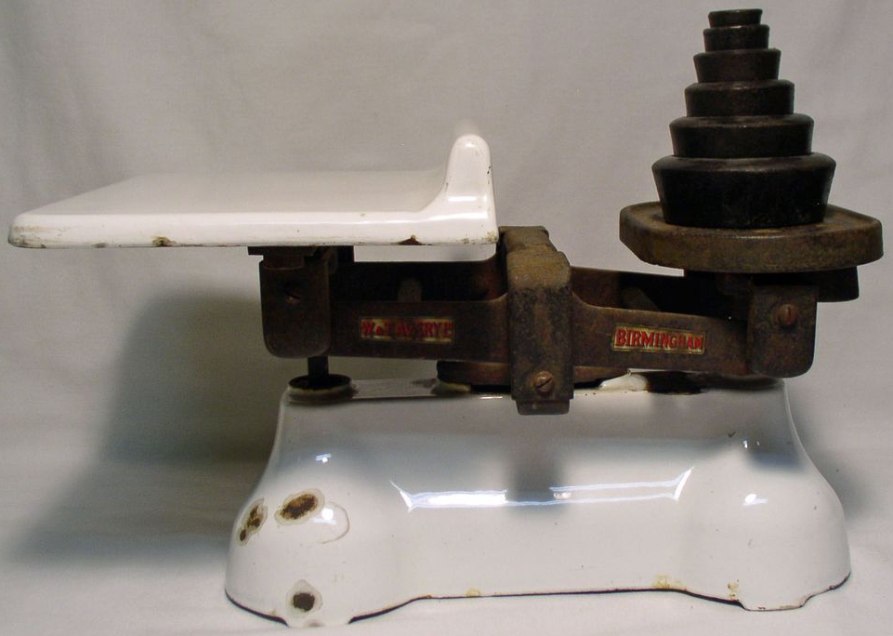
Cultures of Quantification: Domestic Measures
Sharp increase in exact measurement in the home, related to:
new technologies of both measurement and communication;
standardization of recipes, plans;
broadening of print culture to include wider audiences

Slide 6
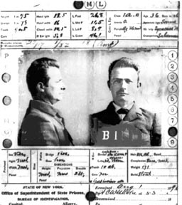
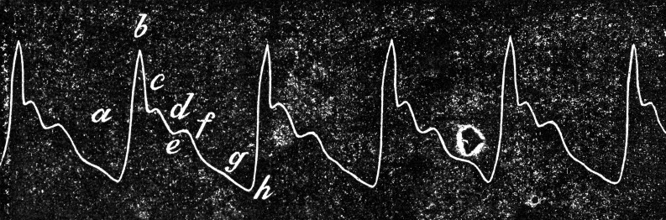
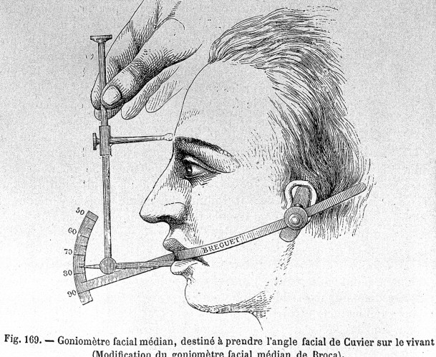
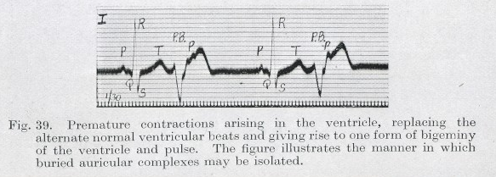
Context: Cultures of Quantification
Clockwise from top left
Bertillonage c. 1900s
Sphygmograph, 1882
Craniometry c. 1870s
Electrocardiograph, 1913
Notes:
Bertillonage, Craniometry, sphygmograph 1882, electrocardiograph 1913

Slide 7
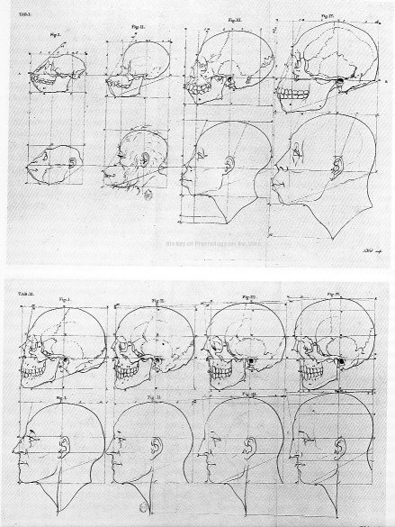
Context: Cultures of Quantification
Measurement comes to medicine with a vengeance in the 18th and 19th centuries
méthode numérique
méthode anatomo-clinique
Quantification is at the heart of these rapidly diffusing if controversial innovations.

Slide 8
The study of diseases and of the deformities, to which they give place, has shown the benefits derivable from corporeal measurements; but in order to recognise whatever is an anomaly, it is essentially necessary to have established the type constituting the normal or healthy condition.
Auguste Quetelet, 1830
Notes:
A. Quetelet, “Sur la Taille Moyenne de l’Homme dans les Villes et dans les Campagnes,
et sur l’Age ou la Croissance est Complètement Achevée,” Annales d’Hygiène Publique,
1830, 3 : 24 –26 quoted in Lawrence T. Weaver, ‘In the Balance: Weighing Babies and the Birth of the Infant Welfare Clinic,’ Bulletin of the History of Medicine, Volume 84, Number 1, Spring 2010, pp. 30-57.
See also J. Rosser Matthews, Quantification and the Quest for Medical Certainty (Princeton, N.J.:
Princeton University Press, 1995).

Slide 9
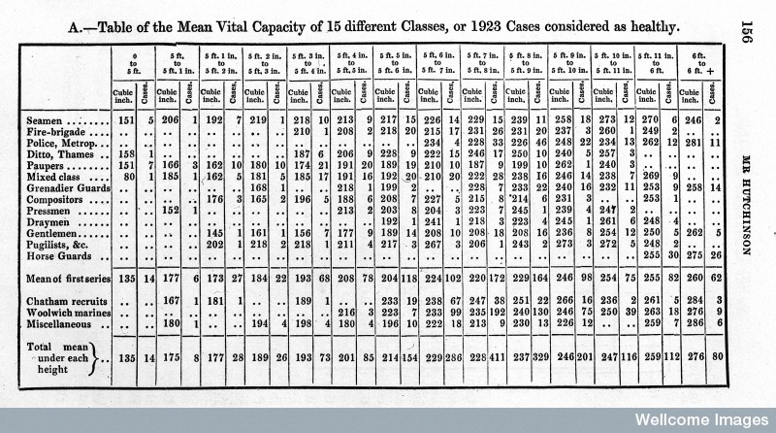
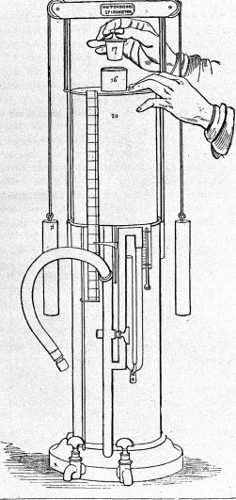
Medicine and Measurement
‘All we know is gathered from physical observation, through the medium of the senses … if a man breathe into the Spirometer …it requires no delicate training of the judgement …to come to a conclusion. Therefore, for the purposes of determining a fact, the Spirometer is ready and definite, without a long system of education.’
John Hutchinson, 1846

Slide 10
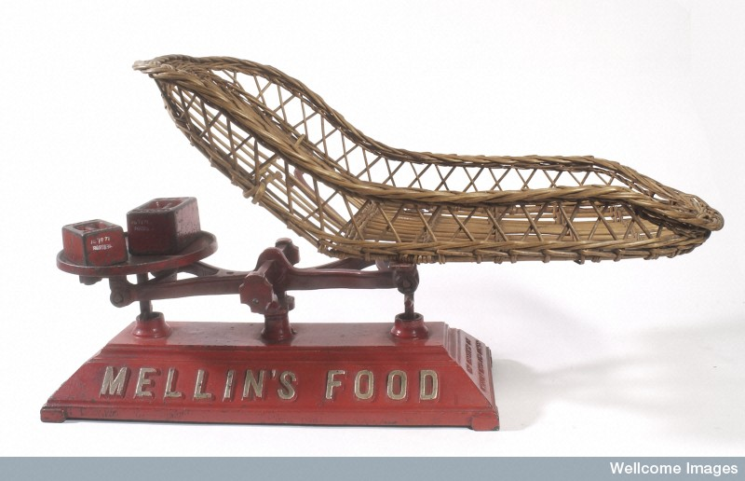
Domestically, these trends merges in a culture of infant – and then adult - gravimetric surveillance focused on weight/height ratios
‘The weight is an expression of the whole man – the volume of his make; a measure of his general health…’
John Hutchinson,1852

Slide 11
But when does this quantifying gaze turn on adults, and why?
‘There can be no doubt…that the majority of the more respectable inhabitants of Great Britain eat and drink twice as much as is beneficial’.
Graham, MD, Modern Domestic Medicine, 1827
‘[O]verweight universally shortens life. Overweight is a burden, not a reserve fund.’
Review of Reviews, London, 1909
But how to be sure?
‘[G]et accurately weighed at starting upon a fresh system, and continue to do so …it will arm them with perfect confidence in the merit and ultimate success of the plan.’
William Banting, Letter on Corpulence, 1864
Notes:
Obesity images, discussion of ‘normal’ and normative weights for adults. Role of war, insurance industry, role of the rag trade and industrialisation in establishing norms.

Slide 12
‘The doctors tell us…’: Medically guided self surveillance
One of the chief institutions of Carlsbad is the weighing machine …To be weighed is part of the day's ceremonial; a very precise invalid has himself weighed before breakfast and after dinner, and before going to bed at night. … His weight is registered solemnly in the proprietor's ledger, and checked by his own private records in his pocket-book. The fat man tells you how many pounds he has lost each day, and checks off the precise influence of the number of glasses of water he has drunk, and the number of kilometres which he has walked and differentiates, as he thinks, precisely the relative influence of water, diet, and exercise, on each day's change of weight. …’
Ernest Hart, ‘Spray from the Carlsbad Sprudel’ BMJ, 1887

Slide 13
Learning to Weigh for Health
‘[P]eople should adopt a new system in the way of albums, and record the histories of their own lives; … they should be taught – and you doctors will have to teach them – to watch themselves intelligently…’
‘I do not believe that we half appreciate the extreme value of the weighing machine in medicine. … the father of every family should have a good weighing maching in the house. Nothing will as soon tell him when his children are wrong as a fall in their weight or arrest of their increment of weight.’ Dr Frederick Akbar Mahomed, 1883

Slide 14
Exact vs Experiential Self-Surveillance
‘Obtain a weighing machine for the use of the household … the expense will be well repaid by the increased facility it gives of attending to and managing the health of children… the accuracy of public weighing machines cannot always be depended upon.’
Francis Galton, ed., Life History Album…Collective Investigation Committee of the British Medical Association, 1884.
‘I have not attended to the weighing but I am reduced in the waist about four inches. My appearance and feelings tell me I am sufficiently reduced; but what I am most thankful for is feeling so much better. I have quite lost that dreadful feeling of oppression and weight… M.H.’
Testimonial in F. Cecil Russell, Corpulency and the Cure, 18th edn, 1896

Slide 15
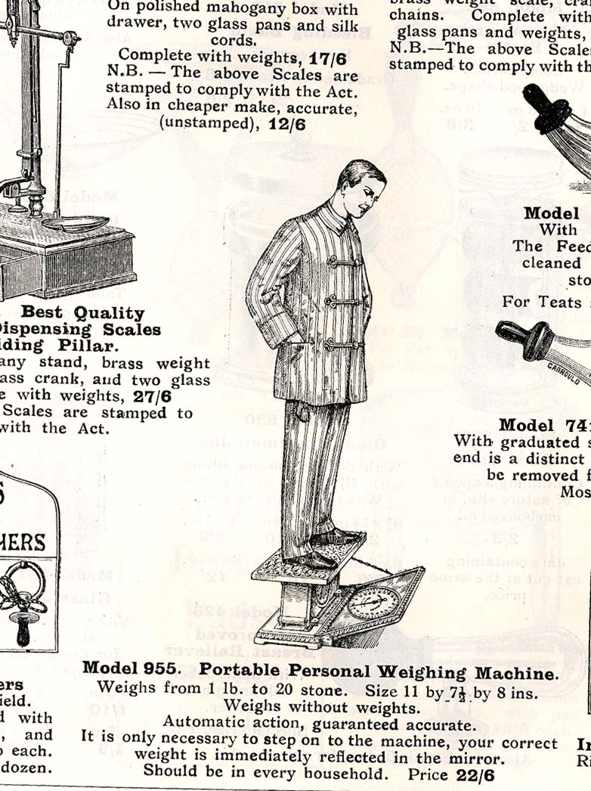
‘Should be in every [affluent] household’: selling health through the bathroom scale
‘The doctors tell us that we should frequently record our weight in order to judge the state of our health, and there is now on the market a personal weighing machine of extraordinary refinement which, for a penny in the slot, will instantaneously record personal weight and issue a printed ticket.’
‘W. and T. Avery, Ltd. A Good Year’, The Times, 25 July 1928
Garrold, 1911

Slide 16
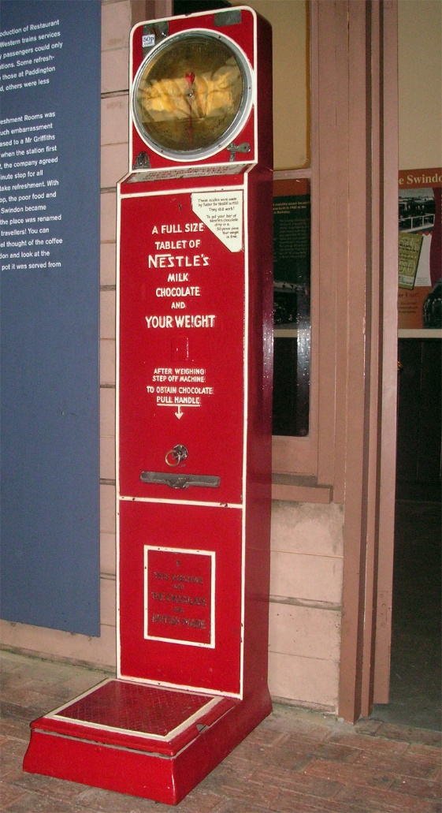
The Spaces of Self-Surveillance: For (Public) Pleasure
Platform Scales, 1933
Newmarket, 1939
Great Western Railway, 1933

Slide 17
‘that subject of inexhaustible interest – us!’
‘The number of weighing machines on our piers and promenades and railway platforms, in chemists’ shops and fun-fairs and snack bars is as large as, if not larger than ever it was, and some of them seem, like telephone kiosks, to be permanently occupied… When customs are truly rooted in the hearts and lives of the people they need no subsidy for their survival. … The child who in the first months of life is cradled on the scale, whose every ounce is charted with loving care, is father to the man who waiting on a train on any platform anywhere cannot resist the lure of the weighing machine … It is cheap … if it tells the slimming maiden that she has lost an ounce, she will not grudge the coin and if it warns the corpulent merchant that he has put on another pound or two, well he is getting more for his money.’
‘Old English Custom’, The Times, 16 August 1956

Slide 18
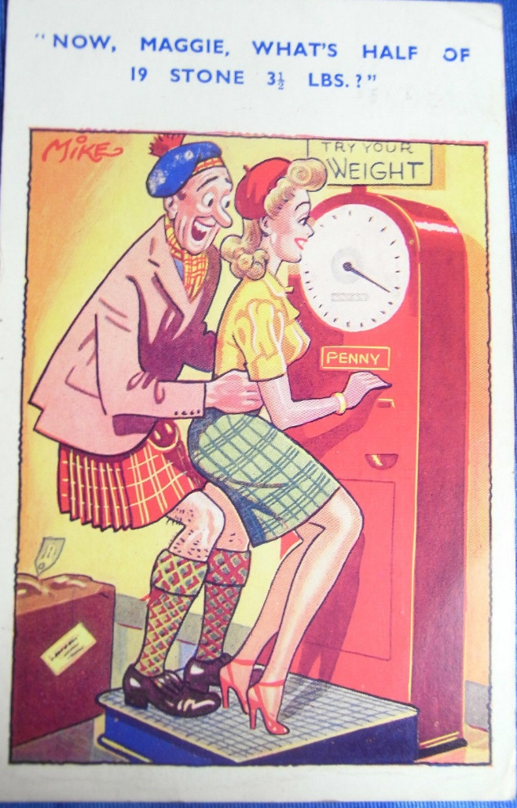
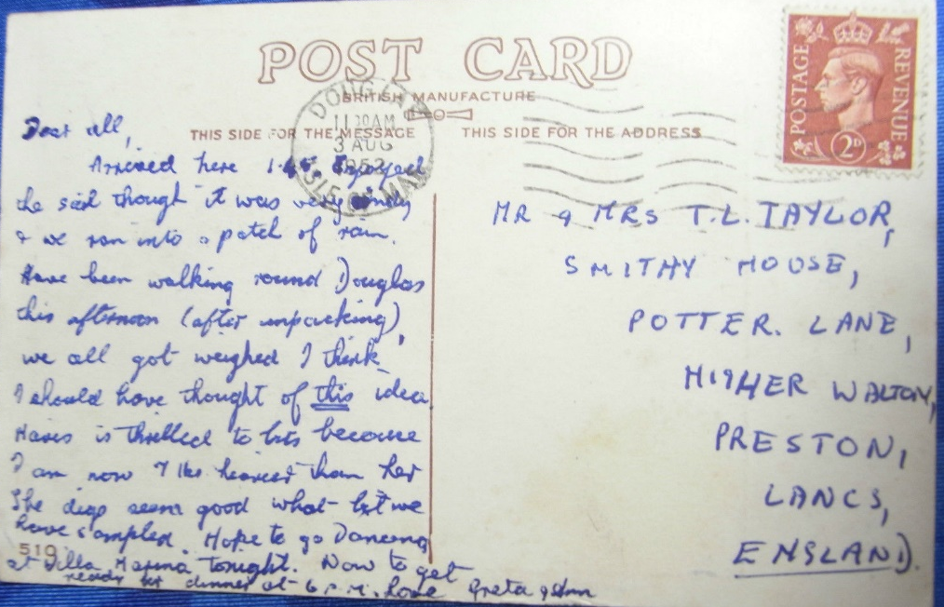
Social Pressures and Self-Surveillance
‘I should have thought of this idea. [M.] is thrilled to bits because I am now 7 pounds heavier than her.’ Greta, 3 August 1952

Slide 19
The Spaces of Self-Surveillance: For Health
Express, London, 1936
Treherbert, Wales 1930s
Notes:
3rd October 1936: The 'Robot Doctor', a machine on display at an exhibition at Central Hall, Westminster. The machine is designed to measure a person's state of health by measuring their heartbeat in relation to their weight and height. (Photo by London Express/Getty Images)

Slide 20
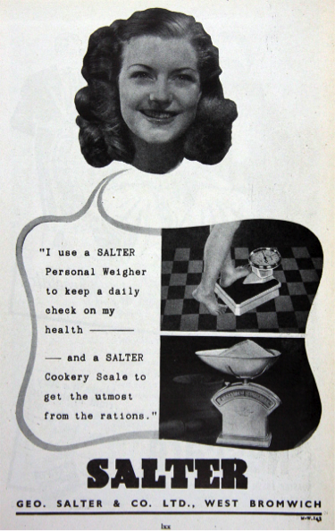
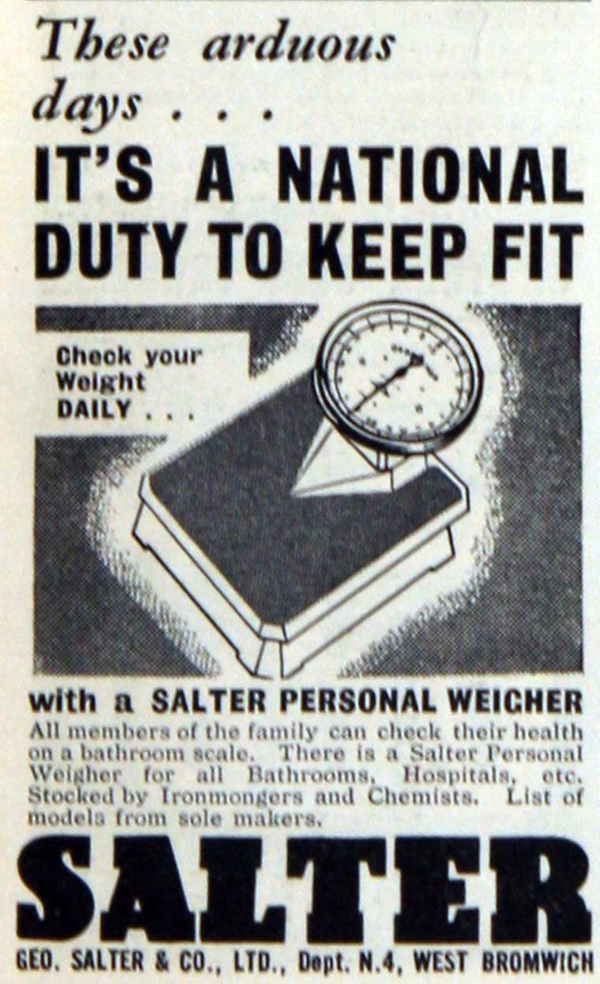
Private Measuring, Public Duty: ‘It’s a National Duty…’
Salter Scales 1947: ‘All members of the family can check their health on a bathroom scale…’→

Slide 21
Secrecy and the Scales
‘[I]t so happens that we keep our weighing-machine in the bathroom. In fact the scales make a fair bid to be the most irresistible fitting for the attention of our guests…We have even known visitors make the most unconvincing excuses for slipping upstairs to weigh themselves. It is all such a deadly secret. None of these women will ever admit to doing it, let alone divulge what the pointer said. …Not that we mind offering our guests any service that would cost them a penny elsewhere, but we do so wish that they would accept the truth more cheerfully. They persist in thinking that the pointer has swung irresponsibly beyond the proper mark, so most of them then jump up and down on the platform to see if the result can be coaxed-back nearer their conception of ideal womanhood.’
‘In England Now’, Lancet, 30 December 1961

Slide 22
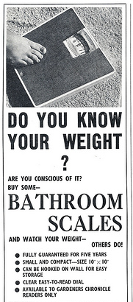
‘Watch your weight – others do!’
'Firstly, there is the general feeling that the slim person personifies the attractive person in our society... Secondly ... there is also the feeling that society caters more effectively for the relatively slim person... Thirdly there is the health factor. Some women have been told by their doctors to lose weight ... there was, however, virtually no specific indication of specific illnesses associated with weight. When probed people referred more to the straightforward issues of the effects of weight itself on mobility -- it was a strain on your legs or a strain on the heart. There were one or two suggestions that one was more susceptible to illness if overweight and also an occasional reference to heart disease.
For women probably the health factor is the least motivating for slimming, particularly amongst the young. However, when their attitudes to overweight in their husbands is [sic] examined the issue is very different. They seem less concerned with the aesthetic picture … but they were concerned about the effect upon his health. They felt he should get rid of weight because he was jeopardising his health.’
Background Study on Slimming Mass-Observation Ltd 1968
Gardeners’ Chronicle, UK 1966 →

Slide 23
Successful Slimmers, Weight Watchers and Unsuccessful Slimmers
‘Unsuccessful Slimmers’: ‘needed some specific goad such as problems with clothes, unkind remarks, prospect of holidays’;
'greater reliance on special diets, diet foods, etc.'
‘It was not simply a question of being larger than they wanted, but, almost more important, that their bodies were no longer the shape they wanted.’
‘Successful Slimmers’: ‘precisely defined goals’; ‘I just cut down from time to time and lose the 4 or 5 lbs. that cause the trouble’ ‘When I get to 10 stone I diet to 9 stone 4 lbs. and then I do a day a week to keep it that way.’
‘Weight Watchers’: ‘Another important aspect of weight-watching was that it was an activity carried out on behalf of whole families as well as individuals. Weight conscious women were often conscious of weight problems … in their husbands and their children, and their overall family catering was influenced by dietary considerations …“I watch my weight all the time. I try to keep to the right weight for my age and size.”
All, Background Study on Slimming Mass-Observation Ltd 1968

Slide 24
So: ‘Domesticated medicine’ or ‘Medicalised homes’?

Slide 25
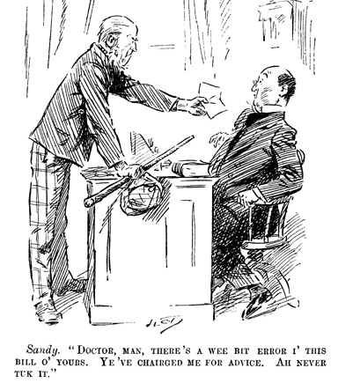
Health decisions and health consumers in the modern household

Slide 26
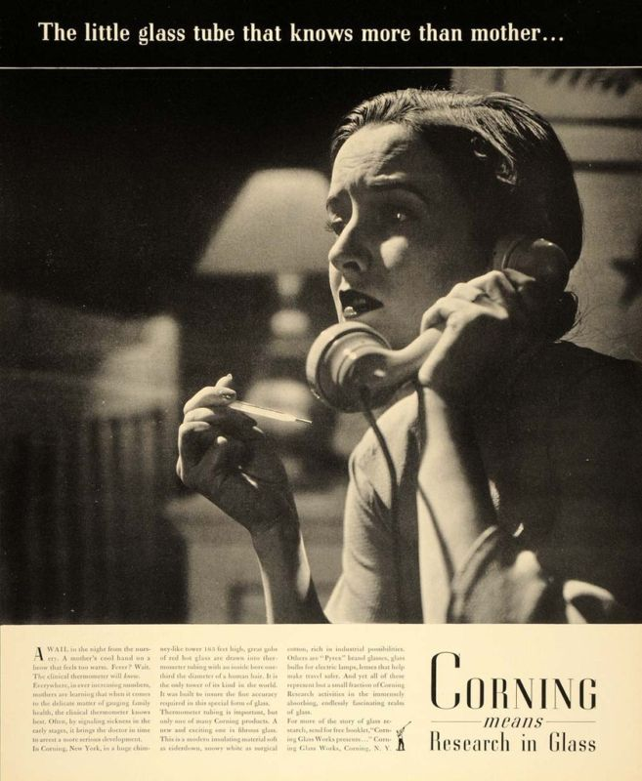
Called into question?
‘A wail in the night from the nursery. A mother’s cool hand on a brow that feels warm. Fever? Wait. The clinical thermometer will know. Everywhere, in ever increasing numbers, mothers are learning that when it comes to the delicate matter of gauging family health, the clinical thermometer knows best. Often, by signalling sickness in the early stages, it bring the doctor in time to arrest a more serious development…’

Slide 27
Empowered to argue?
‘Four-foot-ten Mrs. A., who tips the scale at twenty-two stone … was getting the bad news from a British Railways weighing-machine … when she noticed that the instrument bore a chart giving average weights for height and age. Simple extrapolation of these data revealed that, with her weight and age, she should be eight feet tall, and she therefore claims to be in fact a dwarf and that Dr. X. should have treated her for vertical undergrowth rather than for circumferential overgrowth. … Dr. X. … admitted failing to reduce her weight and invited suggestions for dealing with a woman whose usual elevenses consisted of a pound-and a-half of chips and a bottle of invalid port, and who, because her pills were labelled “before meals”, always insisted on taking a meal after them.’
‘In England Now’, Lancet (21 Jan., 1961),

Slide 28
Confused and Frustrated?
“Well the article said very specifically that you can eat as much butter and cream as you like but my doctor has said that you must cut down on these -- you just don't know what to do.”
“You see a new idea and you think, ‘it might work’ and ‘it must have helped some people or they wouldn't print it’.”
“No two ‘experts’, even if they'd were doctors seemed to give the same advice.”
All, Background Study on Slimming Mass-Observation Ltd 1968

Slide 29
Medical advice ‘prestigious’ but irrelevant?
‘It has been indicated that those who try to slim have fairly good knowledge, particularly as concerns food consumption, of what they should do. The sources from which this information is obtained are of obvious interest. The present study confirms that there is a wide spread of sources of information, which include advertisements, articles, advice from the doctor, and advice from friends and relatives. The suggestion that a substantial quantity of advice comes directly from the doctor must however, be viewed with some suspicion, and perhaps regarded as something of a prestige answer. The indication is that weight reduction is widely discussed between friends and relations, and that the papers are carefully scrutinised for information on this subject, confirms our suspicions.’

Slide 30
‘Profile on Slimmers’ Journal of the Market Research Society, 1967
Source of Advice on ‘Slimming’ | Total | By Sex |  | By Social Class
 |  | Men | Women | AB | C1 | C2 | DE
Advice from the doctor | 35 | 25 | 39 | 29 | 33 | 36 | 41
Advice from friends/relations | 19 | 24 | 18 | 19 | 17 | 23 | 16
Article in paper/magazine | 17 | 11 | 20 | 17 | 19 | 16 | 16
Article in paper/magazine | 6 | 7 | 6 | 6 | 6 | 8 | 4
Advertisement in paper/magazine/book | 3 | 5 | 3 | 7 | 5 | 3 | -
programme on TV/radio | 2 | 1 | 2 | - | 1 | 2 | 3
none of these | 22 | 31 | 19 | 26 | 26 | 19 | 22

Slide 31
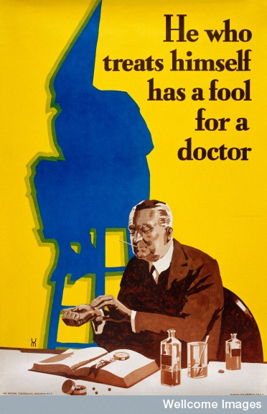
Reading through the (medical) resistance…
1959 ‘many attempts at weight reduction are based on aesthetic, cosmetic, or psychological factors rather than by physiologic concepts or the statistical features upon which the tables are based … obesity cannot be defined in a strictly numerical fashion … inspection and palpation can be used.’
Alvan Feinstein, 1959
Notes:
1959 Alvan Feinstein, ‘The Measurement of success in weight reduction’

Slide 32
The changing medical response
1974 ‘increasing the regularity and extent of self-monitoring should facilitate the self-control process’ but ‘daily weighing under … a slow rate of reduction would result in reduced motivation and participation’. Patients to be weighed instead only by medical study staff.
BUT
2009 ‘Self-weighing promotes weight-loss for obese adults’
Notes:
1974 Alan Bellack Ronald Rozensky and Jeffrey Schwartz, ‘A comparison of two forms of self monitoring in a behavioural weight reduction program’ p.524,
2009 Jeffrey VanWormer, Anna Martinez, Brian Martinson, et al., Self-weighing promotes weight-loss for obese adults’ Am J Prev Med 36 1!), p.70-

Slide 33
The changing medical response
2010 ‘Treating obesity with a novel hand-held device, computer software program and internet technology in primary care’
2012 Dr. Nirav R. Shah, New York's state commissioner of health, Dr. Eric Braverman: ‘Baloney Mass Index’ is ‘an inaccurate obesity classification method that underestimates the epidemic and contributes to failed treatment’; instead, use dual-energy X-ray absorptiometry, [DXA].
Notes:
McDoniel, Wolskee, Shen ‘Treating obesity with a novel hand-held device, computer software program and internet technology in primary care’

Slide 34
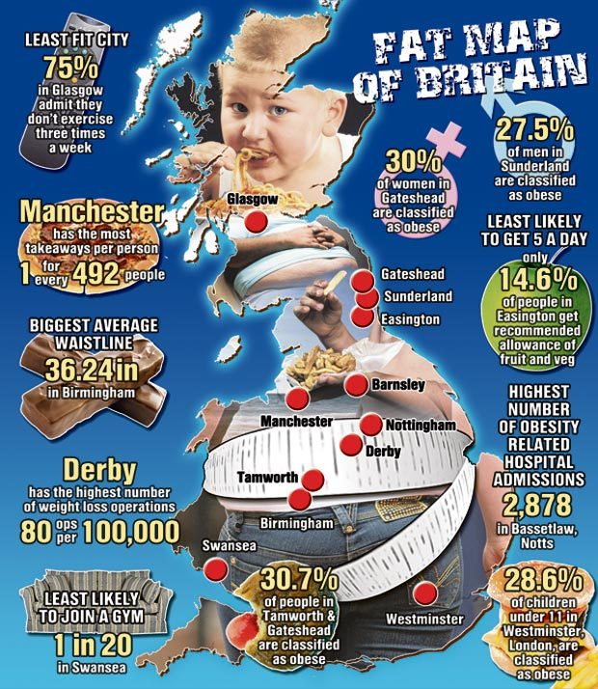
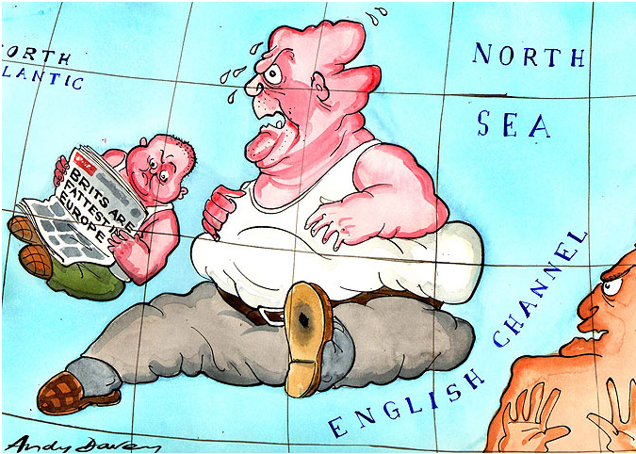
Weighing a nation: images of the ‘obesity epidemic’

