Slide 1
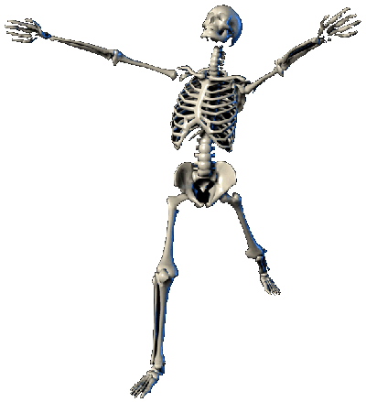
The History
of the
History of the Body

Slide 2
Historical context for the turn to the body/somatic turn in 1990
The body as a new political/economic target for ‘the commodifaction of
everything’ in the fast-neoliberalising Western democratic societies during the 1980s and 1990s.
The individual body -ecomes the prime object of the ideology of ‘free choice’.
It is the reponsibility of its ‘owner’ to constantly improve it (enhance it) work on
it constantly in order to make it and keep it beautiful and desirable. The body becomes the celebrated site of individual ‘freedom’ through individual ‘choice’.
The construction of a positive body image – ‘the body beautiful’ -- becomes a social requirement and central identity marker for success in a society, increasingly shaped by a the values and norms of a competitive corporate ‘bullshit culture’.
‘One of the most salient features of our culture is so much bullshit. Everyone knows this (...) But we take the situation for granted (...) In consequences, we have no clear understanding of what bullshit is, why there is so much of it,
and what functions it serves’. (Harry G. Frankfurter, ‘On Bullshit’, Raritan
Review 1986, reprint 2005)
‘

Slide 3

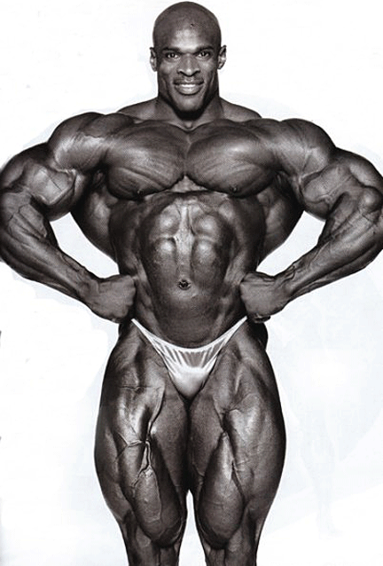
The body beautiful...
....fitter
3

Slide 4

....healthier...

Slide 5
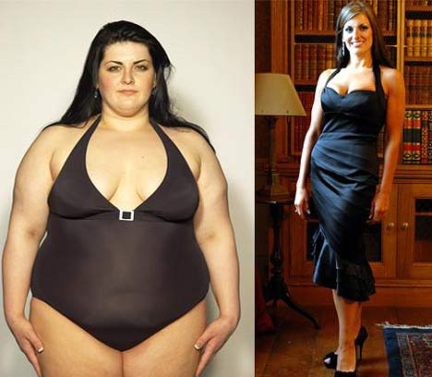
...thinner

Slide 6
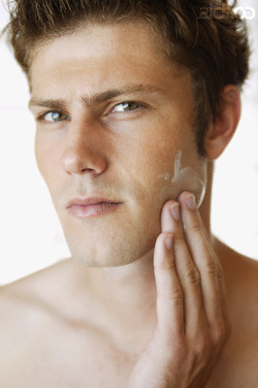
Ready to compete...

Slide 7
Every little helps.......
In 1990, Orlan began The Reincarnation of Sainte - ORLAN. It involved a series of plastic surgeries through which the artist transformed herself into elements from famous paintings and sculptures of women.

Slide 8
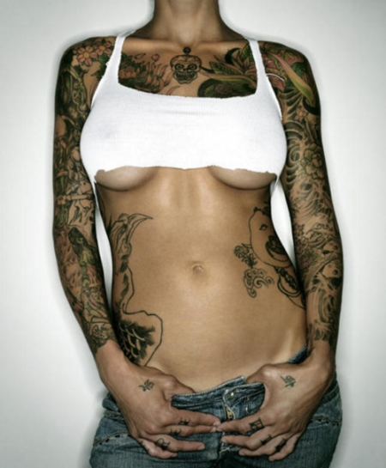
...my body, my choice, my own creation.
Bodies as sites of a rising identity politics
8

Slide 9
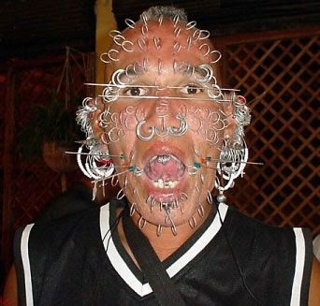

Slide 10
But ‘the bullshit’ commercial body beautiful culture also had a much darker side during the 1980s and 1990s...
the AIDS crisis
Beautiful bodies were being ravaged and killed by a mysterious new disease. The new ‘plague’ was immediately identified as being related to the ‘deviant’ sexual practices of the -- back then – still heavily marginalized gay community.

Slide 11
The rise of an new activist gay culture different from the 1960/70s
‘We are dying and that is real’
ACT UP

Slide 12
But where there is a crisis there is also an commercial opportunity
Commodification of Human Suffering
Social Advertising
Benetton’s AIDS
Awareness campaign,
1992, run by photographer Olivero Toscani
David Kirby dying at home with his family(originally published in Life Magazine, 1990)
Global brands start to ‘sell’ products by ‘raising awareness’ of
controversial social issues (e.g. environment, illness, poverty, sexuality etc.) – caused public outrage in the 1990s

Slide 13
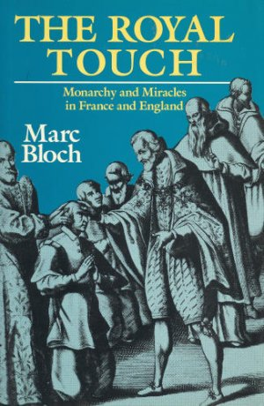
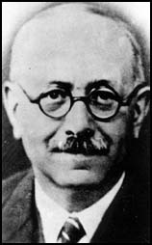
The History of the Body: history
Annales School and the history
of mentalities
Collective mentalities of the body to explain royal power

Slide 14

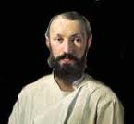
Literature and Anthropology
The grotesque body (inhered from folk culture and its carneval) is a concept, or literary trope, put forward by Russian literary critic Mikhail Bakhtin in his study of François Rabelais' work:
“The grotesque body (...) is a body in the act of becoming. It is never finished, never completed; it is continually built, created, and builds and creates another body.”

Slide 15
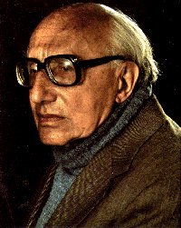
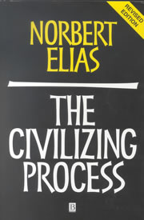
Sociology:
The disciplined body as the central feature of the ’civilizing process’ of Western societies

Slide 16
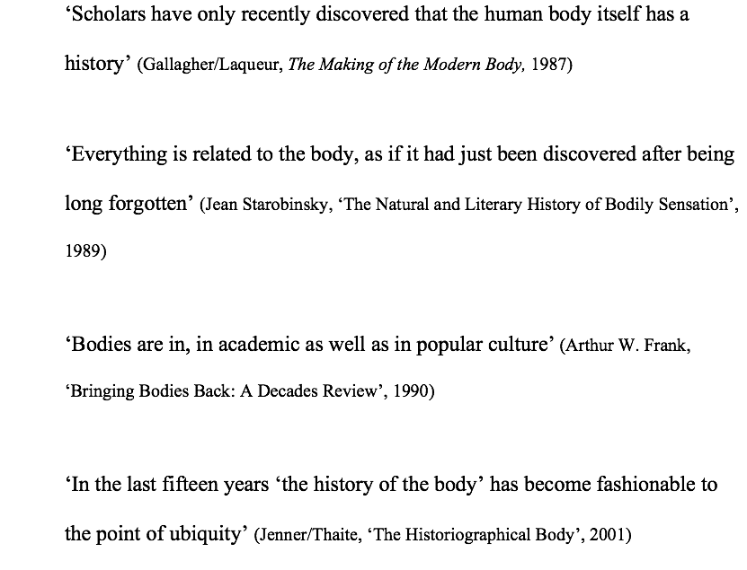
The Somatic Turn in the 1990

Slide 17
The Somatic Turn’ as part of the ‘Linguistic Turn’
The rules of language become the fundamental explanatory model and the irreducible basis of all expressions of human experiences and knowledge, including physiological knowledge of the human body
The body – and the knowledge about it – becomes part of the knowledge/power debates; is the body ’real’ or is a social-cultural construction (a ‘representation’)

Slide 18

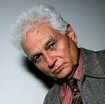
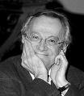
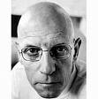
Two lessons from poststructuralism
1. Reality is not representable in any human form (written,spoken, visual or dramatic form)
2. If reality is not representable, there is also no authorative account
That can exist of anything. There is no one who can represent ‘the truth’
of anything. All accounts are ultimately subjective. The distinction between
objective and subjective (the object and the subject) is obsolete.
Consequence for the study of the body: medicine/science do not produce ‘authorative’ knowledge (objective, unbiased or neutral) about the human body; their knowledge it not for the good of humanity but it is part of the strategies/technologies of knowledge/power
AIDS becomes a prime example of this ‘new truth’ – modern medicine is helpless

Slide 19
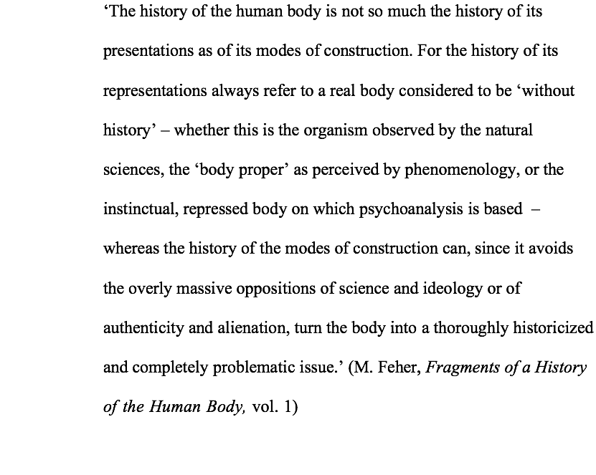

Slide 20
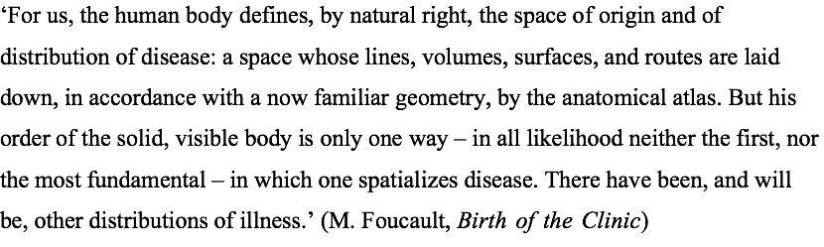
Foucault becomes the most influential theorist of the body in history writing (because he writes ‘histories’ as a philosopher)
In later works he expands on the knowledge/power issue:
Discipline targeting the individual body and regulartory technologies target bodies ’as populations’ (biopower)

Slide 21
Is any human experience ‘real’?
It is not individuals who have experience but subjects who are constituted through experience. Experience in this definition then becomes not the origin of our explanation, not the authoritative (because seen or felt) evidence that grounds what is known, but rather that which we seek to explain, that about which knowledge is produced.
To think about experience in this way is to historicize it as well as to historicize the identities it produces. This kind of historicizing presents a reply to the many contemporary historians who have argued that an unproblematized ‘experience’ is the foundation of their practice: it is a historicizing that implies critical scrutiny of all explanatory categories usually taken for granted, including the category of ‘experience’.
(Scott, Evidence of Experience, 1991, pp.779-80).

Slide 22
The new discourses about the body are not only resulting from 1990s poststructuralist thinking alone: practice theory and embodiment derived from other areas of academic thinking
Theories of practice and ‘the embodiment’ of social structures:
Marcel Mauss, ‘Techniques of the Body’ (1934)
Michel de Certeau, Practices of Everyday Life (1980), ‘Walking through the City’
Pierre Bordieu, Outline of a Theory of Practice (1977) (‘habitus’ concept)
Def. Habitus: is a system of embodied dispositions, tendencies that organize the ways in which individuals perceive the social world around them and react to it. These dispositions are usually shared by people with similar background (in terms of social class, religion, nationality, ethnicity, education, profession etc.), as the habitus is acquired through mimesis and reflects the lived reality to which individuals are socialized, their individual experience and objective opportunities. Thus, the habitus represents the way group culture and personal history shape the body and the mind, and as a result, shape social action in the present.

Slide 23
Where are we now?
Has ‘the body’ become the undisputed central focus in today’s society? Has the theoretical ‘somatic turn’ become our ‘lived reality’?
Which new fields of research have emerged since the 1990s that focus on body ‘difference’? Did such histories change the social reality of those experiencing bodily ‘difference’? Is having one’s
‘own history’ still important to attain social and political power (as it was believed by new social historians of the 1960/70)?
Is the history of emotion the final realization of ‘the somatic turn’?
Or, should we asks ourselves whether our trust in
emotions as truthful expressions of our ‘lived experience’ are in need of a ‘deconstruction’?

Slide 24
I ‘feel’ this is the end!

