Slide 1
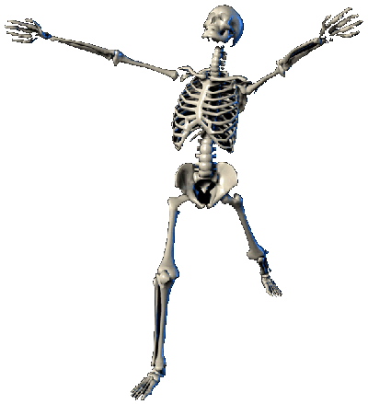
The History
of the
History of the Body

Slide 2
Historical context for the turn to the body/somatic turn in 1990
The body as a new political/economic target for ‘the commodifaction of
everything’ in the fast-neoliberalising Western liberal anglo-American societies during the 1980s and 1990s.
The individual body becomes the prime object of the ideology of ‘free choice’.
It is the responsibility of its ‘owner’ to constantly improve it and enhance it, to
work on in order to make it and keep it beautiful and desirable.
The body becomes the celebrated site of individual ‘freedom’ through individual ‘choice’.
The construction of a positive body image – ‘the body beautiful’ -- becomes a social requirement and central identity marker for success in a society, increasingly shaped by the values and norms of a rising competitive corporate culture.
‘One of the most salient features of our culture is so much bullshit. Everyone knows this (...) But we take the situation for granted (...) In consequences, we have no clear understanding of what bullshit is, why there is so much of it,
and what functions it serves’. (Harry G. Frankfurter, ‘On Bullshit’, Raritan
Review 1986, reprint 2005)
‘

Slide 3

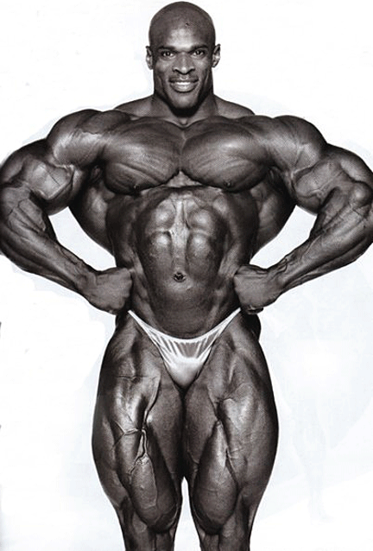
The body beautiful...
....fitter
3

Slide 4

....healthier...

Slide 5
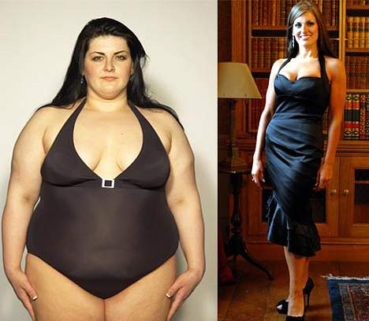
...thinner

Slide 6
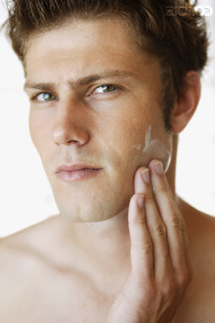
Ready to compete...

Slide 7
Every little helps.......
In 1990, Orlan began The Reincarnation of Sainte - ORLAN. It involved a series of plastic surgeries through which the artist transformed herself into elements from famous paintings and sculptures of women.

Slide 8
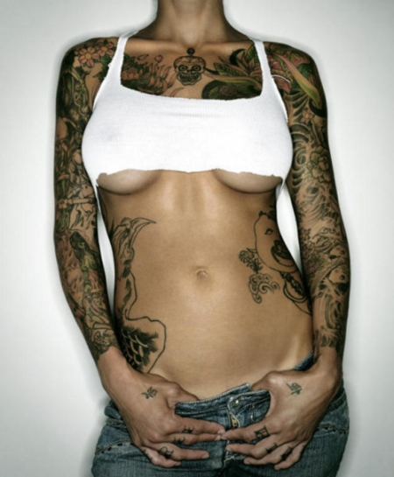
...my body, my choice, my own creation.
Bodies as sites of a rising identity politics
8

Slide 9
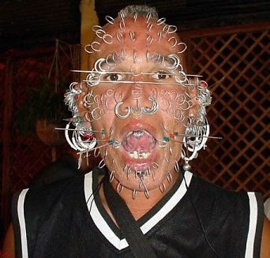

Slide 10
But ‘the bullshit’ commercial body beautiful culture also had a much darker side during the 1980s and 1990s...
the AIDS crisis
Beautiful young bodies were being ravaged and killed by a mysterious new disease.
The new ‘plague’ was immediately identified as being related to the ‘deviant’ sexual practices of the -- back then – still heavily marginalized gay community.

Slide 11
The rise of a new activist gay culture different from the 1960/70s
‘We are dying and that is real’
Aids fundamentally
questioned the authority of medicine and its institutions
ACT UP

Slide 12
But any crisis also brings commercial opportunities: the rise of social advertising in the 1990
Benetton’s AIDS
Awareness campaign,
1992, run by photographer Olivero Toscani
David Kirby dying at home surrounded by
his family (it was originally published in Life Magazine,1990)
Global brands start to sell their commercial products by linking them to ‘raising awareness’ campaigns of controversial social issues (e.g. environment, illness, poverty, sexuality etc.). While totally ‘normal’ today, such campaigns still caused widespread public outrage during the 1990s.

Slide 13
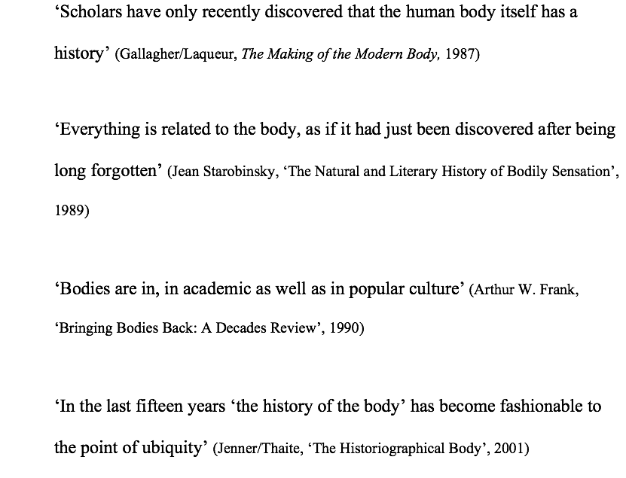
The theoretical answer to such social and cultural change during the 1990s was: The ‘somatic turn’

Slide 14
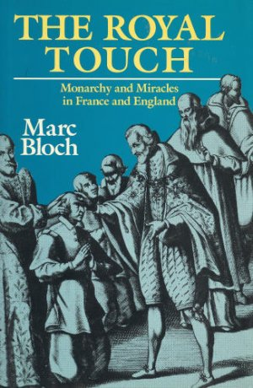
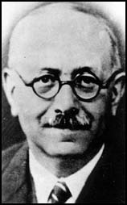
Is there a history of the body?
Annales School and the ‘history
of mentalities’
Collective mentalities of the body to explain royal power

Slide 15

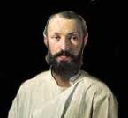
Literature and Anthropology
The grotesque body (inhered from folk culture and its carneval) is a concept, or literary trope, put forward by Russian literary critic Mikhail Bakhtin in his study of François Rabelais' work:
“The grotesque body (...) is a body in the act of becoming. It is never finished, never completed; it is continually built, created, and builds and creates another body.”

Slide 16
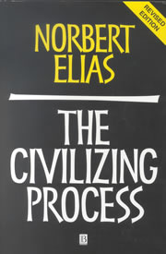
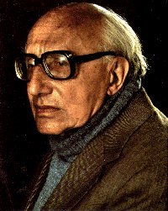
Sociology
The disciplined body as the central feature of the ’civilizing process’ of Western societies
But the history of the body of the 1990s was theoretically different.

Slide 17
The ‘Somatic Turn’ of the 1990s grew out of the ‘Linguistic Turn’ of the 1960s/70s
The rules of language become the fundamental explanatory model and the irreducible basis of all expressions of human experiences and knowledge, including scientific knowledge of the human body
The body – and all the knowledge about it – becomes part of the rising academic debates over ‘knowledge/power’ and whether the body ’real’ or is a ‘social-cultural construction’ or ‘representation’)
The hype over the history of the body coincides with the
rising debates over mainly French theory. In the US there was new term coined for it: poststructuralism.

Slide 18

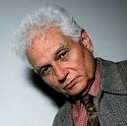
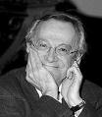
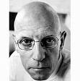
Two lessons from poststructuralism
(based on de Saussure’s theory of signs)
1. Reality is not representable in any human form (written,spoken, visual or dramatic form)
2. If reality is not representable, there is also no authorative account
that can exist of anything. There is no one who can represent ‘the truth’
of anything. All accounts are ultimately subjective. The distinction between
objective and subjective (the object and the subject) is obsolete.
Consequence for the study of the body: medicine/science do not produce ‘authorative’ knowledge (objective, unbiased or neutral) about the human body; their knowledge it not neutral but it is part of the strategies/technologies of knowledge/power (Foucault).
AIDS becomes a prime example of this new theoretical thinking (e.g. why does medicine which claims to know the truth cannot come up with ‘magic bullet? Because it doesn’t hold the universal truth and authority of the body.

Slide 19
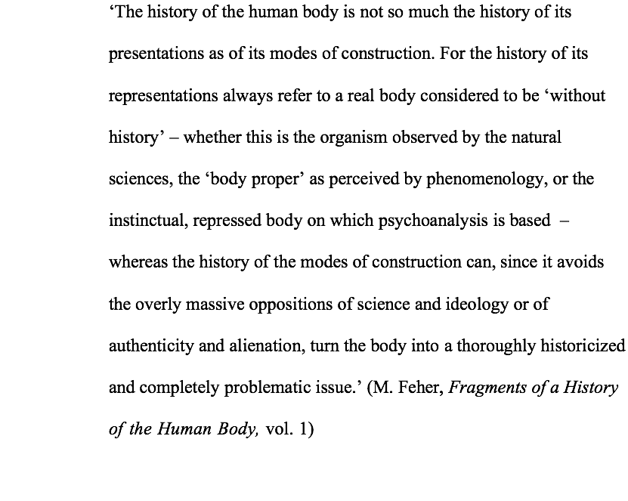
The Human Body: A Representation or a Mode of Construction?

Slide 20
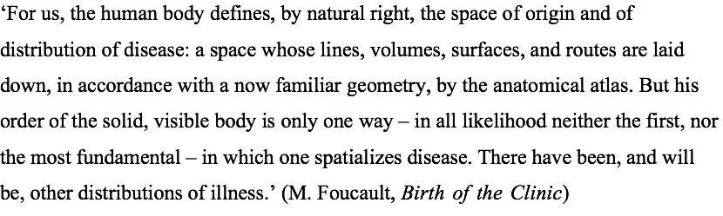
Foucault becomes the most influential theorist historians of the body rely on due to his historization of the human body and the concept of knowledge/power
In later works he expands on the knowledge/power issue:
Discipline targeting the individual body and regulatory technologies targeting bodies ’as populations’ (biopower)

Slide 21
Is any human experience ‘real’?
It is not individuals who have experience but ‘subjects’ who are constituted through experience. Experience in this definition then becomes not the origin of our explanation, not the authoritative (because seen or felt) evidence that grounds what is known, but rather that which we seek to explain, that about which knowledge is produced.
To think about experience in this way is to historicize it as well as to historicize the identities it produces. This kind of historicizing presents a reply to the many contemporary historians who have argued that an unproblematized ‘experience’ is the foundation of their practice: it is a historicizing that implies critical scrutiny of all explanatory categories usually taken for granted, including the category of ‘experience’.
(Scott, ‘Evidence of Experience’, 1991, pp.779-80).

Slide 22
The new discourses about the body are not only resulting from 1990s poststructuralist thinking alone: practice theory and embodiment derived from other areas of academic thinking
Theories of practice and ‘the embodiment’ of social structures:
Marcel Mauss, ‘Techniques of the Body’ (1934)
Michel de Certeau, Practices of Everyday Life (1980), ‘Walking through the City’
Pierre Bourdieu, Outline of a Theory of Practice (1977) (‘habitus’ concept)
Def. Habitus: is a system of embodied dispositions, tendencies that organize the ways in which individuals perceive the social world around them and react to it. These dispositions are usually shared by people with similar background (in terms of social class, religion, nationality, ethnicity, education, profession etc.), as the habitus is acquired through mimesis and reflects the lived reality to which individuals are socialized, their individual experience and objective opportunities. Thus, the habitus represents the way group culture and personal history shape the body and the mind, and as a result, shape social action in the present.

Slide 23
Where are we now?
Has ‘the body’ become the undisputed central focus in today’s society? Has the theoretical ‘somatic turn’ of the 1990s become our ‘lived reality’? Are we still body-obsessed? Are we
still in the grip of biopower? Is our body even more commericalised?
Which new fields of research have emerged since the 1990s that focus on body
‘difference’? Did such histories change the social reality of those experiencing
bodily ‘difference’ (e.g. race, disability, women)? Is having one’s ‘own history’ still
important to attain social and political equality (as it was believed by social historians of
The 1960/70)?
Is the history of emotion the final realization of ‘the somatic turn’?
Or should we ask ourselves whether our trust in our emotions as truthful expressions
of our ‘lived experience’ are in dire need of a ‘deconstruction’?

Slide 24
I ‘feel’ that this is the end!

