Slide 1
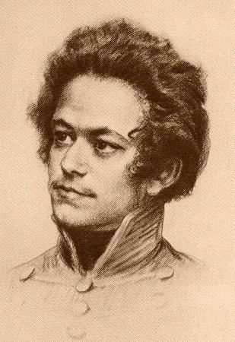
Theories, Skills & Methods Week 3
CLASS
Karl Marx
1818-1883

Slide 2
Approaches to class
Theorists
Karl Marx
Max Weber
Antonio Gramsci
Historians
(Marx): EP Thompson, Jean Jaurès, Georges Lefebvre, Albert Soboul, William Sewell
(Weber): Natalie Zemon Davis, Timothy Tackett
(Gramsci): Lawrence Levine

Slide 3
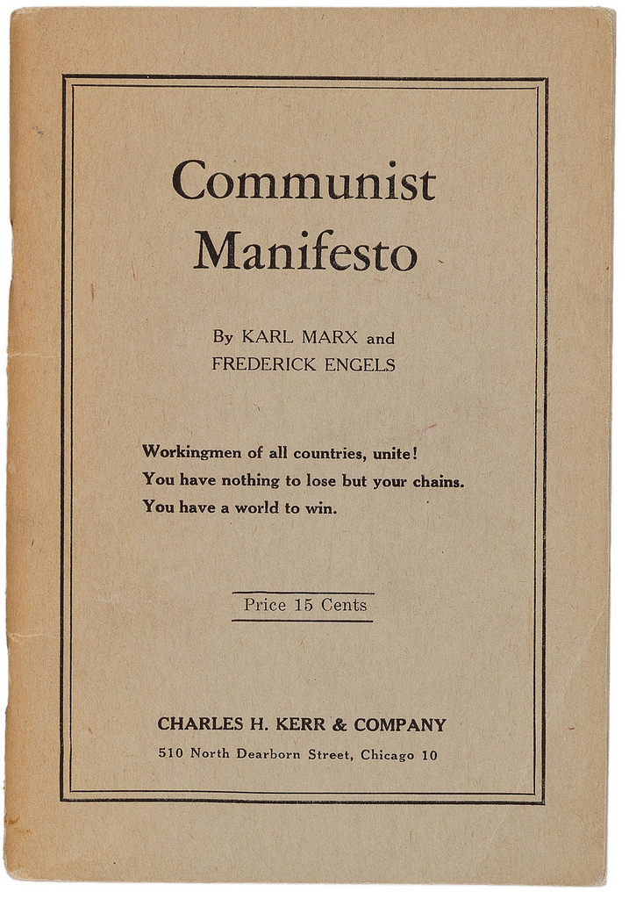
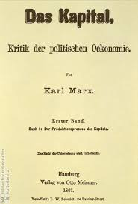
Karl Marx – most famous works
1848
Vol. 1-3
1867-1894

Slide 4
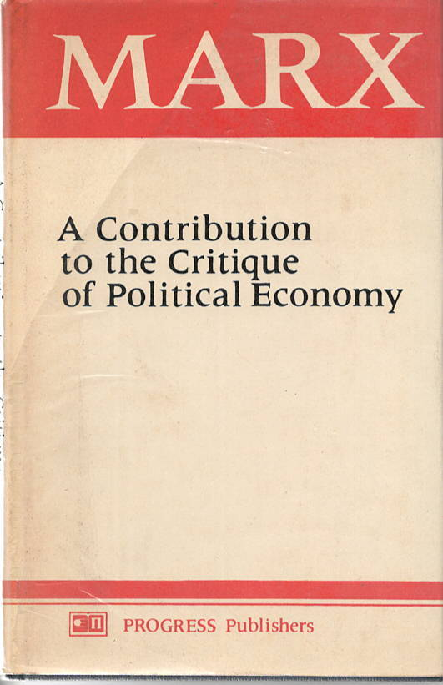
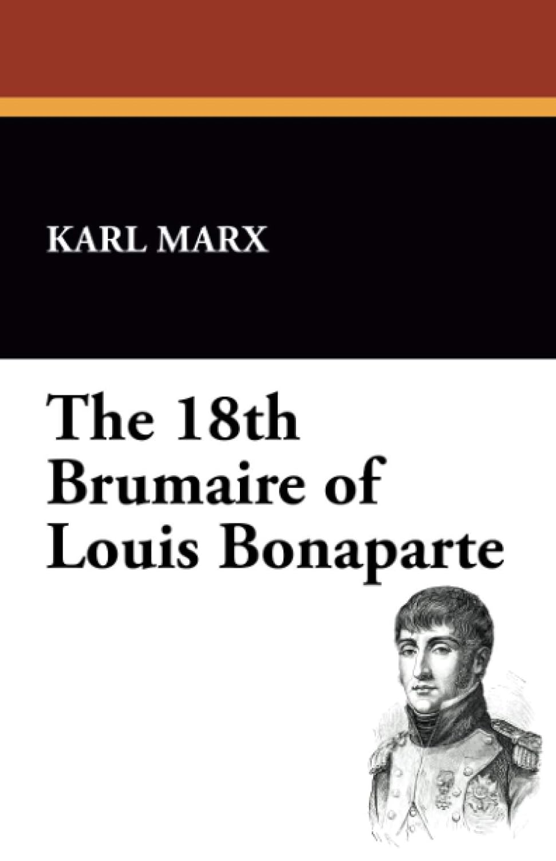
Karl Marx – influential works for historians

Slide 5
Marx’s Context
Romanticism
Industrial Revolution – Creation of Proletariat
Democratic Revolutions (1789, 1830, 1848)

Slide 6
The well-known Marx (prone to vulgarisations)
Critic of Capitalism (alienation, exploitation)
Historical materialism
History as class struggles
Utopian future without classes or states (communism)
But he never wrote a book about communism.

Slide 7
Four phases of Marx’s thought
Until 1845 – Inversion of Hegelian dialectics
Among the ‘Left’ Hegelians in Germany
Like Hegel: History as dialectic (tension) between ‘real’ and ‘rational’. This friction propels consciousness forward.
Hegel’s Endpoint → full consciousness, at one with Absolute Spirit and the state. Man is reconciled with himself, society and nature. History driven by ‘ideas’.
Marx → Endpoint is communist society (no classes, no state). History driven by ‘material forces’.
Marx still wedded to the philosophical and metaphysical: He assumes man’s creative ‘potential’ and sees history as the the gradual realization of it.

Slide 8
1844 – Economic and Philosophical Manuscripts
Alienation through commodification, from…
the product of labour
the means of production
oneself
others in society
Example: E. P. Thompson, The Making of the English Working Class (1963)
Weavers resist commodification of industrialization
Agency and use of cultural meaning in social action (more like Weber??)

Slide 9
Four phases of Marx’s thought
Between 1845 – 1848 Empirical/Materialist
In dialogue with Frederick Engels, British empiricism
Marx drops the metaphysics about ‘potential’
Materialist: human needs, means of production, social relations governing those means of production
History driven by technological innovations, which alter ‘productive forces’, creating a struggle to redefine the social relations surrounding them
Thought itself is a product of material reality
Slavery and proletarianisation frees up some people to be intellectually and artistically creative…

Slide 10
Four phases of Marx’s thought
Between 1848-1857 – Critical theory and materialism
Had to explain failure of 1848 proletariat Revolution
More subtle about how history unfolds (not a straight line of progress)
More attention to superstructure and class consciousness

Slide 11
Four phases of Marx’s thought
Between 1848 1857 – Critical Theory and Materialist
Modes of production (= forces of production + the social relations governing them) allow for various events.
History as ‘jumps and zigzags’ (Engels), not coherent progression
From philosophy to critical theory
Revise your theory in function of new facts!!!
From stadial history to genealogical: influence of Darwin
One can discern the ape in the man, but one could not predict the rise of man from the ape. Backwards historical analysis… not driven by some telos identified through philosophical speculation

Slide 12
Four phases of Marx’s thought
After 1859 – Harder, economic forces predominate
Critique of Political Economy (1859)
Das Kapital 3 vols., 1867-1894
Begins with classical political economists’ assumptions (Adam Smith, David Ricardo) then disproves their assumptions
Contract, barter as equivalent exchanges – NO!
Surplus value through exploitation
Emphasis on contradictions in system
Money and labour defy commodity-functions
Capitalism undermines itself: need for more consumers cannot be met if workers are increasingly impoverished
Rising inequality lowers productivity and prices

Slide 13

Communist Manifesto (Marx/Engels) 1848
Bestselling book of Penguin Books
Next to Bible, most influential text in history
Profit = exploitation
Need for working class consciousness
‘Workers of the world, unite!’
Revolution as key to historical change

Slide 14
Communist Manifesto (Marx/Engels) 1848
Progressive income tax
Abolish inheritances
Abolish private property
Free public education

Slide 15
Eighteenth Brumaire (1852) Marx and Engels
What happened in the 1848 Revolution in France?
Workers Revolt (Feb)
Overthrow of monarchy, creation of 2nd Republic
Crushing of workers (June)
Establishment of conservative Republic (Sept)
Louis-Napoleon elected President (Dec)
Dissolves National Assembly (Dec 1851)
Crowned emperor (Dec 1852)…

Slide 16
Eighteenth Brumaire (1852)
What went wrong in 1848?
Revolutionaries guided by ‘spirits of the past’(1789)
‘Hegel remarks somewhere[*] that all great world-historic facts and personages appear, so to speak, twice. He forgot to add: the first time as tragedy, the second time as farce.’
Highly empirical analysis, goes beneath events to analyse each group’s material interests and consciousness, which aren’t always aligned
Peasants held the revolution back
Further proletarianisation will strengthen working class’s consciousness & political leverage the next time…
Need to work on class consciousness!

Slide 17
Eighteenth Brumaire (1852) Marx and Engels
What went wrong in 1848?
‘Just when [people] seem engaged in revolutionizing themselves and things, in creating something that has never yet existed, precisely in such periods of revolutionary crisis they anxiously conjure up the spirits of the past to their service and borrow from them names, battle cries, and costumes in order to present the new scene of world history in this time-honored disguise and this borrowed language...’
Bourgeoisie was willing to sacrifice its republican commitments to protect its private property…

Slide 18
Key Marxist concepts - 1
Productive Forces
technology
Relations of Production
Property laws
How do people relate to production (as workers, as investors, as managers, etc.)
Superstructure
Politics, ideology, religion, culture, etc.

Slide 19
Key Marxist concepts - 2
Class Struggle and Revolution
When productive forces change, social relations are thrown into question… struggles ensue
Revolution: effort to align social relations with current productive forces

Slide 20
Jean Jaurès, Histoire socialiste de la Révolution française (4 vols, 1901-1904)
Leader of French Socialist Party, 1902
Anti-militarist, assassinated in 1914 (WWI)
Context: rise of communist, socialist, and syndicalist (workers’ associations) at end of 19th century
Sought to combine Michelet’s romantic nationalism with Marx’s ‘history as class struggle’
Saw future socialist republic in France originating in French Revolution… unlike Marx, he embraced 1789!
No socialist revolution needed! France could simply deepen the popular and social aspects already begun in 1789…

Slide 21
Jean Jaurès, Histoire socialiste de la Révolution française (4 vols, 1901-1904)
‘We know that economic conditions, the nature of production and of ownership, are the very foundations of History.’
Histoire socialiste de la Révolution française

Slide 22

Marxist paradigm in French Revolutionary Studies (until 1980s)
Georges Lefebvre
The Coming of the French Revolution (1947)

Slide 23
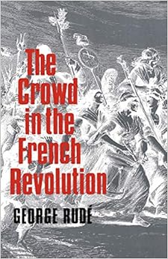
George Rudé-The Crowd in the French Revolution (1959)
Q: Who was the crowd?
A: Future sans-culottes, working class who became radicals through experience of revolutionary action…
Q: What motivated them?
A: Bourgeois political language & working class economic interests – contradiction
Point: consciousness develops through interaction between ideas and interests

Slide 24

Albert Soboul The Sans-culottes of the Year II (1968)
Sans-culottes were not a distinct ‘class’: mix of artisans and wage-earners, petty bourgeois
Borrowed middle-class, bourgeois language
Had separate interests but lacked sufficient class-consciousness to overthrow bourgeoisie, capitalist revolution of 1789.

Slide 25
Albert Soboul The Sans-culottes of the Year II (1968)
Why did the sans-culotte revolution of 1793-94 fail?
Answers like Marx’s Brumaire
Lack of class consciousness
Too heterogeneous as a group
Material factors: most radical elements were sent to the front
Pre-industrial – will need industrial factory setting to create class consciousness

Slide 26

Max Weber (1864-1920)
German sociologist
From ‘class’ to the individual and social action
Influenced by Ranke (historicism) and Nietzsche (disenchantment; rationalization; humans as meaning makers)

Slide 27
Max Weber (1864-1920)
Contingency and unintended consequences
Calvinism → fear of eternal damnation → need for reassurance that one has been chosen to be saved → no intermediaries or acts → solution: act as if one has been saved (frugality, duty to work)

Slide 28
Weber
Individuals and meaning systems
Class – situation in relation to markets
Status – Prestige, honour, systems of inclusion and exclusion. Can overlap with class but not reducible to it.
More emphasis on politics
Rulers as based on charisma or tradition VS
Rulers based on their position within a political bureaucracy
Economic power: position within markets

Slide 29


Weber – debates on capitalism
2012
2022

Slide 30
Weber - Legacies
Cultural anthropology
Clifford Geertz, Interpretation of Cultures
Rather than material changes triggering social and economic changes, changes in meanings and values alter social and cultural practices
Natalie Zemon Davis
How individuals appropriate meaning and turn it towards their own ends.
More individual agency

Slide 31

Timothy Tackett Becoming a revolutionary (1996)
Class theory of French Revolution debunked by 1980s
Revolutionaries were not capitalist bourgeoisie – they were mostly lawyers and Old Regime administrators
Status got them elected
Status differential in the National Assembly radicalized politics, making some more radical.

Slide 32
Antonio Gramsci (1891-1937)
Marxist theorist
Imprisoned under Mussolini
Prison Notebooks (1927-1935)
Builds on Marx’s superstructure
Cultural Hegemony
The way the state creates ideological shackles to maintain its power and the dominance of bourgeois-capitalist relations
Accepts state/civil society distinction but sees coercion and manipulation in both
Bourgeois regimes manufacture ‘consent’
Marxists taking the cultural-historical turn in 1970s and 1980s will borrow from Gramsci

Slide 33
Antonio Gramsci (1891-1937)
Marxist theorist
Imprisoned under Mussolini
Prison Notebooks (1927-1935)
Builds on Marx’s superstructure
Cultural Hegemony
Bourgeois regimes manufacture ‘consent’
Consent, not through force, but through ideological manipulation
Schools, media, associations.
Values of elite get embedded in worldviews and social practices
Cultural hegemony is not static: must absorb ‘counter’ views to stay fresh and legitimate, preventing open conflict
Marxists taking the cultural-historical turn in 1970s and 1980s will borrow from Gramsci

Slide 34
Cultural History
Marx – Class struggle; material forces
Weber – Individuals use meaning to create social difference with economic and social implications (Protestants become capitalists and develop a new basis of status)
Gramsci – Cultural hegemony as means to create or reinforce class dominance. The state protects the bourgeois meaning systems and cultural hierarchies.

Slide 35
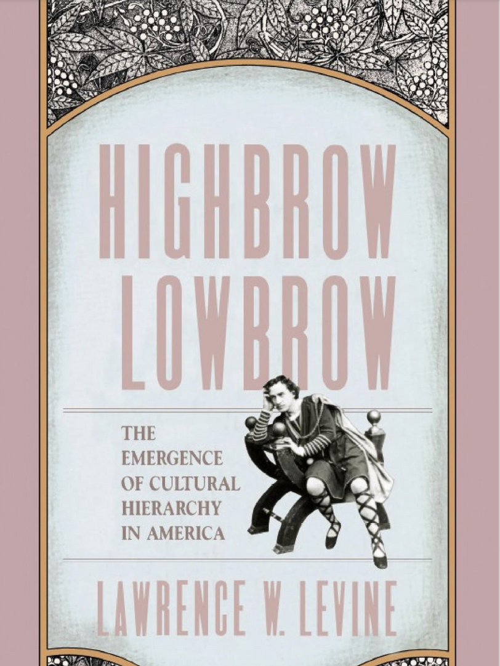
Lawrence Levine (1933-2006)
Shakespeare in America
Sacralization of Culture
Order, Hierarchy and Culture

Slide 36
Shakespeare in America (19th century) The ‘spinach-ification’ of Shakespeare
Part of popular culture before end of 19th century
Railway layers would perform themselves in the evening
Everyone knew the lines
Shakespeare interspersed with circus acts, jugglers, songs, speeches
Arrival of critics and experts – isolating Shakespeare from popular culture
Proper training for performers and spectators
Push to pull Shakespeare from vaudeville…

Slide 37
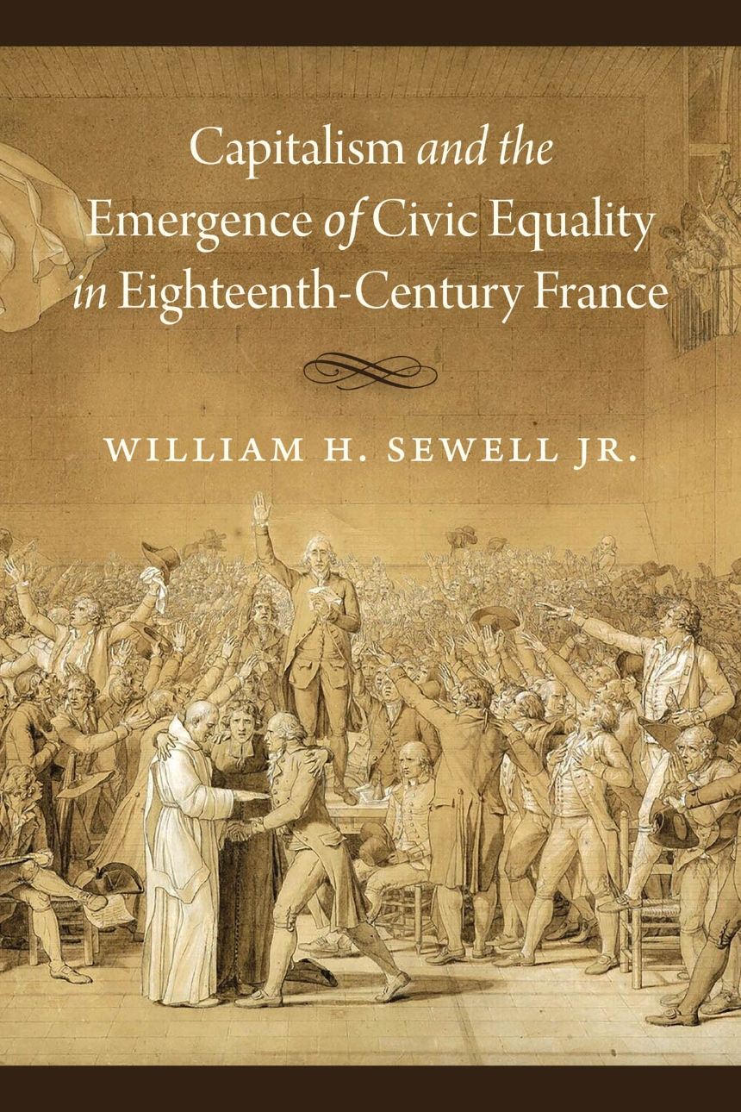
Capitalism without the class? William Sewell
Builds on Moishe Postone’s reading of Marx
Focus on the commodity form, not class struggle
A concrete history of abstraction
How does civic equality become thinkable and desirable? Through experience with commodity form
2021

Slide 38
Capitalism without the class? William Sewell
‘I argue that the eighteenth century French commercial capitalist development fostered a vigorous growth of abstract commodity-based social relations and that the growing experience of such abstraction in daily life helped make the notion of civic equality both conceivable and attractive by the 1780s. This argument postulates a very different kind of causation than the classical Marxist scenario of Lefebvre and Soboul. It sees capitalist development indluencing the Revolution not through a mechanism of class struggle but through a far more gradual and diffuse social and cultural process.’ (p. 7)
2021

Slide 39
Sewell
Use value (concrete; particular to the item)
Exchange value (abstract; measured against the universal benchmark of ‘price’)
Social relations sit behind market exchanges
Anonymity, ontological commensurability between buyers and sellers
Monetary equivalence → legal equivalence

