Slide 1
Disease
Dr Claudia Stein

Slide 2
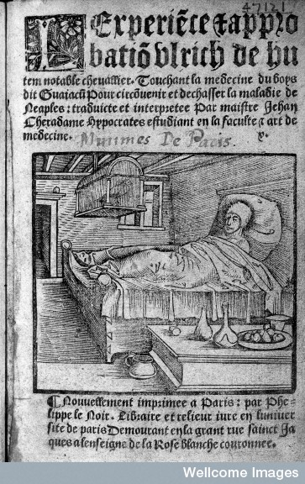
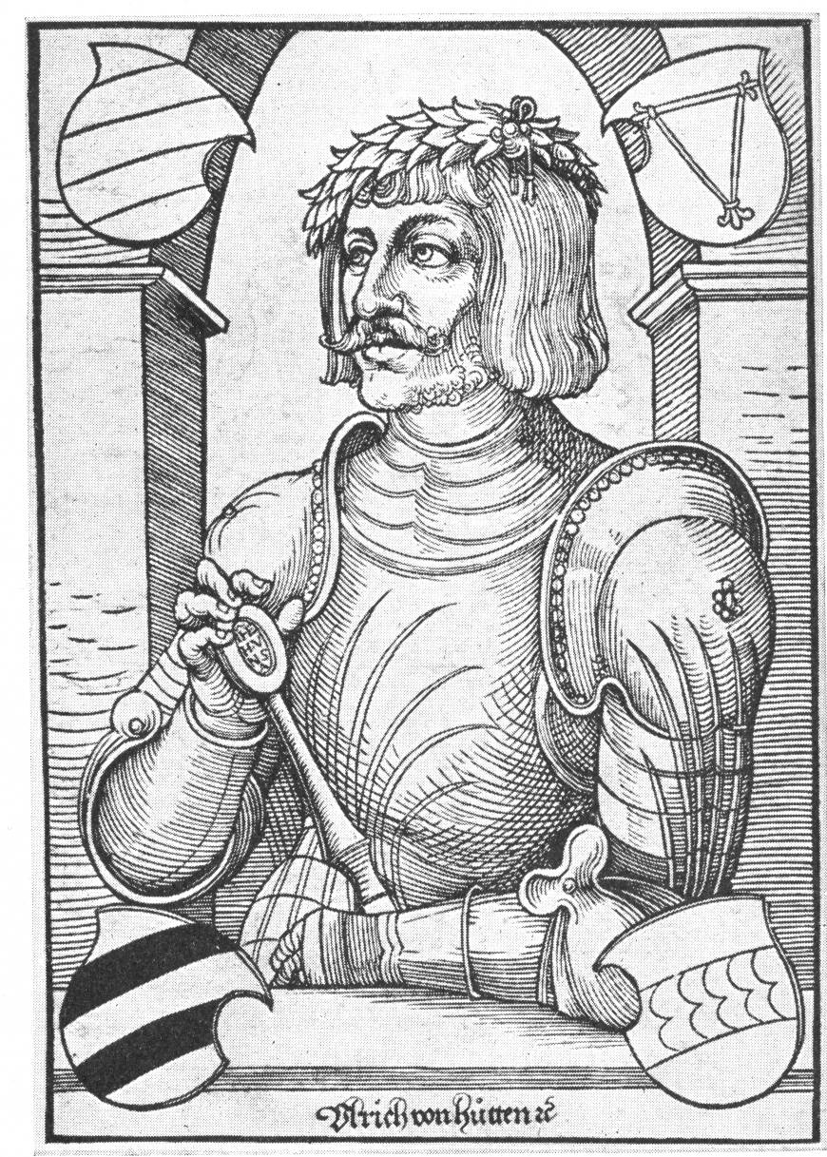
What was the French?
Ulrich von Hutten, 1488-1523

Slide 3
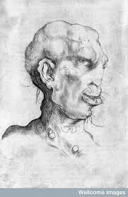
According to medical historians:
The French Pox or Gallus Morbicus = venereal Syphilis?

Slide 4
Problems: Venereal Syphilis is modern disease entity which relies on an entire differen understanding of the human body.
What is today’s understanding of venereal syphilis?
Venereal Syphilis is a sexually transmitted infection caused by the spirochete bacterium Treponema pallidum subspecies pallidum. The primary route of transmission is through sexual contact; it may also be transmitted from mother to fetus during pregnancy or at birth, resulting in congenital syphilis.
The signs and symptoms of syphilis vary depending in which of the four stages:
Primary stage: generally has a sore or sores at the original site of infection. These painless sores usually occur on or around the genitals, around the anus or in the rectum, or in or around the mouth. Last 3-6 weeks, then disappear.
Secondary syphilis: include skin rash, swollen lymph nodes, and fever. The signs and symptoms of primary and secondary syphilis can be mild, and they might not be noticed.
Latent stage: can last 2 to 30 years. No further symptoms.
Tertiary stage: In this stage of syphilis, the bacteria can damage almost any part of the body, but most commonly affects the: eyes, brain and neurological system, heart, bones.

Slide 5
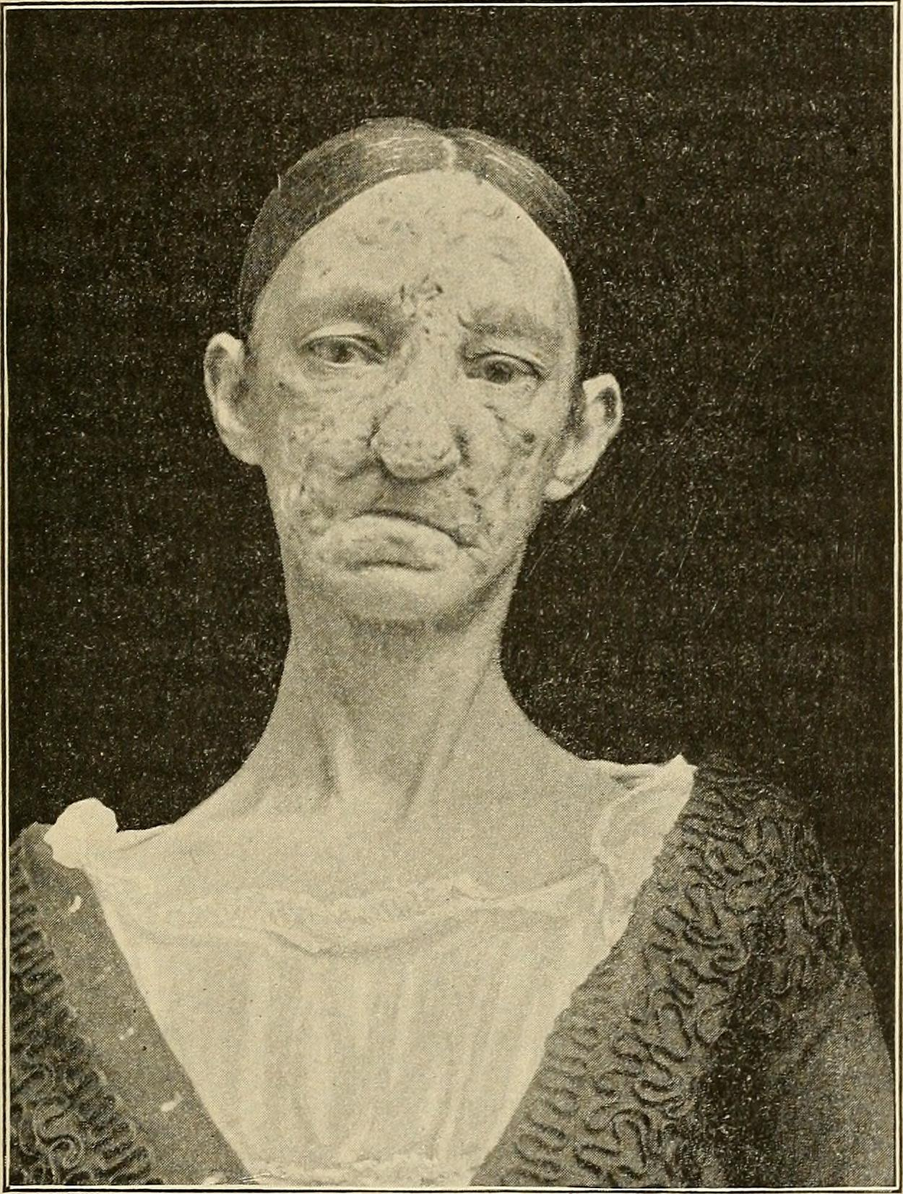
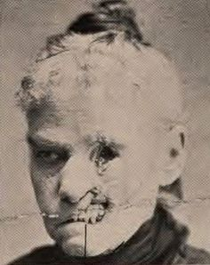
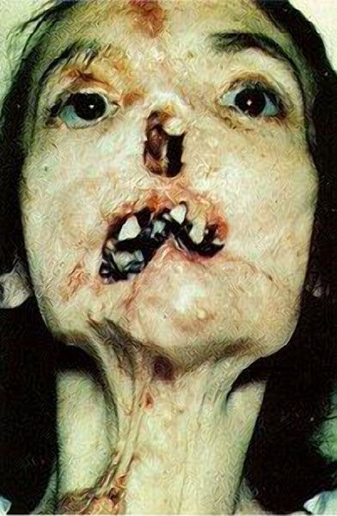
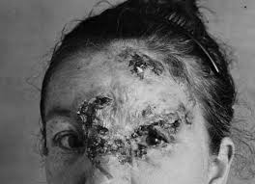

Slide 6
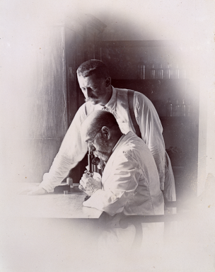
Founder of Bacteriology
Koch developed a new experimental method to test whether a particular micro-organism is the cause of a disease.
Building on Louis Pasteur's work on germ theory Koch used experiments to prove that anthrax was caused by the bacterium Bacillus anthracis was the cause of anthrax
- the bacterium could be observed in the tissue of anthrax victims.
To ‘see’ the agent was to ‘know’ the disease; only when we ‘see’ it it is the disease
fundamental break with earlier understandings of disease causation
Robert Koch, 1843-1910, Nobel
Prize in

Slide 7
Koch’s Postulates:
four criteria designed to establish a causative relationship between a microbe and a disease (he changed them later)
The microorganism must be found in abundance in all organisms suffering from the disease, but should not be found in healthy organisms.
The microorganism must be isolated from a diseased organism and grown in pure culture (in a petri dish!)
The cultured microorganism should cause disease when introduced into a healthy organism.
The microorganism must be re-isolated from the inoculated, diseased experimental host and identified as being identical to the original specific causative agent.
:

Slide 8
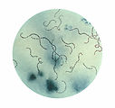
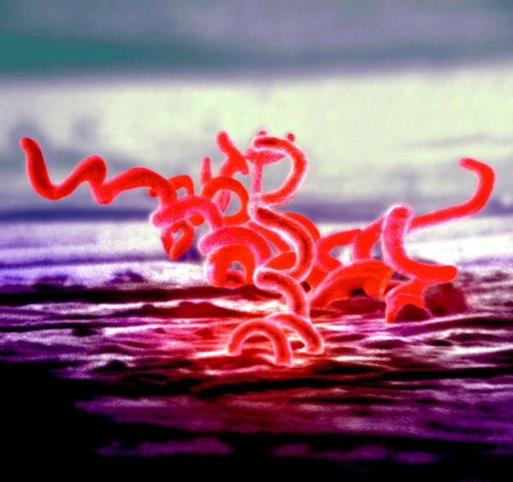
Causal Agent of Venereal Syphilis:
Spiral shaped bacterium, was first isolated by German dermatologist Erich Hoffmann (1868-1959) and the zoologist Fritz Schaudinn (1871-1906) in 1905 in Berlin.
They called it Treponema Pallidum.
The ‘discovery’ of the bacterium allowed for the
linking of all the different symptoms of syphilis and
also explained the latent stage.
Before this was impossible!

Slide 9
To identify a past disease with a modern disease entity
Retrospective Diagnosis:
The identification of a past disease (e.g. French pox) with a modern disease entity. This means that the historians applies modern standards of identifying and understanding to a time in which these did not exist.
What are the problems of such a retrospective diagnosis for historian trying to understand the phenomenon of the French pox in the 16th century?

Slide 10
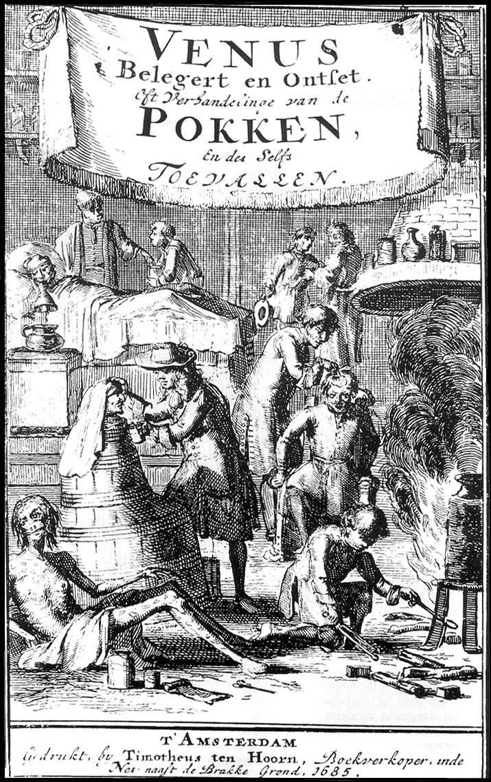
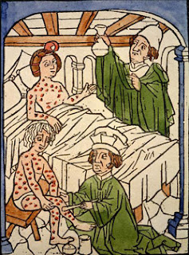
Historical Sources for Retrospective Diagnosis
1. Visual source material
Diagnosis and mercury treatment of the pox, 1495
Mercury treatment early 17th century

Slide 11
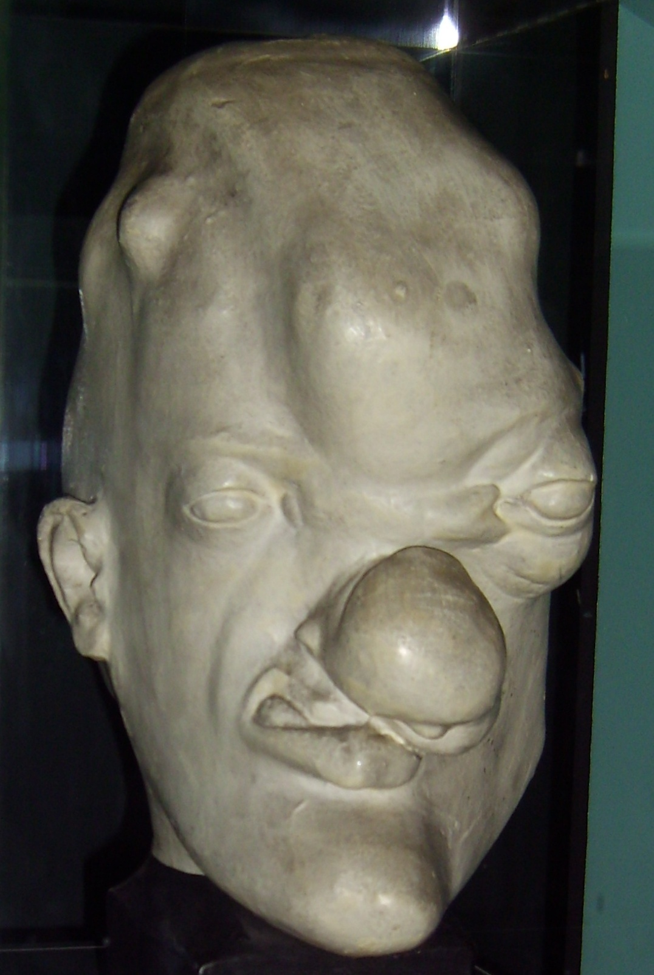
2. Material sources:
Musée de l’homme, Paris

Slide 12
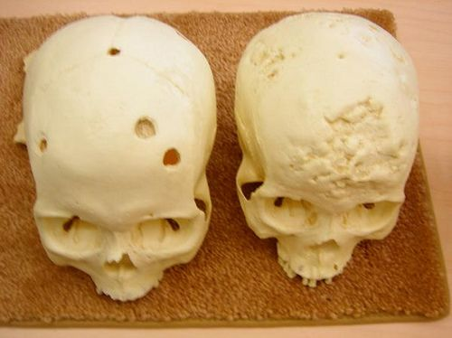
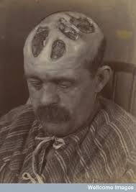
4. Paleopathology:
study of ancient diseases. A branch of science concerned with the pathological conditions found in ancient human and animal remains.

Slide 13
4. Literary sources:
“First of all I had no use of my left foot, for there had this lurked more than eight years. And upon my kneecap there were stinking oozing ulcers and great pains….It would not bear much covering with clothes and if I used my foot the pain was unbearable. I was so weak that I was unable to walk for weeks. My left side was so painful that I could not lift the arm…the left shoulder was week too and under the armpit developed a lump as large as a chicken egg. On my left side I had a large ulcer that did not hurt but that was oozing incessantly as if it was a cancer… At the back of my head I had an open wound which was so painful that I couldn’t bear to touch it…” (Ulrich von Hutten)

Slide 14
Problems:
Can we say that the French Pox was venereal syphilis from the sources? NO
Can we explain the reactions of 16th century contemporaries to it by identifying
it with the modern disease entity syphilis? NO
Is disease only a biological entity or does it transport other connotations? YES

Slide 15
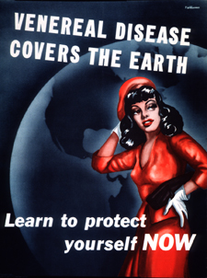

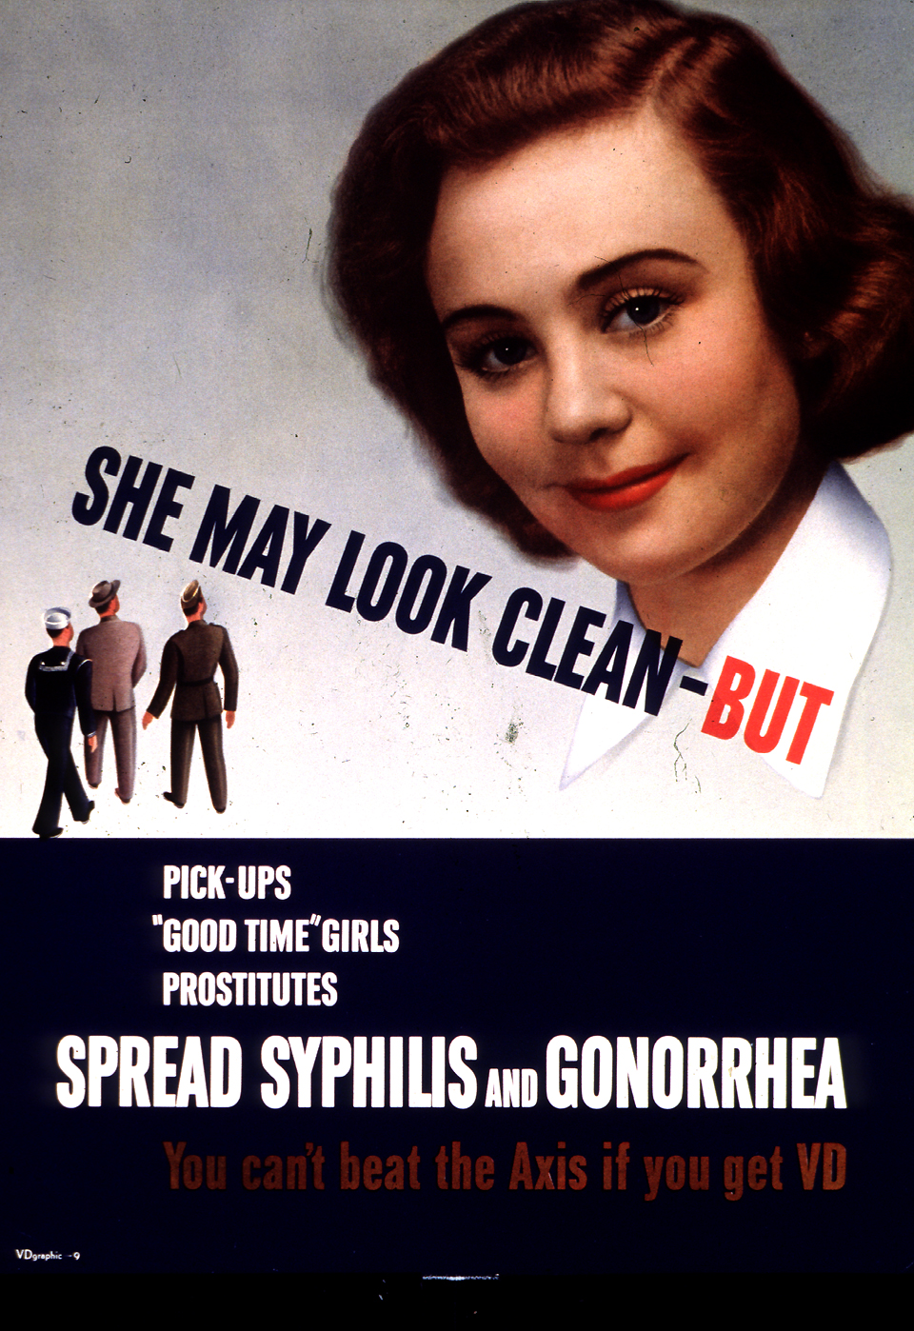
Moral connotations of venereal syphilis:’ moral panic at turn of 20th century in all Western countries
Syphilis as a threat to the family and the nation; PR campaigns against its ‘cause’ -- particularly during WWI and WWII
Enemy: the ‘loose women’ and prostitute

Slide 16
These moral connotations of STDs such syphilis affected the way the history of the pox was
writte
Works on sixteenth-century French pox/syphilis usually focusing on illicit sex and prostitution
Claim: the new disease triggered the rise of ‘rational’ and modern medicine.
‘The epidemic shocked the dormant medical mind of Western Europe into action and brought about a transition from magic to rational medicine’. (Johannes Fabricius)
What about the understanding of the French pox in the 16th century? It was a disease that appeared new and unknown to the contemporaries.
Retrospective diagnosis cannot tell us anything about these issues! It makes the past look like the present!

Slide 17
Retrospective Diagnosis becomes ‘unfashionable’ in medical history from the 1980s: historian increasingly claimed that bodies and their disease were understood ‘differently’ in the past
Michel Foucault, The Birth of the Clinic (1963)
‘Today the human body defines ….the space of origin and distribution of disease. This body is a space whose lines, volumes and surfaces and routes are laid down according to a now familiar geography, that of the anatomical atlas.
But this order of the solid body is only one way – and in likelihood neither the first nor the most fundamental way of of spacialising disease. There have been and there will be other distribution of disease.’
There is no common measure between our understandings of bodies and diseases
and that of earlier times.

Slide 18
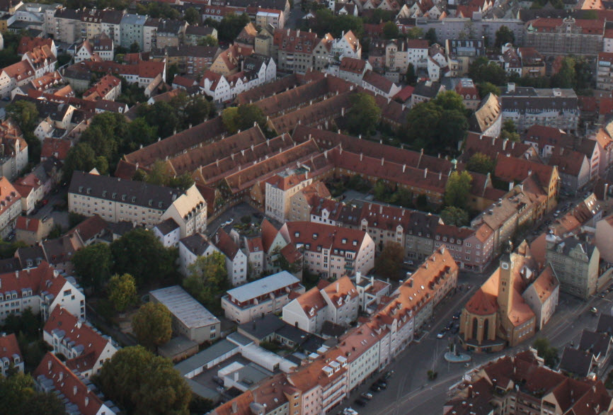
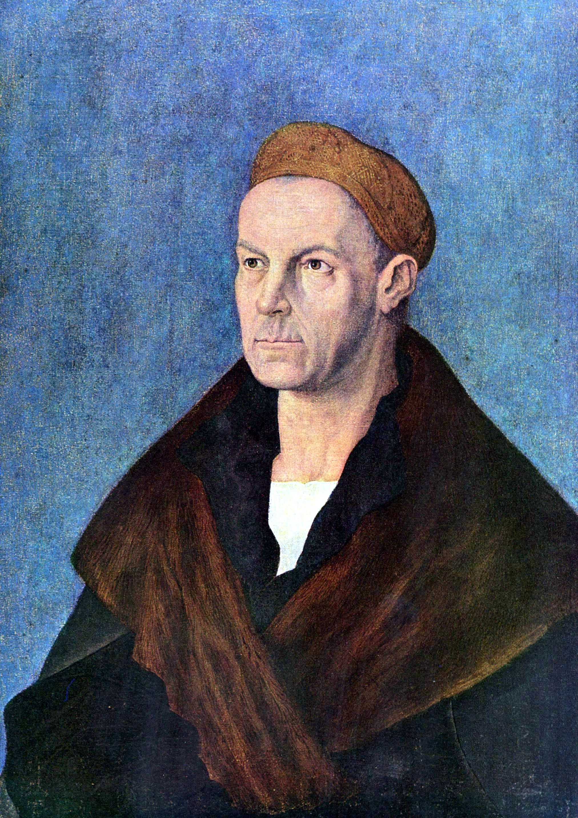
French Pox in 16^{th-}century Imperial Augsburg
The Fuggerei in Augsburg (1521)
Jacob Fugger, 1459-1525

Slide 19
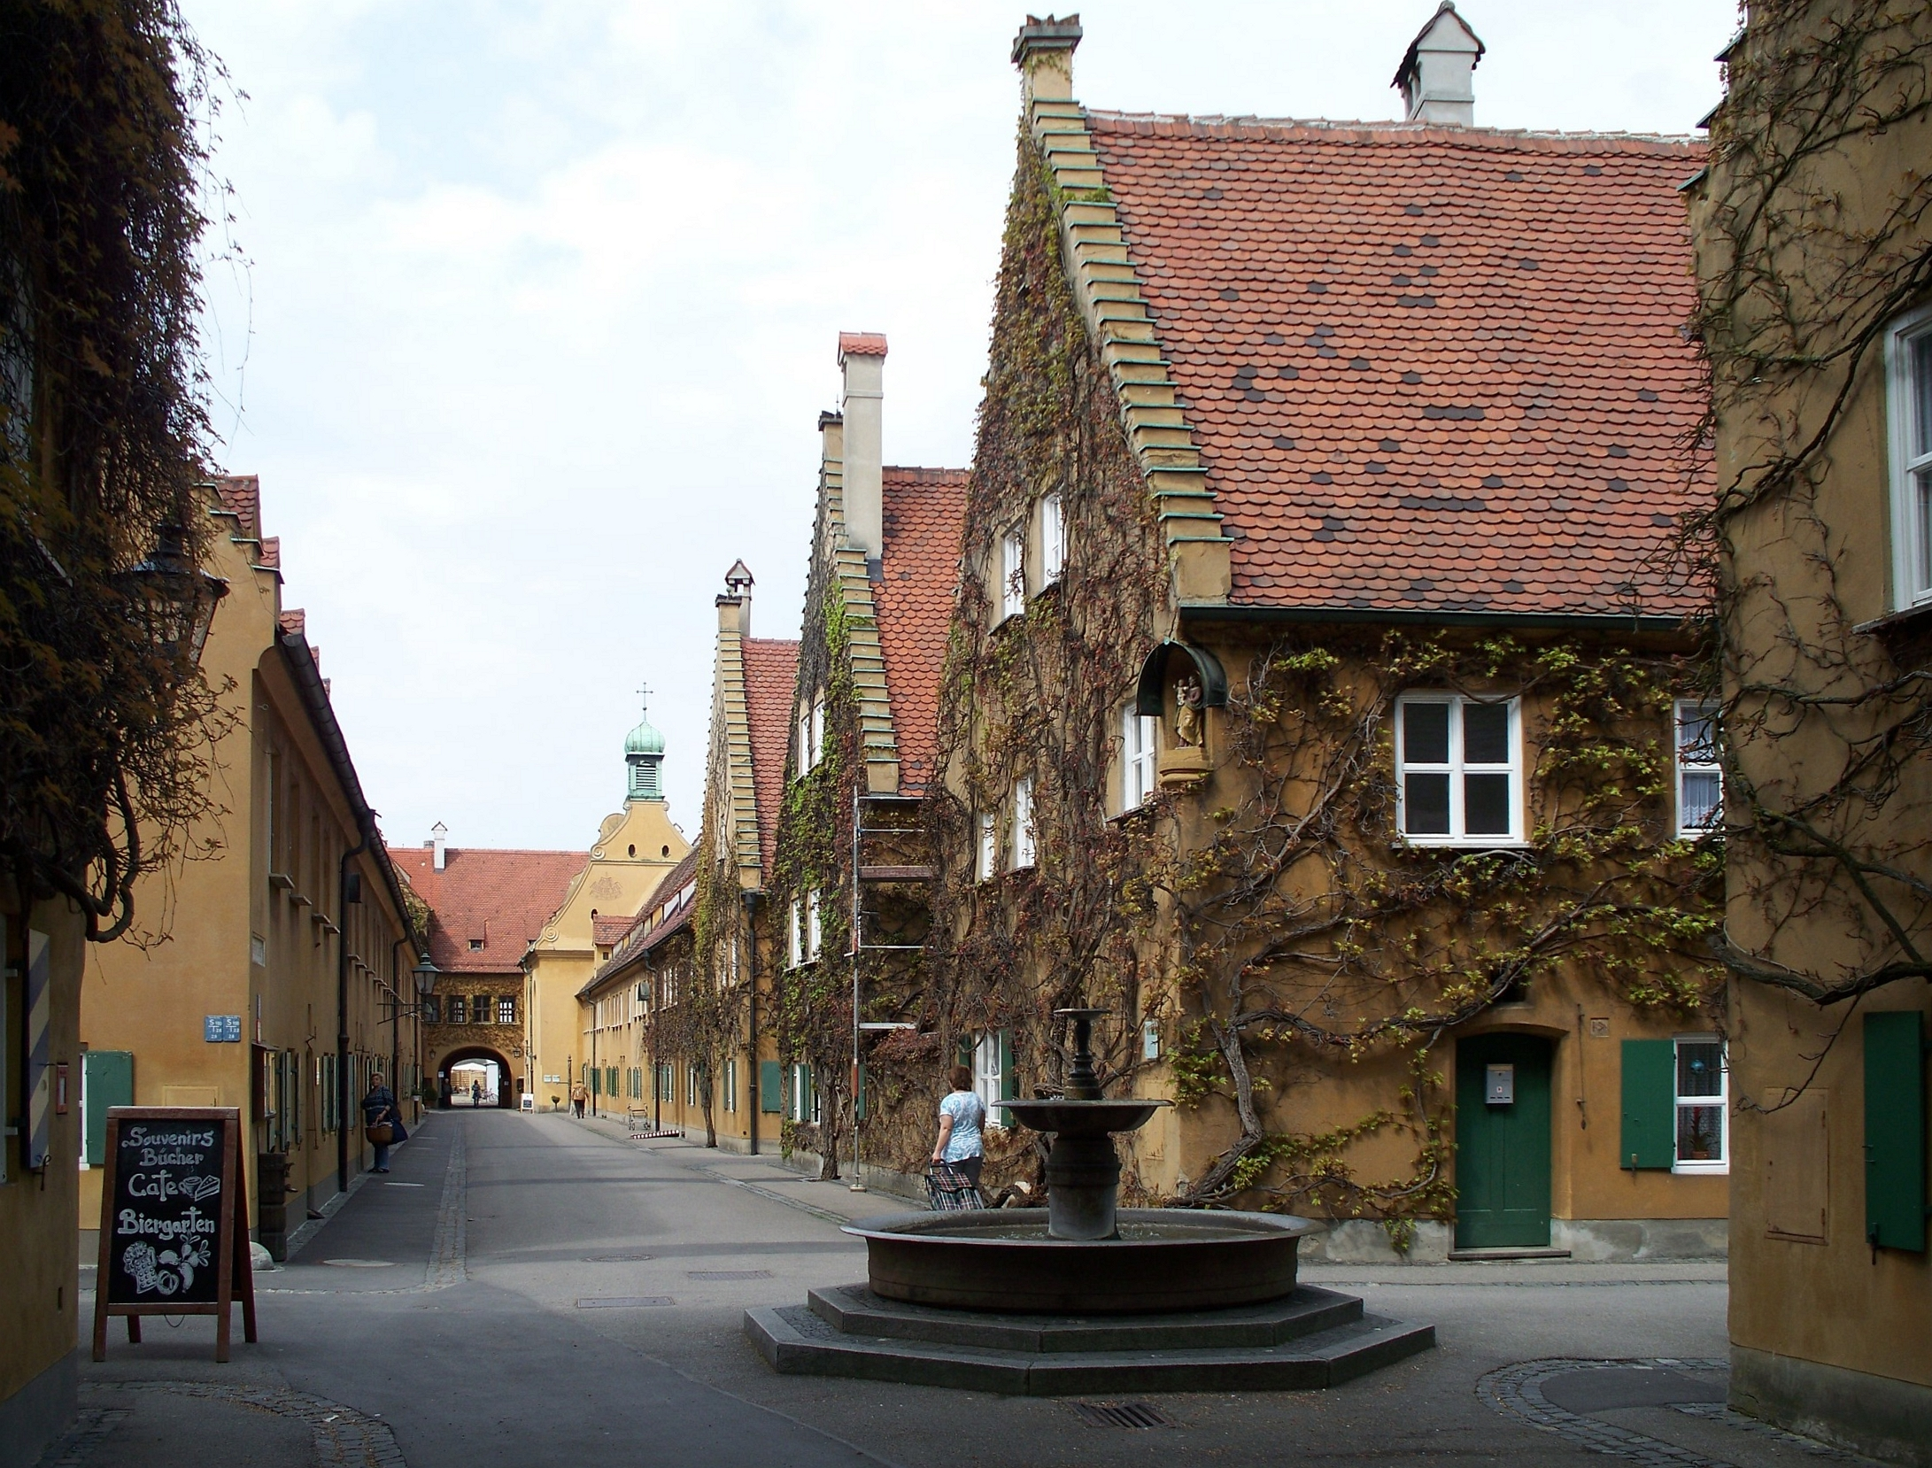
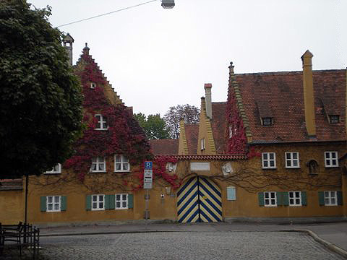
The Fuggerei and its pox hospital 1521-1632
Task: How to explain many cases of disease
metamorphosis? Disease like the pox change
into leprosy, or plague? Do we simply
disregard it as stupid?

Slide 20
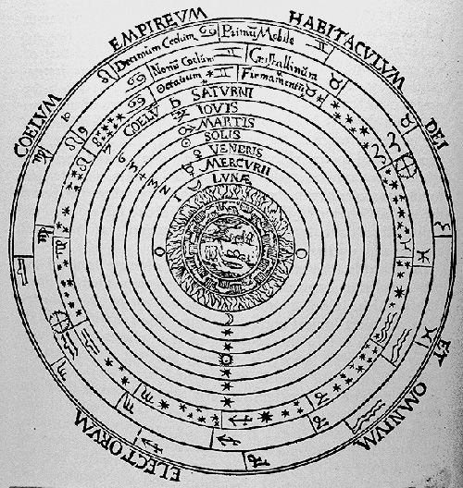
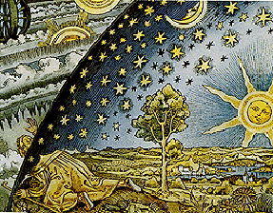
Disease within a cosmos, created and controlled by God alone
The cosmos – whether geocentric or helio-
centric – remains God’s creation
All investigations of nature, including the human body, are therefore also religious
enterprises
Disease is sent by God; stars and planets are his
Servants -- miasma

Slide 21
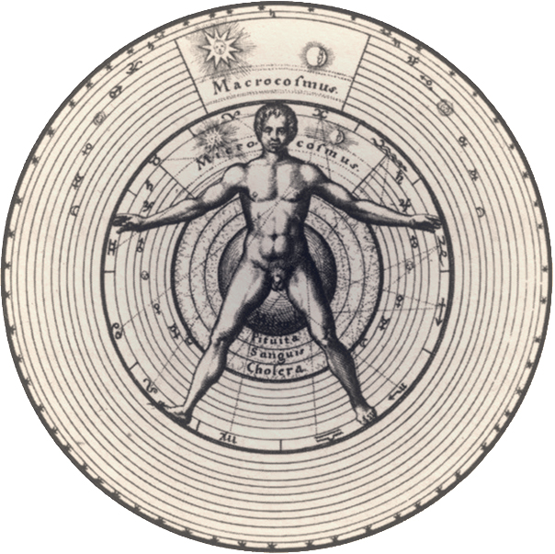
The micro-macrocosm: Man’s body – the microcosm -- mirrors the God-created and controlled wider macrocosm

Slide 22
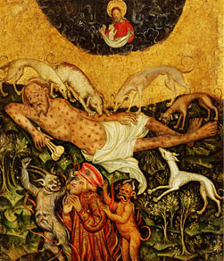
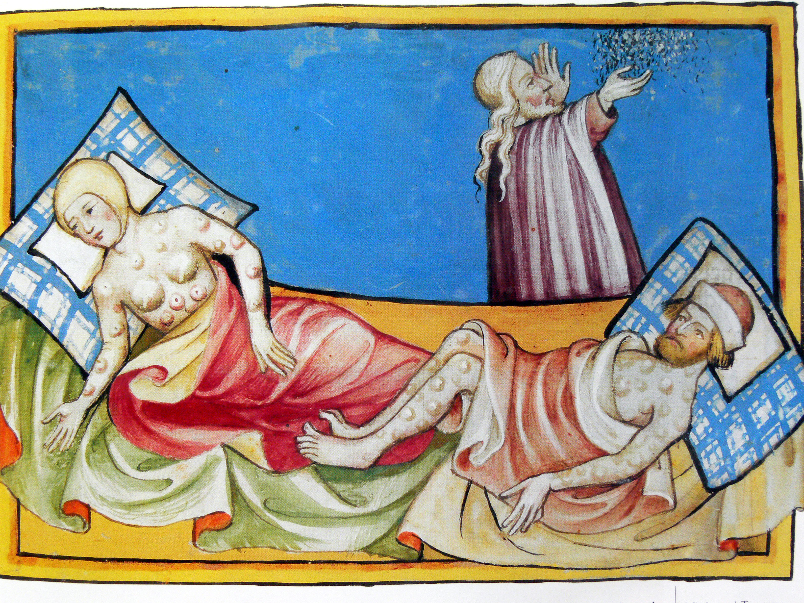
The First cause for all disease was God’s punishment of human sin
Plague in Egypt
Job’s punishment

Slide 23
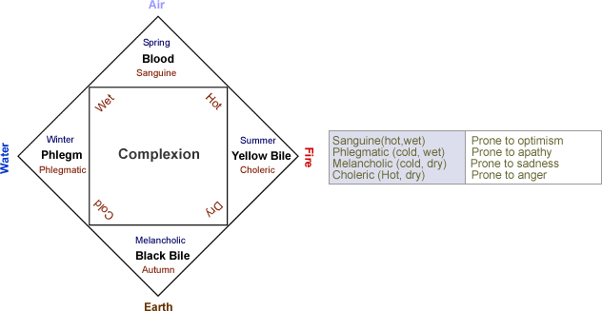
Medical Understanding of the French Pox
Disease is an imbalance of the individuals complexion

Slide 24
There was not one cause for diseseae but four
Aristotelian ‘four causes’:
Four causes refers to an influential principle in Aristotelian thought whereby explanations of change or movement are classified into four fundamental types of answer to the question "why?”.
A change or movement's material cause is the aspect of the change or movement which is determined by the material that composes the moving or changing things. For a table, that might be wood; for a statue, that might be bronze or marble.
A change or movement's formal cause is a change or movement caused by the arrangement, shape or appearance of the thing changing or moving.
A change or movement's efficient or moving cause consists of things apart from the thing being changed or moved, which interact so as to be an agency of the change or movement. For example, the efficient cause of a table is a carpenter, or a person working as one, and according to Aristotle the efficient cause of a boy is a father.
An event's final cause is the end toward which it directs. That for the sake of which a thing is what it is. For a seed, it might be an adult plant. For a sailboat, it might be sailing. For a ball at the top of a ramp, it might be coming to rest at the bottom
(Peter Dear, Revolutionizing the Science, explains it very well!

Slide 25
The French pox is not syphilis! What it was we don’t know from the sources we have but we can reconstruct the understanding of this new disease within the knowledge of the time.

