Slide 1
It All Comes Out in the Wash: Fenland Drainage and Land Improvement Projects in the 17th Century Trans-Atlantic British Empire

Slide 2
Key Questions
What is the significance of early modern environmental interventions to our understanding of human environmental agency and the Anthropocene?
Can the case studies of Fenland Drainage and the colonisation of North America be understood as planetary processes in which humans were the primary agent of environmental and historical change?
  Is it possible to locate more-than-human agencies that either contested human intentions for environmental engineering or created unintended consequences for the state and company authorities?
How useful are the concepts of empire and colonialism for understanding the environmental significance of early modern land use practices?

Slide 3
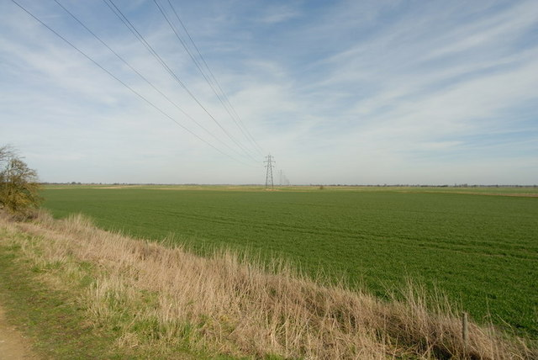
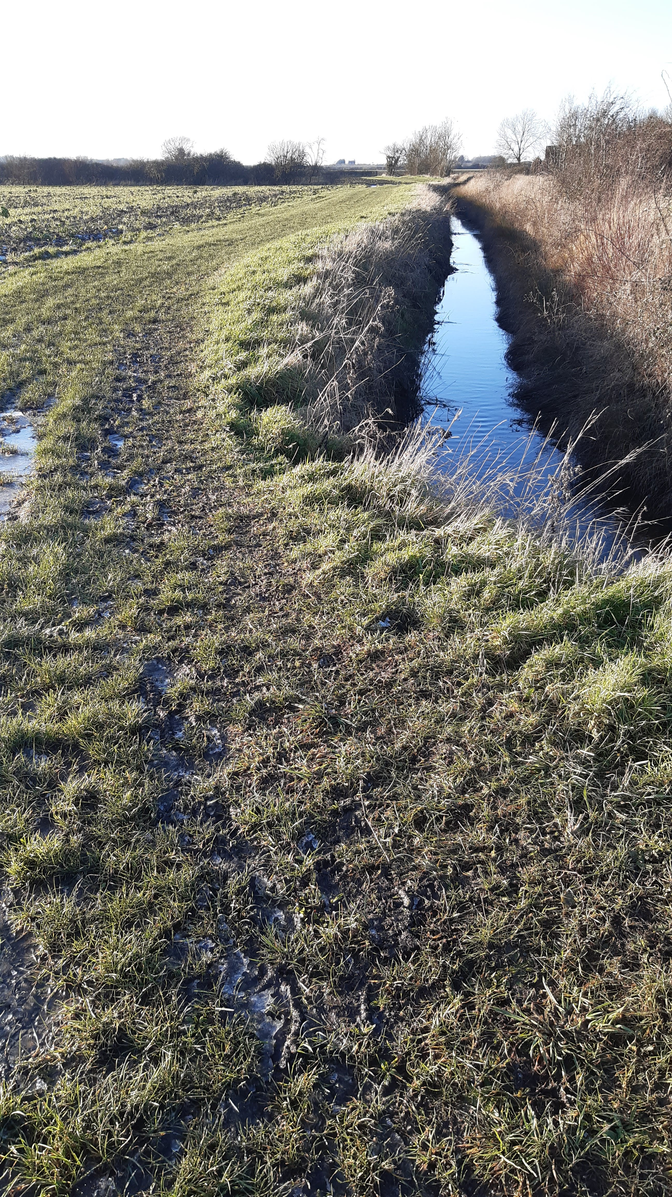

Slide 4
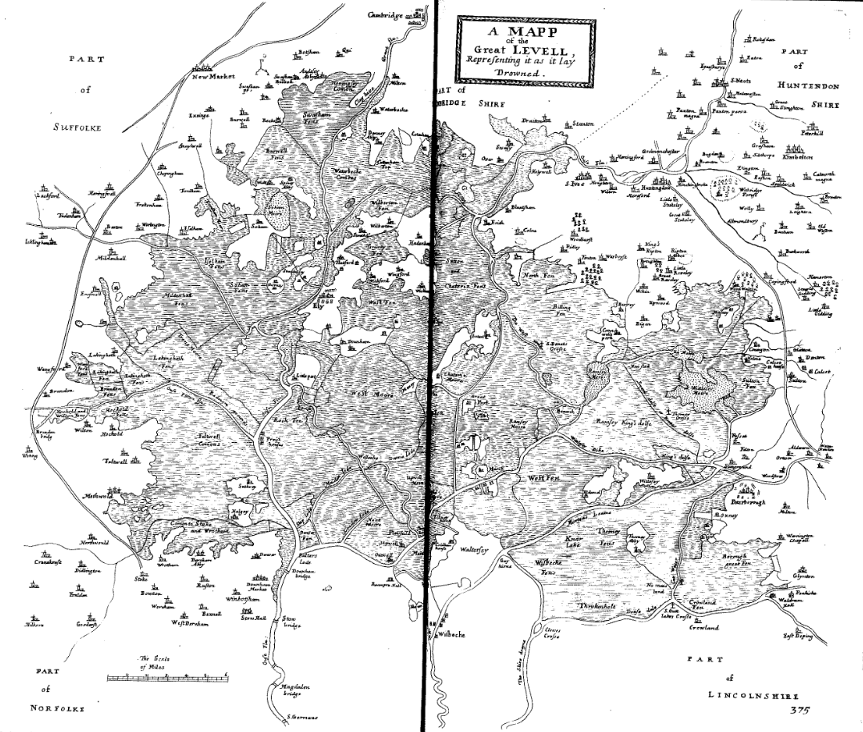
William Dugdale A Mapp of the Great Levell Representing it as it lay Drowned from The history of imbanking and drayning of divers fenns and marshes (1660) p. 373.

Slide 5
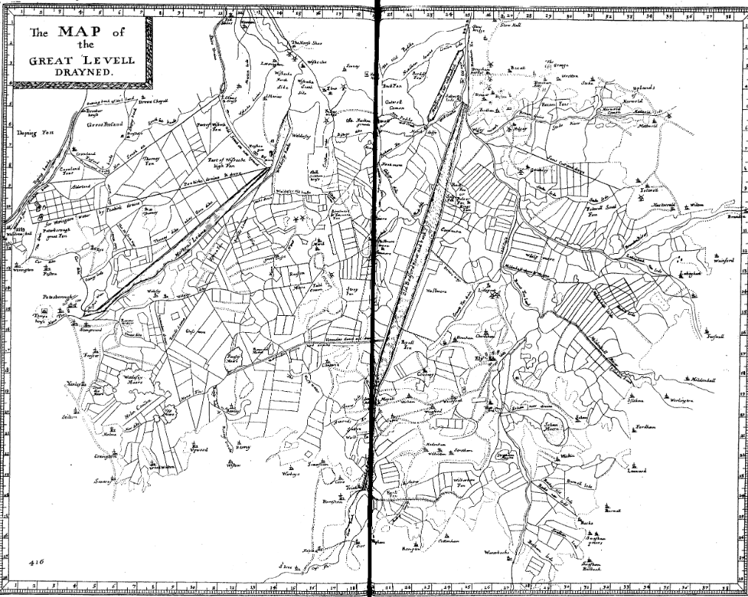
William Dugdale A Map of the Great Levell Drayned, from The history of imbanking and drayning of divers fenns and marshes (1660) p. 417.

Slide 6
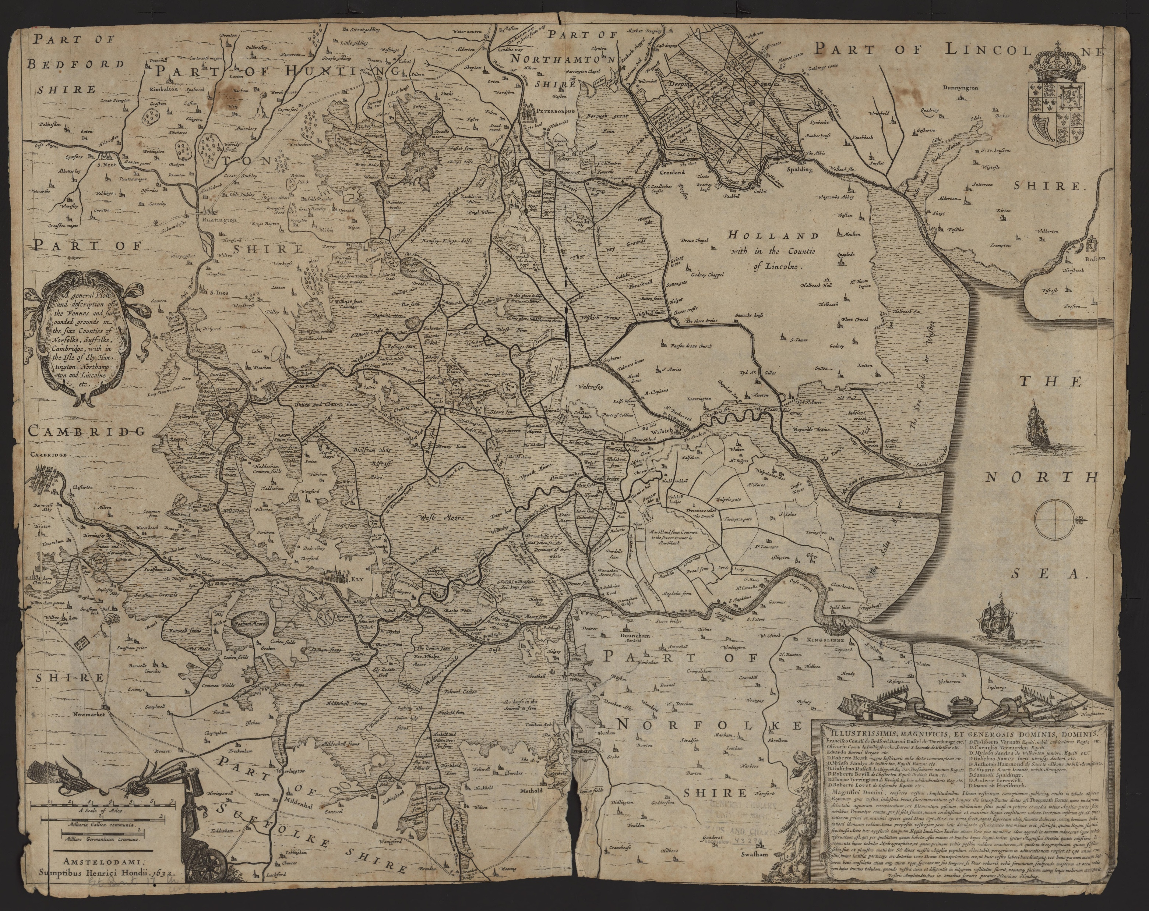
The Fens Before Drainage
Henricus Hondius, A general plott and description of the fenns and other grounds with in the Isle of Ely (1630)

Slide 7
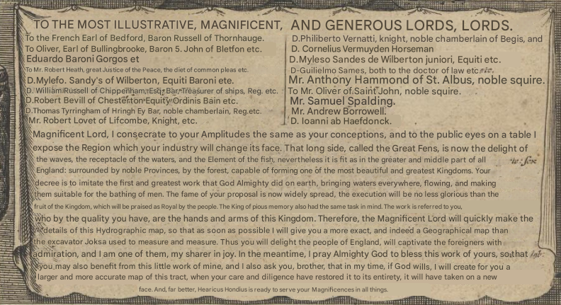

Slide 8
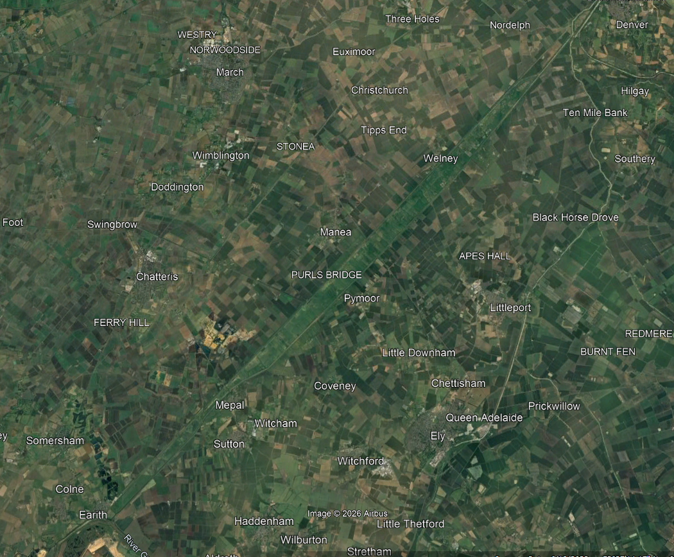
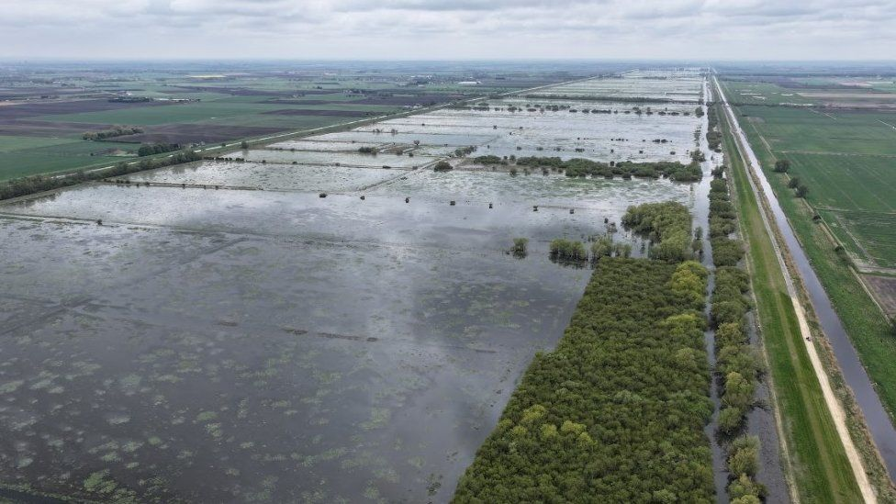
The Bedford Level (aka The Great Level)

Slide 9
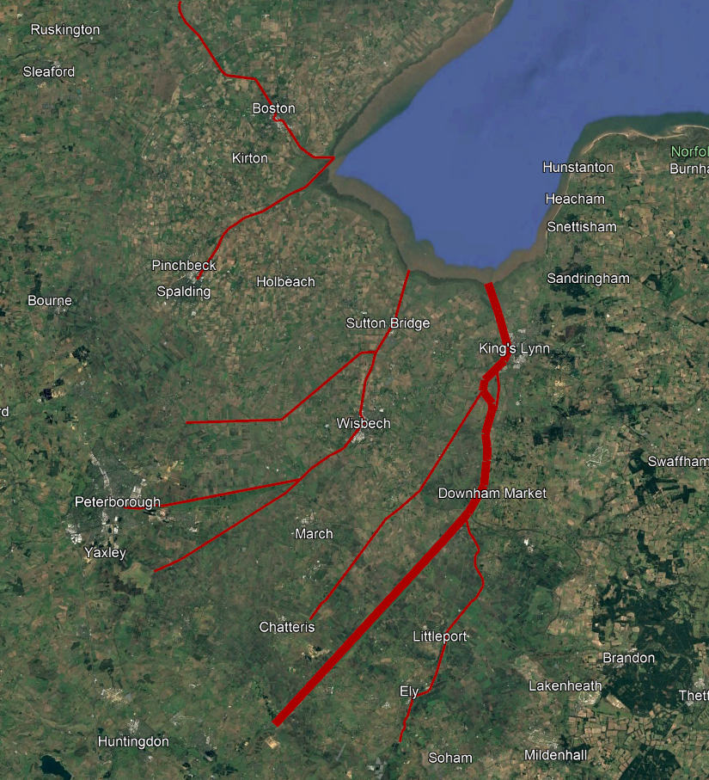
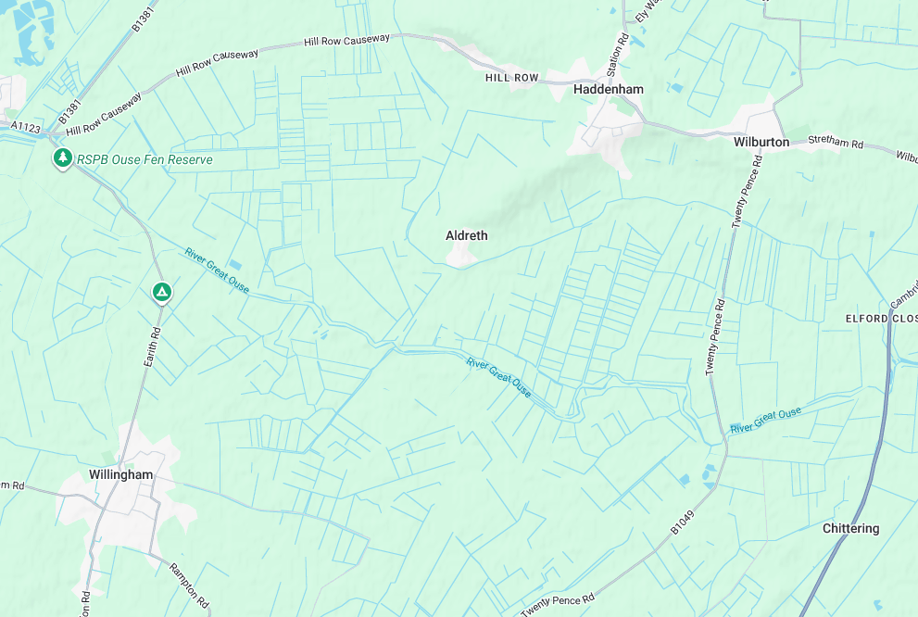

Slide 10
It All Comes Out in The Wash: Fenland Drainage and Land Improvement Projects in the 17th Century Trans-Atlantic British Empire

Slide 11
The Colonisation of North America
“The replacement of Indians by predominantly European populations in New England was as much an ecological as a cultural revolution, and the human side of that revolution cannot be full understood until it is embedded in the ecological one.”
William Cronon, Changes in the Land, (1983)
“With beaver extirpated from the region, their dams collapsed, and the ponds and wetlands they had created drained. In all, up to nine hundred thousand acres of wetlands may have disappeared… Swamps and marshes gave way to lush meadows and fertile croplands, saving English settlers the hard labour of improving agricultural land through ditching and draining.”
Strother E. Roberts Colonial Ecology, Atlantic Economy: Transforming Nature in Early New England (2019) p. 21.

Slide 12
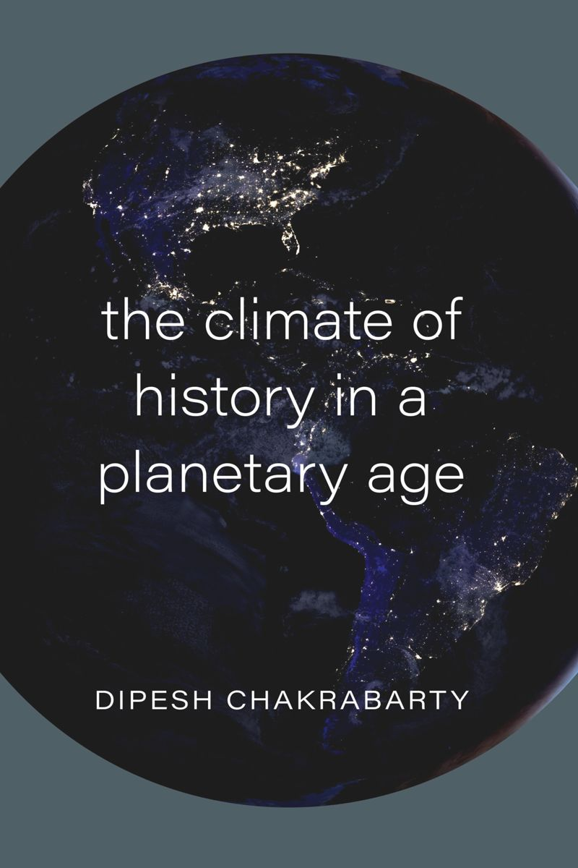
Planetary History
“The planetary, ultimately, is about how some very long-term planetary processes involving both the living and the nonliving have provided, and keep providing, the enabling conditions for both human existence and flourishing. Our recent interference with some of these processes, however, has raised for humans a particularly intractable question with a sense of urgency surrounding it, the question—to use the evocative words of William Connolly—of “facing the planetary.””
Dipesh Chakrabarty, The Climate of History in a Planetary Age, p. 85
Anthropocene: a proposed geological epoch that suggests humans as a species are currently the most geologically significant force, as potentially shown by anthropogenic climate change or the lasting signatures of nuclear activity.

Slide 13
Organic Anthropocene?
“The early modern period is, then, the pivot around which the whole question of the Anthropocene revolves. It marks the critical transitional moment of transition to truly globalized human activity and ecological impact. It was almost entirely achieved by organic means, which pushed human populations into resource frontiers and acts of global exchange which, when mineralized by the emergent power of coal, catapulted humanity into the Great Acceleration. However, the idea of the organic Anthropocene suggests that even without fossil fuels, the human impact on the globe was vast, palpable, and enduring.”
John L. Brooke and Christopher Otter “Concluding Remarks: The Organic Anthropocene” in Eighteenth Century Studies 49.2 (2016) pp. 283
“Examining these efforts at wetland ‘improvement’ draws connections between environmental processes that occurred starkly at colonial frontiers – such as deforestation, soil degradation, extraction of timber, furs, and minerals, and extinctions – and the parallel intensification of land use within Europe, a process often understood as muddier and more gradual.”
Elly Robson Dezateux “Locating Geological Agency in a ‘Small’ Early Modern Anthropocene” in History Workshop Journal 100.1 (2025)

