Slide 1
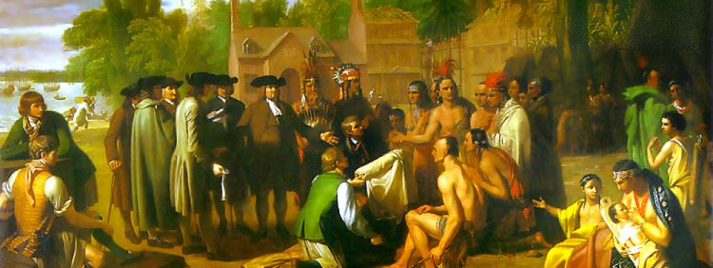
European-American Encounters and Exchanges
Tim Lockley

Slide 2
Themes
Why do Europeans head west?
What do they do when they get there?
How do they interact with native peoples?

Slide 3
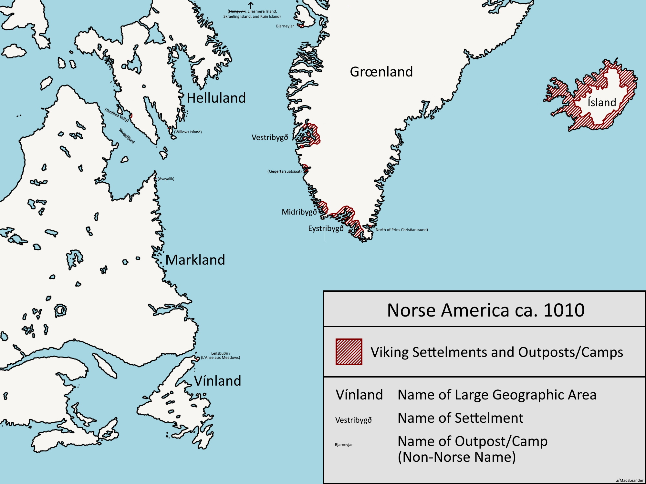
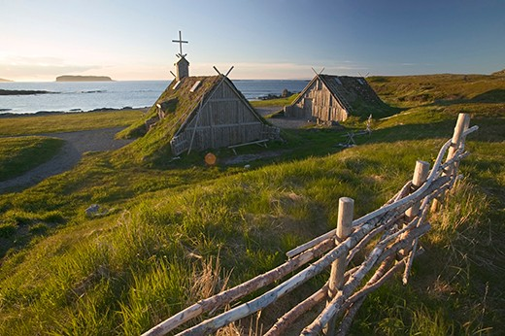
Medieval exploration
Notes:
Norse exploration described in the Icelandic sagas, written in old Icelandic, not widely known. Leif Erikson, son of Eric the Red explored c.1000 AD.
L’Anse aux Meadow in Newfoundland. Greenland settlements existed until early 15th, mostly likely affected by climate change.

Slide 4
Columbus
Notes:
Why he went - sea route to Asia
Extension of other exploration efforts
Not first European to reach Americas but first to publicise it – printed copies of his letters to Ferdinand and Isabella circulated widely in Europe
4 voyages toured coasts of Puerto Rico, Santo Domingo, Cuba, Leeward Islands, Jamaica, Central America, South America,

Slide 5
Genocide of Amerindians
Popn declines 90%
Importance of disease
Racial ideas – extinction
Notes:
Forced labour but mainly disease, including smallpox, measles, and influenza – contributes to European view of Native peoples as weak

Slide 6
Conflict
Technology
Different methods of war

Slide 7
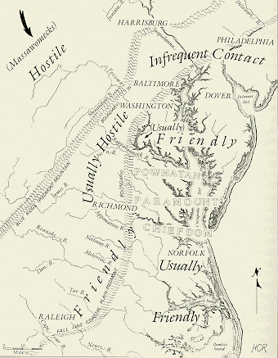
Amerindian divisions
Are Europeans invaders or potential allies?
The numbers game

Slide 8
Demographic collapse
Notes:
Many Sp see this as an ec disaster

Slide 9
Bartolome de Las Casas
Notes:
Las Casas – originally a slaveholder in Hispaniola – became priest 1510 – observed destruction of Indian peoples in Cuba first hand. Memorial de Remedios para las Indias (1516) argues for much better treatment of Indians (poss replacement with Africans) – appointed ‘Protector of Indians’ (1516); later Bishop of Chiapas - ? Achievements (couldn’t end slavery – rise of ‘Black Legend’)

Slide 10
Rapid Spanish advance
1519 conquest of Aztec civilization
1533 conquest of Inca civilization
Spanish supplant local rulers
Encomienda – right to native labour
Notes:
Use of alliances with subject native peoples who were oppressed, paid tribute etc. Cortes had about 600 Spanish soldiers – Moctezuma Aztec leader died shortly after Spanish arrival in Tenochtitlan (allegedly stoned by other Aztecs); Pizzaro had about 200 men when he attacked the Incas in 1533 – last of a number of expeditions from Panama down the Pacific coast, had found gold and jewels being traded by locals, encouraged further efforts; Incan leader Atahualpa captured and then executed
Spanish had horses, cannon, gunpowder weapons, effective fortifications, shock and awe tactics and immense violence, but also luck and exploited native divisions
Conquistadors reward followers with encomienda, land with natives already on it to work like slaves/serfs

Slide 11
Wealth of the Americas
Notes:
Mining of gold and silver from central and south America
Between 1500 and 1650, the Spanish imported 181 tons of gold and 16,000 tons of silver from the New World. In today's money, that much gold would be worth nearly $4 billion, and the silver would be worth over $7 billion
Used to fund Sp wars of expansion eg vs Netherlands; encourages other nations to get involved

Slide 12
Portuguese in Brazil
1494 Treaty of Torsedillas
Pedro Alvares Cabral lands 1500
Importance of Brazilwood
1530s more systematic colonization attempts
Start of sugar cultivation
Importation of Africans to work
Notes:
Lopo Homem Map 1519 shows exploitation of natives to cut Brazilwood – highly prized in Europe, expense, rich colour, hardwood

Slide 13
France and England play catch up
St Kitts (Fr) 1538
Charlesbourg-Royal (Quebec) 1541
France Antarctique (Rio) 1555-57
Charlesfort (SC) 1562-3
Fort Caroline (Florida) 1564-5
Roanoke (NC) 1584-7
Notes:
All failures, either due to Sp / Port / native attacks or harsh environments

Slide 14
The Great Invasion 1600-1750
England – east coast North America, West Indies
France – Canada, Louisiana, West Indies
Spain – southern and western coasts of North America, central America, n & w coasts of south America, West Indies
Portugal – Brazil
Netherlands - east coast North America, West Indies, south America
Sweden - east coast North America
Denmark – West Indies
Notes:
Only untouched areas are interior/west of North America, Amazon, Patagonia

Slide 15
The Columbian Exchange
FROM the Americas: potato, maize, tomato; turkey; cocoa; cotton; tobacco; syphilis
TO the Americas: sugar (India), coffee (Africa), rice (Africa/Asia), bananas (Africa); domesticated livestock inc horses; influenza, malaria, measles, smallpox, typhoid, tuberculosis, yellow fever

Slide 16
Colonial Models I: Staple Crops
Minimal European settlement
Sugar (Brazil, Louisiana, West Indies)
Coffee (Brazil, St Domingue)
Tobacco (Chesapeake)
Rice (South Carolina)
Wood (Brazil, North Carolina)
Notes:
All involved slavery

Slide 17
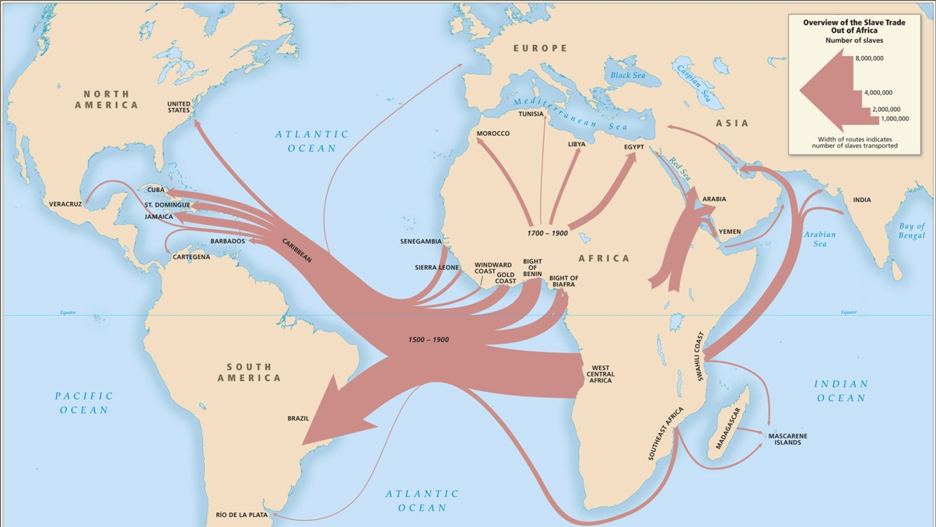
Notes:
Why Africans? Partly about a ready source, partly about lack of local labourers, partly about racial prejudice
Importation of Africans; c.2m 1500-1700; c.4-5m 1700-1800; c.3.5m 1800-1880

Slide 18
Colonial Models II: Trading posts
Minimal European settlement
Mainly at extremes
  Hudson’s Bay Company
  French Canada
  Dutch New Netherlands
  Louisiana (interior)
  Patagonia (Buenos Aires)
Notes:
Impact of fur trade on native peoples

Slide 19
Colonial Models III: Settler Societies
Spanish & Portuguese colonies had more mixed populations with a blending of European, Amerindian and even African cultures and peoples
English colonies tended to remain European.
Role of Religion
Land appropriation
Notes:
Most developed settler societies are New England, Mexico, Rio

Slide 20
European migration to 1700
Spanish 500,000
British 390,000
Portuguese 100,000
French 45,000
Dutch 15,000

Slide 21
Total populations 1750
Spanish America 3m
British America 2m
Portuguese America 1m
French America 100,000
Notes:
Sp, Port and Fr numbers include Native peoples; all include Africans

Slide 22
Conclusion
Diverse mix of societies created by Europeans in the Americas
Wealth and commodities from the Americas transformed Europe
European invasion had devastating impact on native peoples
Demography of entire Atlantic world was changed

