Slide 1
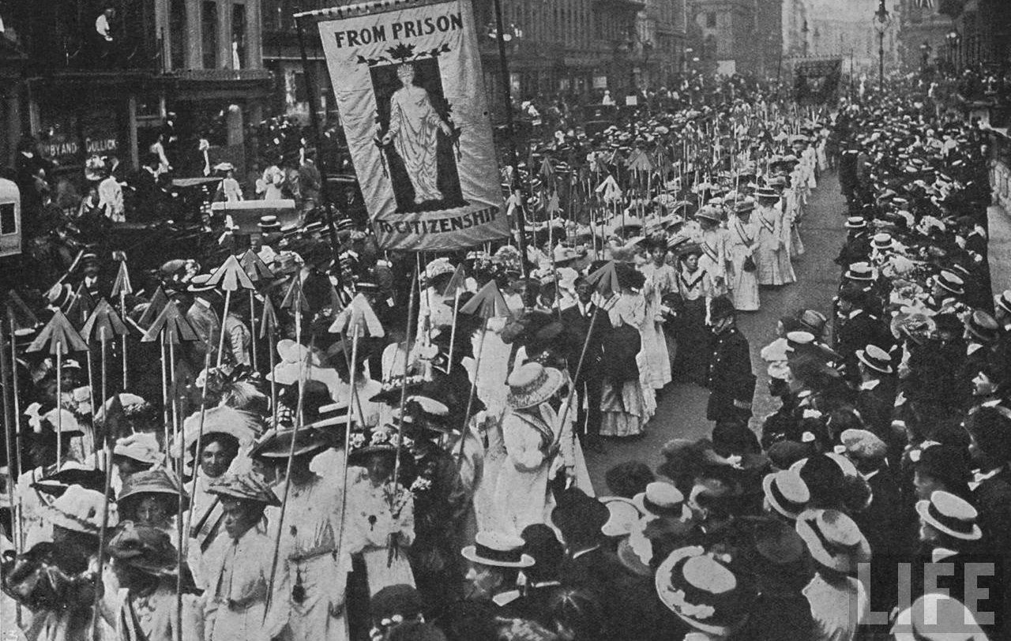

TSM Gender and History
Dr Naomi Pullin
naomi.pullin@warwick.ac.uk
@naomipullin

Slide 2
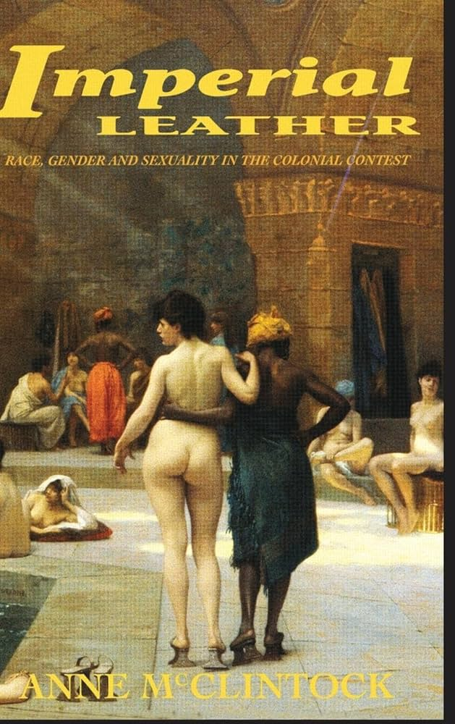
Gender history…
Not just an add-on or separate branch of history.
Necessary for understanding historical change and for bringing a new perspective to the historical discipline.
Attention to gender can encourage the re-writing of a range of histories, e.g. McClintock’s (1995) book on race and empire.

Slide 3
Focus of this lecture
The gendered nature of the historical discipline and the rise of second wave feminism.
The differences between women’s history and gender history.
Gender history in practice.

Slide 4
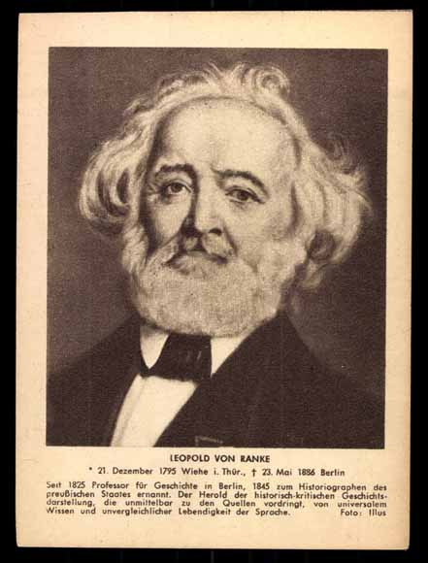
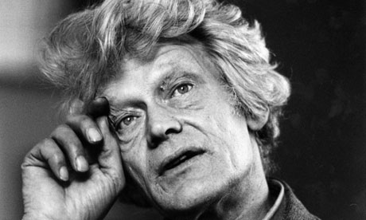
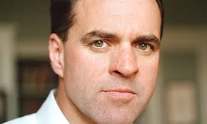
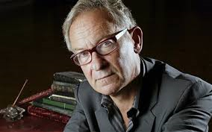
Male, pale and stale…

Slide 5
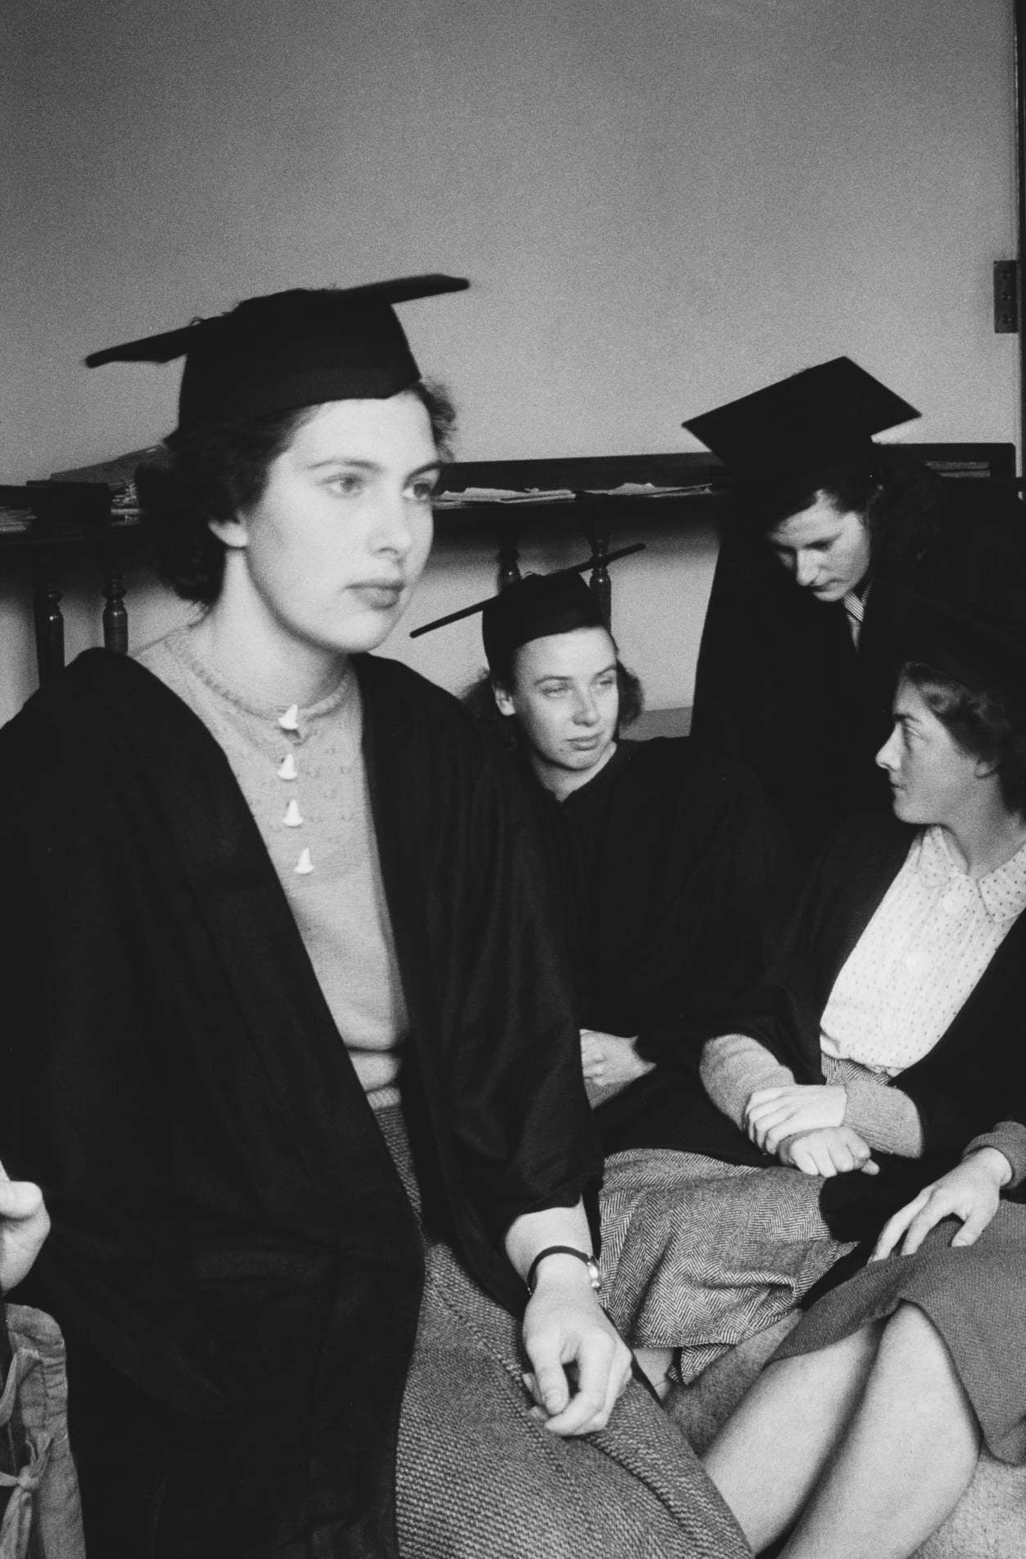
Gender and the professionalisation of history
Professionalisation of history as a discipline from 19th century associated with research conducted within universities.
Women did not attend universities in Britain until 1860s.
1920 = first degrees awarded to women studying at Oxford
1941 = for women at Cambridge.

Slide 6
History and masculine values
Profession connected to masculine ideals of intellect = rational, scientific and rigorous.
Fear that women’s involvement would undermine status of the discipline.
1950 – 15% of teachers of history in the UK were women and only 10% by 1970.
In 2024, only 20% of professors are women.

Slide 7
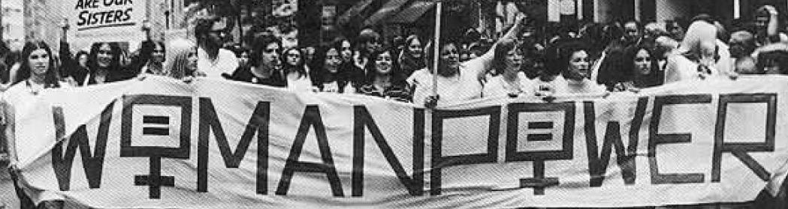
Women’s History
Before 19th century, women’s history was regarded as an important part of histories written about the progress of humanity and civilization.
With professionalisation of history focus on great men and on subjects like military/war studies.

Slide 9
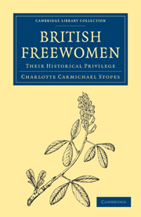
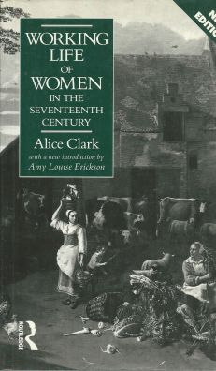
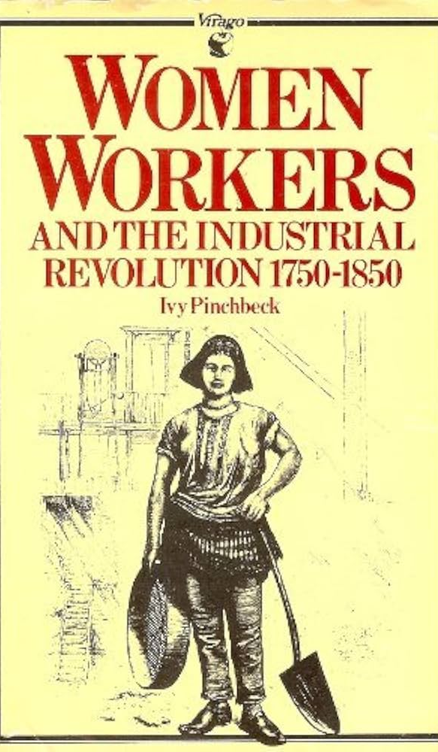

Slide 10
Patriarchy and C20 feminism
Women’s Studies emerged in 1960s and 1970s with second wave feminism.
Aimed to recover women from historical obscurity: to tell ‘herstory’ in pursuit of wider political project.
Stress on historical oppression of women, with emphasis on suffrage, access to higher education, labour history and reproductive rights.
Connected with wider aims of social history movement – moving away from ‘great men’ of history to return ‘ordinary people’ and marginalised groups to the historical record.

Slide 11
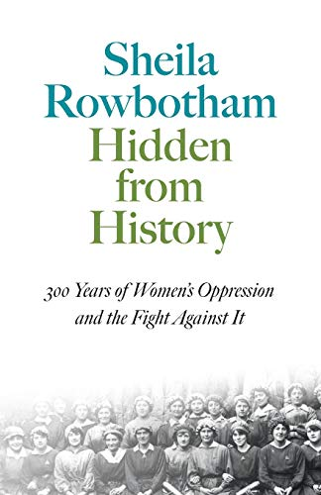
First published 1975.
To reclaim both forgotten history of women and a history of feminist resistance.
Like many studies of this era = focus on early feminists and radicals in history, e.g. suffragettes, pioneers of birth control, working-class women radicals.

Slide 12
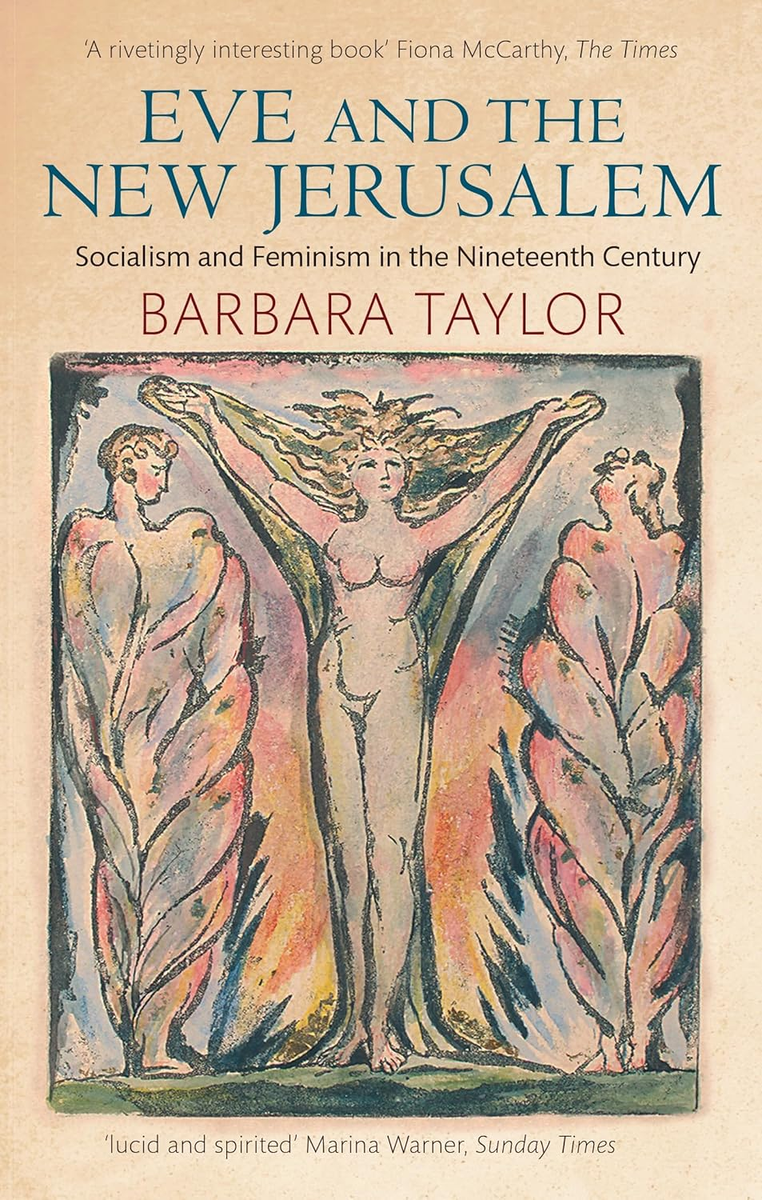
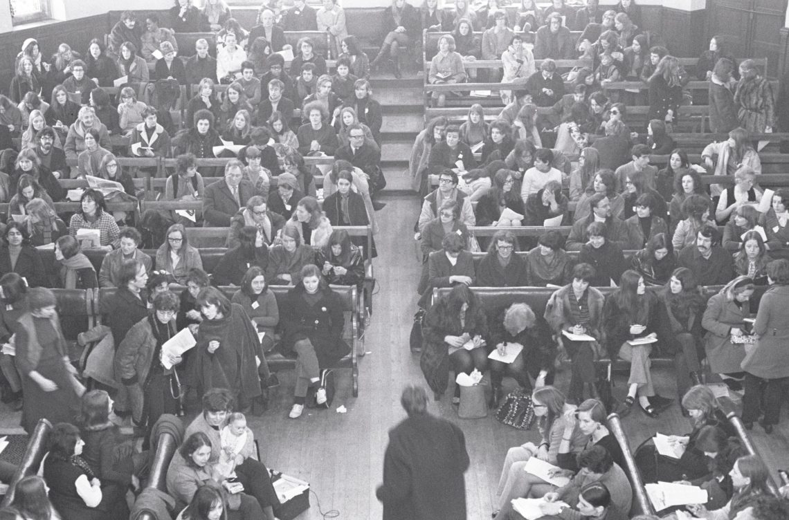
History outside traditional institutions
Women’s Liberation Conference at Ruskin College Oxford, 1970

Slide 13
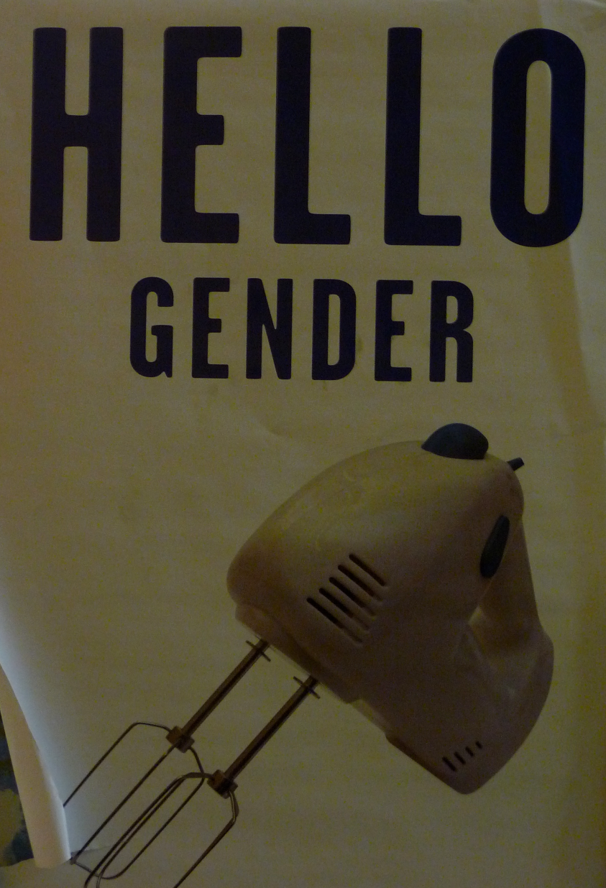
The emergence of gender history
Dissatisfaction from within feminist movement about:
1. Tendency to focus on patriarchy as a system of historical oppression rather than female agency.
2. Focus on history of women.
Concern this could lead to creation of an intellectual culture of ‘separate spheres’: history of war, politics, diplomacy vs. history of the home and the family.

Slide 14
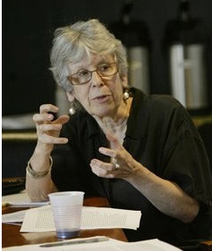
Gender history
Joan Scott, Gender as ‘a useful category of historical analysis’ (1986).
Gender identity was a social/historical creation – originally a grammatical term used to classify things.
Gender = what it means to be a man or woman in a given time or place.
Binary and oppositional classification – emphasising sexual difference as a key division within society – men and women/masculinity and femininity defined in relation to each other.

Slide 15
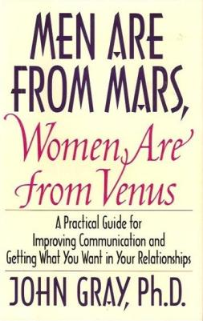
Historian to uncover meanings of masculinity and femininity in the past to understand change over time.
Destabilised category of ‘woman’ – an empty category and no longer an essential, unified existence which existed apart from culture.
Led to split in feminist movement – some worried that focus on gender (and men) would undermine experiences of women. (See Laura Lee Downs).

Slide 16
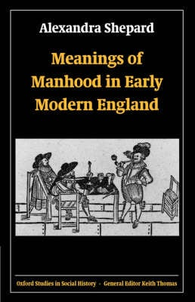
Gender history and Men’s Studies
Gender’ not just shorthand for ‘women’- men’s experiences also mattered.
Masculinity and femininity = categories of meaning through which society understood.
Late 1990s and early 2000’s = emergence of Men’s Studies’. Recognition of ‘double-meaning’ of patriarchy – a society in which some men are dominant over other men.
Joan Scott: ‘gender is a constitutive element of social relations based on perceived differences between the sexes’.
Gender = signifier of power relations.

Slide 17
McClintock, Imperial Leather
‘imperialism cannot be fully understood without the theory of gender power … gender power was not the superficial pattern of Empire, an ephemeral gloss … Rather, gender dynamics were, from the outset, fundamental to the securing and maintenance of the Imperial enterprise.’ (McClintock)

Slide 18
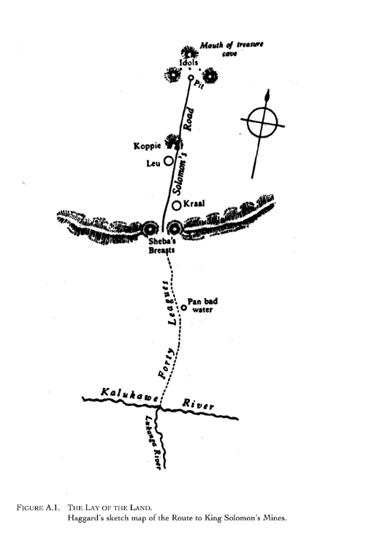
McClintock, Imperial Leather
Empire understood by colonisers and people in Britain in gendered terms.
1. Through gendered language to explain imperial enterprise, e.g. ‘virgin lands’ of unconquered territories and ascribe feminine attributes to indigenous people.

Slide 19
McClintock, Imperial Leather
‘imperialism cannot be fully understood without the theory of gender power … gender power was not the superficial pattern of Empire, an ephemeral gloss … Rather, gender dynamics were, from the outset, fundamental to the securing and maintenance of the Imperial enterprise.’ (McClintock)

Slide 20
McClintock, Imperial Leather
2. Material manifestations of empire also shaped by gendered power dynamics: armies, legal systems, prisons etc.
Women’s labour essential to economic success of empire: as child bearers and educators of new generation of imperial adventurers and colonised labourers.
Colonised and working-class women cooked, cleaned, sexually serviced and cared for children of imperial governors and bureaucrats.

Slide 21
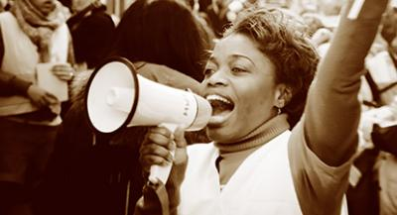
Intersectional feminism
Moves away from focus on white women’s historical experience and privilege.
McClintock = focus on racism and economic exploitation that underpinned colonisation project.
‘Intersectionality’ – coined by black feminist scholars Patricia Hill Collins and Kimberlé Crenshaw in 1990.
Influenced by black feminist theorists and activists – racism, sexism and class exploitation = connected and historically constituted.

Slide 22
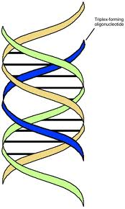
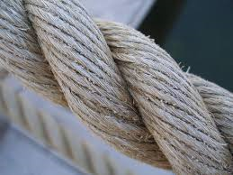
‘Race, gender and class are not distinct realms of experience, existing in splendid isolation from each other … Rather, they come into existence in and through relation to each other… In this sense, gender, race and class can be called articulated categories.’
Anne McClintock, Imperial Leather

Slide 23
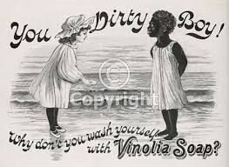
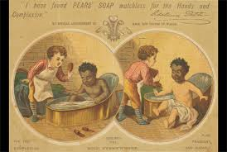
‘Soft Soaping Empire’: Commodity Racism
‘Late Victorian advertising presented a Vista of Africa conquered by domestic commodities’ (McClintock).
Commodities = way for empire to enter large number of British homes democratically. They shape ideas about national identity.
BUT also shows how domestic sphere shaped the empire.

Slide 24
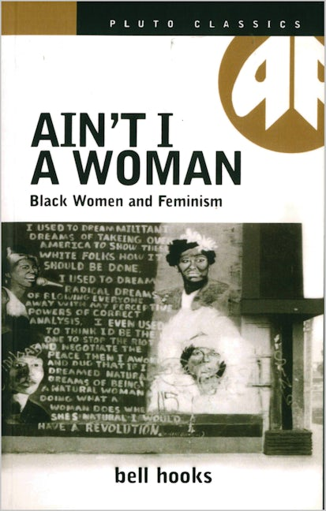
Conclusions
Men and women share a dynamic and connected history.
Writing of history was (and is) a deeply gendered process, shaped by professionalisation of the discipline.
‘Not just a new history of women’, but a ‘new history’.
Space of household = politicised arena that is part of wider national and imperial agendas.
Intersectionality forces us to reconsider how power relations shape the histories we write: category of ‘woman’ not universal and homogenous – can be actively constructed to exclude women from different racialised or class backgrounds.

