Slide 1
Power
TSM 2022
Dr Claudia Stein

Slide 2
Lecture organization
1. Reminder of Marxist notions of power
2. The Rise of a new understanding of power from the 1960s
  Socio-cultural, political context in France
  3. Michel Foucault and his concept of power
    Disciplinary power – power/knowledge nexus
    Biopower

Slide 3
Marxism and Its Notion of Power:
Power relations are understood as manifestations of a specific mode or configuration of class relations. Power is held by the domineering class which ‘supresses’ another class.
Different views among Marxists develop since Marx/Engels on the location of class power (e.g. in social relations of production, in control over the state, or in intellectual ‘hegemony’ over minds (e.g. Antonio Gramsci).
Marxists note the limitations inherent in any exercise of power and try to explain this in terms of structural contradiction that is rooted in one or another form of class domination and antagonisms inscribed therein.
4. Therefore, all forms of social power linked to class domination are inherently fragile, unstable, provisional, and temporary (they can potentially be overthrown!)
5. Continuing struggle is needed to secure class domination, to overcome resistance, and to naturalize or mystify class power.
4. Thus, in their discussions on power Marxists address questions of strategy and tactics. They provide empirical analyses of actual strategies intended to reproduce, resist, or overthrow class domination in specific periods and conjunctures

Slide 4
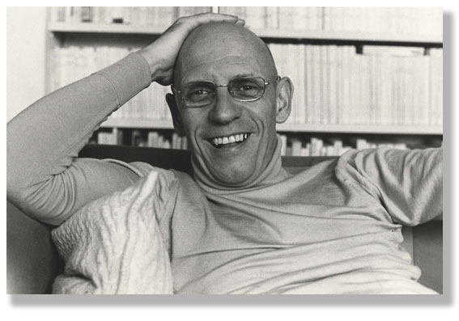
Michel Foucault 1926-1984

Slide 5
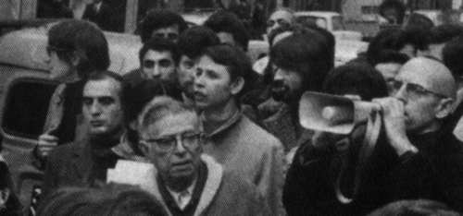
A lifelong political activist – ‘un intellectual engagé’
Foucault and the writer Jean-Paul Sartre

Slide 6
Foucault about his critics and their difficulties to situate him within the then existing political landscape
‘I think I have in fact been situated in most of the squares of the political checkerboard, one after the other and sometimes simultaneously: as an anarchist, leftist, ostensible or disguised Marxist, technocrat in the service of Gaullism, new liberal, and so forth…None of these description is important by itself: taken together, on the other hand, they mean something. And I must admit I rather like what they mean.’

Slide 7
Foucault’s overarching intellectual interest:
‘… the interaction between oneself and others and in the technologies of individual domination, the history of how an individual acts upon himself (or herself);
I am interested in the technologies of the self and a history of the subject.’

Slide 8
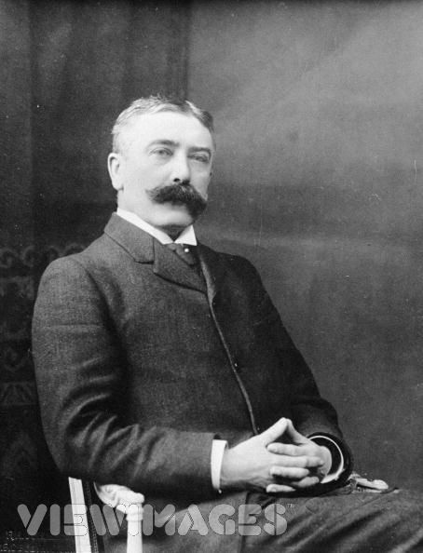
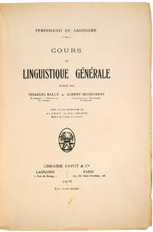
Foucault’s starting point: Linguistics
Cours de linguistique générale (1916)
Linguistics: scientific study of language in broadly three aspects: language form, language meaning, and language in context
Ferdinand de Saussure, 1857-1913, Swiss linguist

Slide 9
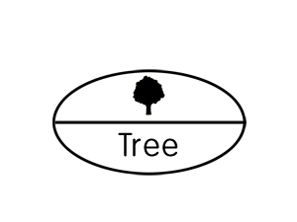
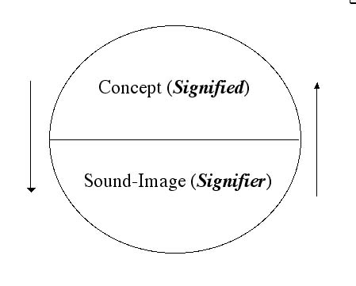
Each word is a ‘sign’ and a ‘sign’ consist of...
Sign, signifier, signified:
The sign is constituted by the relationship of a signifier (a medium, such as a road sign, a word, a gesture) to a signified (also known as the referent, the ‘thing’ being signed.)
The signified is not the thing itself, only a concept of it.

Slide 10
Saussure’s Central Claims:
Languages are not confined to written or spoken words but include any system of communication.
A sign is composed of a ‘signifier’ (vocal sound, image) and a ‘signified’ (the mental concept or structure that speaker and listener share).
A ‘signifier’is established arbitrarily and bears no resemblance to the signified. (Different languages, for example, use different signifiers for the same mental concepts)
Every sign acquires meaning by belonging to a network of other signs. There is in every sign a suggestion of another, oppositional sign. (if you say ‘women’ you immediately also think of ’man’ or ‘child’, anything a ‘woman’ is not. To think about the differences gives meaning to the term ‘women’).

Slide 11
Consequences:
Our relationship to knowledge becomes uncertain because the ‘meaning’ (‘concept’ or ‘signified’) and the ‘signifier’ (sound/image/written word) are separated and their link is arbitrary. They are ‘made-up’ by humans and rely on the internal structure of a language which only allows you to say certain things at a certain moment in time (languages changes throughout time and moves with the changes in human society and culture which is represents!)
The notion of arbitrariness of the sign deeply challenges the modernist understanding of truth: if signs relate only to each other within an own structure, how could language be deemed to refer to the world out there which we call ‘reality’? How could language ever refer to a ‘universal reality’ if the speaker is locked into a system and structure of language that changes over time?
Thus, there is no reality; there is merely a representation of language
Can anyone speak ‘the truth’? There is no authority in terms
truth
gra

Slide 12
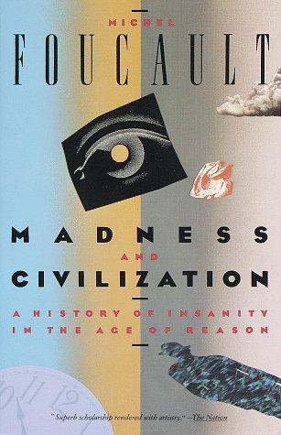


In his first books Foucault focuses on the workings of language
Note: none of these works is about ‘power’!!!!! Please do not
use them if you write about Foucault and power!

Slide 13
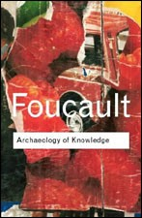
He develops and own methods here: Archaeology
Note: All these books are NOT about power! He is no interested
in it yet but rather in the exploration of the rules of language

Slide 14
Realisation: It is not language and speech that make people act but practices and even material objects
and
He begins to reject other explanations of power at his time
‘ The traditional explanations as the spirit of the time, technology, class, social cultural influences struck me for the most part as being more than magical effective’.
He starts to wonder about the nature of ‘power’ and has new ideas...

Slide 15
Foucault’s ideas about power:
“It seems to me that power must be understood in the first instance as the multiplicity of force relations immanent in the sphere in which they operate and which constitute their own organization; as the process which, through ceaseless struggles and confrontations, transforms, strengthens, or reverses them; as the support which these force relations find in one another, thus forming a chain or a system, or on the contrary, the disjunctions and contradictions which isolate them from one another; and lastly, as the strategies in which they take effect, whose general design or institutional crystallization is embodied in the state apparatus, in the formulation of the law, in the various social hegemonies” (Foucault, 1990, pp. 92-93).

Slide 16
He invents a new method to investigate his new ideas of power
Genealogy:
‘….a historical causal explanation that is material, multiple, and corporeal.
It is concerned with the analysis of historical emergence; it is conceptualised not as the culmination of events, or as the end of a process of development but
rather as a particular momentary manifestation of chances or as a struggle between forces. Genealogy embraces conflicts at a particular moment in time.’

Slide 17
Genealogy is a ‘history of the present:
The subject matter of this kind of history is the origins of present rules, practices or institutions that claim authority over us. It starts from an investigation of the present.
What claims authority over us now? What makes us think that certain ideas, practices, institutions in the present are ‘normal’)
The primary intend is not to understand the past for its own sake (to learn a lesson etc.) but to understand and evaluate the present, particularly with a view to discrediting unjustified claims of authority and power

Slide 18
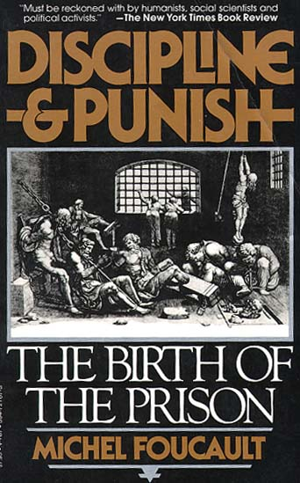
1. Investigation of how power on the individual: discipline
Historical example:
Foucault starts off by investigating a central conflict of is time... The penal system
Analysis of disciplinary power on the individual body which emerges since the late 17th century
Result: power’s key target is the submission of the human body by different forms of discipline

Slide 19
Thus….
‘Discipline’ (or disciplinary power) may be defined neither with an institution nor with an apparatus; it is a type of power, a modality for its exercise, comprising a whole set of instruments, techniques, procedures, levels of applications, targets.’
Aim: Discipline produces ‘docile’ bodies. Bodies which act without being told to act in a particular way

Slide 20
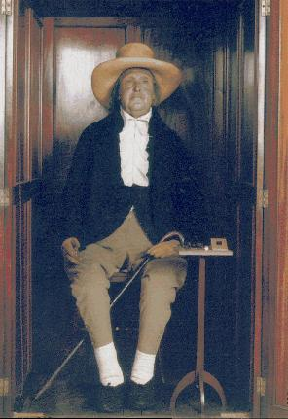
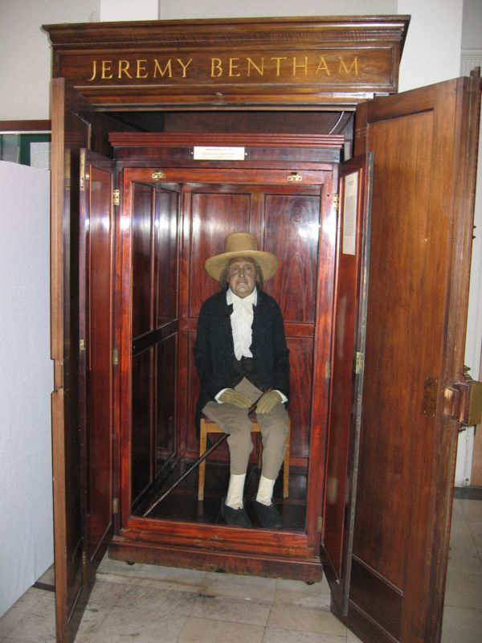
How does discipline function:
1. Hierarchical observation
Foucault uses ideas of Jeremy Bentham, the founder of utilitarianism to show this….

Slide 21
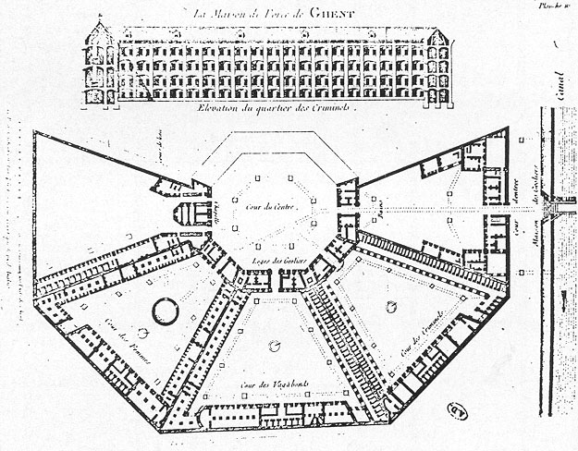
Bentham’s idea of the prison panopticum

Slide 22
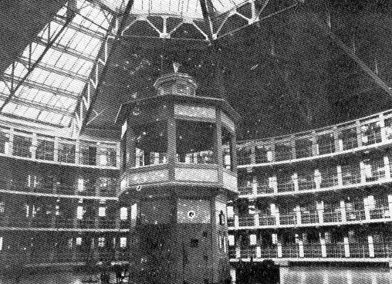
‘….we induce in the inmate a state of consciousness and permanent visibility that assures the automatic functioning of power.’

Slide 23
2. Normalising Judgement
Individuals are judged not by the intrinsic rightness or wrongness of their acts but by where their actions are placed on a ranked scale that compares them to everyone else.
We are subjected to a whole set of micro-normalising judgements (regarding time keeping, activities, speech, of body, of sexuality). We use discipline to punish non-conformity.

Slide 24
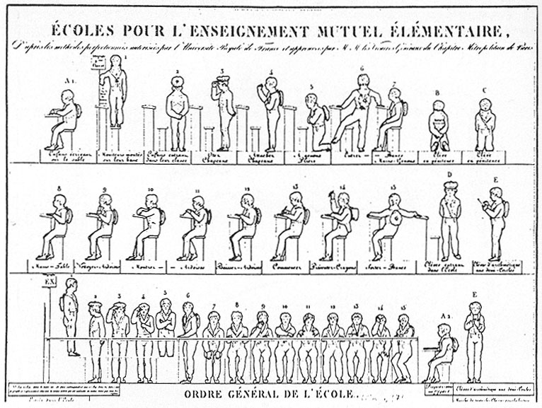
Micro-management of the body in school

Slide 25
3. Examination
combines ‘normative judgement’ with ‘hierarchical observation’ to effect a ‘normalising gaze’ through which individuals may be classified or judged.
The medical examination is a prime locus of modern power/knowledge.

Slide 26
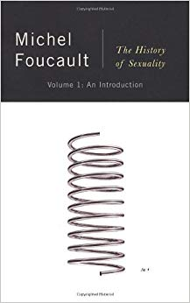


2. How does power work in a group of individuals (e.g. society)
He moves from individuals to the investigation of regulatory power directed at ‘populations’
Human sexuality is THE central mechanism to exercise power over individuals and larger population

Slide 27
How to rule populations?
Biopower:
‘I mean a number of phenomena that seem to me to be quite significant, namely, the set of mechanisms through which the basic biological features of the human species became the object of a political strategy, of a general strategy of power, or, in other words, how, starting from the 18th century, modern Western societies took on board the fundamental biological fact that human beings are a species. This is what I have called biopower.’

Slide 28
The rise of biopower in
17th and 18th century

Slide 29
Aim of a history of the present:
‘A History of the Present’ to facilitate a transformation of the present through the analysis of power:
‘Real criticism consists in uncovering that thought and trying to change it: showing that things are not as obvious as people believe, making it so that what is taken for granted is no longer taken for granted.
To practise criticism is to make harder those acts which are now too easy... [A]s soon as people begin to no longer be able to think things the way they have been thinking, then, transformation becomes at the same time very urgent, very difficult and entirely possible.’

