Slide 1
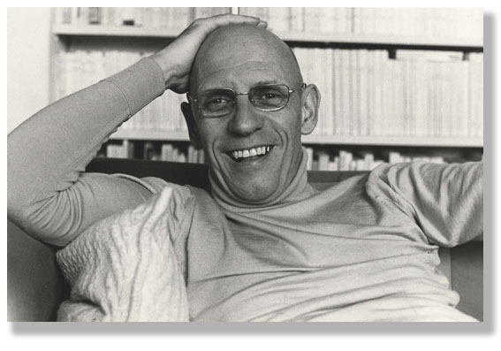
Michel Foucault 1926-1984

Slide 2
Foucault
Most influential thinker of late 20th century
Impact on history, literature, philosophy, cultural studies (pioneer of it), and the history of science and medicine

Slide 3
Foucault on the overall aim of all his work:
‘… the interaction between oneself and others and in the technologies of individual domination, the history of how an individual acts upon himself (or herself); I am interested in the technologies of the self and a history of the subject.’

Slide 4
Foucault – Knowledge as Power
Subjects are created through discourse
Not coercive but epistemic sovereignty: power as discipline and norms

Slide 5
Foucault Lexicon
What you want to be familiar with…
Power/Knowledge
Discourses (techniques, practices, norms)
Archaeology (epistemes)
Genealogy (contingent formation of power structure that persist to today)
Process of historical change… contingency which alters power/knowledge structures….

Slide 6
Historical change we’ve seen so far…
Stadial History → Civilisation, progress (Enlightenment)
Providence → Ranke (don’t look for logical processes of change between each age… just try to ‘get’ the spirit of each age on its own terms)

Slide 7
Historical change we’ve seen so far…
‘Spiritual’ Dialectics → Hegel (tensions and contradictions, such as Master/Slave, between different modes of consciousness and different objects get resolved in ways that advance human consciousness and Reason, moving society toward greater collective and individual self-awareness, culminating in the State, where Reason is at its most sophisticated.)

Slide 8
Historical change we’ve seen so far…
Material Dialectics → Marx: contradictions in modes of production (hence the material), processes of class conflict culminate in the transcending of that conflict, arriving at a society with truly human consciousness (not just class consciousness), without a State, or communism)
Belief systems as motor of change (Weber’s Protestant work ethic → capitalism)

Slide 9
Historical change we’ve seen so far…
Foucault → contingencies come together to produce historical change in how individuals are controlled… technologies of ‘self-hood’ → self-constitution and regulation.

Slide 10
Foucault on critics who try to pigeon-hole him politically:
‘I think I have in fact been situated in most of the squares of the political checkerboard, one after the other and sometimes simultaneously: as an anarchist, leftist, ostensible or disguised Marxist, technocrat in the service of Gaullism, new liberal, and so forth…None of these description is important by itself: taken together, on the other hand, they mean something. And I must admit I rather like what they mean.’

Slide 11
Who was he?
Son of a successful doctor in Poitiers
Entered the competitive École normale supérieure (Paris)
Spent 1950s teaching in Sweden, Poland and Germany while finishing PhD thesis
Rocketed through French system
Clermont-Ferrand (remote mountain region of France)
Tunisia (until 1968)
University of Paris, Vincennes (now Saint-Denis)
College de France
US universities: especially UC Berkeley

Slide 12
Political Context
Intellectually developed in post-war France
Intense soul-searching and divisions among the Left
Gaullism and anti-Gaullism
De-colonisation
1968 and aftermath (the self and sexuality)

Slide 13
Influences - Nietzsche
Historic philosophy: moral norms as tools of power
Genealogies
Critique of belief systems; tyrannies of ‘truth’ and ‘goodness’
Consideration of language systems as well as practices and institutions

Slide 14
Genealogy is a ‘history of the present’:
The subject matter of this kind of history is the origins of present rules, practices or institutions that claim authority over us.
(What claims authority over us, is what makes us think that certain ideas, practices, institutions in the present are ‘normal.)
The primary intent is not to understand the past for its own sake, but to understand and evaluate the present, particularly with a view to discrediting unjustified claims of authority.

Slide 15
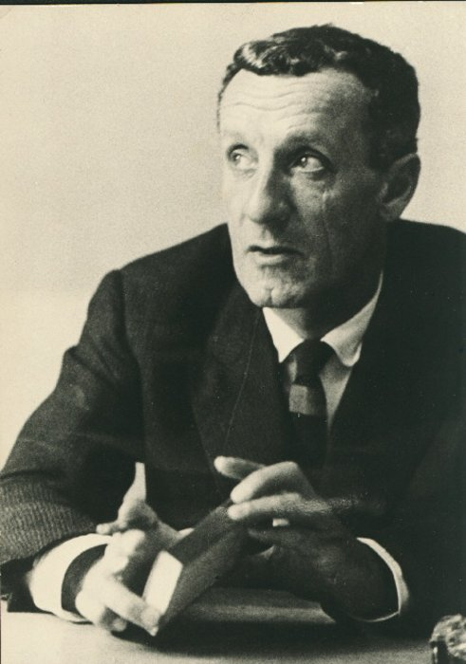
Influences – Phenomenology
(Husserl, Heiddeger, Merleau-Ponty)
study of structures of experience, or consciousness. In its most basic form, phenomenology attempts to create conditions for the objective study of topics usually regarded as subjective: consciousness and the content of conscious experiences such as judgments, perceptions, and emotions. Although phenomenology seeks to be scientific, it does not attempt to study consciousness from the perspective of clinical psychology or neurology. Founder is Edmund Husserl in the 1920s.
Maurice Merleau-Ponty, 1908-1961

Slide 16
Also influenced by structuralist linguistic analysis
Saussure (language as systems of consciousness)
Roland Barthes (linguistic turn: structuralist and later a post-structuralist)

Slide 17
Fraught relationship with Existenialism
- based on the assumption that philosophical thinking begins with the human subject — not merely the thinking subject, but the acting, feeling, living human individual. In existentialism, the individual's starting point is characterized by what has been called "the existential attitude", or a sense of disorientation and confusion in the face of an apparently meaningless or absurd world.

Slide 18
Fraught relationship with Existentialism
A step away from Descartes: the ‘reasoning’ subject can’t bring a ‘reasoned’ order to the world. But existentialists were still anchored in the Cartesian presupposition of the subject’s ‘subjectivity’ – the capacity to be fully in control of one’s thought and actions.
Foucault will reject even this vestige of Cartesian thought in the 1960s → ‘Man is Dead’ (echo of Nietzsche’s ‘God is Dead’)
Later, however, he will come to appreciate Sartre’s concerns with resistance, which requires agency.

Slide 19
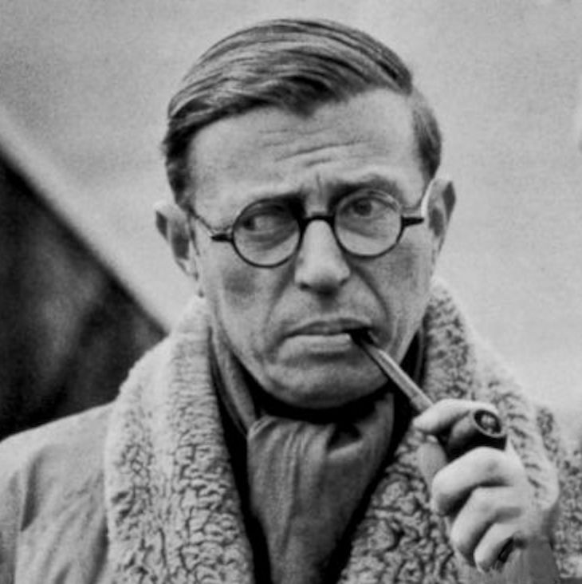
Jean-Paul Sartre
Combined Marxist materialism with individual agency and responsibility (ethics)
Individuals may not be the authors of their conditions but they are responsible for the choices they make within them.

Slide 20
Sartre vs Foucault, 1960s
Sartre’s criticism of Foucault
No explanation of historical change
F was apolitical and bourgeois
F’s model: no conceptual room for resistance or individual responsibility
F’s criticism of Sartre
S was too humanistic. (F sought to dismantle humanism), too indebted to Descartes’s notion of the individual subject (I think therefore I am)
S’s philosophy was too totalizing, and too old-fashioned

Slide 21
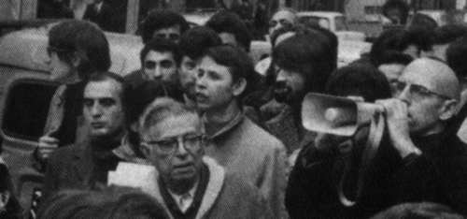
Foucault and Sartre at demonstration, 1971,
in poor Paris area of Goutte d’or, after police murdered a Muslim
suspect

Slide 22
History at the Time
E. P. Thompson (and Sartre)
Rescue the individual and agency from mechanistic, overly materialistic versions of Marxism.
F challenges the naiveté of the former attitudes towards knowledge and questions the autonomy of ‘experience’ and ‘agency’

Slide 23


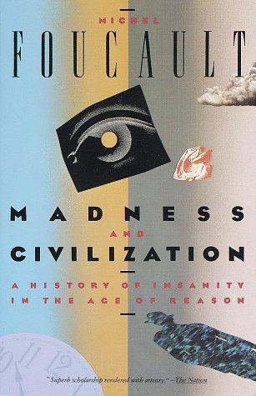

Slide 24
Madness and Civilization 1961 (part of PhD thesis)
Madness is not a constant in history
Madness was treated in different ways before 19th century
E.g., during Renaissance, the mad were thought to possess wisdom. (The fool at Court.)
19th century: madness becomes a medical condition requiring institutionalization and scientific expertise
Upshot: bodies become docile and controlled, not by a sovereign in the first instance, but by knowledge which generates and authorizes controlling practices and institutions.

Slide 25
1966

Slide 26
The Order of Things (1966)
Made him an academic rock star
Attack on humanism and Enlightenment.
His central question: Why is it possible to think certain things in one time but not another?
Conditions of possibility of thought

Slide 27
Episteme: ‘In any given culture and at any given moment there is always only one episteme that defines the conditions of possibility of all knowledge, whether expressed in theory or silently invested in a practice.’
Renaissance Episteme (1450-1650)
Classical Episteme (1650-1800)
Modern Episteme (1800-1966)
Postmodern Episteme (late1960s -?)
Today? ‘Fake is Real’, post-truth Episteme?

Slide 28

1969

Slide 29
Archaeology
is concerned with the analysis of language as a system of the possibility of expression; it is synchronic and does not try to explain change or the origin of the distribution of power.
He claims that at any given historical period, due to a particular language used, there are substantial constraints on how people are able to think (and consequently act).
Foucault’s idea is that thinking involves implicit rules (maybe not even formulated by those following them) that materially restrict the range of possible thoughts.

Slide 30
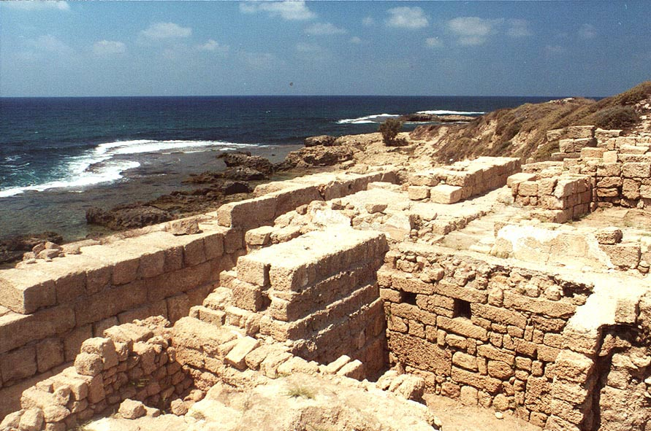
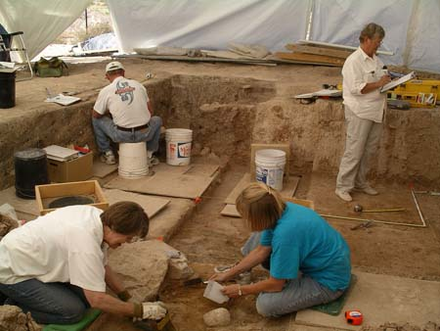
Foucault’s intellectutal ‘tools’:
Method of archaeology

Slide 31
‘What is an Author?’ (1969)
Barthes’s question
The author should be considered ‘not to restore the theme of an originating subject, but to seize its functions, its intervention in discourse, and its system of dependencies… under what conditions and through what forms can an entity like the subject appear; what position does it occupy; what function does it exhibit?’

Slide 32
Influence of ‘What is an Author?’
Gave new direction to historians of print
How does a single author come to be associated with texts by the 18th-19th centuries? Why do only certain texts seem to require an ‘author’? What kinds of laws and cultural practices are generated around the subject of the author (copyright law, a cultish celebration of, say, Shakespeare)

Slide 33

1975

Slide 34
‘Discipline’ may be defined neither with an institution nor with an apparatus; it is a type of power, a modality for its exercise, comprising a whole set of instruments, techniques, procedures, levels of applications, targets.’

Slide 35
From spectacle of the scaffold to institutional confinement and reform
Control of bodies
Creation of norms to regulate bodies

Slide 36
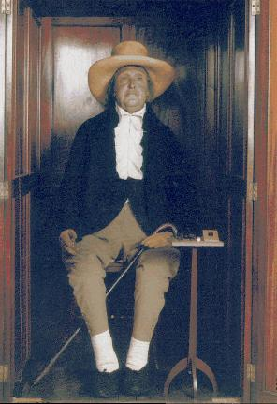
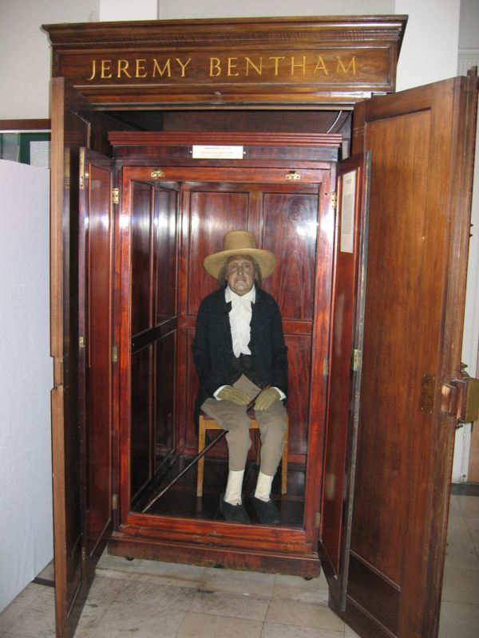
Disciplinary power produces ‘docile bodies’:
1. Hierarchical observation
The ‘stuffed’
Jeremy Bentham
at UCL today (his skeleton is under the clothes)

Slide 37
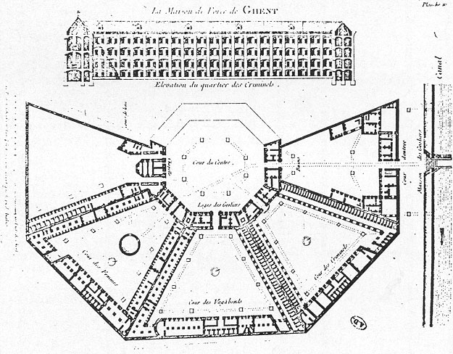

Slide 38
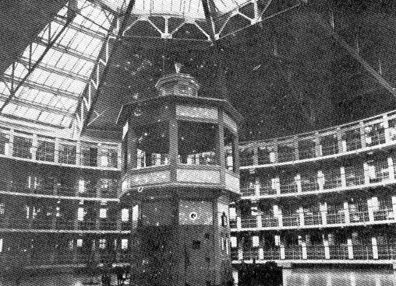
‘….we induce in the inmate a state of consciousness and permanent visibility that assures the automatic functioning of power.’

Slide 39
2. normalising judgement
Individuals are judged not by the intrinsic rightness or wrongness of their acts but by where their actions are placed on a ranked scale that compares them to everyone else. We thus produce ‘normal’ and ‘abnormal bodies’.

Slide 40
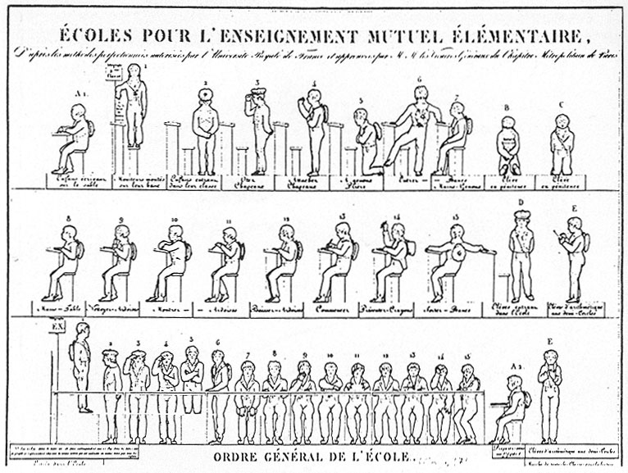

Slide 41
3. examination
combines ‘normative judgement’ with ‘hierarchical observation’ to effect a ‘normalising gaze’ through which individuals may be classified or judged. The examination is a prime locus of modern power/knowledge.

Slide 42
Foucault’s investigation of Power:
has to address not centralised and legitimate forms of power but techniques, which have become embodied in local, regional material institutions.
should concern itself with the exercise or practice of power, its field of application and its effects, and not with questions of possession or conscious intention.
Power is not a commodity or a possession of an individual, a group or a class, rather it circulates through the social body, and is exercised through a net-like organisation in which all are caught; power is strategic; at the same time‘intentional’, yet non-subjective . Therefore analysis begins from micro-level in order to reveal the particular histories, techniques and tactics of power directed towards control of the human body
Power produces knowledge – knowledge produces power (Power/Knowledge); power is productive and not repressive. It often produces pleasure. So, we need to start investigation at what we think is ‘good’, what is pleasurable; what we consider ‘normal’ and proceed from there.
Power requires resistance. We need to consider resistance to power as part of the power game.
.
)

Slide 43
Biopower
‘I mean a number of phenomena that seem to me to be quite significant, namely, the set of mechanisms through which the basic biological features of the human species became the object of a political strategy, of a general strategy of power, or, in other words, how, starting from the 18th century, modern Western societies took on board the fundamental biological fact that human beings are a species. This is what I have called biopower.’

Slide 44
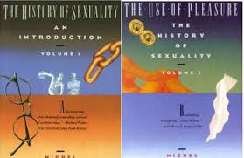
History of Sexuality 3 vols: 1976, 1984, 1984

Slide 45
History of Sexuality
Power produces subjectivity
‘Homosexuality appeared as one of the forms of sexuality when it was transposed from the practice of sodomy (a grab-bag) to a kind of interior androgyny, a hermaphrodism of the soul.’
19th century: medical and criminal discourses
It’s not only what you do, it’s what you are and how your essence threatens society.

Slide 46
‘What is Enlightenment?’ (1984)
Bicentenary of Kant’s famous essay with same title.
F aligns his intellectual project with the Enlightenment, which is surprising, given his critical assessment of Enlightenment epistemology as power.

Slide 47
‘What is Enlightenment?’ (1984)
Kant’s notion of individual emancipation through Enlightenment: ‘man’s emergence from his self-incurred immaturity.’ (‘What is Enlightenment?’ [1784]). Moral autonomy: choose yourself how to act in the world.
Foucault: defends his archaeology of knowledge
‘I do not know whether it must be said today that the critical task still entails faith in Enlightenment; I continue to think that this task requires work on our limits, that is, a patient labor giving form to our impatience for liberty.’
Awareness of how power and limits constitute the self allows us to make decisions about whether to accept, reject or modify. A critique of power may not ‘free’ us in an absolute sense but gives us the means of self-constitution through our use of limits’
A bit of agency enters into the picture.

Slide 48
Criticism by historians
His facts are often wrong. Bends evidence to make (admittedly innovative) claims
Sweeping claims with little attention to nuance and differences, particularities (it’s hard to appreciate the roundedness of historical individuals through an ‘episteme’)
Too synchronic. Can’t account for change. No causation… contingency at most.
No agency or possibility for resistance (early work)

