Slide 1

Structure
Theories, Skills, Methods
HI 9898 - MA in History
Charles Walton, 2023

Slide 2


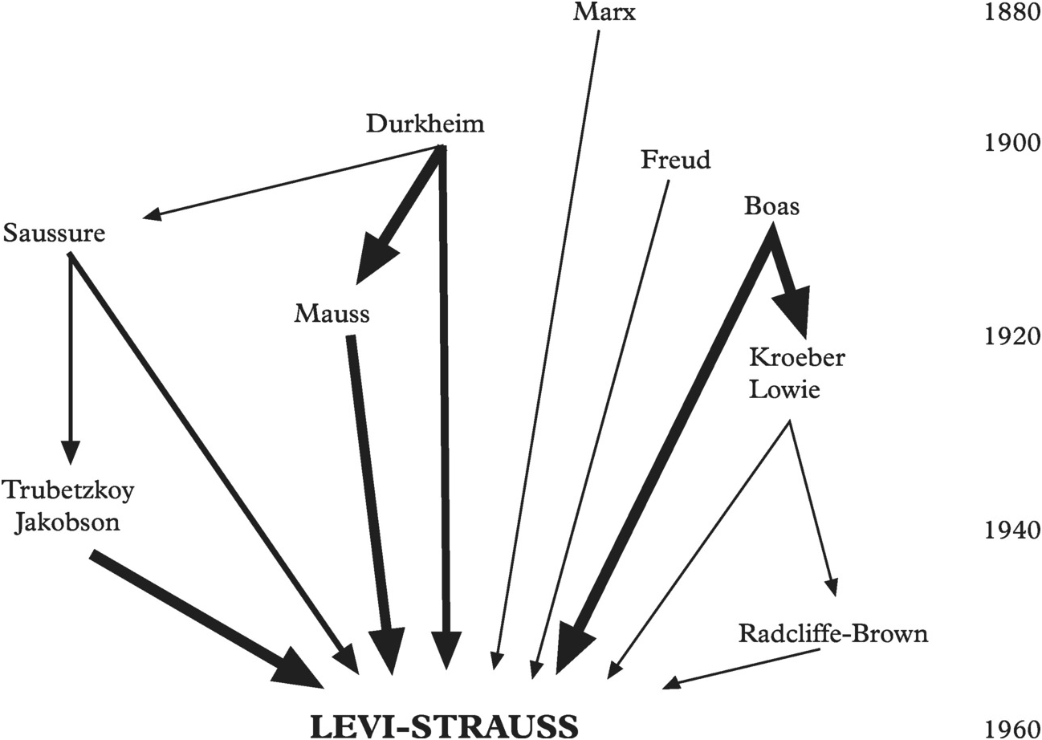
Definitions
Structuralism is a theoretical paradigm positing that elements of human culture must be understood in terms of their relationship to a larger, overarching system or structure.
Key Points:
Emerged in early 20th-century France.
It examines underlying structures that govern the ways elements relate to one another.
Opposed to explaining phenomena by its content, but by the structures that govern its existence.

Slide 3


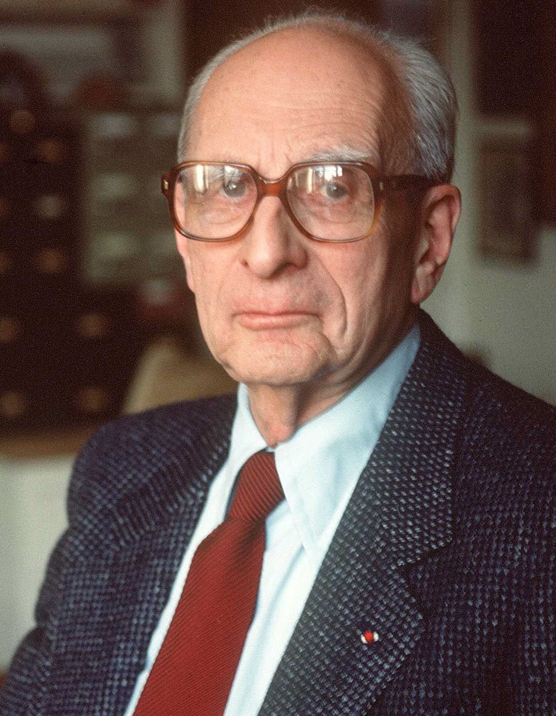
Claude Lévi-Strauss (1908-2009) Cultural Anthropology
Notable Works:
Tristes Tropiques (1955/61)
The Savage Mind (1962/66)
Founder of structural anthropology, focusing on kinship and myth.

Slide 4
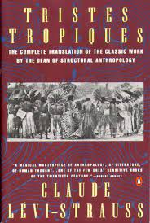
Tristes Tropiques
Doubts about the enterprise of cultural anthropology.
A blend of personal memoir, travelogue, and anthropological exploration.
Opening: ‘I hate travelling and explorers.’ — The paradoxical opening line that sets the tone for the introspective journey.
Lévi-Strauss's travels and fieldwork in Brazil's interior, primarily with indigenous tribes such as the Nambikwara and Tupi-Kawahib.
Uses his experiences to reflect on the nature and purpose of anthropology, emphasizing its role in understanding human societies and cultures.
Culture is a means to mediate and make sense of the natural world, but its expressions (in rituals, myths, kinship) have universal structures.

Slide 5
Lévi-Strauss - Myths
Myths
Oedipus myth
Myths from different cultures share similar structures, based on binary opposites (Saussurian).
Myths function to mediate conflicting forces in a society, finding equilibrium.
More concerned with underlying structures than narrative details.
Binary Oppositions: He identified key pairs of opposites, such as life/death, human/divine, and nature/culture, which help to structure the myth

Slide 6
Lévi-Strauss – Oedipus myth
From consciousness to social structure, not the other way around.
Binary Oppositions (‘raw vs. cooked’): He identified key pairs of opposites, such as life/death, human/divine, and nature/culture, which help to structure myths.
Nature vs. Culture : The Oedipus myth mediates the tension between nature (incestuous desire, as Oedipus unknowingly marries his mother) and culture (the societal taboo against incest).
Overcoming Ambiguities: The myth seeks to resolve inherent contradictions. For example, Oedipus is both son and husband to Jocasta, and both father and brother to his children.
Universal Patterns: Lévi-Strauss believed myths across cultures serve similar purposes, mediating contradictions and reinforcing societal structures.
Key Insight: The true function of the myth is not to tell a particular story but to confront and resolve universal human dilemmas.

Slide 7
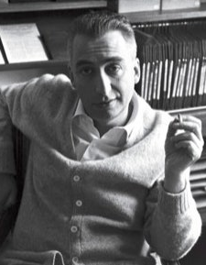
Roland Barthes (1915-1980) Literary Theorist
Notable Works: Mythologies, S/Z, Camera Lucida
Analysed structures in various fields from literature to fashion.

Slide 8
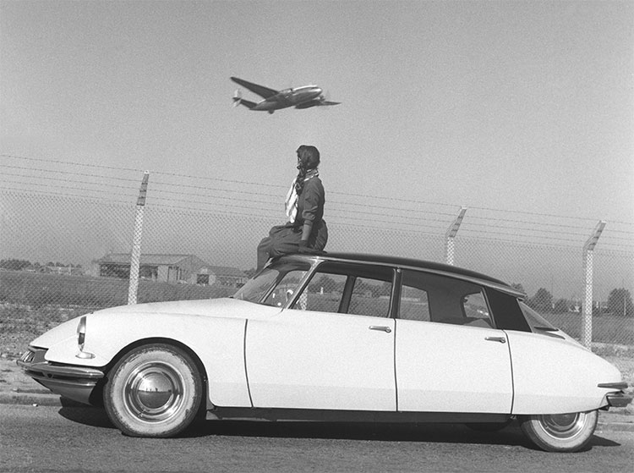
Barthes From structuralism to post-structuralism
Structuralist mode
Studied signs and symbols, both individually and grouped in sign systems.
Identified their underlying messages of norms and power
Citroën DS car: French prestige and technical prowess; modernity in the making
Driving as exciting, something beyond functionality

Slide 9
Barthes
Post-structuralist mode
Considered how signs can be read in different ways
Structures/system are unstable
Dynamic relationship between text and reader
Moby Dick, Herman Melville
Moby Dick
Put aside author’s intentions or background
How do readers create meaning
How texts interacts with other cultural symbols
Enter: History!

Slide 10
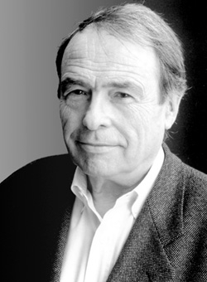
Pierre Bourdieu (1930-2002) Sociologist
Wrote about Algeria over decades, changing his analytical approach across publications.
Lévi-Strauss: Universal Structures
Barthes: Semiotics; text and reader
Bourdieu: Habitus; field; non-determinist

Slide 11
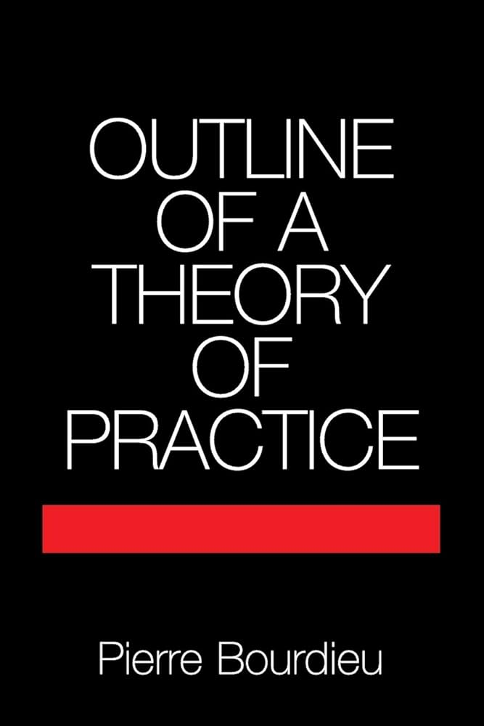
Bourdieu - Habitus
Outline of a Theory of Practice (1980)
Habitus: a set of dispositions individuals acquire over time from their social and cultural environment. These dispositions guide perceptions, appreciations, and actions. Habitus both produces and is produced by social practices. (circular reasoning?)
Bridge between agency and structure

Slide 12
Bourdieu - Field
Outline of a Theory of Practice (1980)
Field: refers to different social arenas where agents and their social positions are located. Agents in a field struggle over capital (economic, social, cultural) and positions.
Notice gap between ‘interests’ and ‘habitus’
Friction between them: source of change

Slide 13
Bourdieu - Doxa
Outline of a Theory of Practice (1980)
Doxa: refers to a set of unquestioned beliefs by which aspects of the world and its constituents (people, things, one's own social situation and practices) are grasped as ‘natural’, taken for granted.
Common sense, engrained.
Varies by field (e.g., what goes without saying differs in the fields of art, education, and politics.

Slide 14
Bourdieu and historical change
Social conditions shape the habitus. As conditions change, so can the habitus. (Marxist materialism)
The habitus is constantly reproduced, leaving room for changing conditions to alter it.
Adjustments according to fields, where competition takes place, inflecting rule-changes.
Hysteresis: mismatch between habitus and field, due to sudden changes in the field. Over time, habitus may adjust to new field conditions.

Slide 15
Bourdieu
Habitus – tends towards reproduction of social structures and dispositions, but it is not immutable.

Slide 16

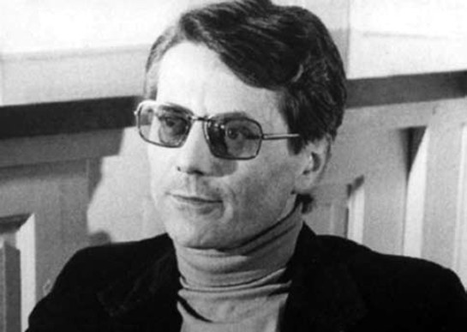
Michel de Certeau (1925-1986) Jesuit priest, interdisciplinary
Developed an influential theory of everyday practices in his seminal work The Practice of Everyday Life (1980).
Insights into how individuals navigate, use, and subtly subvert the structures and systems imposed on them.

Slide 17

Certeau Practice of Everyday Life
Strategies: Associated with institutions and structures of power. They're deliberate, established frameworks used to control or create places. Institutions use strategies to maintain their power and regulate individuals' behaviour.
Tactics: These are employed by individuals and represent ways of operating within systems without owning or controlling them. Tactics are the subtle, clever, and sometimes subversive practices people use in their daily lives to navigate, resist, or repurpose the strategic structures imposed on them.

Slide 18
Certeau Practice of Everyday Life
Consumption as Production: Unlike traditional models which see consumers as passive recipients, de Certeau argued that consumers are active producers of meaning. Through their daily practices (like reading, walking, cooking), individuals reinterpret and transform the meanings intended by dominant systems.

Slide 19
Certeau Practice of Everyday Life
Spatial Practices: De Certeau was particularly interested in how people navigate urban spaces. He viewed walking in the city as a tactical practice where pedestrians can resist the strategic structures of urban planning by choosing their paths and creating their narratives.

Slide 20
Certeau Practice of Everyday Life
The ‘Scriptural Economy’: In the age of mass media and mass production, de Certeau recognized a dominant culture of writing and print. He explored how individuals "read" these scripts (e.g., media, advertisements) and how they might subvert or play with these intended meanings.

Slide 21
Certeau’s readings of Foucault and Bourdieu
Foucault
Bourdieu
Discourses are too totalising.
No agency since agency itself is created through discipline
Can no longer talk about ‘repression’ if there is nothing left to repress.
Habitus – ‘cake and eat it’ problem. Muddles how agency and structure interact.
B is aware of the ‘god-view’ problem of social scientific research and how it over-systematises complex social practice.
Yet his habitus shows how improvisations (dear to C) are themselves regulated unbeknownst to agents.

Slide 22
Certeau Sources of inventiveness and change
Cultural Scripting: De Certeau believed that individuals' actions are shaped by the cultural scripts they've been exposed to. These scripts stem from media, literature, traditions, and other cultural products. While individuals might be influenced by these scripts, they don't passively accept them. Instead, they actively reinterpret and adapt these scripts in their daily lives.
Necessity and Opportunity: Tactics often arise out of necessity, in response to specific situations and challenges that individuals face. They might develop tactics as a way to navigate or negotiate the systems that constrain them. For instance, someone might find a shortcut through the city not because they want to defy urban planning, but because it's the quickest way to their destination.
Creative Resistance: While some tactics arise from practical needs, others might emerge as subtle acts of resistance against dominant systems. This form of resistance is often creative, as individuals find ways to subvert or play with the rules imposed on them.

Slide 23
Certeau Sources of inventiveness and change
Historical and Sociocultural Context: The tactics individuals employ are also shaped by their historical and sociocultural context. The challenges faced by someone in a postcolonial nation, for instance, would differ from those in a metropolitan centre, leading to different tactical responses.
Individual Dispositions: While it's not purely about individual agency, personal dispositions, experiences, and histories do play a role in how one responds to strategies. Two individuals in the same system might employ different tactics based on their personalities, past experiences, and individual goals.
Community and Shared Practices: Tactics can also be influenced by community practices and shared experiences. Within certain communities, specific tactics might be passed down, shared, or developed collectively as ways to navigate dominant structures.

Slide 24

Roger Chartier (1945-- ) Cultural Historian
Textual Practices
Cultural Origins of the French Revolution (1991)
Change of reading practices across 18th century
From intensive to extensive
From reverential to critical, even disrespectful
From ritual to individual opinions
Desacralisation

Slide 25
Practice and Discourse – Three interpretations of the origins of the French Revolution
Robert Darnton’s study of political libels
Forbidden Bestsellers of Pre-revolutionary France (1995)
Narrative frames, material objects collected on shelves as collectors’ items
Roger Chartier
Cultural Origins of the French Revolution (1991)
Descralisation via reading practices; critical of authority
Keith Baker
Inventing the French Revolution 1990)
Discourses: will, reason, justice.
’Public opinion’ becomes an authority (over monarchy)

