Slide 1
Practice
Theory, Skills and Methods
Dr Claudia Stein
2021/22

Slide 2
‘Let us never forget, that the subject-object of history is Man. The incredible multifaceted Man, whose complexity cannot be reduced to a simple formula.’
(Lucien Febvres, 1935)

Slide 3
Postmodern-ity
This term refers to a set of perceived (sociological, political, economical,
technological, etc.) conditions of everyday life, which are perceived as distinctly
different from the conditions of everyday life in ‘modernity’.
These new conditions of everyday life were related to the move of Western societies from industrial societies focussed on production to post-industrial service and consumer-orientated global economies and societies in the 1960s.

Slide 4
Postmodernism:
A term that describes a broad 20th century intellectual movement that occurred across philosophy, the arts and humanities, architecture, and literary criticism etc. and marked a departure from modernism (although it has some intellectual links to it).
Note: Postmodern-ism is the intellectual (cultural, artistic, academic, and philosophical) response to the conditions of postmoder-nity.
While encompassing a broad range of ideas and projects, postmodernism is typically defined by an attitude of scepticism or distrust toward all forms of grand narratives (e.g. the grand narrative of progress, or Marxism and its terminology).
Fundamentally it questioned modern morals and beliefs in rationality, objective reality and the existence of absolute truth which are rooted in the Enlightenment.
Instead, it asserts that all knowledge and truth are the product of unique systems of socio-cultural, economic and political discourse at a particular moment in time, and are therefore always contextual and constructed. There is no universal truth and no human can speak universal truth.
Postmodernism challenged and undermined the certainty over knowledge and morality that characterised modernity and most of modernism (roughly between 1800-1960s).

Slide 5
Core of postmodern French thinking:
Jean-François Lyotard (1924-1998)
French philosopher and literary theorist.
‘Postmodernism is incredulity toward meta-narratives’
What are meta-narratives? E.g.:
Historical progress
Rise of reason and rationality
Rise of democracy
Equality and human freedom
‘Class’ society

Slide 6
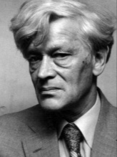
The rise of individual ‘experience’ and ‘culture’ as central categories of oostmodern history writing from the 1960s
Edward Palmer Thompson (1924-1993)

Slide 7
‘The working class did not rise like the sun at an appointed hour. It was present at its own making.’

Slide 8
Linguistic Turn
Analytical turn upon, or problematisation of, words/language used in a given field of study. Also used to refer to the ‘turn’ to linguistic philosophy and linguistic theory in the late 20th century in the humanities and social sciences.
Term first used by the America philosopher Richard Rorty The Linguistic Turn (1967)

Slide 9
What stands at the core of postmodernist critique of Enlightened values
and beliefs?
‘….postmodernism is typically defined by an attitude of scepticism … it questioned Enlightenment morals and beliefs in rationality, objective reality and the existence of absolute truth.’

Slide 10
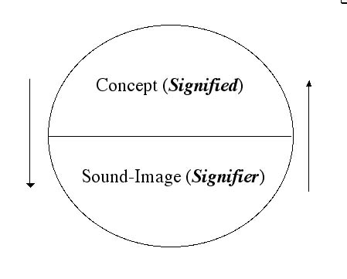
Consequences of linguistic theoretical thinking
Our relationship to knowledge becomes uncertain because the ‘meaning’ (‘concept’ or ‘signified’) and the ‘signifier’ (sound/image/written word) are separated and their link is arbitrary. They are ‘made-up’ by humans and rely the internal structure of a language which only allows you to say certain things at a certain moment in time (languages changes throughout time !)
The notion of arbitrariness of the sign deeply challenges the modernist understanding of truth: if signs relate only to each other within an own structure, how could language be deemed to refer to the world out there? How could language ever refer to a ‘universal reality’ if the speaker is locked into a system and structure of language?
Thus, there is no reality; there is merely a representation of language
Can anyone speak ‘the truth’?

Slide 11
Microhistories focus on ‘practices’ of everyday life

Slide 12
The ‘turn to practice’ in the new cultural history of the 1980s and 1990s
‘Practice is one of the key words of the New cultural history’
(Peter Burke, What is Cultural History?)

Slide 13
What do ‘practices’ consist of?
‘If practices are composed of materials, meanings and competences, histories of practices need to take note of the conjunctions of all three elements at once.’
(Shove, Elisabeth et al., The Dynamics of Social Practice. Everyday Life and How it Changes, Los Angeles 2012, 29).

Slide 14
The Practice of Everyday Life.
Translated by Steven Rendall. University of California Press. 1984 (French 1980)
The Writing of History. Translated by Tom Conley. Columbia University Press. 1988 (French 1975)
Michel de Certeau, 1925-1980

Slide 15
Everyday routine practices: strategies and tactics
‘De Certeau's investigations into the realm of routine practices, or the "arts of doing" such as walking, talking, reading, dwelling, and cooking, were guided by his belief that despite repressive aspects of modern society, there exists an element of creative resistance to these structures enacted by ordinary people. In The Practice of Everyday Life, de Certeau outlines an important critical distinction between strategies and tactics in this battle of repression and expression.
According to him, strategies are used by those within organizational power structures, whether small or large, such as the state or municipality, the corporation or the proprietor, a scientific enterprise or the scientist. Strategies are deployed against some external entity to institute a set of relations for official or proper ends, whether adversaries, competitors, clients, customers, or simply subjects.
Tactics, on the other hand, are employed by those who are subjugated. By their very nature tactics are defensive and opportunistic, used in more limited ways and seized momentarily within spaces, both physical and psychological, produced and governed by more powerful strategic relations.

Slide 16
The Logic of Practice (1990) first published in French in 1980)
Distinction: A Social Critique of the Judgement of Taste (French, 1979)
Pierre Bourdieu, 1930-2002

Slide 17
The conditionings associated with a particular class of conditions of existence produce habitus, systems of durable, transposable dispositions, structured structures predisposed to function as structuring structures, that is, as principles which generate and organize practices and representations that can be objectively adapted to their outcomes without presupposing conscious aiming at ends or an express mastery of the operations necessary in order to attain them.
-- Pierre Bourdieu, “Structures, habitus, practices,” in The Logic of Practice (1990, first published in French in 1980), p. 53

Slide 18
Expressed in a more simple way:
‘Habitus is ‘the way society becomes deposited in persons in the form of lasting dispositions, or trained capacities and structured propensities to think, feel and act in determinant ways, which then guide them’
(Wacquant 2005: 316, cited in Navarro 2006: 16)

Slide 19
Bourdieu extends the idea of capital as a way to explain how power in society was transferred and social classes maintained. Karl Marx believed economic capital (money and assets) dictated your position in a social order. Bourdieu believed that ‘cultural capital’ played an important, and subtle role.
Bourdieu identified three sources of cultural capital: objective, embodied and institutionalised.
Objective: cultural goods, books, works of art
Embodied: language, mannerisms, preferences
Institutionalised: qualifications, education credentials

Slide 20
The relationship between language and practices
Cultural History: Between Practices and Representations (Cornell University Press, 1989)
The Order of Books: Readers, Authors, and Libraries in Europe Between the 14th and 18th Centuries (Stanford University Press, 1994)
On the Edge of the Cliff: History, Language and Practices (Parallax: Re-visions of Culture and Society) (The Johns Hopkins University Press, 1996)
Roger Chartier, 1945-

Slide 21
“…practices, articulated with but not homologous to discourses, are not reducible to discourses, can be considered the fundamental partitioning principle in all cultural history”
-- Chartier, in The Edge of the Cliff, 1997

Slide 23
Practice v. theory
Practice v. the match
Practising v. retired
Practical v. not very useful

Slide 24
The theory of practice
The theory of practice in practice
The limits of the theory of practice

Slide 25
Michel de Certeau, L'invention du quotidien. Vol. 1, Arts de faire (1980), translated as The Practice of Everyday Life, 1984
Pierre Bourdieu, Le sens pratique, 1980, translated as The Logic of Practice, 1990
Roger Chartier, « Les historiens et les mythologies », 1992, translated as « Discourses and Practices: On the Origins of the French Revolution », in On the Edge of the Cliff, 1997

Slide 26
Rulers (pre-Foucault)
Techniques (Foucault)
Tactics (Certeau)

Slide 27
Phrases
Terms
Conditions
Cases

Slide 28
The conditionings associated with a particular class of conditions of existence produce habitus, systems of durable, transposable dispositions, structured structures predisposed to function as structuring structures, that is, as principles which generate and organize practices and representations that can be objectively adapted to their outcomes without presupposing conscious aiming at ends or an express mastery of the operations necessary in order to attain them.
-- Pierre Bourdieu, “Structures, habitus, practices,” in The Logic of Practice (1990, first published 1980), p. 53

Slide 29
Habitus = a set of practices that get good results even though no-one aims for these results nor is able to say how to get good results

Slide 30
Rules (structural anthropologists, eg. Claude Levi-Strauss)
Reason (existentialists like Jean-Paul Sartre, and economic theorists)
Habitus (Bourdieu)

Slide 31
Great books and their ideas (Peter Gay, The Enlightenment, 1966)
Not-so-great books and their representations (Robert Darnton, The Forbidden Bestsellers of Pre-Revolutionary France, 1995)
Subversive societies (Fred E. Schrader, Augustin Cochin et la République française, 1992)
Irreducible practices (Arlette Farge, Subversive Words: Public Opinion in Eighteenth-Century France, 1992)

Slide 32

2018 book

Slide 33

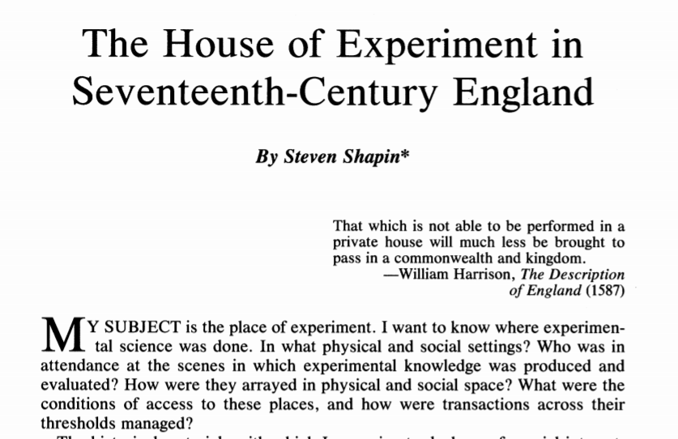
1988 article
2014 book

Slide 34
2018 book

Slide 35
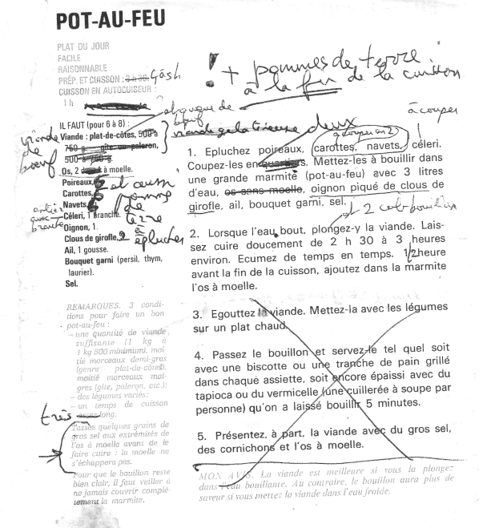
Twenty-first-century recipe, with testing

Slide 36
Are these theories new?
Are they true?
Are they complete?

