Slide 1
Theory, Skills and Methods
‘Race’

Slide 2
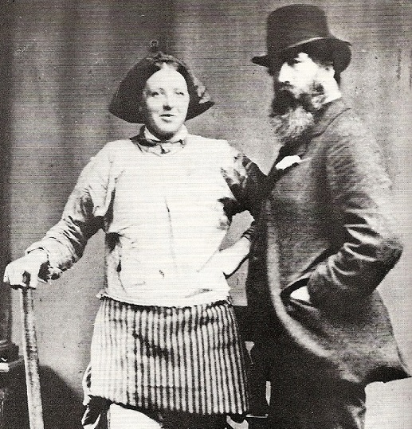
Arthur Munby and Hannah Cullwick
Munby’s partner Hannah Cullwick dressed as a chimney sweep (1862)
A.J. Munby with collier Ellen Grounds at a Wigan photographer’s (1873).

Slide 3
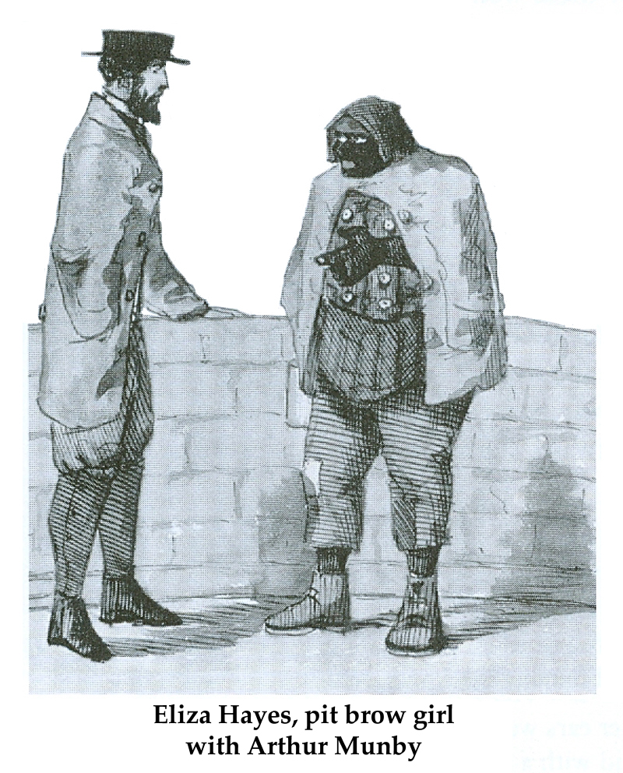
Arthur Munby

Slide 4
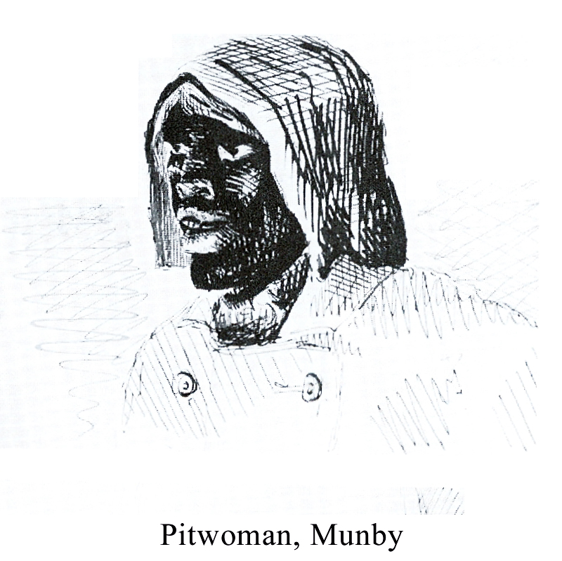
Arthur Munby

Slide 5
‘The dangerous crossings of gender and class are negotiated by projecting onto them the rhetoric of race’.
Anne McClintock, Imperial Leather: Race, Gender and Sexuality in the Colonial Contest, Routledge (New York, 1995), 108.

Slide 6
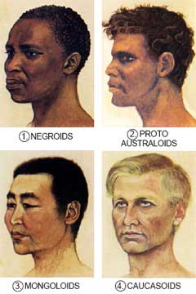
‘racial types’

Slide 7
R.C. Lewontin, ‘The Apportionment of Human Diversity’, Evolutionary Biology, vol. 6 (1972).

Slide 8
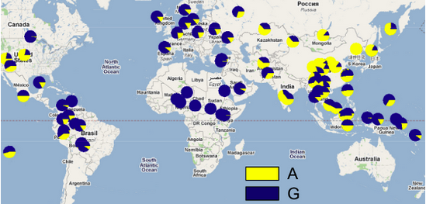
Wet and dry earwax distribution
A = dry earwax type. G = wet earwax type

Slide 9
Georges-Louis Leclerc, Comte de Buffon

Slide 10
Georges Louis Leclerc, Comte de Buffon, The Natural History of Animals, Vegetables, and Minerals; with The Theory of the Earth, in General, trans. W. Kenrick and J. Murdoch, 6 vols (London, 1775-6), I:227-8.
‘There are many causes by which not only the colour, but even the form and the features may be influenced. Of these one of the principal are the food, and the manners, or the mode of living. A civilized people, who enjoy a certain degree of ease and freedom, and who, by the superintendence of a well-regulated government, are protected from actual want and misery, will, from this reason alone, be composed of men more handsome and more vigorous than a savage. An independent nation, of which each individual , deriving no assistance from society, is obliged to provide for his own subsistence, to sustain alternately the excesses of huger, and of a nourishment often unwholesome, . . . to undergo the rigours of the climate, without being able to shelter himself from them; to act in a word, more like an animal than a man--in the supposition that two nations, thus differently circumstances, were to live in the same climate, we could not doubt but that the savage men would be more ugly, more tawney, more diminutive, more wrinkled, than the civilized man. . . .
I would admit, then, of three causes as jointly productive of the varieties which we remark in the different nations of the earth. The first is, the influence of the climate; the second is, the nourishment; and the third is, the manners.’

Slide 11
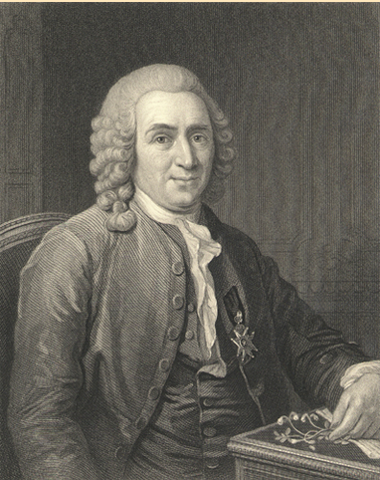
Carl Linnaeus
Carolus Linnaeus (1707–1778) engraved by C. E. Wagstaff from an oil painting by L. Pasch after an original by A. Roslin (1775) at the Royal Swedish Academy of Sciences, Stockholm.

Slide 12
Carl Linnaeus’s classification of homo sapiens
1. Wild man. Four-footed, mute, hairy.
2. American. Copper-coloured, choleric, erect. Hair black, straight, thick; nostrils wide; face harsh; beard, scanty; obstinate, content, free. Paints himself with fine red lines. Regulated by customs.
3. European. Fair, sanguine, brawny. Hair yellow brown, flowing; eyes blue; gentle, acute, inventive. Covered with close vestments. Governed by laws.
4. Asiatic. Sooty, melancholy, rigid. Hair black; eyes dark; severe, haughty, covetous. Covered with loose garments. Governed by opinions.
5. African. Black, phlegmatic, relaxed. Hair black, frizzled; skin silky; nose flat; lips tumid; crafty, indolent, negligent. Anoints himself with grease. Governed by caprice.

Slide 13
Was race invented in the 16th century, rather than the 18th century?
‘The history of racism as we know it today began to be articulated right then, in the sixteenth century, and there, in the Atlantic world.’
Margaret Greer, Walter Mignolo and Maureen Quilligan, eds., ‘Introduction’, Rereading the Black Legend: The Discourses of Religious and Racial Difference in the Renaissances Empires, University of Chicago Press (Chicago, 2007), 2.

Slide 14
race
inherent, intrinsic, heritable physical traits ?
naturalising a hierarchy of difference ?

Slide 15

Re-Biologising Race?
BiDil
‘BiDil has been approved by the US Food and Drug Administration (FDA) for use by self-identified African American patients in addition to routine HF medicines.’

