Slide 1
Race
Theory, Skill and Method
Dr Lydia Plath

Slide 2
Outline
Historians on “race”
Early understandings of “race”
Racist ideas as justifications for slavery
“Race” as a category of analysis

Slide 3
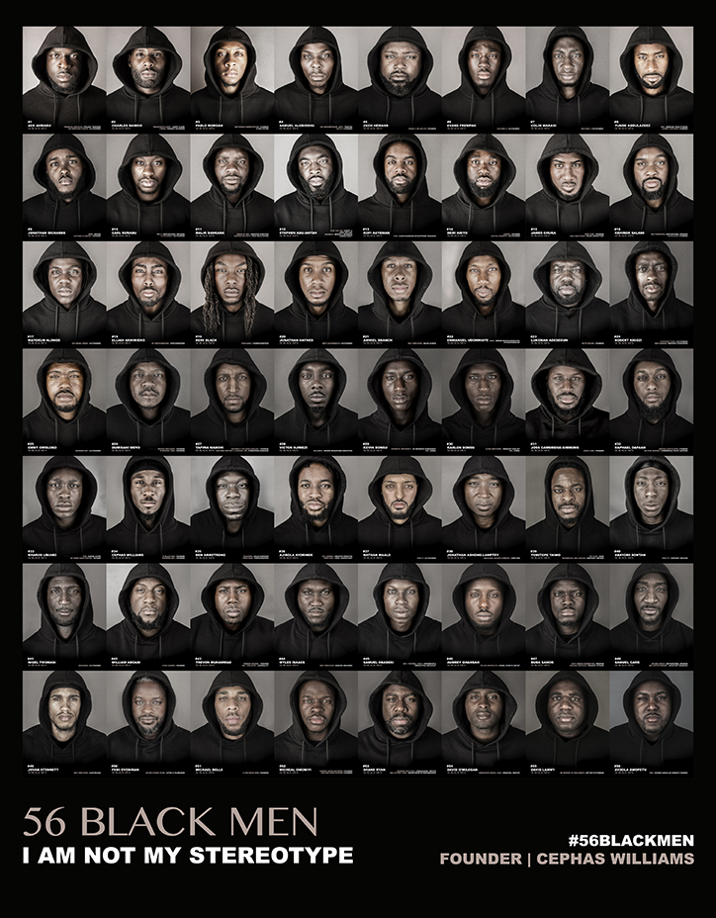
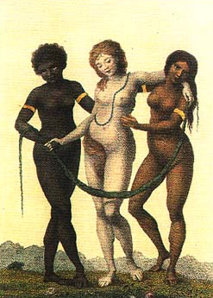
What is “race”?
No biological meaning
Social “construction” / “invention” / “idea”
Varying categorizations
Historically and culturally contingent
Lived reality of racism
‘Europe Supported by Africa and America’ William Blake, c.1777

Slide 4
1: Historians on “Race”

Slide 5
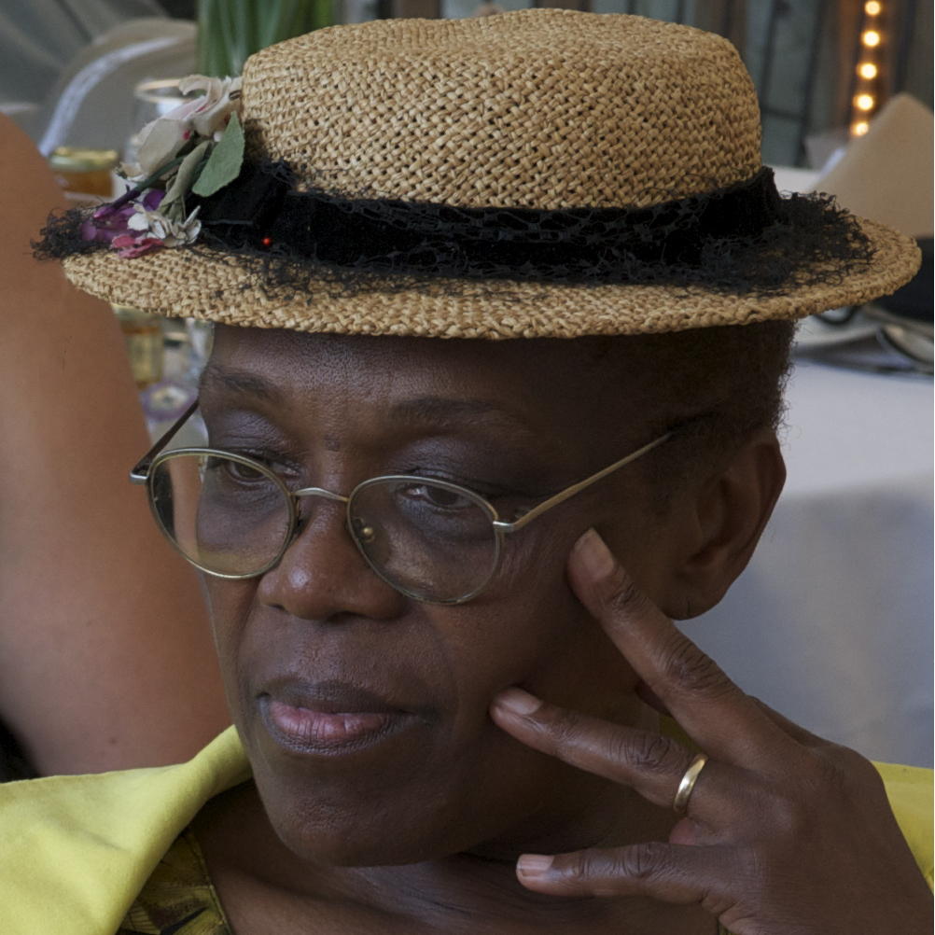

Fields & Fields: “race” vs “racism”
“The term race stands for the conception or doctrine that nature produced humankind in distinct groups…”
“Race is the principle unit and core concept of racism”
“Racism refers to the theory and practice of applying a social, civic, or legal double standard based on ancestry, and to the ideology surrounding such a double standard . . . not an emotion or state of mind . . . Racism is first and foremost a social practice . . . an action and a rationale for action”
Karen E. Fields & Barbara J. Fields, Racecraft: The Soul of Inequality in American Life (Verso, 2014)

Slide 6

Kendi: The purpose of racist ideas
“The common conception that ignorance and hate lead to racist ideas, and that racist ideas initiate racist policies, is largely ahistorical. It has actually been the inverse relationship – racial discrimination has led to racist ideas which has led to ignorance and hate.”
“the principal function of racist ideas in American history has been to suppress resistance to racial discrimination and its resulting racial disparities.”
Ibram X. Kendi, Stamped from the Beginning: The Definitive History of Racist Ideas in America (2016)

Slide 7
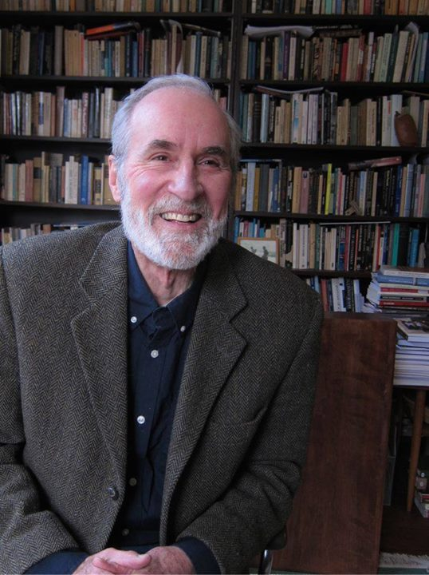
Race as “modern”
“All in all, race is the modern West’s worst idea.”
“race and racism were conceptual realities that emerged in, and were an integral part of, of the modern world.”
Richard H. King, Race, Culture, and the Intellectuals, 1940-1970 (2004).

Slide 8
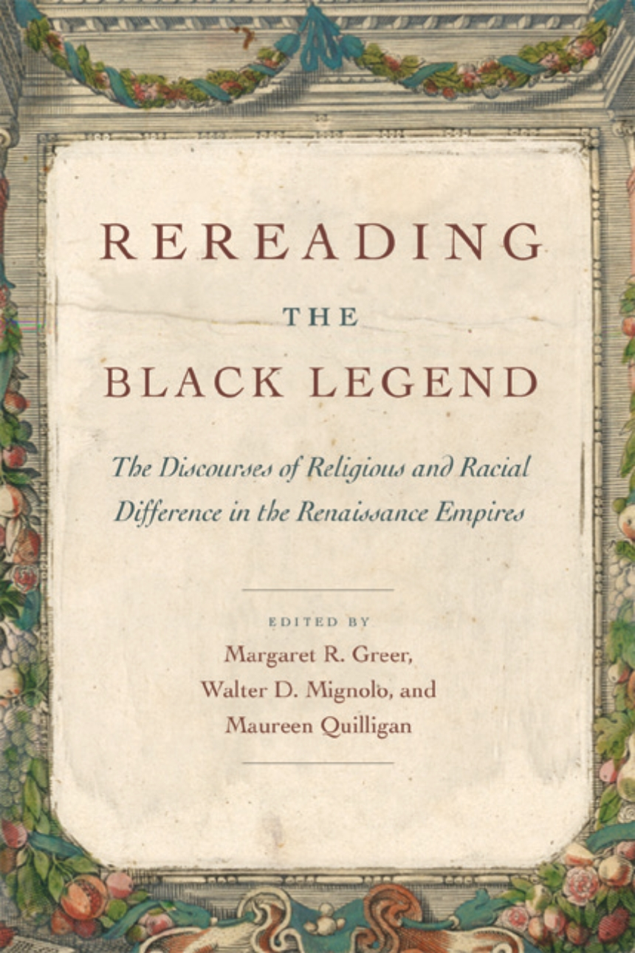
Race as Early Modern?
Is the claim that “race” was invented in the 18th century a British / US –centred idea? Hispanic colonialism started much earlier
‘The history of racism as we know it today began to be articulated right then, in the sixteenth century, and there, in the Atlantic world.’
Margaret Greer, Walter Mignolo and Maureen Quilligan, eds., ‘Introduction’, Rereading the Black Legend: The Discourses of Religious and Racial Difference in the Renaissances Empires (2007).

Slide 9
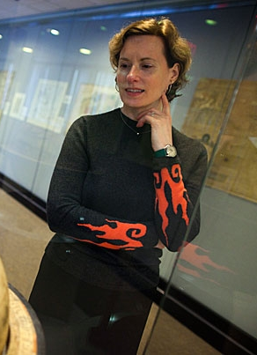
Chaplin: Race as “Atlantic”
“racism in its present form is a specific product of Atlantic history. . . this idea was peculiar to the Atlantic world created by European colonization.”
“The history of slavery makes especially clear that racism took strong hold in the western Atlantic, with powerful implications for the populations that mingled in the Americas, for the social structures of colonial societies, and for ideas of political rights on either side of the Atlantic. It is the continuing legacy of these implications that interests us in race and makes it necessary for us to see how it so deeply marked the modern world.”
Joyce E. Chaplin, “Race” in Armitage and Braddick (eds), The British Atlantic world, 1500-1800 (2009)

Slide 10
2: Early understandings of “race”

Slide 11
Early-Modern Racial Ideas
Less clear than it will be later that race was seen as a fixed, inheritable identity – could change or assimilate
Not necessarily linked to skin colour
Monogenesis

Slide 12
Early-Modern Racial Ideas
“In Africa ‘terrible heat reigns and all the people born there are black’, whereas in parts of Peru the climate was very temperate ‘and the people of those lands are white’.”
José de Acosta, Natural and Moral History of the Indies, trans. Frances López-Morillas (2002 [1590]).
“[Indians are] a sort of white men in America (as I am told) that only differ from us in having no beards” Richard Bradley, A Philosophical account of the works of nature (London, 1721)
‘[Africans are] black as coal. Here, thro’ custom, (being Christians) they account themselves white men’ Journal of a Voyage up the Gambia (London, 1723)
‘Negroes are a race of people who appear to be different from the rest of mankind… but whether these are an original race, or whether the difference arises from the climate, the vapours of that particular soil, the manner of breeding their children, and from the mothers forming of their features, is not here determined.’ Francis Moore, Travels into the inland parts of Africa (London, 1738)

Slide 13
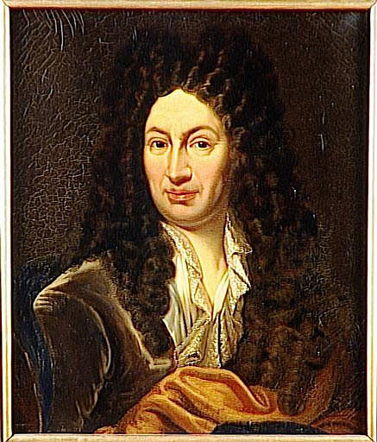
Francois Bernier “A New Division of the Earth” (1684)
Europe, North Africa, Middle East, and parts of south Asia:
“For while the Egyptians, for instance, and the Indians are very dark, or rather sunburnt, this colouring is merely accidental for them, and results merely from the fact that they are exposed to the Sun”
“As far as the Americans are concerned, they are really mostly oliveskinned and their faces have a rather different shape from ours. Nevertheless I do not consider that that difference is so large as to warrant making them a special type distinct from our own.”
Sub-Saharan Africa:
“The following features justify considering the Africans a distinct type: (i) their thick lips and their snub noses, for very few of them have aquiline noses and medium-sized lips (ii) the blackness that is their essential trait and whose cause is not, as people think, the heat of the Sun - for if you transport a Black man and a Black woman to a cold country, their children will continue to be black and so will all their descendants until they intermarry with white women. The explanation for their distinct type must therefore be sought in their sperm and their blood, both of which are, however, the same colour as in all the other types (iii) their skin is quite oily, supple and polished, except for the areas roasted by the Sun (iv) their beards consist of only three or four strands (v) their hair is not truly hair but instead a sort of wool similar to the coat of one of our hunting-spaniels and (vi) their teeth are whiter than the finest ivory and the whole inside of their mouths, like their lips, is red as Coral.
East Asia and Eastern Russia
“The inhabitants of all those Countries are really white; but they usually have large shoulders, their faces are flat, they have snub noses, and their eyes are oval-shaped and come to a point at each corner.”

Slide 14
Georges Louis Leclerc, Comte de Buffon, The Natural History of Animals, Vegetables, and Minerals (1775-6)
‘There are many causes by which not only the colour, but even the form and the features may be influenced. Of these one of the principal are the food, and the manners, or the mode of living. A civilized people, who enjoy a certain degree of ease and freedom, and who, by the superintendence of a well-regulated government, are protected from actual want and misery, will, from this reason alone, be composed of men more handsome and more vigorous than a savage. An independent nation, of which each individual , deriving no assistance from society, is obliged to provide for his own subsistence, to sustain alternately the excesses of huger, and of a nourishment often unwholesome, . . . to undergo the rigours of the climate, without being able to shelter himself from them; to act in a word, more like an animal than a man--in the supposition that two nations, thus differently circumstances, were to live in the same climate, we could not doubt but that the savage men would be more ugly, more tawney, more diminutive, more wrinkled, than the civilized man. . . .
I would admit, then, of three causes as jointly productive of the varieties which we remark in the different nations of the earth. The first is, the influence of the climate; the second is, the nourishment; and the third is, the manners.’

Slide 15
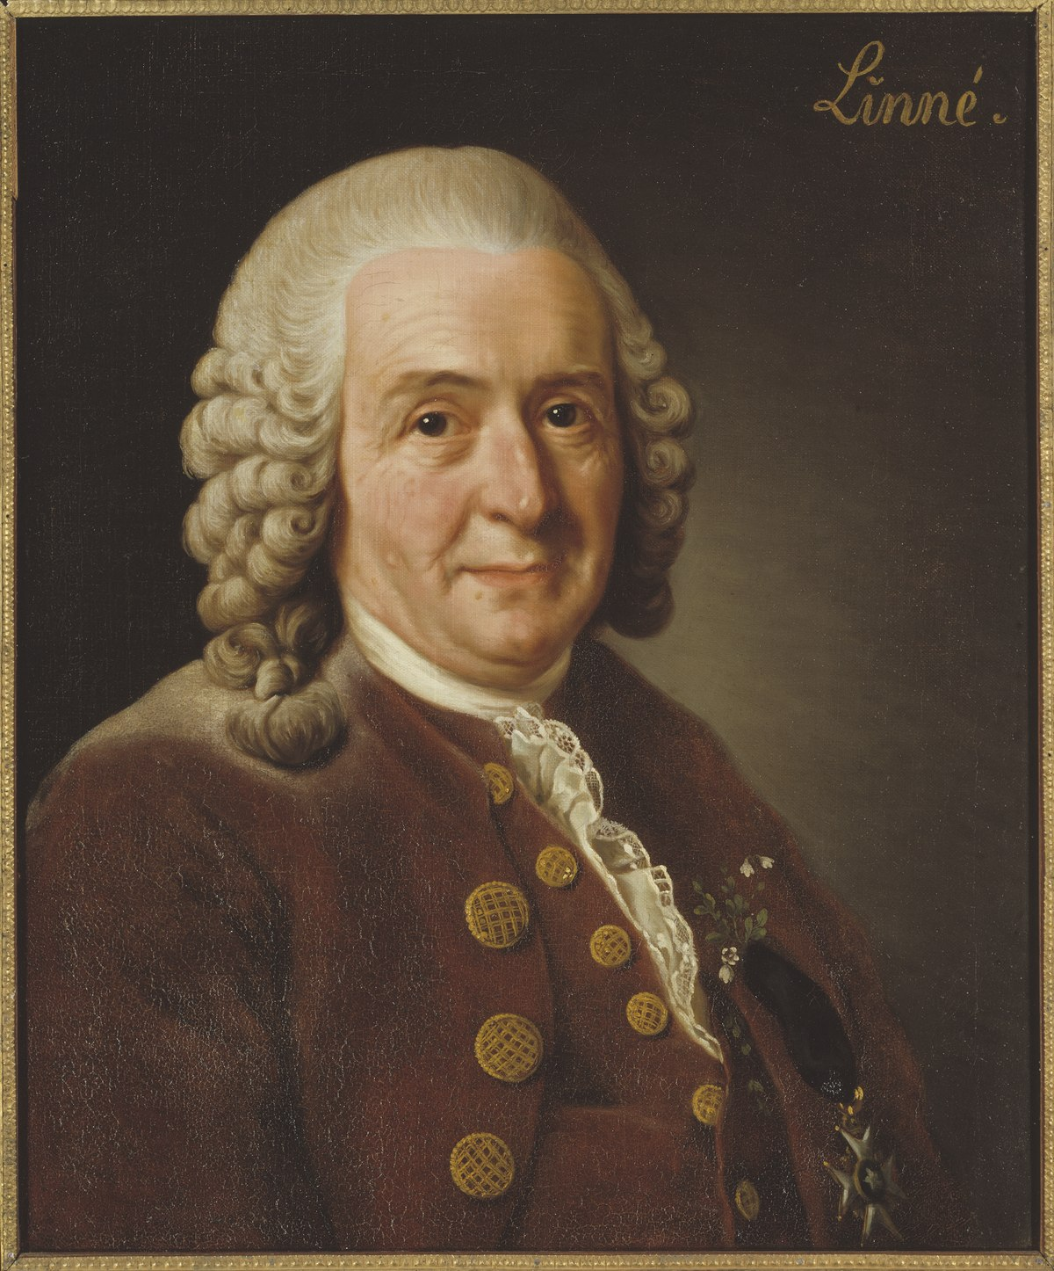
Carl Linnaeus, Systema Naturae (1758)
American. Red, choleric, erect. Hair black, straight and thick; Nostrils wide; Face freckled; Beard scanty. Obstinate, content, free. Paints himself with fine red lines. Regulated by habit.
European. white, sanguine, brawny. Hair abundantly flowing. Eyes blue. Gentle, acute, inventive. Covered with close vestments. Governed by customs.
Asiatic. Yellow, melancholy, rigid. Hair black. Eyes dark. Severe, haughty, covetous. Covered with loose garments. Governed by opinions.
African. Black, phlegmatic, relaxed. Hair black, frizzled. Skin silky. Nose, flat. Lips tumid. Women’s bosom a matter of modesty, Breasts give milk abundantly. Crafty, indolent, negligent. Anoints himself with grease. Governed by caprice.
Notes:
Humours:
Sanguine (blood) – courageous, hopeful, amorous
Choleric (yellow bile) – easily angered, bad tempered
Melancholic (black bile) – despondent, sleepless, irritable
Phlegmatic – calm, unemotional
Tumid = swollen; indolent = lazy; caprice = impulsive

Slide 16
3: Racist ideas as justifications for slavery

Slide 17
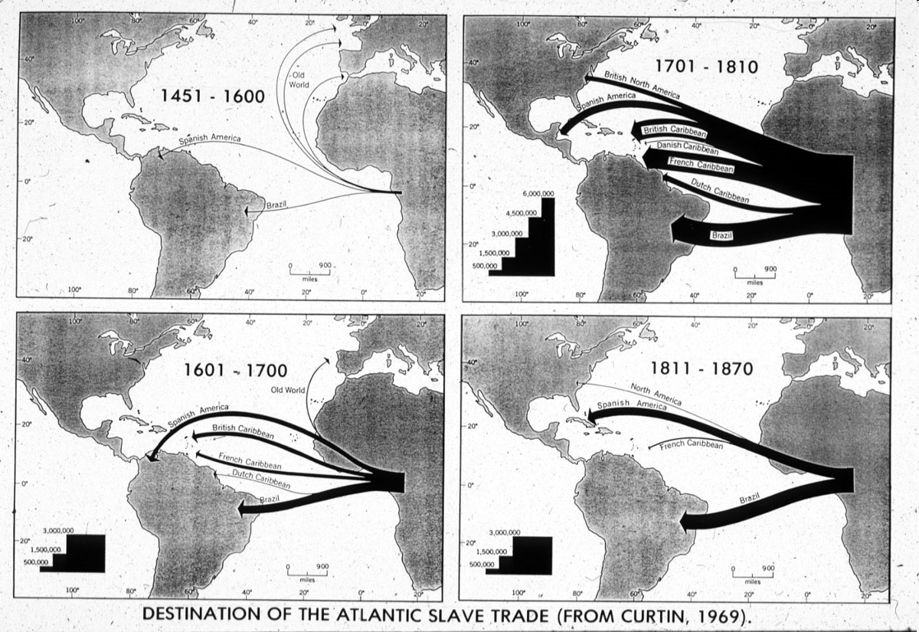
The Atlantic Slave Trade

Slide 18
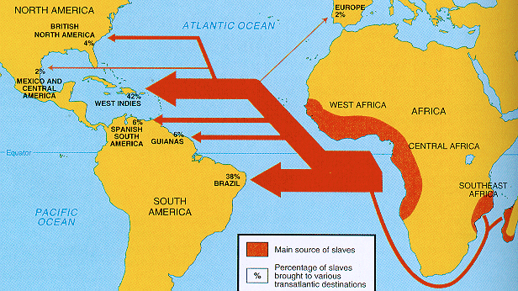
The Atlantic Slave Trade
c.10m Africans transported, 1500-1900

Slide 19
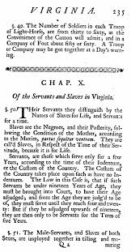
Defining “slavery” in North America
Term “slave” comes from Latin sclavus and enslaved Slavic people in Eastern Europe
First Africans brought to North America in 1619
Slavery takes time to be legally codified in colonial Virginia
Permanent ownership of one person by another
Hereditary via the mother

Slide 20
Race, Slavery and the Law in British North America
“WHEREAS some doubts have arrisen whether children got by any Englishman upon a negro woman should be slave or ffree, Be it therefore enacted and declared by this present grand assembly, that all children borne in this country shall be held bond or free only according to the condition of the mother.” (1662)
“It is enacted that all servants. . . which shall be imported into this country either by sea or by land, whether Negroes, Moors, mulattoes or Indians who and whose parentage and native countries are not Christian at the time of their first purchase by some Christian. . ., are hereby adjudged, deemed and taken to be slaves to all intents and purposes any law, usage, or custom to the contrary notwithstanding.” (1682)

Slide 21
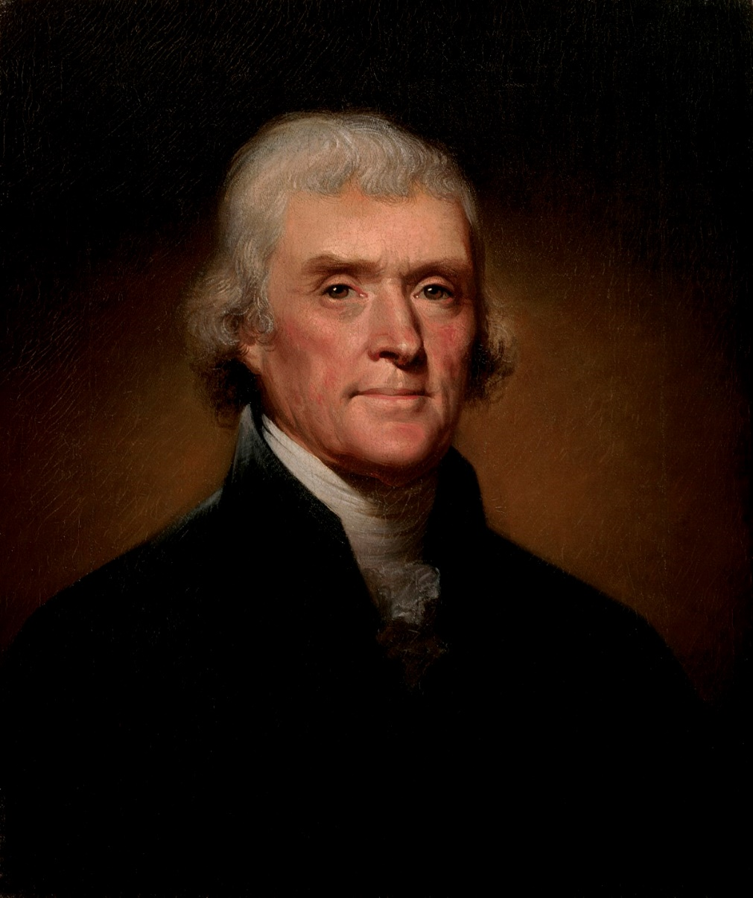
Thomas Jefferson on Race
“The first difference which strikes us is that of colour… the difference is fixed in nature. And is this difference of no importance? . . . there are other physical distinctions …They seem to require less sleep. A black, after hard labour through the day, will be induced by the slightest amusements to sit up till midnight, or later, though knowing he must be out with the first dawn of the morning. They are at least as brave, and more adventuresome. But this may perhaps proceed from a want of forethought, which prevents their seeing a danger till it be present… They are more ardent after their female: but love seems with them to be more an eager desire, than a tender delicate mixture of sentiment and sensation. Their griefs are transient… In general, their existence appears to participate more of sensation than reflection... An animal whose body is at rest, and who does not reflect, must be disposed to sleep of course… This unfortunate difference of colour, and perhaps of faculty, is a powerful obstacle to the emancipation of these people.”
Notes on the State of Virginia (1787)

Slide 22
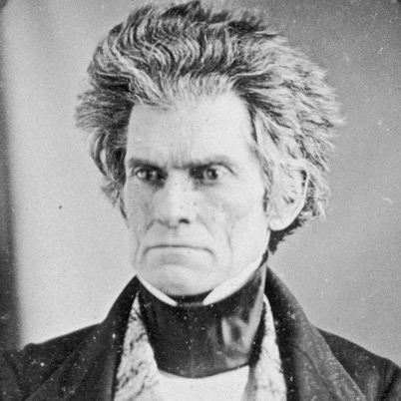
Race in Proslavery Thought
“I hold that in the present state of civilization, where two races of different origin, and distinguished by color, and other physical differences, as well as intellectual, are brought together, the relation now existing in the slaveholding States between the two, is, instead of an evil, a good–a positive good…. Never before, has the black race of Central Africa, from the dawn of history to the present day, attained a condition so civilized and so improved, not only physically, but morally and intellectually.”
- John C. Calhoun, ‘Slavery a Positive Good’ (1837)

Slide 23
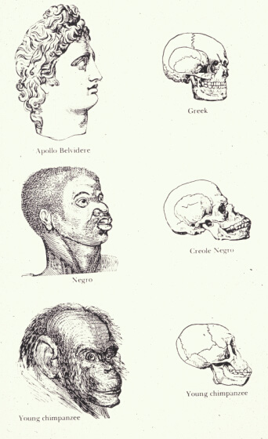
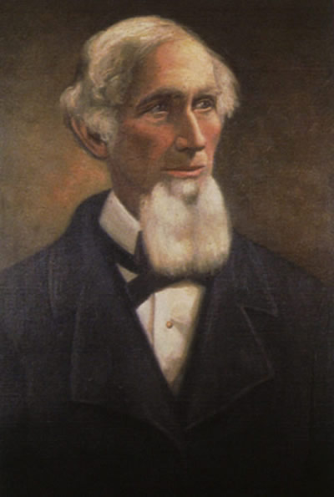
Race in Proslavery Thought
“. . . the negro achieves his greatest perfection, physical and moral, and also greatest longevity, in a state of slavery”
Josiah Nott, Types of Mankind (1854)
Notes:
Humours:
Sanguine (blood) – courageous, hopeful, amorous
Choleric (yellow bile) – easily angered, bad tempered
Melancholic (black bile) – despondent, sleepless, irritable
Phlegmatic – calm, unemotional
Tumid = swollen; indolent = lazy; caprice = impulsive

Slide 24
3: “Race” as a category of analysis

Slide 25
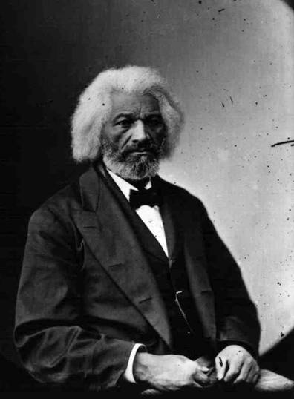
Frederick Douglass on “The Race Problem” (1890)
“It has been well said that in an important sense words are things. They are especially such when they are employed to express the popular sentiment concerning the Negro: to couple his name with anything in this world seems to damage it and damage him likewise. Hence I object to characterizing the relation subsisting between the white and colored people of this country as the Negro problem, as if the Negro had precipitated that problem, and as if he were in any way responsible for the problem… The true problem is not the negro, but the nation”

Slide 26
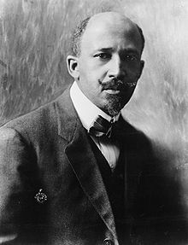
W. E. B. Du Bois on “double consciousness” (1903)
“the Negro is a sort of seventh son, born with a veil, and gifted with second-sight in this American world,—a world which yields him no true self-consciousness, but only lets him see himself through the revelation of the other world. It is a peculiar sensation, this double-consciousness, this sense of always looking at one's self through the eyes of others, of measuring one's soul by the tape of a world that looks on in amused contempt and pity. One ever feels his twoness,—an American, a Negro; two souls, two thoughts, two unreconciled strivings; two warring ideals in one dark body, whose dogged strength alone keeps it from being torn asunder.”

Slide 27
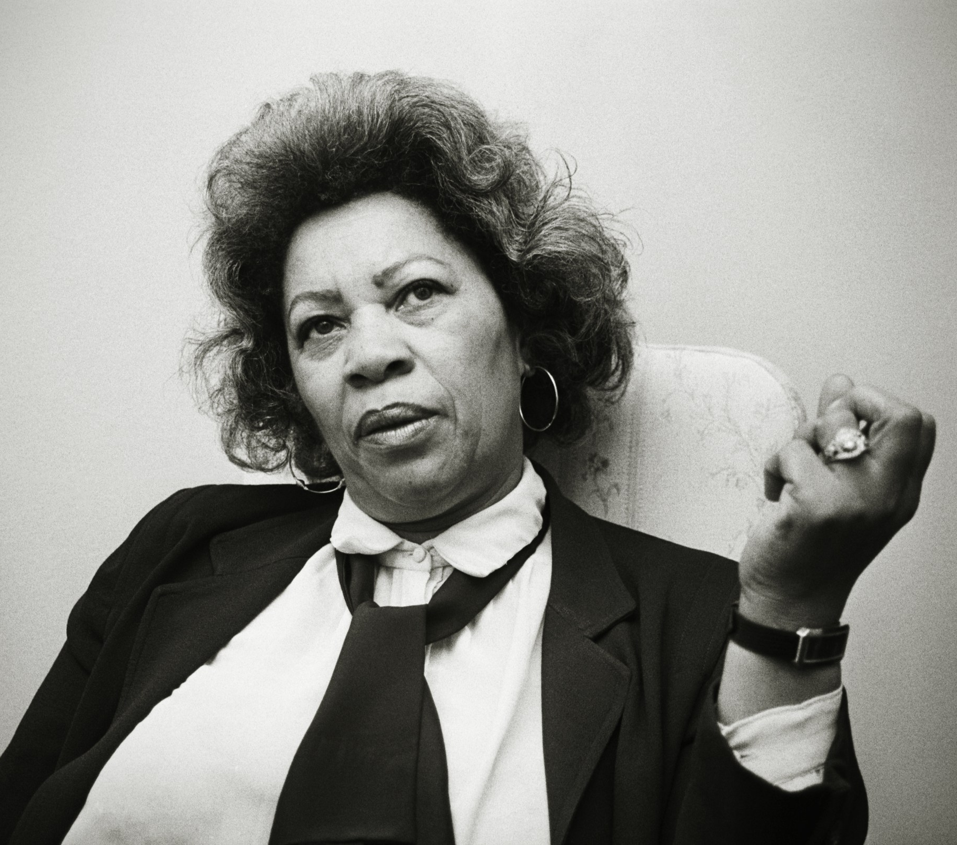
Toni Morrison on racism as distraction (1975)
“The function, the very serious function of racism is distraction. It keeps you from doing your work. It keeps you explaining, over and over again, your reason for being. Somebody says you have no language and you spend twenty years proving that you do. Somebody says your head isn’t shaped properly so you have scientists working on the fact that it is. Somebody says you have no art, so you dredge that up. Somebody says you have no kingdoms, so you dredge that up. None of this is necessary. There will always be one more thing.”

Slide 28
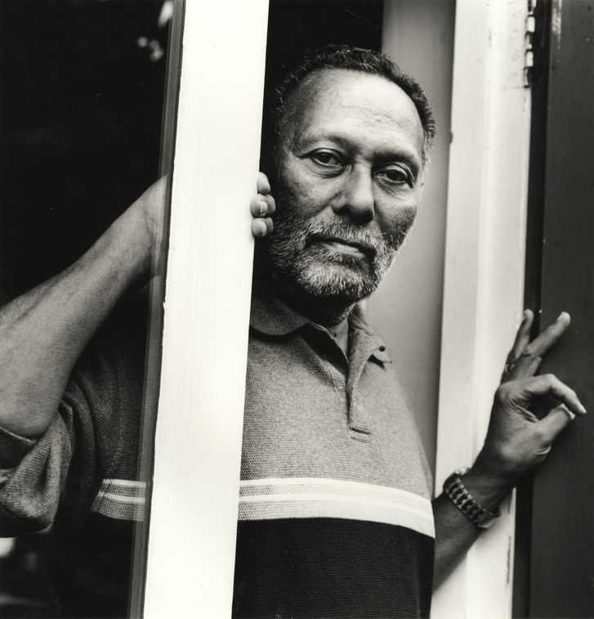
Stuart Hall, “Race, the Floating Signifier” (1997)
“race is more like a language, than it is like the way in which we are biologically constituted. You may think that’s an absurd and ridiculous thing to say, you may even now be surreptitiously glancing around the room, just to make sure that you know your visual appearances are in full working order – I assure you they are, people do look rather peculiar, some of them are brown, some of them are quite black, some of you are pretty brown, some of you are really disgustingly pink in the current light. But, there’s nothing wrong with your appearances, but I want to insist to you that nevertheless, the argument that I want to make to you is that race works like a language. And signifiers refer to the systems and concepts of the classification of a culture to its making meaning practices. And those things gain their meaning, not because of what they contain in their essence, but in the shifting relations of difference, which they establish with other concepts and ideas in a signifying field. Their meaning, because it is relational, and not essential, can never be finally fixed, but is subject to the constant process of redefinition and appropriation. To the losing of old meanings, and the appropriation and collection on contracting new ones, to the endless process of being constantly re-signified, made to mean something different in different cultures, in different historical formations, at different moments of time.”

Slide 29
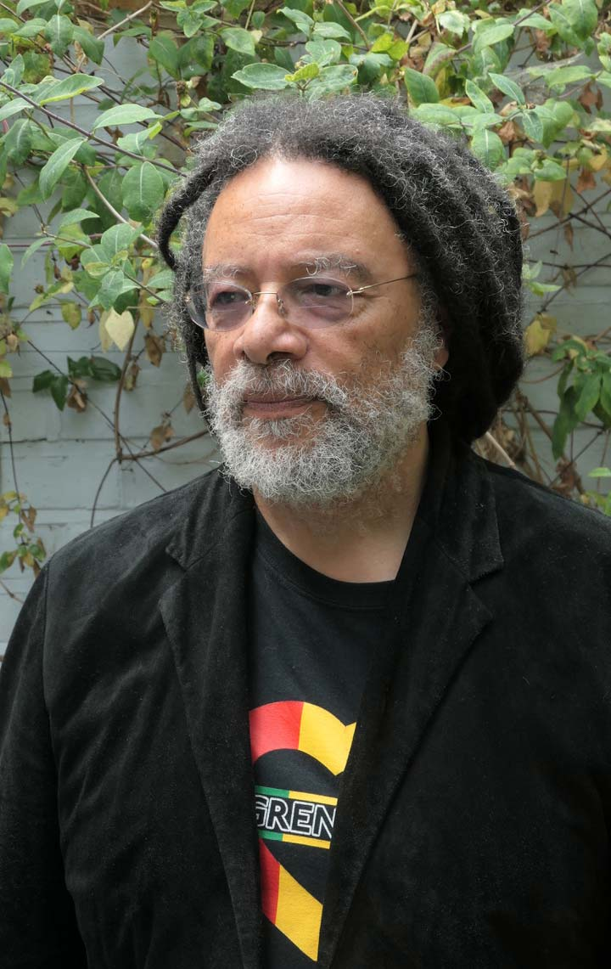
Paul Gilroy on the “Black Atlantic” (1993)
“Striving to be both European and black requires some specific forms of double consciousness … The contemporary black English, like the Anglo-Africans of early generations and perhaps, like all blacks in the West, stand between (at least) two great cultural assemblages, both of which have mutated through the course of the modern world that formed them”
“a nationalistic focus… is antithetical to the rhizomorphic*, fractal structure of the transcultural, international formation I call the black Atlantic”
* An aggregation of threads intertwining like the strands of a rope

Slide 30

Hazel Carby on the erasure of Black women (1998)
“The failure to incorporate black women into the sphere of intellectual equality… is a conceptual and political failure of imagination that remains a characteristic of the work of contemporary African American male intellectuals”

Slide 31

Kimberlé Crenshaw on “intersectionality” (1991)
“Although racism and sexism readily intersect in the lives of real people, they seldom do in feminist and antiracist practices. And so, when the practices expound identity as woman or person of color as an either/or proposition, they relegate the identity of women of color to a location that resists telling… many of the experiences Black women face are not subsumed within the traditional boundaries of race or gender discrimination as these boundaries are currently understood… the intersection of racism and sexism factors into Black women's lives in ways that cannot be captured wholly by looking at the race or gender dimensions of those experiences separately… My focus on the intersections of race and gender only highlights the need to account for multiple grounds of identity when considering how the social world is constructed”

Slide 32
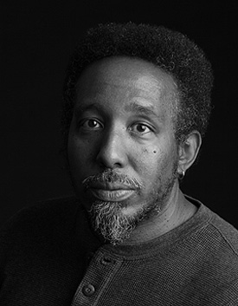
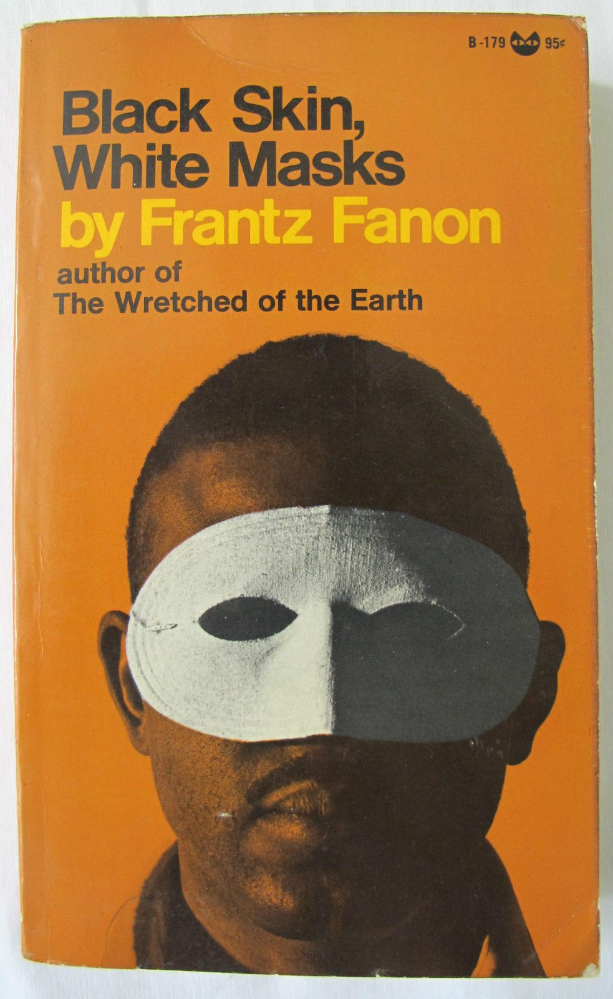
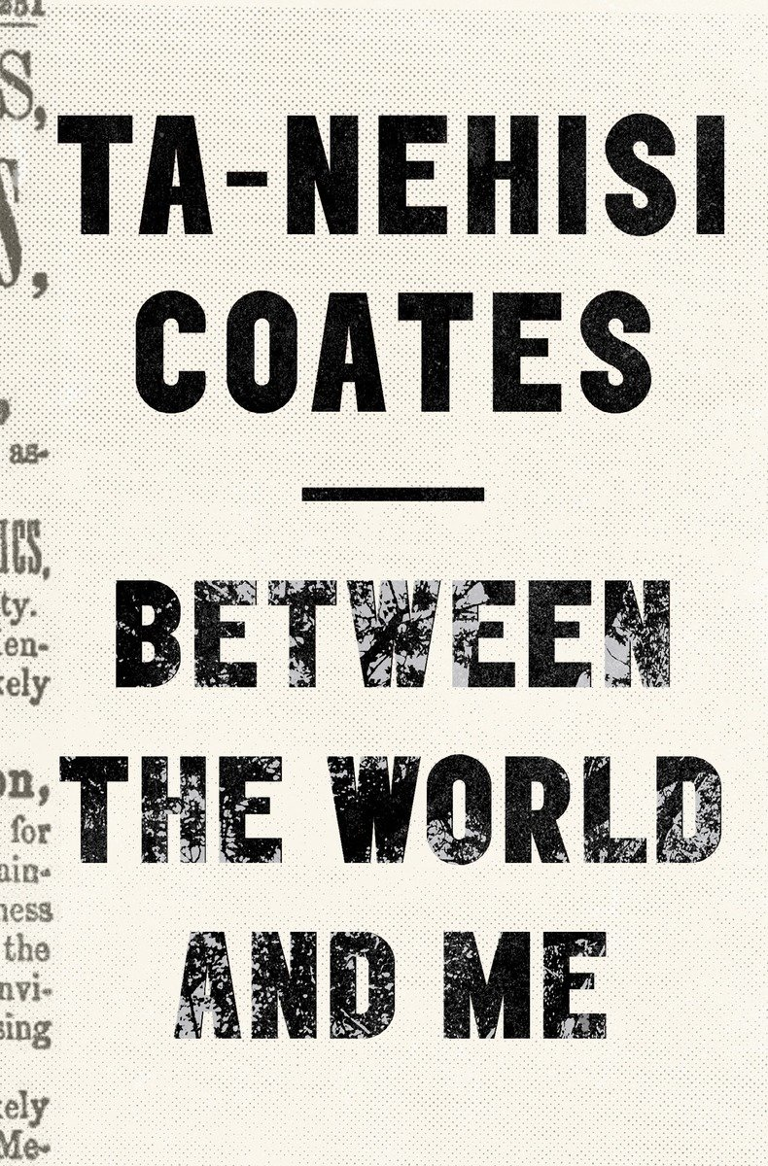

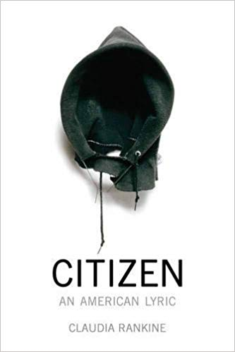
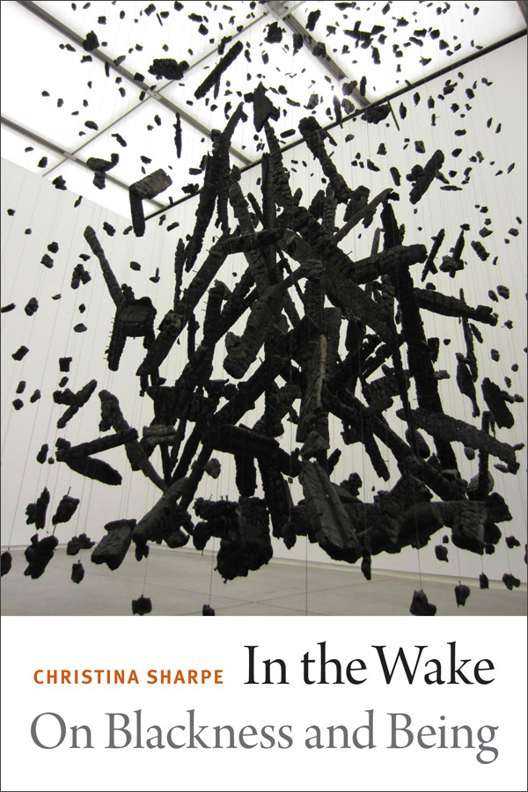
Frank B. Wilderson III on “Afro-Pessimism” (2010)
“The Afro-pessimists are theorists of Black positionality who share Fanon’s insistence, that though Blacks are sentient, the structure of the entire world’s semantic field…is sutured by anti-black solidarity”
“Whereas Humans exist on some plane of being and thus can become existentially present through some struggle for, of, or through recognition, Blacks cannot reach this plane”

Slide 33

Saidiya Hartman on “critical fabulation” (2008)
“The intention here isn’t anything as miraculous as recovering the lives of the enslaved or redeeming the dead, but rather laboring to paint as full a picture of the lives of the captives as possible. This double gesture can be described as straining against the limits of the archive to write a cultural history of the captive, and, at the same time, enacting the impossibility of representing the lives of the captives precisely through the process of narration… By playing with and rearranging the basic elements of the story, by re-presenting the sequence of events in divergent stories and from contested points of view, I have attempted to jeopardize the status of the event, to displace the received or authorized account, and to imagine what might have happened or might have been said or might have been done. By throwing into crisis “what happened when” and by exploiting the “transparency of sources” as fictions of history, I wanted to make visible the production of disposable lives (in the Atlantic slave trade and, as well, in the discipline of history), to describe “the resistance of the object,” if only by first imagining it, and to listen for the mutters and oaths and cries of the commodity. By flattening the levels of narrative discourse and confusing narrator and speakers, I hoped to illuminate the contested character of history, narrative, event, and fact, to topple the hierarchy of discourse, and to engulf authorized speech in the clash of voices.”

