Slide 1
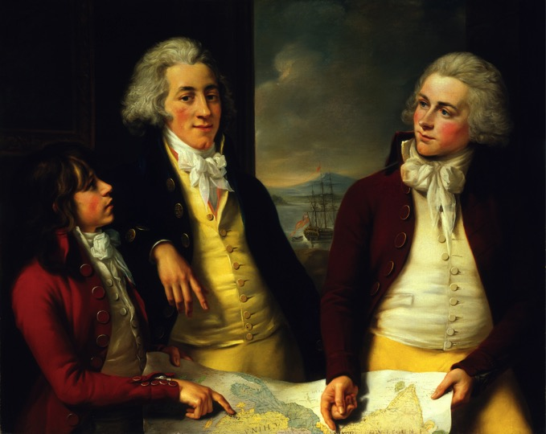
Space
HI989: Themes, Sources, and Methods

Slide 2
This lecture
Major takeaway:
Space is produced by and productive of history
History without space, and ‘The Spatial Turn’
Whose spaces matter? Or, from spatial theory to spatial historiography
Some fashionable concepts and how you might use them: Volume; Network; Scale

Slide 3
How historians have overlooked space
The nation, the region, and the area as implicitly neutral or natural categories for historical study, e.g., ‘British history’, ‘history of London’, ‘modern South Asia’
Each of these categories take on significance at particular moments and in relation to particular bureaucratic/archival infrastructures
Ranke and the nation-state; national and regional archives implemented by state bureaucracies
Area studies and Cold War geopolitics: the American global

Slide 4
How historians have overlooked space
‘[The] kind of history, which reduces space to a stage, that pays attention to events unfolding in time alone, might be called imperial history… Rather than focus on the intentional world of historical individuals, the world of active, spatial choices, empirical history of this kind has as its focus facts which, in a sense, come after the event. The primary object is not to understand or to interpret: it is to legitimate.’
Paul Carter, The Road to Botany Bay: An Exploration of Landscape and History (New York: Alfred A. Knopf, 1988), xvi

Slide 5
Have historians overlooked space?
‘The “spatial turn” is often presented and understood as a phenomenon from the late twentieth century and the twenty-first century. In fact, however, the study of the past has long been saturated with spatialized concepts, both as evidential historical categories and as historiographical frameworks: nation, empire, border, public, domestic, network, and so on.’
Paul Stock, ‘History and the Uses of Space’, in The Uses of Space in Early Modern History, ed. Paul Stock (London: Palgrave Macmillan, 2015), pp. 1–18, here p. 2

Slide 6
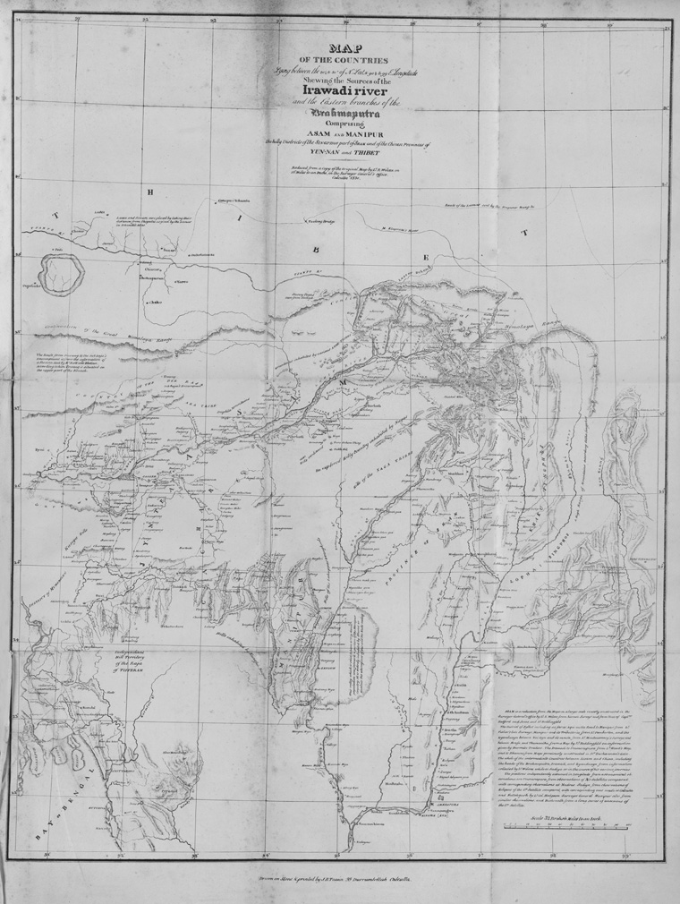
The ‘spatial turn’
Henri Lefebvre, The Production of Space (1974, English trans. 1991)
Space is not merely ‘the passive locus of social relations’, but has an ‘active’ role (p. 11).
‘To speak of ‘producing space’ sounds bizarre, so great is the sway still held by the idea that empty space is prior to whatever ends up filling it’ (p. 15).

Slide 7
The ‘spatial turn’
Henri Lefebvre, The Production of Space (1974, English trans. 1991)
Tripartite division, but every element interacts with each other
Spatial practice: the diverse social occurrences that collectively ‘secrete [a] society’s space’
Representations of space: the ‘conceptualized’ space of bureaucratic and scientific elites—this is ‘dominant’ in L’s opinion
Representational spaces: ‘space as directly lived’, ‘passively experienced’ by ‘“inhabitants” and “users”’

Slide 8
The ‘spatial turn’
Henri Lefebvre, The Production of Space (1974, English trans. 1991)
‘If space is produced, if there is a productive process, then we are dealing with history’ (orig. emphasis; p. 46)
Anti-capitalist modernity: ‘Capitalism and neocapitalism have produced abstract space, which includes the ‘world of commodities’, its ‘logic’ and its worldwide strategies, as well as the power of money and that of the political state’ (p. 53).
‘Products’ (economically exchangeable and repetitive) ‘have vanquished works’ (unique and original).

Slide 9
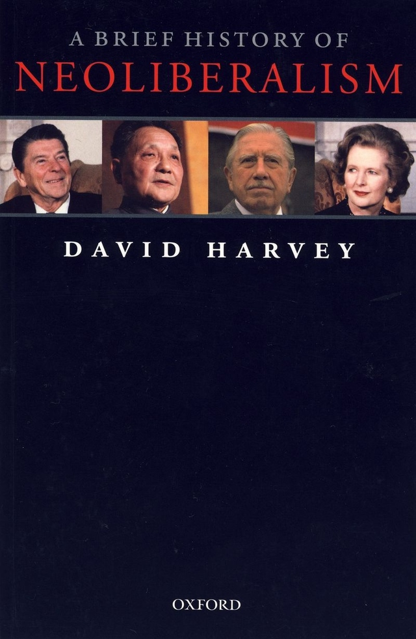
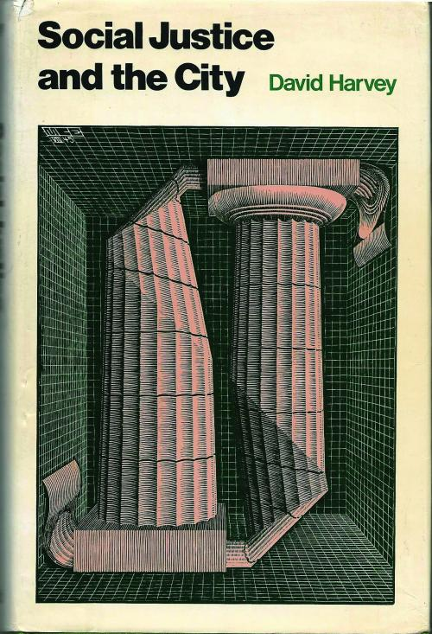

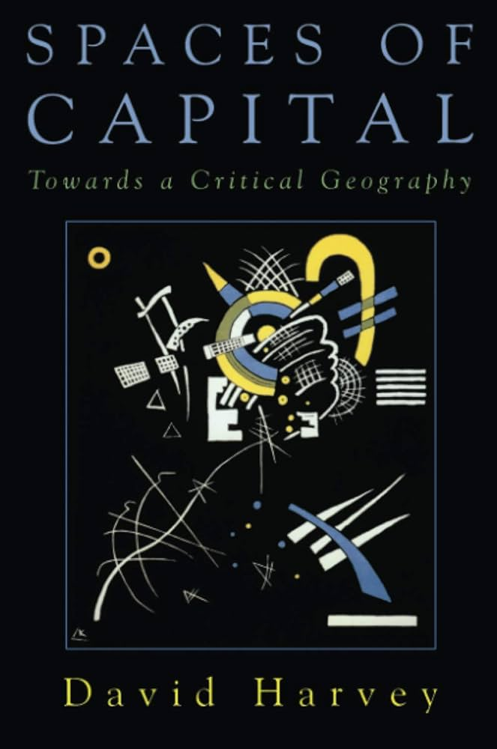
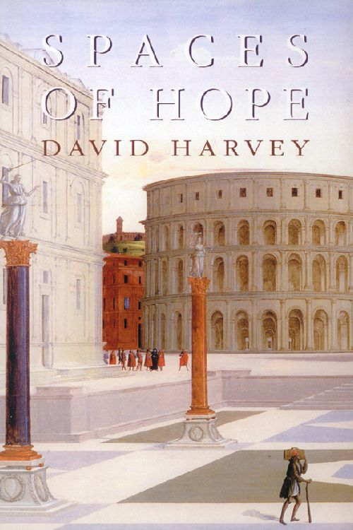
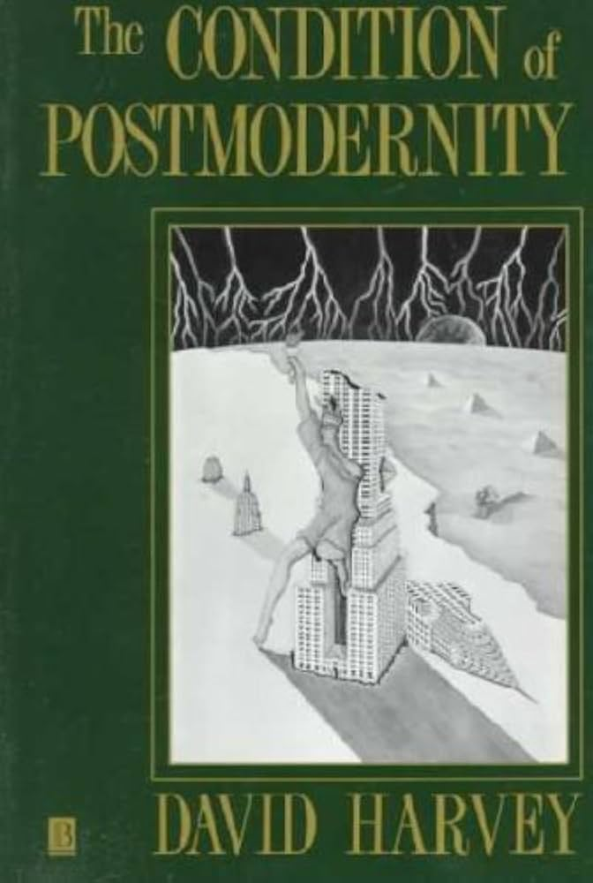
The ‘spatial turn’
David Harvey carries forward Lefebvre’s focus on space as anti-capitalist critique.
A good place to start: ‘Space as a Key Word’ in Spaces of Global Capitalism (2006)

Slide 10
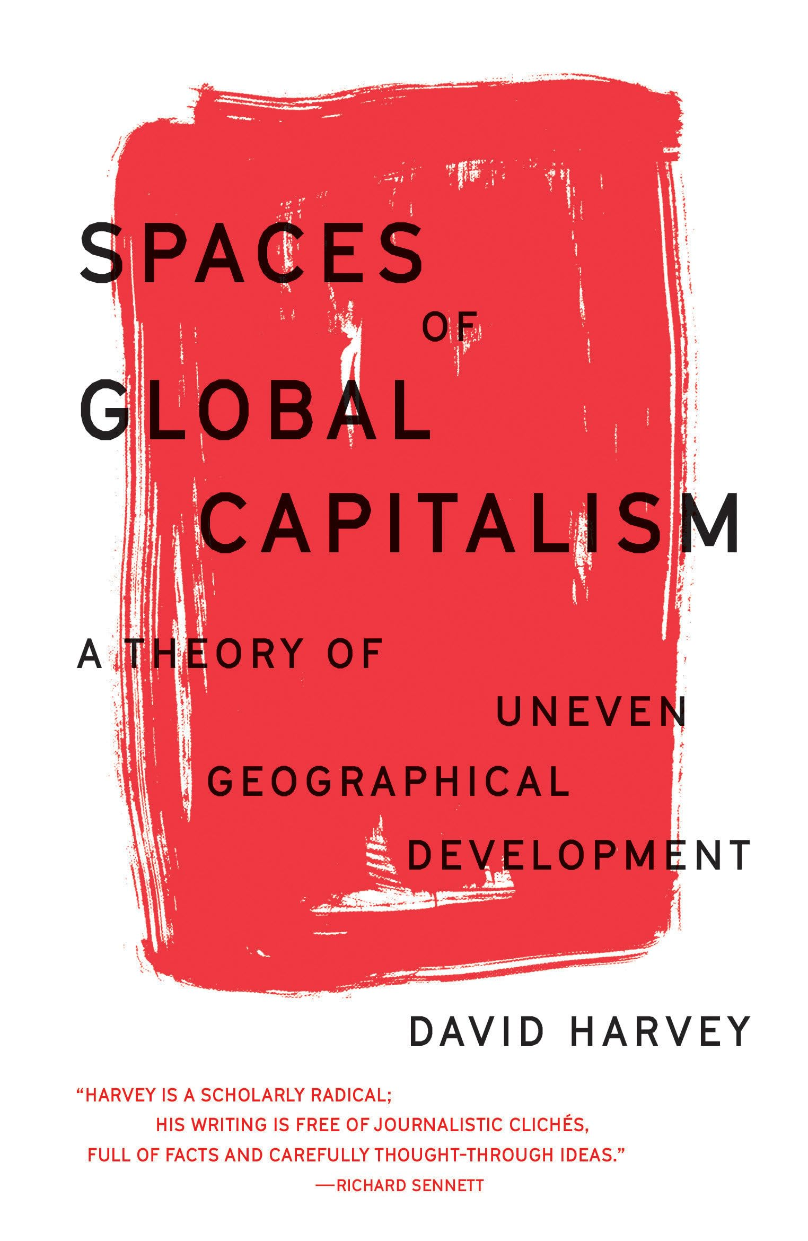
The ‘spatial turn’
David Harvey
Another tripartite division! (And again, not mutually exclusive but intersecting.)
Absolute space: the fixed space of power (maps, private property)
Relative space: dependent on what is being spatialized and by whom
Relational space: ‘processes do not occur in space but define their own spatial frame … An event or a thing … depends on everything else going on around it.’

Slide 11
The ‘spatial turn’
David Harvey
Power (‘the sheer materiality of construction in absolute space and time carries its own weight and authority’)
… but also resistance and change (‘political movements that aspire to exercise some power in the world’ must connect their relational spaces to ‘the absolute spaces and times of social and material life’ for their ‘politics [to] come alive’)

Slide 12
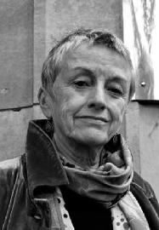
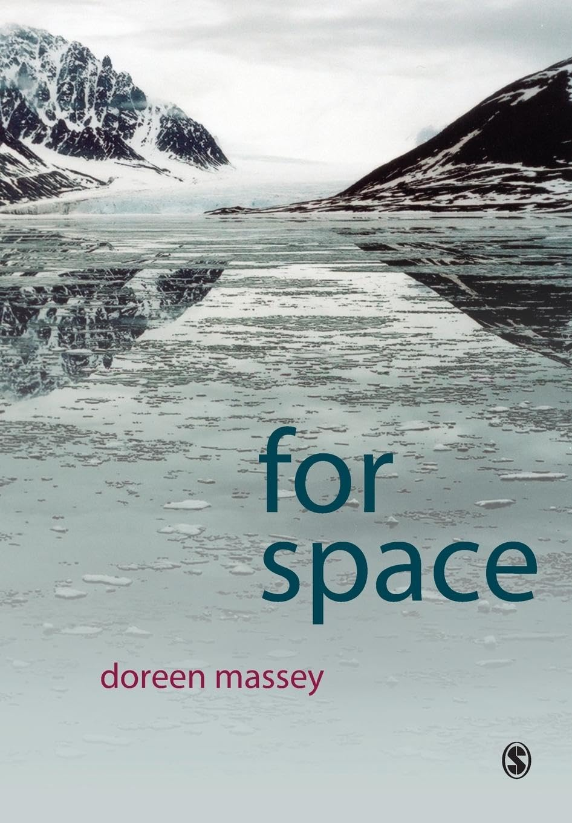
The ‘spatial turn’
Doreen Massey, For Space (2005)
Feminist geographer of labour, development, globalization
Critiques conventional definitions of ‘space’ and ‘place’
Space ‘seem[s] like a surface; continuous and given’, and this ‘deprive[s] … other places, peoples, cultures … of histories’
Place is the basis of reactionary nationalism, sharing the dubious assumption of closed, coherent, always-already divided up units
Capitalist modernity ‘doesn’t see space as emerging from interaction, nor as the sphere of multiplicity, nor as essentially open and ongoing. It is a taming of the challenge of the spatial’ (p. 71).

Slide 13
The ‘spatial turn’
Doreen Massey, For Space (2005)
‘What happens if we let go of those, by now almost intuitive, understandings?’
New definition and approach:
Space: ‘constituted through interactions, from the immensity of the global to the intimately tiny’ (notice attention to scale here)
Space as liberatory: ‘For the future to be open, space must be open too.’
Taking space away from ‘stasis, closure, representation’ and towards ‘heterogeneity, relationality, coevalness’

Slide 14
The ‘spatial turn’
Doreen Massey, For Space (2005)
Some practical implications/research agendas:
Neoliberalism’s always-ongoing creation of a space of free movement (of capital) and a space of enclosed territories (of people).
‘Local places are not simply always victims of the global; nor are they always politically defensible redoubts against the global’ (p. 101).

Slide 15
The ‘spatial turn’
Doreen Massey, For Space (2005)
Some practical implications/research agendas:
‘In spatial configurations, otherwise unconnected narratives may be brought into contact, or previously connected ones may be wrenched apart. There is always an element of “chaos”. This is the chance of space’ (p. 111).

Slide 16
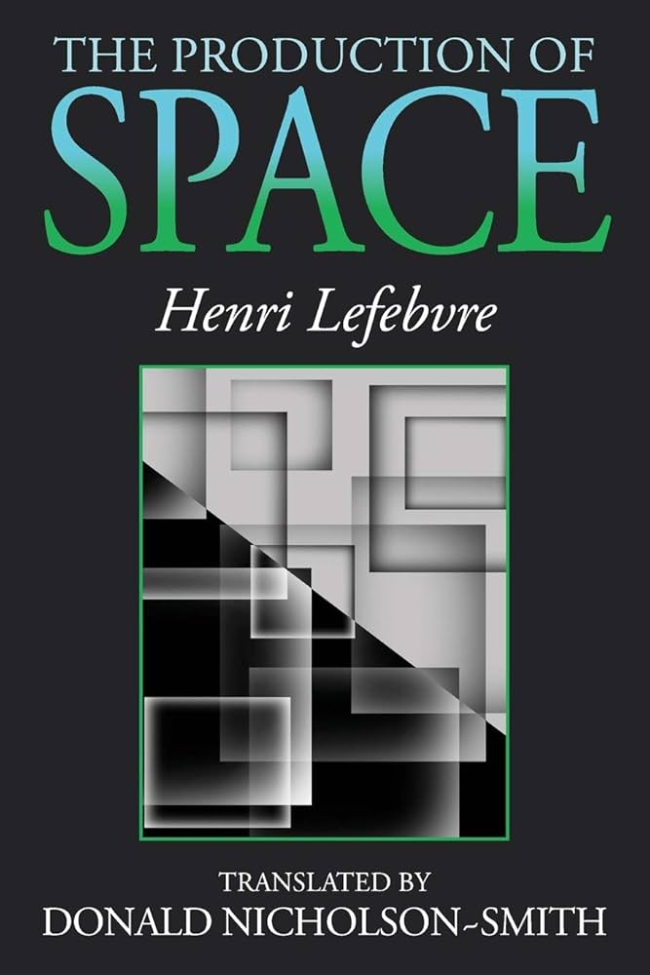
The ‘spatial turn’
Overlaps between Lefebvre, Harvey, and Massey
Broad political orientation (anti-capitalist)
Space as both material and representational
Space as the product of power, but with liberatory potential
Distinct yet interconnected forms of space (some dictated by powerholders’ more fixed representations and infrastructures, others constituted by open-ended, multiple lived practices)

Slide 17
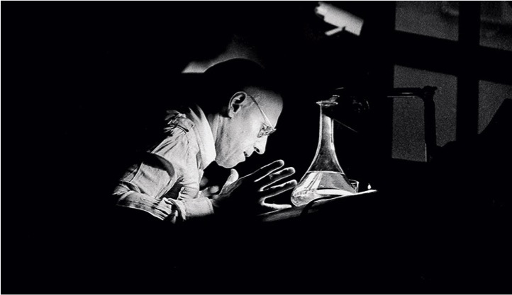
The ‘spatial turn’
And now for something fairly different…

Slide 18
The ‘spatial turn’
Michel Foucault, ‘Of Other Spaces’ (lecture 1967, published 1984, English trans. 1986)
The Heterotopia as a ‘counter-site’ in which ‘all the other real sites that can be found within the culture are simultaneously represented, contested, and inverted’ (p. 24).
‘Either their role is to create a space of illusion that exposes every real space, all the sites inside of which human life is partitioned, as still more illusory… Or else, on the contrary, their role is to create a space that is other, another real space, as perfect, as meticulous, as well arranged as ours is messy, ill constructed, and jumbled’ (p. 27).

Slide 19
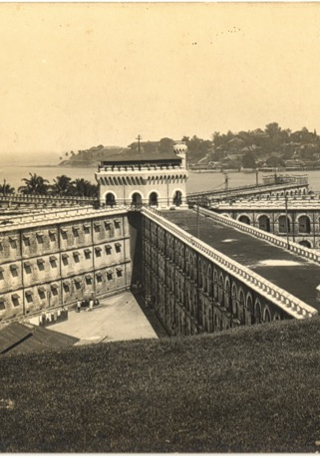
The ‘spatial turn’
Michel Foucault, ‘Of Other Spaces’
Two major types of heterotopia: ‘crisis’ and ‘deviation’.
Crisis: in which moments of rupture (e.g., manifestations of sexual virility, giving birth, dying) can take place.
Deviation: in which individuals whose behaviour departs from the required norm (e.g., disabled, mentally ill, criminal) are placed.

Slide 20
The ‘spatial turn’
Michel Foucault, ‘Of Other Spaces’
Heterotopias are not spaces of unchanging or simple otherness:
Their functions and form can change over time (e.g., the cemetery moved from the town centre to the suburbs as religious belief waned and death came to be associated with illness rather than the immortality of the soul).

Slide 21
The ‘spatial turn’
Michel Foucault, ‘Of Other Spaces’
Heterotopias are not spaces of unchanging or simple otherness:
Tension between isolation and connectedness to non-heterotopic space (‘Heterotopias always presuppose a system of opening and closing that both isolates them and makes them penetrable’, p. 26).

Slide 22
Whose spaces matter?
Political and scientific elites and their territories and maps
Foucault and the New History of Cartography
The Globe and Territory
Spaces as plural and performed in the course of quotidian processes
Massey and de Certeau
Recent border studies
More-than-human space
Braudel and the spatial structures of history
Environmental historians on nonhuman spaces

Slide 23
Whose spaces matter?
Across these contributions to spatial historiography, try to pay attention to there location within two meta-debates:
What is their theory of power (unitary and one-directional or fragmented and multi-directional)
Do they conceive of space in representational or material terms?
Note: both of these debates are not binary choices but a spectrum of possibilities

Slide 24
Elite space
Associated with:
Lefebvre’s ‘representations of space’
Harvey’s ‘absolute space’
Massey’s notion of the conventional definition of space as ‘continuous surface’

Slide 25
Elite space
Foucault’s heterotopias are spaces defined substantially by elites: states, scientists and doctors, religious powerholders, etc.

Slide 26
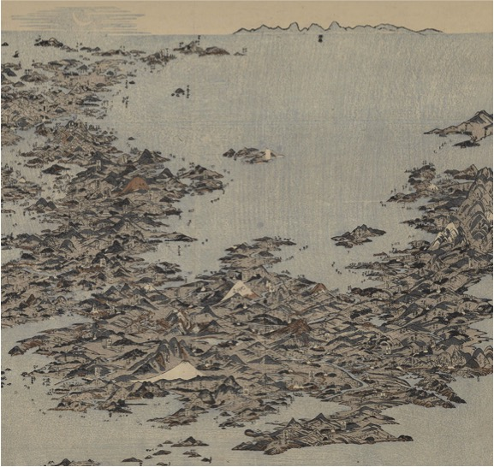
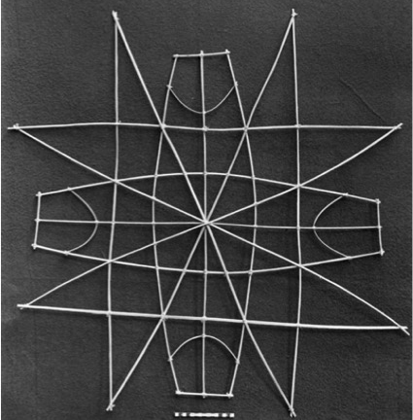
Elite space
The New History of Cartography
Key figure J. B. Harley; inspired by (misreadings of?) Foucault and Derrida
Broader definition of what counts as a map (any ‘graphic representation that facilitate[s] a spatial understanding of things’)
Maps as ‘value-laden texts’ rather than objective and neutral representations of space, serving powerholders’ purposes and suppressing the spatial imaginaries and practices of others.

Slide 27
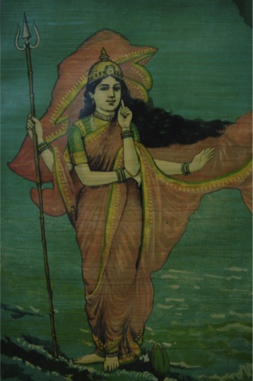
Elite space
The New History of Cartography
What about errors and conspicuous cartographic fallibility?
What about variable reception and use of maps?
What about maps of resistance and contestation?

Slide 28
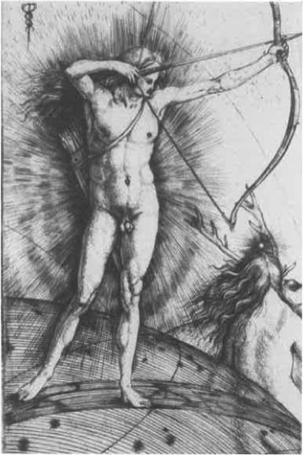
Elite space
Producing ‘the Globe’: Denis Cosgrove, Apollo’s Eye (2001)
‘Conceiving and representing the earth as a unitary, regular body of spherical form’ is a historical process, not a universal and inevitable truth.
The Globe prioritises the visual over other ways of knowing and enacting space.
C18/C19: ‘planetary consciousness’ emerges alongside European imperial expansion.

Slide 29
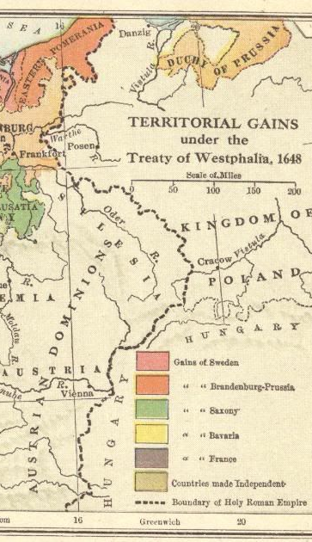
Elite space
Producing ‘Territory’: Stuart Elden, The Birth of Territory (2013)
Modern territory emerges through combination of older modes of law, settlement, and sovereignty under the unprecedented capacities of the state and science.
Although complexity and multiplicity remained in practice, ‘territory’ enabled unitary sovereignty through the measurement and taxation of land, and the military control of terrain.
Territory is a process made to seem like a fixed universal.

Slide 30
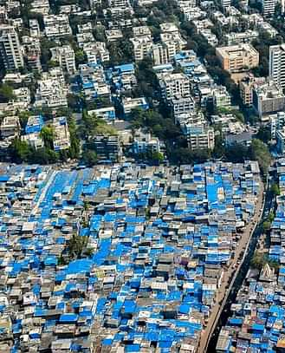
Plural and quotidian spaces
Associated with:
Lefebvre’s ‘spatial practice’ (to an extent)
Harvey’s ‘relational space’
Massey’s ‘chance of space’
…
and perhaps Foucault’s later work insisting that power is always relational and open to possible resistance and reconstitution

Slide 31
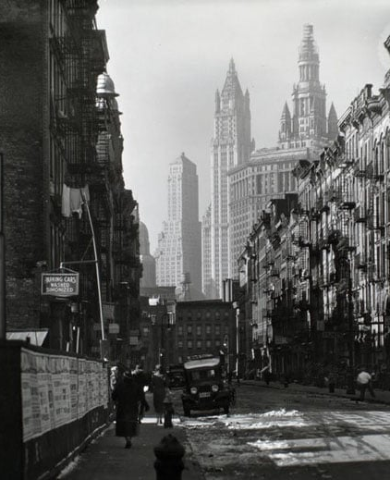
Plural and quotidian spaces
Michel de Certeau, The Practice of Everyday Life (English trans. 1984)
‘An Icarian fall’ from the static and distanced skyscraper gaze to the walker on the streets.
‘The long poem of walking manipulates spatial organisations, no matter how panoptic they may be’ (p. 101).
In contrast to maps, stories ‘tell us what one can do in [space] and make out of it’ (p. 122).

Slide 32
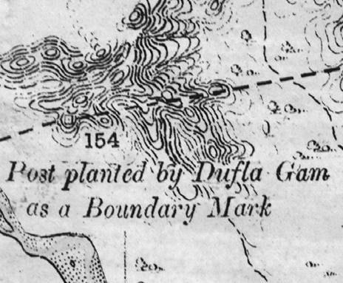
Plural and quotidian spaces
Borders as performed objects (e.g., John Agnew, ‘Borders on the mind’)
The most seemingly state-imposed objects are enacted (and changed) through repeated processes of (not) crossing and interacting.
The border as a ‘constantly evolving’ bundle of human and nonhuman elements: guards, rivers, walls, barbed wire, checkpoints, travellers, vehicles, vendors, traders, animals, microbes.
Borders are ‘equivocal’—i.e., ‘always … open to question, if not to all who would cross them’

Slide 33
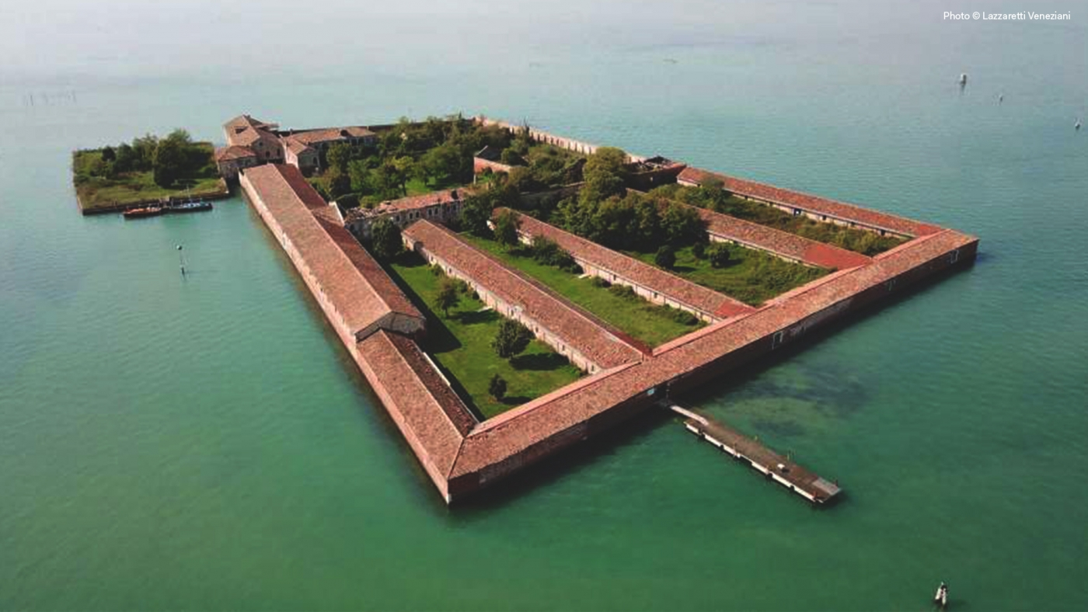
From plural to more-than-human spaces

Slide 34
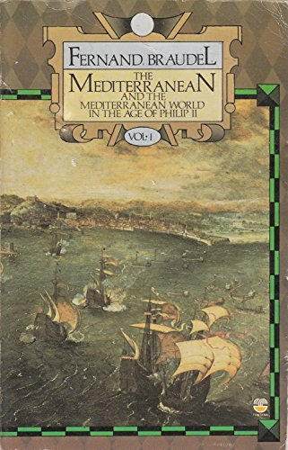
More-than-human space
‘Statesmen were, despite their illusions, more acted upon than actors … The events of history are merely surface disturbances, crests of foam that the tides of history carry on their strong backs.’
Deep environmental structures
Socio-economic structures
Human agency

Slide 35
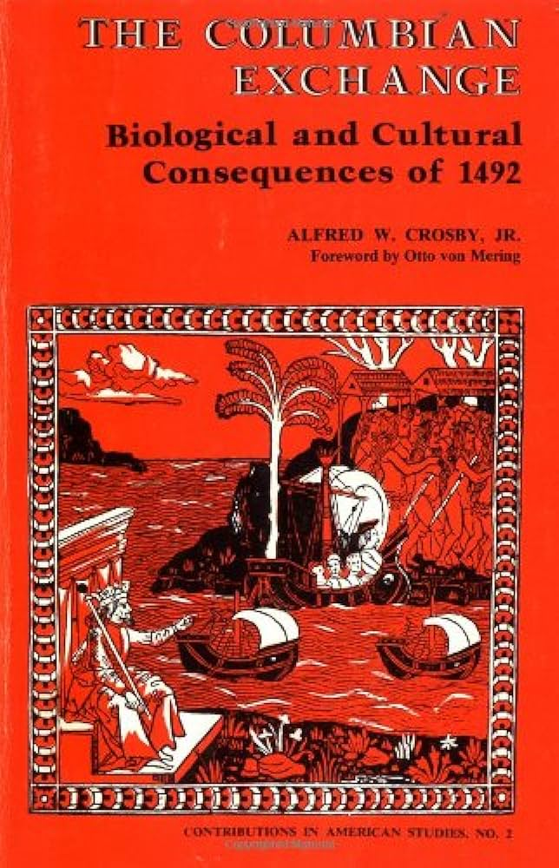
More-than-human space
Animals, microbes, and plants as ‘expansionistic’ agents that ‘often spread far beyond the European frontier, often to people who had barely heard of the white invaders’ (Ecological Imperialism, p. 203).
E.g., smallpox reached northwest Pacific coast of North America in 1782–3, ahead of European humans.
Nonhuman spaces related to, but not determined by, human agency.

Slide 36

More-than-human space
‘Human life in Beringia was shaped, in part, by the ways energy moved over the land and through the sea’ (p. 4).
‘In aggregate, [nonhuman actors and their spaces] made humans one subject among many acting in Beringia’ (pp. 8–9).
‘What power do human ideas have to change their surroundings, and how are people in turn shaped by their habitual relationships with the world? Put another way, what is the nature of history when nature is part of what makes history?’ (p. 3)

Slide 37
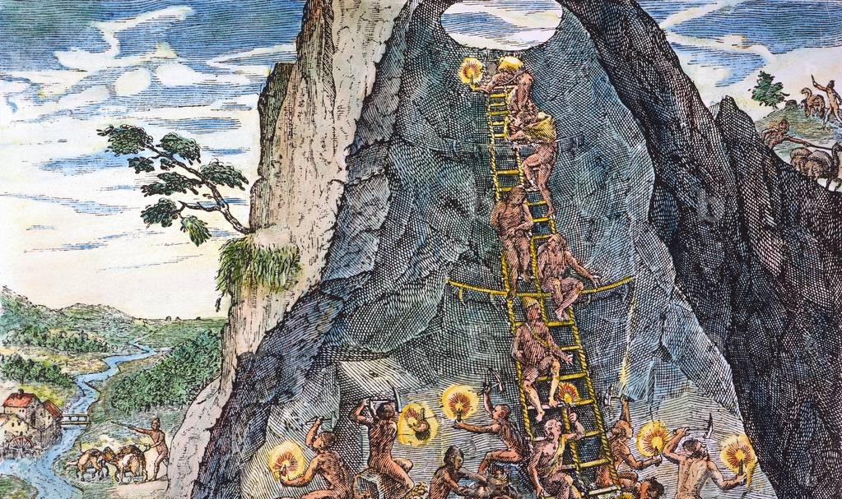
Three fashionable concepts in spatial history
1. Volume
‘Increasingly the reach of the state has also been directed downward, penetrating ever deeper into the subterranean realm… Counterintuitively, technological advances have reduced rather than extended the state’s lower and upper limits’
Franck Billé, ‘Voluminous: An Introduction’, in Voluminous States: Sovereignty, Materiality, and the Territorial Imagination, ed. Franck Billé (Durham, NC: Duke University Press, 2020), pp. 8–10

Slide 38

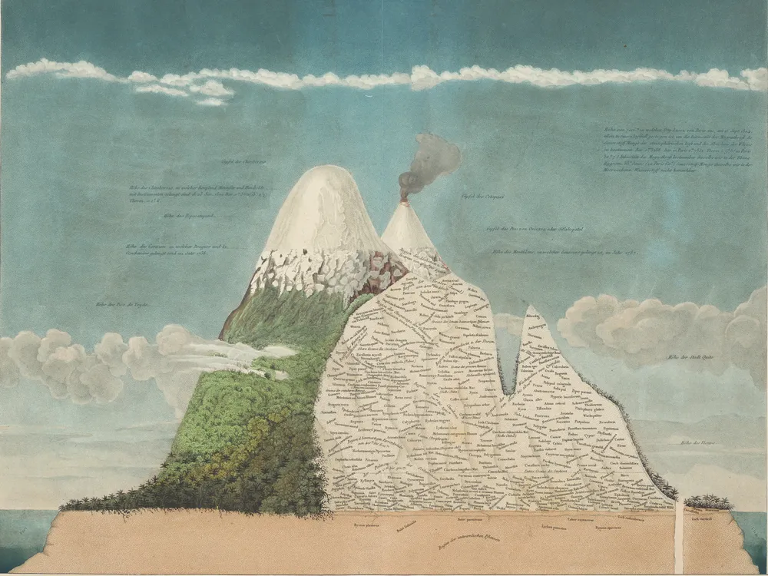
Three fashionable concepts in spatial history
1. Volume
Examples: mines, atmosphere, mountains and ‘high places’, deep oceans, sovereignty and resistance as vertically banded

Slide 39
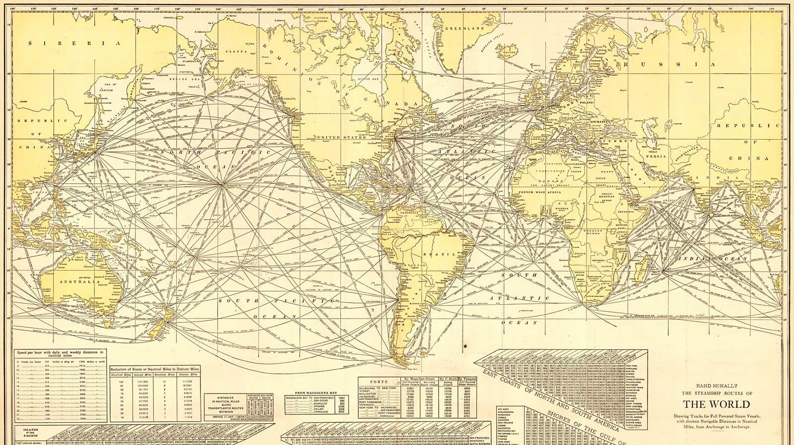
Three fashionable concepts in spatial history
2. Network
Influenced by Latour’s Actor-Network Theory, especially in the notion that power doesn’t simply flow from a core to peripheries
Connections and mobilities as creative and generative, rather than diffusing stable ideas and products

Slide 40
Three fashionable concepts in spatial history
2. Network
Influenced by Latour’s Actor-Network Theory, especially in the notion that power doesn’t simply flow from a core to peripheries
‘British colonial discourses were made and remade, rather than simply transferred or imposed, through the “geographies of connection” between Britain and settler colonies.’
Alan Lester, Imperial Networks, p. 5

Slide 41
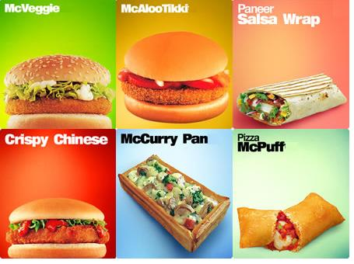
Three fashionable concepts in spatial history
3. Scale
Focused on shifts (material and imaginative) between scales such as local and global
Inspired by diverse disciplines, including ecology and anthropology (e.g., Arjun Appadurai’s ‘glocalization’)
Expansion of history into macro (big/deep/global/planetary) and micro domains

Slide 42
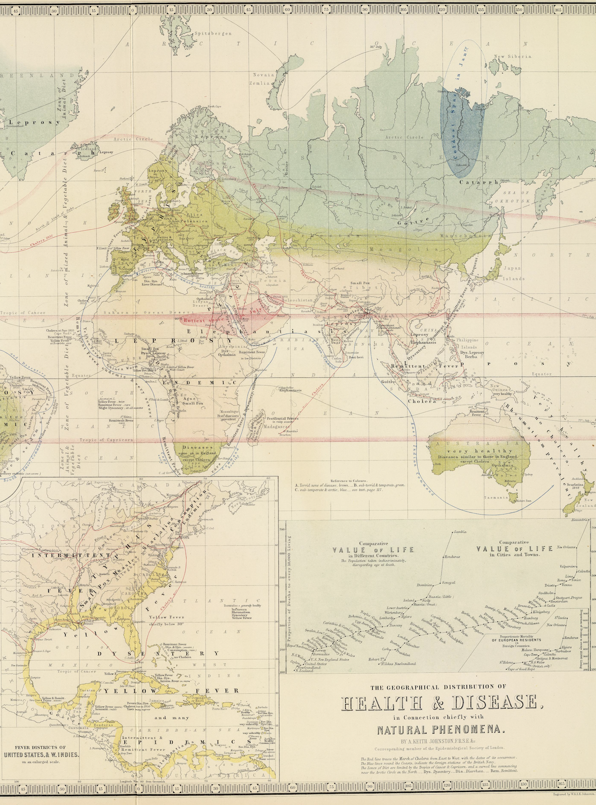
Three fashionable concepts in spatial history
3. Scale
‘What is needed is a history of scaling. By scaling, I mean the work of mediating between different systems of measurement, formal or informal, designed to apply to different slices of the phenomenal world … in order to arrive at a common standard of proportionality… A focus on scaling disrupts the linear narrative of a push toward ever larger dimensions of thought.’
Deborah Coen, ‘Big Is a Thing of the Past’, p. 312

