Slide 1
TSM: Space
Professor David Lambert
Monday 16th November

Slide 2
Lecture structure
Space and the ‘spatial turn’
Background and context
Key arguments in For Space
Examples

Slide 3
The ‘spatial turn’
‘Contemporary critical studies in the humanities and social sciences have been experiencing an unprecedented spatial turn. In what may in retrospect be seen as one of the most important intellectual developments in the late twentieth century, scholars have begun to interpret space and the spatiality of human life with the same critical insight and interpretive power as have traditionally been given to time and history (the historicality of human life) on one hand, and to social relations and society (the sociality of human life) on the other’ (Soja, 2005 [1999], ‘Thirdspace’, 261).

Slide 4
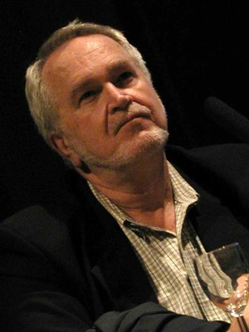
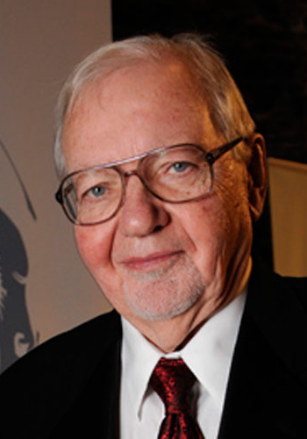
The ‘spatial turn’
Ed Soja (1940-2015)
Fredric Jameson (b. 1934)

Slide 5
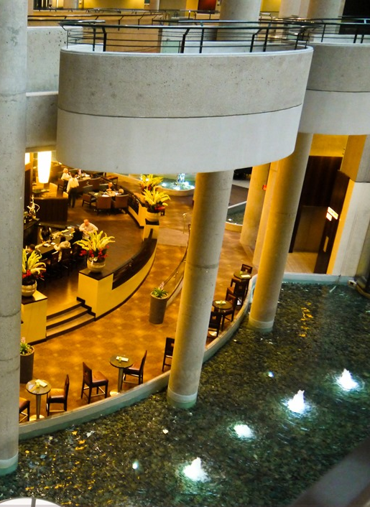
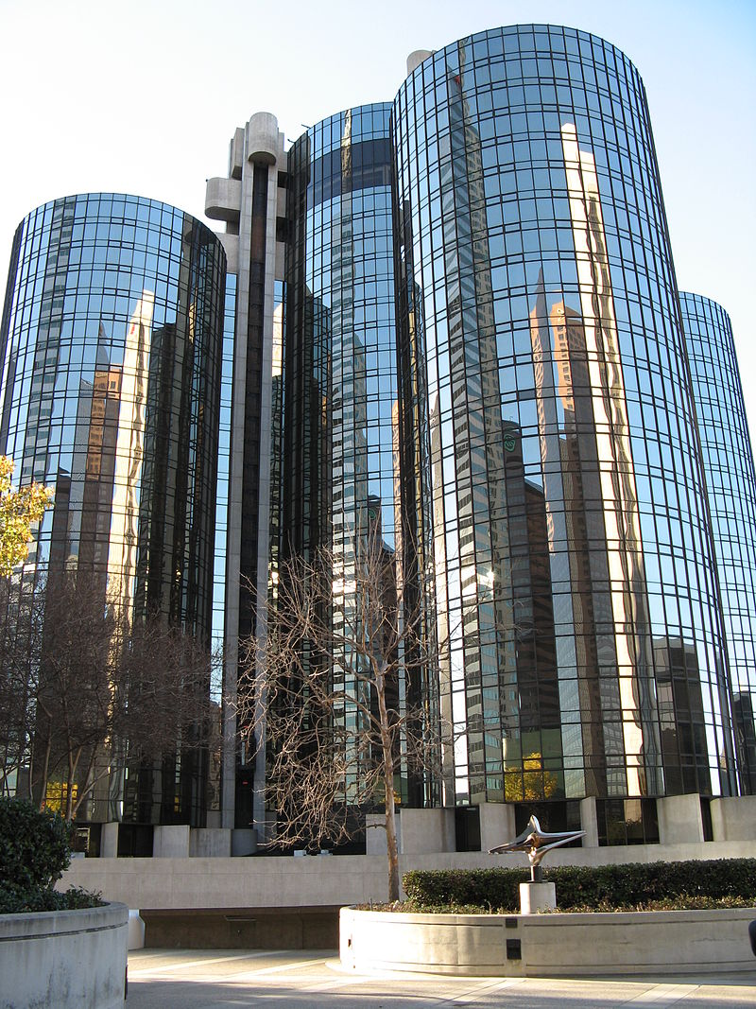

Slide 6
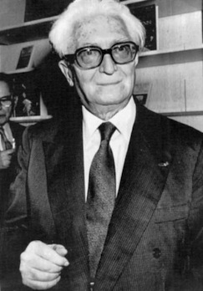
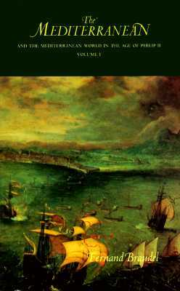
The Annales School
Fernand Braudel
(1902-1985)
The Mediterranean and the Mediterranean World in the Age of Philip II (1949)

Slide 7
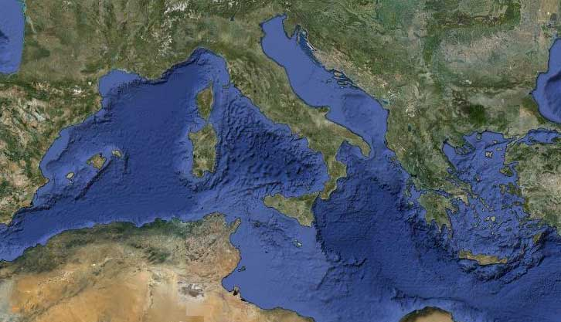
The Mediterranean World

Slide 8
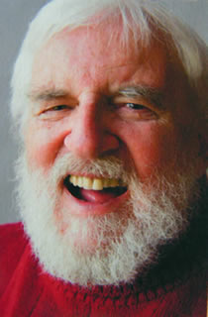
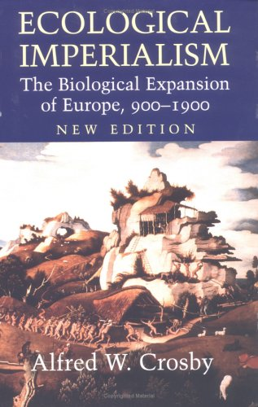
Environmental and ecological history
Ecological Imperialism (1986)
Alfred Crosby (1931-2018)

Slide 9
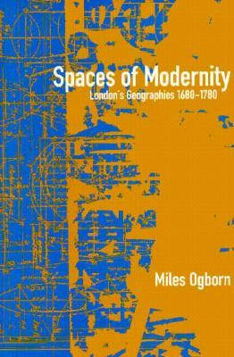
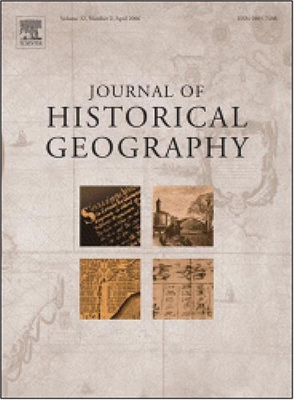
Historical geography
Miles Ogborn, Spaces of Modernity: London’s Geographies, 1680-1780 (1998)
Journal of Historical Geography (founded 1975)

Slide 10
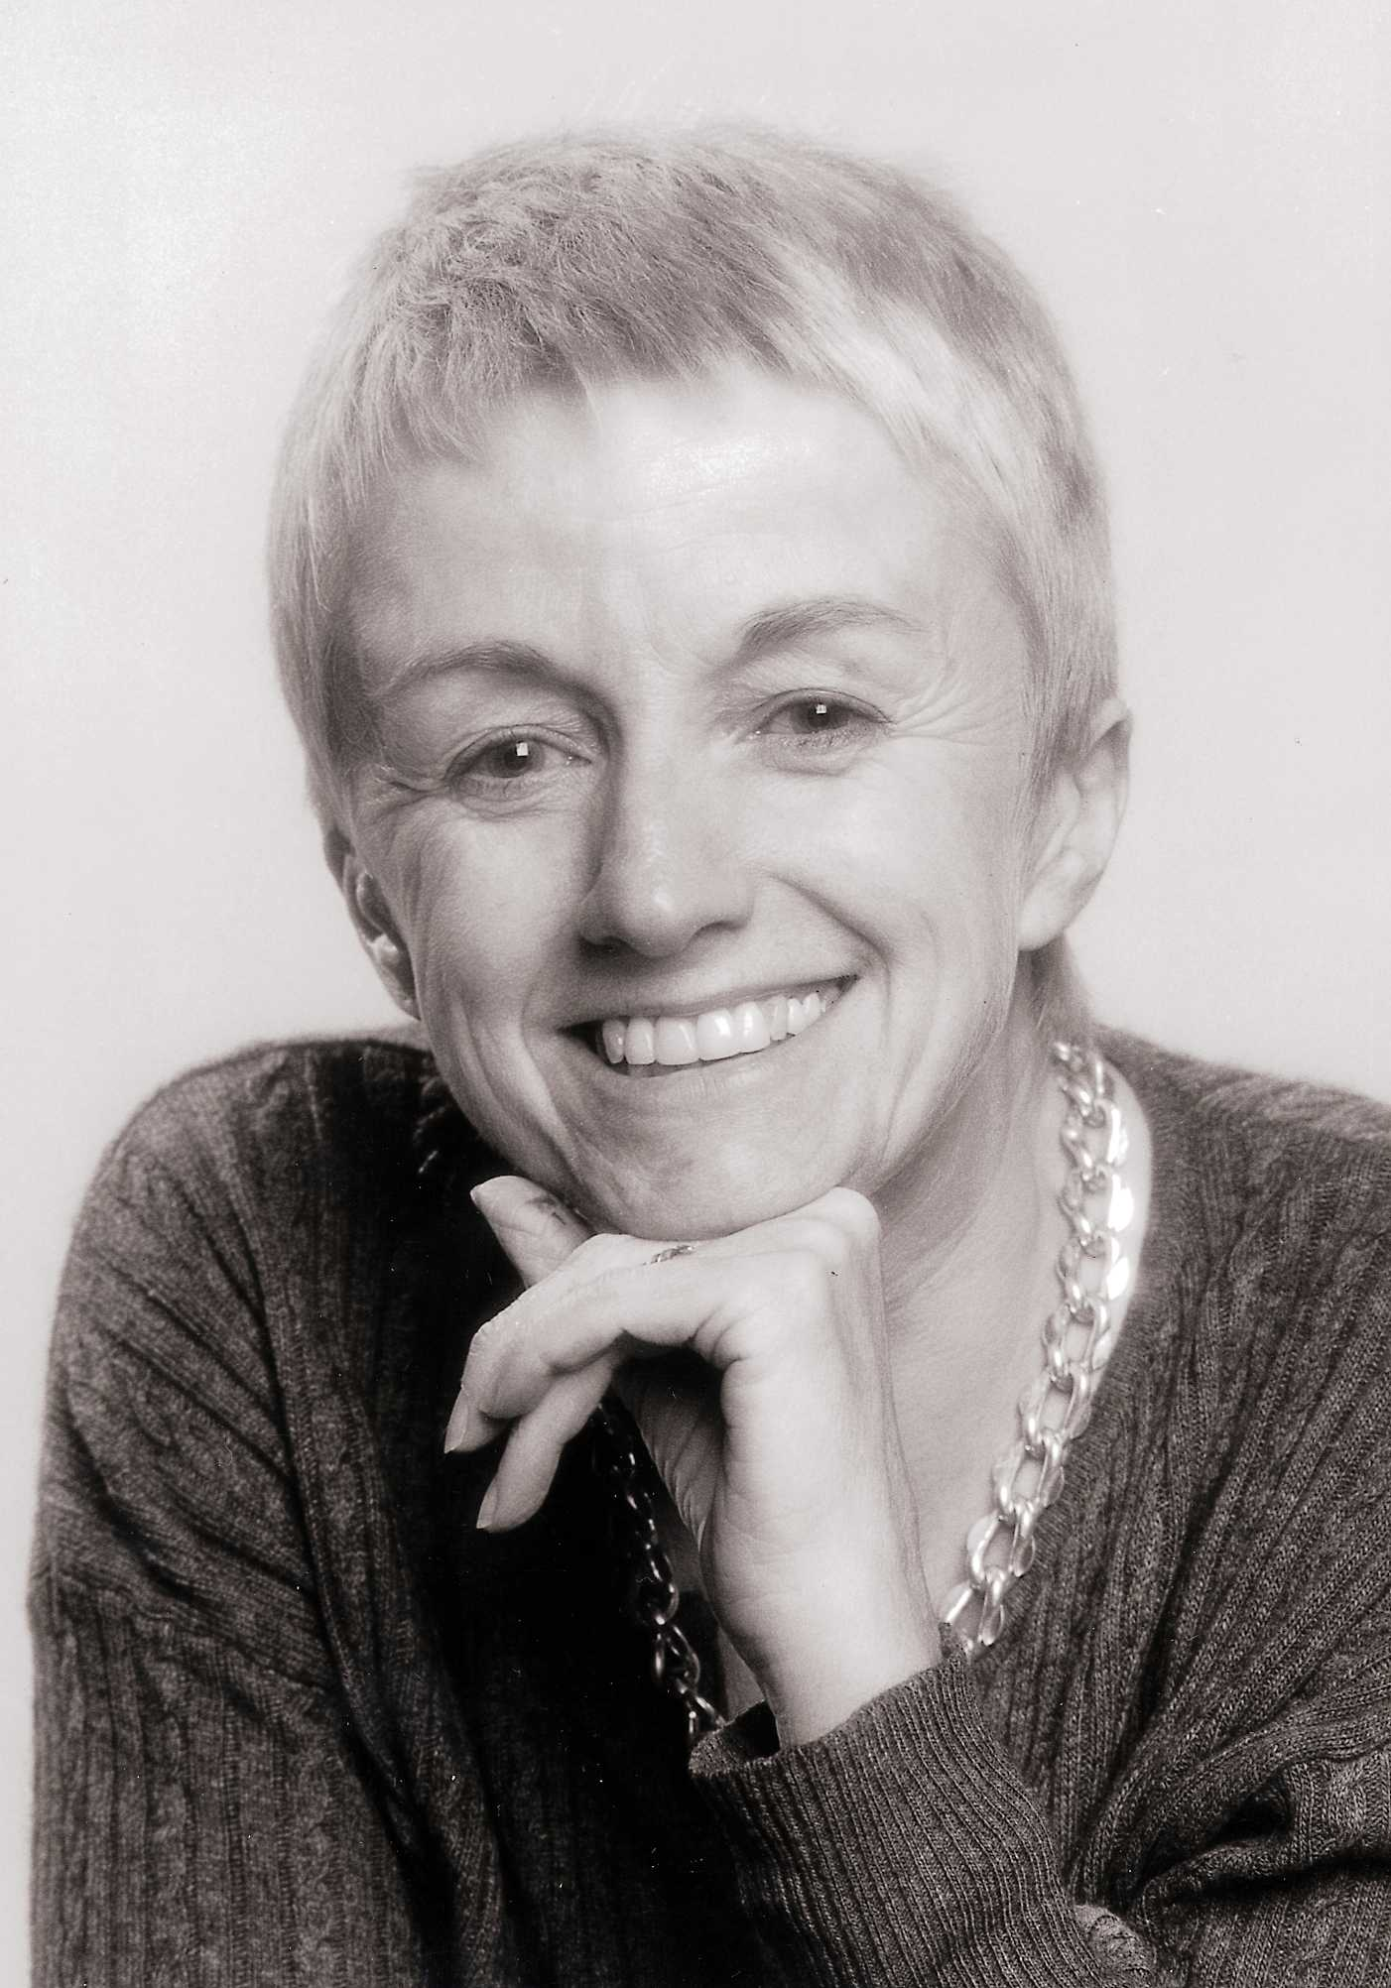
Doreen Massey
Born Manchester, 1944
Emeritus Professor of Geography at the Open University (retired 2009)
Died in 2016

Slide 11
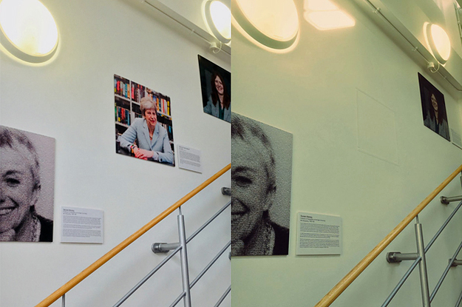
Oxford Geography Department’s ‘Wall Of Women’

Slide 12
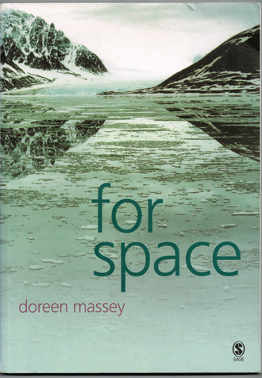
Doreen Massey

Slide 13
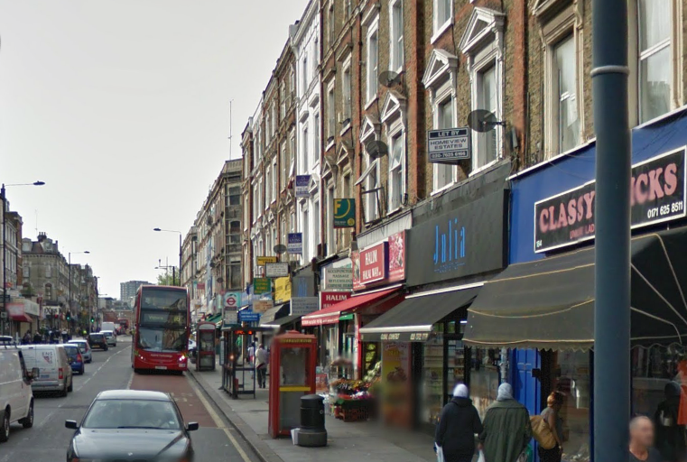
Kilburn High Road and a ‘global sense of place’

Slide 14
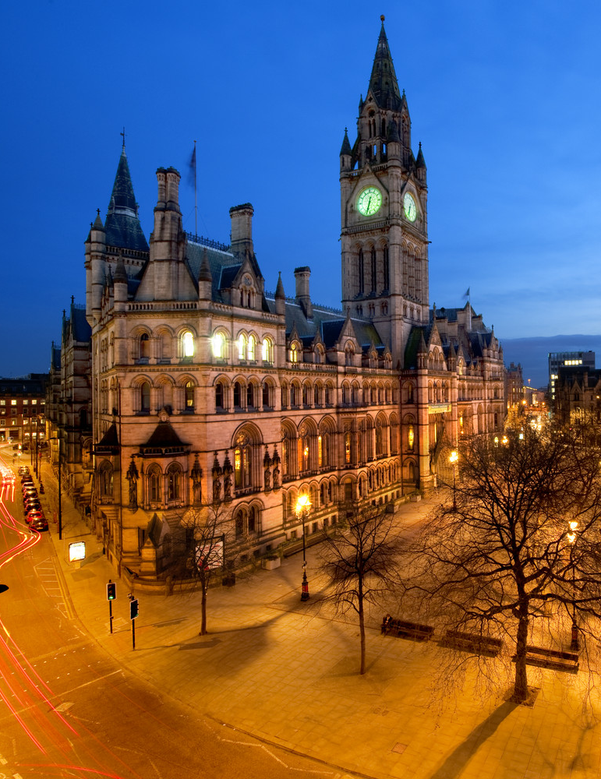

Supporting LFC and a ‘global sense of place’

Slide 15
Kilburn High Road and a ‘global sense of place’

Slide 16
Doreen Massey

Slide 17
Space is there…
‘Unlike time, it seems, you can see space spread out around you. Time is either past or to come or so minutely instantaneously now that it is impossible to grasp. Space, on the other hand, is there. One immediate and evident effect of this is that space comes to seem so very much more material than time. Temporality seems easy to imagine in the abstract, as a dimension, as the dimension of change. Space, in contrast, has been equated...with the material’ (For Space, p. 117).

Slide 18
…but it is not just there
‘What is needed...is to uproot “space” from that constellation of concepts in which it has so unquestioningly so often been embedded (stasis; closure; representation) and to settle it among another set of ideas (heterogeneity; relationality; coevalness...)’ (For Space, p. 13).

Slide 19
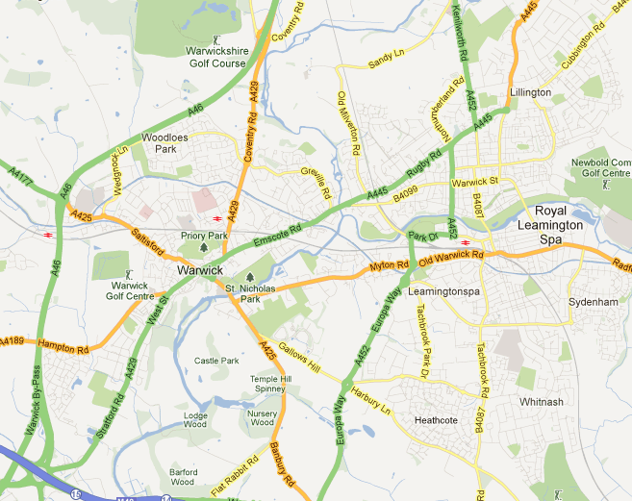
Space is not a surface

Slide 20
Space is not a surface
‘What if, instead, it [space] presents us with a heterogeneity of practices and processes? Then it will not be an already-interconnected whole but an ongoing product of interconnections....Then it will be always unfinished and open. This arena of space is not firm ground on which to stand. In no way is it a surface’ (For Space, p. 107).

Slide 21
Space is inherently multiple, plural and fluid
‘Without space, no multiplicity; without multiplicity, no space....Multiplicity and space...[are] co-constitutive....[Space] is always in the process of being made. It is never finished; never closed. Perhaps we should imagine space as a simultaneity of stories-so-far’ (For Space, p. 9).

Slide 22
Space is inherently multiple, plural and fluid
‘Without space, no multiplicity; without multiplicity, no space....Multiplicity and space...[are] co-constitutive....[Space] is always in the process of being made. It is never finished; never closed. Perhaps we should imagine space as a simultaneity of stories-so-far’ (For Space, p. 9).

Slide 23
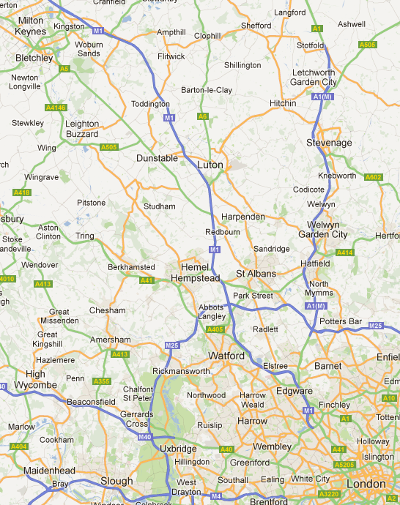
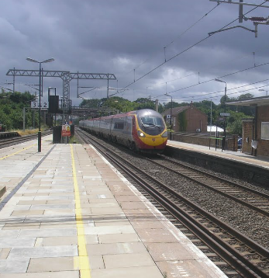
Train journey from London to Milton Keynes

Slide 24
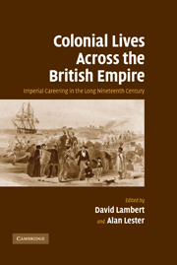
Imperial networks
Co-edited with Alan Lester (Professor of Historical Geography, University of Sussex)
Part of the ‘New Imperial History’
12 biographical studies of trans-imperial careers

Slide 25
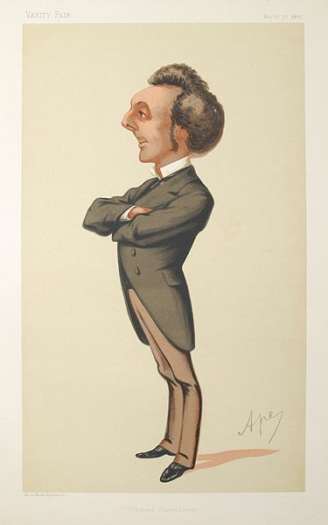
Sir John Pope Hennessy (1834-91)

Slide 26
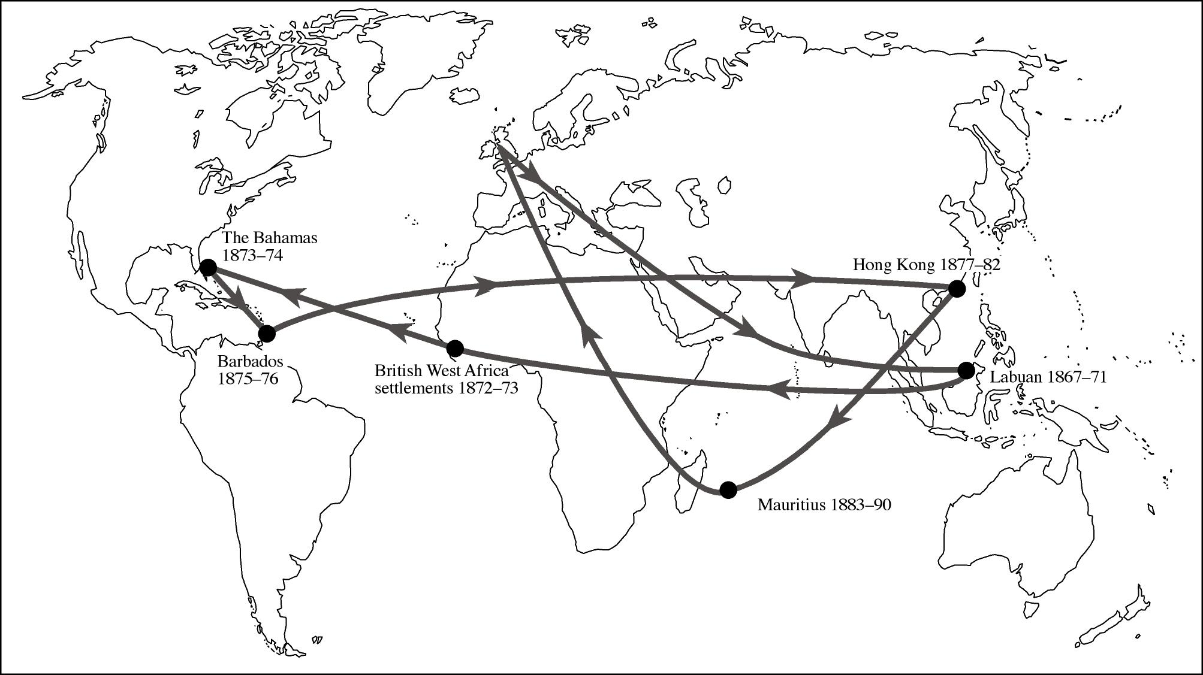

Slide 27
Thinking spatiality
What would it mean to think about the spatiality of your own historical interests?
What would it mean to think about this spatiality in Massey’s terms, i.e. as relational, heterogeneous and unfinished?

Slide 28
TSM: Space
Professor David Lambert
Monday 16th November

