Slide 1
TSM: Space
Professor David Lambert
Monday 29th October

Slide 2
Lecture structure
Space and the ‘spatial turn’
Background and context
Key arguments in For Space
Examples

Slide 3
The ‘spatial turn’
‘Contemporary critical studies in the humanities and social sciences have been experiencing an unprecedented spatial turn. In what may in retrospect be seen as one of the most important intellectual developments in the late twentieth century, scholars have begun to interpret space and the spatiality of human life with the same critical insight and interpretive power as have traditionally been given to time and history (the historicality of human life) on one hand, and to social relations and society (the sociality of human life) on the other’ (Soja, 2005 [1999], ‘Thirdspace’, 261).
Notes:
The ‘spatial turn’ in the arts and sciences in the 1980s. Engel and Nugent (2010) trace the conceptual roots of the spatial turn to Ernst Cassirer and Henri Lefebvre (1974). Lefebvre in The Production of Space (1974) contends that there are different modes of production of space (i.e. spatialization) from natural space ('absolute space') to more complex spatialities whose significance is socially produced (i.e. social space). Lefebvre analyses each historical mode as a three-part dialectic between everyday practices and perceptions (le perçu), representations or theories of space (le conçu) and the spatial imaginary of the time (le vécu).
Frederic Jameson appears to have coined the epochal usage of the term for the 1980s paradigm shift. Jameson (1988 / 2003, 154) notes that the concept of the spatial turn, "has often seemed to offer one of the more productive ways of distinguishing postmodernism from modernism proper, whose experience of temporality -- existential time, along with deep memory -- it is henceforth conventional to see as dominant of the high modern."

Slide 4
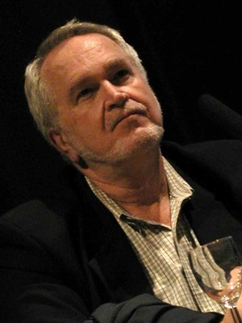
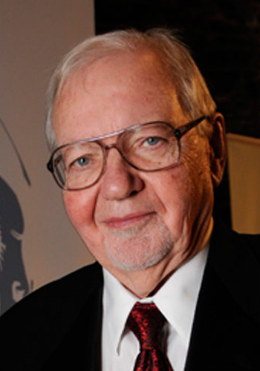
The ‘spatial turn’
Ed Soja (1940-2015)
Fredric Jameson (b. 1934)

Slide 5


Slide 6
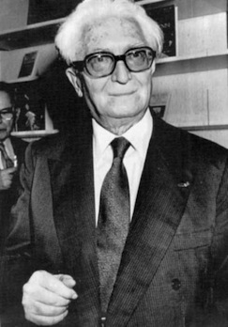
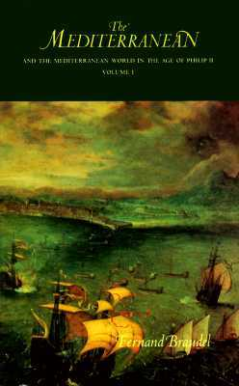
The Annales School
Fernand Braudel
(1902-1985)
The Mediterranean and the Mediterranean World in the Age of Philip II (1949)
Notes:
The Annales School – Fernand Braudel, The Mediterranean and the Mediterranean World in the Age of Philip II (1949; English translation 1973). It is named after its scholarly journal Annales d'histoire économique et sociale, French but with broader influence. The Annalistes advocated a histoire totale, including an emphasis on the long and medium-term development of economy and society, which included an emphasis on geography and environment.

Slide 7
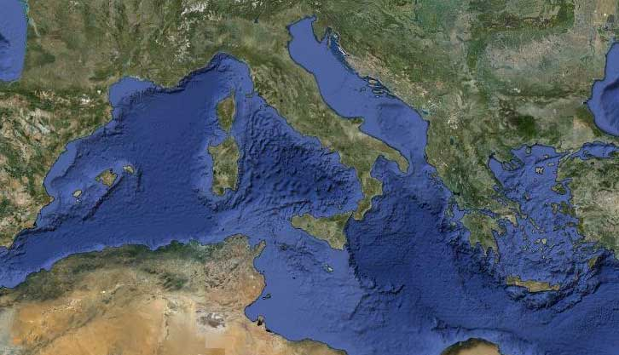
The Mediterranean World

Slide 8
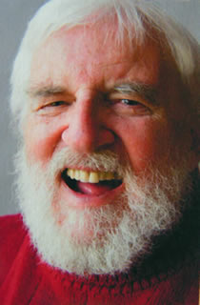
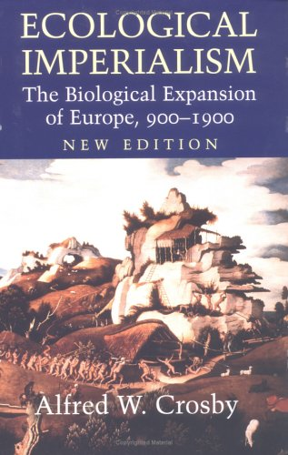
Environmental and ecological history
Ecological Imperialism (1986)
Alfred Crosby (1931-2018)
Notes:
Environmental and ecological history – Alfred Crosbie, Ecological Imperialism: The Biological Expansion of Europe, 900-1900 (1986). The study of human interaction with the natural world over time, emphasizing the active role nature plays in influencing human affairs. Environmental historians study how humans both shape their environment and are shaped by it. Links to the Annales School, environmental history emerged as a self-conscious field in the United States in the 1960s and 1970s. Links to environmental movement.

Slide 9
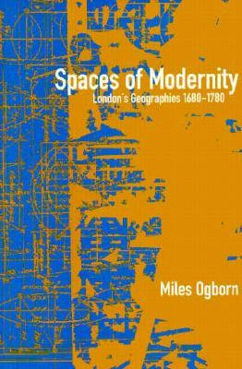
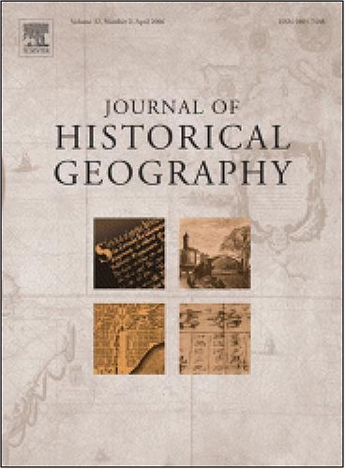
Historical geography
Miles Ogborn, Spaces of Modernity: London’s Geographies, 1680-1780 (1998)
Journal of Historical Geography (founded 1975)
Notes:
Historical geography – closely related to environmental history, especially in the North American context, and standing in a not-always-easy relationship with the French Annales School, Historical geography is the study of the human and physical geographies of the past. A common theme is how a place or region changes through time. Many historical geographers study geographical patterns through time, including how people have interacted with their environment, and created the cultural landscape (wiki). Journal of Historical Geography (established 1975); Felix Driver, Power and Pauperism: The Workhouse System, 1834-1884 (1993) and Miles Ogborn, Spaces of Modernity: London’s Geographies, 1680-1780 (1998).

Slide 10
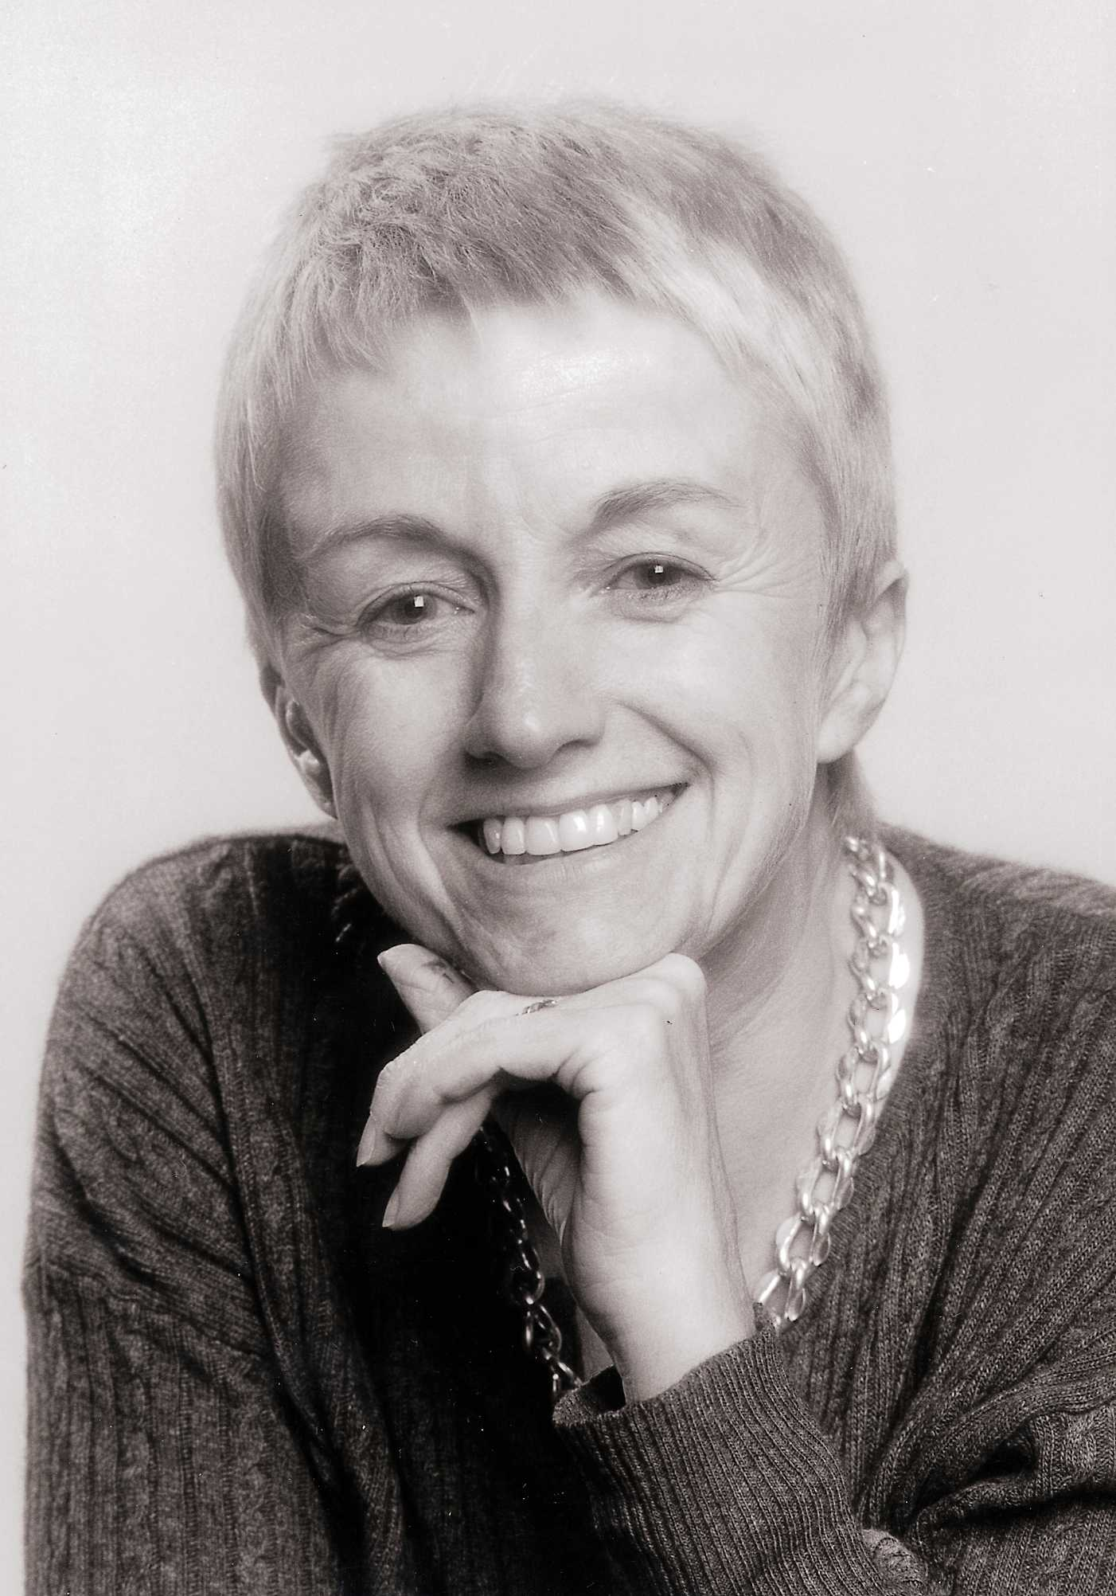
Doreen Massey
Born Manchester, 1944
Emeritus Professor of Geography at the Open University (retired 2009)
Died in 2016
Notes:
Massey was born in Manchester in 1944 and studied at Oxford and Philadelphia, beginning her career with a thinktank, the Centre for Environmental Studies (CES) in London. CES contained several key analysts of the contemporary British economy, and Massey established a working partnership with Richard Meegan, among others. CES was closed down and she moved into academia at The Open University. She was awarded the Victoria Medal of the Royal Geographical Society in 1994. After a distinguished career, she won the Prix Vautrin Lud (the ‘Nobel de Géographie’) in 1998.

Slide 11
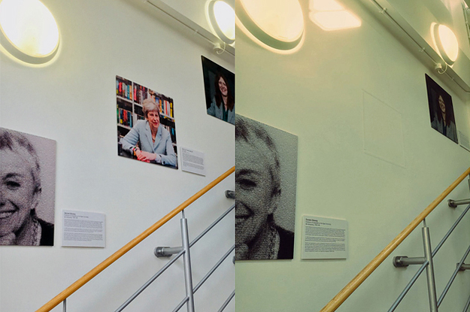
Oxford Geography Department’s ‘Wall Of Women’
Notes:
While Massey has argued for the importance of place, her position accords with those arguing against essentialised or static notions, where:
- places do not have single identities but multiple ones.
- places are not frozen in time, they are processes.
- places are not enclosures with a clear inside and outside.
Massey used the example of Kilburn High Road in north west London to exemplify what she termed a 'progressive' or 'global' sense of place, in the essay 'A Global Sense of Place‘ (originally published in Marxism Today in 1991).

Slide 12
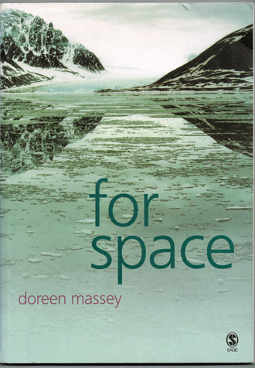
Doreen Massey
Notes:
Doreen has long-term interests in the theorization of 'space' and 'place' and in demonstrating the importance to both everyday life and wider politics of how we conceptualise both space and place. Empirically this work has engaged with a critique of current forms of globalisation, issues of regional uneven development, and of the city. In all of this the aim has been to work between, and to show the relationship between, philosophical and conceptual issues on the one hand and the directly political on the other. Her 2005 book For space laid out much of this groundwork, bringing together arguments formulated over many years.

Slide 13
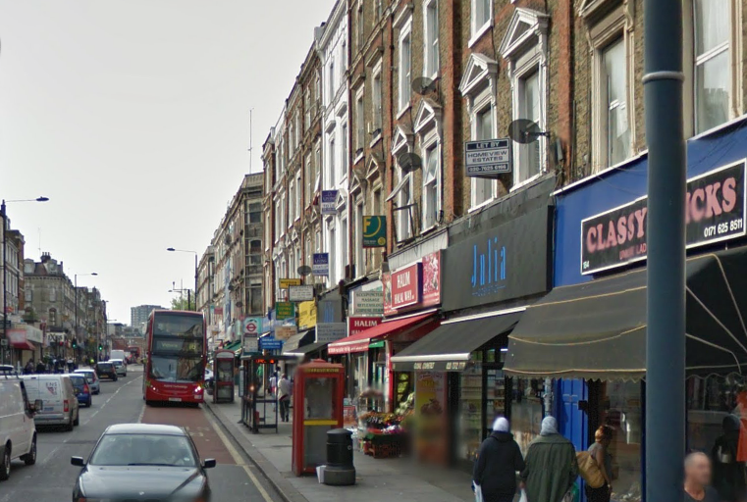
Kilburn High Road and a ‘global sense of place’
Notes:
While Massey has argued for the importance of place, her position accords with those arguing against essentialised or static notions, where:
- places do not have single identities but multiple ones.
- places are not frozen in time, they are processes.
- places are not enclosures with a clear inside and outside.
Massey used the example of Kilburn High Road in north west London to exemplify what she termed a 'progressive' or 'global' sense of place, in the essay 'A Global Sense of Place‘ (originally published in Marxism Today in 1991).

Slide 14
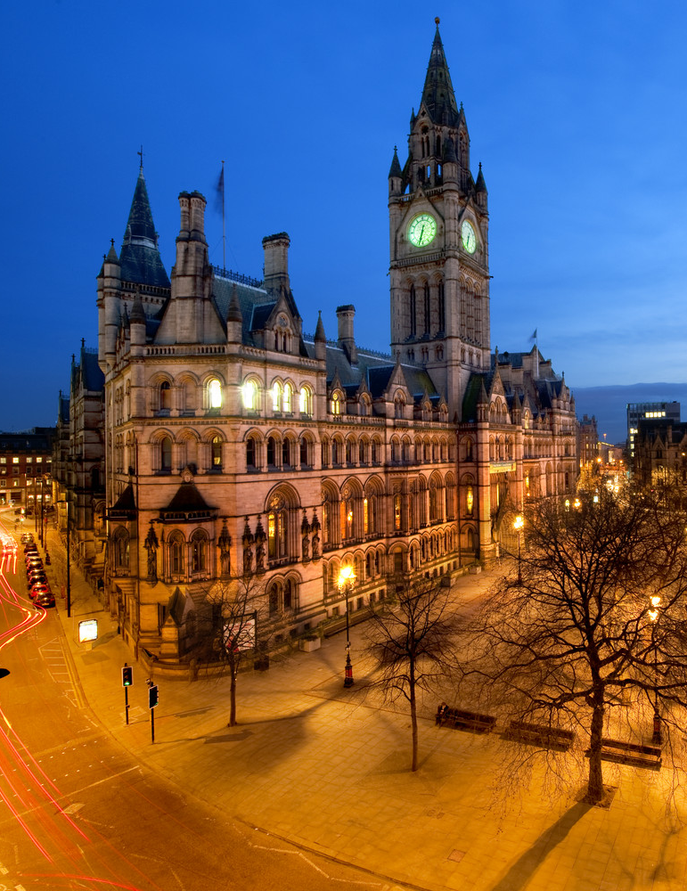

Supporting LFC and a ‘global sense of place’

Slide 15
Kilburn High Road and a ‘global sense of place’
Notes:
The ‘open, relational construction of place in no way works against specificity and uniqueness, it just understands its derivation in a different way’ (Massey, For Space, p. 169).

Slide 16
Doreen Massey
Notes:
Doreen has long-term interests in the theorization of 'space' and 'place' and in demonstrating the importance to both everyday life and wider politics of how we conceptualise both space and place. Empirically this work has engaged with a critique of current forms of globalisation, issues of regional uneven development, and of the city. In all of this the aim has been to work between, and to show the relationship between, philosophical and conceptual issues on the one hand and the directly political on the other. Her 2005 book For space laid out much of this groundwork, bringing together arguments formulated over many years.

Slide 17
Space is there…
‘Unlike time, it seems, you can see space spread out around you. Time is either past or to come or so minutely instantaneously now that it is impossible to grasp. Space, on the other hand, is there. One immediate and evident effect of this is that space comes to seem so very much more material than time. Temporality seems easy to imagine in the abstract, as a dimension, as the dimension of change. Space, in contrast, has been equated...with the material’ (For Space, p. 117).
Notes:
It is around us and can be physically experienced. Associated with landscape (material and built), architecture, with things and their place in the world.
This is why it is attractive to some historians, who are put off by the emphasis on image, text and discourse that reflected the influence of literary and cultural studies on history.

Slide 18
…but it is not just there
‘What is needed...is to uproot “space” from that constellation of concepts in which it has so unquestioningly so often been embedded (stasis; closure; representation) and to settle it among another set of ideas (heterogeneity; relationality; coevalness...)’ (For Space, p. 13).
Notes:
Notice the ambivalence in Massey’s writing. Throughout For Space she wants to challenge this too-easy association of space with this static solidity and get us thinking about it in different ways. Space, for example, is not a safe, easy concept that can be latched on to.

Slide 19
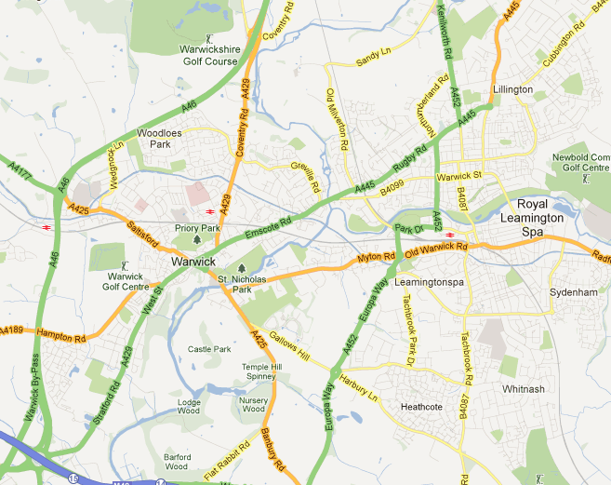
Space is not a surface

Slide 20
Space is not a surface
‘What if, instead, it [space] presents us with a heterogeneity of practices and processes? Then it will not be an already-interconnected whole but an ongoing product of interconnections....Then it will be always unfinished and open. This arena of space is not firm ground on which to stand. In no way is it a surface’ (For Space, p. 107).
Notes:
One of the reasons why we tend to think of space in this way is not just because it is around us, but also because of how it is depicted in maps. We equate the qualities of the map with those of space itself.

Slide 21
Space is inherently multiple, plural and fluid
‘Space is more than distance. It is the sphere of open ended configurations within multiplicities. Given that, the really serious question which is raised by speed-up, by “the communications revolution” and by cyberspace, is not whether space will be annihilated but what kinds of multiplicities (patternings of uniqueness) and relations will be co-constructed with these new kinds of spatial configurations’ (For Space, p. 91).
Notes:
The ‘spatial turn’ in the arts and sciences in the 1980s

Slide 22
Space is inherently multiple, plural and fluid
‘Without space, no multiplicity; without multiplicity, no space....Multiplicity and space...[are] co-constitutive....[Space] is always in the process of being made. It is never finished; never closed. Perhaps we should imagine space as a simultaneity of stories-so-far’ (For Space, p. 9).
Notes:
Sometimes Massey calls this the ‘hybrid’ characteristic of space, of specific places.
‘Simultaneity’ - those stories that are happening simultaneously
Space is ‘the sphere of a multiplicity of trajectories’ (Massey, For Space, p. 119)

Slide 23
Space is inherently multiple, plural and fluid
‘Without space, no multiplicity; without multiplicity, no space....Multiplicity and space...[are] co-constitutive....[Space] is always in the process of being made. It is never finished; never closed. Perhaps we should imagine space as a simultaneity of stories-so-far’ (For Space, p. 9).
Notes:
The ‘spatial turn’ in the arts and sciences in the 1980s

Slide 24
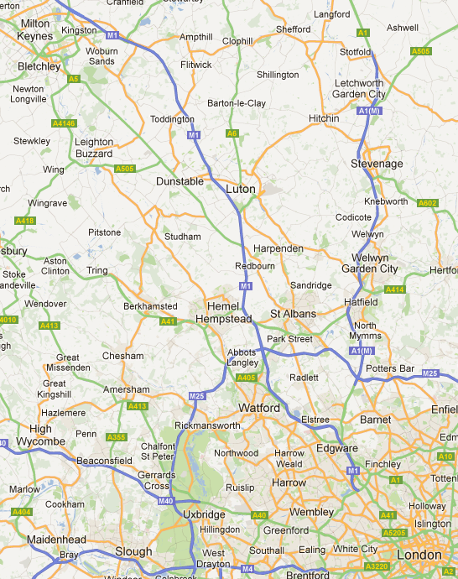
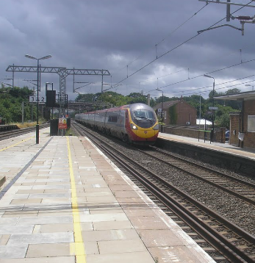
Train journey from London to Milton Keynes

Slide 25
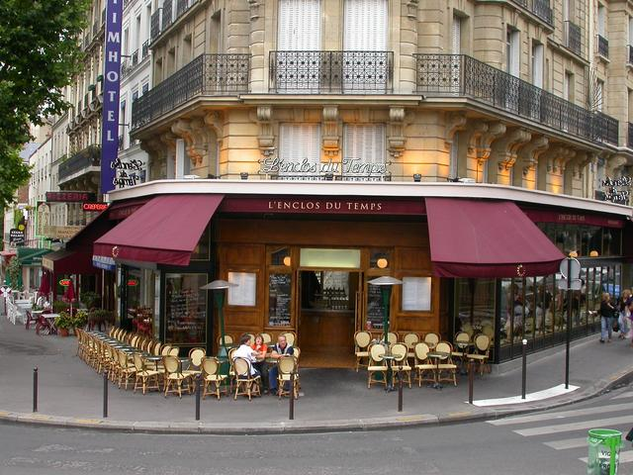
A Parisian cafe

Slide 26
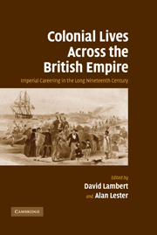
Imperial networks
Co-edited with Alan Lester (Professor of Historical Geography, University of Sussex)
Part of the ‘New Imperial History’
12 biographical studies of trans-imperial careers
Notes:
Massey was born in Manchester in 1944 and studied at Oxford and Philadelphia, beginning her career with a thinktank, the Centre for Environmental Studies (CES) in London. CES contained several key analysts of the contemporary British economy, and Massey established a working partnership with Richard Meegan, among others. CES was closed down and she moved into academia at The Open University. She was awarded the Victoria Medal of the Royal Geographical Society in 1994. After a distinguished career, she won the Prix Vautrin Lud (the ‘Nobel de Géographie’) in 1998.

Slide 27
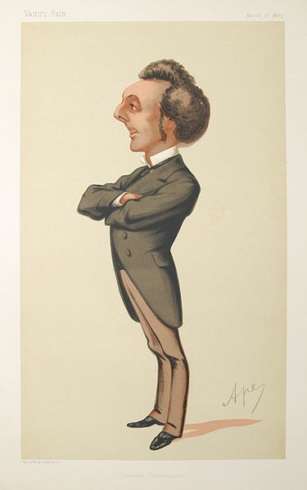
Sir John Pope Hennessy (1834-91)

Slide 28
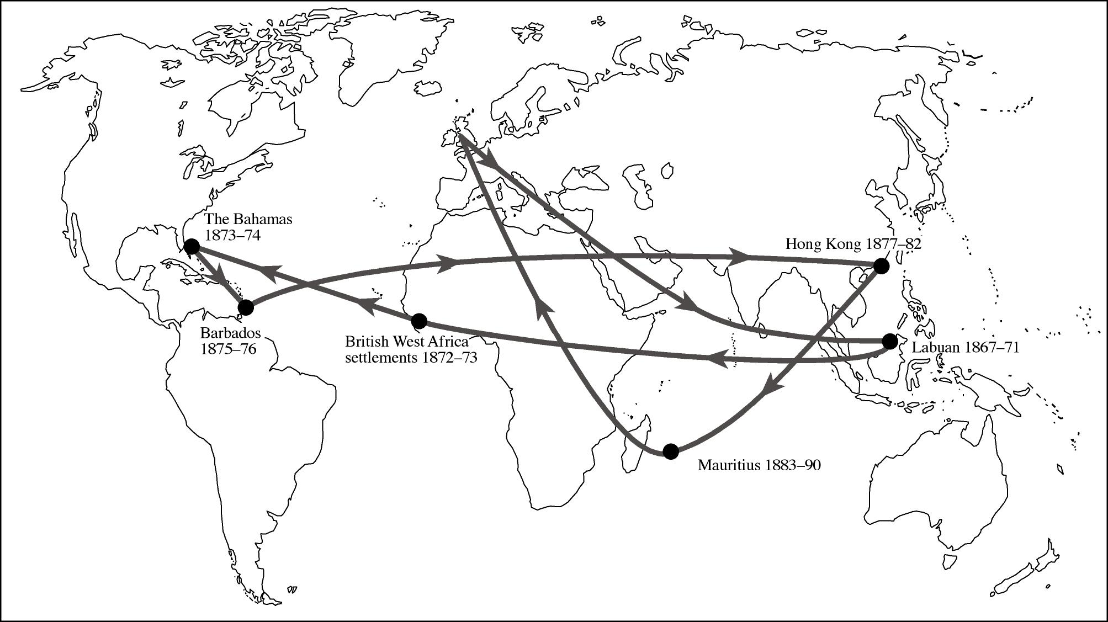

Slide 29
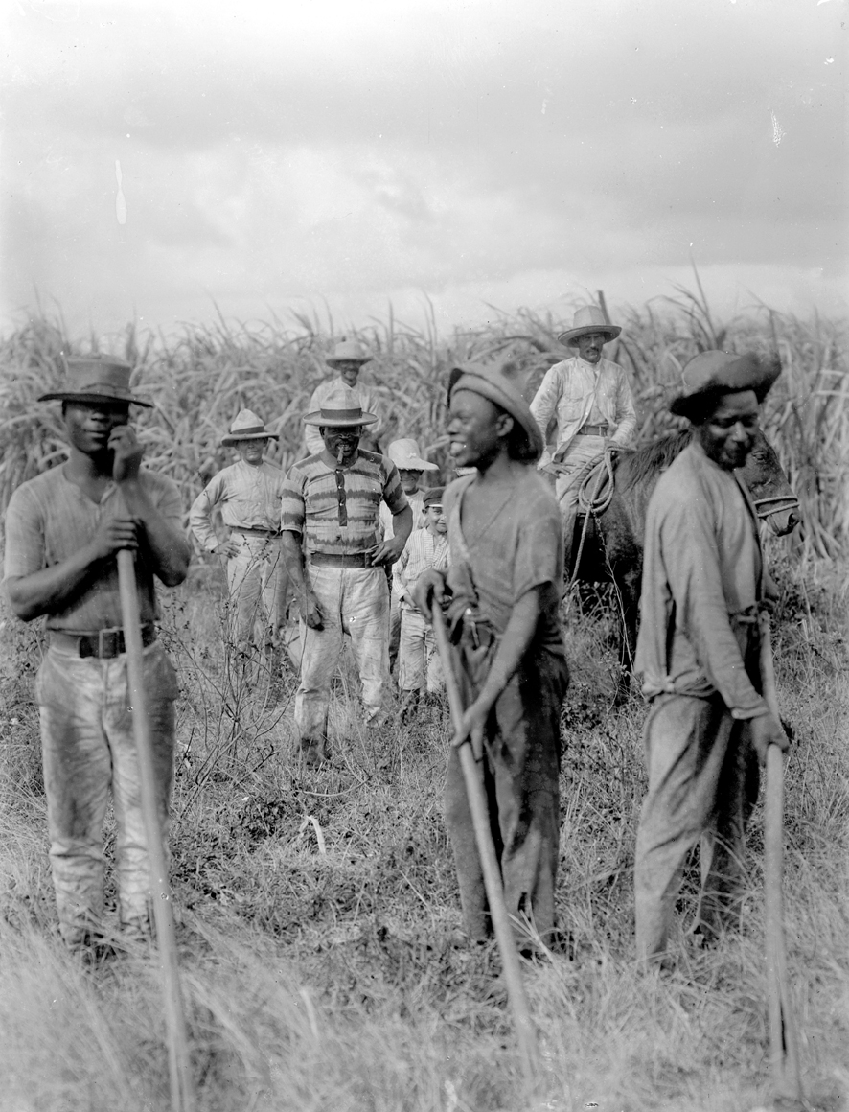

Slide 30
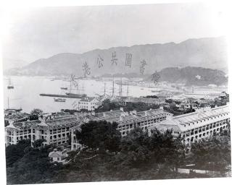

Slide 31
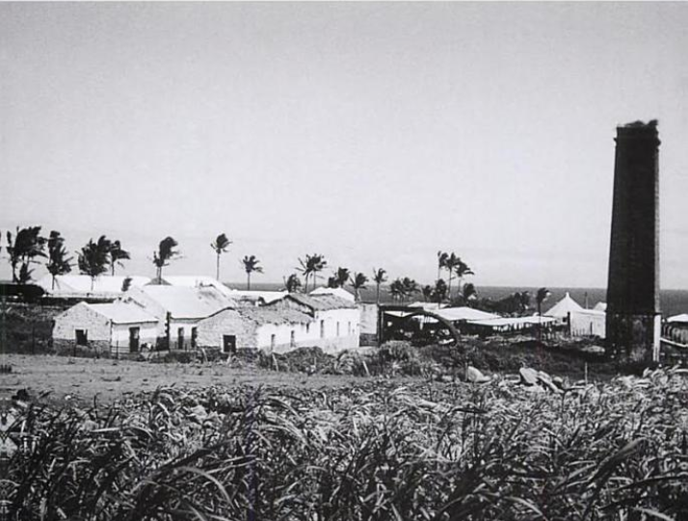

Slide 32
Thinking spatiality
What would it mean to think about the spatiality of your own historical interests?
What would it mean to think about this spatiality in Massey’s terms, i.e. as relational, heterogeneous and unfinished?

Slide 33
TSM: Space
Professor David Lambert
Monday 29th October

