Slide 1

Theory
TSM – Week 2
Charles Walton

Slide 2
Have historians always been ‘theoretical’?
1. What do we need to look at as historians?
2. How should we look at it?
3. Why should we look at it in certain ways?

Slide 3
From lenses to theory:
A brief history of history
1. Enlightenment
2. Historicism
3. Dialectical History
4. Evolutionary history
5. Structuralism
6. Post-structuralism

Slide 4
Antiquarianism (17th and 18th centuries)
  Assessment and accumulation of archives and objects. Highly technical and specialized, with intense scrutiny of sources.
  Aim: to authenticate sources and classify knowledge.
  The more famous ‘philosophical’ historians found this too narrow.
  Voltaire: ‘Details be damned! [They] kill great works!’
  It persisted, especially in German universities, where historicism was developed (next week’s lecture).
Notes:
VOLTAIRE QUOTE: LETTER FROM 1738: ‘Malheur aux détails ! la postérité les néglige tous : c’est une vermine qui tue les grands ouvrages. Ce qui caractérise le siècle, ce qui a causé des révolutions, ce qui sera important dans cent années, c’est là ce que je veux écrire aujourd’hui.’ Oeuvres completes de Voltaire, tome 35, p. 29-30 (Garnier, 1880)

Slide 5
Enlightenment
Philosophical History
From cyclical to unilinear histories → Progress of civilization
Commerce and civility → key drivers of progress
Discovery of natural laws of human nature and society
Stadial history – societies progress in stages
Moral lessons
History can help us better understand the present
Empathy with past suffering can make us better people today

Slide 6
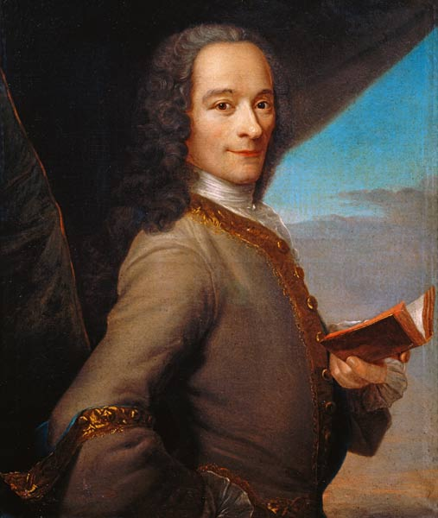
Essay on the Manners and Spirit of Nations (or 'Universal History') (1754)
One of many secular mid-century studies of morals and customs.
Argues that all civilizations progress but emphasises Europe’s superior advancement.
The Age of Louis XIV (1751)
Hardly about Louis XIV.
About the perfection of French civilization.
François-Marie Arouet, 1694-1778,
known as Voltaire

Slide 7
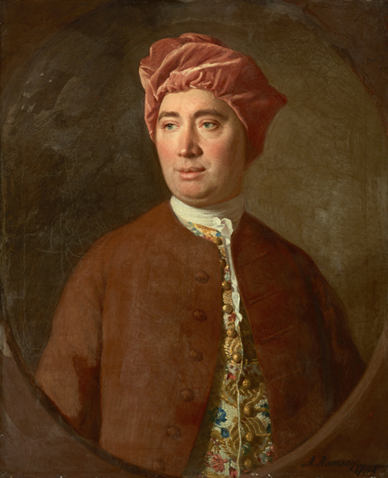
Hume’s History of England
3 vols., 1754-1761
Unsatisfied with prior historians who took sides -- Tory/Whig
Uninterested in search the for the ‘ancient constitution’ in medieval era to justify a certain politics of his day
- History: tracing the origins and evolution of structures and tensions
Between Crown and Commons
more abstractly: between authority and liberty
David Hume (1711-1767)

Slide 8
Discovery of Natural Laws and Human Nature
Before Enlightenment History as art in search of a scientific method
During Enlightenment History as the science of societies and morality… a kind of proto-sociology

Slide 9
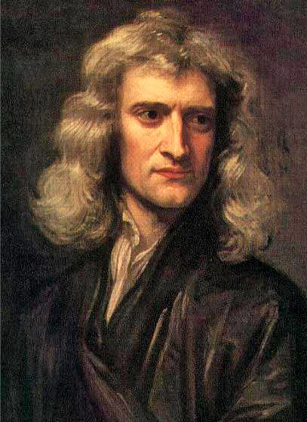
Search for NATURAL LAWS
For nature (Newton); for society (Montesquieu)
Newton’s Law of Gravity
Empiricism → reasoned hypothesis → law
If the physical world conforms to natural laws, don’t humans and societies as well?
David HUME
‘Mankind are so much the same, in all times
and places, that history informs us of nothing new or strange in this particular. Its chief use is only to discover the constant and universal principles of human nature, by showing men in all varieties of circumstances and situations and furnishing us with materials from which we may form our observations and become acquainted with the regular spring of human action and behaviour…’
David Hume, Enquiry Concerning Human
Understanding (1748)
Isaac Newton, 1642-1726
Notes:
Newton's law of universal gravitation states that every particle attracts every other particle in the universe with a force which is directly proportional to the product of their masses and inversely proportional to the square of the distance between their centers.

Slide 10
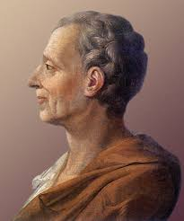
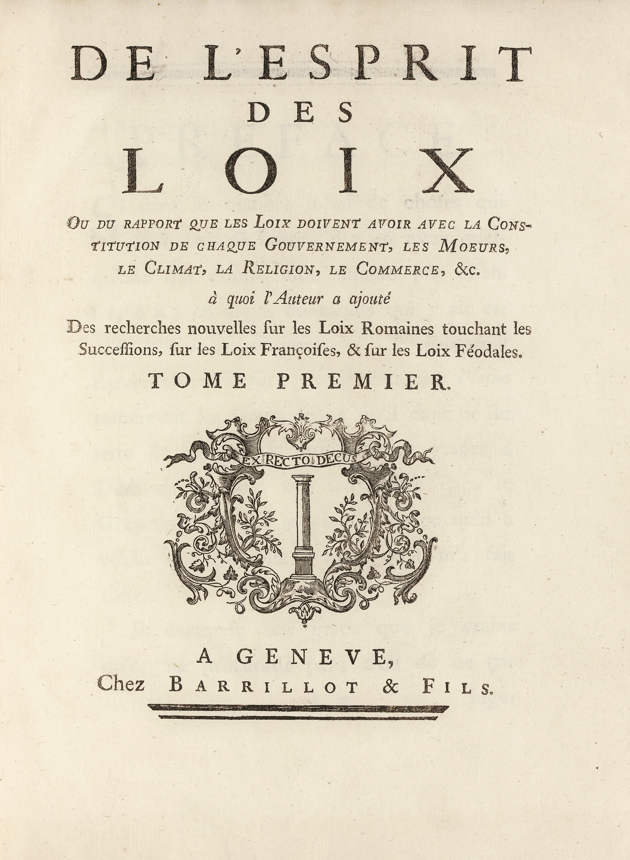
The Spirit of the Laws (1748)
Baron de Montesquieu, 1689-1755

Slide 11
Montesquieu –
Spirit of the Laws (1748)
Vatican put book on its Index of forbidden books in 1751
Erudite sociological history: he used historical examples to discover ‘natural laws’ governing societies.
Two level of laws: positive (particular, declared) and general (deduced, natural but invisible)
Climate and geography shape a society and its history

Slide 12
Discovery of Natural Laws and/or Human Nature
Montesquieu
The Spirit of the Laws (1748)
‘I have first of all considered mankind [and have concluded that] amidst such an infinite diversity of laws and manners, they were not solely guided by the caprice of fancy…’

Slide 13
Discovery of Natural Laws and/or Human Nature
Montesquieu
The Spirit of the Laws (1748)
I have laid down the first principles [i.e., hypotheses], and have found that the particular cases follow naturally from them; that the histories of all nations are only consequences of them, and that every particular law is connected with another law… of a more general extent…

Slide 14
Spirit of the Laws (Montesquieu) universalism and exceptionalism
Sociology
History
Forms of government and their corresponding guiding principles
  Monarchy → Honour
  Republics (aristocratic and democratic) → Virtue
  Despotism → Fear
Most of world oscillated between between good and bad government (cycles)
From monarchy to despotism
From republic to oligarchy
BUT European exceptionalism:
Commercial prosperity is due to climate and geography

Slide 15
Scottish Stadial Historians
Evidence and conjecture
Stadial --> history unfolds in stages
Even more stress on unilinear historical development
Shift from focus on forms of government to socio-economic structures
-- subsistence, production and exchange drive historical change
Dugald Stewart referred to this kind of history as ‘theoretical’ or ‘conjectural’ history in 1790s

Slide 16
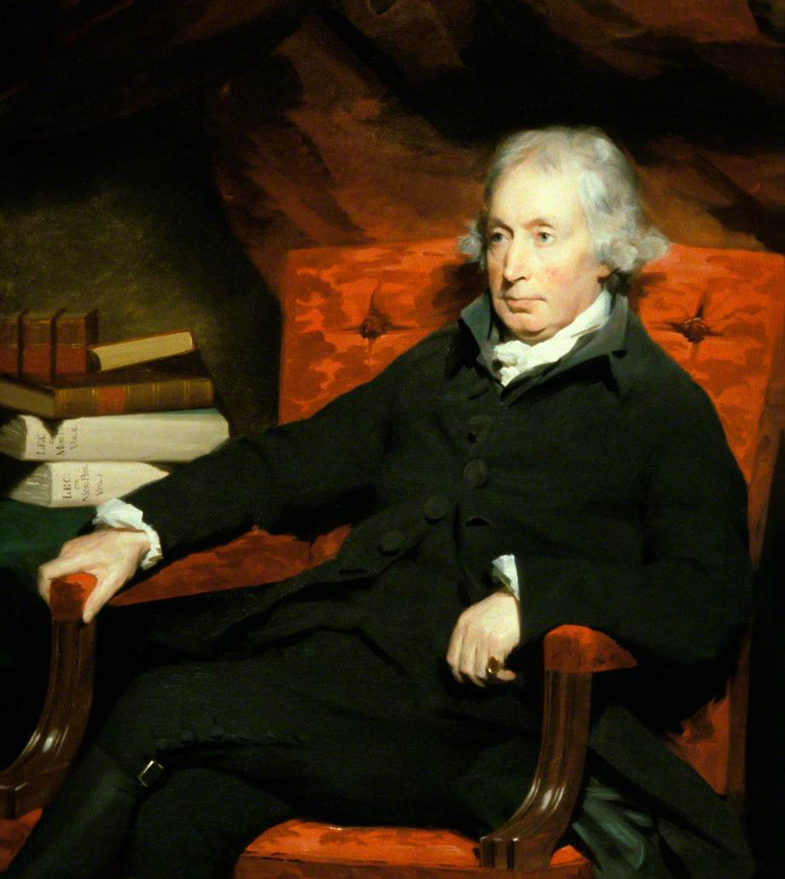
Scottish Stadial History
An Essay of the History of Civil Society (1767)
Hunting – no property, no wealth to accumulate, stage of ‘savagery’
Pasturage – less mobile but still nomadic, wealth can be accumulated
Agriculture -- even less mobile, farmer live on land in own houses, more wealth and greater inequality
Commerce – property ownership, laws governing property, complex societies
Adam Ferguson (1723-1816)

Slide 17
History’s Purpose
Moral lessons through disinterested inquiry
Why study history, according to Hume?
Entertaining writing leads to erudition, the accumulation of knowledge and moral-intellectual improvement.
‘A man acquainted with history may, in some respects, be said to have lived from the beginning of the world, and to have been making continual additions to his stock of knowledge in every century.’ (note: knowledge is cumulative)
History has the power to direct readers’ wills and make them become more virtuous; because historians do not possess the vice of self-love or self-interest.
David Hume (1711-1767)

Slide 18
A darker story:
A History of the East and West Indies
Abbé Raynal and Diderot (1770)
Ten-volume cosmopolitan and critical history of European imperialism in Asia and the Americas – early critique of Eurocentrism
Commerce drives history but is ambivalent:
- strengthens bonds within and between societies
- but can also be rapacious
Europeans’ inability to see themselves through the eyes of foreigners
‘Heart of Darkness’: when Europeans leave their societies and culture, their mask of civility falls off, and they turn into brutes, wreaking devastation.

Slide 19
Enlightenment History:
Eurocentric?
All societies tend to privilege stories about themselves over others, if they are not subjugated and deprived of the capacity and legitimacy to tell their own stories… (colonial powers would try to deprive them of these…)
Many Enlightenment historians often believed that Europeans were superior
But they were also capable of critiquing European abuses of power and recognizing the equality of all human beings and of questioning European universalism

Slide 20
Key questions for Historiography
  1. What have historians considered important to study? (topics)
  From rulers, battles, saints and miracles
  To civilisations and their progress or regress
  2. How have they gone about studying them? (methods)
  Analyse manners/customs, institutions, production/exchange, laws
  3. And with what aims? (purpose)
  To develop empathy and knowledge as means to achieve moral perfection
  To better understand natural laws and human nature

Slide 21
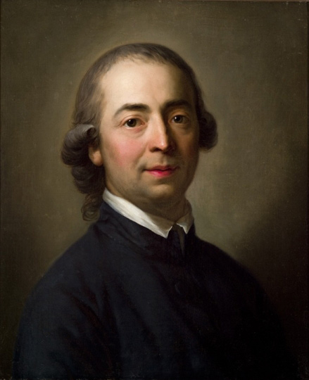
Johann Gottfried Herder (1744-1803)
Literary critic, philosopher
Annoyed by French cultural supremacy; celebrated German language and culture
Opposed to universal measures
One should examine societies on their own terms
Organic rather than universal progress

Slide 22
Johann Gottfried Herder (1744-1803)
‘Whoever has so far undertaken to trace the progression of the centuries usually brought along a favourite idea on his journey: “greater virtue” or “happiness”.’
‘Should the general... philosophical tone of our century so generously bestow “our own ideal” of virtue’ on every remote nation?
Yet another philosophy of history

Slide 23
Johann Gottfried Herder (1744-1803)
Societies are unique and organic; they progress but by growing genetically, through their own experience, culture and contingent interactions with other societies. Only God knows where it all ends up.
Pro: this approach critiques the hidden prejudices within universalism
Con: can lead to moral relativism and enthno-nationalism. ‘Prejudice is good in its time; it makes people happy.’ Another History…

Slide 24
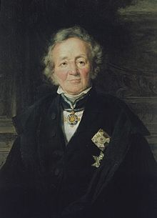
The Professionalisation
of History
Leopold von Ranke
1795-1886

Slide 25
Ranke’s context
Reaction to French Enlightenment, Revolution and Napoleonic Empire
German Enlightenment compatible with faith
  Not material freedom but spiritual freedom
Romanticism
German philology (study of language)

Slide 26
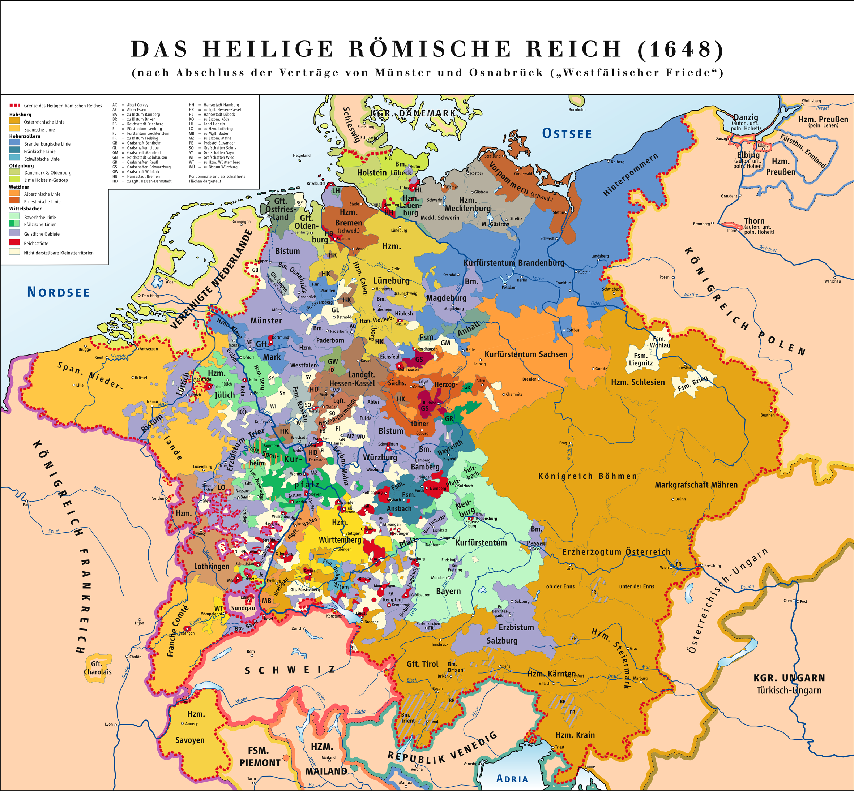
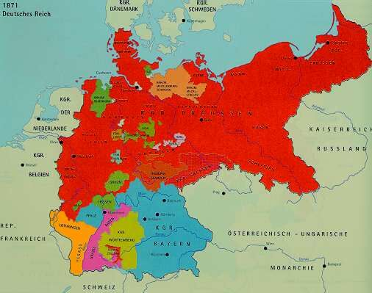
Germany – A nation, a people, a state
in search of itself
Germany under Bismark, 1871
Different colours indicate steps of
unification in the 1860s and 1871
1648 – Treaty of Westphalia

Slide 27
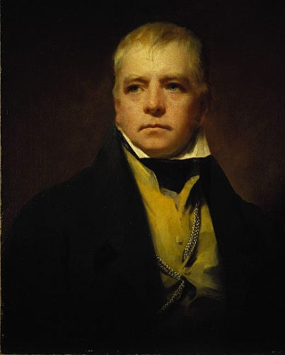
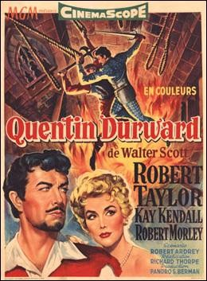
Sir Walter Scott (1771-1832)

Slide 28
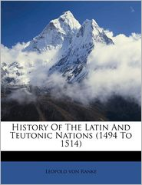
‘The strict presentation of facts, no matter how conditional and unattractive they might be is
undoubtedly the supreme law of any historian.’
(1824)

Slide 29
History has had assigned to it the office of judging the past and of instructing the present to the benefit of future ages… to such high office the present work does not presume; it seeks to only show the past ‘how it essentially was’ (wie es eigentlich gewesen)
(History of the Latin and Teutonic Peoples, 1824)

Slide 30
Error of translation into English
eigentlich – as really instead of essentially

Slide 31
Historismus (Historicism/Historism)
‘History is the way in which humanity becomes and is conscious of itself. The epochs of history are ... the stages of self-knowledge, its knowledge of the world, its knowledge of God ... History is humanity’s awareness of itself, its self-consciousness.’
Johann Gustav Droysen (1808-1884)
:

Slide 32
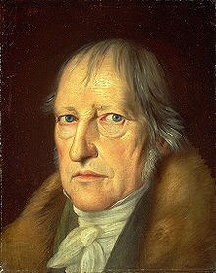
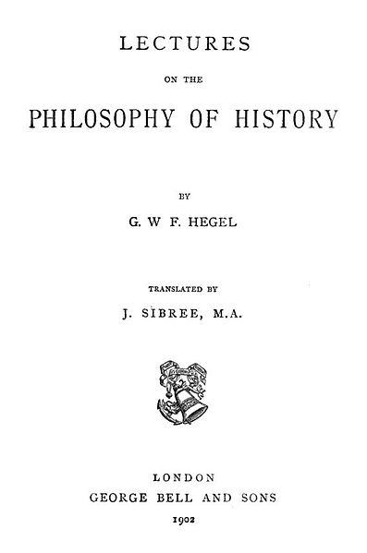
Geist (spirit, sometimes also translated as mind)
Georg Friedrich Hegel (1770-1831)
"World history... represents the development of the spirit's consciousness of its own freedom and of the consequent realization of this freedom.”
This realization is seen by studying the various cultures that have developed over the millennia, and trying to understand the way that freedom has worked itself out through them.

Slide 33
Hegel vs Ranke
Ranke grounded the metaphysical aspects of Hegel’s philosophy of history (dialectical path towards freedom and self-realization) in factual details culled from archives
Ranke drew on philological tradition in Germany (as opposed to philosophical history of Enlightenment)
Meditating on history is almost like praying – commune with the facts

Slide 34
Ranke: Impartiality of the historian
Historians do not judge the past BUT:
‘It would be impossible not to have one’s own opinion in the midst of all the struggles of power and of ideas which bear within them decisions of the greatest magnitude. Even so, the essence of impartiality can be preserved. For this consists merely in recognizing the positions occupied by the acting forces and in respecting the unique relationships, which characterize each of them. One observes how these forces appear in their distinctive identity, confront and struggle with one another; the events and the fates, which dominate the world, take place in this opposition. Objectivity is also always impartiality.’

Slide 35
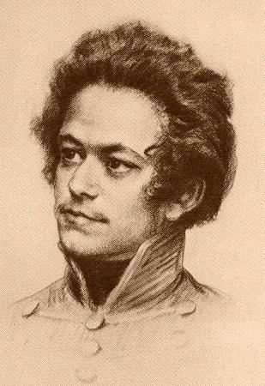
Historiography
Week 5
Karl Marx
1818-1883

Slide 36
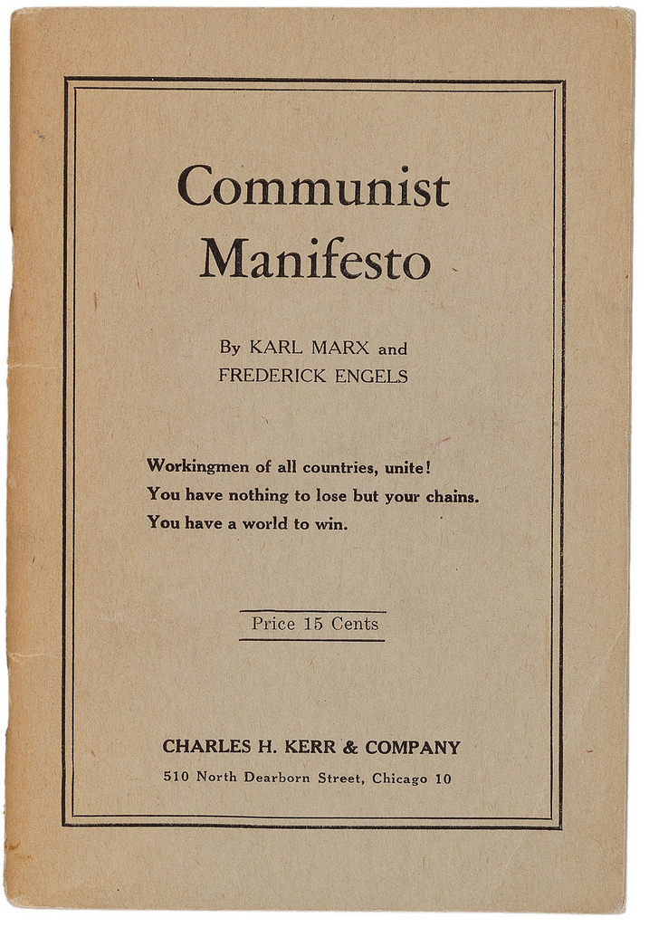
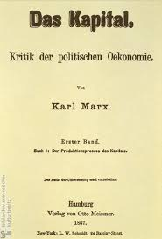
Karl Marx – most famous works
1848
Vol. 1-3
1867-1894

Slide 37
Marx’s early thought
Until 1845 – Inversion of Hegelian dialectics
  Among the ‘Left’ Hegelians in Germany
  Like Hegel: History as dialectic (tension). Hegel: between ‘real’ and ‘rational’. This friction propels consciousness forward.
  Hegel’s Endpoint → full consciousness, at one with Absolute Spirit and the state. Man is reconciled with himself, society and nature. History driven by ‘ideas’.
  Marx → Endpoint is communist society (no classes, no state). History driven by ‘material forces’.
  At this stage, Marx is still philosophical and metaphysical: He assumes man’s creative ‘potential’ and sees history as the the gradual realization of it.

Slide 38
Eighteenth Brumaire (1852)
Marx and Engels
What happened in the 1848 Revolution in France?
  Workers Revolt (Feb)
  Overthrow of monarchy, creation of 2nd Republic
  Crushing of workers (June)
  Establishment of conservative Republic (Sept)
  Louis-Napoleon elected President (Dec)
  Dissolves National Assembly (Dec 1851)
  Crowned emperor (Dec 1852)…

Slide 39
Eighteenth Brumaire (1852)
What went wrong in 1848?
  Revolutionaries guided by ‘spirits of the past’(1789)
  ‘Hegel remarks somewhere[*] that all great world-historic facts and personages appear, so to speak, twice. He forgot to add: the first time as tragedy, the second time as farce.’
  Highly empirical analysis, goes beneath events to analyse each group’s material interests and consciousness, which aren’t always aligned
  Peasants held the revolution back
  Further proletarianisation will strengthen working class’s consciousness & political leverage the next time…
  Need to work on class consciousness!

Slide 40
Eighteenth Brumaire (1852)
Marx and Engels
What went wrong in 1848?
  ‘Just when [people] seem engaged in revolutionizing themselves and things, in creating something that has never yet existed, precisely in such periods of revolutionary crisis they anxiously conjure up the spirits of the past to their service and borrow from them names, battle cries, and costumes in order to present the new scene of world history in this time-honored disguise and this borrowed language...’
Bourgeoisie was willing to sacrifice its republican commitments to protect its private property…

Slide 41
Key Marxist concepts - 1
Productive Forces
  technology
Relations of Production
  Property laws
  How do people relate to production (as workers, as investors, as managers, etc.)
Superstructure
  Politics, ideology, religion, culture, etc.

Slide 42
Key Marxist concepts - 2
Class Struggle and Revolution
  When productive forces change, social relations are thrown into question… struggles ensue
  Revolution: effort to align social relations with current productive forces

Slide 43
Charles Darwin – used by historians
Progress version
  ‘Survival of the fittest’ = historical improvement
Contingency version
  ‘Survival of the fittest’ = best adapted to current circumstances
  Circumstances may change in unanticipated ways

Slide 44
Structuralism vs post-structuralism
Saussure – semiotic systems
Barthes – semiotic systems extended to culture more broadly
Systems of meaning

Slide 45
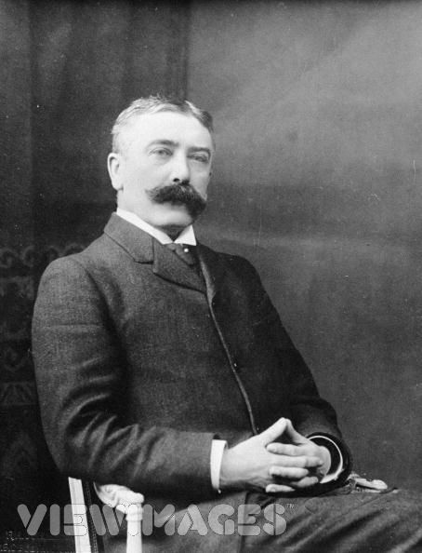
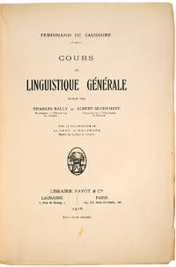
Cours de linguistique générale (1916)
Linguistics: scientific study of language in broadly three aspects: language form, language meaning, and language in context
Ferdinand de Saussure
1857-1913

Slide 46
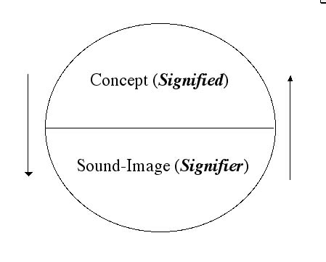
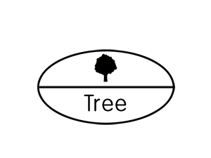
Sign, signifier, signified: The sign is constituted by the relationship of a signifier (a medium, such as a road sign, a word, a gesture) to a signified (also known as the referent, the ‘thing’ being signed.)
Note: The signified is not the thing itself, only a mental concept of it which the ‘speaker’ and ‘listener’ share.

Slide 47
Saussure’s Central Claims
Languages are not confined to words but include any system of communication that uses ’signs’.
A sign is composed of a ‘signifier’ (vocal sound, image, gesture) and a ‘signified’ (the mental concept or structure that speaker and listener share).
Important: The mental concept/structure precedes the ‘signifier’ in existence (according to Saussure and later ‘structuralists’ – poststructuralists will reject this).
A ‘signifier’ is established quite arbitrarily and bears no resemblance to the’ signified’. Different language use different ‘signifiers’ for the same mental images.
Every sign acquires meaning by belonging to a network of other signs. There is in every sign a suggestion of another, oppositional sign.

Slide 48
Structuralism for historians?
Synchronic analysis
Cultural anthropology – ‘getting’ how meaning operates in a (past) society
Not well-adapted to explaining change over time (the diachronic)

Slide 49
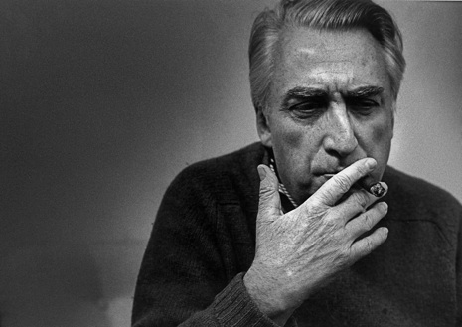
Barthes developed Saussure’s theory further. He politised it, moving it from mere language to the study of cultural & every-day objects. Unlike Saussure, Barthes was a politically motivated left-winger living in right-wing France in the 1950s , and he observed that sign systems are highly motivated and deeply structured by political power. Understanding each sign meant placing it in its political context
Roland Barthes, 1915-1980
Barthes is first a structuralist (following Saussure) but then turns to post-structuralism
Definition of Structuralism:
posits that elements of human culture must be understood in terms of their relationship to a larger, underlying system or structure (e.g.Clifford Geertz ‘thick description’in Interpretation of Culture (1973).
Epistemology: the branch of philosophy concerned with the nature and scope of knowledge.

Slide 50
Barthes in structural mode:
‘The starting point of these reflections was usually a feeling of impatience at the sights of the ‘naturalness’ with which newspaper, art and common sense constantly dress up a reality which, even though it is the one we live in, is undoubtedly determined by history. In short, in the account given of our contemporary circumstances, I resented seeing Nature and History confused at every turn, and I wanted to track down the decorative display of what-goes-without-saying, the ideological abuse which, in my view, is hidden there.
(Barthes, Mythologies, p. 11)
The aim of his structural efforts:
‘The goal of all structuralist activities is to reconstruct an ‘object’ in such a way as to make evident the rules of its functioning.’ That is, to look for the implicit associations between signs and relate them to some structure: e.g., a bourgeois value system.

Slide 51

Example:
‘I am at the barber's, and a copy of Paris-Match is offered to me. On the cover, a young Negro* in a French uniform is saluting, with his eyes uplifted, probably fixed on a fold of the tricolour. All this is the meaning of the picture. But, whether naively or not, I see very well what it signifies to me: that France is a great Empire, that all her sons, without any colour discrimination, faithfully serve under her flag, and that there is no better answer to the detractors of an alleged colonialism than the zeal shown by this Negro* in serving his so-called oppressors. I am therefore again faced with a greater semiological system: there is a signifier, itself already formed with a previous system (a black soldier is giving the French salute); there is a signified (it is here a purposeful mixture of Frenchness and militariness); finally, there is a presence of the signified through the signifier... In myth (and this is the chief peculiarity of the latter), the signifier is already formed by the signs of the language... Myth has in fact a double function: it points out and it notifies, it makes us understand something and it imposes it on us...’

Slide 52
Poststructuralism
Definition: a philosophical direction within the wider movement of postmodernism. Postmodernists argue that all knowledge is constructed by humans (and language) within a given culture and time. No ‘facts’ exist independent of ‘structure’. But they tend to not understand these structures as ‘real’. They are interventions of the observer. (eg. Class, gender, ethnicity)
Poststructuralists tend to argue that we need to be aware of structures, using them as devices to aid our inquiry, but we also need to de-centre and problematise them for study (e.g. Joan Scott’s famous article on ‘experience’ is a perfect example).

Slide 53
How Postructuralism differs from Structuralism
Eschews a stable « system » of structuring signs
Stresses inventiveness in appropriating texts
Still indebted to the analytical tools of structuralism (It’s not a rejection! Same people doing both!)

Slide 54
Barthe’s (poststructural)
The Death of the Author (1967)
Wink to Nietzsche’s ‘God is Dead’ – end of metaphysics
Published a year before the events of May 1968: spirit of revolt against authority (and author-ity)
Stop looking for author’s intentions!!
  We don’t know what they were and they don’t matter
A text is an explosion of language’s myriad possibilities: there is no fixed semiotic system that stabilizes its meaning; texts are unstable; they’re all up for grabs.
A text isn’t authoritative: a text occasions creativity!

Slide 55
The ‘author’s death’ opens up opportunities for historians
Discourses instead of ideas
  Ideas: products of an author’s mind
  discourse: the broader socio-linguistic context
Conditions of production of texts (technological, financial, institutional)
Uses of texts
  Reading practices (reverential, intensive, or extensive)

