Slide 1
Theory, Skills and Methods week 2: Theory
Dr Claudia Stein

Slide 2
Recap
Historical Method
Defined in the 19th century by the German historian Leopold von Ranke (;critical method’)
Empirical gathering of primary material (archival documents, visual material objects, oral testimony. digital sources, scientific data)
Source criticism: is the source genuine (e.g. digital sources)? Who is the author/the maker/the speaker? Is it an eyewitness report or a report on an event by someone else? Is it anonymous? Were did the source originate? In what context did the source emerge at the time of its production? How did it get to the place where it is kept (e.g. colonial archives?); what are the biases within the source itself – from the perspective of time; what is left out?)
Analysis: analysis of the internal logic of source within the knowledge of the time it was produced; the intention of author/maker at the time? What is said in the source and what is perhaps absence from the source? Language and concepts used (meaning of terms/concepts change)? Modes of production?
Relation of source to other sources that talk about the same event?
But what is the ‘meaning’ of all this empirical information and critical source analysis?

Slide 3
Theory
In history writing, the majority of ‘theories’ – or ‘frameworks’ to interpret the empirical material -- do not originate in academic history writing itself but in neighbouring disciplines such as social and political theory, philosophy, anthropology, but today also increasingly from the natural sciences, life sciences (e.g. evolutionary cognitive brain sciences, evolutionary psychology, epigenetics, geography, environmental sciences).
Such theories usually deal with the present (e.g. sociology, political science) and therefore try to understand today’s societies and cultures (e.g. cultural anthropology).
Historians foften use such theories to establish ‘meaning’ of their sources to their readership. (They transport therefore ’the present’ into the past. Theories allow them to synthesis their material and offer a hypothesis (thesis) that guides the logic and organisation of their narrative and addresses the expectations of their readership.
Use theories to offer insights into two main areas of interest:
Human individual and/or collective agency and human experience at a particular moment in time (synchronic)
Theoretical explanations of historical change over time (diachronic)
Synchronic and diachronic theoretical explanations can be pursued independently from each other. Some historians focus on synchronic explanations (e.g. microhistory); some were only interested ‘in long duree’ change (e.g. Annales school).

Slide 4
Recap
Historical Materialism (note: Marx never used the term himself!)
Historical materialism is Karl Marx's theory of history, which argues that economic conditions (the "mode of production") are the primary drivers of social, political, and intellectual change throughout history.
It posits that all societal institutions, from government and law to religion, family, and culture, are shaped by the underlying economic system and the resulting class struggles between those who own the means of production and those who do not.
Social change (and historical change) occur as contradictions within the mode of production lead to a new system, progressing history from one stage to the next.

Slide 5
Superstructure:
Superstructure:
comprises the cultural, ideological, political, legal, and social institutions (like governmental agencies, culture, family, or religion, ideology, etc.) that are shaped and determined by the economic base (the mode of production and class relations). The superstructure's primary function is to reproduce and legitimize the interests of the ruling class by promoting ideologies that obscure class conflict and maintain the existing power structure.
Societies in each stage of history are organized from the bottom up. The ‘modes of production’ produce social reality of people (superstructure)
Relations of production: the social relationships that emerge between people during the process of production, distribution, and exchange of material wealth, fundamentally based on the owner-
ship or lack of owner-
ship of the
means of
production
Relations of Production
Class: class is defined by a person’s/groups relationship to the forces of production—either owning them or selling their labour to survive (in capitalism:proletaria -
bourgeoisie)
Forces of Production
Forces and means of production: These are the tools, technology, and raw materials society uses to produce goods, as well as the collective labour and knowledge of the laboring people.

Slide 6
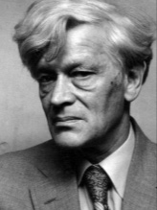
The ‘New’ Social History (UK) -- one of the 1970s neo-Marxist approaches
‘I am trying to rescue the poor stockinger, the Luddite cropper, the “obsolete” hand-loom weaver, the “utopian” artisan, and even the deluded follower of Joanna Southcott, from the enormous condescension of posterity...(p.13)
It is also a reaction against
the overwhelming statistical
‘methodological approach’ of
old Marxist social history: statistics and numbers.
Edward Palmer Thompson (1924-1993)
In contrast to the ‘old’ social history, inspired by Marx historical materialism, and mainstream 19th-century history (e.g. political
history, intellectual history and the history of ‘great men’ and their politics)

Slide 7
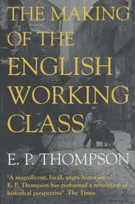
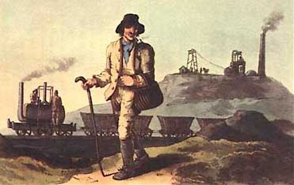
The Making of the English Working Class (1963)

Slide 8
A new definition of ‘class’ in opposition to older Marxist views that understand class as arising automatically from an underlying economic structure (so-called forces of production; review next week!)
‘I do not see class as a “structure”, nor even as a “category”, but as something which in fact happens (and can be shown to have happened) in human relationships...Like any other relationship, it is a fluency which evades analysis if we attempt to stop it dead at any given moment and anatomize its structure.
The finest-meshed sociological net cannot give us a pure definition of class, any more than it can give us one of deference or of love. The relationship must always be embodied in real people and in a real context. Moreover, we cannot have two distinct classes, each with an independent being, and then bring them into relationship with each other. We cannot have love without lovers, nor deference without squires and laborers. (p.1)
‘The working class did not rise like the sun at an appointed hour. It was present at its own making.’

Slide 9
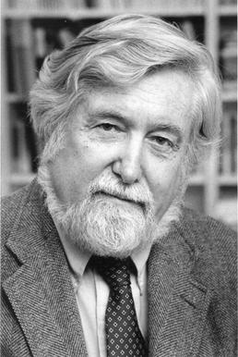
The Anthropological – the Cultural Turn 1970s/80s (US)
The Interpretation of Culture (1973) -- Balinese Cock fight
Geertz sought to separate off anthropology from its influences from functional sociology (structural and institutional agenda). He comes to define ‘culture’ as a ‘semiotic concept’ whose analysis is not ‘an experimental science in search of law but an interpretive one in search of meaning.’ (Thick Description, 1973, p. 5).
And,
‘.......historically transmitted pattern of meanings embodied in symbols, a system of inherited conceptions expressed in symbolic forms by means of which men communicate, perpetuate, and develop their knowledge about and their attitudes towards life’.
Method of ‘thick description’: a thick description results from a scientific observation of any particular human behaviour that describes not just the behaviour, but its context as well, so that the behaviour can be better understood by an outsider. The anthropologists needs to consider his/her own biases.
Clifford Geertz, 1926-2006
Note: anthropology is never concerned with the past! It works in the present (synchronically)

Slide 10
The ‘ethnographic/anthropological turn’ opens up new ways of thinking about the past identify new sources...
The early modern French historian Nathalie Zemon Davis on her discovery of symbolic anthropology for her study of early modern French history in the early 1970s. She used to be a Marxist.
‘I could consider the social and cognitive meanings of symbolic and ritual forms of behaviour, which earlier I had accounted for only in terms of groups solidarity….(she used to work with Marxist theories and methodologies)
Now I could look at the non-literature with more discernment…and take more serious the techniques and endowments of oral culture, such as proverbs and memory devices. I began to doubt my earlier commitment to a single ‘progressive’ trajectory towards the future…’
(Davis, 1997, 14).
Nathalie Zemon Davis, 1928-2023
The term societ disappears in history writing and is
replaced by ‘culture’.

Slide 11

History writing in the ethnographic grain includes a new enthusiasm for the use of literary sources and narrative style
Famous example:
The Great Cat Massacre and Other Episodes in French Cultural History (1984)
‘When we cannot get a joke, or a ritual, or a poem, we know we are on to something. By picking at the document where it is most opaque, we may be able to unravel an alien system of meaning.”’
The role of ‘difference’, ‘desire’ and ‘surprise’ becomes central for understanding the past; claim: like other non-European cultures in the present, past European societies are to be understood as ‘foreign lands’, cultures which share nothing with the culture of the ‘observer’ – the historian.
Robert Choate Darnton (1939-)

Slide 12
The Past is ‘the Other’: No links between the Historian and the Past?
‘…other people are other. They do not think the way we do. And if we want to understand their way of thinking, we should set out with the idea of capturing otherness. […] nothing is easier than to slip into the comfortable assumption that Europeans thought and felt two centuries ago just as we do today – allowing for the wigs and wooden shoes. We constantly need to be shaken out of a false sense of familiarity with the past, to be administered doses of culture shock.’ (Robert, Darnton)
Claim: To understand and accept something as ‘difference’ makes you question your own culture and opens up ways into a ‘different’ future. It makes you aware of your biases.
Some consequences to be considered: during ‘the cultural turn’ the term ‘society’ gets lost in history writing and with it, Marxist notions of power and conceptions of historical change (e.g. revolutions); cultural history writing tends to be ‘descriptive’ (thick descrioption) and synchronic (focussed on a moment in time);
Problem: how to explain historical ‘change’ and ‘transformation’ through time (diachronic approach)

Slide 13
By the 1990s, the historian-anthropologists gets influenced by linguistic theories and language philosophies and they
They are confronted with new notions of power (different from Marx and neo-Marxist approaches)
Linguistic Turn (def.):
Analytical turn upon (or problematisation of) words/language used in a given field of study.
Term is first used by the American analytical (then pragmatic) philosopher Richard Rorty in his The Linguistic Turn (1967)

Slide 14
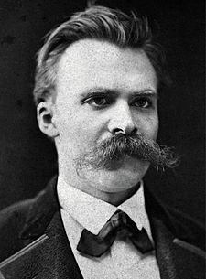
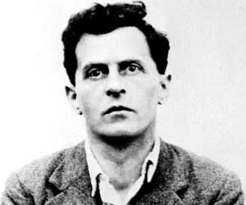
Inspirations for philosophers of language in the 1960s/70
Ludwig Wittgenstein (1889-1951)
Friedrich Nietzsche (1844-1900)

Slide 15
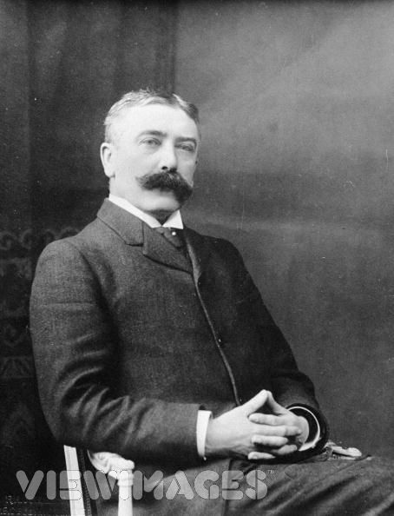
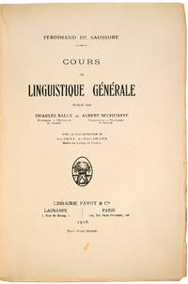
Most important inspiration for them is modern linguistics
Claim: A word is a sign (signified/
signifier)
Language is an arbitrary and
historical system signs;
Cours de linguistique générale (1916)
Linguistics: scientific study of language in broadly three aspects: language form, language meaning, and language in context
Ferdinand de Saussure, 1857-1913

Slide 16
Central claims of ‘linguistic turn’ enthusiasts:
Reality is NOT representable in any form of human culture (whether written, spoken, visual or dramatic)
Because ‘reality’ is not representable in any form, no authoritative account can exist of anything.
Nobody can make claim of possessing a ‘universal’ truth of anything. There is never a single single authority on a given subject of knowledge (this includes claims made in the natural sciences because they also use linguistic systems!)
Language is a nothing but a representation of ‘reality’

Slide 17
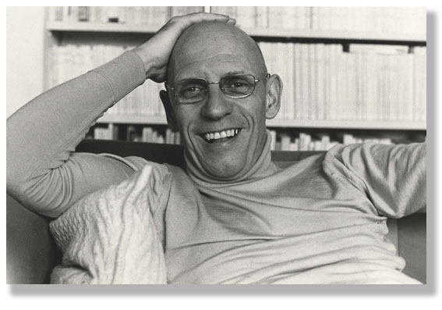
A French philosopher who does ‘history’ –and cannot be ignored by historians – who radically challenges Western liberal thinking about power, its connection to all knowledge and human experience forever....since the 1970s his theory has long become mainstream and has been absorbed by cultural history
A critical history of the present
‘Real criticism consists in … showing that things are not as obvious as people believe, making it so that what is taken for granted is no longer taken for granted.
To practise criticism is to make harder those acts which are now too easy... [A]s soon as people begin to no longer be able to think things the way they have been thinking, then, transformation becomes at the same time very urgent, very difficult and entirely possible.’
Michel Foucault 1926-1984

Slide 18
History matters but why? What is it for?
bell hooks, Teaching to Transgress: Education as the Practice of Freedom (1994)
Geoff Eley, A Crooked Line : From Cultural History to the History of Society (2006)
Questions:
Why do both authors consider theory important in the classroom?
What do they consider the ‘pedagogical purpose’ of theory in their respective disciplines?
What do we learn from their accounts about the wider historical context that shaped their ’favorite’ theory?
The aim of hooks’ Critical Pedagogy (1994) is to transform students into ‘political subjects who recognize their historical, racial, class and gender situatedness (…) and are politically and ethically motivated to struggle in the interest of greater human freedom and emancipation’. But how can her critical pedagogy succeed if it fails to understand its own ‘historical situatedness’?
The new cultural history (Eley) and critical pedagogy reflect the neoliberal transformation of American and British society in the 1980/90. Discuss

Slide 20
Geoff Eley
‘I’ve tried to capture the ways in which politics and the writing of history are constantly informing each other. Politics —whether in the grand, institutional, and macro-discursive dimensions or in the micropolitical, personal, and everyday— can profoundly infuence the kinds of history we’re able to think and do.
History and politics bleed into each other all the time. Thus my book is about the politics of knowledge associated with social history and cultural history in the broadest of ways.’ Eley, Geoff. A Crooked Line : From Cultural History to the History of Society, University of Michigan Press, 2005.

