Slide 1
Cold war consumption

Slide 2
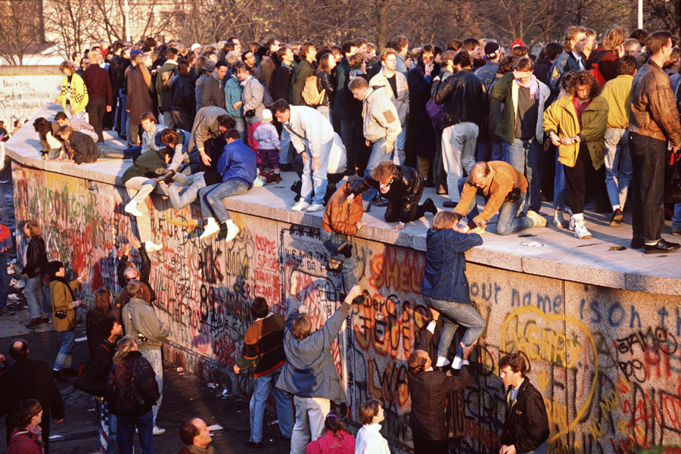
The inevitable triumph of blue jeans, James Dean and rock‘n’roll?
https://www.youtube.com/watch?v=Z3pe-3ZnL8Y

Slide 3
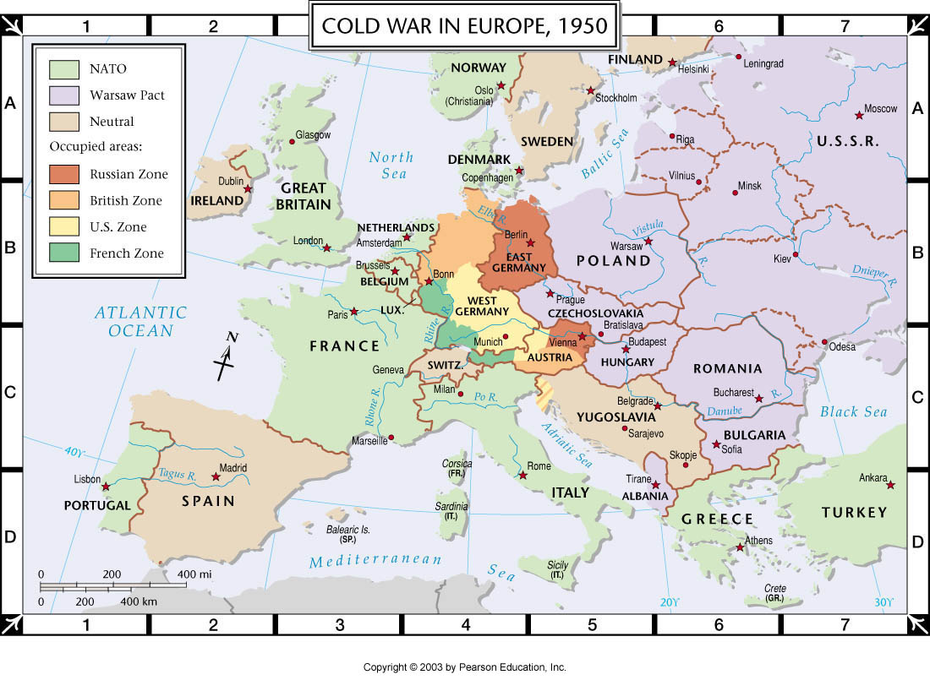

Slide 4
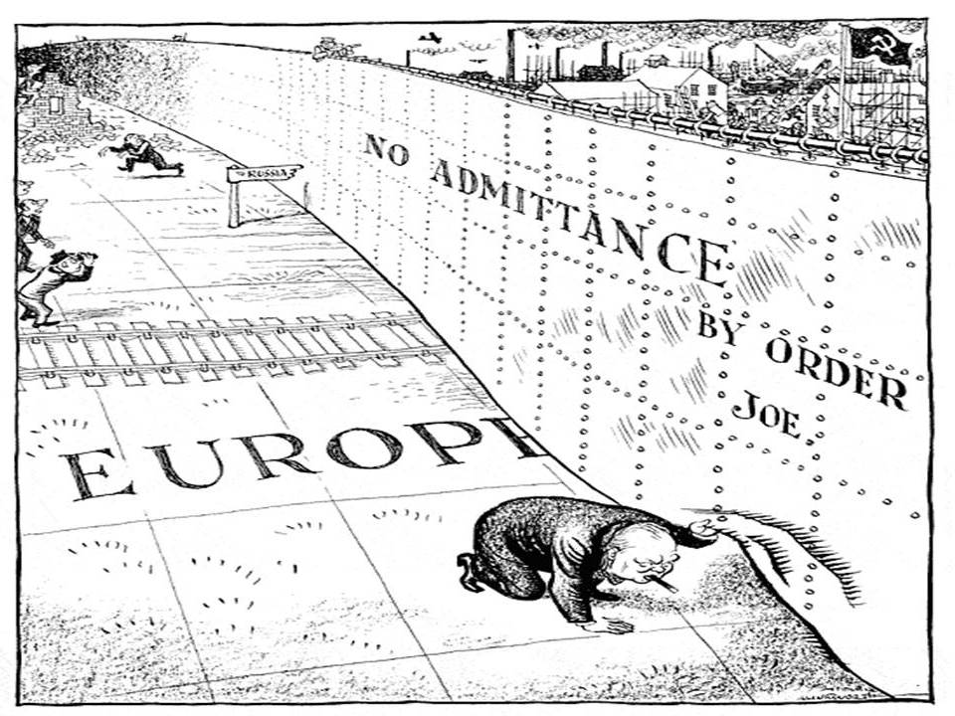
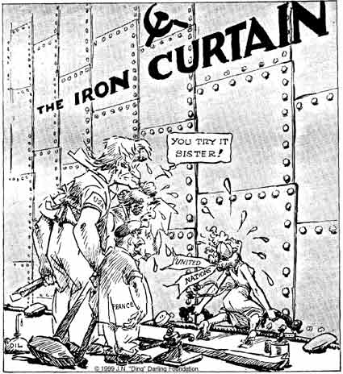
A figurative curtain– but an increasingly impermeable boundary between east and west
“Ding”
Darling,
1947
“Illingworth,” Daily Mail, 6 March 1946.

Slide 5
A young East Berliner works on a concrete wall that was later topped by barbed wire at a sector border in the divided city on August 18, 1961. People’s Police stand guard in the background as another worker mixes cement (Associated Press). https://www.theatlantic.com/photo/2019/11/photos-before-fall-berlin-wall/601714/

Slide 6
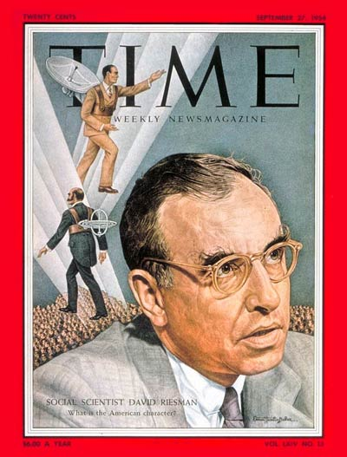
Riesman’s “Nylon War” (1951)
Who and/or what is being satirised here?
How do you read Riesman’s politics?
Although this essay outlines a fantasy scenario,
it nevertheless tells us a good deal about the ‘actually existing
cold war’ as it had taken shape by 1951. What do we learn
about this conflict’s peculiar features here?
How prophetic was Riesman’s essay?
What does the “Nylon War” tell us about the gendered
aspects of cold war cultural/consumer politics?

Slide 7
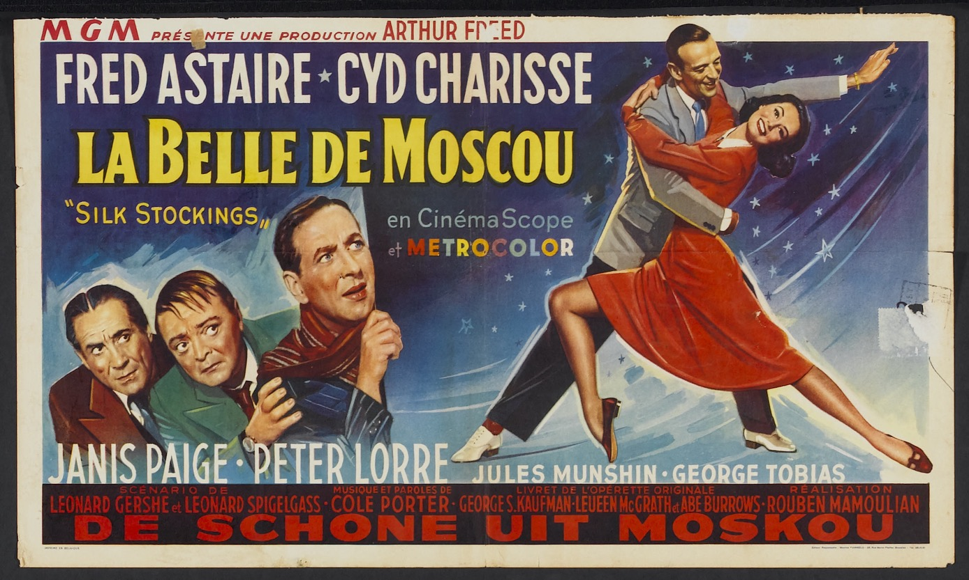
Silk Stockings (dir. Rouben Mamoulian, 1957)
https://www.youtube.com/watch?v=mShkuOBdWig

Slide 8
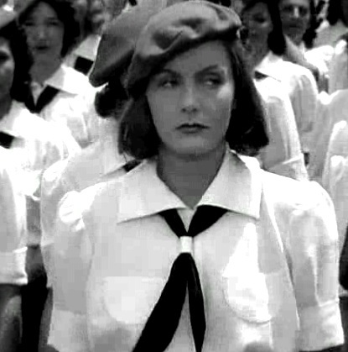
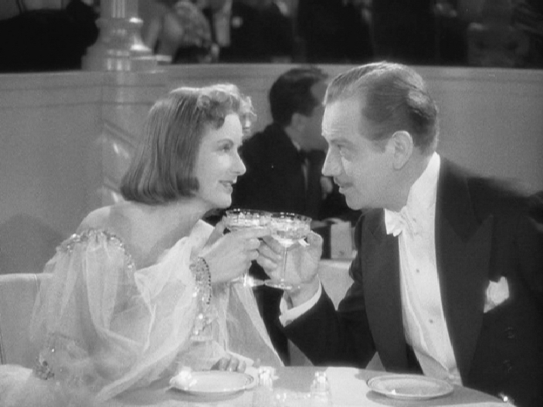
Ninotchka, dir. Ernst Lubitsch, 1939
Greta Garbo’s transformation from
dour socialist cadre to champagne-
sipping socialite

Slide 9
Tensions in the “cultural cold war”
“containment” (Kennan’s “Long Telegram”/NSC 68) or “rollback”?
Albania (1949)
The United States Escapee Program (1952)
a slow war of attrition or frontal assault on the Soviet bloc?
covert vs overt action
Voice of America; Radio Liberty (1951)
Where did consumption fit in the matrix of cold war strategies?

Slide 10
The politics of international exhibition
“The Louisiana Purchase Exposition, commonly known as the Saint Louis World's Fair of 1904, was the last great international exposition before World War I. The fair, built on a 1,200 acre site, included hundreds of thousands of objects, people, animals, displays, and publications from 62 exhibiting countries and 43 of the 45 states. The setting of world records, such as the largest organ, and working displays of every important technological advance were significant design goals. The Fair was a combination of trade show, civic showpiece, and monument to culture, along with more than a tinge of American pride. The Fair showcased the grandiose ambition of the gilded age, forming a kind of collective tribute to the nineteenth century's international understanding of the furtherance of peace, prosperity, and progress. It's a grand snapshot in time of American and foreign societies as they wished to portray themselves.”
https://www.sos.mo.gov/archives/mdh_splash/default.asp?coll=muellis

Slide 11
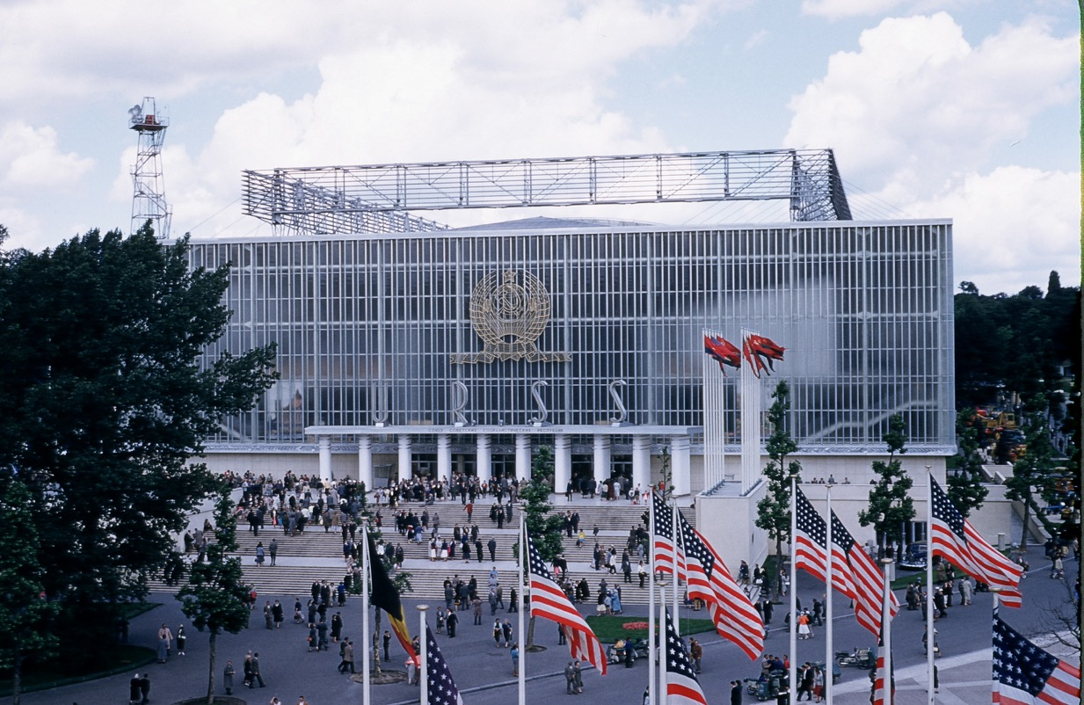

The Brussels World’s Fair, aka Expo ’58

Slide 12
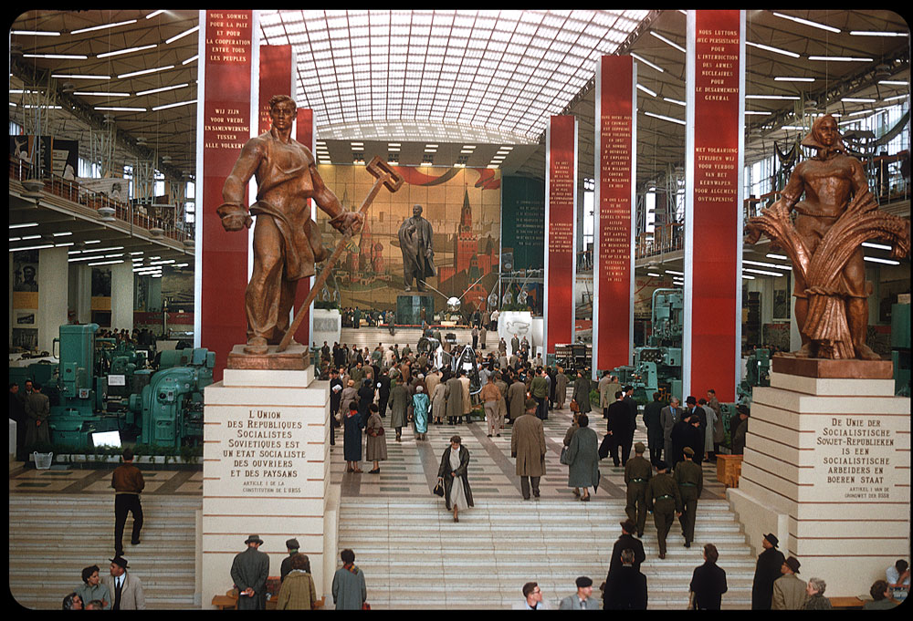

Slide 13
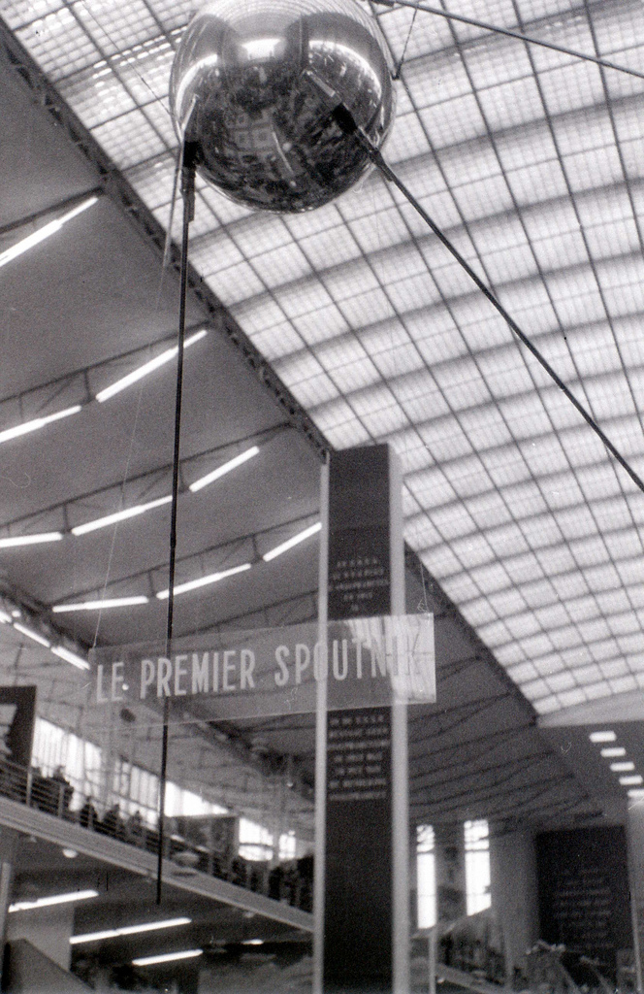
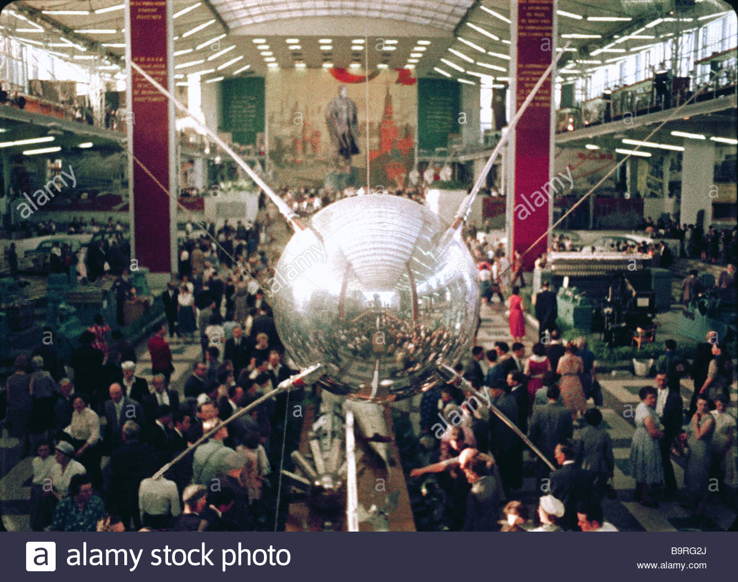

Slide 14
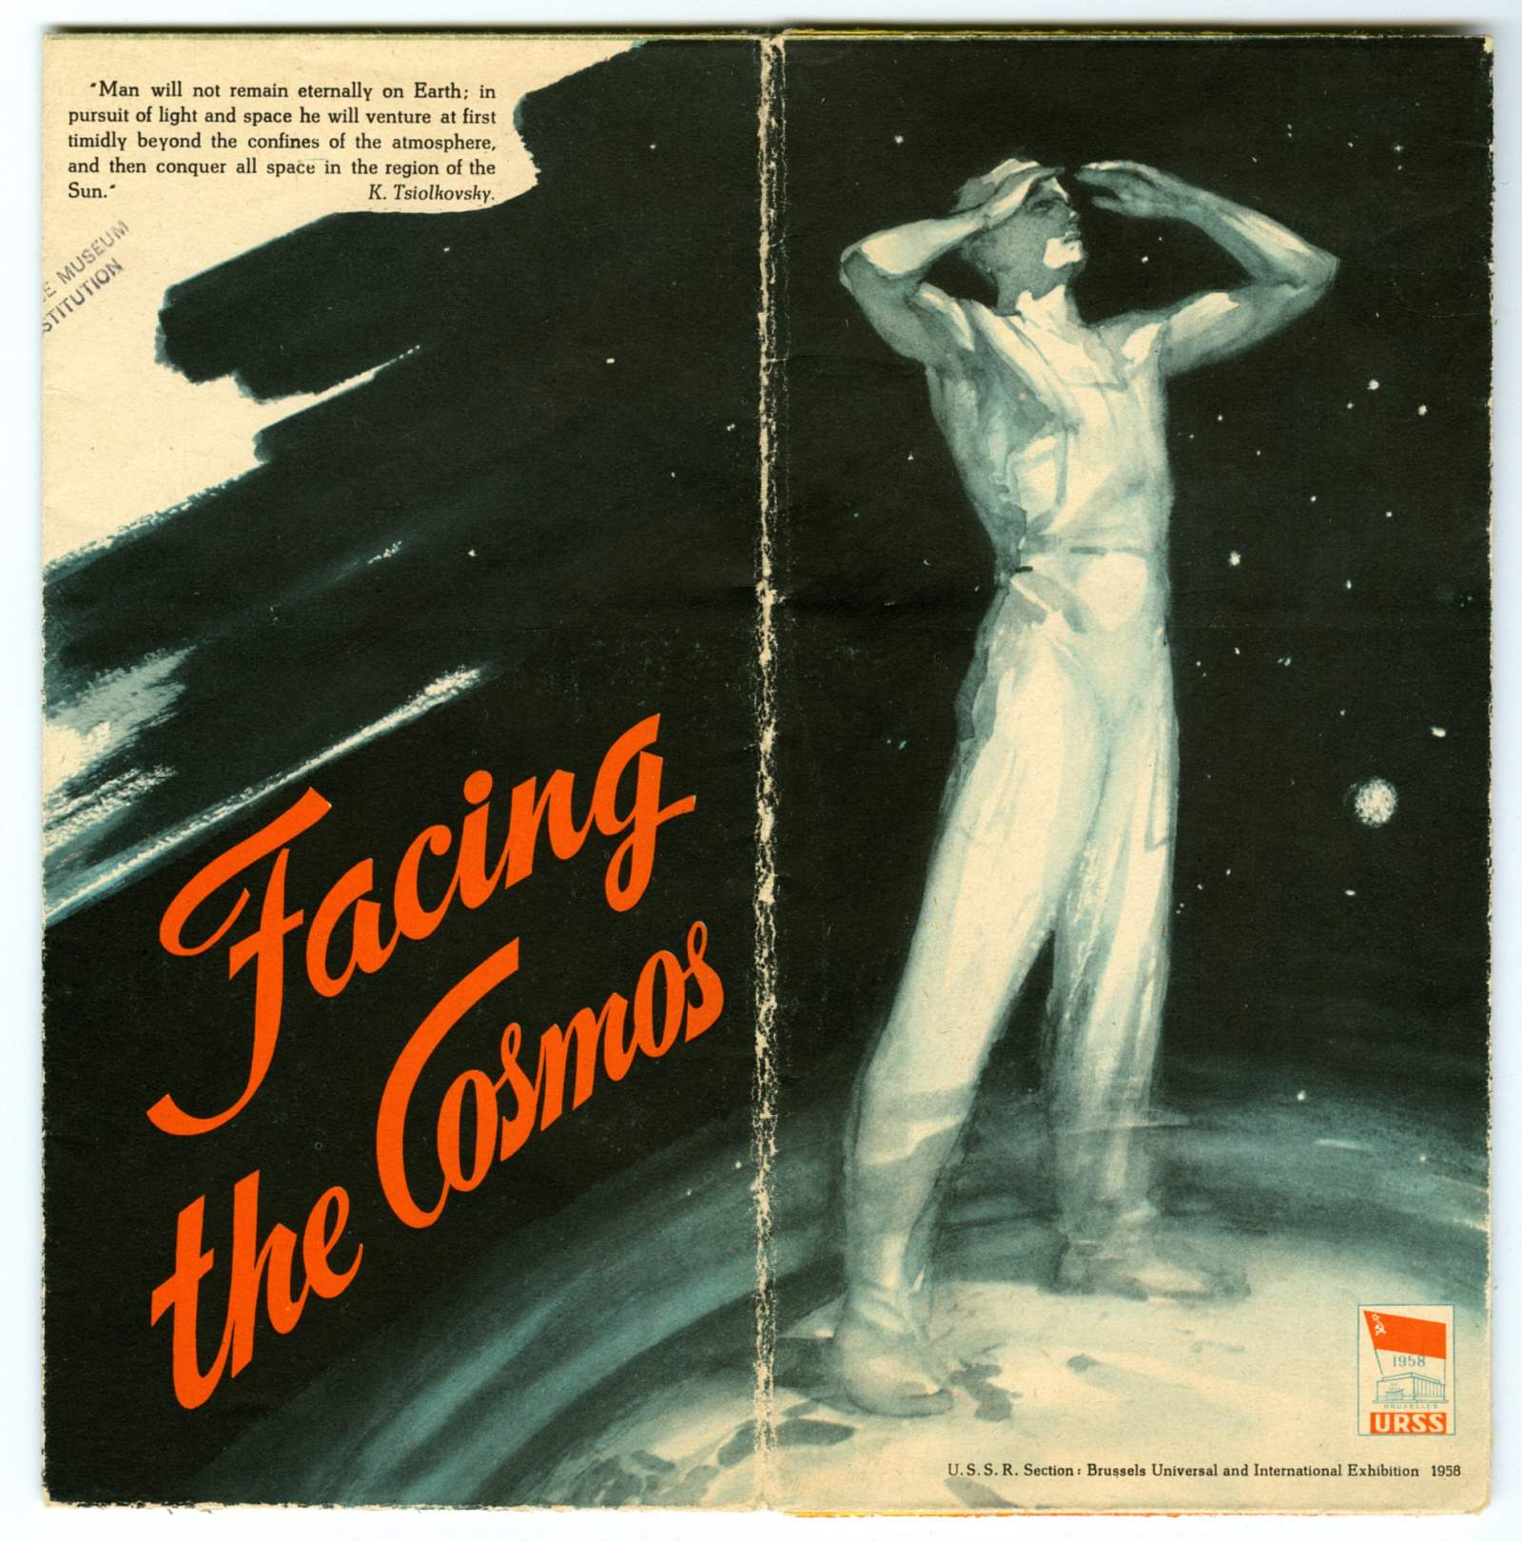
English-language brochure "Facing the Cosmos" produced for the USSR Section of the Brussels Universal and International Exhibition 1958 (a.k.a. Expo 58, Brussels World's Fair, Exposition Universelle et Internationale de Bruxelles), held in Brussels, Belgium, April 17 to October 19, 1958; provides information about the Soviet Union's Sputnik program, including launch vehicle and details of both the Sputnik 1 satellite and the Sputnik 2 mission which carried the dog "Laika" as a passenger.
https://airandspace.si.edu/collection-objects/sputnik-russia-1958-ephemera

Slide 15
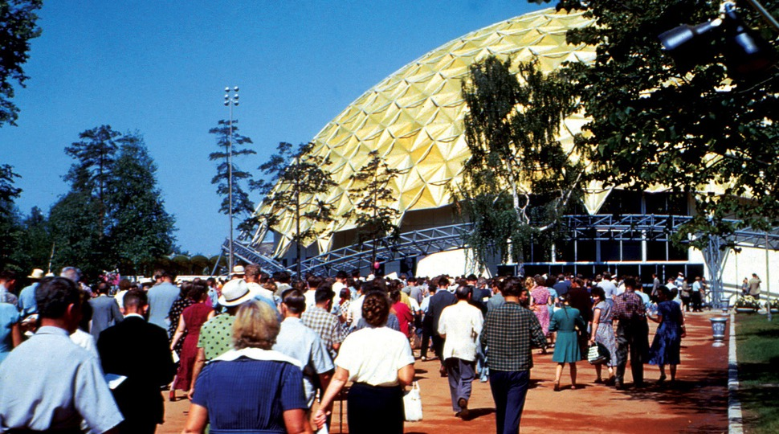
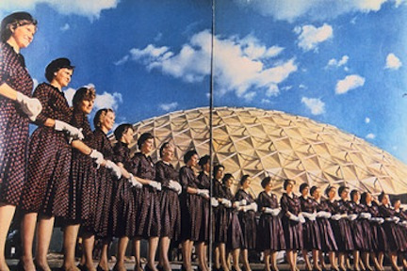
The American National Exhibition, Moscow, 1959
https://www.youtube.com/watch?v=kMLfjVnXxLI

Slide 16
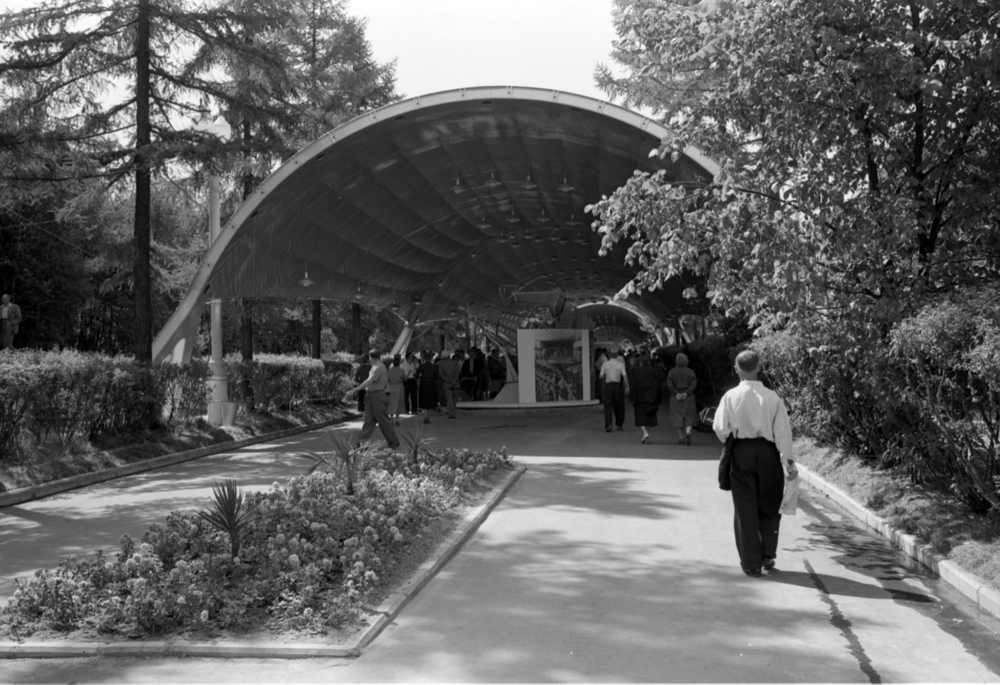
A man walking toward
the USSR Exhibition
in Sokolniki Park, Moscow,
next to the American
National Exhibition on
Aug. 5, 1959. (Thomas O’Halloran/Library of
Congress)
https://www.washingtonpost.com/news/in-sight/wp/2017/06/12/these-photos-show-what-the-soviet-union-thought-the-future-would-look-like/?utm_term=.8707f7403b7b

Slide 17
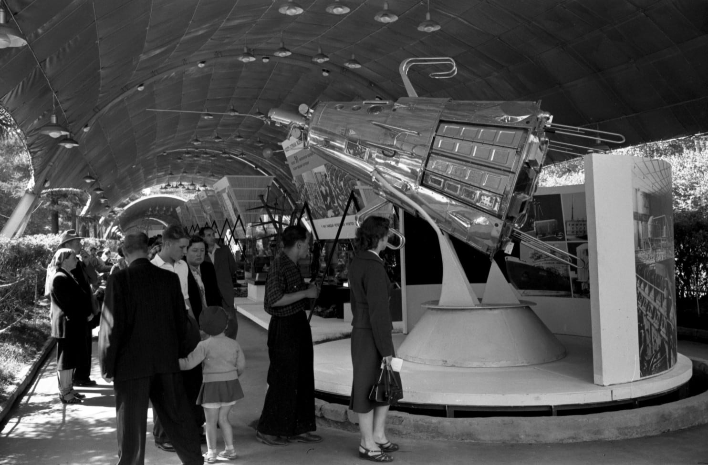

Slide 18
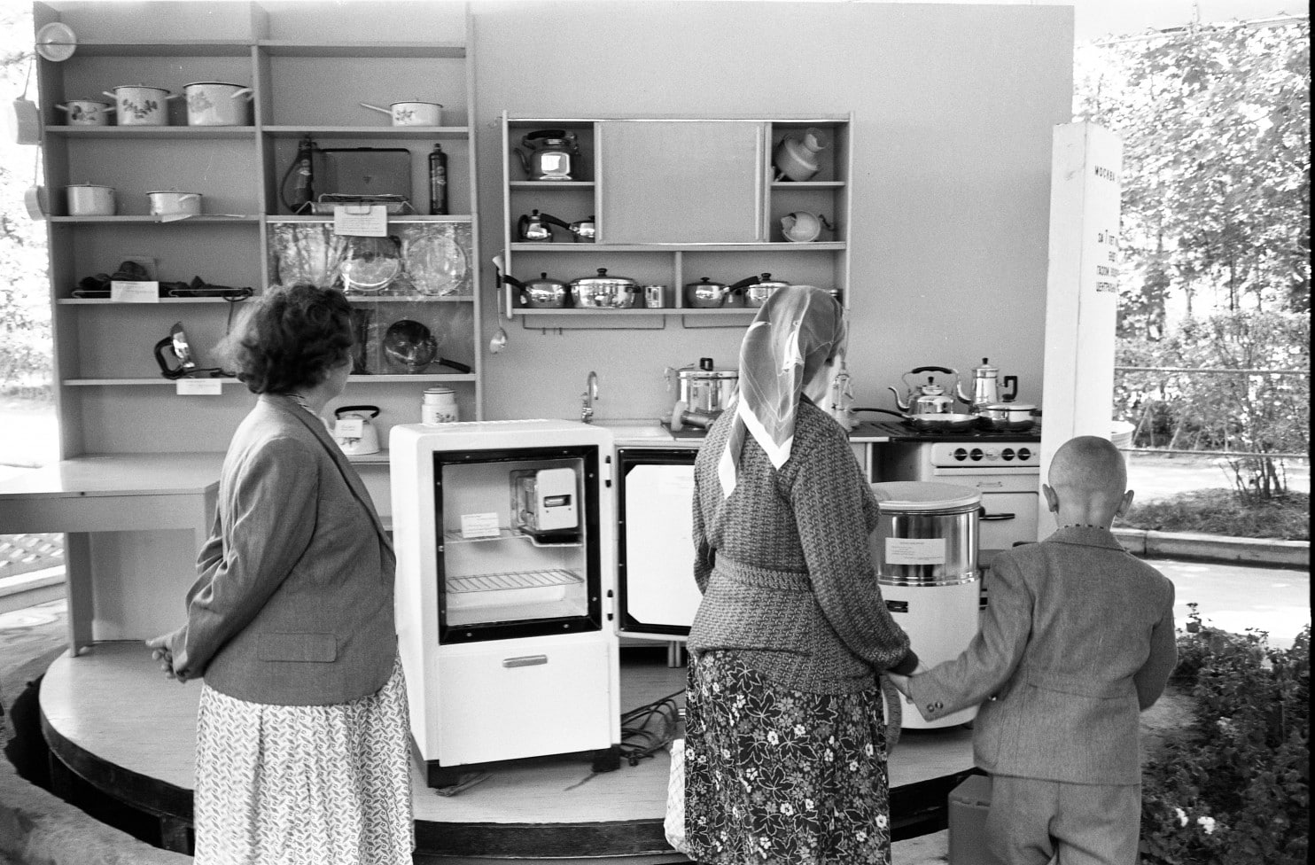
People look at refrigerators and kitchen equipment at the Soviet exhibit that was located next to the
American National Exhibition in Moscow on Aug. 5, 1959. (Thomas O’Halloran/Library of Congress)

Slide 19
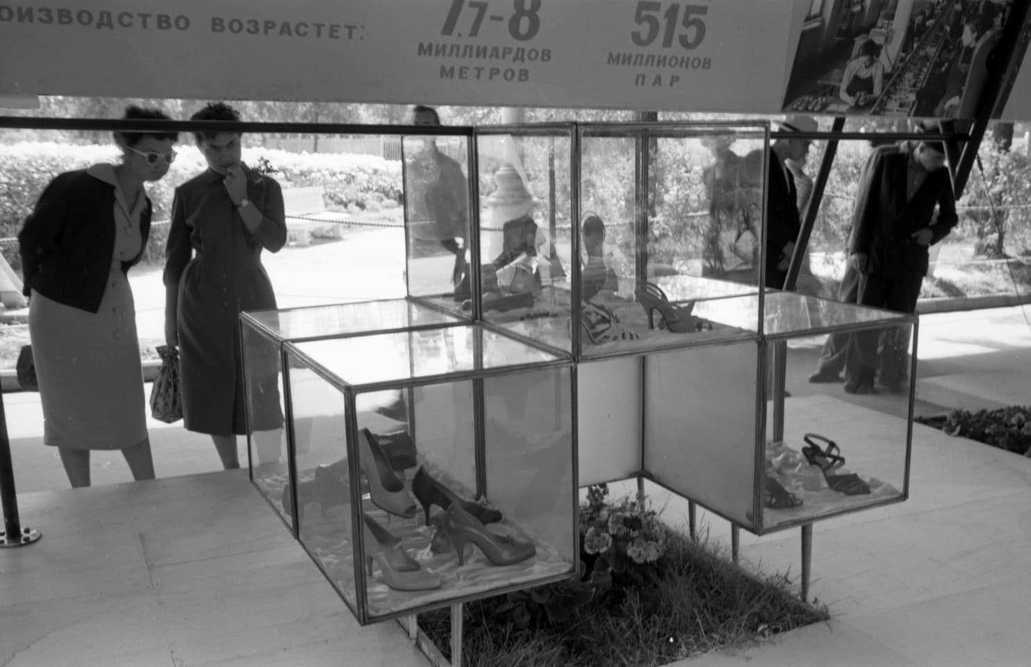

Slide 20
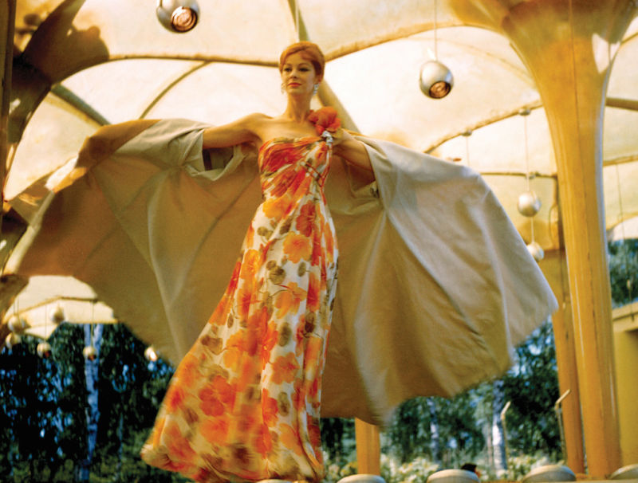
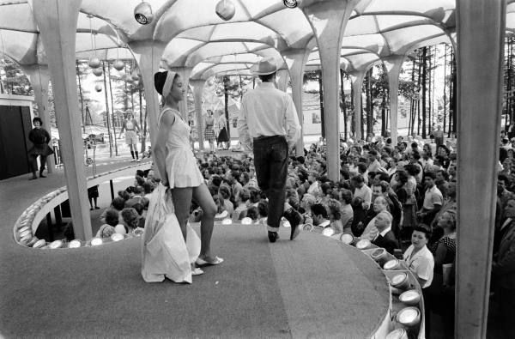

Slide 21
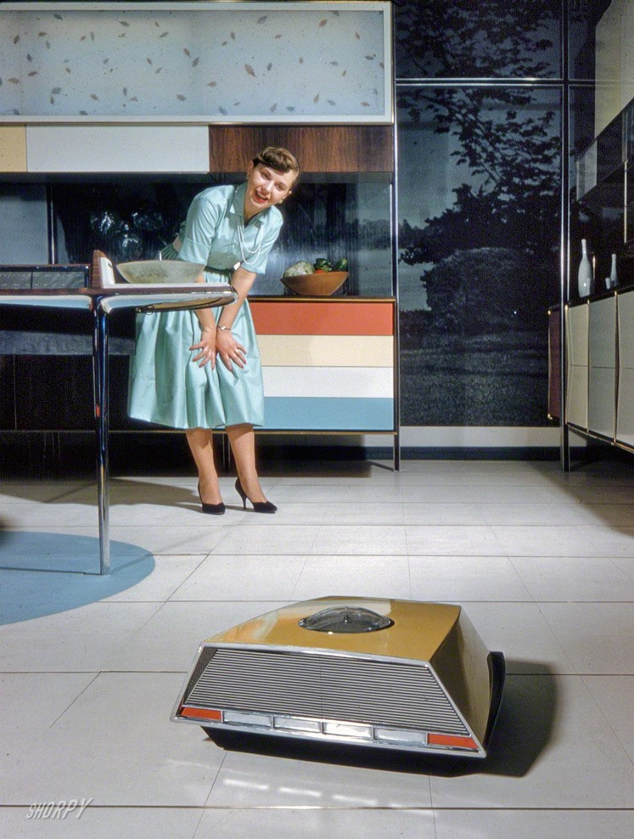
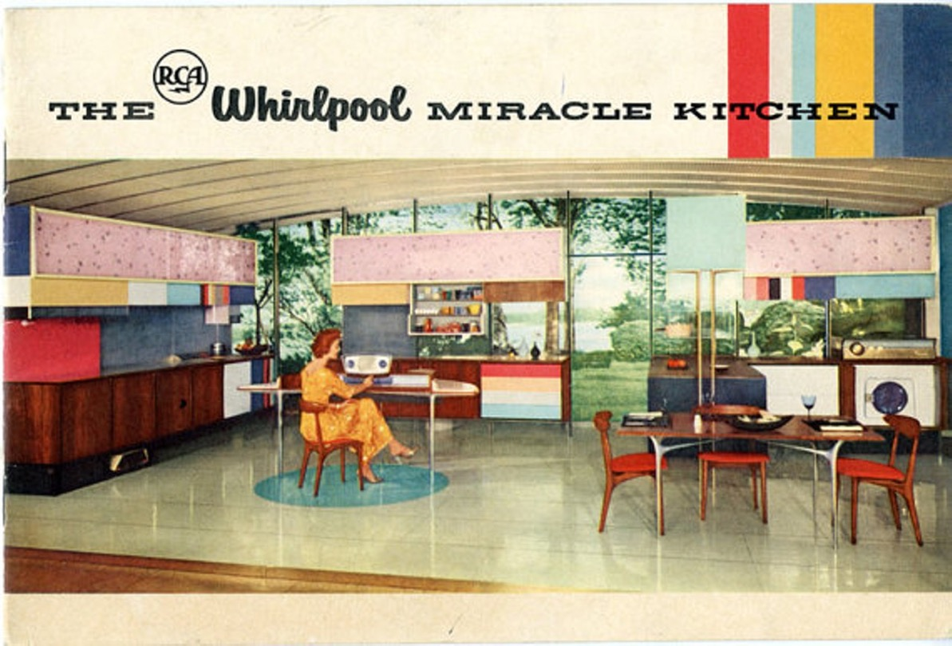

Slide 22
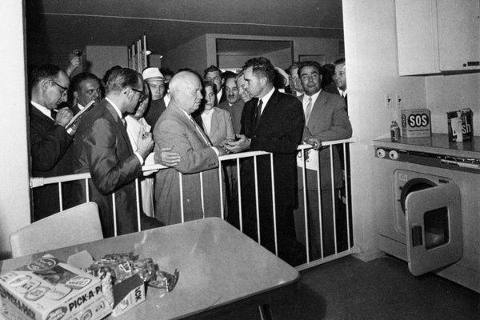
Nikita S. Khrushchev and
Richard M. Nixon spar
in the model kitchen.
Credit Sovfoto/UIG, via Getty Images
https://www.youtube.com/watch?v=-CvQOuNecy4
https://www.youtube.com/watch?v=lN9ENvzSPfw

Slide 23
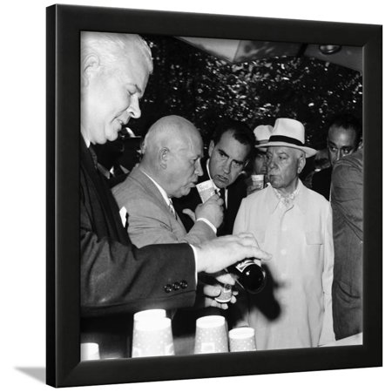
From miracle kitchen to nostalgic kitsch
American National Exhibition, Moscow, USSR, 1959 Framed Print Wall Art
Average rating:0out of5stars, based on0reviewsWrite a review
Art.com
$67.99
-$103.99
List $111.99
https://www.walmart.com/ip/American-National-Exhibition-Moscow-USSR-1959-Framed-Print-Wall-Art/864848709

Slide 24
Some suggested discussion questions
“Although the cold war is often characterized as a ‘war of ideas’, it would be more apt to
regard superpower competition as waged at the level of material ‘stuff’: a war of, and for
consumers.” Discuss.
2. Why did international fairs become cold war battlegrounds? What kinds of spaces were these
Exhibits?
3. Was the central dynamic of the cultural cold war ultimately one of convergence or of
divergence?
4. How far do the readings refute the triumphalist narrative that “we” [the US/”the West”]
won the cold war, and that this victory owed a good deal to the irresistible allure of
American consumer culture and products?

Slide 25
Mister Twister
https://www.youtube.com/watch?v=21Ckc9IuTVw

