Slide 1
Cold war consumption

Slide 2
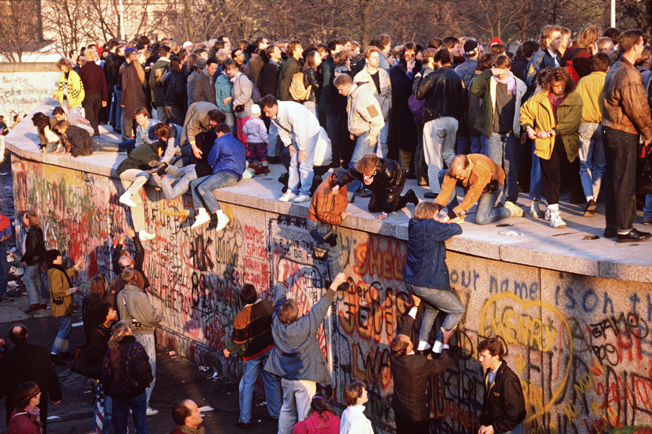
The inevitable triumph of blue jeans, James Dean and rock‘n’roll?
https://www.youtube.com/watch?v=Z3pe-3ZnL8Y

Slide 3
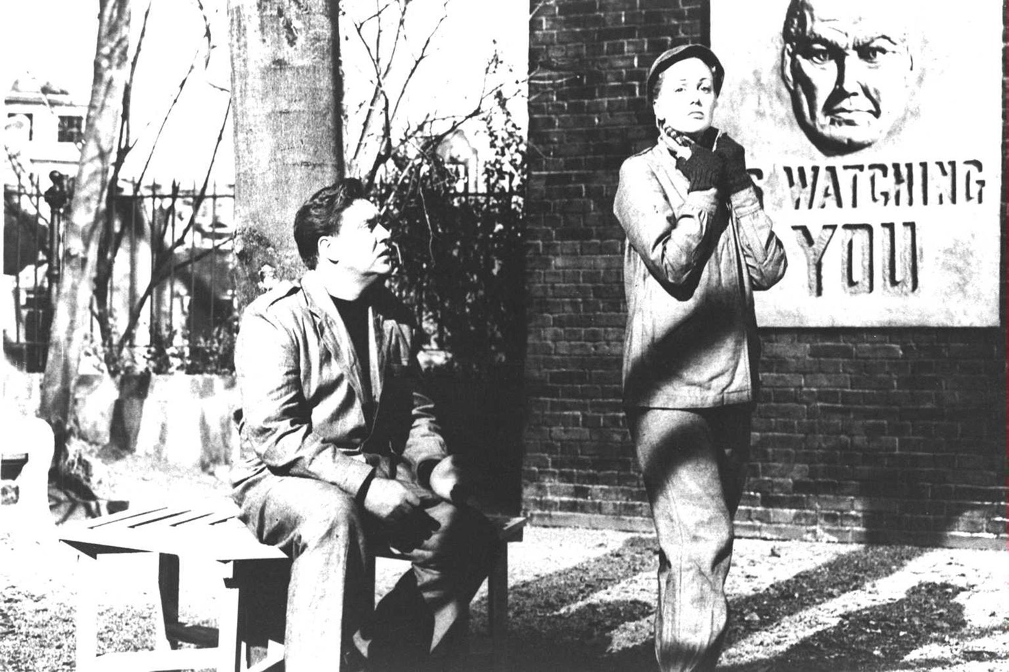
The 1956 film
adaptation of
George Orwell’s
1984
https://www.vogue.com/article/1984-bestseller-amazon-trump-alternative-facts

Slide 4
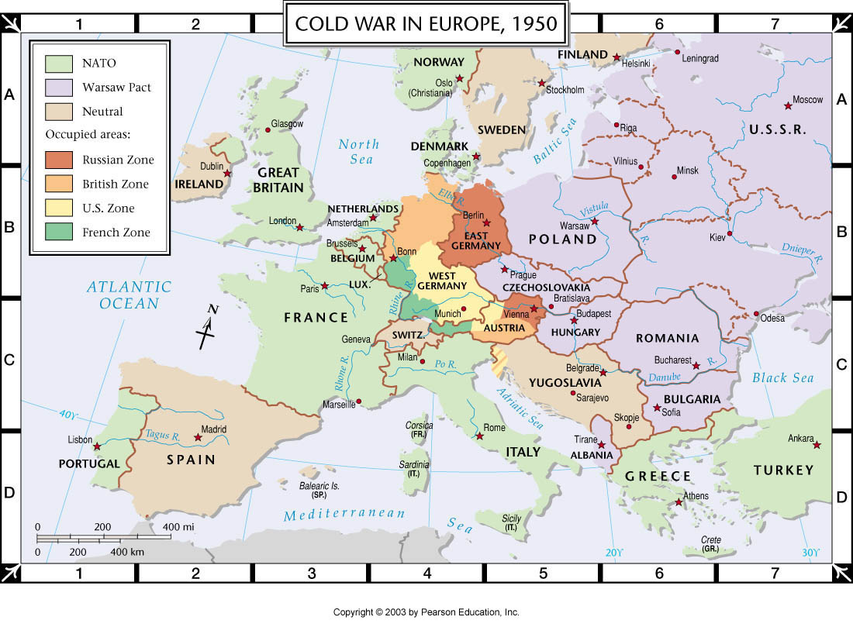

Slide 5
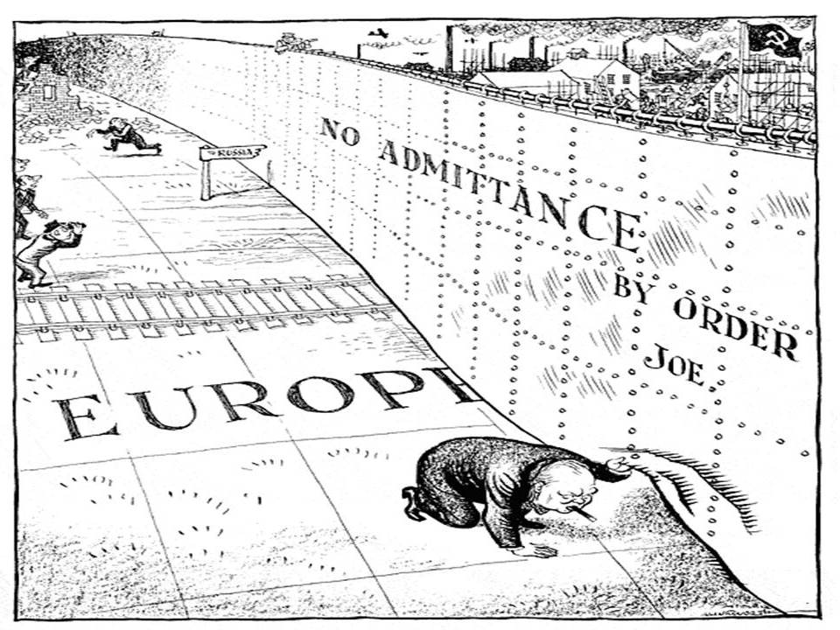
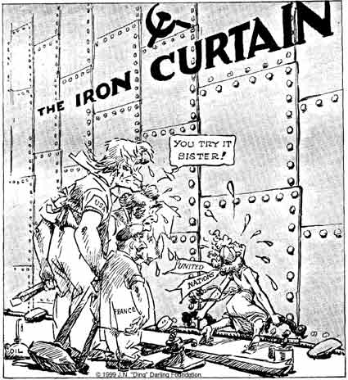
A figurative curtain– but an increasingly impermeable boundary between east and west
“Ding”
Darling,
1947
“Illingworth,” Daily Mail, 6 March 1946.

Slide 6
A young East Berliner works on a concrete wall that was later topped by barbed wire at a sector border in the divided city on August 18, 1961. People’s Police stand guard in the background as another worker mixes cement (Associated Press). https://www.theatlantic.com/photo/2019/11/photos-before-fall-berlin-wall/601714/

Slide 7
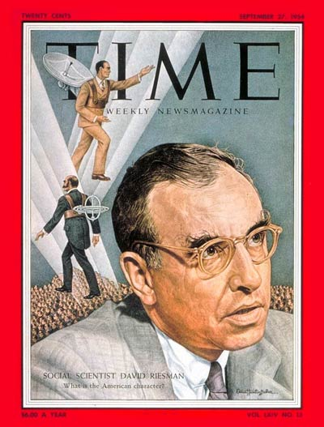
Riesman, “The Nylon War” (1951)
1) Who and what is being satirised here?
2) Although this essay outlines an imaginary scenario,it nevertheless tells us a good deal about cold war politics within the US–- as well as between the US & USSR–- as they had taken shape by 1951. What do we learn?
3) What does Riesman’s satire indicate about the gendered aspects of cold war cultural/consumer politics?
David Riesman (September 22, 1909 – May 10, 2002)

Slide 8
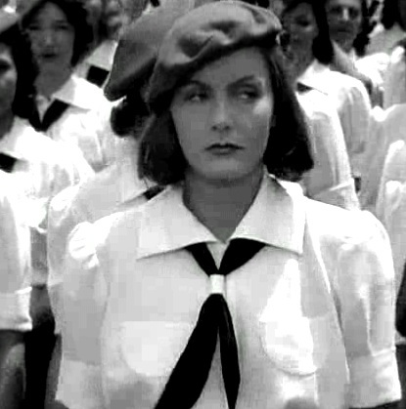
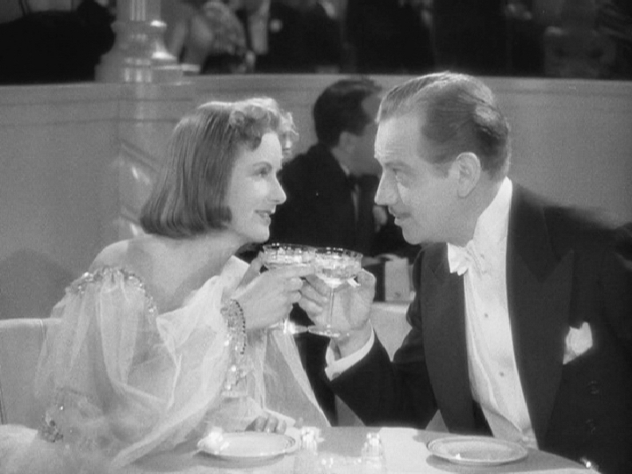
Ninotchka, dir. Ernst Lubitsch, 1939
Greta Garbo’s transformation from
dour socialist cadre to champagne-
sipping socialite

Slide 9
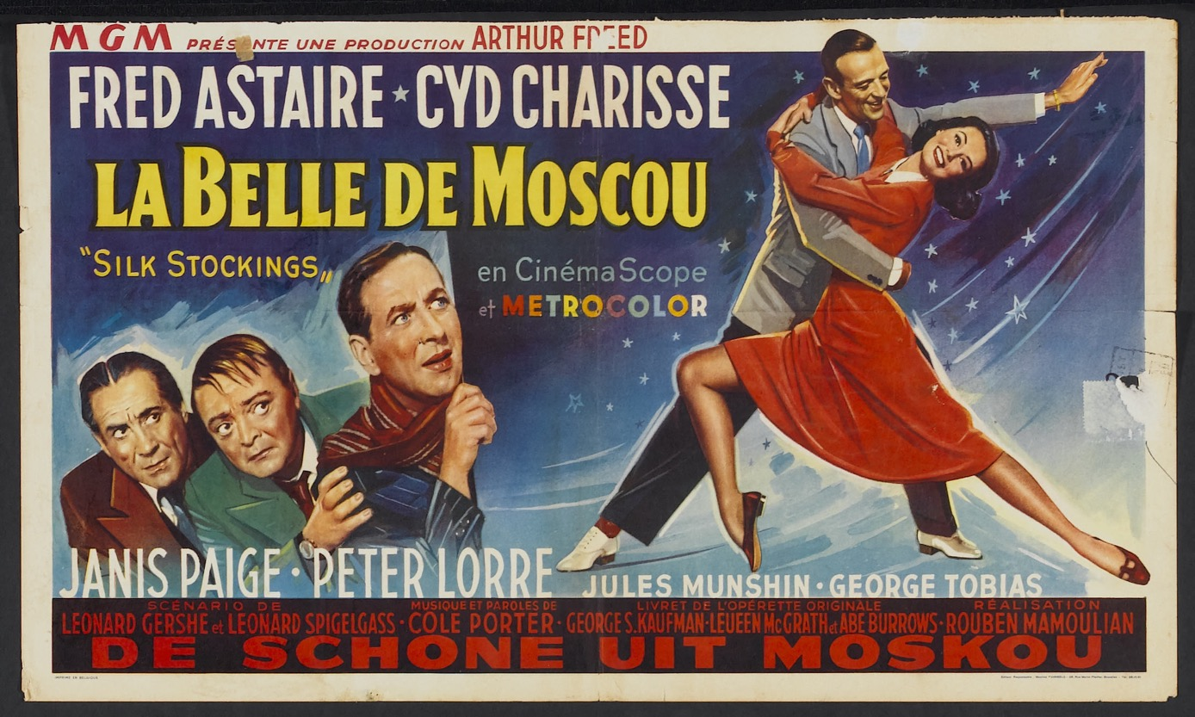
Silk Stockings (dir. Rouben Mamoulian, 1957)
https://www.youtube.com/watch?v=mShkuOBdWig

Slide 11
Tensions in US cold war strategy
“containment” or “rollback” of Soviet power?
Albania (1949)
The United States Escapee Program (1952)
a slow war of attrition or frontal assault on the Soviet bloc?
covert vs overt action
How to puncture the iron curtain?
The importance of Germany/Berlin
Voice of America; Radio Liberty (1951)

Slide 12
The politics of international exhibition
“The Louisiana Purchase Exposition, commonly known as the Saint Louis World's Fair of 1904, was the last great international exposition before World War I. The fair, built on a 1,200 acre site, included hundreds of thousands of objects, people, animals, displays, and publications from 62 exhibiting countries and 43 of the 45 states. The setting of world records, such as the largest organ, and working displays of every important technological advance were significant design goals. The Fair was a combination of trade show, civic showpiece, and monument to culture, along with more than a tinge of American pride. The Fair showcased the grandiose ambition of the gilded age, forming a kind of collective tribute to the nineteenth century's international understanding of the furtherance of peace, prosperity, and progress. It's a grand snapshot in time of American and foreign societies as they wished to portray themselves.”
https://www.sos.mo.gov/archives/mdh_splash/default.asp?coll=muellis

Slide 13

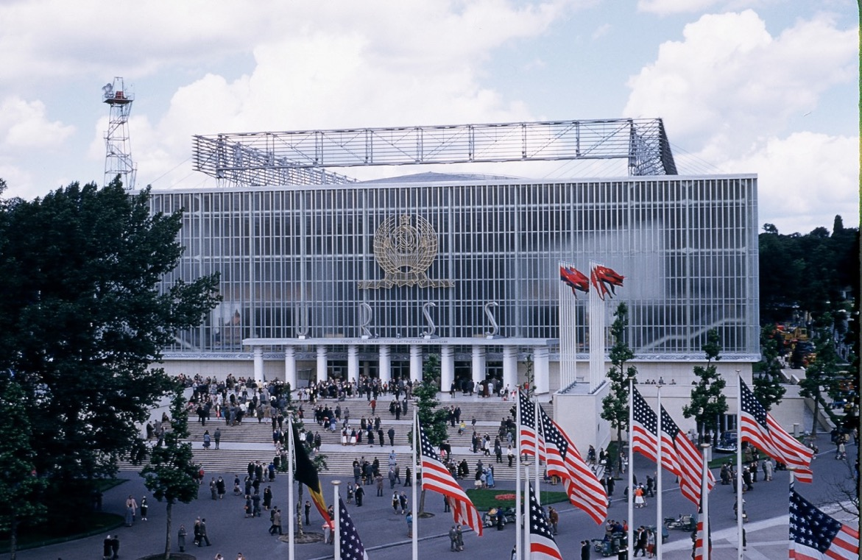
The Brussels World’s Fair, aka Expo ’58

Slide 14
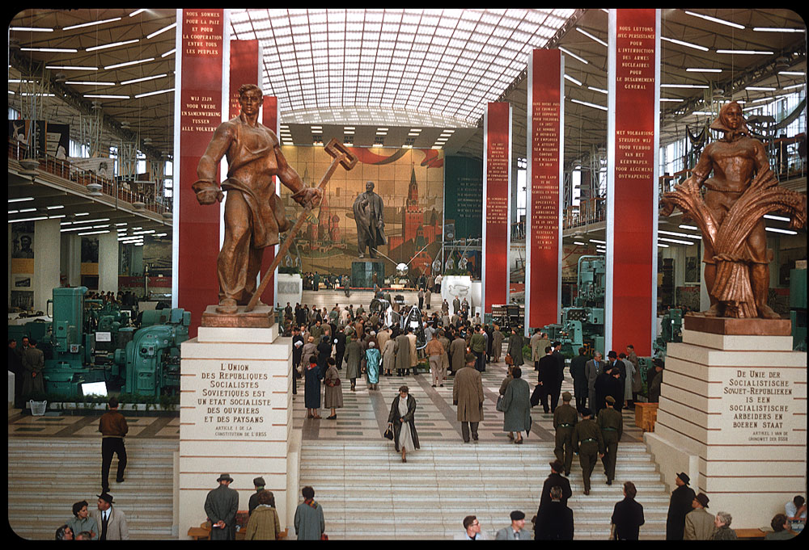

Slide 15
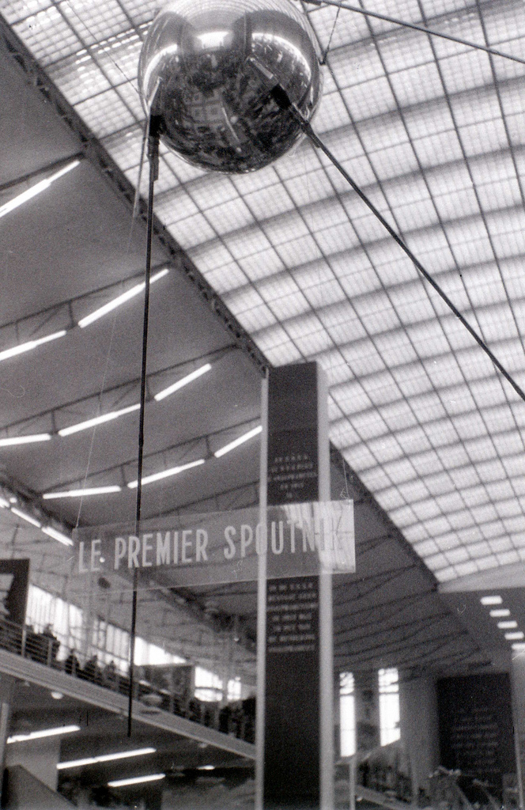
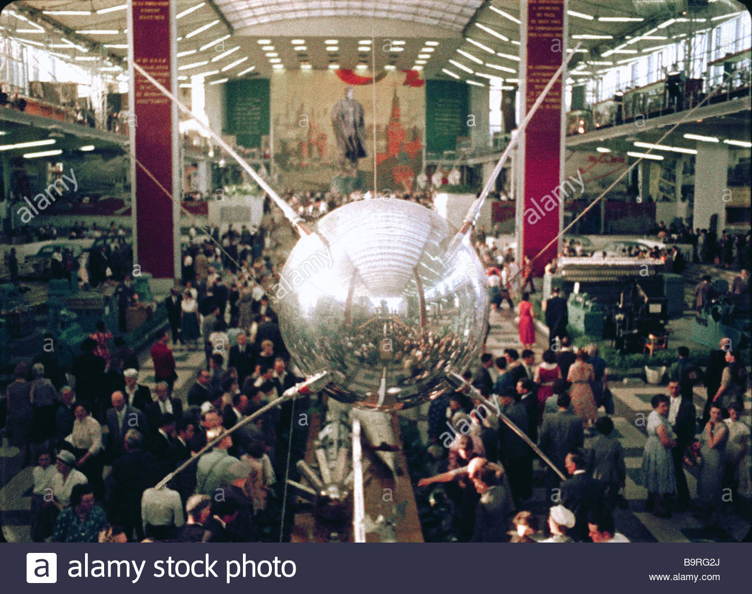

Slide 16
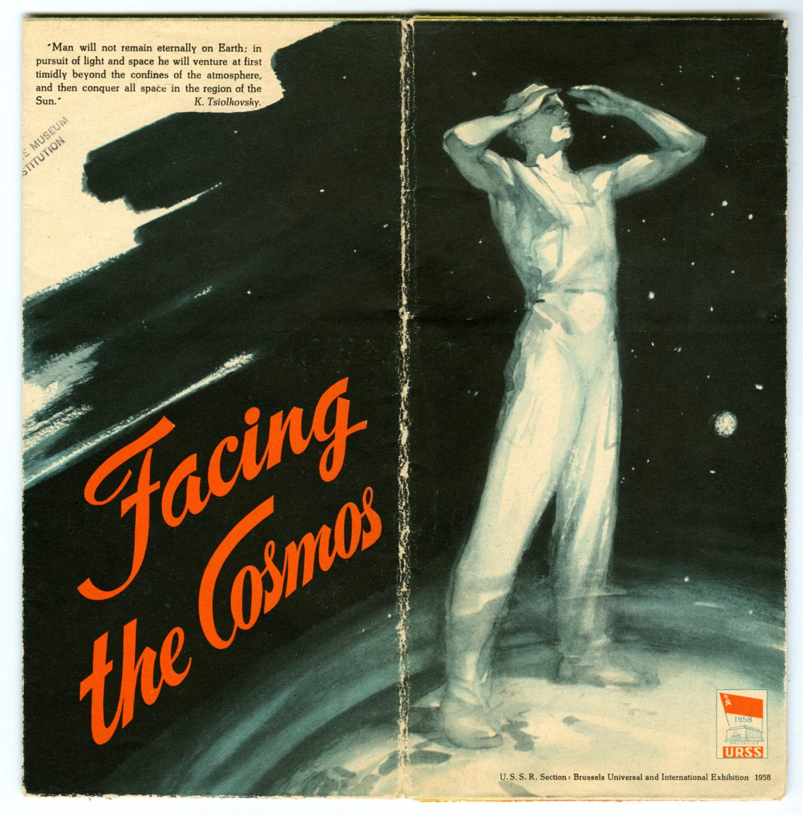
English-language brochure "Facing the Cosmos" produced for the USSR Section of the Brussels Universal and International Exhibition 1958 (a.k.a. Expo 58, Brussels World's Fair, Exposition Universelle et Internationale de Bruxelles), held in Brussels, Belgium, April 17 to October 19, 1958; provides information about the Soviet Union's Sputnik program, including launch vehicle and details of both the Sputnik 1 satellite and the Sputnik 2 mission which carried the dog "Laika" as a passenger.
https://airandspace.si.edu/collection-objects/sputnik-russia-1958-ephemera

Slide 17
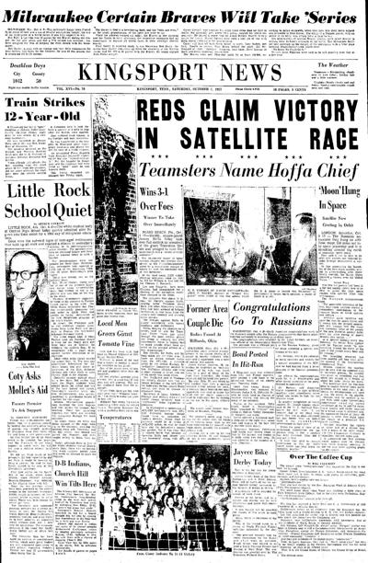
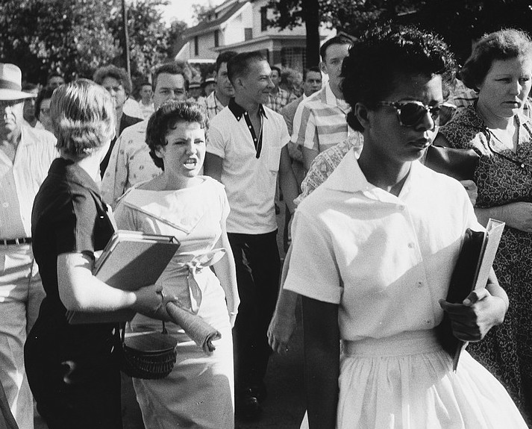
Space and race
Black student Elizabeth Eckford is jeered by white student Hazel Bryan as she attempts to enter Little Rock Central High School, Arkansas, 3 Sept. 1957.
The front page of the 6 Oct. 1957, Kingsport News (Tennessee) reported the launch of the Soviet satellite Sputnik.

Slide 18
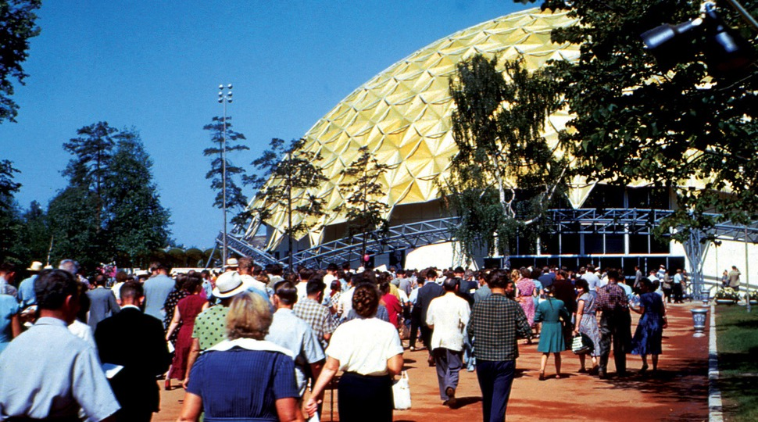
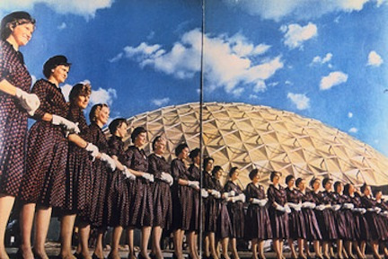
The American National Exhibition,
Sokolniki Park, Moscow, 1959
https://www.youtube.com/watch?v=kMLfjVnXxLI
For whom was the ANEM held? What objectives did
Washington invest in it, and why did Moscow agree?

Slide 19
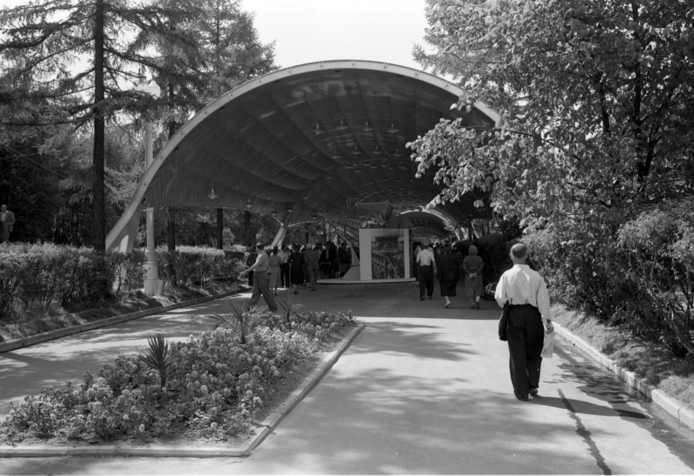
A man walking toward
the USSR Exhibition
in Sokolniki Park, Moscow,
next to the American
National Exhibition on
Aug. 5, 1959. (Thomas O’Halloran/Library of
Congress)
https://www.washingtonpost.com/news/in-sight/wp/2017/06/12/these-photos-show-what-the-soviet-union-thought-the-future-would-look-like/?utm_term=.8707f7403b7b

Slide 20
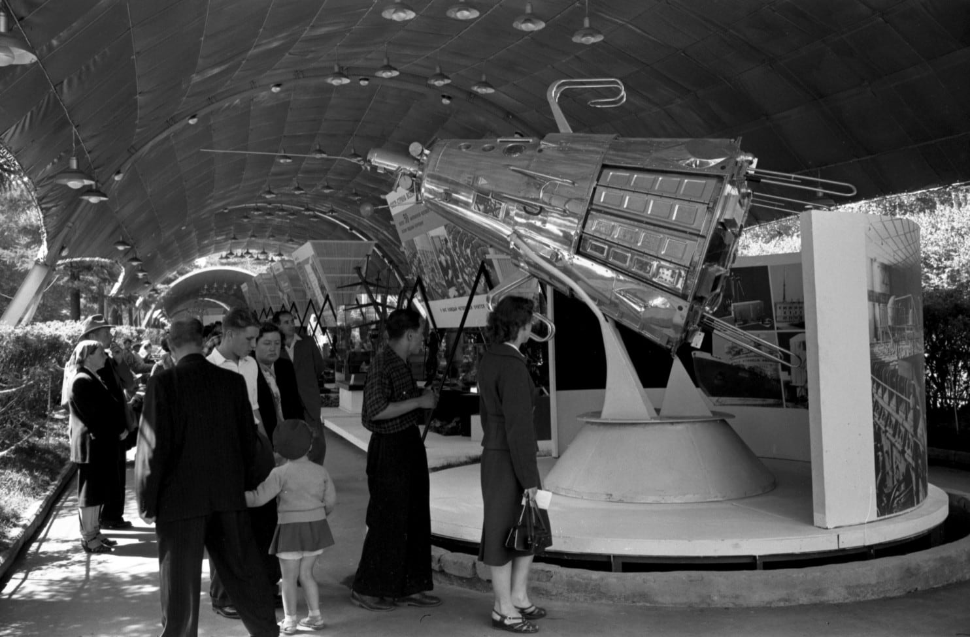

Slide 21
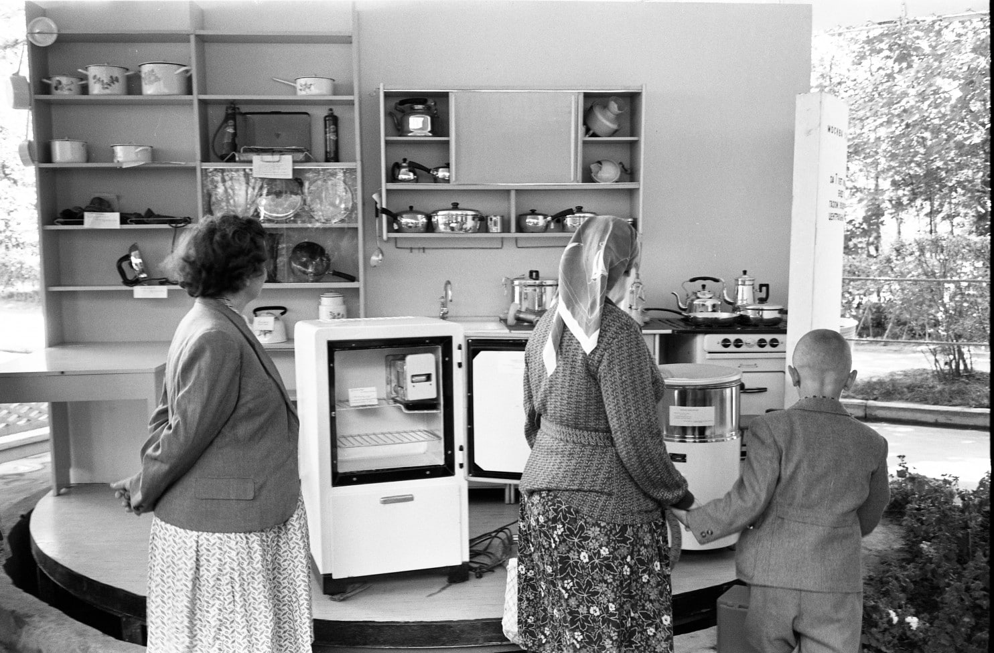
People look at refrigerators and kitchen equipment at the Soviet exhibit that was located next to the
American National Exhibition in Moscow on Aug. 5, 1959. (Thomas O’Halloran/Library of Congress)

Slide 22
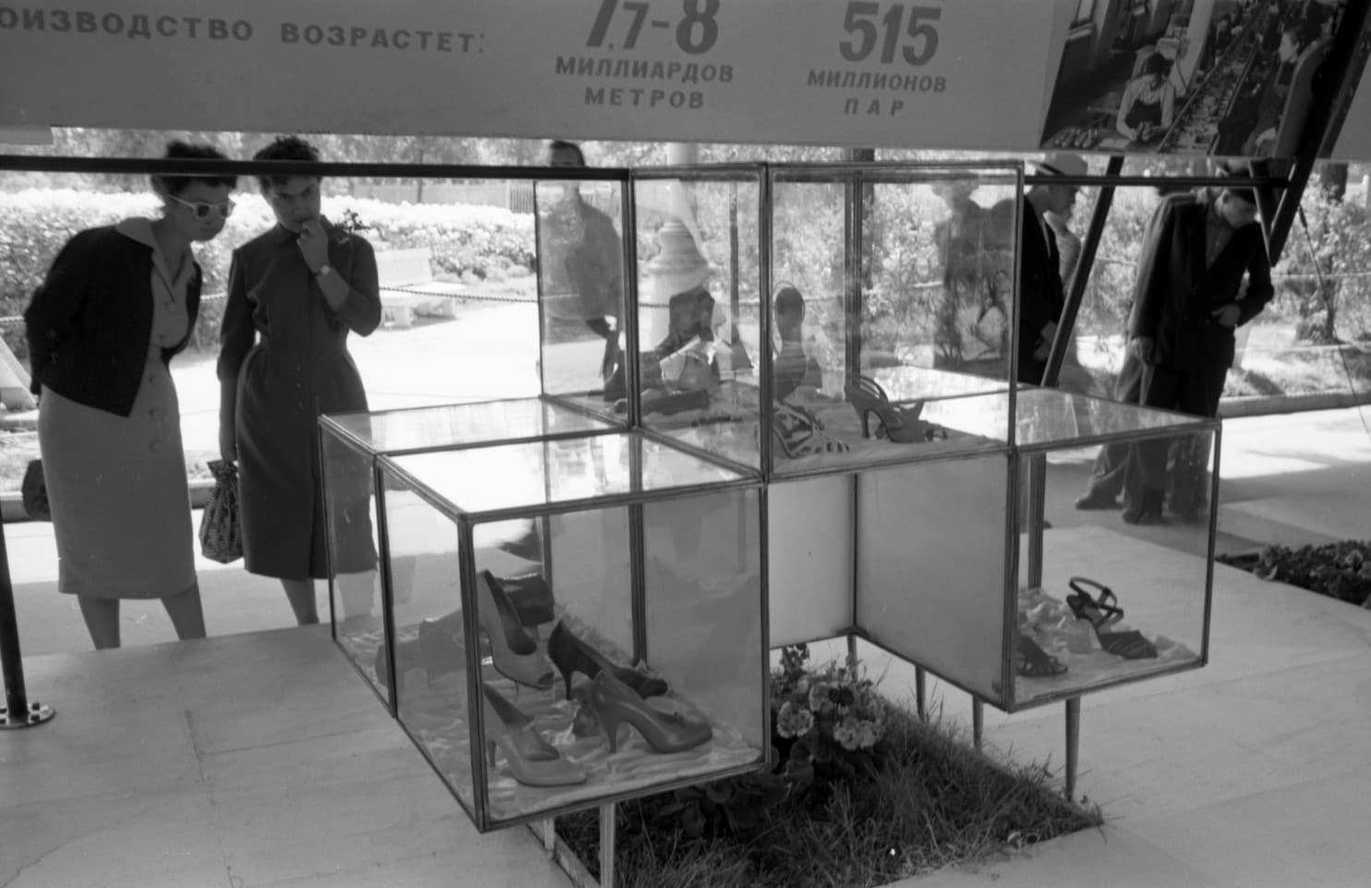

Slide 23
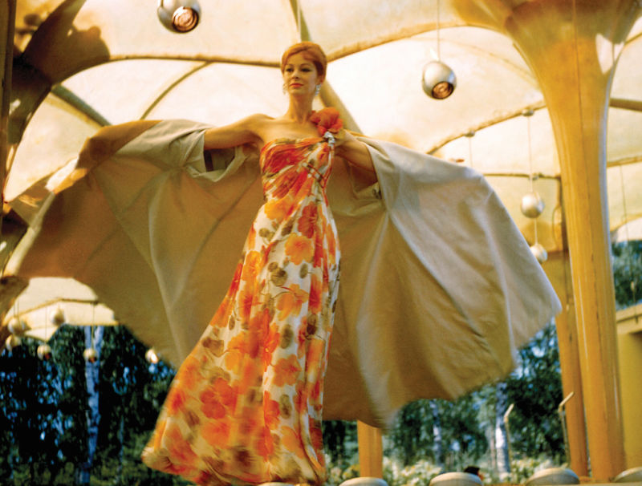
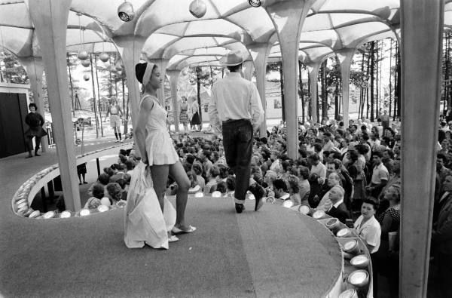

Slide 24
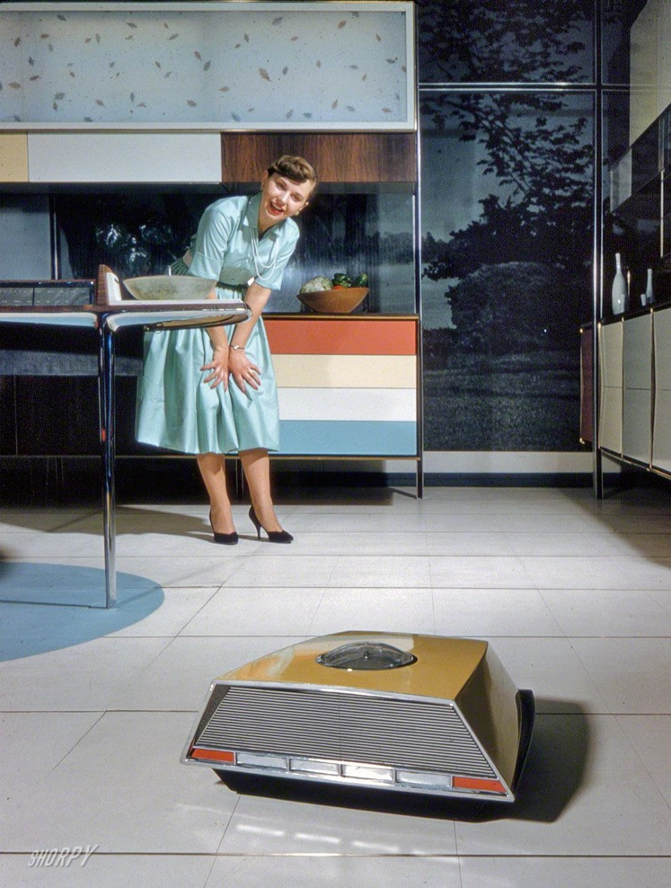
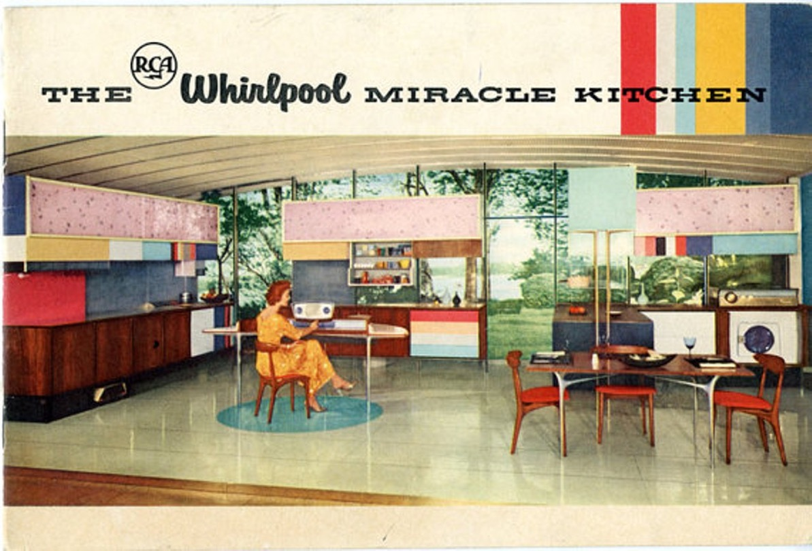

Slide 25
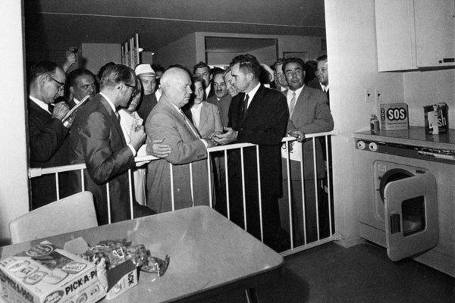
Nikita S. Khrushchev and
Richard M. Nixon spar
in the model kitchen.
Credit Sovfoto/UIG, via Getty Images
https://www.youtube.com/watch?v=-CvQOuNecy4
https://www.youtube.com/watch?v=lN9ENvzSPfw

Slide 26
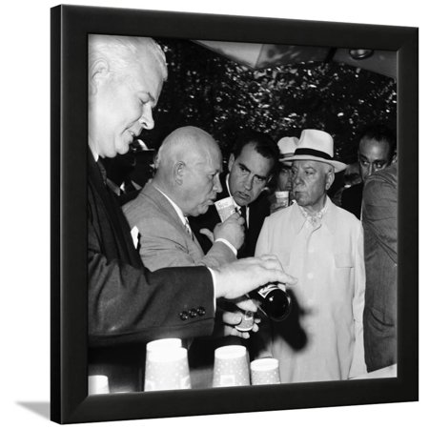
From miracle kitchen to nostalgic kitsch
American National Exhibition, Moscow, USSR, 1959 Framed Print Wall Art
Average rating:0out of5stars, based on0reviewsWrite a review
Art.com
$67.99
-$103.99
List $111.99
https://www.walmart.com/ip/American-National-Exhibition-Moscow-USSR-1959-Framed-Print-Wall-Art/864848709

Slide 27
Some suggested discussion questions
1. What meanings did American and Soviet cold warriors attach to consumption?
2. What kind of space was the ANEM? Was it a ‘battleground’ or something else?
3. What challenges do historians face in trying to appraise Soviet audience reception?
4. How far do the readings refute the triumphalist narrative that “we” [the US/”the West”] won the cold war, and that this victory owed a good deal to the irresistible allure of American consumer culture and products?

Slide 28
Mister Twister
https://www.youtube.com/watch?v=21Ckc9IuTVw

