Slide 1
HI995 (Themes and Approaches to the Historical Study of Empire), Week 3:
Empire and slavery: The case of Cuba
Camillia Cowling
c.cowling@warwick.ac.uk

Slide 2
Content warning: the whole session deals necessarily with profoundly racist ideas and histories. The film for the session contains some racist images and discusses racist language used in the C19 and early C20 in Cuba.

Slide 3
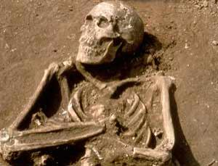
Excavation in today’s Dominican Republic: Columbus’s African shipmates

Slide 4
Africa and Latin America: a 400-year relationship
More Africans than Europeans arrived in the Americas before about 1800 (many were free as well as enslaved; most Latin American territories had more free people of colour than enslaved at most times)
Major cities of Portugal and southern Spain already had large numbers of sub-Saharan African residents in C15-C16
Slavery lasted the longest in Latin America – abolished in Brazil 1888, Cuba 1886

Slide 5
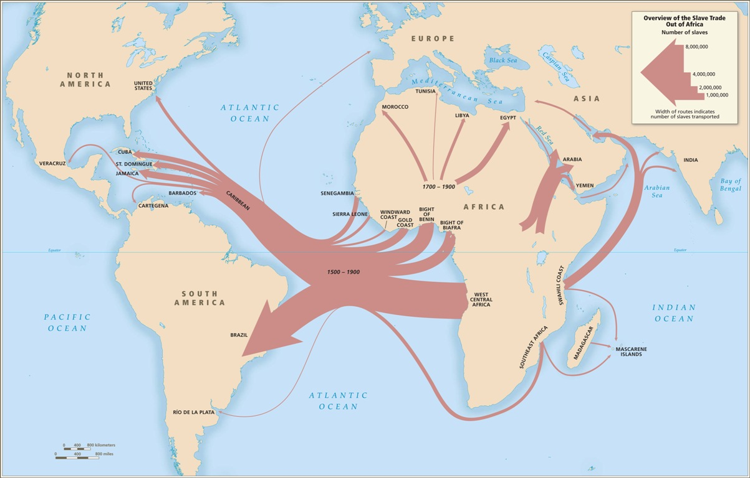
Notes:
www.slavevoyages.org – See this website for a wealth of statistics and current information as well as introductory essays and visual resources.

Slide 6

1940s recordings of Brazilian former slave songs by historian Stanley Stein:
In the days of slavery
I endured many an insult,
I got up early in the morning
The leather whip beat me for no reason
Now I want to see the fellow
Who can shout at me from the hilltop
‘Say ‘God bless you master’ ,’
No sir, your slave is now free
No tempo do cativeiro
Aturava muito desaforo
Levantava de manha cedo
Com cara limpa levo o couro, ai
Agora quero ver o cidadao
Que grita no alto do morro
Vai-se Cristo, seu moco
Seu negro agora ta forro
Notes:
Translation of song recorded by Stanley and Barbara Stein in Vassouras in the 1940s; in: Cangoma Calling: Spirits and Rhythms of Freedom in Brazilian Jongo Slavery Songs, eds. Pedro Meira Monteiro and Michael Stone, Luso-asio-afro-Brazilian studies, 3 (2013) [open access book, available here, with sound files for all songs. http://www.laabst.net/docs/CangomaCalling_text300dpi.pdf (This song is track 14), pp.136-7 Transcription and notes by Gustavo Pacheco with the collaboration of Robert W. Slenes; lyric and endnote translations by Pedro Meira Monteiro and Michael
Stone, with the collaboration of Gustavo Pacheco and Robert W. Slenes. (see note 178 for more info on the transcription and translation process).

Slide 7
Cangoma Calling: Spirits and Rhythms of Freedom in Brazilian Jongo Slavery Songs, eds. Pedro Meira Monteiro and Michael Stone, Luso-asio-afro-Brazilian studies, 3 (2013)
For the recordings, song translations, and an open access book about the Brazilian jongo songs (recorded in Vassouras, Brazil, in the 1940s by Stanley and Barbara Stein), see:
http://www.laabst.net/docs/CangomaCalling_text300dpi.pdf
Notes:
Image is from p. 164. caption reads “One of the people interviewed by Stanley and Barbara Stein, possibly one of the jongo singers.
Vassouras, 1948-1949.”

Slide 8
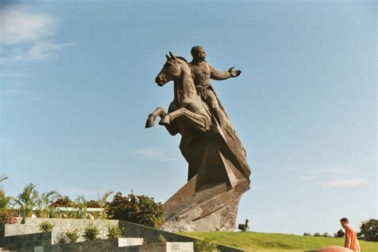
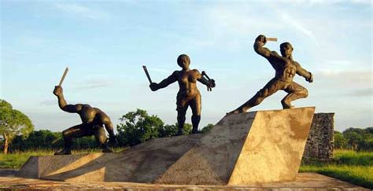
Antonio Maceo, mixed-race general in the wars against Spain; Carlota Lucumi, heroine of anti-colonial slave rising in Matanzas in 1843

Slide 9
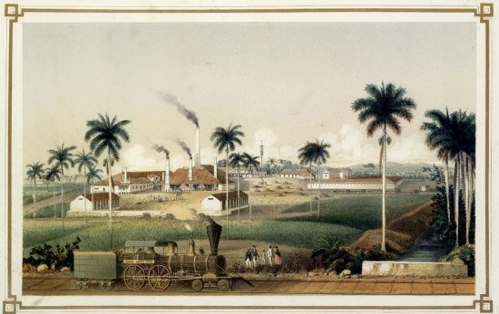
Ingenio Ácana, Matanzas, Cuba 1857
Notes:
Ingenio Ácana, Matanzas, Cuba 1857; owned by D Jose Eusebio Alfonso. From LaPlante and Cantero, Los ingenios, 1857.

Slide 10
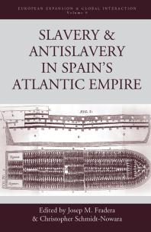
“colonias para despues de un imperio” / Colonies for after empire / post-imperial colonies – Josep Fradera

Slide 11
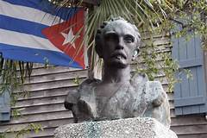
José Martí

Slide 12
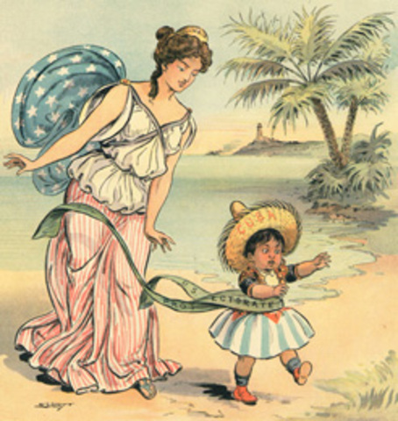
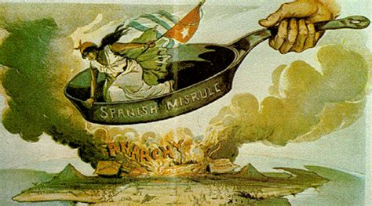
US popular cartoons, Cuba in 1898: US images of imperialism (See Louis Perez Jr, Cuba in the American Imagination)
Take attendance register.

Slide 13
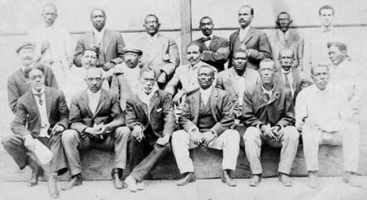
The Partido Independiente de Color (Independent Party of Colour) 1908-1912; members mostly former enslaved; anti-racist politics repressed through racist massacres

Slide 14
“Slaves” or “enslaved”?
Many historians today use “enslaved people” not “slaves” some/ all of the time
Recognises that no-one is born a slave; slaves are made
A political position, but so is “slave”
From 1820/ 1826, African slave trade is ILLEGAL to Cuba and Brazil respectively but continues anyway. Most people living as slaves in these main trading areas of Americas after this are ILLEGALLY enslaved.
Some scholars use “enslaved” when discussing personhood and subjecthood and “slave” when discussing slaveholders’ perspective

Slide 15
Race or “race”?
Biologically speaking, “race” does not exist.
Many historians therefore choose to put “race” in quotation marks in their writing.
However, race has a very significant history as a SOCIAL CONSTRUCT.
consider race as a PROCESS: HOW ideas about race are CONSTRUCTED & vary across time & place: “race-making”
See PBS website: “Race: The Power of an Illusion”

Slide 16
Introductory reading
Christopher Schmidt-Nowara, Slavery, Freedom, and Abolition in Latin America and the Atlantic World.
Introduction, chapter 4, and the biographical case study at the end of Ch 4

Slide 17
Readings on Cuba
Ada Ferrer, Freedom's Mirror: Cuba and Haiti in the Age of Revolution, Introduction
David Sartorius, "Cuban Counterpoint: Colonialism and Continuity in the Atlantic World," in New Countries: Capitalism, Revolutions, and Nations in the Americas, ed. John Tutino (2016)
Jose Marti, "My Race" [Mi raza], 1893, extract here
Ada Ferrer, Insurgent Cuba: Race, Nation, and Revolution, 1868-1898 (UNC Press 1999), introduction and ch 6, "Insurgent Identities: Race and the Western Invasion, 1895-1896"
Louis Perez, Jr., Cuba in the American Imagination: Metaphor and the Imperial Ethos (UNC Press, 2008), chapter 3: "Metaphor as Paradigm".

Slide 18
Questions
Why did slavery persist for so long in Cuba?
What was the effect of Haitian anticolonial war on Cuba?
What made some Afro-Cubans in nineteenth-century Cuba loyal to Spain?
Was anticolonial war possible without slave emancipation?
How did different post-emancipation legacies shape US relations with Cuba after 1898?

Slide 19
Initial questions
What was Latin America’s role in the expansion of colonial (and post-colonial) slavery in the Atlantic?
What was the relationship between national independence and the abolition of slavery in Latin America?
Was slavery an ‘archaic’ relic of coloniality by the C19? If not, why not?

