Slide 1
HI997 (Themes in Global & Comparative History) Week 7: Migration and unfree labour
Dr Camillia Cowling
c.cowling@warwick.ac.uk

Slide 2
Readings/ sources
Eltis, David. “Free and Coerced Migrations: the Atlantic in Global Perspective,” European Review, 12 (2004): 313-28.
Diana Paton, “Gender History, Global History, and Atlantic Slavery: On Racial Capitalism and Social Reproduction.” American Historical Review (2022)
Emma Christopher, Cassandra Pybus, and Marcus Rediker, eds. Many Middle Passages: Forced Migration and the Making of the Modern World (e-book at Library). University of California Press, 2007 (introduction)
Madhavi Kale, Fragments of Empire: Capital, Slavery, and Indentured Labour in the British Caribbean (1998) (introduction and chapter 1)
www.slavevoyages.org

Slide 3
Initial questions: the transatlantic slave trade
How much have you previously studied this topic?
Which areas of the “Atlantic World” were mainly involved? What directions did the trade take over time? Who was trafficked?
When did the trade end?

Slide 4
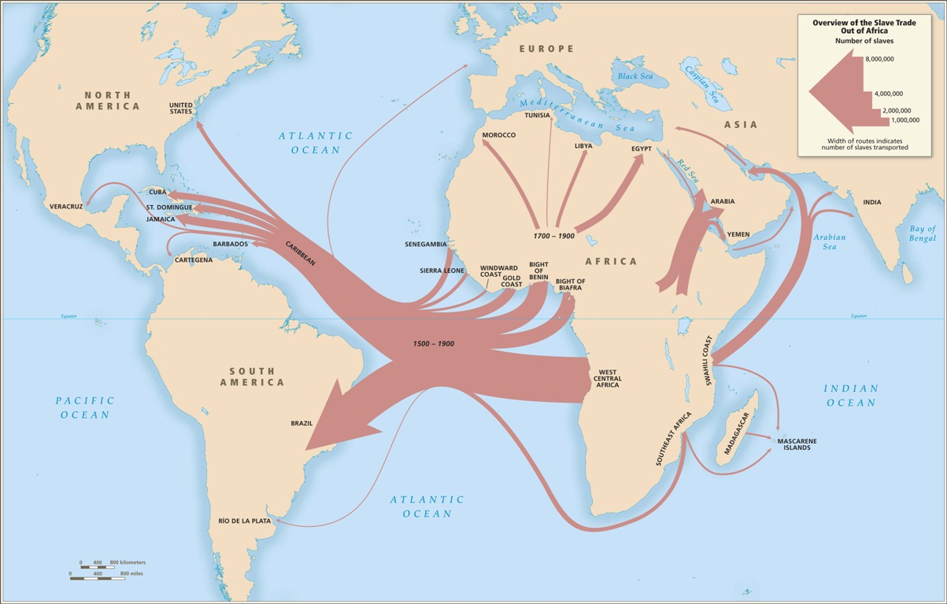

Slide 5
The Atlantic slave trade in numbers (1500-1900)
12.52M Africans embarked across Atlantic over whole period of slave trading (10.7M arrived)
Brazil and the Caribbean as a whole together received 80% of all slaves traded to Americas
The US received only 4%
Brazil and Cuba were responsible for most of the trade after 1807: over 2M to Brazil in the C19; over 700,000 to Cuba

Slide 6
Beyond the numbers: other approaches to the study of human movement
Atlantic world and African Diaspora as formed by links of culture, memory as well as by commodities production
Insights of the “spatial turn” in the humanities: analyse spaces and places as well as time
Space: a physical pre-existing entity
Place: social, a product of human interactions & power dynamics and by a FLOW of people through spaces over time

Slide 7
“Slaves” or “enslaved”?
Many historians today use “enslaved people” not “slaves” some/ all of the time
Recognises that no-one is born a slave; slaves are made
A political position, but so is “slave”
From 1820/ 1826, trade is ILLEGAL. Most people living as slaves in main trading areas of Americas after this (Brazil/ Cuba) are ILLEGALLY enslaved.
Some scholars use “enslaved” when discussing personhood and subjecthood and “slave” when discussing slaveholders’ perspective

Slide 8
Race or “race”?
Biologically speaking, “race” does not exist.
Many historians therefore choose to put “race” in quotation marks in their writing.
However, race has a very significant history as a SOCIAL CONSTRUCT.
consider race as a PROCESS: HOW ideas about race are CONSTRUCTED & vary across time & place: “race-making”
See PBS website: “Race: The Power of an Illusion”

Slide 9
Questions
What approach does each author/ source take towards the study of coerced migration? How effective do you think it is? What are its limitations?
What were the racializing and gendered effects of trafficking?
Is it possible to tell personal/ human histories of forced labour migration?
Does the history of the Atlantic trade look different if viewed through a global history lens? What contributions can scholars of the Atlantic “Middle Passage” offer to those working on forced migration at other places or times?
Did these readings change the way you thought about other “big” themes on this course – violence? Environmental history? Imperial history? Labour?

