Slide 1
Power, Agency and Historical change in historical materialism
Dr Claudia Stein

Slide 2
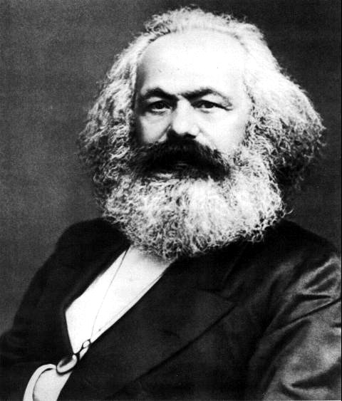
Marx work as a philosopher, political theorist, political economist, journalist and revolutionary socialist shaped the modern world.
Marx’ ‘historical materialism’ were not simply a theory of society and historical change. It also did change the world.
Karl Marx, 1818-1883

Slide 3
But Marx’s ideas about power, agency and historical change were not domineering in the 19th century

Slide 4
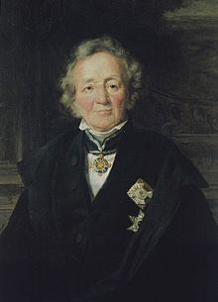
He was thinking with – and against – what he came to identify as ‘bourgeois’ history writing
Leopold von Rank, 1795-1886
Karl Marx, 1818-1883

Slide 5
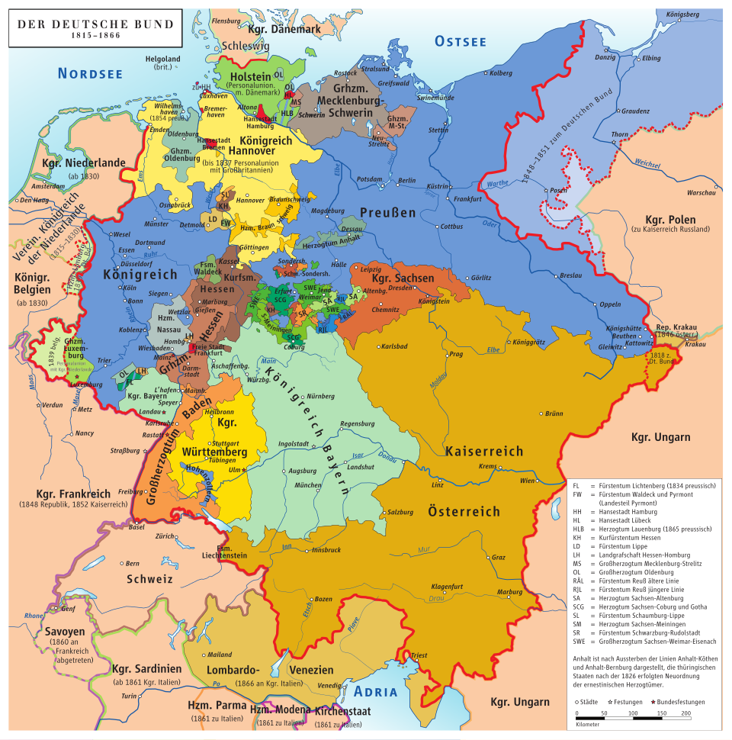
Wider political, social-cultural, economic context of the German-speaking lands until 1871 that shaped any German understanding of ‘history’
There was no single German political nation; instead, there was a collection of separate states with different rulers, laws, religions, and customs. Industrialisation – like in Britain is still relatively unknown in most German territories (takes off in the last 3rd of 19th century).
There was enthusiasms for Enlightenment ideas and the achievements of the French Revolution, particularly among the bourgoisie, but majority of German rulers and their subjects were hesitant to fully embrace ideologies of the French (fear of violence; war); reliance on the importance of religion and traditional political powers to provide peace and societal order (e.g. enlightened absolutism)
But: Sparked by economic hardship, mass poverty, and political discontent, there were a series of protests and rebellions across the German states demanding national unity, individual freedoms such as freedom of the press, and a unified German nation-state. While the initial phase saw rulers make concessions, including the formation of a national assembly, ‘the revolutions’ in the 1840s/50s ultimately failed as internal divisions between middle-class liberals and working-class radicals grew, and conservative forces reasserted control. (e.g. Restauration)

Slide 6
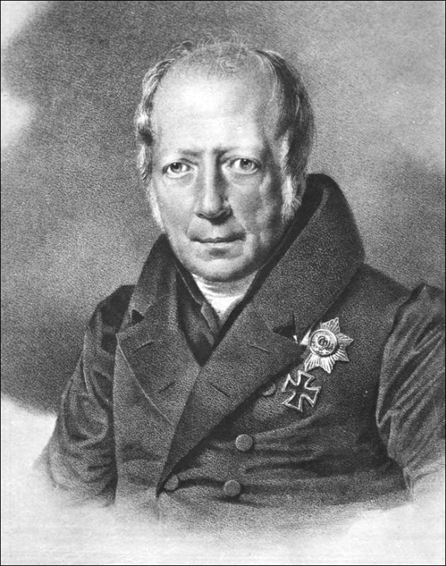
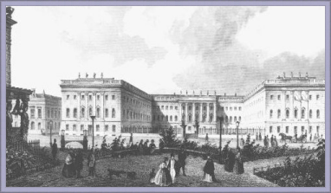
While German states lack modern political representation, they develop a world-famous education system ….particularly the kingdom of Prussia
The German states in the 19th century were world leaders in prestigious education and Prussia set the pace. The modern university system emerged from the 19th- century German universities, especially Friedrich Wilhelm University (now named Humboldt University of Berlin. It pioneered the model of the research university with well-defined career tracks for professors.
History writing when Marx appears on the scene…..
Humboldt University, Berlin (founded 1811)
Wilhelm von Humboldt (1767-1835); minister of education in Prussia
‘Bildung’: engl. ‘education’/’formation’ but has a much broader humanistic meaning
Humboldt believed that the university (and education in general, as in the Prussian education system) should enable students to become autonomous individuals and world citizens by developing their own reasoning powers in an environment of academic freedom. (e.g. Bildungsbürger und Weltbürger)

Slide 7
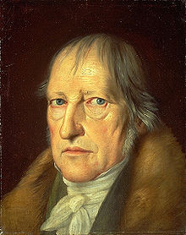
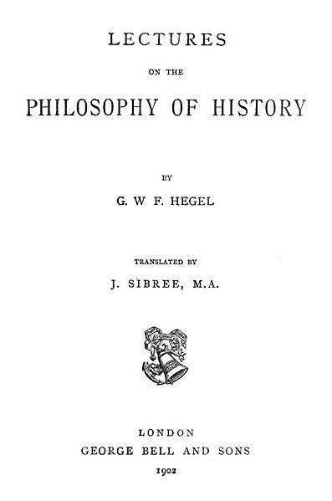
Fundamental intellectual influence on Ranke’s and Marx’
understanding of history
The philosophy of history by Hegel
Hegel’s calls his own project philosophical history. He maintains that with philosophical history the historian cannot be content with finding empirical expressions of past experiences (e.g. the archival sources).
His task is to find the overall sense and the hidden ideas that created and drove such empirical expressions (and the sources there of) in the first place.
The Geist (spirit) is similar to the unique society/culture of people at a time (involves every single human expression) and is constantly reworking itself to keep up with the changes within that culture/society. At the same time working to produce changes in the culture (moving history on towards its aim of ‘freedom’.
Closed to this understanding in English is the concept of ‘Zeitgeist’
Georg Friedrich Hegel (1770-1831)

Slide 8
The development of ‘the spirit’ moves progressive forward, aiming to achieve its own freedom
‘World history... represents the development of the spirit's consciousness of its own freedom and of the consequent realization of this freedom.’
Hegel, Lectures on the Philosophy of History, 1831)
Hegel maintains that the consciousness of freedom in history moves from despotism to a sense that freedom is a privilege of a few, those who are able to lead the whole of humanity to be free in and of itself.
Hegel’s philosophical history is a history of ‘thought’; inspired by the Enlightenment idea of ‘reasoning’ as the fundament capacity of human beings allowing ‘progress’. Human reason is the driver off humanities ‘progress’.
Note: Hegel believes that the spirit of human freedom is best nurtured within a constitutional monarchy in which the monarch embodies the spirit and desires of the governed.

Slide 9
What does Hegel mean by ‘consciousness’?
In G.W.F. Hegel's philosophy, consciousness (Bewusstsein) refers to the mind’s relational engagement with an external object or world that stands apart from it. It requires consciousness to grasp the ’reality’ of the world outside oneself.
Rather than a static state of awareness, consciousness for Hegel is a dynamic, developmental process. In The Phenomenology of Spirit, Hegel traces how consciousness tests its understanding of reality, runs into contradictions, and transforms into higher stages of consciousness, producing higher forms of knowledge of reality (reflected in a higher spirit).
Difference ‘mind’ and ‘brain’:
The brain is a physical, tangible organ inside your skull, while the mind is an abstract set of conscious and unconscious processes that arise from the brain's activity. It does not equal the brain’s physiological functioning.
Human consciousness moves ‘dialectically’

Slide 10
Dialectic method
How does ‘the spirit’ of a people in a particular historical epoch move from to the next stage of freedom? How does the periods overall ‘spirit’ becomes more free?
Hegel's dialectic is a philosophical method of development and reasoning that involves a process of thesis, antithesis, and synthesis.
An initial idea (thesis) generates a contradictory opposing idea (antithesis), and their tension is resolved in a higher, more complex concept (synthesis) that preserves aspects of both.
This cycle drives progress and understanding in history, thought and collective consciousness, moving from less sophisticated to more sophisticated forms of reasoning
Thesis: An initial concept, idea, or state of affairs at a particular moment in time (e.g as part of the spirit of an age)
Antithesis: The contradiction or opposing concept that arises from the thesis, highlighting its limitations or one-sidedness (e.g. the spirit of an age is questioned)
Synthesis (or Sublation): The resolution of the tension between the thesis and antithesis into a new, more comprehensive idea of spirit. This new concept "sublates" the previous stages, meaning it transcends them while also preserving their essential truths.

Slide 11
Synthesis is achieved by means of violence and war
In Hegel’s view the synthesis – the new stage of spirit of freedom – is reached through violent action (e.g. wars).

Slide 12
Hege’s ideas are central in 19th century German thinking about ‘history'
The so-called ‘father’ of modern history writing. He invents history’s ‘critical method’ (e.g. to base history writing on the empirical collection of sources and their critical analysis) and he turned history into a rigorous academic discipline, studied at research universities (first in Germany, then all over the world).
Early life and education:
Ranke is born in 1795 in Thuringia into a family with a strong Lutheran background. He studied theology and philology at the University of Leipzig but rejected a career as a protestant minister. He decided to become a school teacher and began to think about the nature of history writing and how it should be taught), while reading through the entire school library.
He is a a ‘man of his time’, a Romantic and strong believer in God’s power to govern human life in the present and past.
Leopold von Ranke (1795-1886)

Slide 13
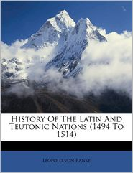
History is not an abstract philosophical idea (e.g. Hegel’s idea of progressive freedom of spirit)
Historians need facts, facts, facts…
‘The strict presentation of facts, no matter how condition and unattractive they might be is undoubtedly the supreme law of any historian.’
The book was a major success and earned him
a professorship at the world’s most prestigious university
of Berlin in 1824.
In Berlin he institutionalized history writing:
Set up lectures and seminars in which students and professors discuss their findings and analyse ‘historical facts – history as an academic research discipline
‘critical method’ becomes the method of all academic history writing
He invents ‘the footnote’ in history.
1824

Slide 14
Ranke’s history writing and its underlying assumptions...
The most famous sentence ever uttered about the purpose of academic history writing is also the most widely misunderstood in the English-speaking world!
… to such high office the present work does not presume; it seeks to only show the past ‘how it essentially was’ (German: ‘wie es eigentlich gewesen’)
(History of the Latin and Teutonic Peoples, 1824)
What Ranke means is: Historians do the humble job of empirically collecting the facts in the archive to then reconstruct what ‘essentially’ happened.
What does ‘essentially’ mean: he means ‘the essence’ of a historical epoque. He relies on Hegel’s idea of spirit but in his case it becomes religious

Slide 15
The unity of a historical period was for Ranke ultimately provided by God; human
agency and historical change derive from God’s will
As a Protestant he had a strong belief in Providence
‘Every epoch is immediate to God and its worth is not at all based on what derives from it but rests in its own existence, in its own self’
‘Every human being, something eternal, comes from God, and this is a vital principle.’
‘It is not necessary for us to prove at length that the eternal dwells in the individual. This is the religious foundation in which our efforts rest. We believe that there is nothing without God, and nothing lives except through God.’
For Ranke then follows:
never judge the past from one’s own standpoint but to grasp its uniqueness via divination or intuition
(because that is defying God’s will!)
there is no progress in history to a higher state of civilization in history because every historical period
is equal to God – fundamental difference to Marx

Slide 16
A warning! Ranke is probably the most misunderstood historian in the anglophone world
English-speaking world often understands Ranke’s ‘critical method’ simply as empiricist collection of facts. The objective historians collects them neutrally and objectively.
Why? Due to translation error of his famous motto:
‘… to such high office the present work does not presume; it seeks to only show the past ‘wie es eigentlich gewesen’
(History of the Latin and Teutonic Peoples, 1824)
‘Eigentlich’ continues to be translated as ‘really’ or ‘actually’ into English -- wrong
Ranke hopes to get at ‘the essential’ characteristics of an age, given by God, by collecting the facts first! To reduce him simply as an empiricist – as it is often done by English historians until today -- is not getting at his philosophical and religious aims.
Note: Theories of history ‘travel’ and change their meaning.

Slide 17
Marx reject such thinking about history and aims to develop
an own explanation of how society operates and changes
Throughout time
Marx work as a philosopher, political theorist, political economist, journalist and revolutionary socialist shaped the modern world.
Marx’ ‘historical materialism’ were not simply a theory of society and historical change. It also did change the world.
Karl Marx, 1818-1883

Slide 18
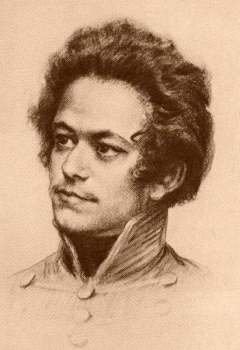
Marx’s Life
1818-35: childhood and early youth in a liberal bourgeois merchant family in Trier (assimilated Jewish family, he was raised in protestant faith. Exposed to Enlightenment, Romantic, liberal and radical world-views through family and acquaintances.
Engagement with Jenny von Westphalen who was older and of aristocratic background.
1835-36: University of Bonn. Heavy drinking, gambling, etc. – father intervenes to move him to Berlin.
1836-42: University of Berlin. Develops wide range of intellectual interests: jurisprudence, history, and especially philosophy. Involved in ‘Left-Hegelian’ circles.
1842-49: Cologne, Paris, Brussels, Paris, Cologne, Paris. Years of revolution and counter-revolution: for Marx, constant political exile and flight. Years of intense political agitation, radical political journalism (heavily censored). Marx begins studying political economy. Develops lifelong friendship with Friedrich Engels (son of wealthy manufacturer).
1849-1883: London.

Slide 19
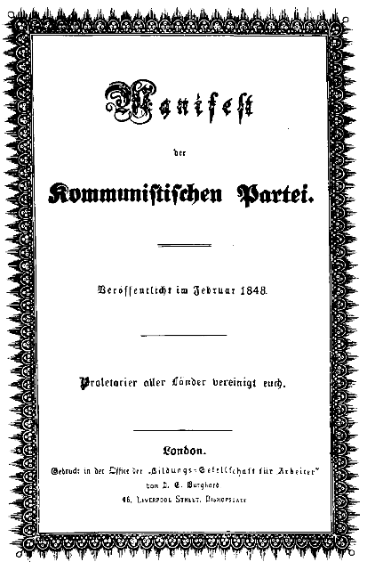
Marxism as an activist ideology
‘The philosophers have only interpreted the world in various ways; the point, however, is to change it.’
All previous historical movements were movements of minorities, or in the interest of minorities. The proletariat movement is the self-conscious, independent movement of the immense majority, in the interest of the immense majority

Slide 20
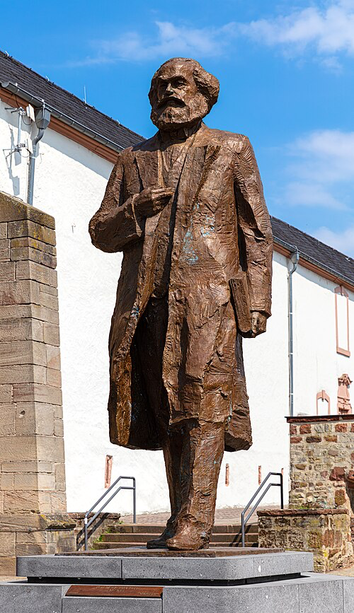
Is the admiration for Marx’s work over?
A new statue of Marx was unveiled on May 5, 2018, to mark the 200 anniversary of the Karl Marx’s birth in his hometown.
The work by sculptor Wu Weishan is a gift from the People’s Republic of China.
And his ideas about the causes of historical change continue to inspire, particularly in moments of crisis.
2015 ‘The Communist Manifesto’ was the bestselling book worldwide.

Slide 21
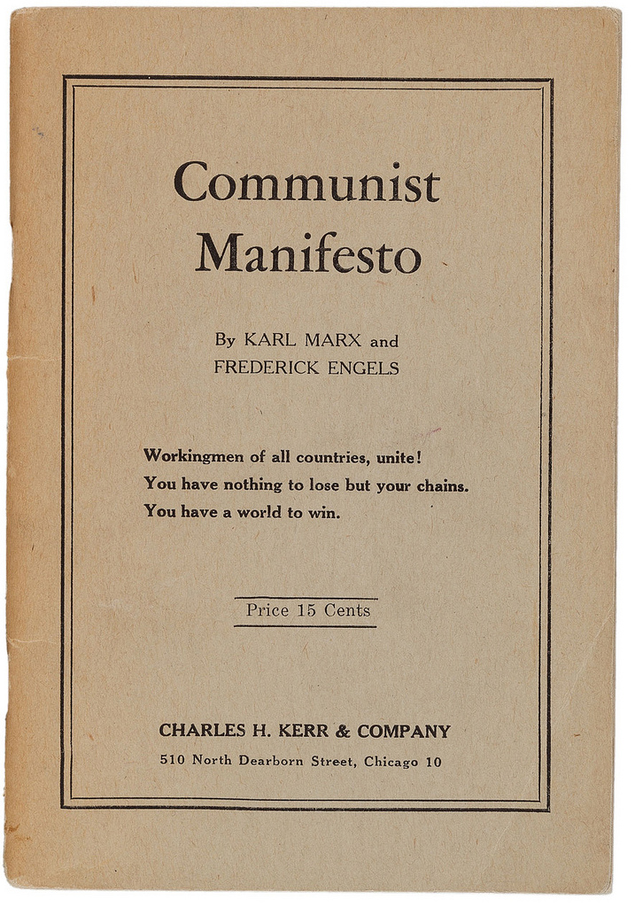
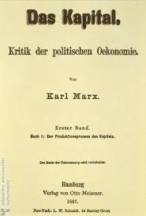
Most famous works
1848
Vol. 1-3
1867-1894

Slide 22
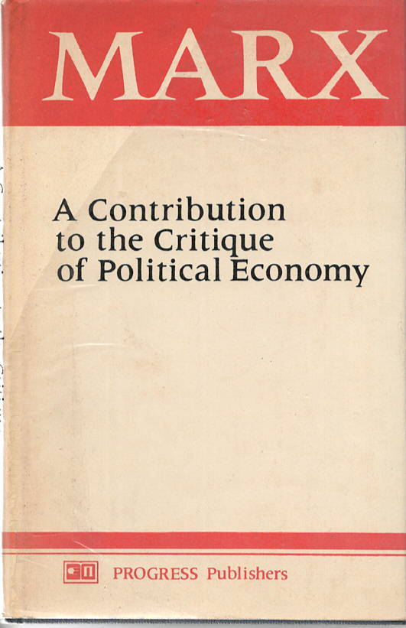
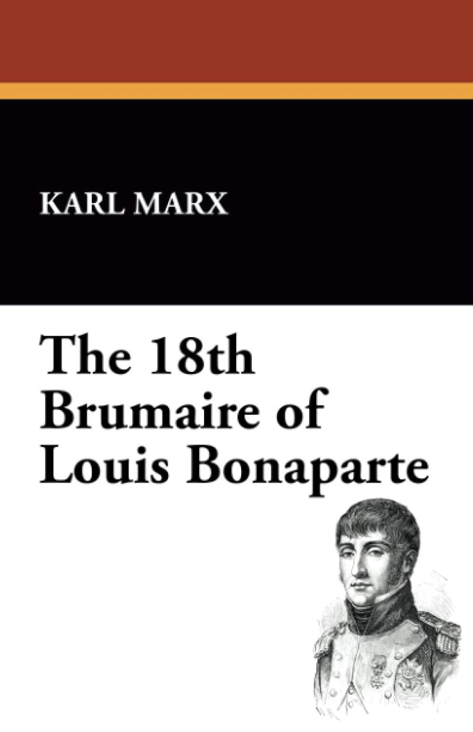
Karl Marx – influential works for historians
1844
1852

Slide 23
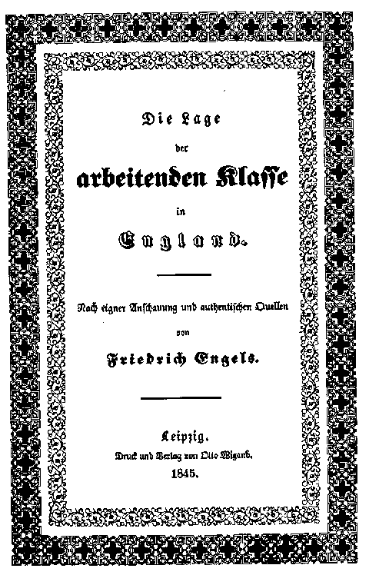
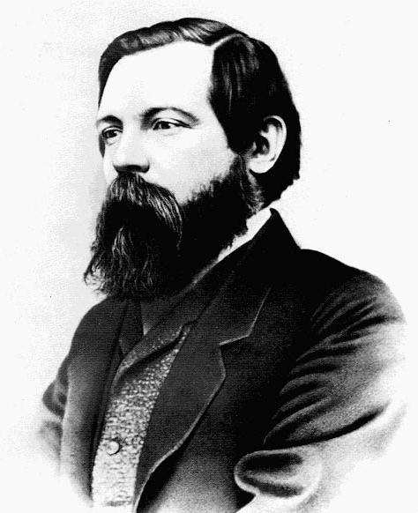
Marx has a lifelong
friendship and working
relationship with
Friedrich Engels
Engels edits and publishes most of Marx’s notes (e.g. 2nd, 3rd volume of the Capital)
Friedrich Engels
1820 – 1895

Slide 24
Progressive stages of societal development according to ‘historical materialism’
Communism
Classless society
Socialism
Dictatorship of the Proletariat
SOCIALIST REVOLUTION
Expropriation of Expropriators
Capitalism
Bourgeoisie against Proletariat
Feudalism
Feudal lords against Peasants
Slaveholder Society
Slaveholders against Slaves
Primitive Communism
Hunter-gatherer societies

Slide 25
What causes historical change in historical materialism?

Slide 26
Historical Materialism
(note: Marx never used the term himself!)
Historical materialism is Karl Marx's theory of history, which argues that economic conditions (the "mode of production") are the primary drivers of social, political, and intellectual change throughout history.
It posits that all societal institutions, from government and law to religion, family, and culture, are shaped by the underlying economic system and the resulting class struggles between those who own the means of production and those who do not.
Social change (and historical change) occur as contradictions within the mode of production lead to a new system, progressing history from one stage to the next. (Note: he follows Hegel’s dialectic here).

Slide 27
Superstructure:
Superstructure:
comprises the cultural, ideological, political, legal, and social institutions (like governmental agencies, culture, family, or religion, ideology, etc.) that are shaped and determined by the economic base (the mode of production and class relations). The superstructure's primary function is to reproduce and legitimize the interests of the ruling class by promoting ideologies that obscure class conflict and maintain the existing power structure.
Societies in each stage are organized from ‘the bottom up’. The ‘modes’ of production’ produce social reality of people (superstructure)
Relations of production: the social relationships that emerge between people during the process of production, distribution, and exchange of material wealth, fundamentally based on the owner-
ship or lack of owner-
ship of the
means of
production
Relations of Production
Forces of Production
Forces and means of production: These are the tools, technology, and raw materials society uses to produce goods, as well as the collective labour and knowledge of the labouring people.

Slide 28
The concept of class
Class "in itself": A group of people who share the same objective economic conditions and position in the production system (e.g., all factory workers), even if they do not yet realize it or act together
Class "for itself": The stage where workers recognize their shared exploitation, bond together, and develop an active political awareness to challenge the ruling class.
Class Consciousness -- False Consciousness
Before reaching true class consciousness, workers often suffer from false consciousness—a distorted view of reality where they fail to see their true position. The superstructure keeps them in such false consciousness.
Instead of seeing themselves as an exploited collective, they view themselves as isolated individuals or buy into ruling-class narratives (such as believing hard work alone guarantees upward mobility)

Slide 29
Human agency
‘Men make their own history! And all human ‘thinking’ is the outcome of their active real lives!’
‘The philosophers have only interpreted the world in various ways; the point, however, is to change it’
(Karl Marx's 11th and final note in his Thesis on Feuerbach, written in 1845 and published posthumously in 1888)
‘In direct contrast to German philosophy, which descends from heaven to earth, here we ascend from earth to heaven. That is to say, we do not set out from what men imagine, conceive, nor from men as narrated, thought of, in order to arrive to men in flesh. We set out from real, active men and on the basis of their real life process we demonstrate the development of the ideological reflexes and echoes of this life process.’ (German Ideology, p. 7)
Note: Marx does not consider capitalism to be outcome of some sort of essential human nature and the motivation of man in capitalism to be universal motivation of humanity (as many intellectuals of his time did, including those who came to believe in Darwinism which spread at his time).

Slide 30
Marx’s understanding of ’Man’ agency and historical change
What is man ? He uses the term ‘man’ (germ. Mensch); stands for mankind/humankind. For Marx, man (which includes all human beings) is born with an inner invisible potential which differs from its raw material (we might say today human biology), which, as such, cannot be changed.
Yet, humans do change in the course of history, Marx argues, they develop and transform themselves.
Since humans makes their own history, humans are their very own product.
History, is the history of man’s very own self-realization. All humans are born with this potential of self-realization.
They activate this inherent potential through their labor, work and production.
History is nothing but the self-creation of humans through the process of their labor.

Slide 31
Concept of Labor and Man’s Alienation
Labor is the self-expression of man, an expression of his individual physical and mental power.
In this process of genuine activity man develops himself, becomes himself; work is not only a means to an end – the product – but an end in itself, the meaningful expression of human energy; hence, work, should be fulfilling and help to actualize the potential of every single human.
Marx critiques of capitalism is not the injustice in the distribution of wealth; it is the perversion of labor into forced, meaningless labor, hence the transformation of man into a ‘crippled monstrocity’.
Alienation
Alienation (or estrangement) means that man does not experience himself as the acting agent in his grasp of the world but that the world (nature, others, and he himself) remain alien to himself. They stand above and against him as objects, even through they may be objects of his own creation (e.g. invented concepts)
Alienation mean that man essentially experiences the world and himself passively, receptively; he is not in control of his world.
To be in an alienated state allows no grows, not development.
In his alienated state humans don’t t make his own history; it s made for them

Slide 32
Alienation in capitalism
Marx viewed man not as an isolated or fixed biological creature, but as a "species-being" (Gattungswesen) whose nature is fundamentally social, cooperative, and shaped through active labor
As private property and division of labor develop in capitalism (machinery, industries but also AI) , labor loses its character of being an inner expression of man’s potential.
Labor and its products assume an existence separate from man, his will and his planning.
Labor is alienated because the work has ceased to be a part of the worker’s nature.
Consequently, he does not fulfill himself in his work but denies himself, has a feeling of misery rather than well-being, does not develop freely his mental and physical energies but is physically exhausted and mentally debased. The worker therefore feels himself at home only during his leisure time, whereas at work he feels homeless.
        The superstructure is organized so to create ‘false consciousness’ in people, so that they alienate themselves without being asked to do so.

Slide 33
The aim of socialism (and communism)
Marx looked at socialism as the condition of human freedom and creativity, not as in itself
the goal of man’s life.
It is the first real emergence, the genuine actualization of man’s nature as something real. Socialism
or communism is a society which permits the actualization of man’s inherent essence, by overcoming
his alienation. It is nothing less than creating the conditions for the truly free, rational, active and
independent man.
It is a society that serves the needs of man.
Question: Well, doesn’t modern capitalism serve our needs?
Aren’t big cooperation serving our needs (e.g. consumption)? Aren’t political elites endlessly trying to find out what our needs are, to understand us, and serve our needs? Or does religion serves our real needs?
Well, no, Marx would argue
Marx believed in true needs of humans and artificially produced needs of man (as capitalism does). Capitalism makes humans forget their true needs.

Slide 34
Some thoughts
Try to use Marx’s historical materialism to our current situation
Forces of production? Relation of production? Superstructure? Class?
Where does ‘alientation’ can be found in the current system?
Where do you detect ‘false consciousness’ in your daily life?
Is ’labor’ the key to becoming fully human today? Can ‘labor’ be ever meaningful in capitalism? What about
the disappearance of ‘labor’ today?
Where does education and university study fit into the overall structure of historical materialism? Is education a form of producing ‘false consciousness’?

Slide 35
The end

