Slide 1
Theory, Skills and Methods
Theory and Historical Practice in Anglo-American History Writing post WWII
Dr Claudia Stein

Slide 2
Some general ‘facts’ about English-speaking history writing and its relation to ‘theory’
Tends to emphasise empirical dimension of history (in contrast to French, Italian or French history writing traditions)
    Note: ‘Empiricism’ is itself a theory! It is a philosophy of knowledge which holds that true knowledge or justification comes either only or primarily from sensory experience or empirical evidence. Founded in the 17th century (e.g. Bacon, Locke, Hume).
‘Historians are magpies’ (Maxine Berg); they tend not to produce own ‘theories’
but ‘steal’ theories from neighboring disciplines (e.g. sociology, political science,
anthropology, philosophy, linguistics); currently they also turn to the natural sciences,
particularly life sciences (e.g. evolutionary psychology, epigenetics, geography) and
environmental sciences to make ‘meaning’ of their sources.

Slide 3
Difference between historical method and theory
Historical method is the practical set of rules and techniques used to gather and evaluate evidence. How to? the so-called critical historical method was invented by German Leopold von Ranke (1795 – 1886), the founder of modern source-based history writing.
    Empirical collection of materials
    Involves external criticism (verifying if a document is authentic, dating it, checking authorship) and internal criticism (evaluating the credibility and bias of the content (source criticism).
    organizing data, and synthesizing facts into a chronological or narrative account
Historical theory provides the overarching conceptual framework that explains how and why history unfolds or shapes how we interpret that evidence. The intellectual lens, assumptions, or overarching idea about the nature of historical knowledge and human change
    Explores ideas like causation, determinism, progress, objectivity, agency, power, and whether history follows broad social laws or structural patterns (concepts)
    Deals with the meaning behind the facts and the epistemological question of how we can truly know or represent past minds and societies.

Slide 4
Two meanings of ‘historiography’
Historiography is the study of the methods/theories used by historians in developing history as an academic discipline. That is what we are doing in this module!
The term historiography is also used for any body of historical work on a particular subject

Slide 5
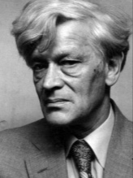
Postwar II theoretical developments in English-speaking history writing
The ‘new’ social History or ‘history’ from below
‘I am trying to rescue the poor stockinger, the Luddite cropper, the “obsolete” hand-loom weaver, the “utopian” artisan, and even the deluded follower of Joanna Southcott, from the enormous condescension of posterity...(p.13)
Emerges outside of academic history writing in left-wing, neo-Marxist circles.
Reaction against tradition history writing but also against traditional Marxist historiography at the time(e.g. numbers and statistics as main ‘methodological approach’).
Edward Palmer Thompson (1924-1993)
Central is the increasing focus on individual and collective ‘experiences’ of those who traditional history had not
considered

Slide 6
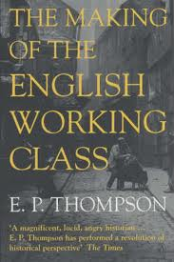
The Making of the English Working Class (1963)
Inspired a whole range of new kind of histories: 2nd wave feminist historiography,
subaltern history, history of race
All these new trends were deeply committed to neo-Marxist approaches in
the 1960s and 1970s.

Slide 7
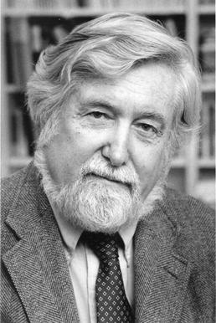
The Anthropological and Cultural ‘Turn’ during 1980s from the US
The Interpretation of Culture (1973) – symbolic anthropology
Geertz sought to separate off anthropology from its influences from functional sociology (structural and institutional agenda). He comes to define ‘culture’ as a ‘semiotic concept’ whose analysis is not ‘an experimental science in search of law but an interpretive one in search of meaning.’ (Thick Description, 1973, p. 5).
‘.......historically transmitted pattern of meanings embodied in symbols, a system of inherited conceptions expressed in symbolic forms by means of which men communicate, perpetuate, and develop their knowledge about and their attitudes towards life’.
Method of ‘thick description’: a thick description results from a scientific observation of any particular human behaviour that describes not just the behaviour, but its context as well, so that the behaviour can be better understood by an outsider. The anthropologists needs to consider his/her own biases.
Clifford Geertz, 1926-2006
Note: anthropology is never concerned with the past! It works in the present (synchronically)

Slide 8
The ‘anthropological turn’ opens up new ways of thinking about the past for historian who
Had been committed to the ’new’ social history...
The early modern French historian Nathalie Zemon Davis on her discovery of symbolic anthropology for her study of early modern French history in the early 1970s.
‘I could consider the social and cognitive meanings of symbolic and ritual forms of behaviour, which earlier I had accounted for only in terms of groups solidarity….(she used to work with neo-Marxist theories and methodologies)
Now I could look at the non-literature with more discernment…and take more serious the techniques and endowments of oral culture, such as proverbs and memory devices. I began to doubt my earlier commitment to a single ‘progressive’ trajectory towards the future…’
(Davis, 1997, 14).
Nathalie Zemon Davis, 1928-2023
Key development: The concept of ‘society’ disappears in history writing and is replaced by the concept of ‘culture’.

Slide 9
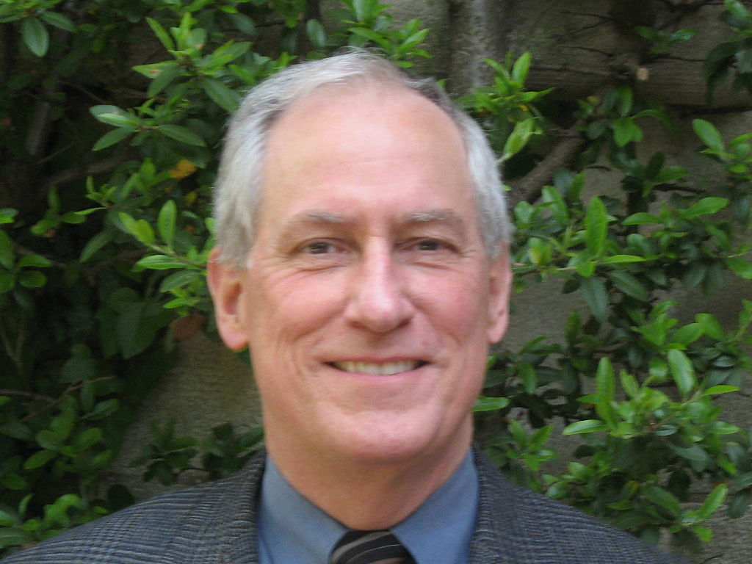
The anthropological turn coincides with’ the literary turn’ and the new enthusiasm of historians for literary sources and literary styles of writing
Famous example:
The Great Cat Massacre and Other Episodes in French Cultural History (1984)
‘When we cannot get a joke, or a ritual, or a poem, we know we are on to something. By picking at the document where it is most opaque, we may be able to unravel an alien system of meaning.”’
The role of ‘difference’, ‘desire’ and ‘surprise’ becomes central for understanding the past; claim: like other non-European cultures in the present, past European societies are to be understood as ‘foreign lands’, cultures which share nothing with the culture of the ‘observer’ – the historian.
Robert Choate Darnton (1939-)

Slide 10
The Past is ‘the Other’: No links between the Historian and the Past?
‘…other people are other. They do not think the way we do. And if we want to understand their way of thinking, we should set out with the idea of capturing otherness. […] nothing is easier than to slip into the comfortable assumption that Europeans thought and felt two centuries ago just as we do today – allowing for the wigs and wooden shoes. We constantly need to be shaken out of a false sense of familiarity with the past, to be administered doses of culture shock.’ (Robert, Darnton)
Key claim: To understand and accept something as ‘difference’ makes you question your own culture and opens up ways into a ‘different’ future. It makes you aware of your biases.
Some consequences to be considered: during ‘the cultural turn’ the term ‘society’ gets lost in history writing and with it, Marxist notions of power and conceptions of historical change (e.g. revolutions); cultural history writing tends to be ‘descriptive’ (thick description) and synchronic (focussed on a moment in time);
Problem: how to explain historical ‘change’ and ‘transformation’ through time (diachronic approach)

Slide 11
The new social history and the new cultural history also engage with a theoretical development that is rooted much earlier philosophical movements (end 19th century/early 20th century). But these only inspires English-speaking historians from the 1980s/1990
The Linguistic Turn
A key 20th-century development in Western philosophy/linguistics that shifted the focus of philosophical inquiry from studying the mind or reality directly to analysing the language used to describe them. Instead of treating language as a transparent medium for thoughts, philosophers argued that language actively shapes, constructs, and limits our understanding of reality and philosophical problems.
Term is first used by the American analytical (then pragmatic) philosopher Richard Rorty in his The Linguistic Turn (1967)
‘…a catch-all phrase for divergent critiques of established historical paradigms, narratives, and chronology, encompassing not only poststructuralist linguistic criticism, linguistic theory, and philosophy but also cultural and symbolic anthropology, new historicism and gender history.’
Kathleen Canning, ‘Feminist History after the Linguistic Turn: Historicising Discourse and Experience’, Sign 19 (1994), 417.

Slide 12
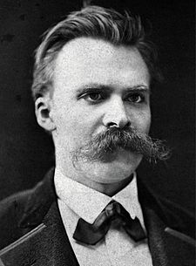
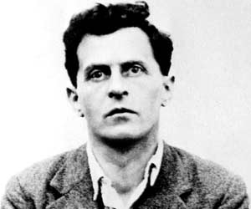
Inspirations for philosophers of language in the 1960s/70
Ludwig Wittgenstein (1889-1951)
Friedrich Nietzsche (1844-1900)

Slide 13
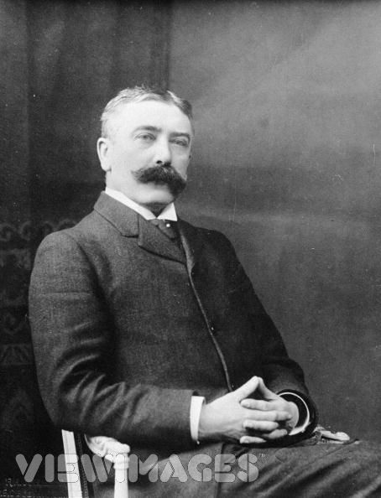
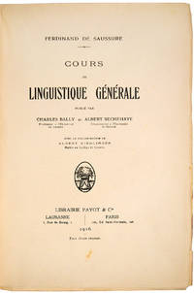
Most important inspiration for them is modern linguistics
Claim: A word is a sign (signified/
signifier)
Language is an arbitrary and
historical system signs;
Cours de linguistique générale (1916)
Linguistics: scientific study of language in broadly three aspects: language form, language meaning, and language in context
Ferdinand de Saussure, 1857-1913

Slide 14
Central claims of ‘linguistic turn’ enthusiasts:
Reality is NOT representable in any form of human culture (whether written, spoken, visual or dramatic)
Because ‘reality’ is not representable in any form, no authoritative account can exist of anything.
Nobody can make claim of possessing a ‘universal’ truth of anything. There is never a single single authority on a given subject of knowledge (this includes claims made in the natural sciences because they also use linguistic systems!)
Language is a nothing but a representation of ‘reality’

Slide 15
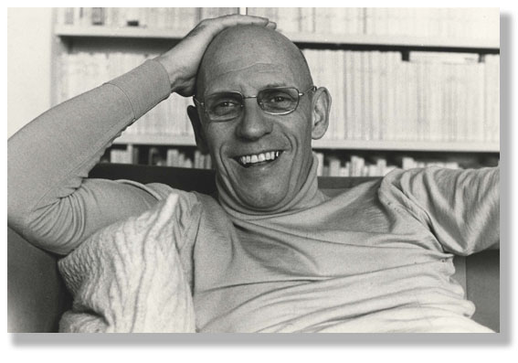
Probably the most important thinker of ‘the linguistic turn’ for historians was a French philosopher. His work, written in the 1960 to early 1980s, only ‘hits’ English-speaking historians from the 1990s and is central to what comes to be called ‘poststructuralism’. He changes historians thinking about knowledge/power forever!
A critical ‘history of the present’
‘Real criticism consists in … showing that things are not as obvious as people believe, making it so that what is taken for granted is no longer taken for granted.
To practise criticism is to make harder those acts which are now too easy... [A]s soon as people begin to no longer be able to think things the way they have been thinking, then, transformation becomes at the same time very urgent, very difficult and entirely possible.’
Michel Foucault 1926-1984

Slide 16
Let’s do some theoretical thinking about history!

Slide 17
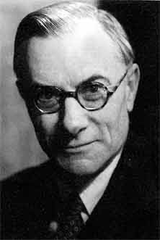
‘History consists of a corpus ascertained facts. The facts are available to the historian in documents, inscriptions and so on, like fish in the fishmonger's slab. The historian collects them, takes them home, and cooks and serves them in whatever style appeals to him.’
‘The facts are really not at all like fish on the fishmonger’s slab. They are like fish swimming about in a vast and sometimes inaccessible ocean; and what the historian catches will depend, partly on chance, but mainly on what part of the ocean he chooses to fish in and what tackle he chooses to use – these two factors being, of course, determined by the kind of fish he wants to catch. By and large, the historian will get the kind of facts he wants.’
‘History writing is a continuous process of interaction between the historian and his facts, an unending dialogue between the present and the past.”
‘History writing is a continuous process of interaction between the historian and his facts, an unending dialogue between the present and the past.’
Edward Hallett Carr (1892 – 1982)
What is history is based on his series of G.M. Trevelyan lectures, delivered at the University of Cambridge from January to March 1961.

Slide 18
‘Study the historian before you begin to study the facts.’

