Slide 1
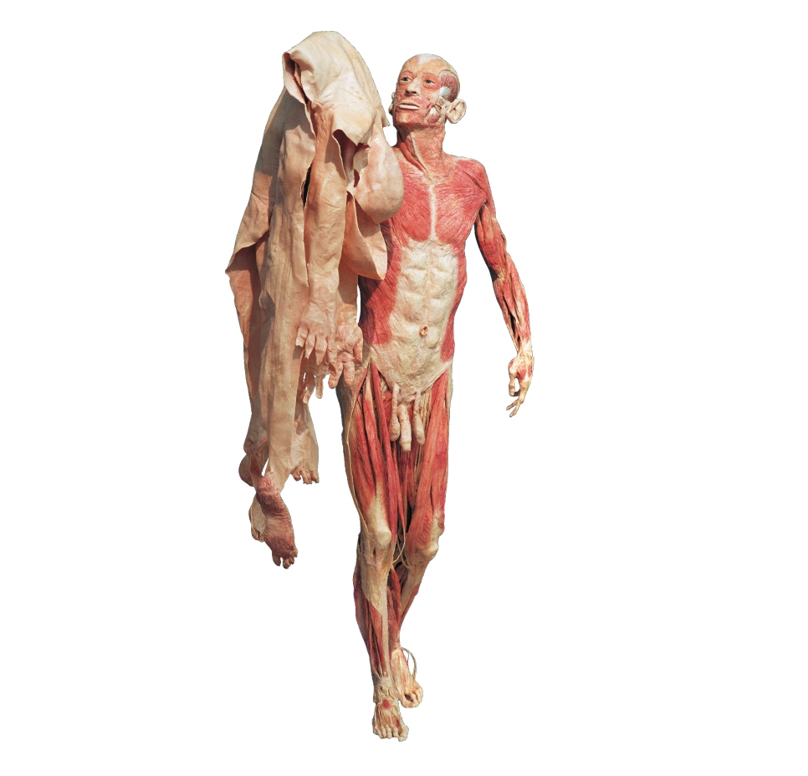
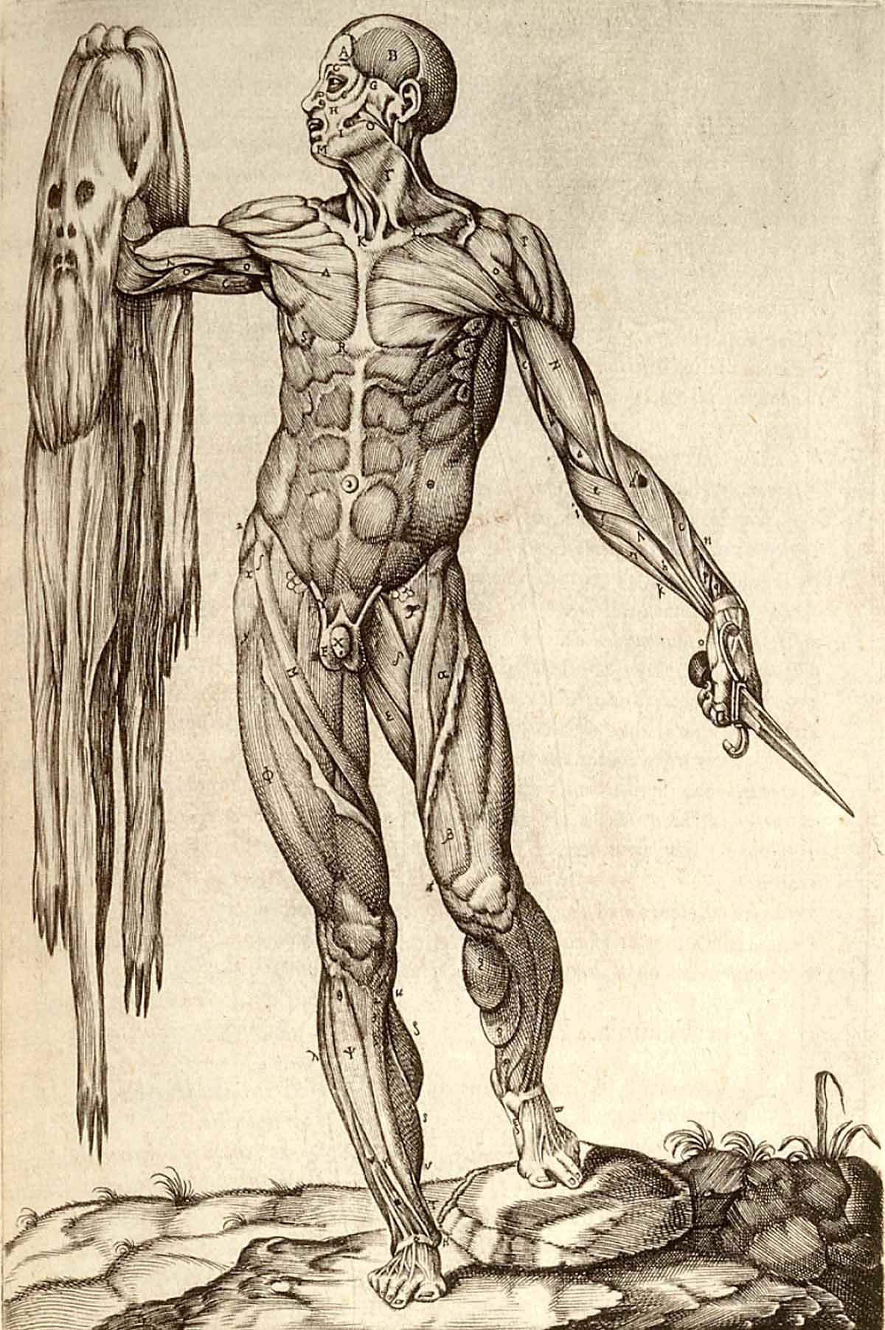
The Rise of ‘Experience’ in the Making of Medical Knowledge
Gunther von Hagen, Body Worlds,
http://www.bodyworlds.com/en.html

Slide 2
The role of ‘experience’ in the making medical knowledge
The production of medical/scientific knowledge today is based on what we call scientific ‘empiricism’.
Def. Empiricism argues that all knowledge of the body (and nature in general) is rooted in the senses and the experience that they provide.
Empiricism is a philosophy of knowledge that was first proposed in the 16th century and really took off during the 17th century.

Slide 3
But what about medical/scientific knowledge before the rise of sense experience based on empiricism?
For thousand of years physicians had no need for it because their knowledge was based on a radically different natural philosophy.

Slide 4
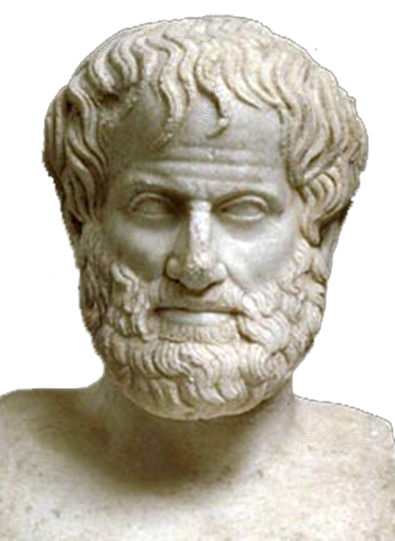
A philosopher who dominates the understanding of knowledge about the natural world for thousands of years....
Some of his writings:
On the heavens
On sleep and sleeplessness
On animals
On the soul
Virtues and vices
Meteorology
Metaphysics
On Longlivity and Shortness of Life
Poetics
Generation and Corruption
And many, many more …
Note: Aristotle’s writings were ‘christianised’ throughout the centuries and came to represent the world of the Christian God
Aristotle, 384 BC – 322 BC

Slide 5
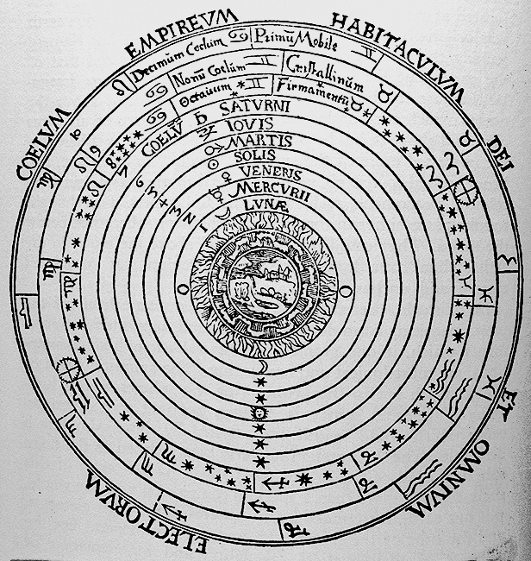
Aristotle’s cosmos in a Christian world
By the 13th century Aristotle’s
ideas about the natural world were aligned with the Bible by
Christian natural philosophers

Slide 6
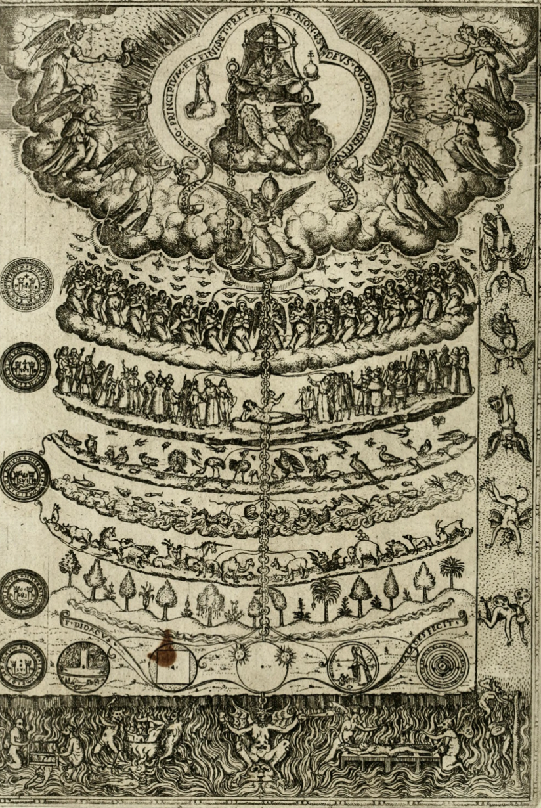
The Great Chain of Being
In the ‘Great Chain of Being’
the Aristotelian natural world and Christian spiritual worlds were intertwined
We today see them as separate but
for contemporaries they were one single
World.

Slide 7
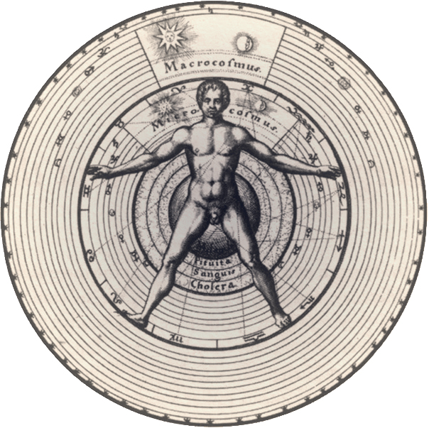
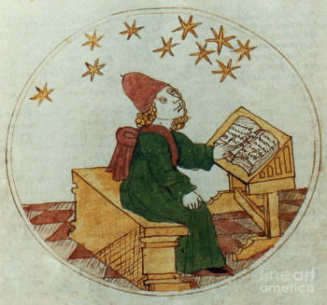
The human body was known as the microcosm. Everything in the body was mirrored within the wider macrocosm of God’s created world
This is why astrology was a central task of all academic physicians.

Slide 8
Natural philosophy and Medicine
Those who investigate nature, the cosmos and the human body called themselves ‘natural philosophers’ (all academic physicians are also always trained as natural philosophers)
Def. Natural philosophy
A category also known as ‘physics’. It refers to systematic
knowledge of all aspects of the physical world, including
living things (based on Aristotle’s philosophy).
As the natural world was understood as God’s creation, all natural philosophy was therefore understood as a theological enterprise. It was about understanding God’s world.
Natural philosopher understood their job to a form of worship.
Natural philosophers are not scientists! Their aim was to re-discover the all the knowledge of the lost world of Paradise and bring back human knowledge lost through the Fall.

Slide 9
How to investigate nature and the human body around 1500?
What do natural philosophers do? They do not question God’s creation!
Collecting and cataloguing the wonders of God’s creation – all the things humans
forgot due to the Fall
Explaining why things were the way they were
They they were not about ‘discoveries’ but they tried to answer the question: Why did
God make things the way they are? And how do we as humans (and sinners) can gain
back some of God’s knowledge?

Slide 10
The role of sense ‘Experience’ for an Aristotelian natural philosopher:
Thinking about nature starts from sense experience, they agreed.
However, that is not the knowledge natural philosophers are after:
They aim to achieve ‘universally’ true knowledge.
Their aim is to discuss why things are the way they are! The way God had made the world and the human body.
Practical knowledge, based on sense experience, was therefore not true knowledge, they believed.
In this thinking there is no room for ‘novelty’ or ‘discoveries’ (as we
celebrate in modern science)

Slide 11
Due to their way (style) of thinking, their endeavor was called:
Scholasticism; scholastic: Scholasticism is a term applied to the intellectual and academic style of the medieval universities, a style stressing debate, disputation, and the effective use of canonical texts (such as those of Aristotle) in the making of arguments. A ‘scholastic’ is a practitioner of that style of thinking.
Syllogism: The central technical device in formal logic in the universities of the
Middle Ages and early modern period, derived from Aristotle’s writings on
logic, and consisting of a ‘major premises’ (all As are B), a ‘minor premise’ (C is A),
And a ‘conclusion’ (therefore C is B)
Example:
a. All men are mortal (major premises)
b. Socrates is a man (minor premises)
c. Therefore Socrates is mortal (conclusion)
The method is ‘deductive’ – they move from what they know as truth to why it is the way it is. (God is truth – and why is it so?) – our own thinking is ‘inductive’ and moves the other way round!
The method is ‘deductive’ – they move from what they know as truth to why it is the way it is. (God is truth – and why is it so?)
They follow a particular logic called syllogism - This takes the form of a logical deductive structure derived from incontestable basic statements or ‘premises’. It is derived from Aristotle’s writings on logic - consisting of a ‘major premises’ (all As are B), a ‘minor premise’ (C is A), and a ‘conclusion’ (therefore C is B)/
Example: All men are mortal, Socrates is a man, therefore Socrates is mortal.

Slide 12
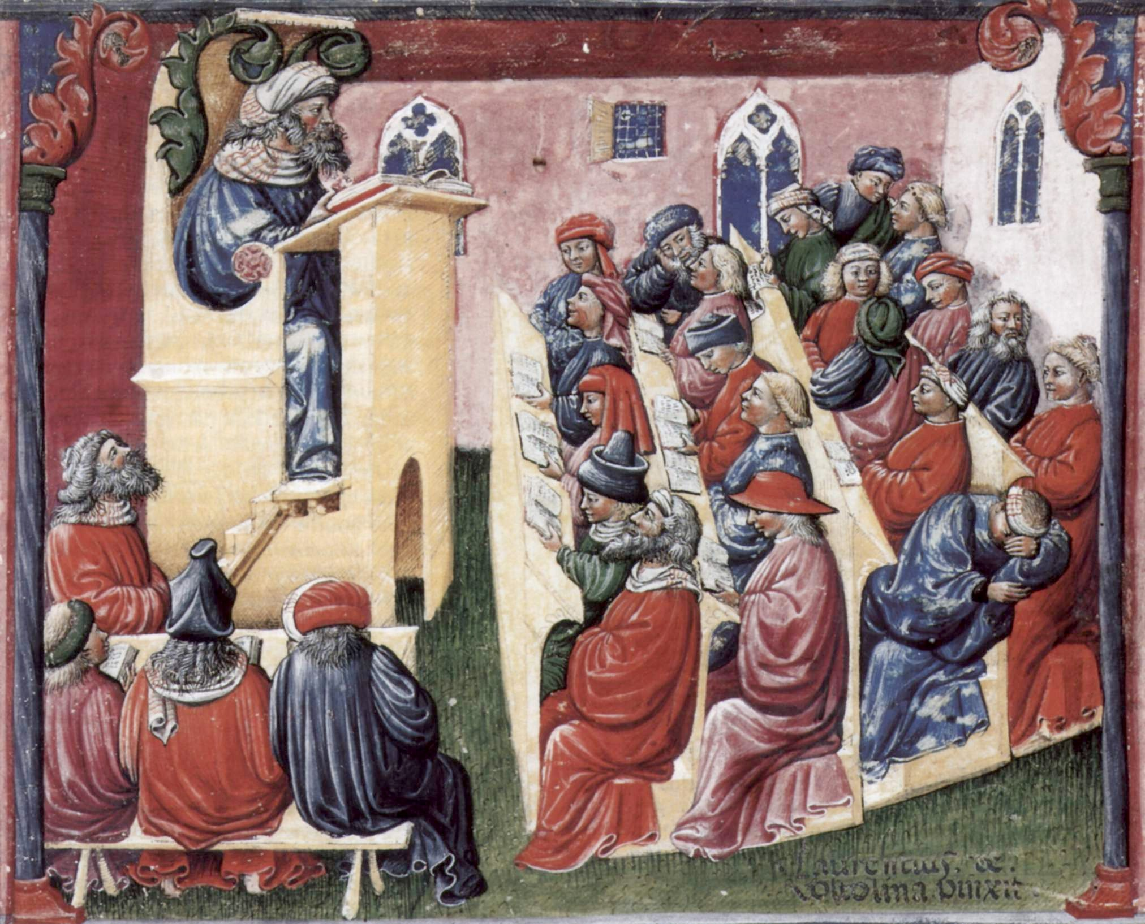
How to learn medicine
1. Academic medicine
The highest form of
gaining knowledge
Production of knowledge is based on the interpretation of ancient texts; personal sensual experience is not valued as important in the production of academic medical knowledge; physicians are masters of texts

Slide 13
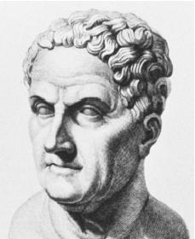
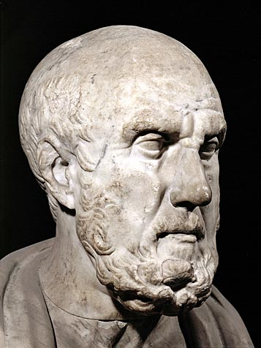
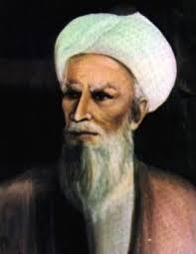
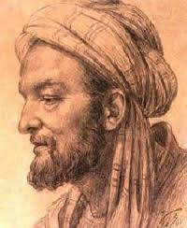
A celebration of classical knowledge
Hippocrates of Cos, c. 460 – c. 370 BC
Galen of Pergamon, 130 AD – 200 AD
Avicenna (Latinate form of Ibn-Sīnā),
c. 980 AD – 1037 AD
Rhazes, 854 AD – 925 AD

Slide 14
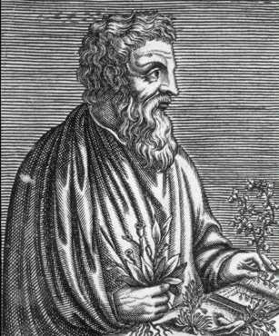
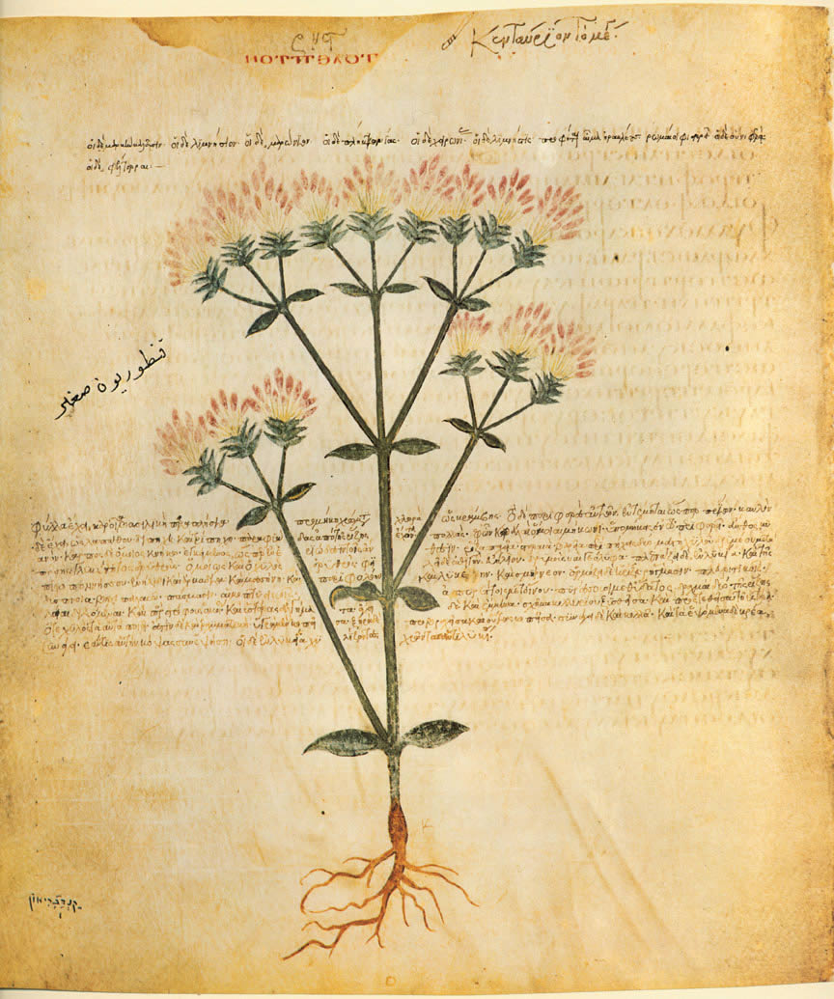
Botanical knowledge
materia medica: something from which medical
remedies can be prepared
De materia medica, 5 vols.
Dioscorides, 40 AD - 90 AD

Slide 15
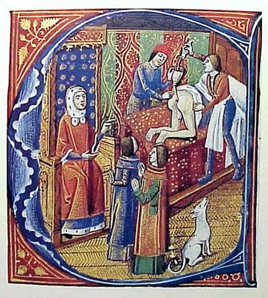
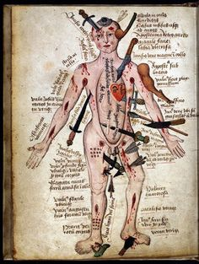
2. Non-academic medicine
BUT practical knowledge is considered ‘lower’, or
less ‘noble’ knowledge because it deals with practical
ends'
Surgical texts

Slide 16
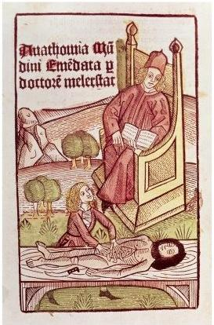
The rise of practical knowledge in medicine
Mondino de’ Luzzi, also called Mondino, ca.1270-1326
Anathomia corporis humani, 1316
His way of describing body parts becomes hegemonic for two centuries:
One begins those of the abdominal cavity
then proceeds via the thorax to the head and extremities
Anatomy was taught from books; the practical work
was done by a surgeon; however anatomy was
practice at universities

Slide 17
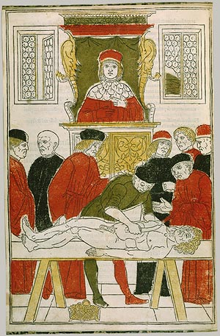
Teaching of anatomy before the 16th century
Joannes von Ketham, 1493

Slide 18
Important for the rise of ‘practice’ in anatomy i16th/16th century:
Humanism
Humanism: a cultural movement originating in Italy in the late fourteenth Century and the fifteenth century. It consisted of a reverence for and close study of the writings
of Greek and Roman antiquity and promoted attempts at the emulation of ancient
cultural achievements.
The rise of Galen as a medical ‘superstar’ of 15th and 16th century medicine:
Physicians aim to ‘re-discover his anatomical practice
Thomas Linacre (1460-1524) translates Galen’s On the Natural Faculties (1523)
Johannes Guinter of Andernach (1487-1574), professor in Paris, translated the newly
discovered and most important text of Galen, On Anatomical Procedures, 1531. Vesalius was one of his students and admired his work

Slide 19
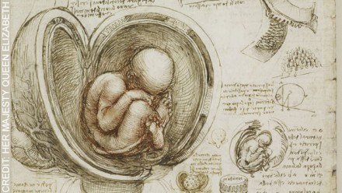
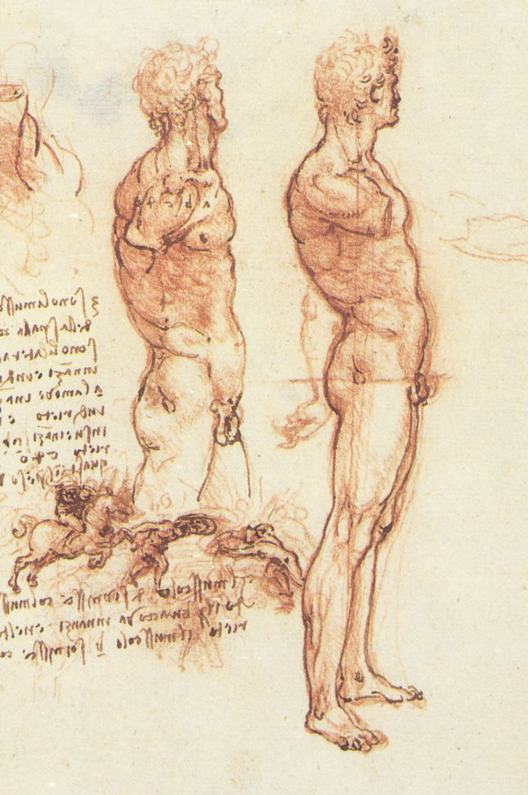
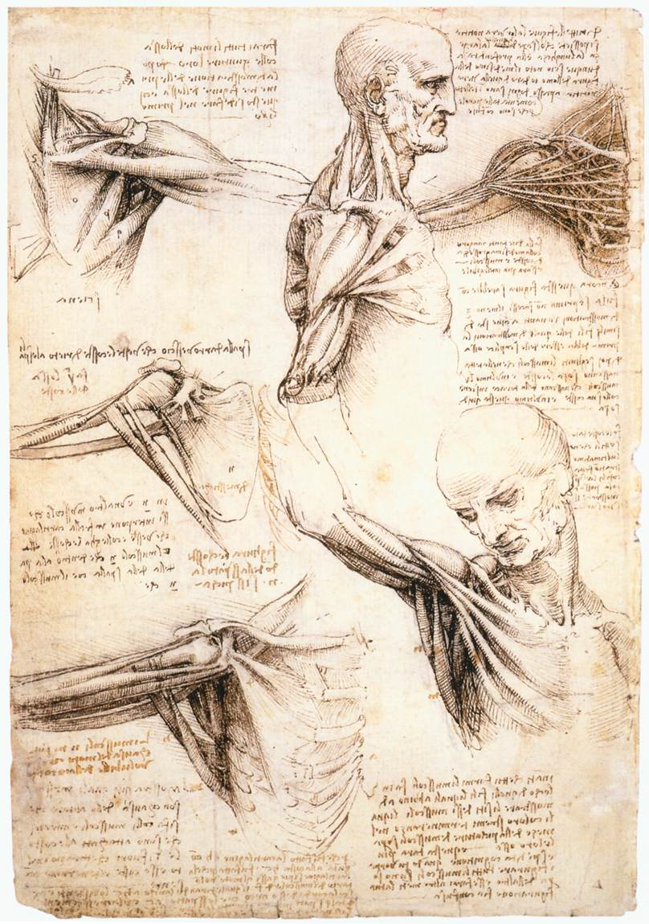
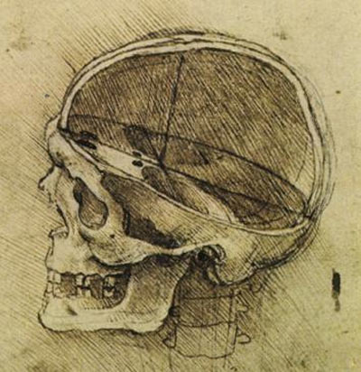
Leonardo da Vinci, 1452-1519
The rise of ‘naturalistic’ representation of human bodies in art

Slide 20
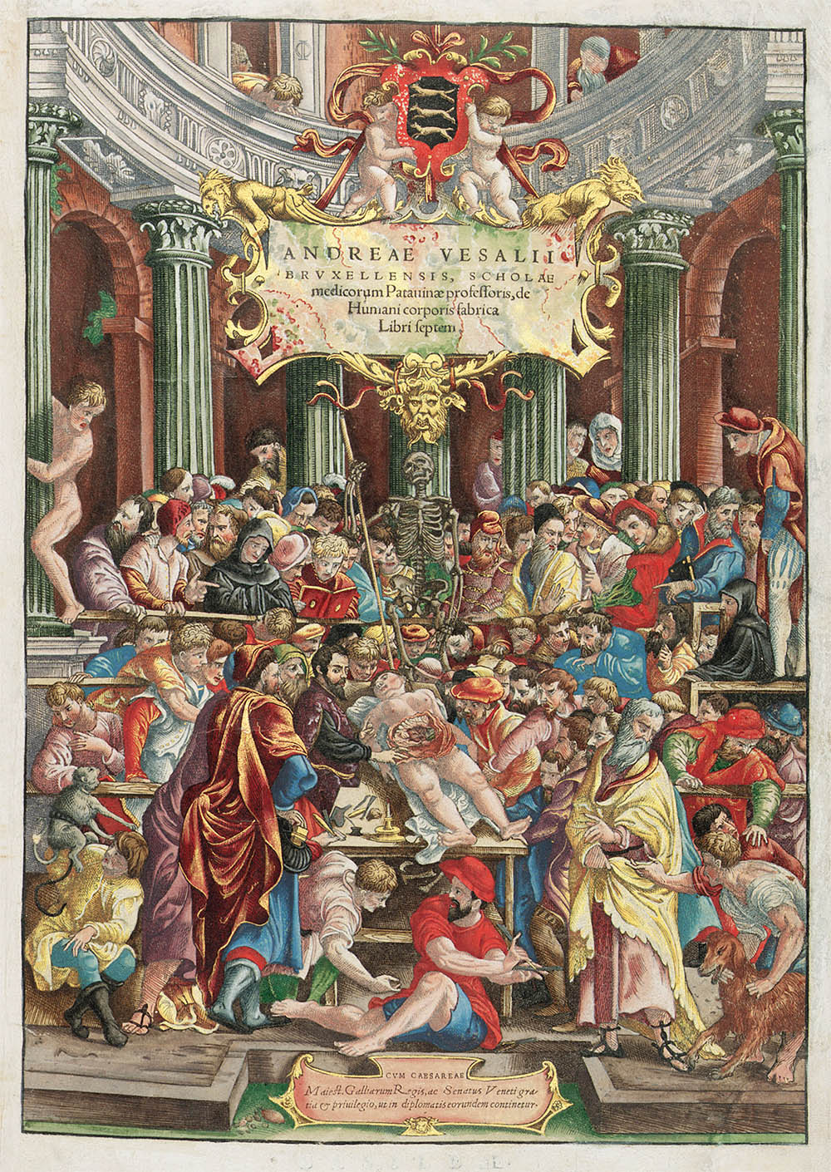
Vesalius brings two forms of experience together: knowledge of the ancient physicians and practical experience of dissections
‘I decided that this branch of natural philosophy ought to be recalled from the region of the dead. If it does not attain a fuller development among us then ever before or elsewhere among the early professors of dissection, at least it may reach such a point that one can assert without shame that the present science of anatomy is comparable to that of the ancients, and that in our age noting has been so degraded and then wholly restored as anatomy.’
(De Fabrica, Preface, in Dear, p. 38)

Slide 21
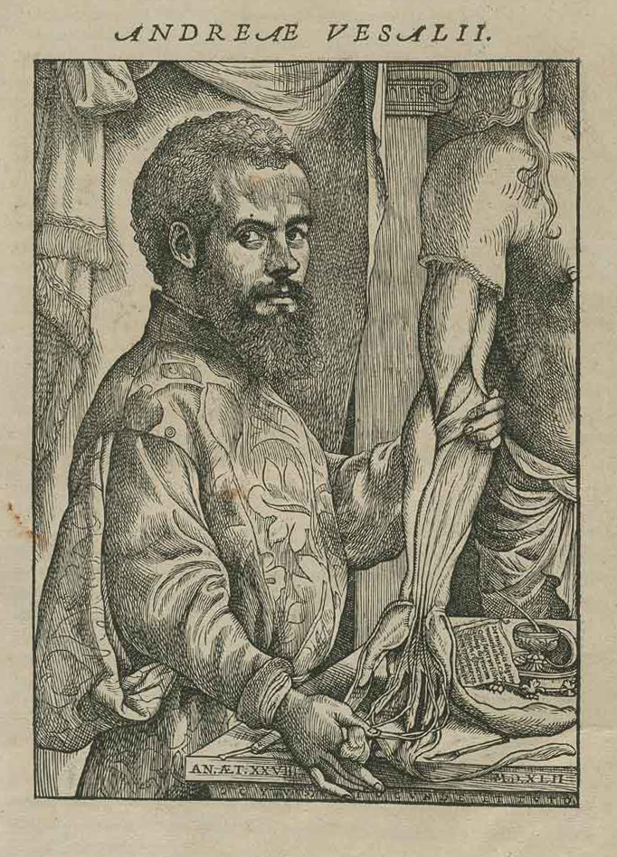
Vesalius aims to ‘purify’ medicine
and bring back Galen’s ‘true’ medicine
‘Let them use their hands…as the
Greeks did and as the essence of
the art demands’
Book 1: skeleton
Book 2: myology, all the muscles and their relations
Books 3 and 4: venous, arterial and nervous systems
Books 5-6: organs of the abdominal and thoracic cavities and the brain
Book 7: he reports own experiments and vivisections

Slide 22
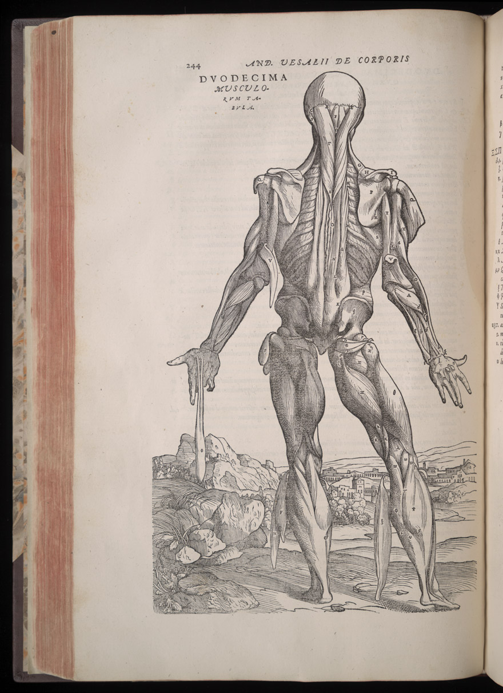
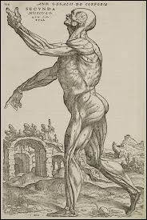

Slide 23
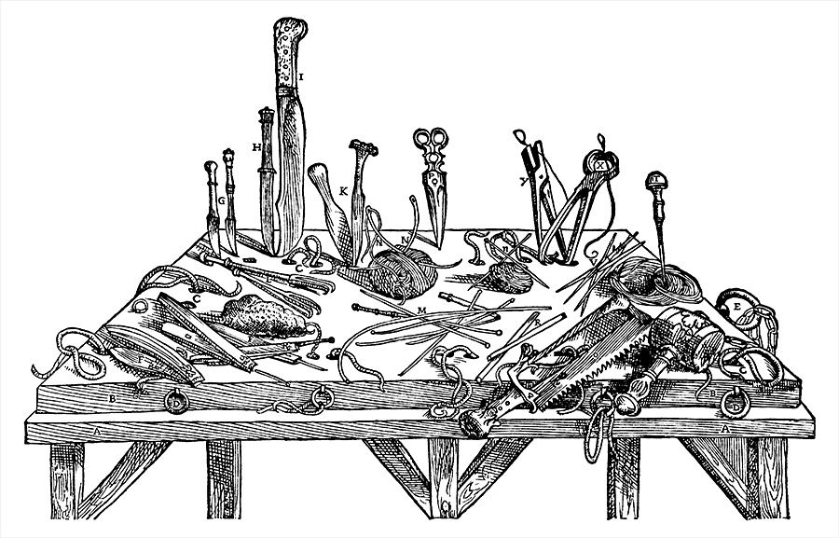

Slide 24
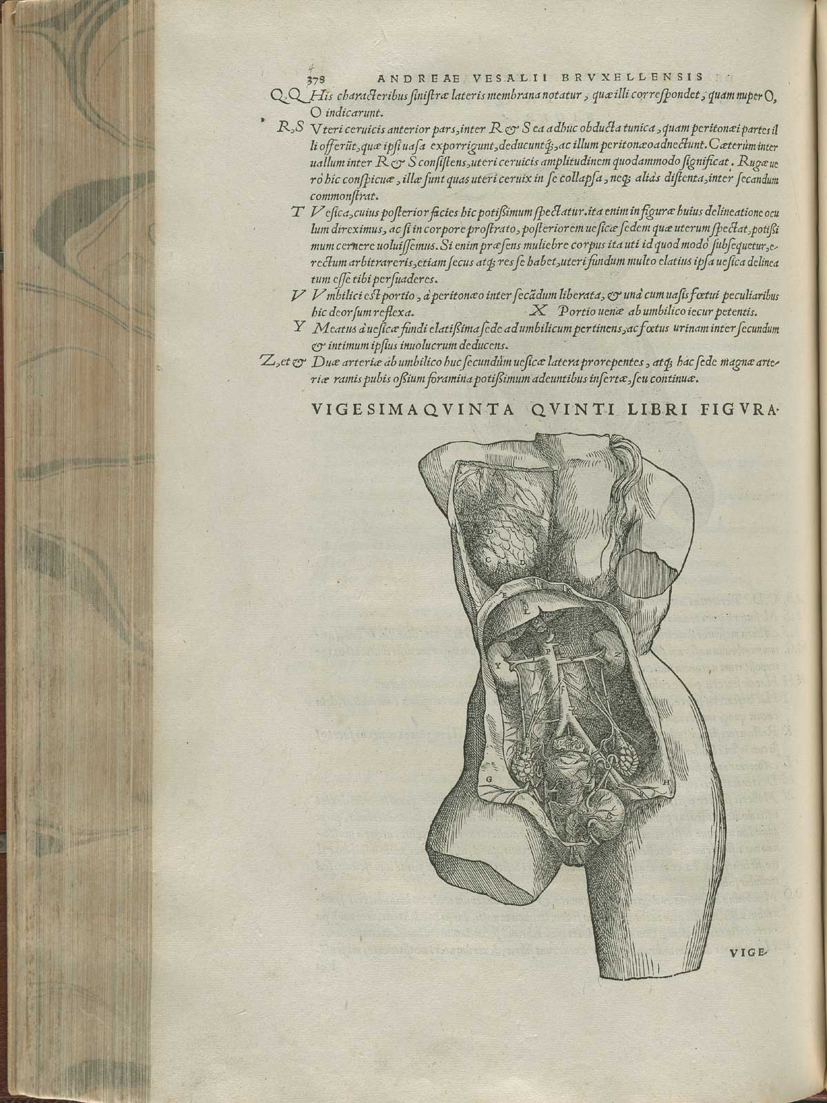
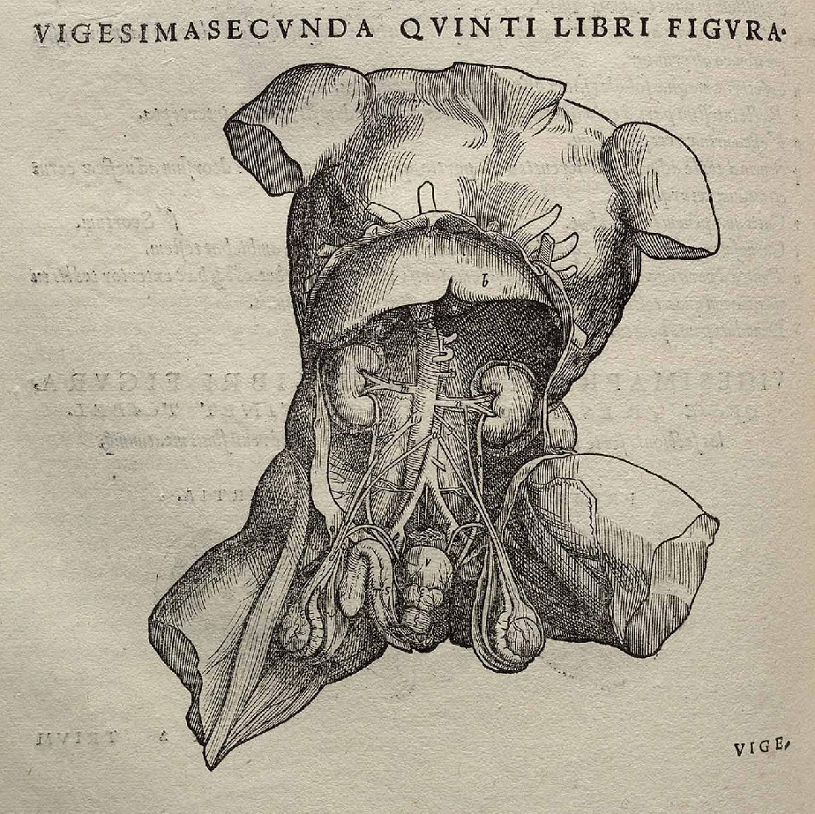

Slide 25
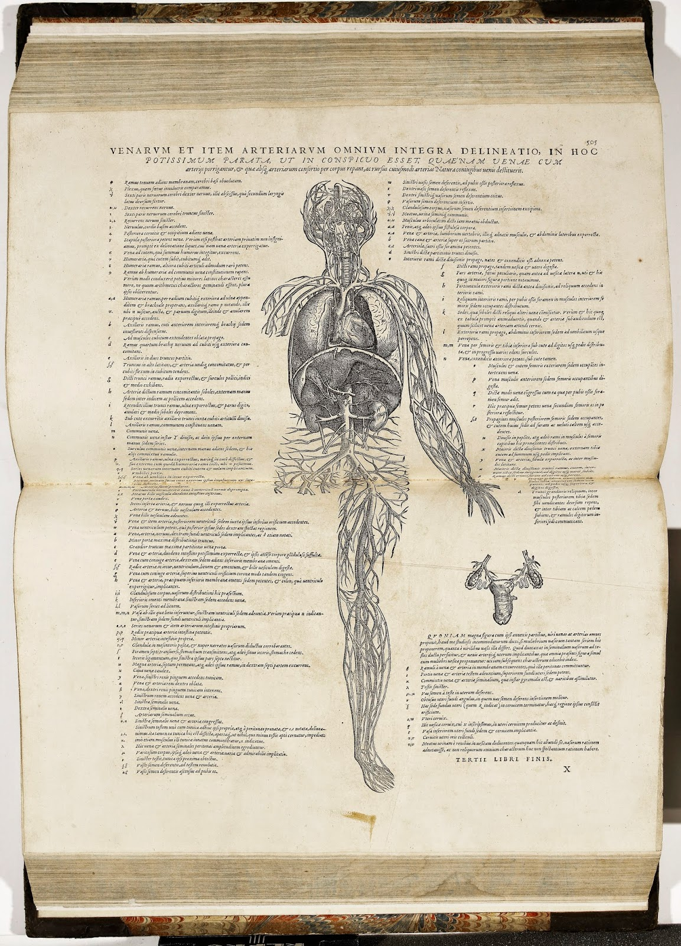

Slide 26
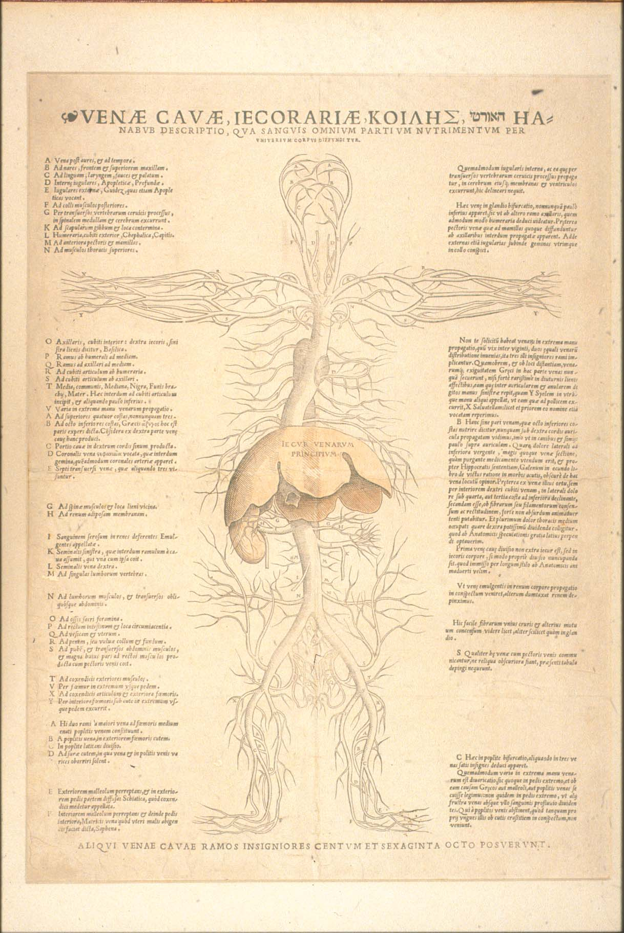
Vesalius introduces ‘practice’ in the making
of anatomical knowledge
BUT
But he aims to reform medicine and bring it back to the classical time. He wanted to be the new Galen.
He is a reformer NOT a revolutionary! He doesn’t break with classical authors.

Slide 27
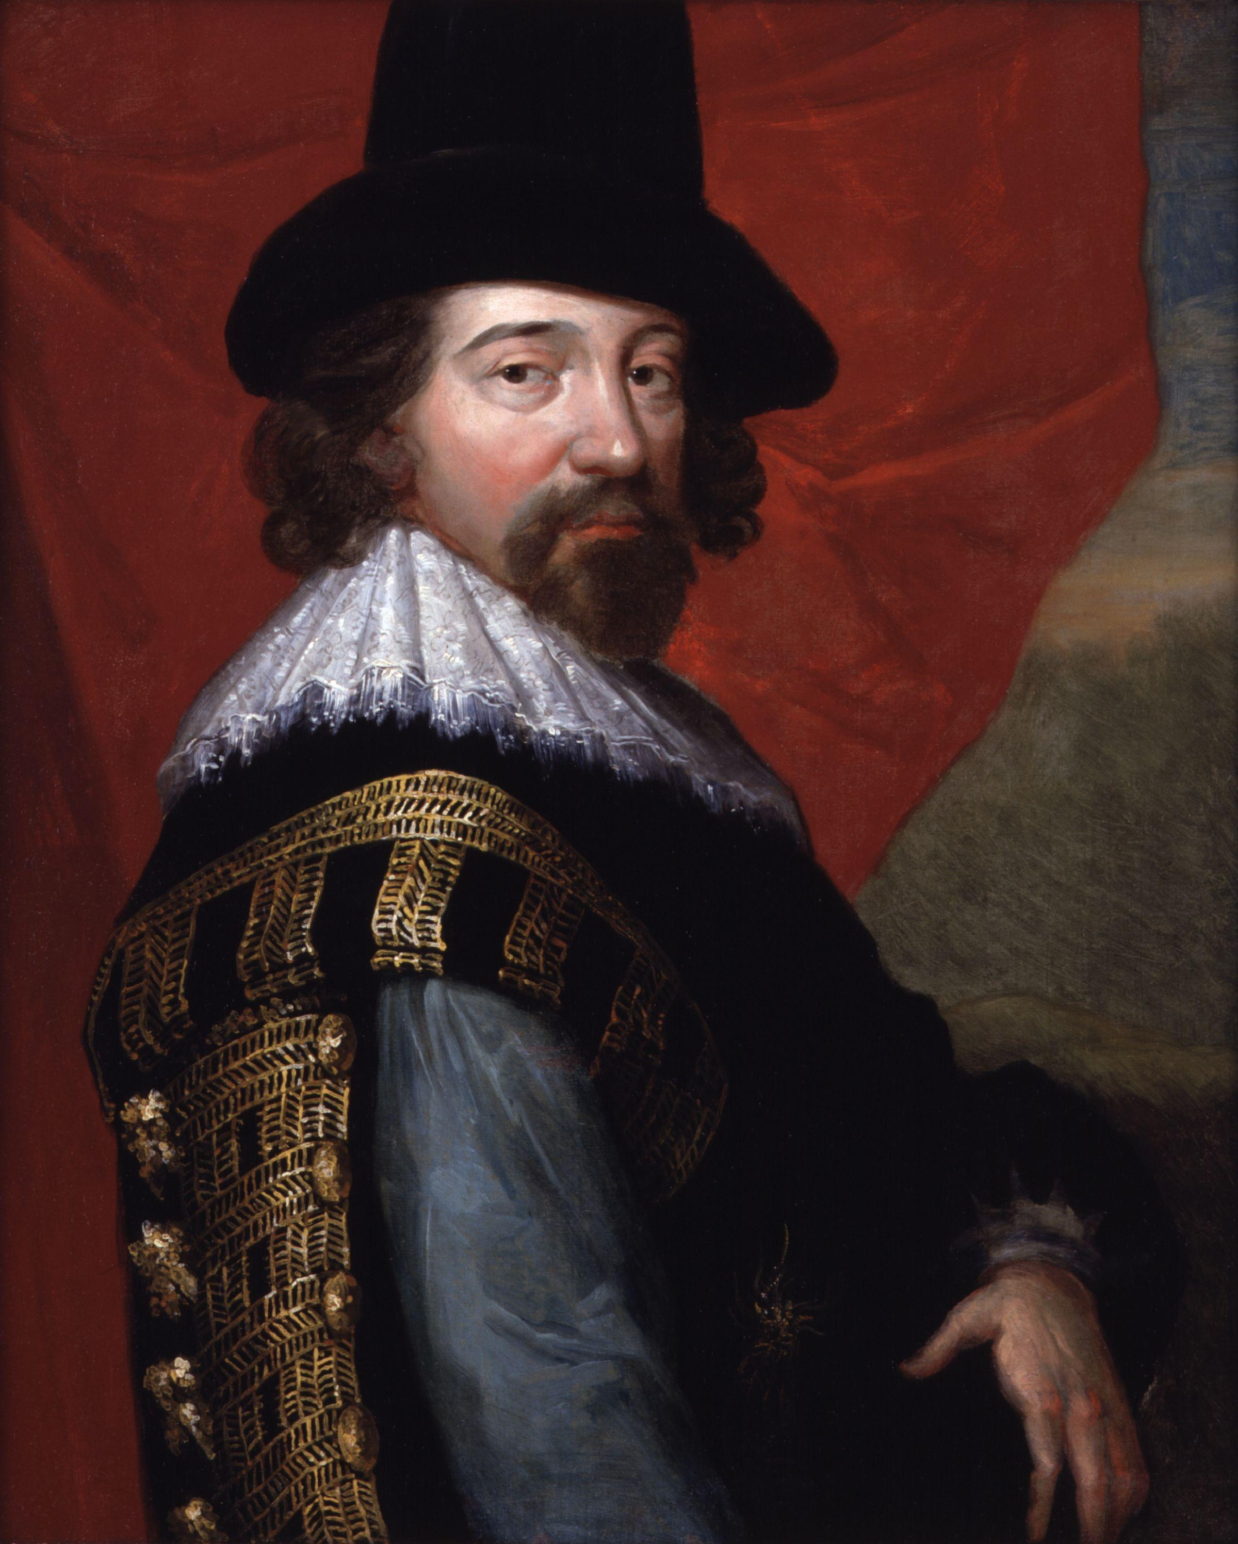
The rise of empiricism
He is celebrated as the ‘father’ of the modern scientific method: empiricism
Empiricism argues that all knowledge is rooted in the
senses and the experience that they provide.
Francis Bacon (1561 – 1626), Lord Chancellor under Queen Elisabeth I

Slide 28
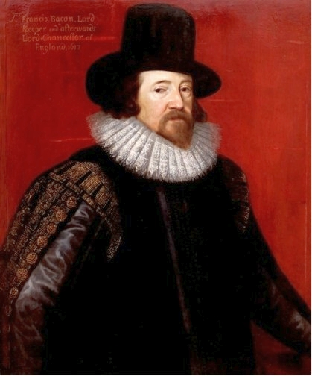
‘Nature, to be commanded, must be obeyed.’
(To use science/medicine to human benefit, we must first study and submit to how nature actually works rather than relying on pure speculation.)
Bacon’s aim was to get rid of Aristotle and scholasticism and introduced a radical new way of
producing knowledge: ‘empiricism’
Empiricism is based on ‘inductive reasoning’
Def. a bottom-up mental process where you start with specific observations, collect data, look for patterns, and draw broad general conclusions or build new hypotheses.
He himself started to do ‘experimentations’ (to collect experience (or data)). Allegedly he died due to one of his experimentations with a frozen chickens in order to understand food preservation.
He also entertained the idea to freeze himself to live forever! Well, it didn’t work…

Slide 29
The End

