Slide 1
Socialist medicine
Dr Claire Shaw

Slide 3
Karl Marx, 1818 – 1883

Slide 4
Withering away of the state
Revolution
Revolution
Revolution
Revolution
Modes of Production | Primitive communist Hunter-gatherer |  | Settled agriculture in river valleys |  | Feudal |  | Bourgeois-democratic Capitalist |  | Socialist |  | Communist
 | Pre-History |  | Antiquity |  | Middle Ages |  | 19th Century |  | ? |  | ?
Marx’s Stages of History

Slide 5
‘Man will become immeasurably stronger, wiser, and subtler; his body will become more harmonized, his movements more rhythmic, his voice more musical. The forms of life will become dynamically dramatic. The average human type will rise to the heights of an Aristotle, a Goethe, or a Marx. And above this ridge new peaks will rise.’
Lev Trotsky, Literature and Revolution, 1923

Slide 7
NARKOMZDRAV (People’s Commissariat of Health)
It/He watches over you
At home and in the street,
So you will be a healthy little boy,
And not a wet hen.

Slide 8
‘Don’t Drink, Dad!’
D. Bulanov, 1929

Slide 10
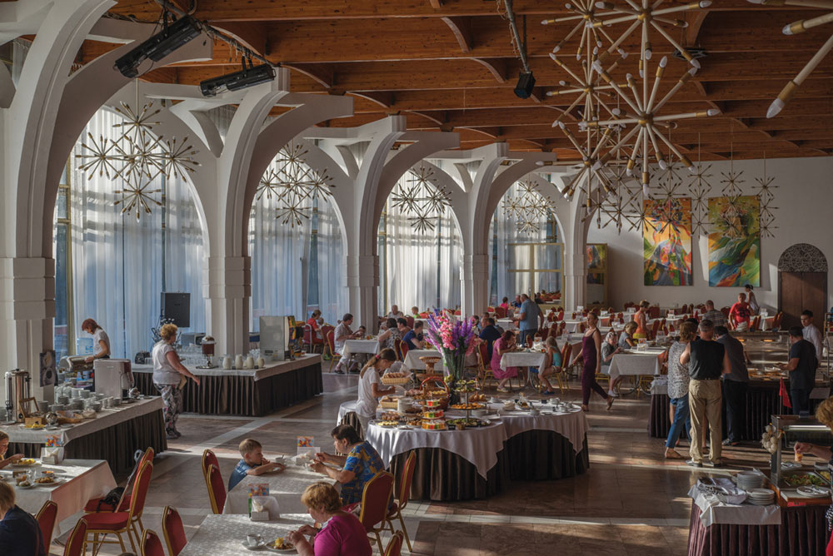

Slide 11
‘8 Hours for Leisure – 8 Hours for Sleep – 8 Hours for Work’
Moscow: MOZ, 1927

Slide 12
‘Wherever I went, there they were. Pictures or charts relating to every conceivable type of thing – cooking, washing, exercising, cleaning the house, getting rid of fleas and dirt, packing fruits or vegetables for shipment or preservation; mixing different kinds of grain or vegetables for animal or human food; pruning trees; running the automobile or caring for the house; making the right sort of roof for the winter; arranging the right sort of ventilation in summer; showing the right sort of clothing for baby or school child; showing the proper arrangement of a new town; showing methods of building a cellar or silo – a thousand and one things in connection with the life of the people’.
Theodore Dreiser, 1929

Slide 13
Nikolai Semashko, 1874 - 1949

Slide 14
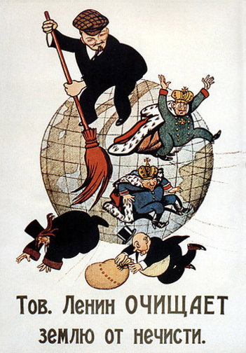
‘Comrade Lenin Cleanses the World of Filth’ Viktor Deni, 1920

Slide 15
The Red Army has crushed the White Guard parasites – Yudenich, Denikin, and Kolchak.
Fight now against infection!
Annihilate the Typhus-bearing louse!

