Slide 1
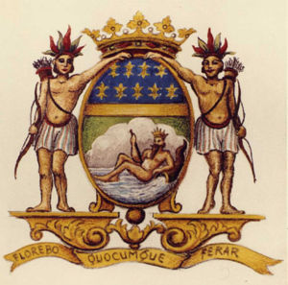
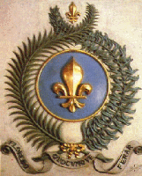
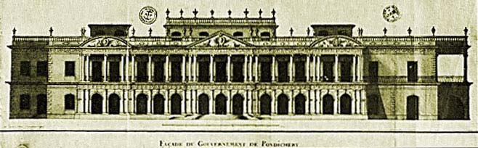
The French East India Company

Slide 2
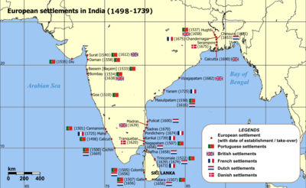

Slide 3
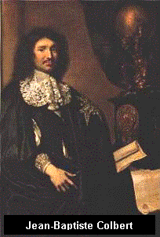
Background
La Compagnie des Indes Orientales established by Colbert in September 1664.
Started with 2,500,000 livres, which was wasted on attempts to colonise Madagascar.
Frequent loans from the King of France. Its capital mainly provided by the French royal family.
Reorganisation 1684-85 (after Colbert’s death) placed it more directly under the king’s control.
1719 - formed as a legal body by the French crown. Portuguese and Dutch companies were influenced by shareholders, but the French company was influenced by the crown.
Merchants in France reluctant to invest in a company over which they had no control –
Financial difficulties
Administrative centre – Paris, not a port. Company HQ - Port Louis on the Atlantic, later at
Lorient in Brittany.
India also seen as an opportunity for Christian missionaries and visitors to study religious
practices, language and technology i.e. printing and dyeing of textiles.
Dutch merchants were naturalised in order to get enough qualified personnel e.g.
Francois Caron

Slide 4
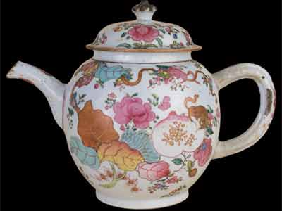
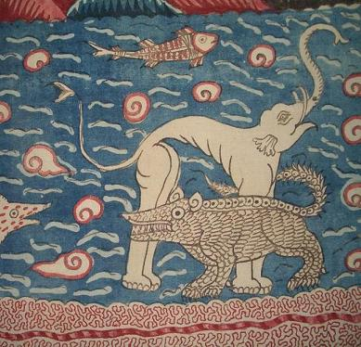
Merchandise
Coffee
Textiles (basic French trading item)
Silver from Manila
Spices, timber, rice, horses and elephants from SE Asia and Bengal, exchanged for textiles from S. India
Canton – source of tin, porcelain, tea and silk and profitable place to exchange silver for gold (used as currency in S. India).
French ships exchanged cloth and freight from Pondicherry with rice, timber and rope for building and marine repairs. This basic supply trade was important and fairly profitable for the impoverished French traders.

Slide 5
Trading Routes
Surat - starting point for French commerce in India
Based on 4 ports: Chandanagore in Bengal, Pondicherry on the Coromandel Coast (administrative centre), Mahe on Malabar, and Surat in Gujarat
French entered the inter-Asian trade routes from Coromandel in 1719. Before then, no private trade allowed to Company employees and concentrated its efforts on trade with Europe.
French developed the route to Mokha, based on Company’s annual demand for 500, 000 pounds of coffee to Europe.
Manilla important for French traders on inter-Asian routes
Ports of Aceh, Merqui and Pegu very important to French – less prestigious than Manilla or Canton but less demanding of capital
Some goods exported to Persian markets
An account manager recommended that the chief trade should be at Pondicherry, “because piece goods and other wares can be got there at first hand and cheaper than anywhere else in India.”

Slide 7
War and Battles
Political disruption in Asia during 1720-30 created many inconveniences for traders. Between the Marathas and the Mughal Emperor.
European wars affected French operations –lack of capital, bankruptcy, Pondicherry briefly occupied by Dutch in 1693, French company’s trading monopoly leased to group of merchants who paid a percentage of voyages.
The renewal of maritime warfare in Europe, starting with the entry of England into the War of Spanish Succession in May 1702, meant the rapid decline of the company for financial reasons.
1744-45 disastrous year for company when French entered war of Austrian Succession, declaring war on Britain. Trade suspended with India and China for time being. No ships arrive from France or return from Pondicherry.
1746 – French capture Madras. English invade Pondicherry.
1748 – Siege of Pondicherry by Admiral Boscawen (English). Unsuccessful.
1761 – Colonel Coote takes Pondicherry after it barricades itself. Exodus of Indians.
1763 – Pondicherry restored to the French

Slide 8
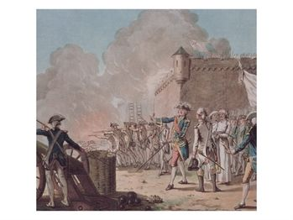
Lifting of the siege of Pondicherry, 1748

Slide 9
Problems
Small factors that disadvantaged Pondicherry in comparison with English, Dutch and Indian ports:
1) The English and Dutch Asian networks established themselves in the previous century, when Asian maritime economy was generally expanding.
2) The strength of Madras, San Thomé and Porto Novo were a challenge Pondicherry could not meet – handicapped by reputation for poor credit and religious intolerance.
Comparing the French company with the English, the Abbé Carré said the French “never have been able to send a ship to India up to time nor arrange for her prompt return whereas the English are never out more than fifteen days or three weeks in [knowing] the time for their ships’ arrival…and make considerable progress and wonderful profits.”
The failure of France to achieve more in the East Indies in the age of Colbert and Louis XIV is explained chiefly by the lack of a sufficiently strong mercantile marine and the priorities given at Versailles to central Europe and the Med.
De la Haye’s failure to get a suitable winter resting base for ships in Ceylon and in Siam in the 1680s. Every fleet had to avoid battle or rush home with their missions half accomplished.
Constant friction between the Navy and the company.
Whenever the French company seemed to be recovering from financial difficulties, war broke out in Europe.

Slide 10
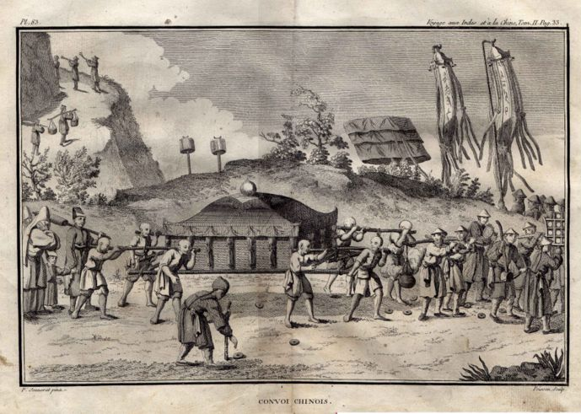
Private Trade
Company privileges leased to private traders in St Malo to help financial situation
Inter-Asian trading out of Pondicherry with private companies from 1719
Jourdan de Grouée’s successful Compagnie de Chine

Slide 11
Bibliography
Holden Furber, Rival Empires of Trade in the Orient: 1600-1800 (Minneapolis, 1976)
Catherine Manning, Fortunes à Faire: The French in Asian Trade 1719-48 (Aldershot, 1996)
Catherine Manning, ‘French Country Trade on Coromandel, 1720-50’ in Om Prakash (ed.), European Commercial Expansion in Early Modern Asia (Aldershot, 1997)
J.F. Price and K. Rangachari (eds.), The Private Diary of Ananda Ranga Pillai (Chennai, 1985)

