Slide 1

PGR Induction
Mark Knights

Slide 2
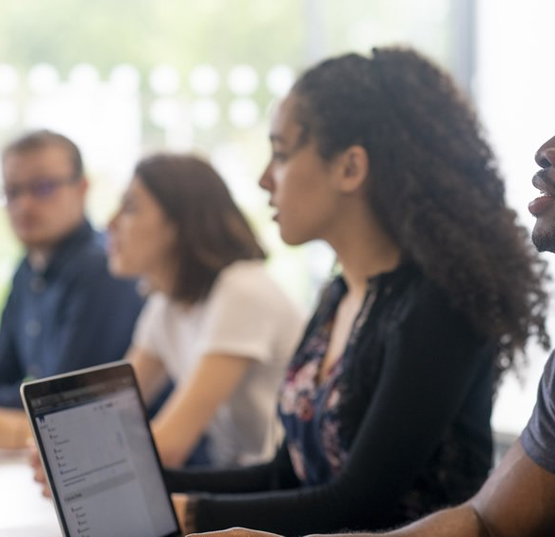
Introducing…
General Introduction/introductions
Monica Dinu
Dept/CADRE/DC
https://warwick.ac.uk/services/dc/eventsandopps/welcome/ for videos from the
Wellbeing Team
Library [The Postgrad Hub is on Floor 2 of the Junction building (the old Sports Centre building on University Road, almost opposite Humanities.]
Professional Development (Skills Forge)
Careers – video by Millie Tissut
DC - virtual ‘welcome’ events (6th October, 18 November) –if you missed them, they are recorded.
In-person/online/hybrid!

Slide 3
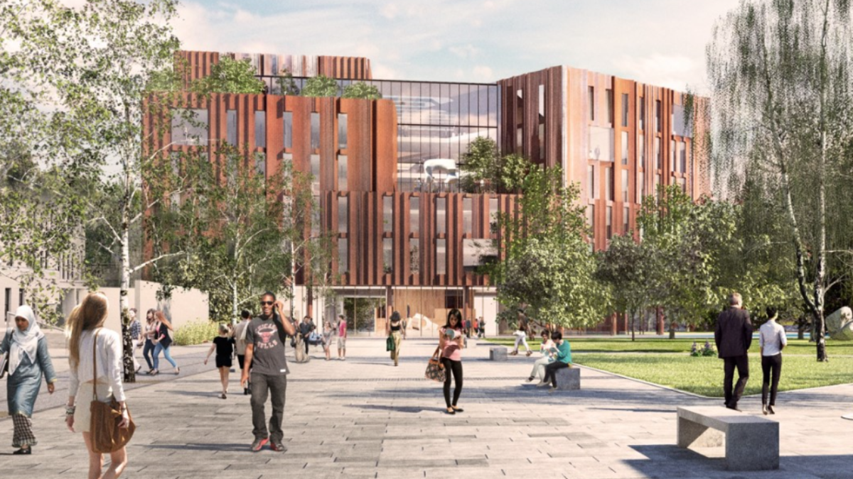
Our new home… (soon!)

Slide 4
Some basics
Warwick core values:
Include commitments to equality, diversity, excellence in all areas of research and learning, an ambitious and entrepreneurial attitude, an openness to rational enquiry with intellectual integrity, and accessibility to students from all backgrounds at all stages of their learning. Ours is a highly cosmopolitan and diverse community in which different perspectives are essential to the generation of ideas.
As part of that community, we expect you to treat your peers and colleagues with respect; engage with ideas, disagree courteously
There is support and a reporting system at
Report + Support - University of Warwick (a link is also on MyWarwick)

Slide 5

Our Research Culture
As a graduate student, you are part of our research community
Large, research-active department. Most permanent members of staff on teaching and research contracts, all actively involved in advancing our field and involved in individual and collaborative projects
Centres (Early Modern and Eighteenth Century; History of Medicine; Global History and Culture; European History)
and networks (Feminism, violence, medieval, oral, queer, parish, science and technology)
+ some cognate ones outside the dept (Centre for the Study of the Renaissance; Yesu Persaud Centre for Caribbean Studies; Humanities Research Centre; Institute for Advanced Studies).
You can be involved in more than one!

Slide 6

Please do attend research seminars and workshops! Regular Wed pm slot for online seminars: 4.30-7. PGR ‘Work in Progress’ meets weekly on Mondays 5-6.30 via Teams.
You can suggest activities too!
There’s lots of information in the pgr handbook Postgraduate Research Handbook (warwick.ac.uk)

Slide 7
Roles
Your role:
develop your own project with initiative as well as guidance
Be proactive about planning ahead, researching secondary materials, contacting libraries and archives etc
write frequently and submit it on time
Take the initiative to ask for meetings with supervisors and to tell them about skills training you need (nb SkillsForge)
Please read the Handbook on the website – sets out expectations of meetings – and engage with Doctoral College/CADRE (Centre for Arts Doctoral Research Excellence)

Slide 8
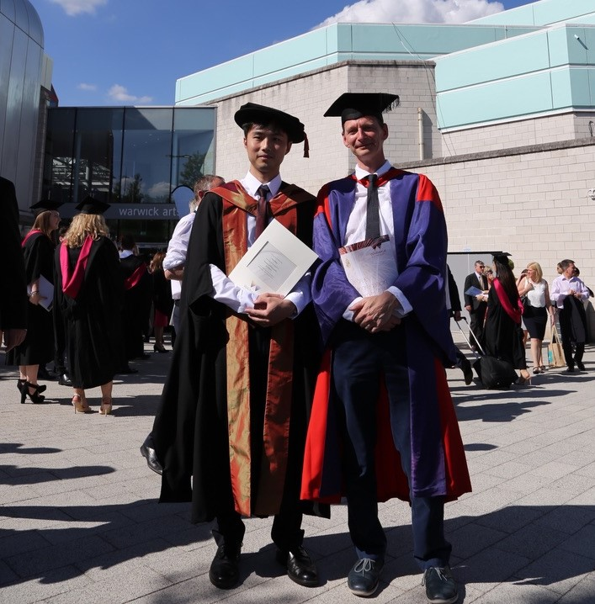
The Supervisor
‘To give guidance about the nature of research and the standard expected, about the planning of the research programme, about literature and sources and the use of requisite techniques (including instruction where necessary) and to encourage students to keep aware of all relevant developments within the subject’.
To read material you write and give feedback
To maintain regular contact
Discuss training requirements
Ensure you are on track to complete within the registration period
To be accessible by arrangement
To assist with development of transferable skills eg conferences
To advise on ethical issues
Recent introduction of two supervisors as the norm for M4C funded pgrs – no ‘right’ way of running these and nb online/f2f provision (covid but also if away on research) but
Key that this is right!
Supervisor(s) are also personal tutors

Slide 9
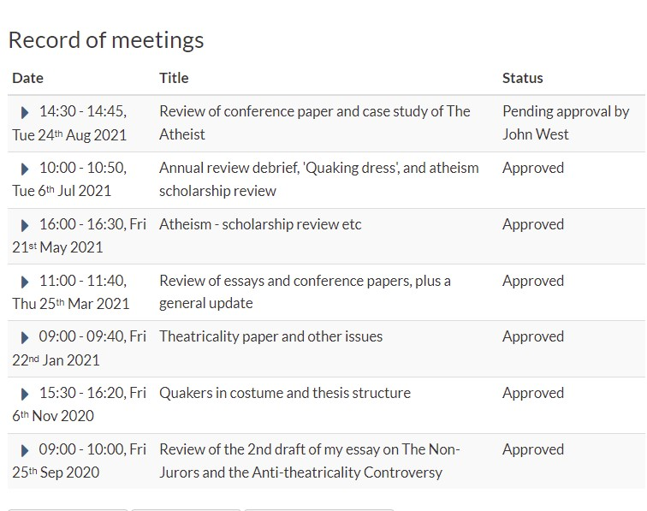
SUPERVISIONS should occur every 3-4 weeks in the first year, monthly thereafter during term-time; less frequently out of term and for part time students. You can initiate these. Students funded via M4C have their own recording portal.
UP TO THE STUDENT to log a short note recording the session on tabula – supervisor then reads this and approves the record. YOU MUST DO THIS PLEASE
You may also need to remind your supervisor to log your meeting as a ‘monitoring point’

Slide 10
My role
Run the Graduate Research Forum (GRF) – Thursdays 5-6.30 Ramphal 3.25.
Week 2 Project Design, The Upgrade and Ethics
Week 3 ‘PhD Survival Guide’ (CADRE event) NB Wed 20th October 11-12.30
Week 4 Warwick’s Modern Records Centre – the session will cover what the MRC holds but also, more broadly, how to find and use materials in archives.
Week 5 Oral History - with Rosie Doyle from the Warwick Oral History Network
Week 6 ---------- Reading Week - No GRF session
Week 7 Public Engagement - a joint, online session with Birmingham university and with Angela McShane (formerly of V&A and Head of Research Development, Wellcome Trust). NB this session will be held online.
Week 8 Digital Humanities - with Steve Ranford.
Week 9 Research Journeys: Naomi Pullin.
Week 10 Postdoctoral Projects and Applications - a joint session with existing postdocs, facilitated by Mark Philp

Slide 11
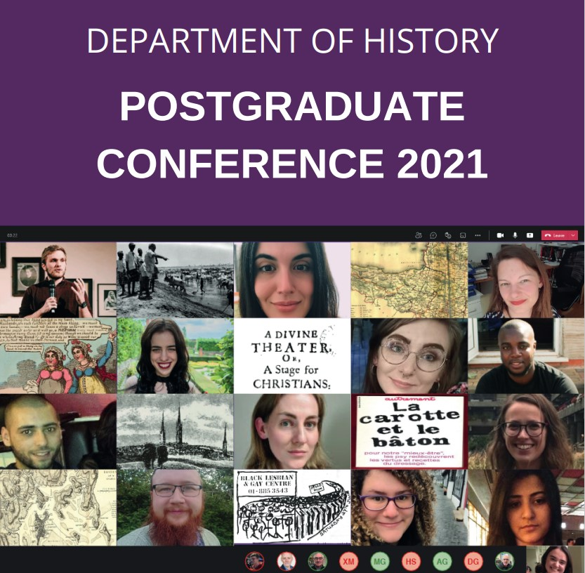
And…
Oversee the pgr community’s progress
Troubleshoot where necessary
My ‘office hours’ are Mondays (2-3pm) and Thursdays 4-5
Liaise with your rep (Niels Boender)
Run an annual review process (usually in May) – again this is different for M4C funded students
Help facilitate the annual postgraduate conference

Slide 12
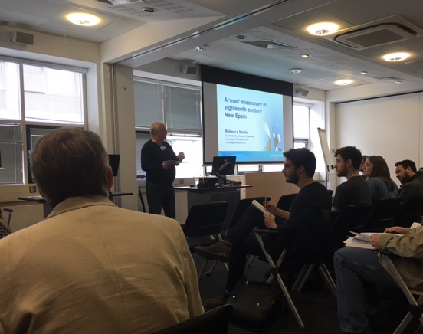
POSTGRADUATE CONFERENCE
Excellent event in May
Predominantly a PGR event; expect you all to present AT LEAST once or twice in your career; first year is a good opportunity to get more feedback on general shape of your project
Some MA students will also present on their work, but this is really YOUR SHOW
Panels organised by PGRs; ORGANISING COMMITTEE IS COMPOSED OF STUDENTS, W/ ADVICE FROM DIRECTOR OF PGR. Many First years take advantage of this opportunity.
Conference: Staff v. happy to come along and chair / commentary / audience
Very enjoyable, social end to the academic year

Slide 13

Useful to know!
Monica Dinu, Postgraduate Coordinator
PGHistoryOffice@warwick.ac.uk
Tel 50495
Office: H3.41, third floor of the Humanities Building but more routinely online
Temporary withdrawals [TWD]:
You must discuss with your supervisor and me first. This is an online form process to the Graduate Office, but be aware of implications:
If you’re funded, funding stops
Lose library card
lose contact w/ supervisor until you re-register
So if you’re thinking about it you must speak with supervisor and myself.
Similarly for changing between FT and PT – how that change happens also depends on how you are funded, so talk to us at earliest opportunity.

Slide 14

Money Matters
Different funding councils have different arrangements
many of you are on FUNDED PhDs - these have expense and travel and research allowances built into them, and you should use those first [NB PLAN AHEAD] but there is some
Departmental support: I administer a personal research grant for every student in History – about £250 per student per year to support your research activities. This is yours to use – online form through which you can reimburse. No deadline.
This needs to be precise amounts and receipts – get you in the practice of being a history researcher, where this occupies much of your time. (worth stressing this - some students had been very lax in the past).
IF YOU NEED MORE – let’s say there’s an overseas conference you really want to present at, or an archive you desperately need to visit – GET IN TOUCH. Write an application with full costs, also indicating where else you are trying to get money from. I can make discretionary allocations.
I’m encouraging you not to be selfish, to think of the cohort!
OTHER PLACES offering funding –
Humanities Research Committee
Institute of Advanced Study
Royal Historical Society has small grants
Economic History Society, likewise

Slide 15

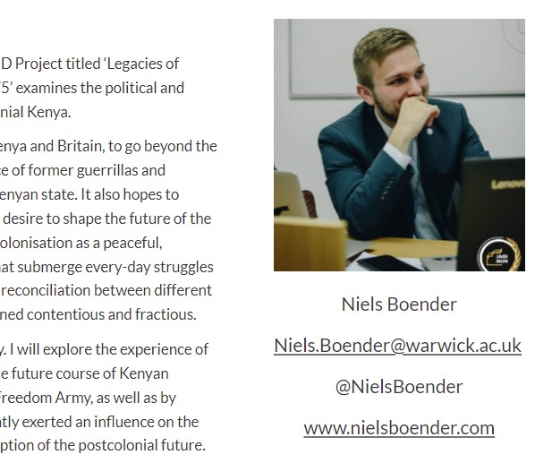
E-PORTFOLIOS Current PhD Students (warwick.ac.uk) ePortfolio Request Form (warwick.ac.uk)
Being part of research community!
Up on the Dept website
Describe project, funding;
Describe talks, conferences you attend, update it regularly
Link it to twitter profiles or academica.edu profiles, if you have those, or blogs
This is a condition for funded students …
… but good practice for all!
I will be chasing you to see that this is regularly updated
Visibility massively helps in job hunt / postdoc positions at the end
The website uses its own software – relatively intuitive.

Slide 16

Social media
Some of our Research Centres run collective blogs – contact the Centre directors
The Department also runs one and a twitter account – contact Jane Mallin Jane.Mallin@warwick.ac.uk
You can contribute to public engagement activity elsewhere – NB the week 7 GRF on this!

Slide 17

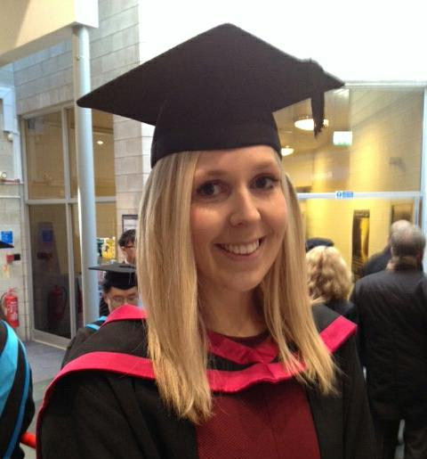
Teaching Opportunities
TEACHING:
This is open to you to do, after your first year, and important to consider if you are thinking about a career in academia. Graduate Teaching Assistant [GTA]
PGRs can teach up to 2 seminars a week, max.
There is a module run by the Learning Development Centre – ‘Prepare to Teach’ - it is compulsory for anyone wanting to teach and it will run in term 2.
Teaching is run by the History Office – so any queries / expressions of interest to CLAUDIA GRAY. We can’t guarantee teaching but try to accommodate requests.

