Slide 1

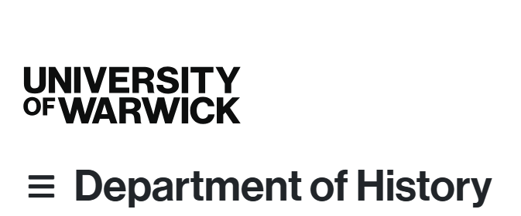
Designing your Project, the Upgrade Process and Ethical Considerations
BK - GRF 16/10/25

Slide 2
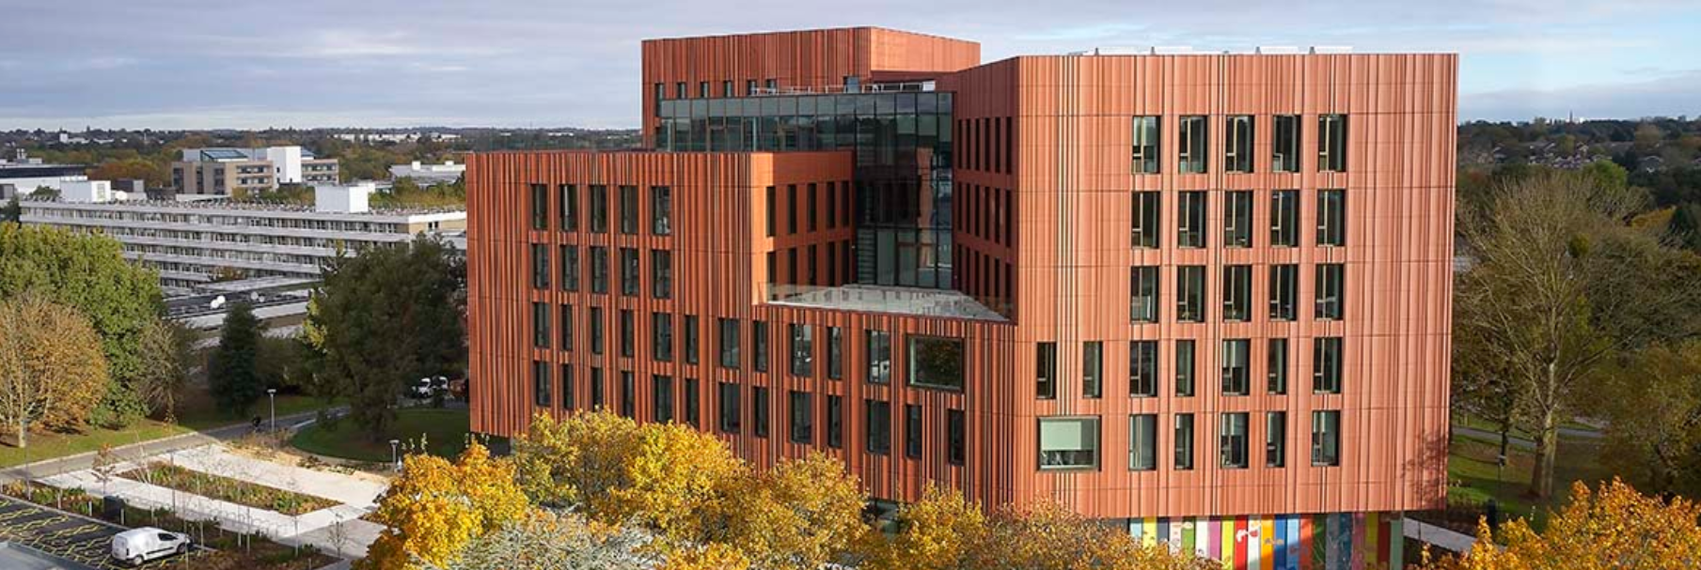
A couple of weeks in -
Your standout moment?

Slide 3

1. Designing your project
What was your experience designing your BA or MA dissertation?
What were the key challenges?
How do you think a PhD might differ?

Slide 4

Key considerations
What exactly is your central research question?
Which concepts / theories can you draw upon?
How will your work change, support or advance existing scholarly views?
Why have you decided on this particular timeframe or setting - might there be better ones?
Which sources are you using for your approach and what challenges do they present?
Do you need specific skills (language, quantitative methods, paleography, Digital Humanities etc.) and are you confident you have (or can acquire) these?
What other resources / contacts might help?

Slide 5

2. History’s Upgrade Process
You will have your progress reviewed each year (usually in May) but at the end of the first year you will have a formal interview – passing this ‘upgrade’ moves you from ‘MPhil’ to ‘PhD’ track.
There is information in our PGR Handbook (now accessible ?) and more specifically here.
Usually held in summer term of your first year – except for M4C students (in Feb) or if there were delays …

Slide 6
What will you need to submit?
A draft chapter of 5,000 – 6,000 words in length (5k for M4C; can be an extended literature review, where relevant, or a case study that illustrates some key themes of your proposed work)
2) A 2,500 word Research Proposal, giving a synopsis of your PhD project and a working title, with bibliography (not part of the word count) of relevant primary and secondary material [1.5-2k for M4C, no bibliography]
A chapter plan and timetable for completion of your thesis (max. 1500 words)
A completed History Ethics Review / Research Integrity Training

Slide 7
What to put in the research proposal?
Your overall aim in pursuing this project – what do you hope to achieve;
The central research question(s) you plan to address and what kinds of answers you are anticipating (i.e. hypotheses to be verified / falsified / modified);
A demonstration of your ability to situate your work within the existing scholarship and to show how your research engages with this body of studies, methodologies and ideas;
What particular methods / theories / concepts you plan to use;
An outline of your source-base and where you will be consulting these materials (NB: this may involve letters or reconnaissance trips to relevant research libraries and / or archives in advance);
Could use these points as subheadings i.e. Aims, Research Questions, Scholarly Context / Historiography, Methodology, Sources (plus ideally anticipated chapter structure).

Slide 8

A good moment for honest / transparent reflection of:
How are you defining your terms or research areas (and why these)?
Might your agenda be too narrow or – more likely! – too broad?
How will you achieve all objectives given your specific circumstances?
Is your timetable realistic (3 years)?
Will you be able to provide the in-depth analysis required in the word length allowed (80K)?
Do you have the requisite skills and resources?
What are the ethical issues in your research?

Slide 9
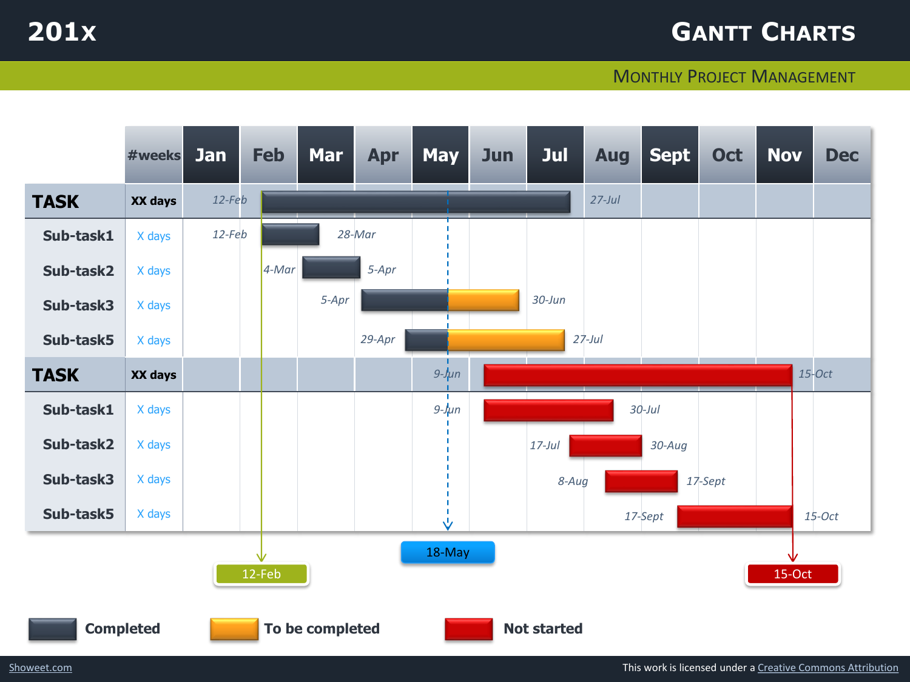
Chapter Plan and Timetable
Useful exercise, but no one is going to hold you to it exactly!
Shows that you have thought about the design of the project and how you will impose a sense of order / argument onto the material
You have 80k words, so, with an introduction (c.10-12k) and conclusion (4-6k), this leaves scope for around 5-6 chapters of about 10-12k words. NB: you will nearly always have too much material!
The timetable helps you plan research trips, chapter writing, publication ambitions, applications for jobs / postdocs and check whether you remain on track
Some people like to use GANTT charts (on the right) but it’s up to you.
You are expected to complete in 3 years & registered for a maximum of 4 - you must complete within that time. At the end of that time the university will de-register you!

Slide 10
The upgrade interview has 5 main purposes:
Test your ideas with two independent academics (NOT your supervisors)
Receive constructive feedback from informed scholars to help refine and improve your plans
Make contact with possible future advisors
Gain experience of a ‘viva’ style of examination
Test your ability to work at doctorate level
Try to enjoy the occasion - not supposed to be ‘scary’!
The atmosphere is friendly and supportive but be prepared for a serious exploration of your work, which includes critical questioning

Slide 11

The Panel
Two members of (mainly) History staff – discuss with your supervisor who is most appropriate
Your supervisor(s) will attend (not M4C) but not speak! They can observe and take notes
Musical chairs element at the end to ensure supervisory arrangements are working well
Panel offers constructive feedback & makes recommendations
The panelists submit a formal report which is shared with your supervisor(s)

Slide 12

Some common issues that arise:
Unclear or over-ambitious set of research questions
Vague understanding of relevant sources
Lack of (or inadequate) research methodology
Unrealistic (chronological, regional) scope or timetable
Some conceptual gaps or fuzzy terminology
BUT IN GENERAL A HELPFUL
REVIEW OPPORTUNITY, see e.g. these student
Upgrade Experiences

Slide 13

M4C has its own process!
Mid-Year Review and End of Year Report: February - March 2026.
A research statement of 1500-2000 words indicating the scope of your thesis, and outlining the key research questions, research context and methodology.
A 5000-word example of your written work i.e. a short chapter or a section of discursive prose from your thesis, or equivalent output for practice-based PhDs.
For M4C award holders in year one (or part-time equivalent) requests for extended funding can be made where there is a rationale for complex or extended training, skills acquisition, extended archival visits, fieldwork or placement needs. An M4C award can be extended up to a maximum of 6 months full-time or 12 months part-time.
Assessment review interview with two assessors from outside of the supervisory team. (NB this does not preclude assessors subsequently acting as internal examiners on final submission of the thesis).

Slide 14
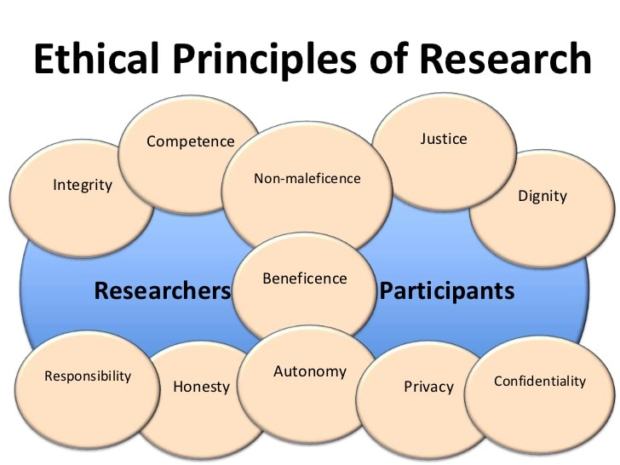
3. Does your project have ethical implications?
A thorough review …
establishes risks and benefits for all involved
ensures respect and fair treatment for (potentially vulnerable) participants, building on their capacity to accept or reject involvement
assesses dangers to & maintains standards of researchers
→ consider this early on!

Slide 15
Two types of key ethical considerations:
Ethics in Research (Research Tasks & Processes): risks to you, participants and institutions. See departmental / university guidance set out on Travel, Do I need Ethical Approval and Applying for Ethics.
Everyone needs to complete an Ethics Review Form as part of the upgrade – in many cases, timely discussion with supervisors and scrutiny by panel is sufficient;
However, research in regions considered dangerous, on topics relating to national security, with sensitive questions etc may – and everyone working with human participants will – require external approval by the University’s Humanities & Social Sciences Research Ethics Committee (HSSREC);
2. Ethics of Research (Standards & Attitudes of Researchers): how to carry out your project – from inception to publication / dissemination – with integrity, transparency and honesty (e.g. staying clear of misconduct, plagiarism, damaging cultural heritage resources, misrepresentation of findings …)

Slide 16

How did you get on with Research Integrity Training (Epigeum)?
Please remember that all PGR need to complete the full epigeum course of 8 modules;
In addition, all research staff and students working with human participants should complete the supplementary ‘Protecting Human Participants’ module
Access the course here

Slide 17
Looking ahead …
Monday: 5 pm in FAB 5.01 - ‘Work in Progress’ with Roberta Bivins (hybrid)
Tuesday: CADRE Welcome / Induction / M4C Intro, 21 October 10-2, Wolfson Research Exchange in UL – info under CADRE workshops
Wednesday: PGR Voice Drop in at 11 in FAB 3.45 (reps + anyone welcome)
Thursday: GRF session about UL services in the Library (meet directly in Floor 1 Foyer near barriers for 5 pm)
Week 4: Archives ‘double’ session, starting with workshop on ‘Researching and Communicating archival sources’ (led by Dr Geraldine Fela) at 3.30 in in JX2.02 (Junction, adjacent to FAB – please come along), then at Modern Records Centre MRC from 5 pm
Please arrange to meet with me for a ‘personal tutor’ chat at some point this term (15 mins blocks Mondays 12-1; Thursdays 3-4; FAB 3.49; book via my department staff page)

