Slide 1

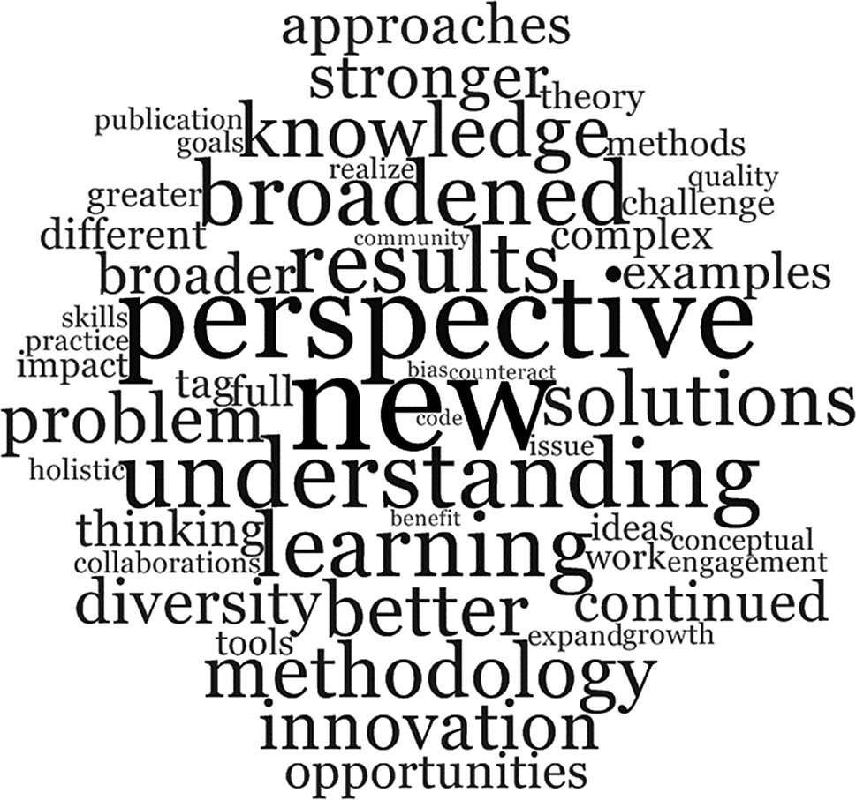

‘-disciplinarity’
Inter-
‘-nationalization’
BK / GRF 2025-26

Slide 2
What is a discipline?
Communities of scholars who share a field of inquiry or discourse or objects of study
All have a distinct heritage / structure
They may use specialised terminologies or concepts / methods or customs / practices or scholarly traditions / bodies of work – and these can create borders or boundaries with others
They have a system of communication through journals, conferences, centres, events etc

Slide 3
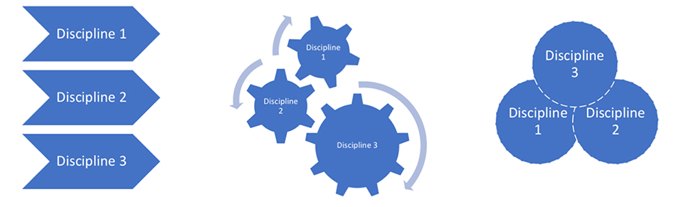
Some Definitions & Distinctions
Multidisciplinarity is understood to be an additive approach – using knowledge from more than one discipline which are not themselves transformed by being used in conjunction with one another.
Interdisciplinarity is characterized as interaction across and between disciplines. Becomes one activity.
Transdisciplinarity aspires to be a more holistic approach, aiming to displace or supersede disciplinary formations and restrictions.

Slide 4
Types of interdisciplinarity
Three different logics or rationales of interdisciplinarity:
Integrative, working towards synthesis;
Subordinate, belonging under larger umbrella (e.g. social sciences being affiliated to science more generally);
Agonistic / antagonistic, demarcating from specific other approaches
Barry, Born and Weszkalyns, ‘Logics of Interdisciplinarity’ (2008)
In the third form interdisciplinarity emerges through interferences or frictions between disciplines and between disciplines and other forms of knowledge, which can be both challenging & constructive. Disciplines may be transformed in the process.

Slide 5

Benefits of interdisciplinarity?
Connections, new perspectives (e.g. environmental history)
Modifications, extensions (non-human dimensions)
Using insights from other scholars (wine affected by climate change)
Topicality, new models, but actually … (disability studies)
Collaborations, partnerships
Robustness, more rigorous, broader explanations

Slide 6
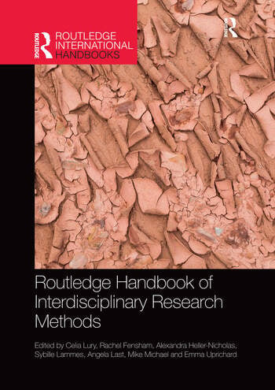
Lury, Celia (ed.), Routledge Handbook of Interdisciplinary Research Methods (2017)
Wedging - something that connects scholars with different interests, in more than just a cursory way, like placing a wedge in a door. (Ch. 16 by Jane Calvert)
Deriving - to derive is not simply to come into possession of something, rather it is to acquire something by means of drawing it out from something else, and often in the endeavor of drawing it out, transforming it. We derive by extension. We derive by modification. … What we derive from design, as mode of making-as-inquiry, is not solutions, but rather productive glitches, difficulties, and complications. (Ch. 3 by Carl Disalvo)
Disrupting - The idea of disrupting, as developed here, refers to an improvisatory process that ‘corrupts’ ethnographic and design principles when they are brought together. (Ch. 4 by Yoko Akama and Sarah Pink)

Slide 7
Institutional support @ Warwick
ARTS
Humanities Research Centre
FACULTIES
School for Cross-Faculty Studies (degree programmes)
Cross-faculty centres, projects & initiatives
Centre for Interdisciplinary Methodologies
Institute for Advanced Studies
UNIVERSITY
Interdisciplinary Research Spotlights – Business, Manufacturing & Innovation; Health; Society and Culture; Sustainability plus two themes that run across all those ‘Behaviour’ and ‘Digital’.

Slide 8

Challenges / difficulties ?
Could be a fad, passing fashion
Opportunistic
Dilutes history, makes us less distinctive
Involves steep learning curves
Potential for misunderstandings
Disciplines being at different stages
Challenge of bias, reading it in our way

Slide 9
Critical voices
What is behind the recent rise of calls for interdisciplinarity?
Many funding bodies expect it: UKRI, Wellcome Trust
Some writers – such as Richard Tabulawa, ‘Interdisciplinarity, Neoliberalism and Academic Identities’ (2017) – see this in relation to a global context of a growing instrumentalisation of knowledge for utilitarian purposes.
Tabulawa’s suggestion is that interdisciplinarity is not some neutral or technical re-arrangement of knowledge. Rather, it is a political tool seeking to wrest the power to control the processes and products of the university away from academics and forming new structures that support the needs of the market-based economy, i.e. serving a neoliberal agenda

Slide 10
Is History inherently interdisciplinary?
The different branches of social, economic, religious, demographic etc history all have their specific canons, methods and debates, often in natural dialogue with e.g. sociology, economics, theology and statistics.
Historian on the Edge [Guy Halsall], ‘What do we mean by ‘Interdisciplinarity’?:
‘What is at stake here is how one draws and defines the dividing lines on the map of the academy, and what is involved in intellectual exchange. [What] I suggest, might be a more meaningful way of thinking about the fruitful confrontation of difference – a more interesting way of drawing the lines that sub-divide academia – is the confrontation of theoretical approaches.’

Slide 11
Internationalization
Transcend the ‘Anglophone Bubble’
Engage with other academic cultures
Reap potential benefits
Accessing work in other countries / languages
Attending conferences and workshops abroad
Opening further funding / fellowship sources
Career opportunities beyond the UK system
...
Enacting Warwick’s university strategy
Researching in overseas libraries / archives
Exploring other perspectives / approaches
Understanding different priorities / traditions

Slide 12
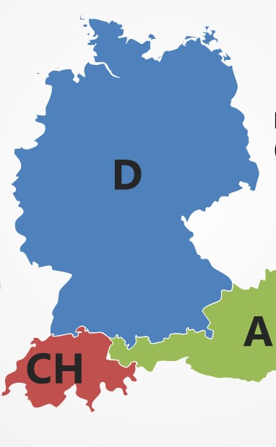
Example 1: The German Lands
Key role in early development of our discipline (19thC)
Fairly hierarchical / formal structures
Mass universities, few courses selective
Structured support for emerging scholars funded by the German Research Foundation (DFG), incl.
Research Training Groups (graduate colleges with interdisciplinary themes [e.g. 2017-: Global Intellectual History in Berlin], bespoke training opportunities, international partners …)
Collaborative Research Centres (e.g. TG Dresden – Invectivity) hubs with postdocs, conferences, publication projects
Second / higher doctorate (Habilitation) needed for permanent posts, less focus on one single area of expertise
Relatively few permanent academic positions and long waiting times post-doctorate, with frequent dead ends

Slide 13
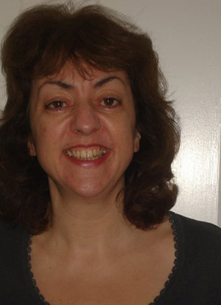
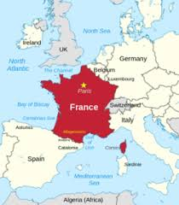
Example 2: FRANCE
Penny Roberts
History’s Director of Research / Former Faculty Chair

Slide 14
The wider world … your experiences ? We heard about the Australian, Chinese, Indian, Kenyan and US systems

