Slide 1
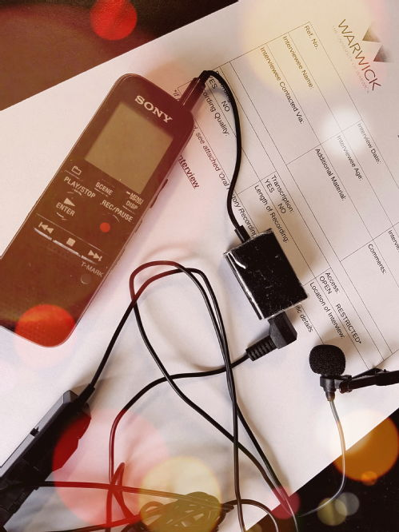
An introduction to oral history
Pierre Botcherby Outreach & Widening Participation Officer, Modern Records Centre Co-Director, Warwick Oral History Network

Slide 2

A few talking points…
Who has used oral sources and/or undertaken oral history/interviews before? What sorts of sources are oral?
Who will use oral sources and/or undertake oral history/interviews for their thesis?
Benefits of oral history…
Drawbacks of oral history…

Slide 3
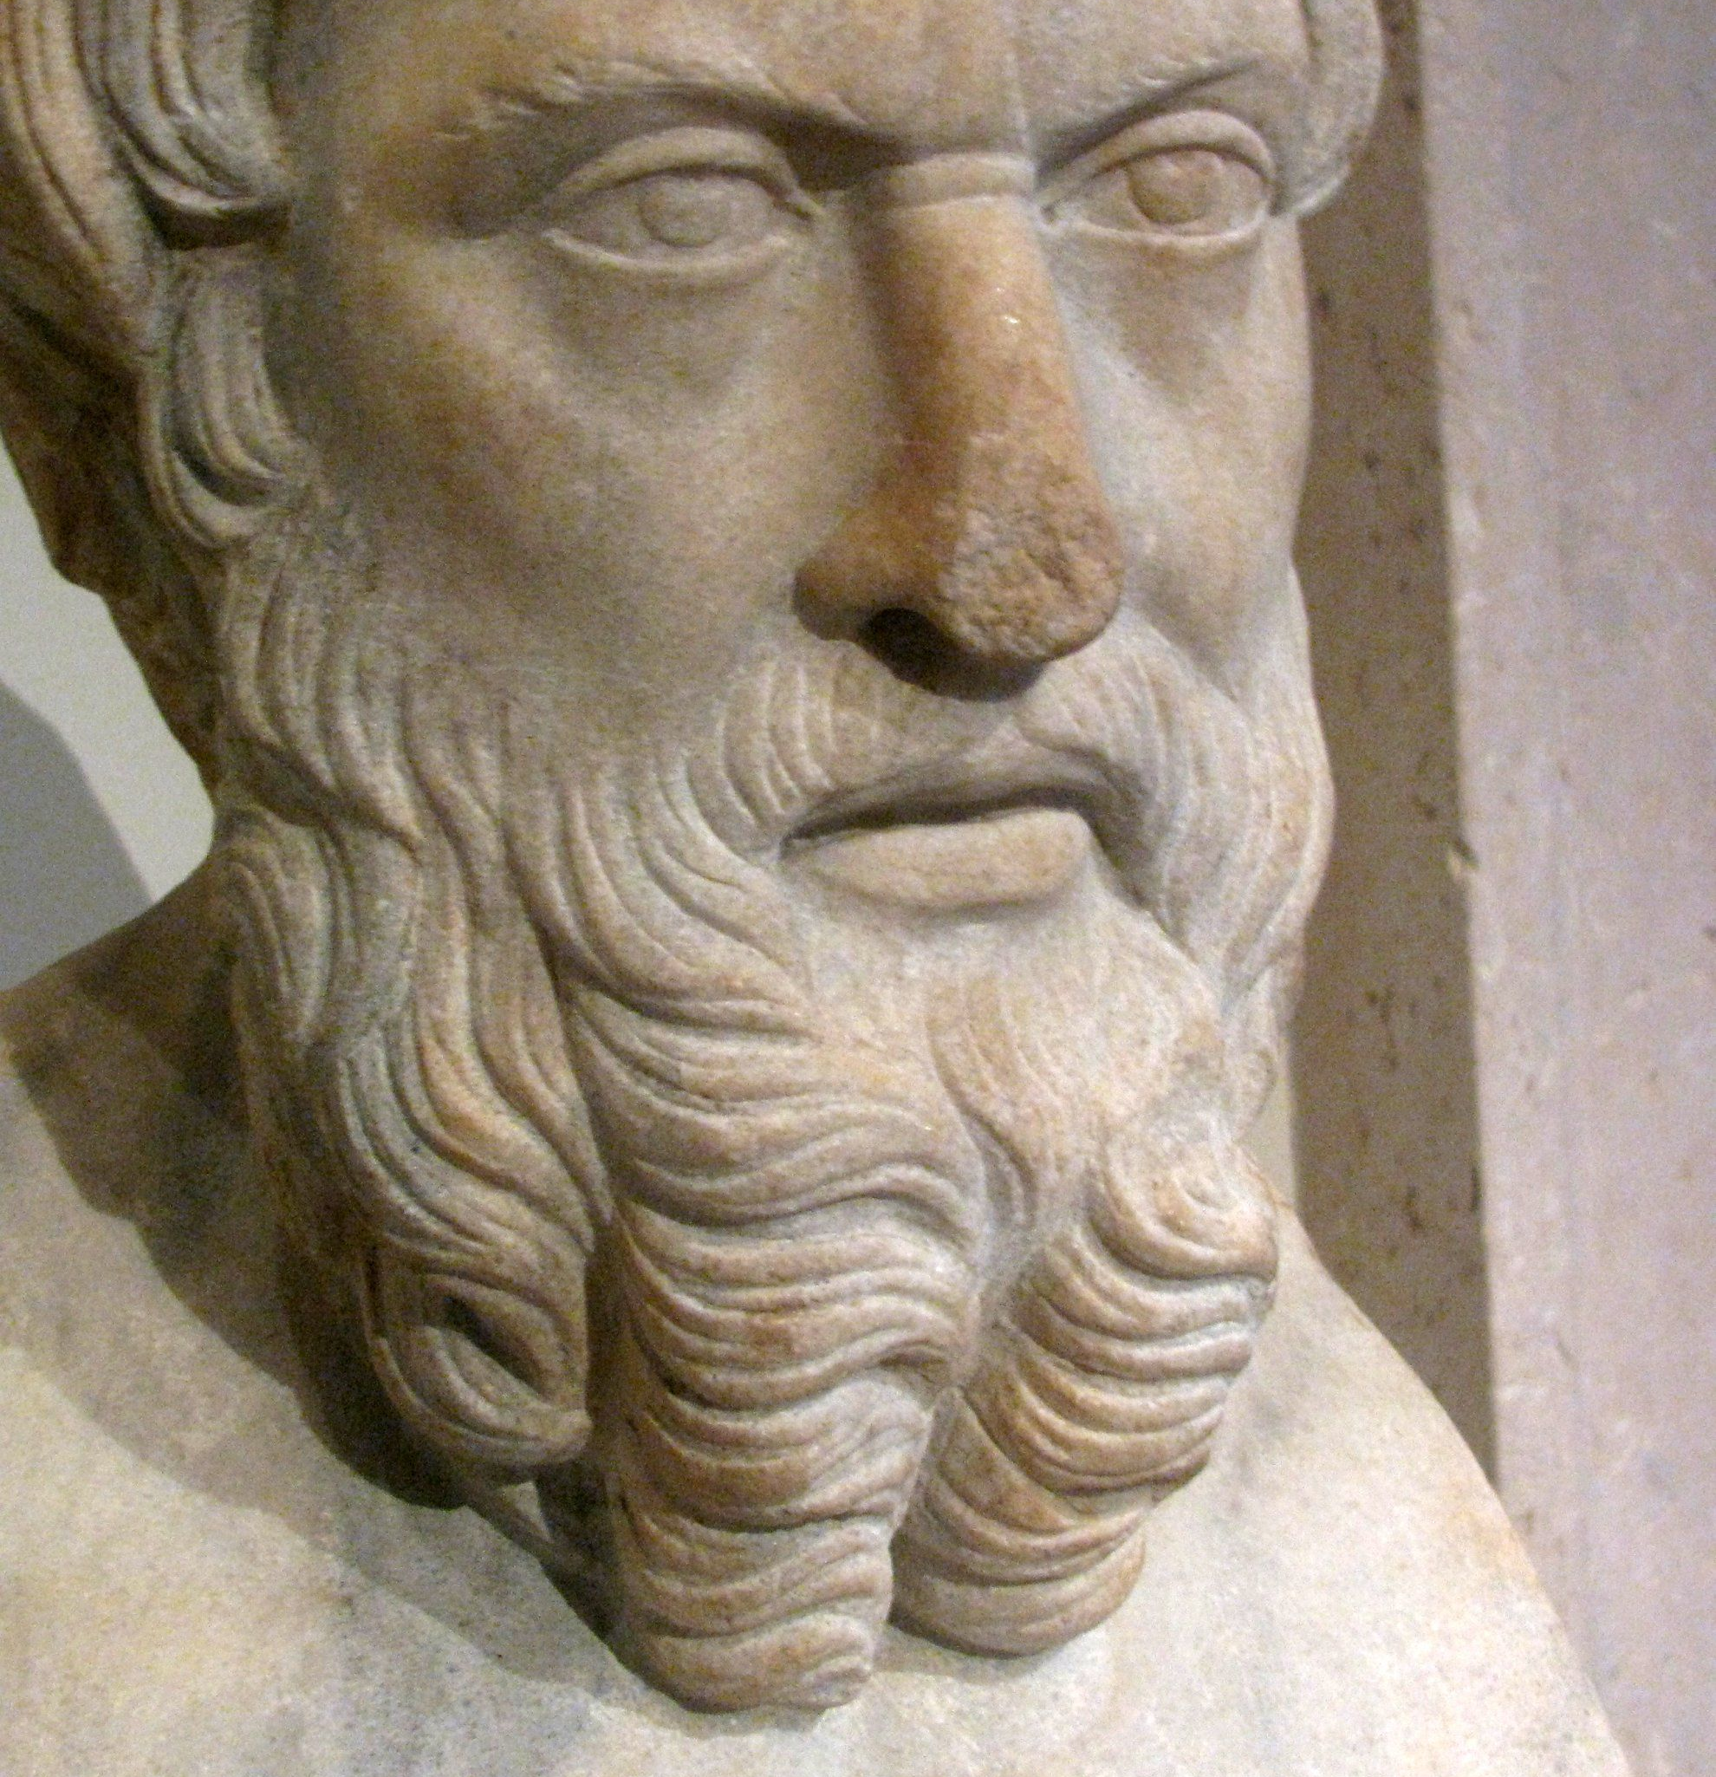
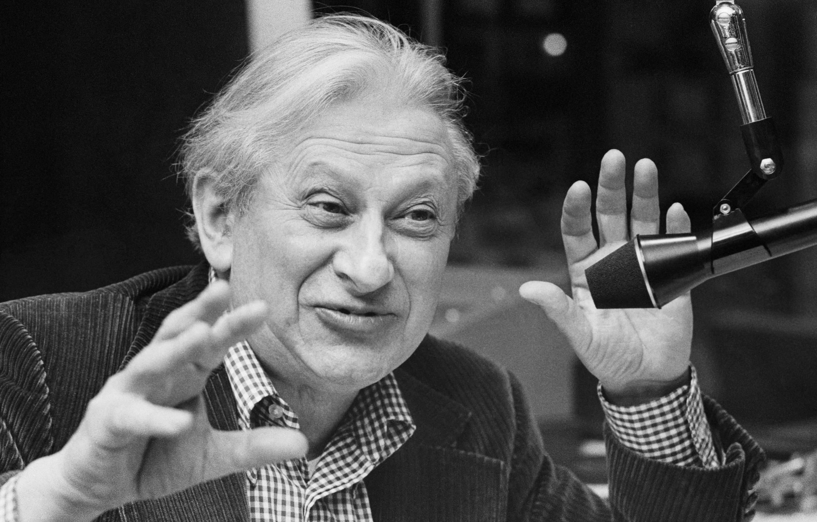
Oral history: a brief history
Herodotus, Thucydides, Bede, Samuel Johnson…
Post-war ‘recovery history’ – academic suspicion of methodology
Ronald Blythe, Akenfield, (1972), HC4014.B5 (External Store)
George Ewart Evans, Ask The Fellows Who Cut The Hay, (1962), DA670.76.B5
Links to idea of ‘history from below’, use in labour history
Studs Terkel, Working: People Talk About What They Do All Day and How They Feel About What They Do, (1974), HD8072.T4
Alessandro Portelli, The Death of Luigi Trastulli, And Other Stories, (1991), D16.253.P6
1970s: ‘sheen’ of social science: scientific sampling, factual cross-checking
1980s: cultural history: not what was said, but how and why – how the past is remembered
1990s: black/ethnic minority history, LGBT history, history of medicine, trauma, construction of identities

Slide 4
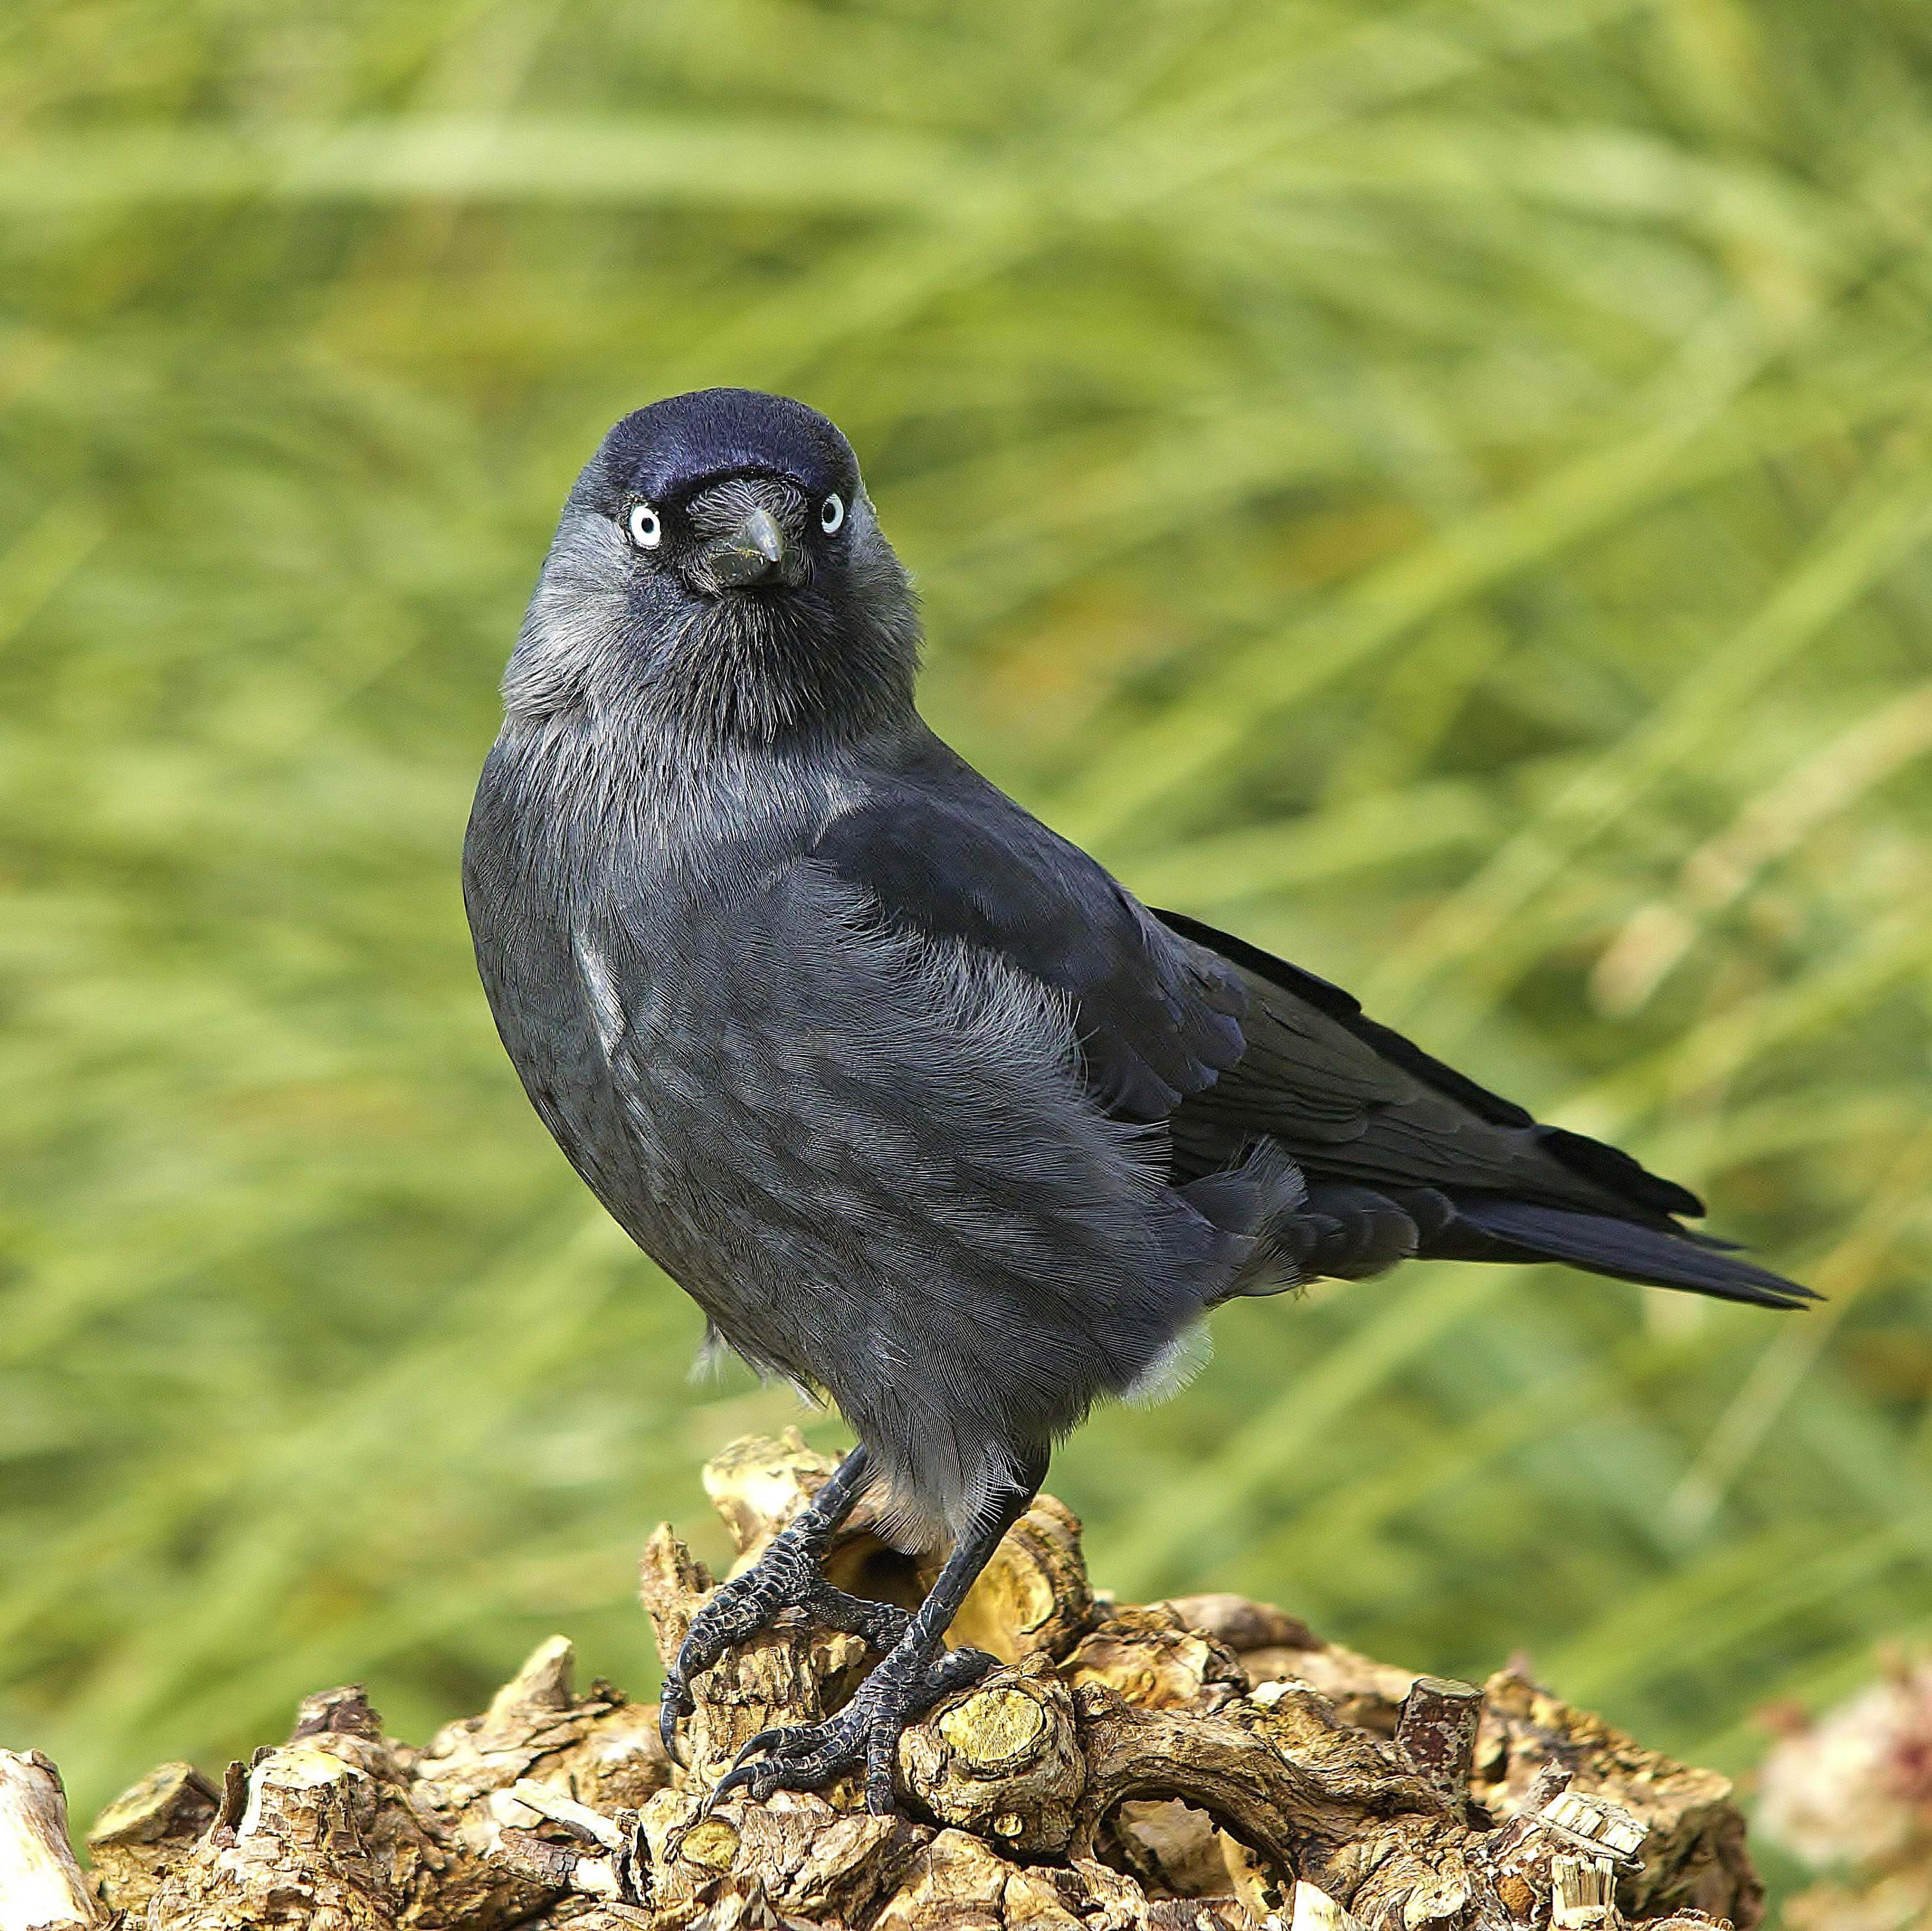
A historical jackdaw
Who, me?!
‘the shiny, attractive theories which have originated elsewhere and appl[ying] them to its own field of study’ – an interdisciplinary methodology
What is said – people, dates, events, chronology
How it is said – tone, speed, rhythm, language, emotions
Why it is being said – self, personal memory, collective memory, feelings and emotions, subconscious

Slide 5
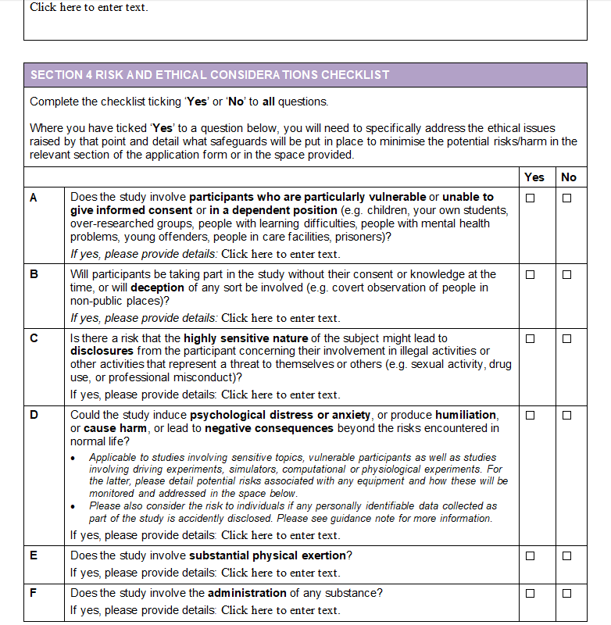
Some important considerations
Ethics
University ethics committees versus oral history associations
Need to respect ethics of different communities
Positionality
Gatekeepers
Insider versus Outsider (and sometimes in between)
Different modes of story-telling
To archive or not to archive
To reuse or not reuse
Questions of accessibility, e.g. disability

Slide 6
Conducting an interview
Before
Finding interviewee(s)
Building rapport
Research
What to ask/discuss
During
Life Story approach
Consent forms
Recording
Best practice guidelines vs reality of fieldwork
Safeguarding: yourself and interviewee
After
Summary sheet
Full transcript
Continue rapport with interviewee
Respectful use of data
Archive?

Slide 7
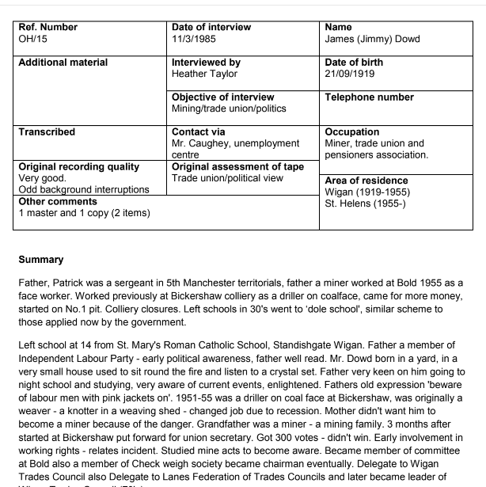
The Summary Sheet
Details of interviewee
Details regarding interview
Overview of contents of interview – not a full transcript
Ideally include timestamps or topics

Slide 8
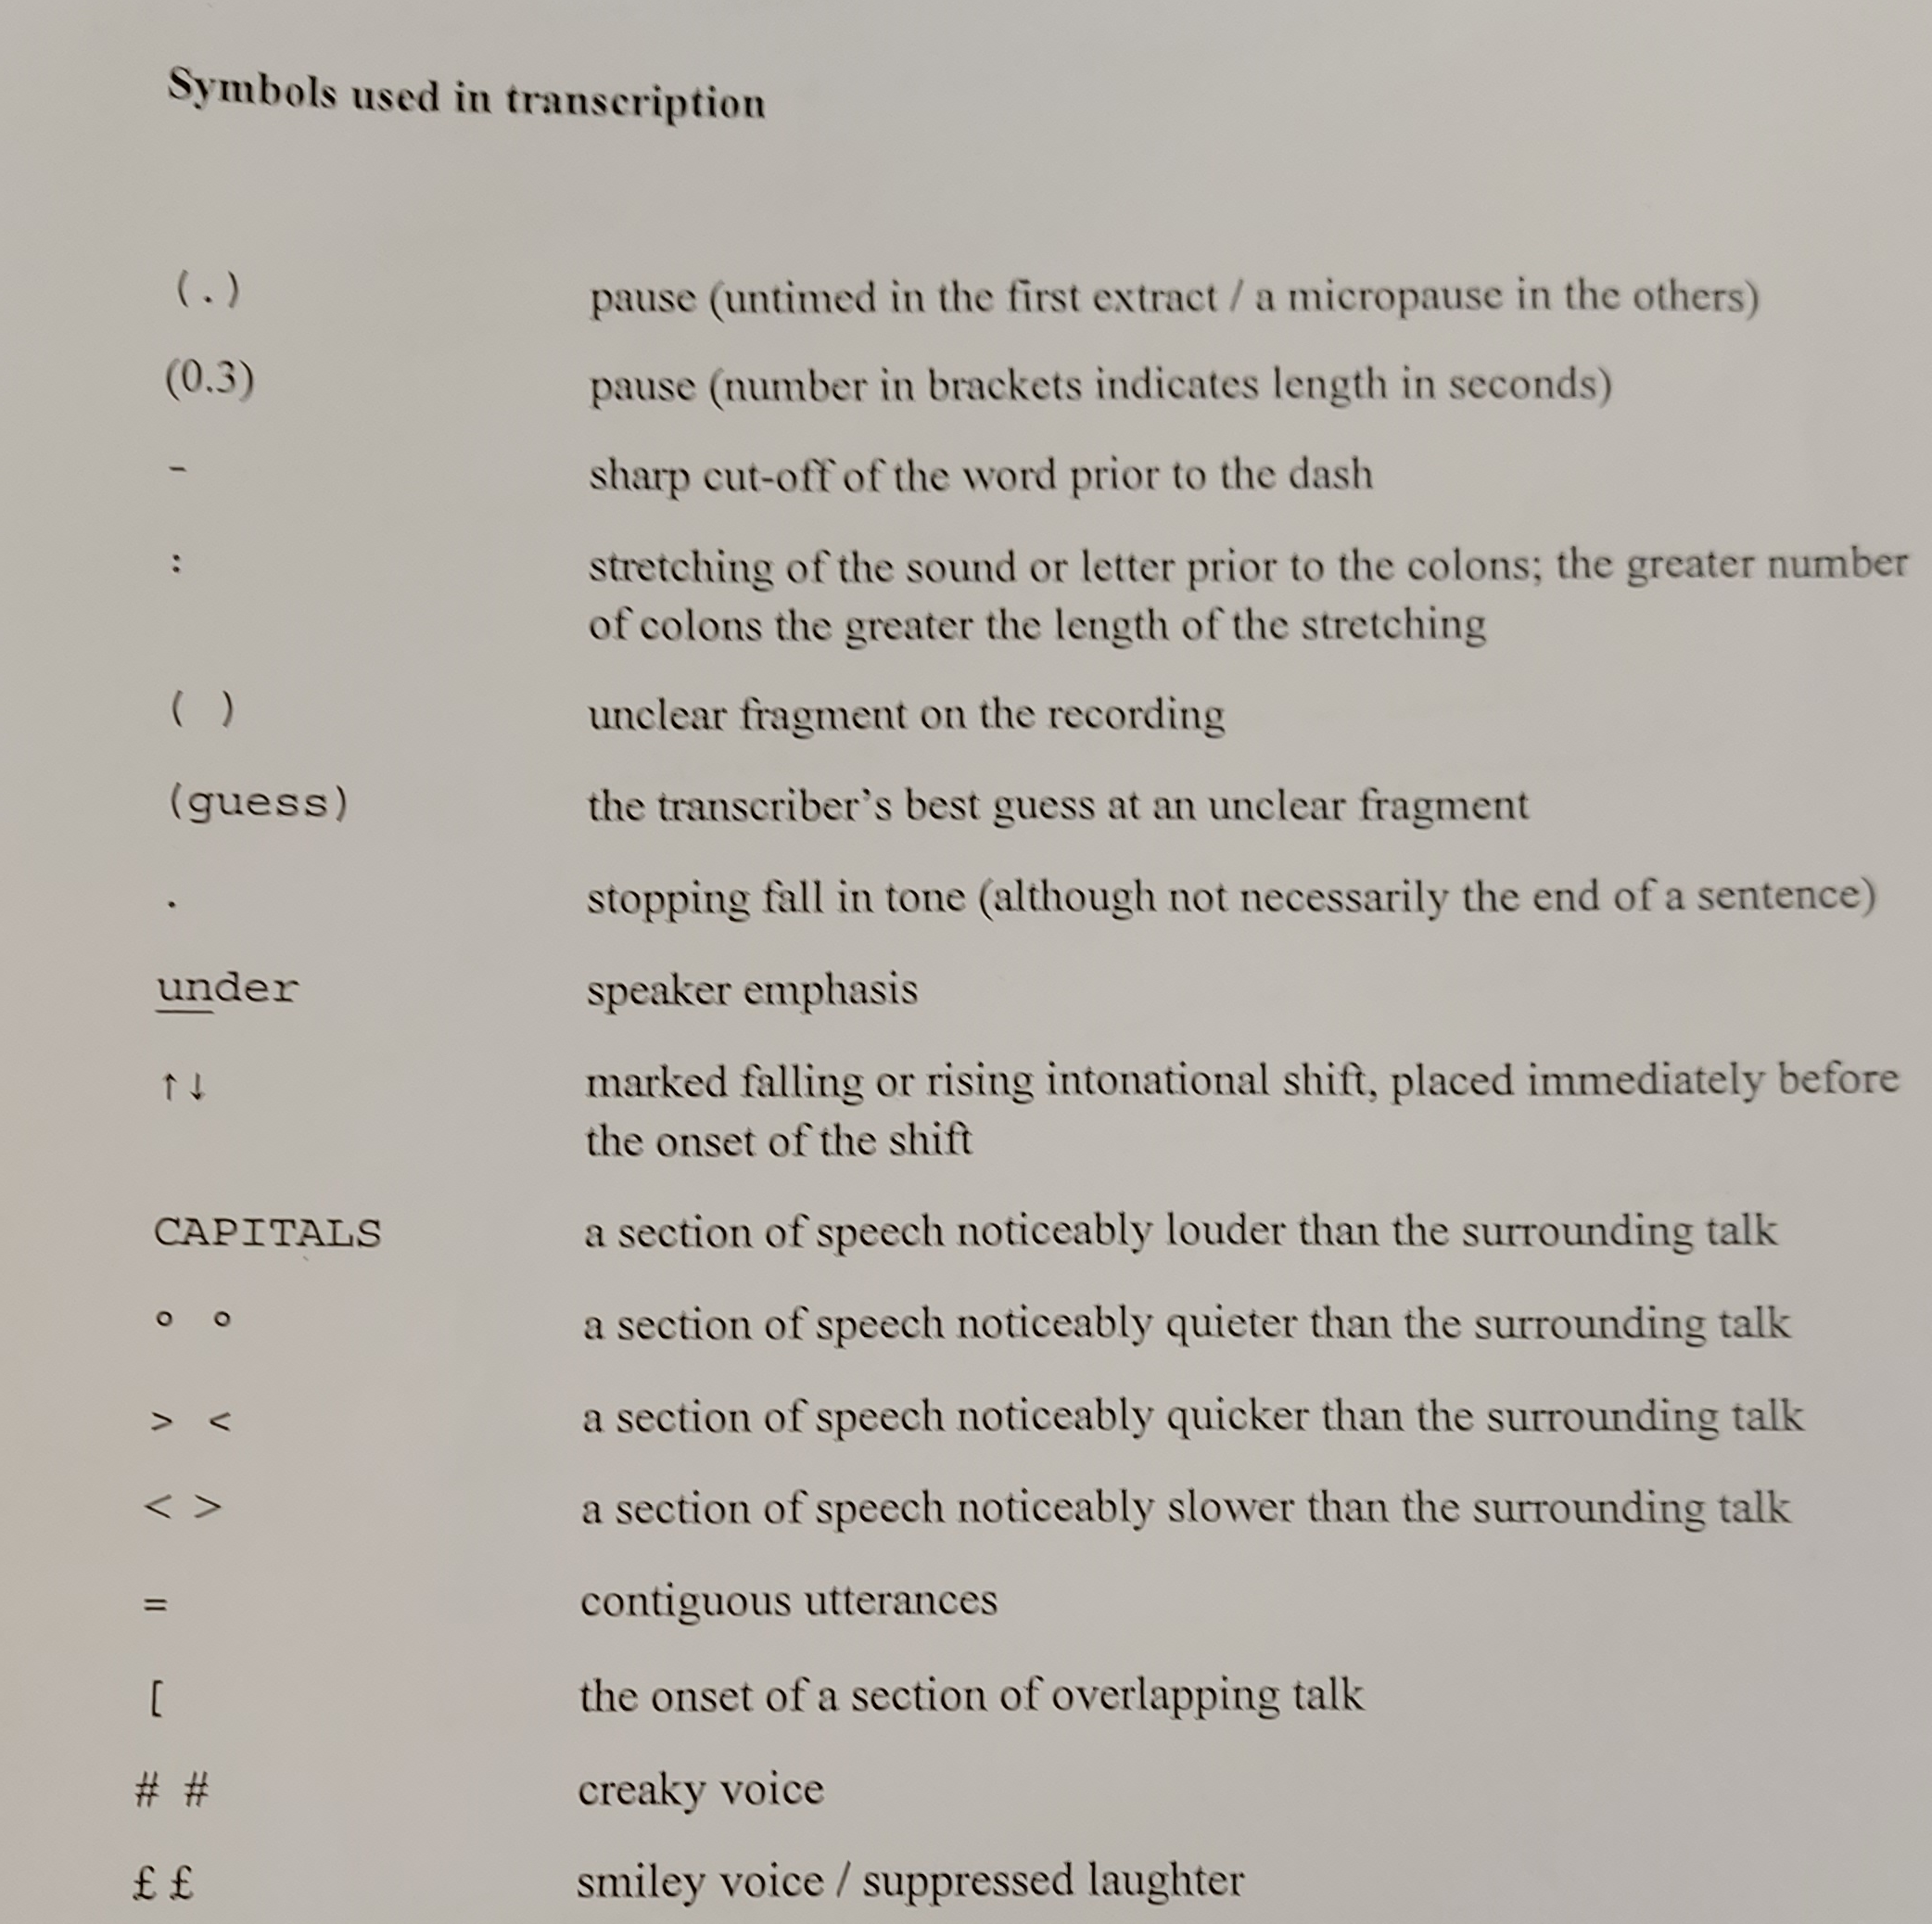
Transcribing
Interview in full
Manually versus software
Just the words?
Repetitions
Pauses
Emotions
Unclarities
Flattening
What about for publication?

Slide 9


Transcript of interview extract (19'45-21'12):
In 1961 [pause] I became really involved in the union. This was the time when [pause] they elected Joe Gormley as General Sec'etary. Well… me being of the other… in support o' the other candidate, who was Mick- Michael Weaver… err not Michael Weaver, Jim Hammond – Mick Weaver was one of the supporters, from Mossely Common – I..I begun to have-- I..I came into a position where I was involved in confrontations with people who supported Gormley and people who supported Jim Hammond and at..at one stage – and this is true what I what I say – in err 1961, there were 2 elections because there was alleged ballot riggin' what went on and all this and err which..which did happen of course and err I knew quite a lot about it and I called for a different system of..of balloting and err err I err somehow or other my.. message got into the columns of the Daily Express.. and the Daily Express printed it. A reporter happened to be at one of our meeting when all this dialogue was goin' on at that time and err I was threatened with expulsion from the union [laughs] 'cos see, I said, “well, you get on with your expellin' and I'll get on with my-- I'll see my solicitor,” but nothing came of it, you see […]
Interviewee confusing and correcting their narrative
Reflecting the interviewee’s accent and pronunciation – sense of persona
How the narrative is told, e.g. speaker emphasising their importance
Hesitations, pauses
Interviewees’ emotions
Further considerations: fact checking, looking up events/names, comparing to other interviews… just like any written primary source!

Slide 10
Activity: transcribing
Listen through once without making notes
Listen through again to note down key points
Listen again trying to transcribe word-for-word

Slide 11
“D’you remember, a bit, a bit of a daft example, but it shows the point. I used to think like employers were came in two packages. There was like John Wayne’s ranch and, d’you remember J.R. Ewing in the, er Dallas, he was the bad guy [PB: er, no I, I don’t---] ah ok, if, if you ever look it up, it sounds silly but some employers… John Wayne was like the great TV hero so if you worked on his ranch and you broke your leg, he’d look after you. He’d say you work for me, you’ve broke your leg, when you’re better, you can carry on I’ll look after you. You work on J.R. Ewing’s ranch, and he was a bad guy and you broke your leg, you’re out the door. And it seemed to me private sector is like that, sort of ruthless, or exploitative and whereas the public sector… sometimes a bit too soft to be honest, but er, they didn’t always get the balance right but it was kind of you’re one of us and, you do your best and we’ll do our best for you...”
Ken, former coal miner, September 2018
Activity: transcribing
Listen through once without making notes
Listen through again to note down key points
Listen again trying to transcribe word-for-word

Slide 12
Activity: interviewing
Let’s practice the life story interview technique. Work in pairs:
The interviewer wants to know about how/why the interviewee came to do a PhD
Firstly: work together to think about what sorts of questions/topics you might ask
Secondly: role play the interview with one of you as interviewer and one of you as interviewee
Interviewer: let the interviewee lead; react to what they say; deviate from your topics/questions if need be; steer when necessary…
Then swap roles

Slide 13
Oral history resources
Warwick Oral History Network
Modern Records Centre
Oral History Society
Oral History Association
British Library
Oral History journal
Oral History Review journal

Slide 14
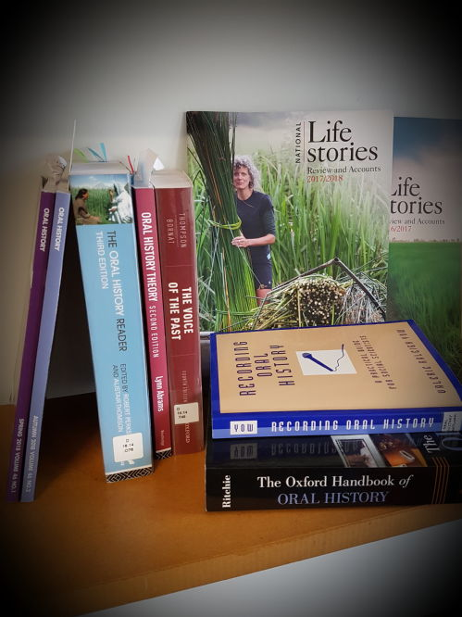
Introductory bibliography
Abrams, Lynn, Oral History Theory (2nd ed.), (Routledge, London, 2016) [1st edition only available as E-book]
Frisch, Michael H., A Shared Authority: Essays on the Craft and Meaning of Oral and Public History, (State University of New York Press, Albany, 2011) [available via Document Supply request]
Janesick, Valerie J., Oral History for the Qualitative Researcher, (Guilford Press, New York, 2010) [D 16.253.J26]
Perks, Robert, Thomson, Alistair (eds), The Oral History Reader, (3rd ed.) (Routledge, London, 2016) [D16.14.O76 and E-book]
Portelli, Alessandro, The Death of Luigi Trastulli and Other Stories: Form and Meaning in Oral History, (State University of New York Press, Albany, 1991) [D 16.253.P6 and E-book]
Ritchie, Donald A., The Oxford Handbook of Oral History, (Oxford University Press, Oxford, 2011) [available as an E-book]
Thompson, Paul, Bornat, Joanna, The Voice of the Past: Oral History (4th ed.), (Oxford University Press, Oxford, 2017) [D16.14.T48 and E-book]
Yow, Valerie Raleigh, Recording Oral History: a Guide for the Humanities and Social Sciences (3rd ed.), (Rowman & Littlefield, Lanham, 2015) [D16.14.Y68]

