Slide 1
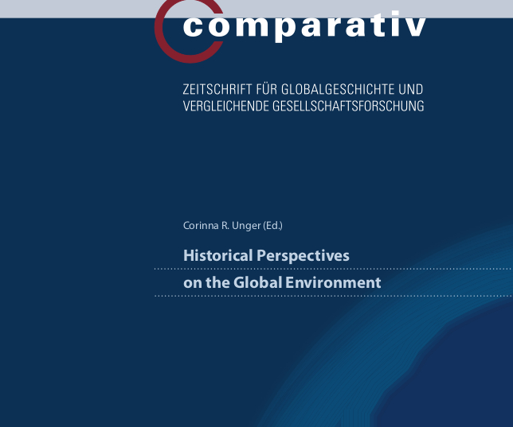
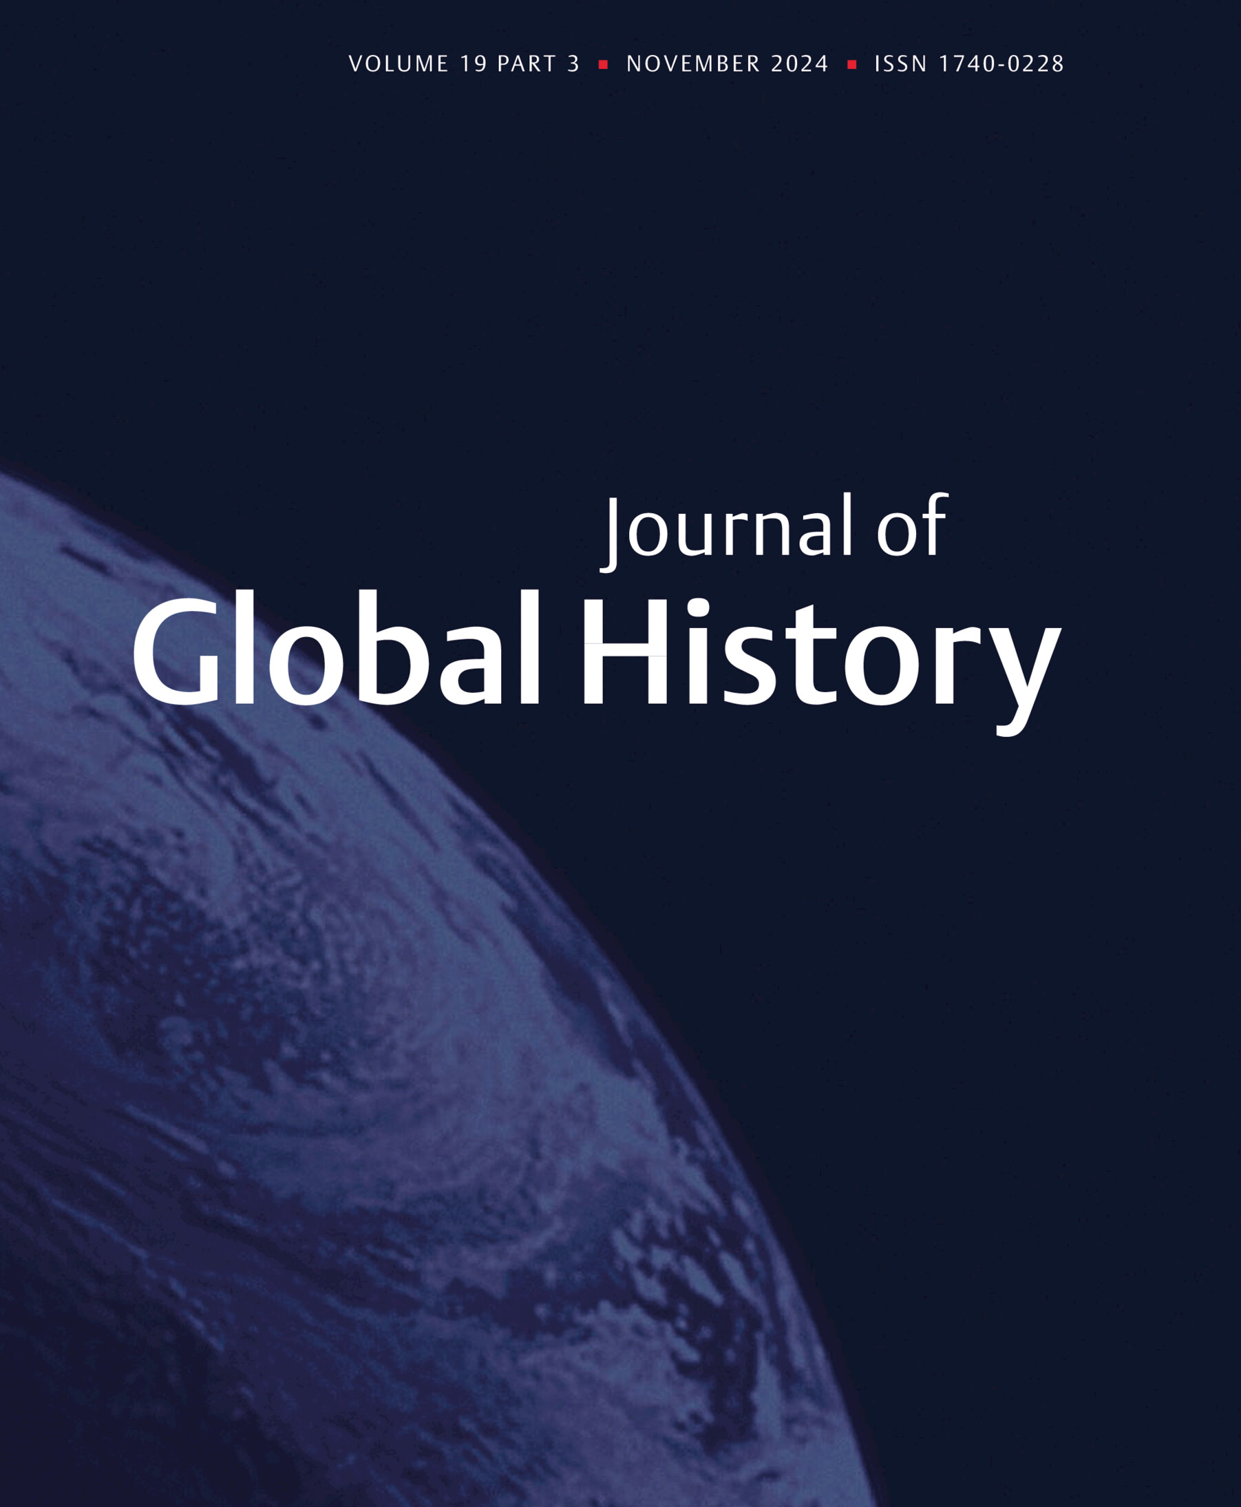
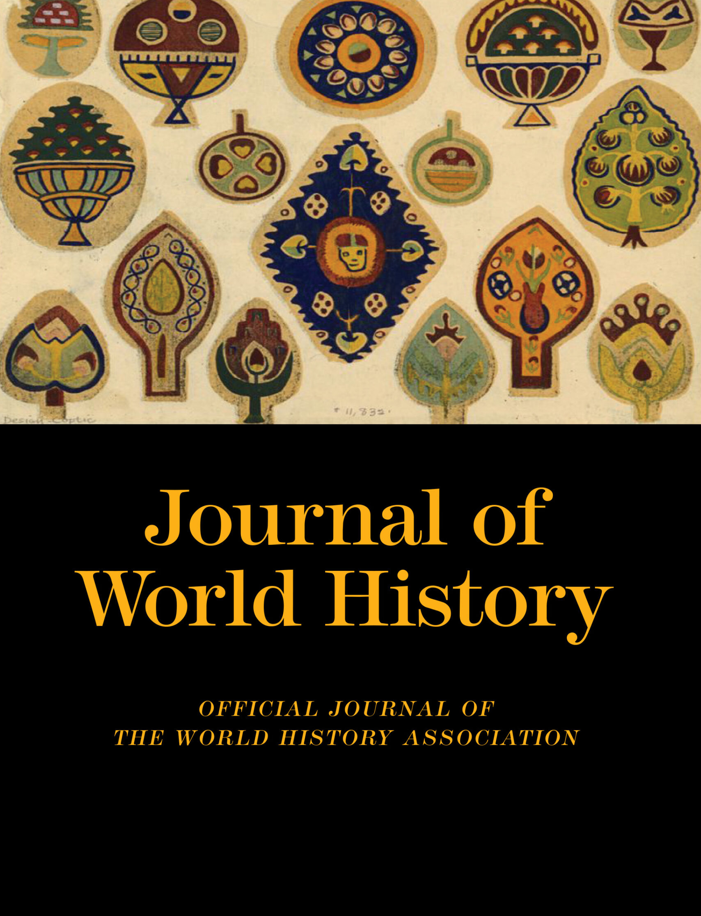
Journal Publishing
History GRF May 2026

Slide 2
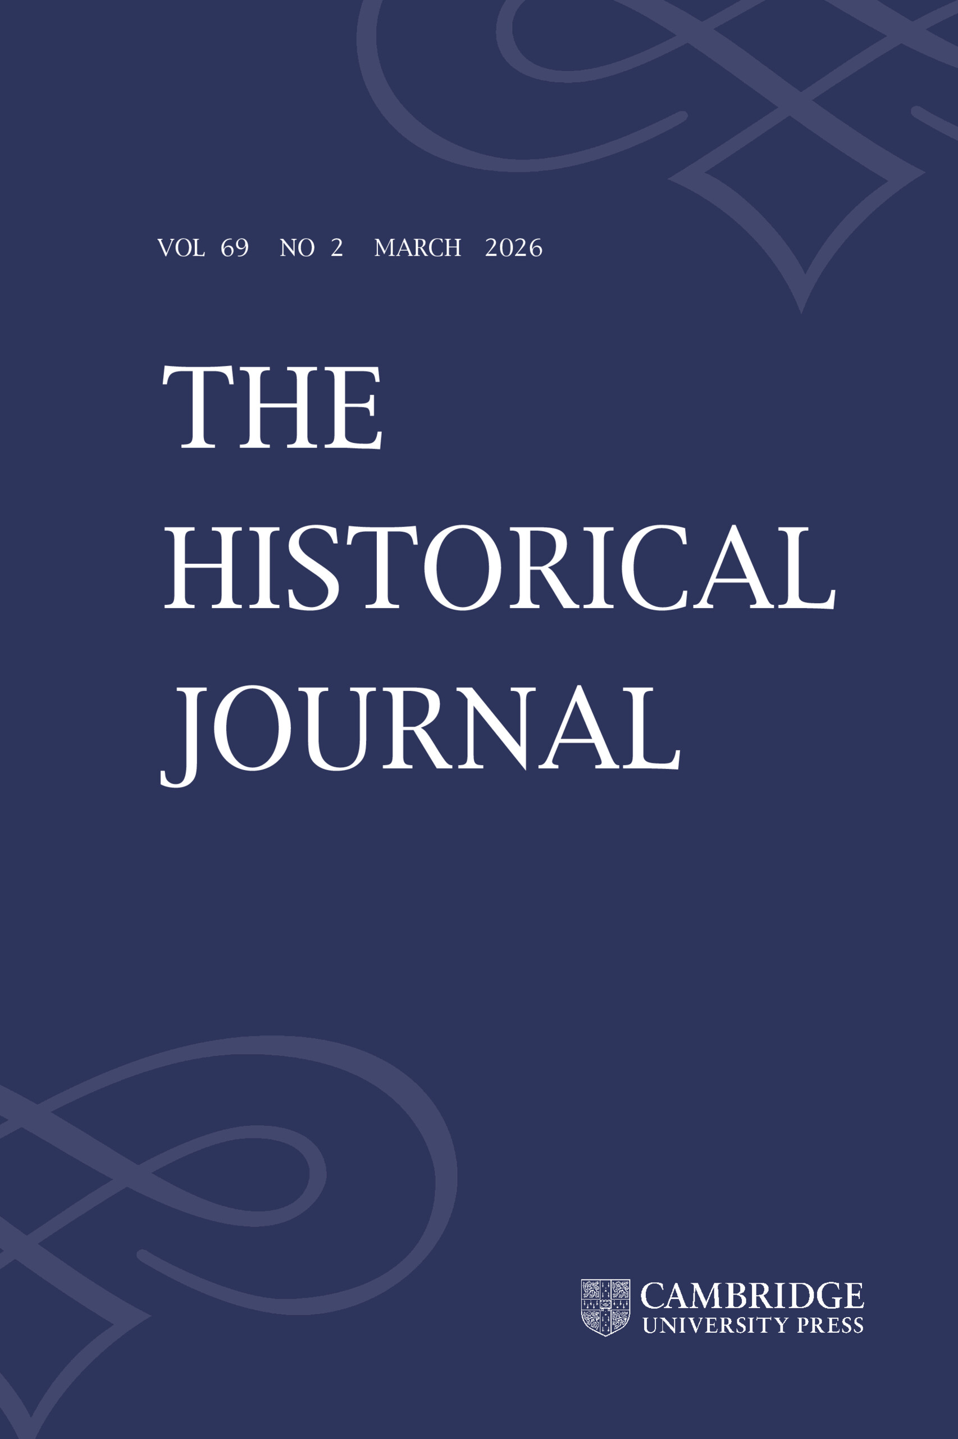
Four key points
Pick the right venue for your work (how to research the publishing landscape?)
Situate your research methodology and findings as a contribution to the relevant field (e.g. what makes this global history?)
Engage with existing historiography and debates in this field (e.g. why should historians of gender pay attention?)
Attend to the publisher’s process (how to improve your chances of acceptance and what to expect after submitting your work?)

Slide 3
Pick the right venue for your work
(how to research the publishing landscape?)
Mission statements; accessibility (OA?); reach and impact
Recent journal issues – approaches, debates, topics
Read recent articles for style & structure
Check for balance between historiography, empirical analysis, claims to novelty
If in doubt, contact editor

Slide 4
Situate your work as a contribution to the field
What is your main intervention?
How does it engage with and extend the state of the field?
Identify key debates and ensure your historiography is up-to-date
What is the larger significance of your arguments?
Explain your approach and how it draws on methods from the field (or applies methods from outside to it)
(if the fit isn’t natural, submit it elsewhere!)

Slide 5
Do’s Don’ts
Highlight your central argument and intervention in the introduction
Discuss the paper’s contribution to developing new knowledge
Explain how the argument contributes to the state of the field
Embed paper’s objectives in debate, theory, and existing literature
Engage readers who have no expertise on your specific topic
Think carefully about structure and logic of the paper
Have colleagues, supervisors, and friends read drafts before submitting
Omit important historiographical connections from the introduction
Forget to discuss the state of the field, and how your paper will change, enrich or further support it
Forget to indicate why journal audience should be interested in your study/argument
Say that something is interesting just because it has never been studied before
Write with ambiguity, circular reasoning, be overly repetitive or overly complex
Forget to signpost your arguments and link up your sections
Submit a draft that has not already been through extensive editing

Slide 6
Attention to process
Length, style guide, type of contribution
Cover letter + submission system
Responding to peer review
Revising your submission

Slide 7

JGH Review Process
ScholarOne for all submissions and editor-author communication
JGH receives c. 175 submission per year; publishes c. 24 articles
Desk rejects (c. 66%) vs out for review (c. 34%)
Minimum of 3 reviewers’ reports (double-blind) + editor’s comments
After first-round review: Reject (c. 15%) vs Revise & Resubmit (c. 85%)
Revised versions may either be returned to original reviewers or assessed only by the editor, depending on the nature of demanded revisions.
Accept vs another round of major/minor revisions
Final decision; copy-editing; production; proofs
Note: Careful Response to Reviewers is very important!

Slide 8
What does JGH encourage and offer?
Diversity in authorship and readership: gender, ethnicity, age, experience, academic/geographic/cultural background, etc.
Select development editing for scholars for whom English is not a first language; who study or work at universities outside of North America and Western Europe and where editing support is not readily available; and whose initial submissions and evidence base indicate a clear fit with JGH’s mission
Openness to working with ECRs and articles stemming from dissertation research
We are keen to receive submissions on the early modern era (c. 1500-1800 CE) or earlier
Thorough and supportive peer review process; working closely with editors
Fast turn-around times on decisions (desk reject or out for review)
Visibility and open access (15,000-20,000 article downloads per month)

Slide 9
Questions?

