Slide 1
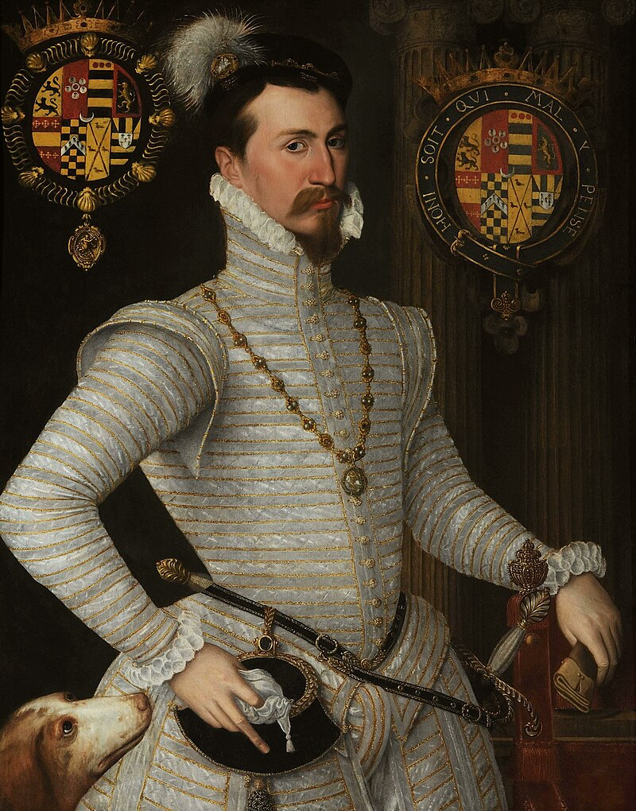

Angus Crawford Public engagement: student perspective 3rd year History PhD Student
angus.r.crawford@warwick.ac.uk

Slide 2
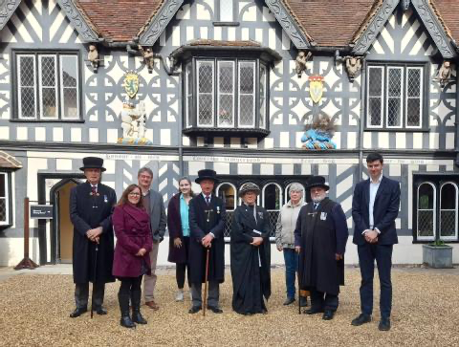
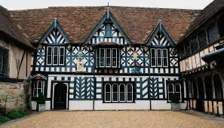
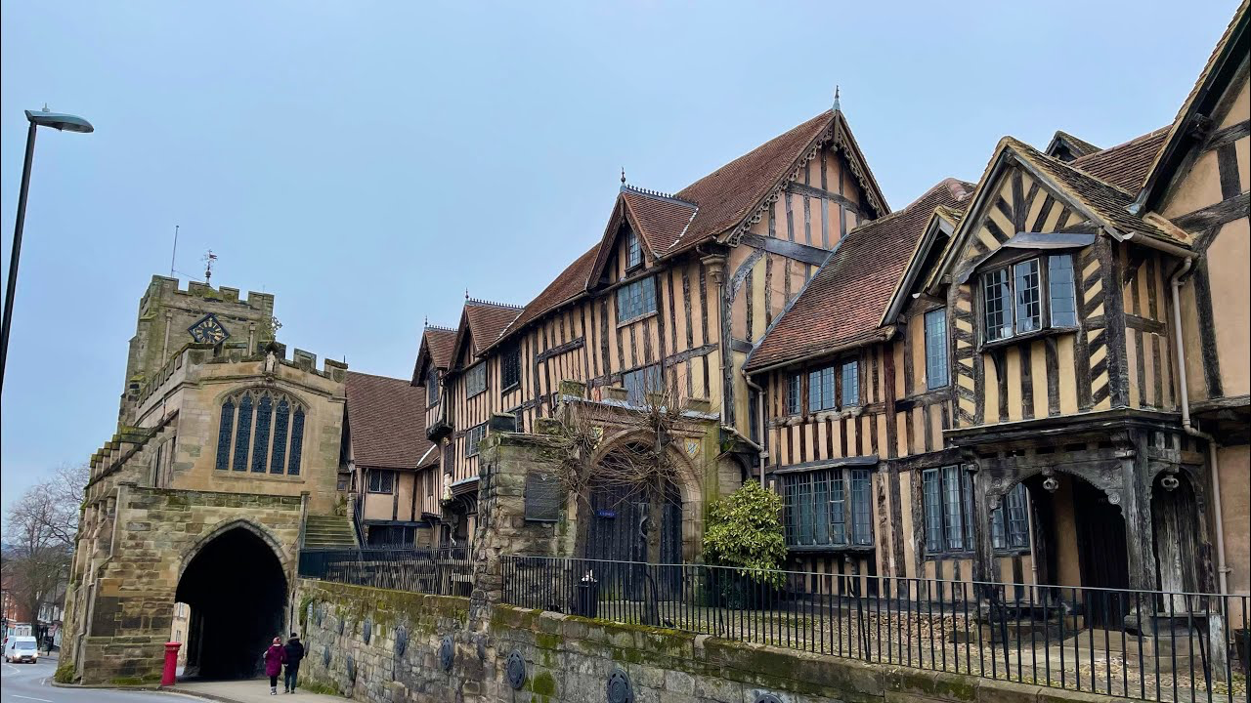
Lord Leycester Hospital (almshouse) Warwick – buildings date to the late C14th, but the charity was founded in 1571. It still operates on the original site to this day. ‘Leycester’ because it was founded by the Earl of Leicester; and ‘hospital’ in the medieval sense of hospitality and relief rather than the modern notion of medicinal care.

Slide 3
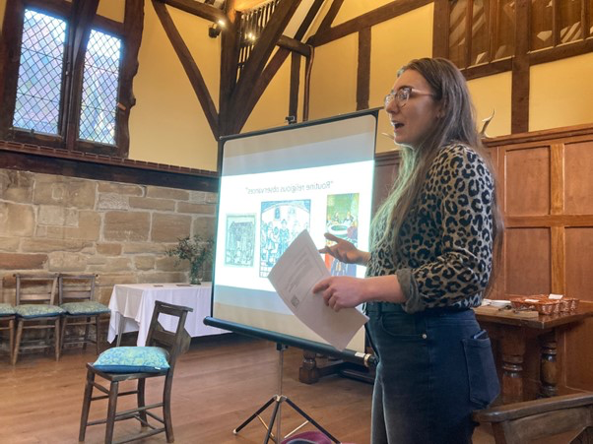
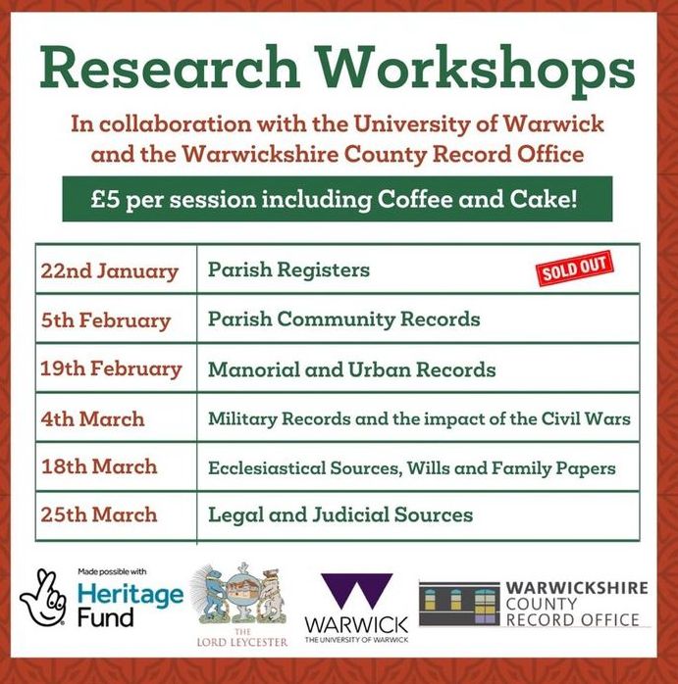
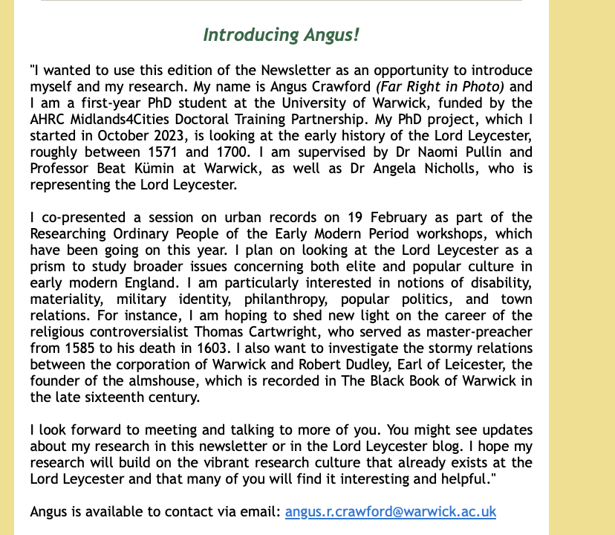
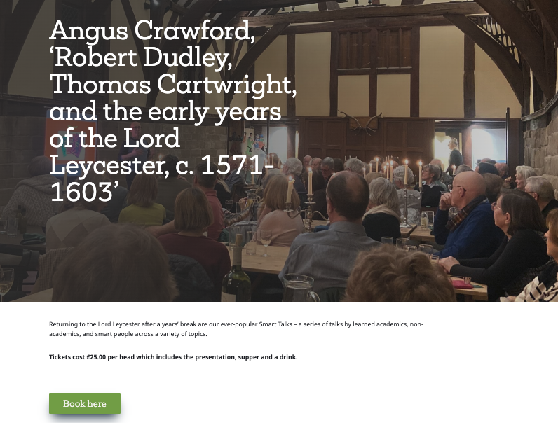


Slide 4
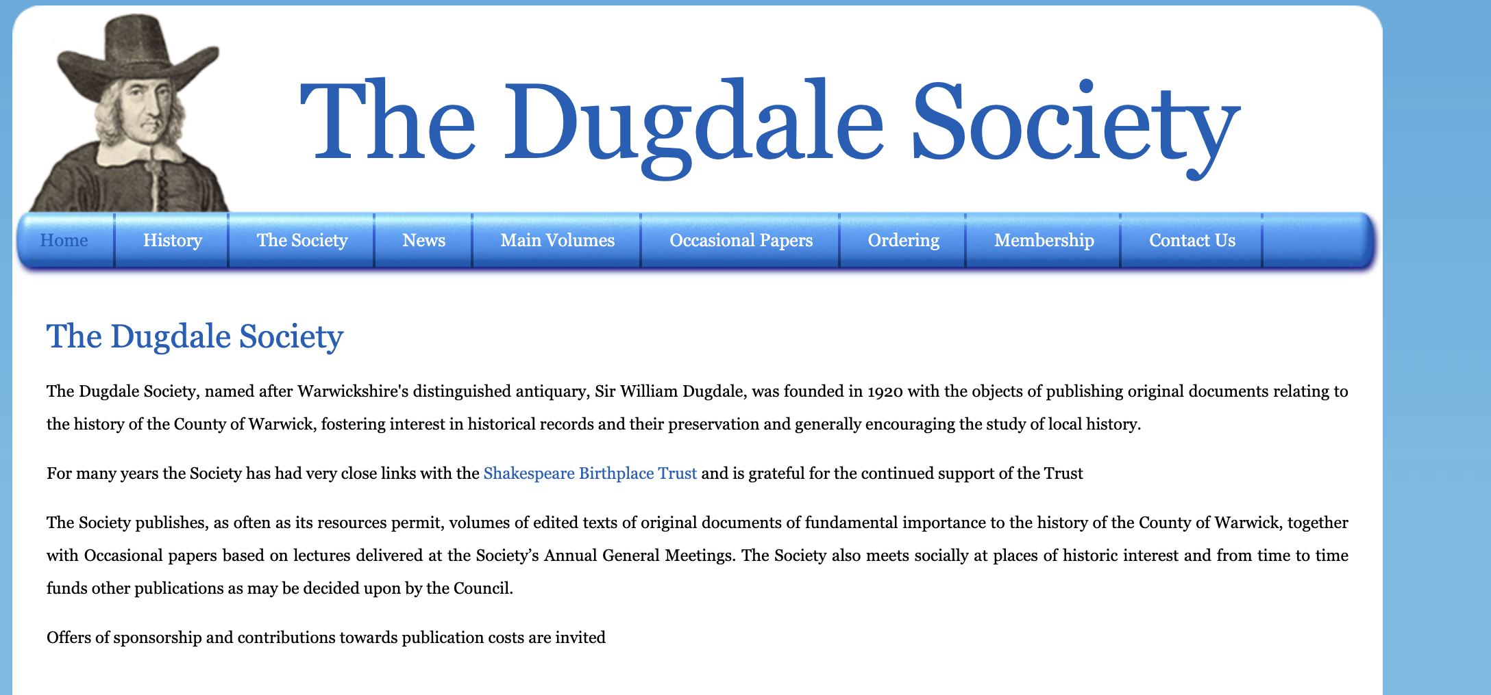


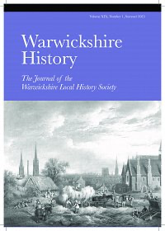
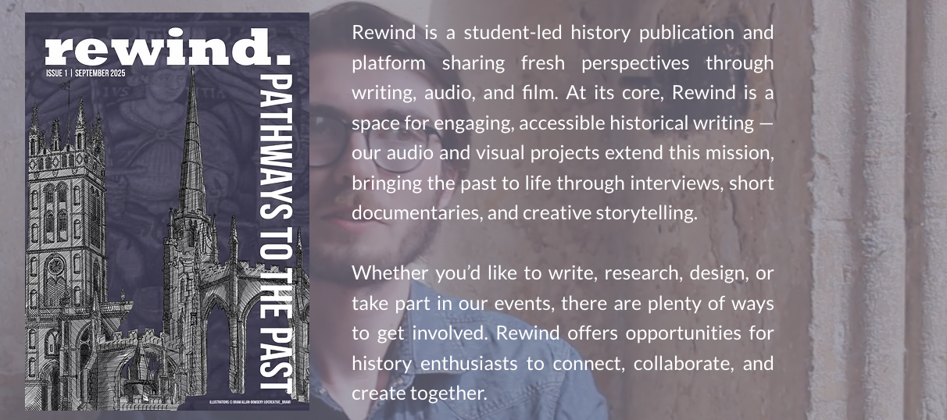
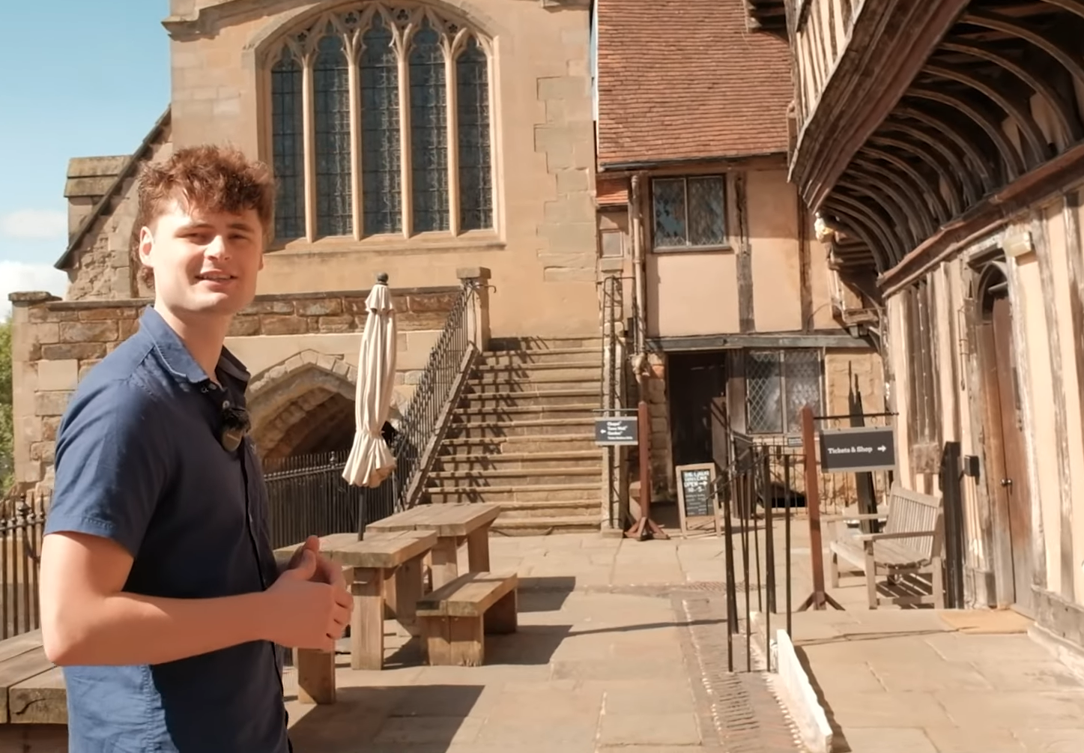
https://www.youtube.com/watch?v=Lf10t7vzuGQ&t=1s

Slide 5
